Slide 1

The effect of genetic linkage on influenza virus adaptation
Katia Koelle
Department of Biology
Emory University
April 17, 2018
Institute for Disease Modeling

Slide 2
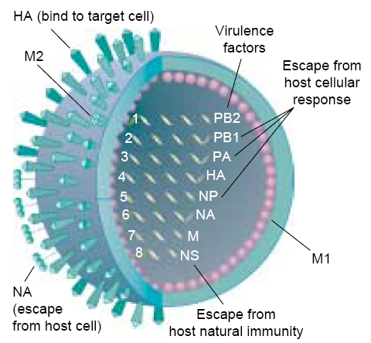
Influenza A/H3N2
Notes:
Segmented virus – 8 gene segments
Mutation rate on the order of 10^-5 to 10^4 mutations per site per replication cycle - ~1 mutation per cycle
Underscore the importance of HA

Slide 3
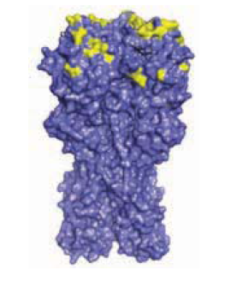
Prediction of HA evolution from influenza sequence data
Long history: Bush et al. (1999) Science: Predicting the evolution of human influenza A’s HA
(18 influential sites)
More recently:
Phylogenetic tree + mutations at antigenic + non-antigenic sites
Only topology of phylogenetic tree
Local branching index
Łuksza and Lässig (2014) Nature
Neher et al. (2014) eLife

Slide 4
Assumptions of prediction models
Complete genetic linkage within the HA (no intrasegment recombination)
The role of the rest of the flu genome on HA evolution is negligible
✓
Do the other gene segments matter to the evolutionary trajectory of the HA?
To what extent is there linkage between gene segments of flu?
Is there evidence for selection on the other gene segments of flu?
Notes:
Both of these methods implicitly incorporate the effects of linkage – that fitness of a strain is determined by multiple mutations that are linked across the HA (not necessarily epistasis…)

Slide 5
To what extent is there linkage across influenza’s gene segments?
Notes:
Here, present an individual level analysis

Slide 6



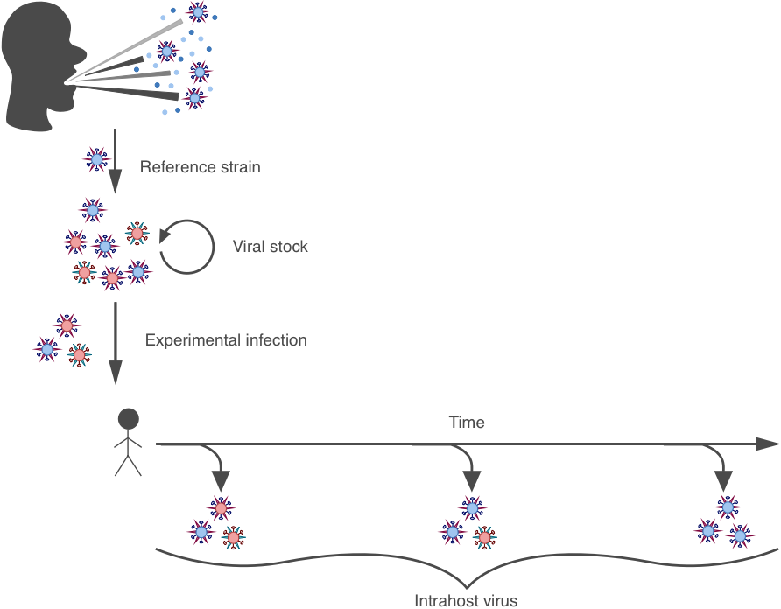
Influenza human challenge study
Ashley Sobel Leonard
Chris Woods
Micah McClain
“naïve”
Sobel Leonard, A. et al. (2016) Journal of Virology
Notes:
Chris Woods and Micah McClain, two infectious disease clinicians at Duke who performed an influenza challenge study in humans about a decade ago (2009). In this challenge study, a naturally circulating H3N2 strain
was isolated and used as a reference strain. This strain was passaged in eggs and cell media to obtain the viral stock, which was in turn used to inoculate the subjects. Subjects were then followed over the course of a week. We had virus sequenced from different timepoints days post challenge, as well as from the viral stock.

Slide 7
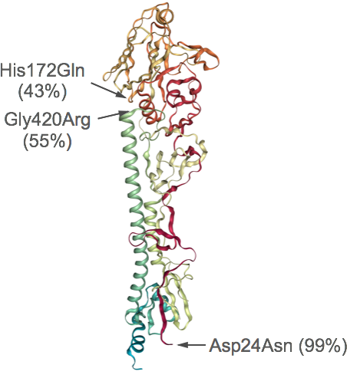
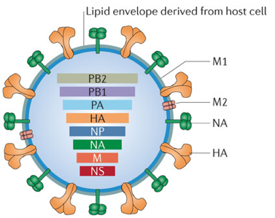
Viral stock adapted to passage environments
HA protein
8 variants distributed across 3 gene segments: PA, HA and NP
3 non-synonymous variants on HA gene segment
Sobel Leonard, A. et al. (2016) Journal of Virology
Notes:
Previous work of ours found that the viral stock was genetically heterogeneous and that the high frequency variants identified on the HA of the virus were all adapted to their passaging environments.

Slide 8
Variant frequency changes during infection
Reversion of intrahost viral population to reference strain
Notes:
What we found by looking across individuals – a subset of whom are shown here – is that there was rapid reversion of the intrahost viral population to the H3N2 reference strain

Slide 9

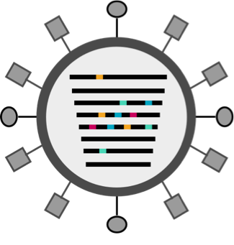
Reassortment models
r = 1
r = 0
Sobel Leonard, … Illingworth (2017) PLoS Pathogens
Notes:
Now, in a later study, one that focused on genetic linkage, we asked whether the changes in allele frequencies that we observed in this previous study provided support for a model in which reassortment between flu’s gene segments occurred rapidly. Shown here with each column being a different gene segment. Or were these data more supportive of a model with no reassortment- so genetic linkage across gene segments. Or something intermediate between these two?
Now, I won’t go into the details here for the sake of time, but it is clear that the rate of reassortment impacts changes in allele frequencies as you can see here for a scenario with the fitness effects of these colored alleles being the same across all simulations. So what we effectively did was to instead go from observed changes in allele frequencies back up to inferring fitness effects of alleles and also the extent of reassortment.

Slide 10
Effective rate of reassortment is limited during human infection
…1
No reassortment
Rapid reassortment
Notes:
Somewhat surprisingly, we found evidence for very limited reassortment across all the subjects we looked at

Slide 11
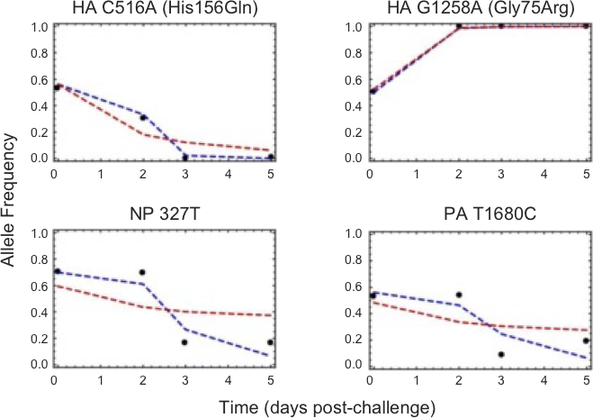
Variant frequency changes for subject Flu5001
No reassortment
Rapid reassortment
Notes:
To see why the no – or low- reassortment model is doing much better than a model with rapid reassortment, we can look at a single subject, here #5001.You can see in blue that the no reassortment model can capture coordinated changes in allele frequencies across gene segments much more effectively than the rapid reassortment model.

Slide 12
Intrasubtypic reassortment at the population level
HA tree
Maljkovic Berry et al. (2016) BMC Biology
It occurs, but not rampantly → linkage across genome

Slide 13
A significant amount of linkage exists across the flu genome
Is there evidence for selection on the other gene segments of flu?
Notes:
Here, present an individual level analysis
Other pathways – purging of load through reassortment
Selection occurring on WHOLE genome, not just HA

Slide 14

Influenza H3N2 gene segment phylogenies
n = 676 full genomes
Raghwani, Thompson, Koelle (2017) Virus Evolution
Notes:
We sought to address this question by looking at whole genome viruses of H3N2, collected and made publicly available. Inferred MCC phylogenies

Slide 15
Times to most recent common ancestor differ across segments
Selection acts strongly on the HA
Notes:
We can then, using these phylogenies, determine the times to most recent common ancestor for strains circulating in a given year
Mean = dashed black lines
Gray dashed = HA mean
See that the smallest TMRCA is HA across the 8 gene segments

Slide 16
Model to gauge whether selection acts on internal gene segments
5% of individuals coinfected
2 gene segments:
1 antigenic (HA), 1 non-antigenic (one of the 6 internal gene segments)
Mutations drawn from distribution of fitness effects:
  - antigenic gene segment: split between beneficial and deleterious
  - non-antigenic gene segment: 100% neutral OR
              mostly deleterious
Notes:
2 gene segments. Birth/death – birth probability fitness related. Coinfection events where an infected individual could transmit their strain to an already infected individual (allowing up to two strains in a single individual). These coinfected individuals would freely reassort viral segments, so when they transmitted, yield any combination of gene segments with equal probabilities. De novo mutations
So, we developed a simple Moran model to see what factors could reproduce these tmrca dyanmics. The moran model assumed only 2 gene segments (antigenic = HA, non-antigenic). We allowed for three different process – birth/death event – one randomly sampled individual recovered, and new one was born (w/probability proportional to fitness); coinfection event; one infected gave strain to another singly infected individual. When a coinfected individual happened to transmit a strain, the choice of which parental segment was passed on was random. Mutations also occurred at a certain rate. - both benficial and deleterious on antigenic segment; only deleterious on non-antigenic gene segment

Slide 17
Models without selection on non-antigenic gene segment do not recover TMRCA patterns
w/out selection
Notes:
What I need to tell you is that the majority of mutations across the genome are deleterious – some lethal, and others sublethal deleterious.

Slide 18
Models with selection on the non-antigenic gene segment were able to recover TMRCA patterns
w/ selection
Notes:
What I need to tell you is that the majority of mutations across the genome are deleterious – some lethal, and others sublethal deleterious.

Slide 19
Limited viral reassortment
Selection of non-antigenic gene segments
(most likely purifying)
Other gene segments have the potential to impact the evolutionary dynamics of influenza’s HA
This opens up alternative strategies for influenza virus to adapt antigenically

Slide 20
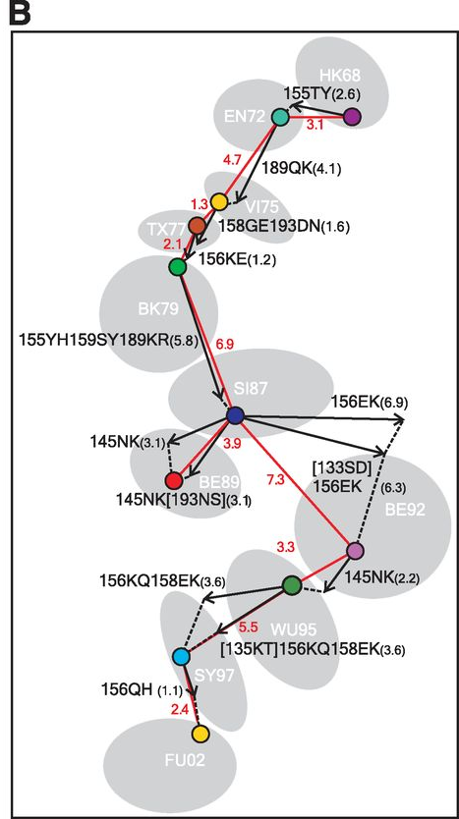
Sweeps require big antigenic mutations in good genetic backgrounds
Reassortment provides a means by which an antigenic mutant can to get into a better genetic background
Koelle & Rasmussen
(2015) eLife
Koel et al. (2013) Science
Notes:
So, the model that I just described does not have any interactions between the resident strain and the antigenic mutant, so here are some results that allow the number of susceptible hosts to change, and allows for strain competition explicitly. One caveat in these simulations is that since we are now considering finite population sizes, Muller’s ratchet will be acting, so we need a certain fraction of the mutations to be slightly beneficial rather than slightly deleterious. Based on recent work of Michael Desai’s we expect an epsilon critical – fraction of the mutations that are beneficial- to be 8%, which works out perfectly in simulations. So, what I have plotted here is the mutational background in which the antigenic mutant occurs (good background, average background), and over here, the size of the antigenic mutation. As most antigenic mutations are small in size, and they occur in an average genetic background, this scenario is the most common, and results in rapid loss. Less common is that a small sigma mutant occurs in a good genetic background. In this case, there will be transient circulation. Another scenario is that a large antigenic escape mutant occurs in an average genetic background, and transiently circulates. Finally, very rarely, a large antigenic mutation can occur in a good genetic background, and this jackpot scenario will lead to an antigenic cluster transition.

Slide 21

Acknowledgements
DELETERIOUS MUTATIONS
Koelle & Rasmussen
(2015) eLife
SELECTION ACROSS THE FLU GENOME
Raghwani, Thompson, Koelle
(2017) Virus Evolution
LIMITED EFFECTIVE REASSORTMENT
Sobel Leonard, et al. (2017) PLoS Pathogens
Funding sources: RCN Infectious Disease Evolution Across Scales; Center for Inference and Dynamics of Infectious Diseases (U54GM111274-01); Medical Scientist Training Grant (T32 GM007171)

Slide 22
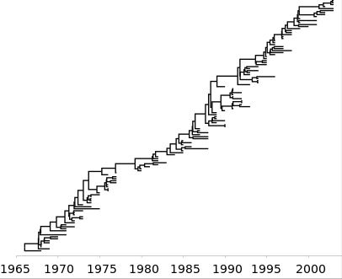
Genetic evolution of influenza A/H3N2’s HA
Rapid turnover of viral population
Low genetic diversity at any point in time
‘Spindly’/‘ladderlike’ phylogeny
Volz, Koelle, Bedford (2013) PLOS CB
Notes:
Long been appreciated that the evol dynamics of the HA occur at the same time scale as the virus’s epidemiological dynamics
Immune escape – driver of the virus’s evolutionary dynamics (at least in the HA)
Now, I would argue that some of the best, and data-rich examples or eco-evolutionary dynamics in nature are provided to us by RNA viruses that are extremely rapidly evolving pathogens. They have exceptionally high mutation rates and short generation times. This together with their large population sizes effectively ensures that they can adapt to their host population and the immune landscape presented by their hosts. This rapid evolution is known to affect the virus’s epidemiological dynamics, and in turn, these epidemiological dynamics create the host immune landscape that drives viral adaptive evolution. What I’d like to focus on today is the eco-evolutionary dynamic in influenza, or, what has been termed by Bryan Grenfell and colleagues this virus’s ‘phylodynamics’ – which means jointly understanding the ecological and the evolutionary dynamics of viruses, where evolution is through de novo mutation.

Slide 23
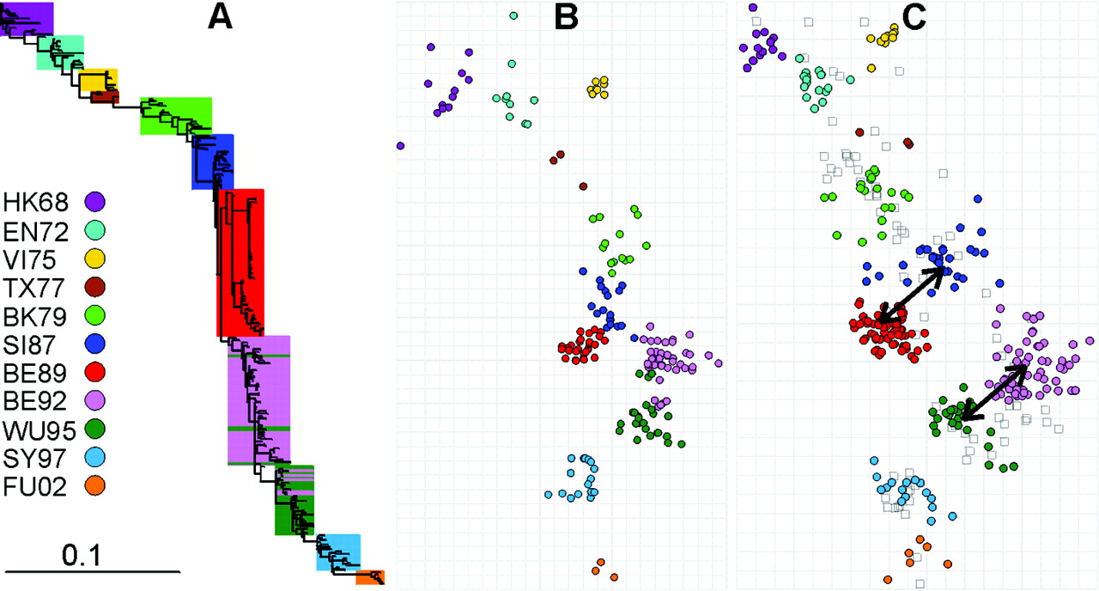
Antigenic evolution of influenza A/H3N2
Smith et al. (2004) Science
Rare, punctuated antigenic change
Antigenic variation within clusters
Koel et al. (2013) Science
Notes:
A third characteristic feature, recently identified, is that these cluster transitions are precipitated by very few amino acid changes, with 7 of the 10 cluster transitions due to a single amino acid change, with the remaining three transitions caused by more, by the majority of antigenic change comes from a single amino acid change.

Slide 24
Distribution of fitness effects on gene segments
Site-directed mutagenesis study of influenza virus
Does not capture selective advantage of antigenic mutations
Visher et al. (2016) PLoS Pathogens
We assumed that mutations were either beneficial (30%; exp. distn mean 0.03) or deleterious (70%; exp. distn mean 0.09) on the antigenic gene segment.
In models with selection on the non-antigenic gene segment, we assumed that only 5% of mutations were beneficial on the non-antigenic gene segment; 65% neutral; 30% deleterious.
We also simulated models with 100% of mutations being neutral on the non-antigenic gene segment.
Notes:
What I need to tell you is that the majority of mutations across the genome are deleterious – some lethal, and others sublethal deleterious.

Slide 25
Take home messages
Predicting (and understanding) influenza HA evolution is:
- Not only about beneficial mutations
- Probably not only about the hemagglutinin (HA)
→ Mutations and their distn of fitness effects across the flu genome
Partial linkage across loci on different segments
Notes:
Other pathways – purging of load through reassortment
Selection occurring on WHOLE genome, not just HA

Slide 26
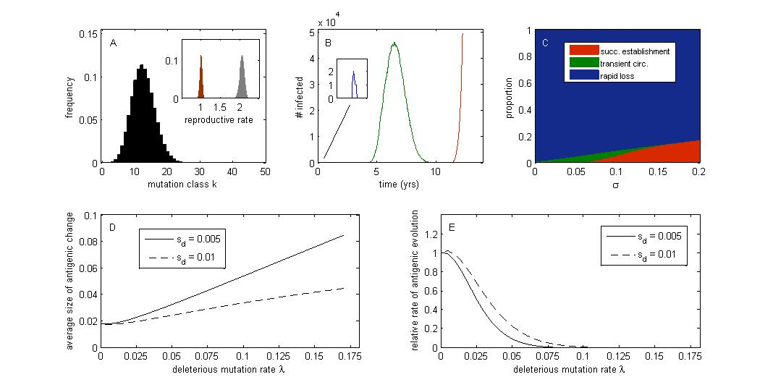
Toy model: Viral population subject to only deleterious mutations
R
R₀
Notes:
To do that, let me give you first a really short, 2 minute introduction to this virus.

Slide 27
Fates of antigenic mutants
Antigenic mutations occur in a certain genetic background with k deleterious mutations
Antigenic mutations are of a certain size σ, which quantifies the degree of immune escape
Calculate reproductive rates R of invading mutant strain: R_{m}(t = 0) and R_{m}(t = ∞)
THREE POSSIBLE FATES Peck (1994) Genetics
Notes:
Now we can ask, what happens when an antigenic mutation occurs. That antigenic mutation will occur in a certain genetic background with i deleterious mutations, and it will be of a certain size, sigma, which quantifies the degree of immune escape. The mean reproductive rate of the resident strain is 1, it is endemic in the population, and we can also calculate the R of the invading strain at the time of its emergence t = 0 and at time t = Inf, which is to say, once it has reached its own mutation-selection balance. Here, calculation of R at t = Inf ignores any change to the susceptible population. These two reproductive rates depend on i and sigma. Now, there are three possible fates that this antigenic mutant is subject to. First, if its reproductive rate at t = 0 is less than 1, it will rapidly be lost from the population. If its reproductive rate at t = 0 is > 1, but at time t = Inf, it is < 1, if it doesn’t go stochastically extinct, it will first transiently rise and then decline deterministically as a result of the deleterious mutations it is accumulating. Finally, if both the initial and final reproductive rates are > 1, if the mutant isn’t stochastically lost, it will rise and successfully establish in the population.

Slide 28
Probabilities of fates
Which fate occurs depends on:
the antigenic mutant’s initial deleterious mutation load:
          lower load k → higher reproductive rates
the antigenic mutant’s degree of immune escape σ :
          higher σ → higher reproductive rates
Notes:
Now, which fate occurs depends on the antigenic mutant’s deleterious mutation load. Better genetic background leads to a higher initial and higher final reproductive rate. It also depends on the mutant’s degree of immune escape, sigma, with a higher sigma leading to higher R’s. So, while most small antigenic mutants are rapidly lost, some transiently circulate, and as sigma increases, transient circulation is replaced by successful establishment. Here in this figure, we are assuming that sigma is exponentially distributed, which one can argue from a theoretical basis.

Slide 29
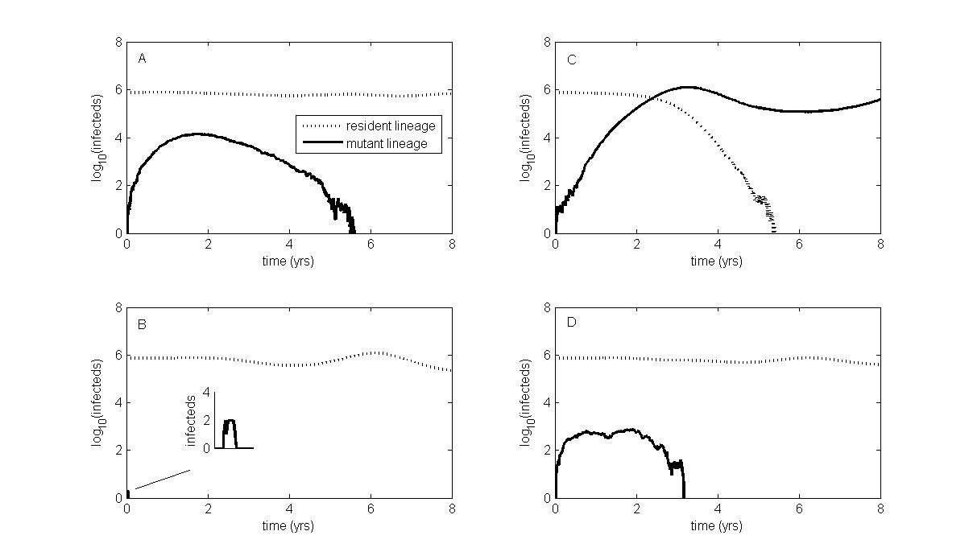
Cluster transitions require a jackpot combination
low immune escape mutation
high immune escape mutation
successful establishment
low load
VERY RARE
“JACKPOT”
transient circulation
avg load
transient circulation
rapid loss
Slows adaptive evolution; makes adaptive evolution more punctuated than would be the case otherwise
Notes:
Toy model – most mutations are deleterious (constant fitness effect – sd). Occasionally, a rare beneficial one occurs.

Slide 30
Cluster transition consistent with occurrence of the ‘jackpot’ strategy
Cluster transition
145N → 145K
WU95-like mutants that only transiently circulated
Koel et al. (2013) Science
Notes:
So, the model that I just described does not have any interactions between the resident strain and the antigenic mutant, so here are some results that allow the number of susceptible hosts to change, and allows for strain competition explicitly. One caveat in these simulations is that since we are now considering finite population sizes, Muller’s ratchet will be acting, so we need a certain fraction of the mutations to be slightly beneficial rather than slightly deleterious. Based on recent work of Michael Desai’s we expect an epsilon critical – fraction of the mutations that are beneficial- to be 8%, which works out perfectly in simulations. So, what I have plotted here is the mutational background in which the antigenic mutant occurs (good background, average background), and over here, the size of the antigenic mutation. As most antigenic mutations are small in size, and they occur in an average genetic background, this scenario is the most common, and results in rapid loss. Less common is that a small sigma mutant occurs in a good genetic background. In this case, there will be transient circulation. Another scenario is that a large antigenic escape mutant occurs in an average genetic background, and transiently circulates. Finally, very rarely, a large antigenic mutation can occur in a good genetic background, and this jackpot scenario will lead to an antigenic cluster transition.

Slide 31
Alternative strategy for hitting the jackpot – via purging of deleterious mutations through reassortment
high σ
Low load
Avg load
Notes:
Another possibility for hitting the jackpot is for a large antigenic mutation to occur first in an average genetic background, and transiently rise. A co-infection can then occur in the population, and even with both viruses have average mutation loads, their progeny can have low mutation loads because the deleterious mutations they carry need not be the same. Once the antigenic mutant has purged itself of its mutation load, it will sweep through the population.
Eqn 14: walckak

Slide 32
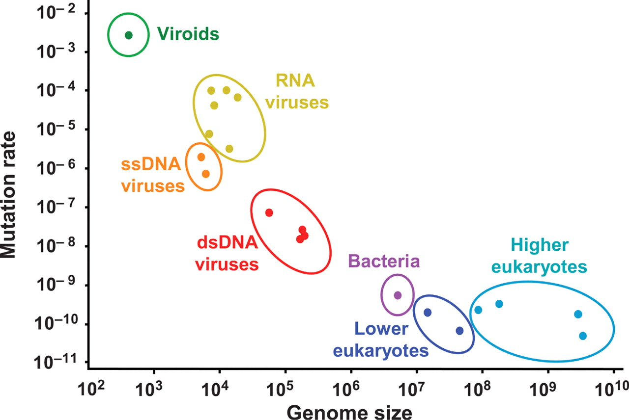
RNA viruses
- Influenza
HIV
Dengue
Ebola
Chikungunya
Zika
Gago et al. (2009) Science
Notes:
IAV is an RNA virus, that like many other RNA viruses has the ability to rapidly adapt to new environments, including new hosts. The capacity of RNA viruses to rapidly adapt is in large part due to their extremely high mutation rates, that range from 10-6 to 10-4 per site per replication cycle, resulting in 1-2 mutations per genome per cycle (given their size). However,

Slide 33
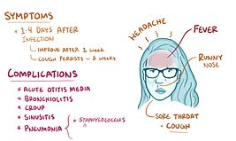
Influenza A/H3N2
Seasonal flu in humans caused by:
  influenza A/H3N2
  influenza A/H1N1
  influenza B (Yamagata & Victoria)
Influenza A virus
Segmented RNA virus (8 segments)
Mutation rate on the order of 10⁻⁵ to 10⁻⁴ per site per replication cycle = ~1 mutation per genome per replication cycle
Importance of HA for adaptive antigenic evolution
Notes:
Now, just a bit of background on the virus – now, probably don’t have to tell you what the symptoms of the flu – given that we’re coming out of the worst flu season since the 2009 pandemic, and that 1 out of 3 or 4 of you got the flu this winter. Let me tell you a bit about the genetics of the virus.
Segmented genome
Focus on HA evolution
Specifically, I’ll be focusing on Influenza A/H3N2, the dominant virus causing influenza in humans, and therefore the most intensively studied flu virus.
H3N2 has been with us since 1968. It, like the other flu viruses, is a segmented RNA virus with a high mutation rate. The fourth gene segment codes for the hemagglutinin protein HA, depicted here, which gets the virus into host cells, but is also the major target of our neutralizing antibodies, such that changes in the HA enable antigenic drift.

Slide 34
‘Phylodynamic’ simulations
Mutation load
Fraction susceptible
Fitness R
Notes:
However, when we add in deleterious mutations, we find that we can easily reproduce a ladderlike phylogeny, with part of the variation in viral fitness explained by variation in antigenicity, but the other part being explained by mutation load variation across the viral population.

