Slide 1
Travel Patterns and Disease Transmission
Alicia Kraay

Slide 2
Background
Prior research focused on differences between communities in terms of travel (ex: gravity models)
May be significant heterogeneity within communities
Ex: Adults are more likely to travel outside of the region than children
Travel heterogeneity may also be relevant to disease risk

Slide 3
Background
Travel
Risk
Travel + Risk

Slide 4
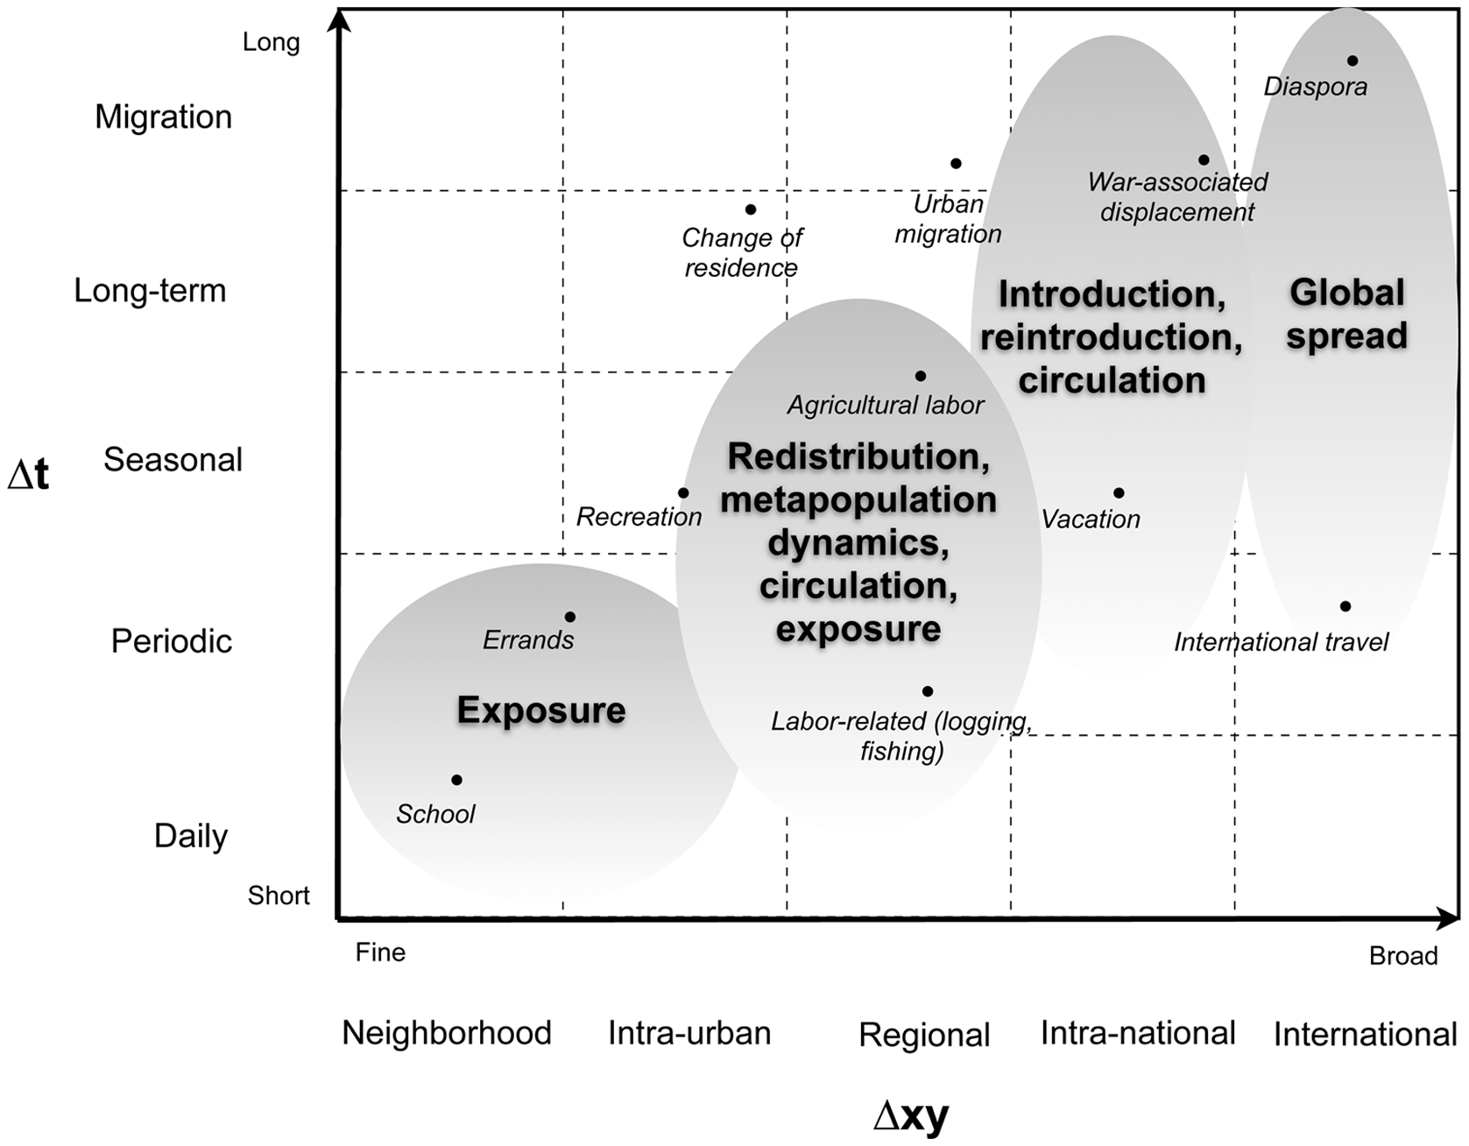
Short term, long distance travel
Stoddard ST, Morrison AC, Vazquez-Prokopec GM, Paz Soldan V, Kochel TJ, Kitron U, et al. (2009) The Role of Human Movement in the Transmission of Vector-Borne Pathogens. PLoS Negl Trop Dis 3(7): e481. doi:10.1371/journal.pntd.0000481

Slide 5
Research Aims
1. Evaluate demographic change over time occurring in tandem with road construction
2. Identify time stable determinants of travel (GEE Regression Models)
3. Investigate how accounting for these determinants in a disease transmission model affects risk and disease etiology (SIR Models)

Slide 6
EcoDess Study Region

Slide 7
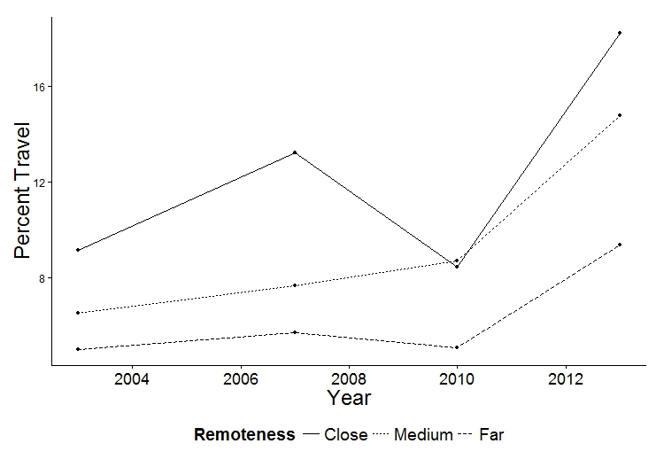
Development & Demographic Change Over Time

Slide 8
Consistent Determinants Over Time
 | Unadjusted OR | Adjusted OR
Remoteness | .69 (.59, .82) | .51 (.38, .67)
Age
<5 | Ref | Ref
5-13 | .75(.59, .95) | .65 (.50, .85)
>13 | 2.94(2.25, 3.85) | 1.73 (1.30, 2.31)
Adjusted for duration of residence, secondary school availability, highest household education, and occupation

Slide 9
Transmission Model Age and Travel
City demographics and infectious risk similar to Borbon (Ro=1.89)
City residents do not travel to remote villages
Transmission beta to children is twice as high as for adults
Population structure and travel taken from 2013
Notes:
Series of two village models for close, medium, and far villages paired with the city
Loosely parameterized based on rotavirus, not accounting for return to susceptibility (short time scale)

Slide 10
Measuring Travel
$τ_{Adult}=c×τ_{Child}$
No Heterogeneity: c=1
Medium Heterogeneity: c=2
High Heterogeneity: c=3
$$\overline{τ}=f_{Child}τ_{Child}+f_{Adult}τ_{Adult}$$

Slide 11
Travel Increases Risk
 | Low Travel ($τ$=.013) | Medium Travel ($τ$=.024) | High Travel ($τ$=.027)
Low Transmission (Village Ro=.89) | .020 | .027 | .031
High Transmission (Village Ro=1.43) | .021 | .029 | .032
Notes:
Cumulative Incidence
Increased community transmission alters the amount of amplification

Slide 12
Increase in Direct Risk to Travelers Stronger than Indirect Risk to Non-Travelers
 | Effect on Adults (% Risk Difference) | Effect on Children (% Risk Difference) | Community Effect (% Risk Difference)
Low Transmission
Medium vs None | 1.6 | 0.2 | 1.3
High vs None | 3.1 | 0.3 | 2.6
High Transmission
Medium vs None | 1.7 | 0.3 | 1.4
High Vs None | 3.2 | 0.6 | 2.8
Notes:
Risk difference

Slide 13
Heterogeneity in Travel Changes Source of Cases
Village Ro=.89
Village Ro=1.43
Children
Adults
Notes:
Attributable fraction
Also note that most cases still occur in the city, even when transmission and heterogeneity are high

Slide 14
Heterogeneity in Travel Homogenizes Risk
Observed Travel Ratio
Notes:
Village and City Ro are Equal for all simulations (Ro=1.63).

Slide 15
Conclusions
Increased travel increases risk of disease, suggesting a mechanism by which road development affects risk
Adults are critical for disseminating disease to remote regions, despite their lower risk of infection
Population centers drive infection risk for remote communities, regardless of local transmission parameters
Heterogeneity in travel homogenizes risk, suggesting that the differential in transmissibility by age may be greater than previously thought

Slide 16
Acknowledgements
Collaborators:
Andrew Brouwer
Joseph Eisenberg
EcoDess Study Project Staff
Funding: MIDAS

