Slide 1
Global Burden of Tuberculosis from 1990 to 2017: Methods and findings from the 2017 Global Burden of Disease Study
Jorge Ledesma (on behalf of the GBD TB team)
April 15, 2019

Slide 2
Outline
Background
TB modeling strategy
Findings
Limitations and conclusions

Slide 3
Background
Sustainable Development Goal to end the TB epidemic by 2030
Information on TB burden and trends are necessary for monitoring progress
Global Burden of Disease (GBD) Study framework
A systematic quantification of health loss due to diseases, injuries, and risk factors by age, sex, and geography

Slide 4
Outline
Background
TB modeling strategy
Findings
Limitations and conclusions

Slide 5
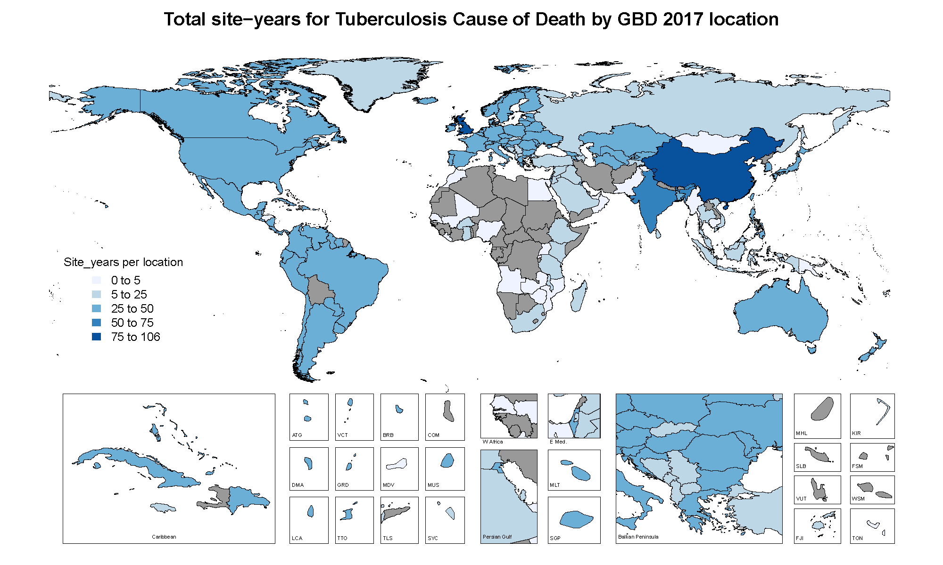
Mortality input data
Input data | GBD 2017
Total data sources | 19,404 site-years
Vital registration data | 17,405 site-years
Vital registration data - Sample | 740 site-years
Verbal autopsy data | 898 site-years
Surveillance | 361 site-years

Slide 6
Modeling TB (no-HIV) mortailty
Model: Cause of Death Ensemble model (CODEm)
 | Covariate | Direction
Level 1 | TB prevalence Latent TB infection prevalence SEV scalar Alcohol per capita Smoking prevalence Cigarettes per capita Fasting plasma glucose TB strain prevalence-weighted transmission risk | + + + + + + + +
Level 2 | Healthcare Access and Quality Index (HAQI) Adult underweight proportion Indoor air pollution Outdoor air pollution Population density | - + + + +
Level 3 | Log Lag-Distributed Income (LDI) Education (years per capita) Sociodemographic Index (SDI) | - - -
CODEm evaluates a large number of potential models with varying combinations of predictive covariates
Selected ensemble of CODEm models that performed best on out-of-sample predictive validity tests
Notes:
HAQI, Alcohol per capita, TB prevalence, adult underweight population, smoking prevalence, and TB infection

Slide 7
Modeling HIV-TB mortality
Input data
Vital registration data from countries with high quality VR data where cause of death data for directly coded HIV-TB and TB were available (438 site-years)
Number of TB cases (new and re-treatment) recorded as HIV-positive and number of TB cases with an HIV test result recorded in the TB register from WHO

Slide 8
Modeling HIV-TB mortality
(1) Mixed effects regression to estimate proportions of HIV-TB cases among all TB cases
(2) Estimate the relative risk (RR) of TB deaths in HIV positive individuals
$$RR=\frac{D_{c,y}P_{c,y}−D_{c,y}}{D_{c,y}P_{c,y}−P_{c,y}}$$
$D_{c,y}$= fraction of HIV-TB deaths among all TB deaths
$P_{c,y}$ = proportion of HIV-TB cases among all TB cases
(3) Estimate TB deaths attributable to HIV using a population attributable fraction approach

Slide 9
Nonfatal TB modeling approach
Goal: Use all available data to consistently estimate incidence, remission, excess mortality, prevalence and cause-specific mortality
Data: Annual case notifications, prevalence surveys, cause of death data, latent TB infection (LTBI) prevalence data
Tool: Dismod-MR 2.1

Slide 10
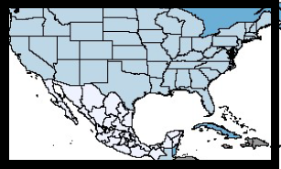
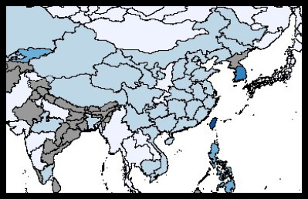
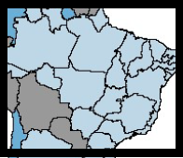
Nonfatal input data
Input data | GBD 2017
Overall data sources | 1,917 site-years
Case notifications | 1,751 site-years
Prevalence survey data | 166 site-years
Notes:
2,000 site years – 1,800 notifications & 200 prevalence surveys

Slide 11
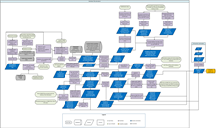
Key steps in modeling nonfatal TB
(1) Estimate prevalence of LTBI
(2) Divide prevalence, incidence, and CSMR by LTBI prevalence
Incidence from two sources
Notification data from countries with high quality VR data
Incidence estimated based on MI ratios for remaining countries
Input data from locations with high quality VR data
Healthcare access and quality index (HAQI) as a covariate
Anchor the lower end of the HAQI scale with data from an untreated cohort of pulmonary TB cases in the 1960s
(3) Run through DisMod-MR 2.1 to ensure consistency of estimates
(4) Multiplied outputs by the risk-weighted LTBI prevalence to get population-level estimates
(5) Split TB all-forms into HIV-TB and TB no-HIV
(6) Split HIV-TB and TB no-HIV into MDR-TB, XDR-TB, and drug-susceptible TB

Slide 12
Outline
Background
TB modeling strategy
Findings
Limitations and conclusions

Slide 13
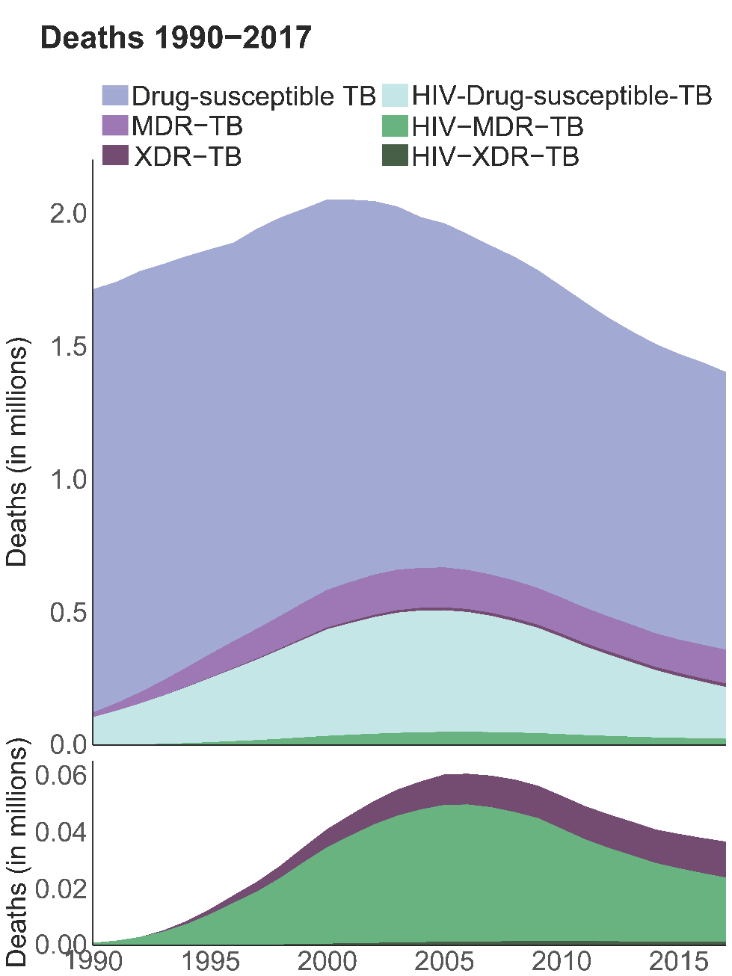
Global TB deaths by drug-resistance type and HIV status
Number of deaths
 | 1990 | 2017
All TB | 1,712,812 | 1,402,122
Drug-susceptible TB | 1,590,152 | 1,044,149
MDR-TB | 17,557 | 126,886
XDR-TB | - | 12,637
HIV-drug-susceptible-TB | 104,270 | 194,617
HIV-MDR-TB | 833 | 22,601
HIV-XDR-TB | - | 1,232

Slide 14
Age-standardized TB (HIV-negative) mortality rates, both sexes, 2017
Notes:
Central African Republic, Burundi, Somalia, Zimbabwe, Lesotho

Slide 15
Annualized rate of change for age-standardized TB (HIV-negative) mortality rates, both sexes, 2007 – 2017

Slide 16
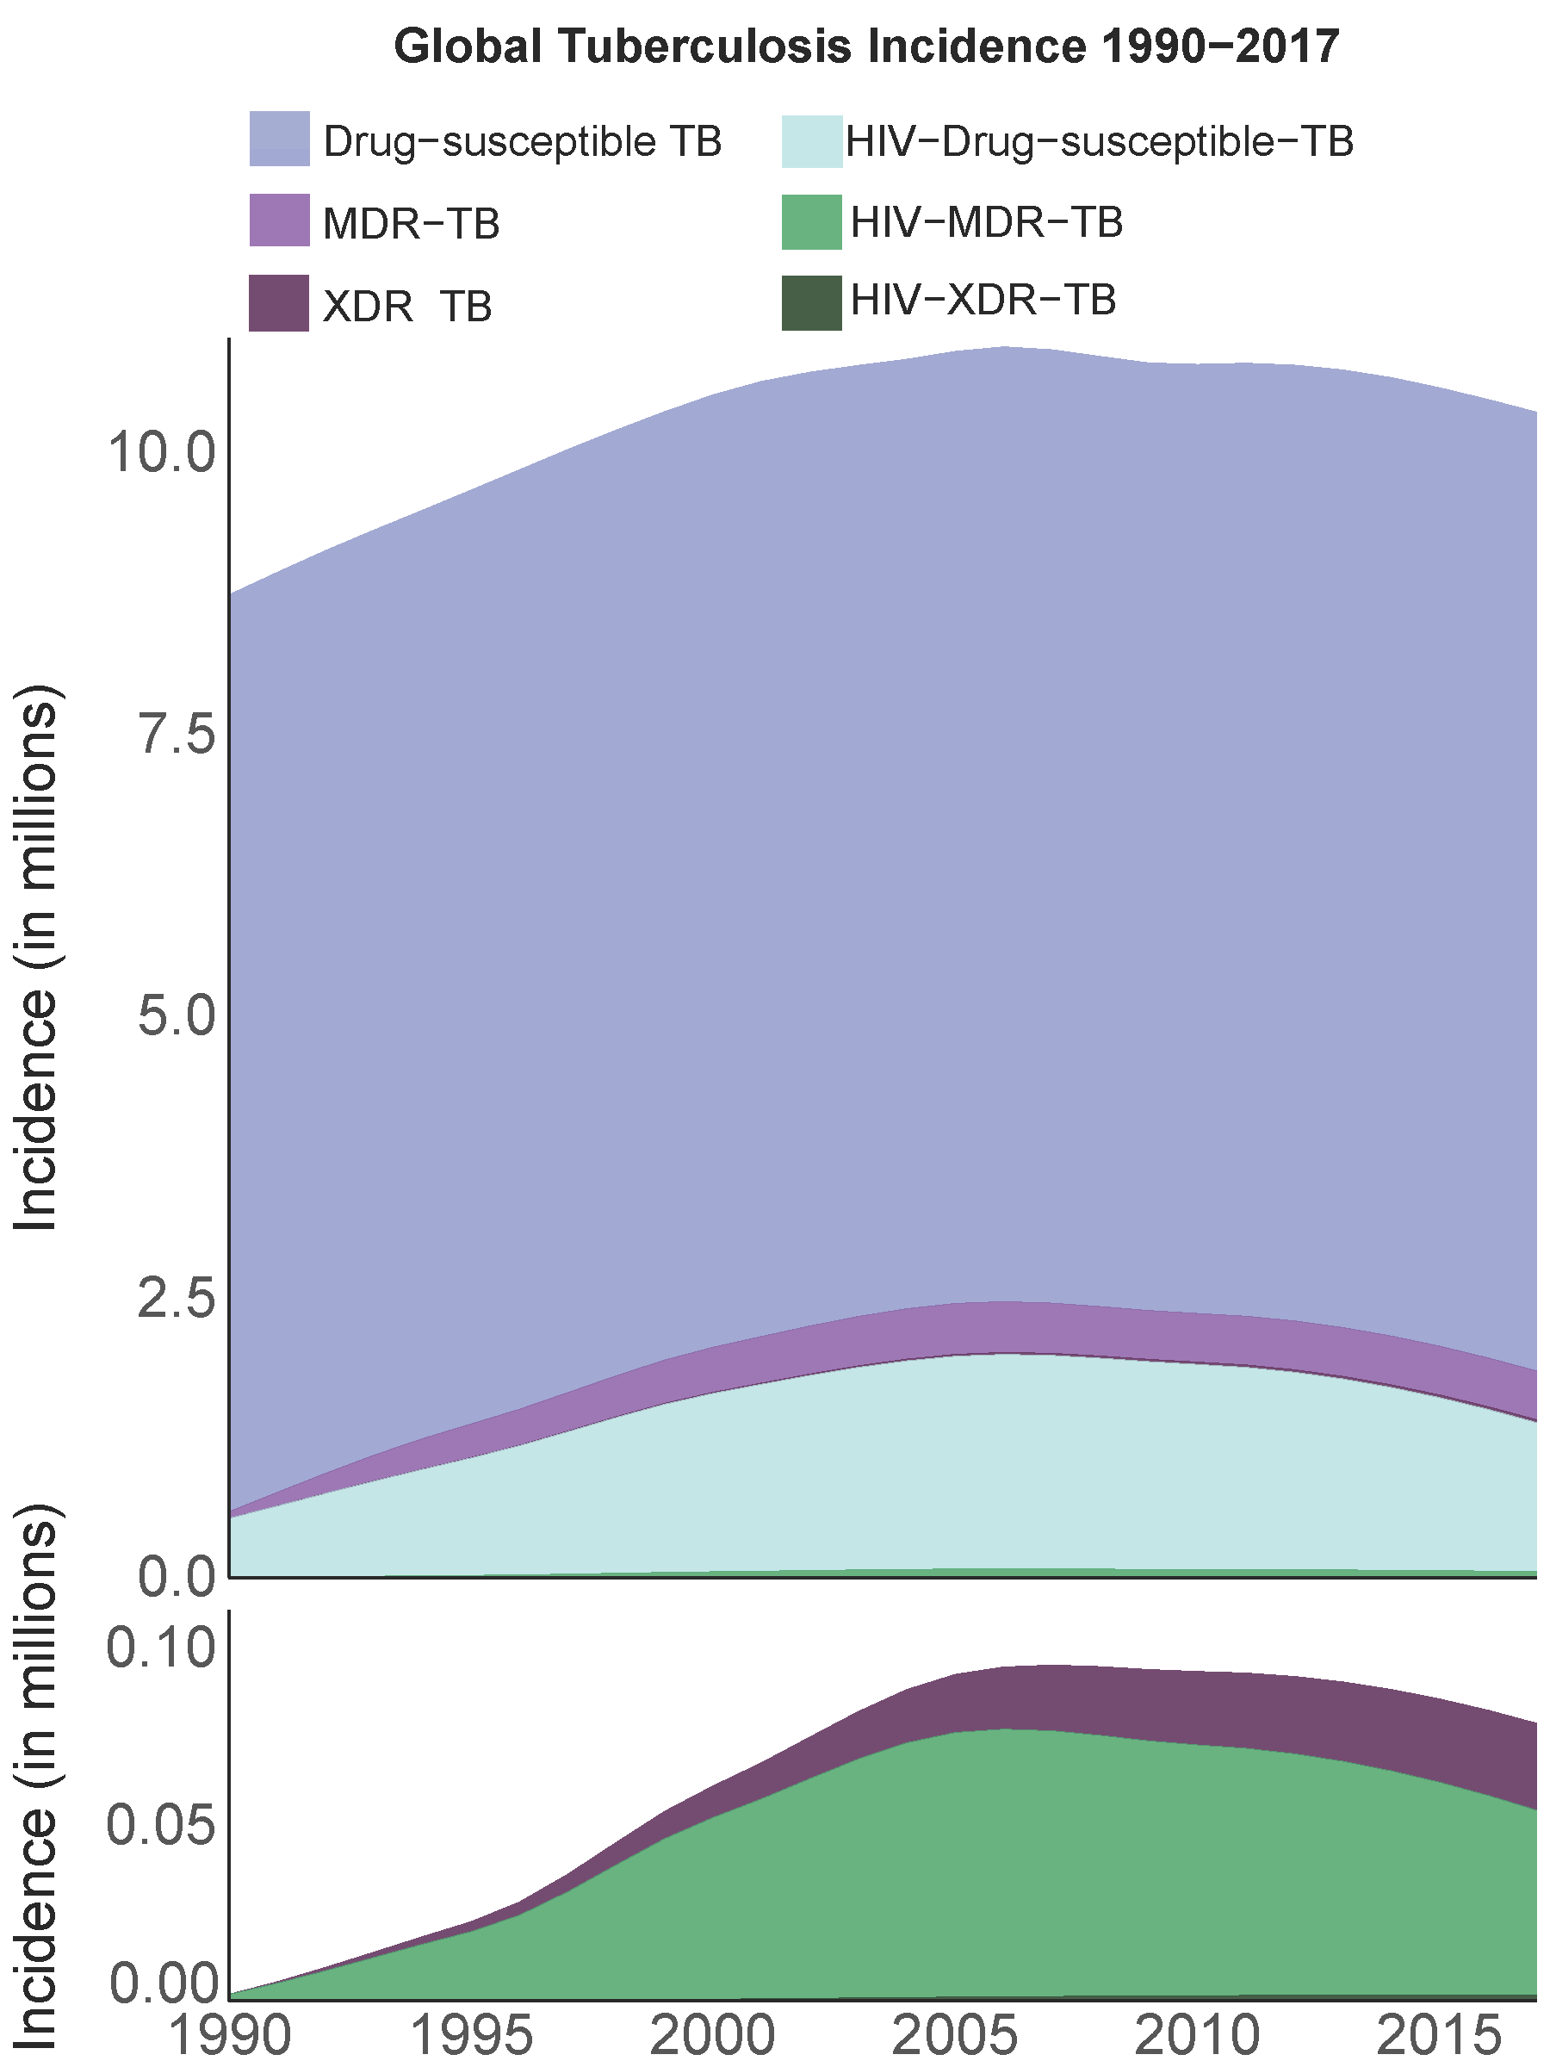
Global TB incidence by drug-resistance type and HIV status
Incidence 1990-2017
Incident cases
 | 1990 | 2017
All TB | 8,719,525 | 10,341,076
Drug-susceptible TB | 8,135,756 | 8,508,571
MDR-TB | 58,277 | 432,772
XDR-TB | - | 24,471
HIV-drug-susceptible-TB | 523,669 | 1,321,568
HIV-MDR-TB | 1,822 | 52,006
HIV-XDR-TB | - | 1,689

Slide 17
Age-standardized TB (HIV-negative) incidence rates, both sexes, 2017
Notes:
Central African Republic, Burundi, Lesotho, DRC, Zimbabwe

Slide 18
Annualized rate of change for age-standardized TB (HIV-negative) incidence rates, both sexes, 2007 – 2017

Slide 19
Outline
Background
TB modeling strategy
Findings
Limitations and conclusions

Slide 20
Limitations & Conclusions
Limitations
Lack of high quality data in high TB burden countries
Rely on regional level patterns and covariates to help predict for locations without data
Conclusions
Substantial variation in trends for incidence and mortality across countries
Incidence is declining at a slower pace compared to mortality
Need to improve case finding, early diagnosis, and treatment

Slide 21
Acknowledgements
Christopher Murray
Theo Vos
Simon Hay
Mohsen Naghavi
Bobby Reiner
Kirsten Wiens
Jennifer Ross
Sarah Johnson
Natalia Bhattacharjee

Slide 22
Thank you!
Questions?
GBD 2019 TB Team:
Hmwe Kyu
Emilie Maddison
Molly Biehl

