Slide 1
Leveraging HPC to accelerate research
7th IDM Symposium – Benoît Raybaud
April 2019

Slide 2
IDM
IDM mission
shape global efforts to eradicate infectious diseases
achieve permanent improvements in the health of those most in need
advise policymakers, promote quantitative decision-making and advance scientific methodologies
To fulfill this mission scientists at IDM relies on models, tools and High Performance Computing

Slide 3
IDM Scientific Workflow
To get the most accurate results, models need a lot of parameters
Population dynamics
Health system, immunity, etc.
Vector population and dynamics
Climate
Complex intervention schedule
Migrations
Spatial simulations

Slide 4
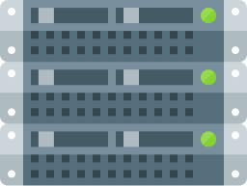
Iterative processes
HPC Cluster
Exploration of parameter space
Workstation
Stochasticity
Single simulation
Laptop
Complexity / Runtime
Notes:
Even despite the complexity, If we would be running only one simulation, we could get away with a laptop and still get results in acceptable time
Problem is usually we want to explore a multi dimensional parameter space and analyze various outcomes / multiple location with migration / large
Additionally, model is stochastic so we need to run multiple realizations of the same scenario to be confident in the outcome
All of this require more than just a laptop to run in an acceptable timeframe (within hours instead of days or weeks) and this is why IDM is hosting and leveraging HPC resources

Slide 5
Standard HPC workflow
Shared folder
Upload

Slide 6
Standard HPC workflow
Connect and execute
Returns
Job ID

Slide 7
Standard HPC workflow
Check status
Job ID
Status report

Slide 8
Standard HPC workflow
Copy

Slide 9
COMPS
COmputational Modeling Platform Services
Experiments management
Monitoring
Visualizations
Assets management
Workflows
Programmatic access
Cloud Environments
IDM Cluster
Notes:
Multiple environments accessible

Slide 10
COMPS UI
No command line needed to
Check status of experiments
Cancel/Delete jobs
Check resources availability
Open simulations inputs/outputs
Globally accessible through a browser
Search feature, favorites, easy sharing
Hierarchy of objects
Tagging
Unified access to different environments and platforms
Notes:
Usually researcher will have to run a command line tool to get the status for their jobs. Looking at a queue and it may be cumbersome to know about how busy the resources are
The COMPS team developed a very convenient UI to the COMPS system allowing researchers to
Have a global view of the availability of resources
Quickly check their jobs
Access jobs they ran (including input/output files)
Directly from a browser window

Slide 11
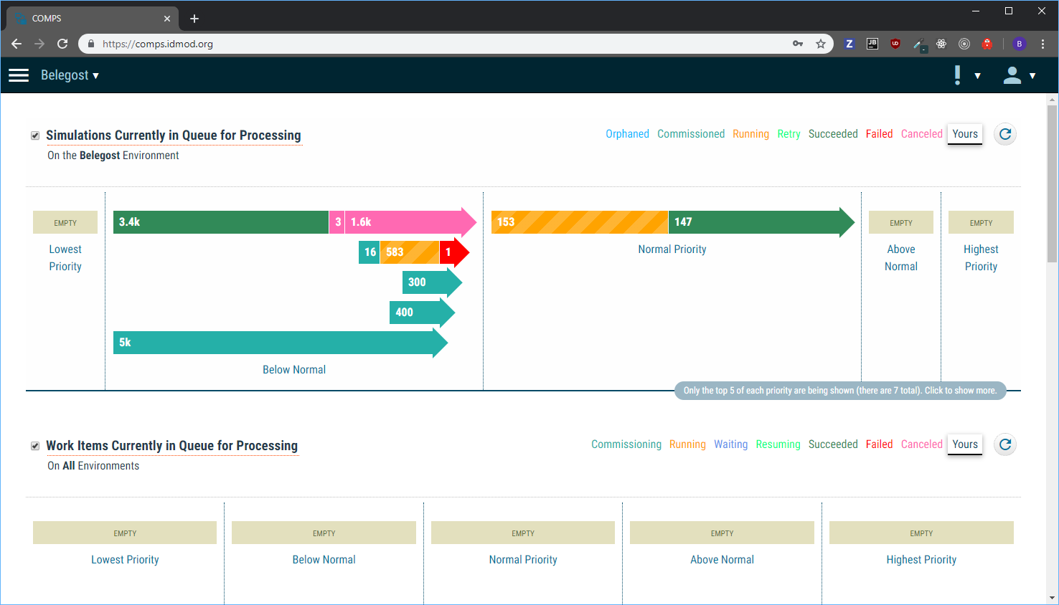

Slide 12
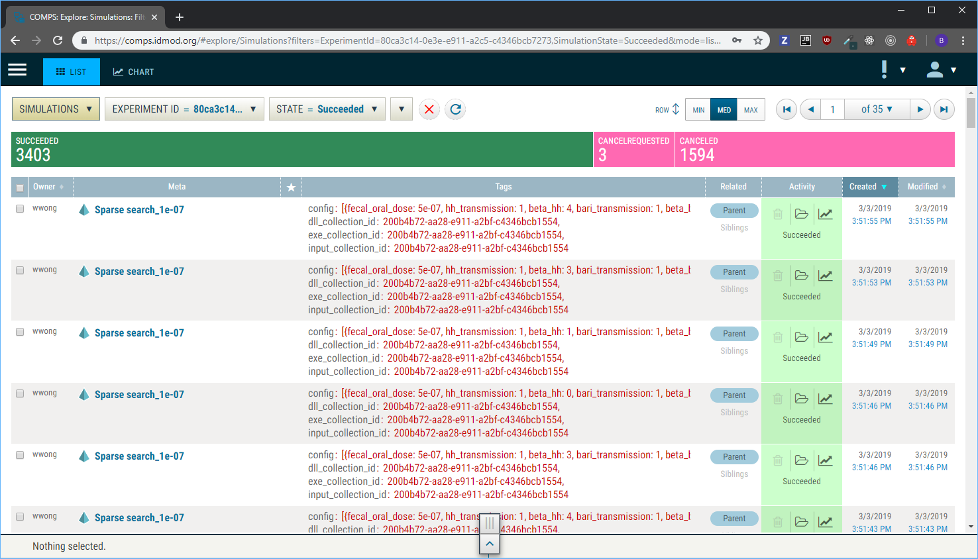

Slide 13
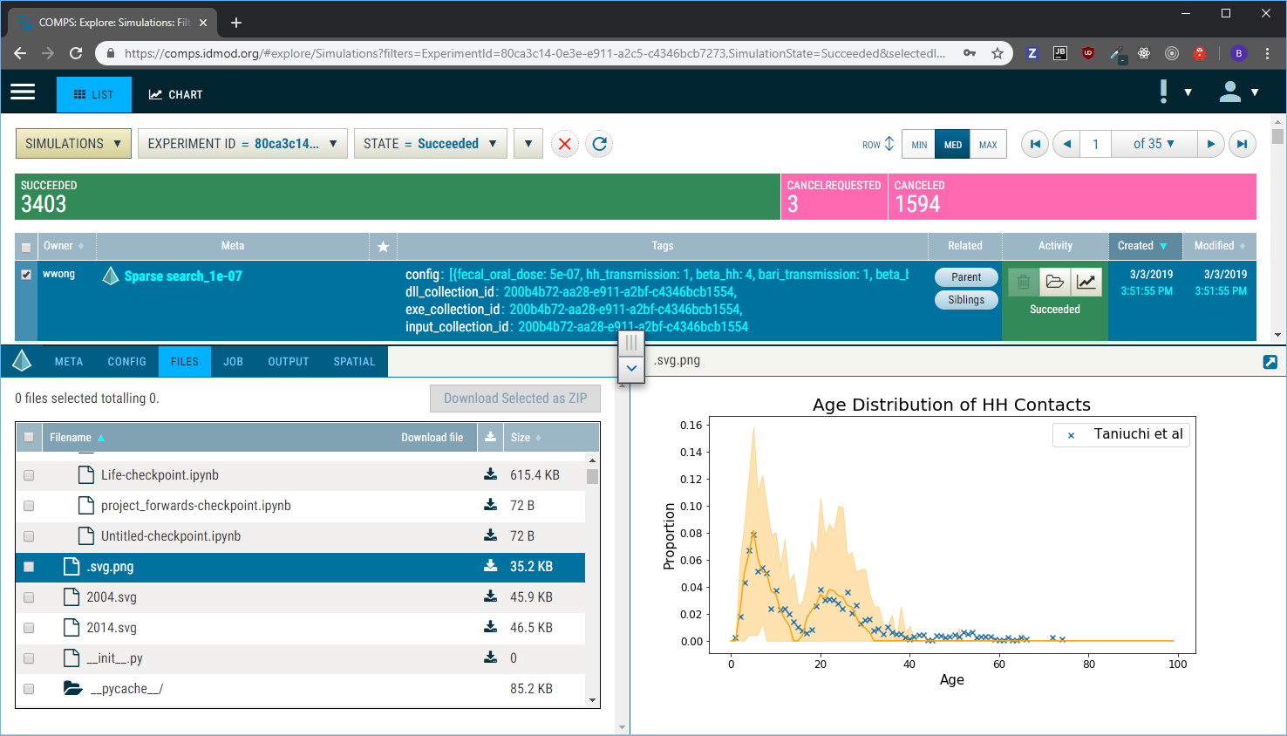

Slide 14
Assets Management
Challenging to determine which executable/files were used for a given simulation
In regular HPC settings, the user bear the responsibility for
Managing the files to ensure reproducibility
Minimizing file duplication to conserve disk space
COMPS is introducing the concept of Asset Collections to solve those issues
Notes:
Even by being organized, it can be hard to know which executable was used for a given simulation
If we are conscious and centralize some of the shared inputs same issue
Lets say we want to ensure reproducibility
Will probably have to keep the particular executable and inputs for each experiments we are running
May lead to hitting the disk space quota and have to choose what to delete
May be complicated to know what to delete
So in regular HPC setting, it can be challenging to
Conserve disk space
Being able to reproduce old results

Slide 15
Asset collections
REPRODUCIBILITY
TRANSPARENT
Choose files locally and/or from existing collections
When submitting job, collection is created and linked
SPACE EFFICIENT
If file already exists, simply links it
IMMUTABLE
Cannot be changed
Modifications create a new collection
Notes:
Give a real example/scenario of reproducibility!!

Slide 16
Asset collections
User Space
HPC Cluster
My_file.txt
Available assets
Input.bin
Check status
?
Executable.exe

Slide 17
Asset collections
User Space
HPC Cluster
My_file.txt
Available assets
Input.bin
Check status
Executable.exe

Slide 18
Asset collections
User Space
HPC Cluster
My_file.txt
Available assets
Input.bin
Check status
Executable.exe

Slide 19
Asset collections
User Space
HPC Cluster
My_file.txt
Available assets
Check status
Input.bin
Collection #3
Executable.exe
Available Collections
Collection #1
Collection #2
Collection #3

Slide 20
Asset collections
User Space
HPC Cluster
Simulation
Collection #3
Submit
My_file.txt
Input.bin
Executable.exe
Simulations

Slide 21
Programmatic Access and middleware tools
API allowing tools to communicate and leverage the COMPS features
Middleware tools
Python tools to shift the user focus to the experiment design instead of technical details
Supports running locally but works best with COMPS
Common platform enabling sharing of workflows

Slide 22
Server Side Modeling Tools
Allows to run workflows directly on COMPS
Relies on Docker containers to ease environment creation and sharing
Leverage the existing infrastructure
COMPS UI
Asset collections
Middleware tools
Notes:
Laptops Slower to analyze
Laptops Needs time to download the files from the cluster
Laptop needs to be up to monitor and make sure to process all when done
Easier to share the environment
If I want to share my workflow with another researcher, less pain to set up as it all runs server side
Easier to use specific versions of libraries

Slide 23
Server Side Modeling Tools
Workflow is built locally in the user environment
Familiar tools
Same toolset present on the server
When ready, sent to the COMPS platform
Data locality
Cluster close to the data ⇒ faster download before processing
More cores available to the workflow
Less time taken to process and analyze data
Convenience
Integrated to the UI
No need of keeping laptop awake to monitor
Notes:
Make sure to mention the laptop to not have to run

Slide 24
How to access those tools?
If working with IDM research team, already can leverage the tools
If not, contact us to get in touch with the appropriate research group
support@idmod.org

Slide 25
Thank You!

