Slide 1
What do we know about the economics of integration and health system strengthening for improving cost-effectiveness and efficiency of health services in limited resource settings?
Carol Levin
IDM's 7th Annual Modeling Symposium
16 April 2019
Notes:
This presentation will highlight the role of integration and health system strengthening for improving reach and quality of services in low-and middle-income settings. It will explore available evidence on costs, effectiveness, efficiency and cost-effectiveness of integrating health services (as well as integrating across sectors) to improve health outcomes in primary health care delivery.

Slide 2
Overview
Defining integration Economic aspirations of integration
What do we know?
Lessons from HIV integration
Draw on some random work that I’ve done
Learn from new approaches to broaden economic evaluations to account for health system strengthening/integration.
Notes:
Focus on HIV (vertical) and HIV and other primary health care services
Draw on immunization
Draw on multisectoral approaches for nutrition.

Slide 3
Integration- multiple definitions- whose perspective?
Health Service integration
Joining together different kinds of services or operational programs to maximize outcomes (UNAIDS).
The organization, coordination and management of multiple activities and resources to ensure delivery of more efficient and coherent services (USAID/PEPFAR).
Notes:
Health service integration—what it is, and whether it is beneficial— has been the subject of debate, with advocates suggesting financial and logistical efficiencies that promote sustainability and improve access and equity, while others argue that integration my reduce access and quality of care through overloading service delivery platforms and overburdening already weak health systems.
What is Integration? Within the health sector…
Across the health sector
Definition depends on some degree on who is asking—still tends to be discussions about integration within diseases, like HIV, integration of HIV and PMTCT, or integration of HIV services and RH services.
More recently, integration of chronic diseases (prevention of CVD, diabetes, mental health) prevention and treatment with primary care (which to date has been focused on infectious diseases).

Slide 4
Defining integration in relation to health systems
Assimilation of health interventions into each of the critical functions of the health system
(Atun et al 2010)
Health system components:
Governance
Financing
Management
Service delivery
Monitoring and evaluation
Demand generation
Notes:
This is the most restrictive definition of integration in that it aims to measure the extent, pattern and rate of assimilation into EACH of the critical functions of a health system.
Where the focus is on an intervention that refers to a combination of technologies (vaccines, drugs), inputs into service delivery, organizational changes and modifications in processes related to decision making, planning and service delivery.
Paper by Sweeny et al. (2012) describe the potential efficiency gains of integrating HIV counseling and testing into ANC services to prevent mother to child transmission of HIV.
Integration at the governance level (such as co-ordination of strategic and operation planning and performance level) may improve technical efficiency by sharing scarce resources, such as skilled planners and managers.
At the financing level, integration may improve technical efficiency by merging the costs of separate financing systems. Co-ordinated financing systems may also reduce perverse incentives that may be created by competing programmes and thus impact allocative efficiency.
At the health management systems level, integration can facilitate improvements in technical efficiency through reductions in management systems costs. This can include joint procurement, joint supply chain systems, sharing of middle managers, joint training and supervision, sharing of information, education and communication materials, and joint management information systems.
At the facility level, integration can contribute to reductions in facility costs resulting from joint yse of fixed factors of production.
For patients, integration may lead to less fragmented services, higher levels of continuity of care, better referral systems and possibly reductions in patient/community-level costs resulting from fewer visits to facilities, greater proximity of services and reduced delays in accessing treatment.

Slide 5
Defining integration as coordination or co-location of multisectoral program components
Multisectoral approaches that work across sectors --agriculture, health, water, sanitation, hygiene (WASH), early childhood development, social transfers -- to reduce poverty, end hunger and improve health and well-being.
Notes:
Emergence of food systems and double burden of malnutrition—highlights the need for multisectoral solutions to improve health and nutrition
Integrate program components to increase the supply of nutritious foods alongside components to increase household demand for those foods.
Nutrition sensitive value chains in the agriculture sector that have improved nutrition and economic well-being as their outcomes.
Integration of child nutrition and early childhood to improve cognitive development and contribute to SDGs.

Slide 6
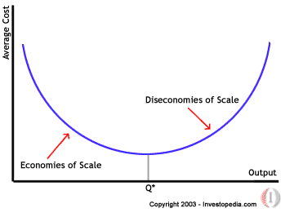
Integration may improve technical efficiency- Scale
Economies of scale
Average cost = Total cost (TC)/Q
Large scale production results in lower unit (average) costs
Cost per beneficiary, cost per patient on ART, cost per child vaccinated, cost per facility-based birth, etc.
Diseconomies of scale occur because more expensive to reach hard to reach populations, poor management, poor health worker motivation, etc.
Notes:
Economists care about efficiency!
Efficiency means getting the best possible outcomes for the available resources. Most of us immediately think of low cost per output.
Technical efficiency focuses on using the right mix of resources to produce health services and can be assessed by measuring the unit cost of health services.
Economies of scale, or reductions in service costs associated with increased scale of service provision, may be found where integration enables expansion of service coverage to clients who have not previously accessed them.
Economies of scale takes advantage of large scale production that result in lower unit (average) costs (cost per unit)
Where the average cost is equal to the total cost of the intervention divided by the total quantity produced (or total number of beneficiaries reached). Economies of scale – spreads total costs over a greater range of output.
As the number of beneficiaries are reached, the average unit cost (AC in the figure) decreases as production rises efficiency is reached with the given resources. As production rises past this point the average unit cost increases, providing diseconomies of scale. In global health settings, diseconomies of scale may occur as we extend services to more remote and hard to reach areas. Or management problems, or motivation by health workers, etc.

Slide 7
Integration may improve technical efficiency- scope
Economies of Scope (EoS)
Total Costs
TC₁₊₂(x₁+x₂) < TC₁(x₁)+TC₂(x₂)
Benefits
Estimate the savings or gains as
a percentage of joint production
Intervention TC1=$1.5m
Intervention TC2= $2.4m
Joint TC1+TC2 = $3m
EoS_{TC} = (1.5+2.4-3)/3
=0.9/3
=0.3
30% total cost reduction
B₁₊₂(x₁+x₂) > B₁(x₁)+B₂(x₂)
Source: Hauck, K., et al. "How can we evaluate the cost-effectiveness of health system
strengthening? A typology and illustrations." Social Science & Medicine 220 (2019): 141-149.
Notes:
Economies of scope, or reductions in service costs from combining services, may be found through shared use of a common infrastructure, over- heads and certain ‘indivisible’ operational resources.
Total costs of providing intervention 1 and 2 jointly are less than providing them separately.
Total benefits of providing intervention 1 and 2 jointly are greater than providing them separately.
So for example, if the costs of providing intervention 1 are c1 (x1) = $1.5m, the costs of providing intervention 2 are c2 (x2) = $2.4m, and
the costs of providing the two interventions together are c1+2 (x1 + x2) = $3m, then the value of the economies of scope are 0.9/0.3 =0.3…this measure indicates the savings or gains of joint compared to separate production as a percentage of joint production—shows that providing the two interventions together results in costs savings of 30%. IN THEORY!
Is there evidence of this?

Slide 8
Integration may improve allocative efficiency
Allocative efficiency is concerned with whether the right mix of health services are provided.
Typically assessed using measures of cost-effectiveness or cost benefit analysis.
Notes:
Allocative efficiency is concerned with whether the right mix of health services are provided and is commonly assessed using measures of cost-effectiveness or cost benefit analysis.
Allocative efficiency: choosing the optimal mix of interventions to achieve the sector or health program goals.
CEA and CUA focuses on the least cost way of producing a good (health technology, for example) or health service. These techniques compute the ratio of input to output (or vice versa) with inputs valued in monetary terms and is therefore a measure of economic efficiency. CEA considers only one measure of effectiveness and as a result often omits important social costs and benefits.
CBA can be used to measure both economic and allocate efficiency questions. It can be measured either within the health care sector or across other sectors of the economy because in principle it assesses all relevant costs and benefits that result from an intervention. While in theory this provides the most comprehensive form of economic evaluation, its use in the health sector has been limited largely due to the practical problems of measuring and valuing these benefits.

Slide 9
Economics of integration
What do we know?

Slide 10
Integration at the service delivery level: HIV and primary health care
Our most robust evidence comes from the HIV literature.
Integrated HIV services are cost-effective.
Evidence on economies of scale limited- comes mostly from pilot studies.
Evidence on economies of scope is mixed.
Integration of HIV counseling and testing with other services can reduce costs of counseling and testing by 17 to 80%
Doesn’t always reduce the costs.
Notes:
Much of what we know comes from the HIV literature (with other services like SRH, TB and NCDs) and is focused at the service delivery level,
First, I’ll focus on what we know from HIV and service delivery, and then provide an example from above service delivery level integration, focusing on supply chain management from immunization programs.
A wide range of integrated HIV services are cost-effective.
Integration may reduce the costs of delivering some key HIV services.
Limited cost-effectiveness data on integrated HIV services at scale. Mostly pilot programs
Focus is on integrated clinical services:
HIV counseling& testing in antenatal care services.
TB services for HIV positive clients (and HIV services for TB clients.
FP services for HIV positive clients.
Lower unit costs were reported, mostly driven down by improved use of human resources.
Lack of studies that identify efficiency gains from integration above the service delivery level and to HIV service users.
Lack of high quality studies comparing the costs of integrated services with those of stand-alone alternatives.
A more recent study by Siapka and others looked at scope for cost savings and efficiency gains in HIV services published in 2014.
Economies of scale:
In reviewing 40 studies, they found that most studies were not large enough estimate relationship between costs and scale—only 9 studies had large enough samples for econometric analysis. And they were not necessarily focused on integrated services, but rather on a range of HIV services offered (not clear if through integrated or stand alone programs).
Economies of scope:
The same study looked at 23 studies that reported findings from economies of scope (including the previous study by Sweeney et al 2012.
The integration of voluntary HIV counseling and testing with other health services was found to improve quality, increase the utilization of services and reduce the cost per visit in some programmes, but not others. MIXED RESULTS
Compared with the costs of stand-alone services, the integration of HIV counseling and testing with other health services has been reported to reduce unit costs – of the counseling and testing – by between 17% and 79%.
Economies of scope may actually represent the indirect effects of economies of scale—that is integration may have brought HIV services to new clients rather than improved efficiency through the joint provision of services.

Slide 11
Integration at the service delivery level: HIV and SRH
HIV and Sexual Reproductive Health (SRH) services
Little or modest efficiency gains from integrating HIV and SRH.
Efficiency gains more likely in settings that delivery HIV and SRH at low scale with high levels of fixed costs.
Must have high complementarity of services—that is similar types of resources are needed.
Distributing advice, pills or condoms doesn’t use the same level or type of resources that the HIV counseling, testing and treatment cascade.
Notes:
Study by Carol Dayo-Obure in Kenya and Swaziland. The Costs of Delivering Integrated HIV and Sexual Reproductive Health Services in Limited Resource Settings. The objective of their study was to generate evidence on the total and unit costs of delivering as part of the Integra initiative to evaluate three different models of integrating HIV and SRH in the two countries. They collected data from 30 health facilities in Kenya and 10 health facilities in Swaziland.
High variability in unit costs. Used econometric analysis to explore efficiency in greater detail.

Slide 12
Integration at the service delivery level: HIV and NCDs
Emerging focus on Noncommunicable diseases (NCDs)
Limited quantitative evidence of the cost or cost-effectiveness of integration among NCD’s in HIV.
Most studies were from community based HIV testing programs.
The incremental cost of adding NCD screening to a non-facility program ranged from 6 to 30% of HIV testing and counseling in Kenya, Uganda, and South African settings.
Nugent, Rachel, et al. "Costs and cost-effectiveness of HIV/noncommunicable disease integration in Africa: from theory to practice." Aids 32 (2018): S83-S92.

Slide 13
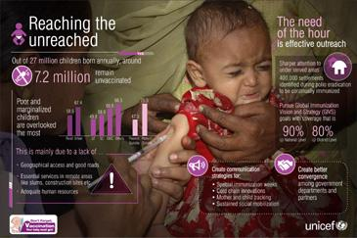
Integration above the service delivery level- example from immunization programs
Immunization average cost per child fully vaccinated has gone from $20 per fully immunized child to over $50 per fully immunized in past 20 years.
We don’t see the cost per child vaccinated going down.
Why?
Notes:
Immunization is one of the most cost-effective public health interventions. Lots of evidence on costs and cost-effectiveness.
Increasing cost per child fully vaccinated. We don’t see cost per child vaccinated going down? Why? Is it inefficient? No. It is a successful program that has received consistent donor funding since around late 1990s.
Most of this increase has come from a mix of expanding routine immunization and introducing new more expensive vaccines into an existing national immunization program. Increase in total and unit costs also reflect investments in health system strengthening. Investing in supply chain systems to accommodate successful national immunization programs.
Hard to look at economies of scale, because keep introducing new and more expensive vaccines into national immunization programs
(Some economies of scope demonstrated through implementation of child health days, where a package of child health interventions are offered during a campaign outreach for one week twice a year. Typically this is a low cost per child reached when focusing on a single intervention out of the package b/c of shared cost.)
So, an increasing cost per beneficiary doesn’t necessarily imply program inefficiency. This is not to say that there aren’t program inefficiencies within and across countries. It is just hard to capture this in LMIC with heterogeneity in country context and health systems of varying quality.
Immunization offers some interesting lessons for integration. But not at the service delivery level per se. It has always been a vertical program, with its own supply chain system that is often parallel to the national essential drugs and supply list. Interestingly, Immunization offers a glimpse of what might be possible when trying to integrate above the facility level—for example focusing on supply chains that integrate vaccines with other essential supplies.

Slide 14
Innovative supply chain idea in Senegal
Create a moving warehouse from the regional level to health posts to increase quality of vaccines and reduce stock outs.
Deliver vaccines along with other essential public health commodities—reproductive health products.
Notes:
Senegal had two parallel supply chains from the national level to health posts.
One for vaccines and one for essential drugs and supplies.
PATH introduced a moving warehouse into St. Louis region of Senegal, and conducted implementation research on acceptability, feasibility, and costs.
The moving warehouse idea required integration of two parallel supply chains. To do this required buy in from government agencies/departments that would see their resources changed, since one supply chain would reduce management positions at central and sub-national levels. High transaction costs associated with change.

Slide 15
Costs of innovation and integration in Senegal
Costs of integrating vaccines and reproductive health supplies using the moving warehouse, Saint Louis Senegal
Source: WHO, PATH. Optimize: Senegal Report, Seattle: PATH; 2013
Notes:
Estimate the baseline costs of vaccine supply chain—for the old system where vaccines are pushed from the central level and then districts and health centers pull vaccines from the vaccine stores at level above them).
Increased costs and outputs, no decrease in costs, but no increase. Total costs are likely to increase in the short-term as we invest in health systems.
Lower cost per dose depends on outputs and outcomes achieved over a longer period than a demonstration project.
Integration helped offset and reduce costs of innovation. Fixed costs were spread over a larger number of commodities moving through the system.

Slide 16
Integration as part of multisectoral strategies to improve child and maternal health
What exactly is a multisectoral integrated program?
Occurs across more than one sector and government ministries, with multiple implementing partners, at all governing administrative levels.
Different ministries, different budgets, different access to donor funds, different modes of decision making.
Integrated programs require stakeholder engagement, regular and joint planning, implementation, and monitoring and evaluation.
Coordination of program components at local level.

Slide 17
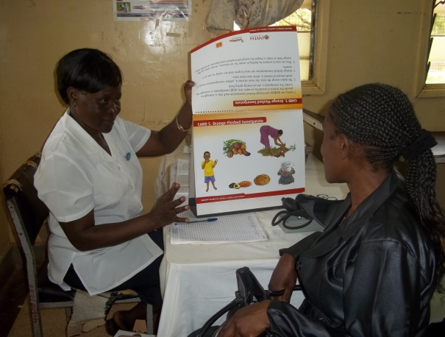
Implementation components of an integrated agriculture/health and nutrition project
1. COMMUNITY SENSITISATION
2. ANC CLINIC ATTENDANCE/
NUTRITIONAL COUNSELING
3. VOUCHER ISSUING AT ANC CLINIC
6. AG EXTENSION ACTIVITIES
5. PREGNANT MOTHER’S CLUBS
4. VOUCHER REDEMPTION
Notes:
From 2009 to 2013, PATH and the International Potato Center designed, introduced and evaluated an integrated agriculture, health and nutrition project, called, “MAMA SASHA’ in Western Kenya.
An integrated program connects pregnant women from their communities to nearby ANC clinics. Community Health workers raise awareness and increase demand for services. Nurses provide nutrition counseling and provide a mechanism for women to pick up vines for planting in their home gardens; They can participate in pregnant mother’s clubs, that reinforce a standard set of BCC messages for maternal and child nutrition. They receive home visits by agriculture extension agents, that also provide the same BCC messages.
Source: Cole, D. C., Levin, C., Loechl, C., Thiele, G., Grant, F., Girard, A. W., ... & Low, J. (2016). Planning an integrated agriculture and health program and designing its evaluation: Experience from Western Kenya. Evaluation and program planning, 56, 11-22.

Slide 18
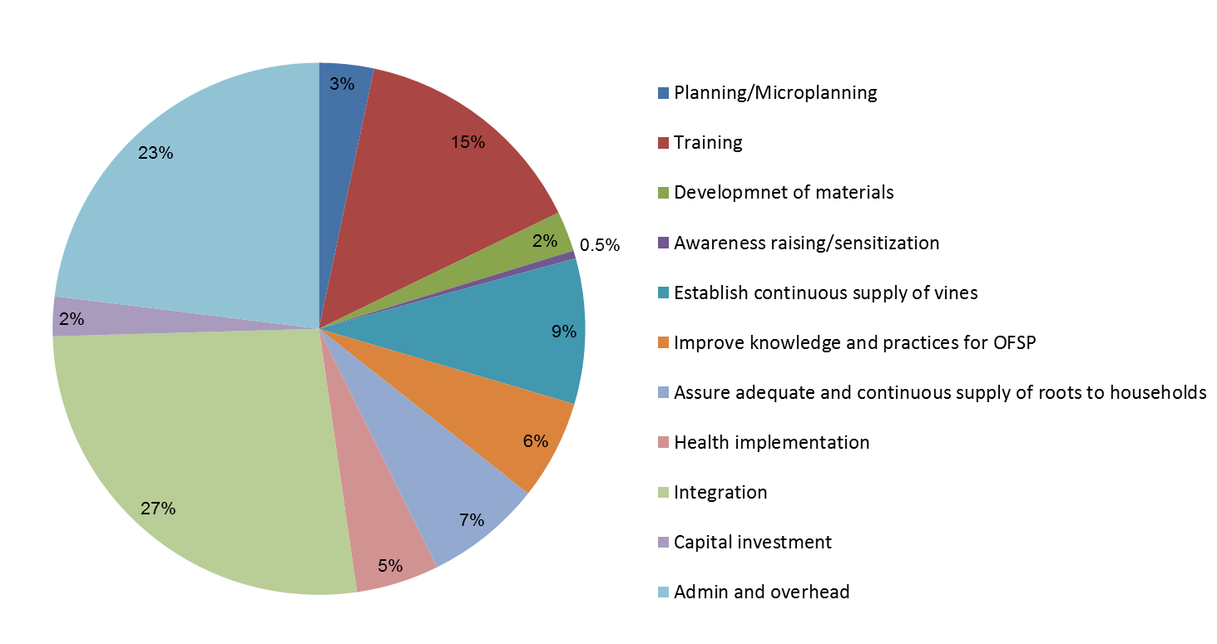
Average cost of integrated agriculture/health/nutrition program -USD 150 per beneficiary
27% of total costs to
support integration
Levin et al. ‘What is the cost of integration? Evidence from the Mama SASHA project to improve health and nutrition through an integrated orange flesh sweet potato production and health service delivery model.’ Manuscript under review, 2019.

Slide 19
Common sense and New economic evaluation approaches
Improving models of disease prevention and treatment by incorporating integration and health system strengthening

Slide 20
Some practical ideas for improving evidence base
Collect information on costs of integrated programs, include service delivery, above site costs (related to governance, management, human resources and financing) and patient costs.
Reluctantly recommend to collect data from large samples. Better to build cost surveillance data system to help generate facility level data for econometric analyses on economies of scale and scope.
Conduct economic evaluation as part of clinical trials, demonstration trials and impact evaluations at scale.
Modify mathematical models to allow for integration and health system impact and costs.
Notes:
Models and empirical evaluations may want to compare stand alone treatment or prevention programs with integrated programs.

Slide 21
Follow best practices for generating improved evidence
1
International Decision Support Initiative (iDSI) Reference Case for Economic Evaluation
2
Global health Cost Consortium (GHCC) Reference Case for Global Health Costing
3
Harvard T.H. Chan School of Public Health Benefit Cost Analysis Guidelines
Sources:
1 International Decision Support Initiative (iDSI) Reference Case for Economic Evaluation
2 Global Health Cost Consortium Reference Case on Global Health Costing (GHCC)
3 Harvard T.H. Chan School of Public Health Benefit-Cost Analysis guidelines

Slide 22
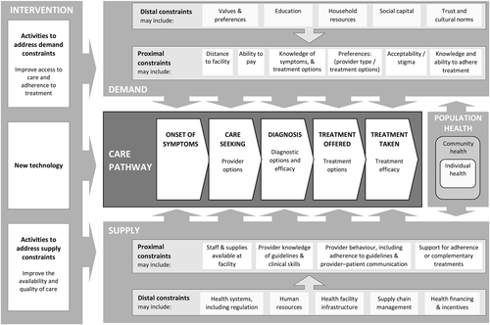
Incorporate Demand and Supply Constraints into Economic Evaluations in Low‐Income and Middle‐Income Countries
Health Economics, Volume: 25, Issue: S1, Pages: 95-115, First published: 19 January 2016, DOI: (10.1002/hec.3306)
Source: Vassall, Anna, et al. "Incorporating demand and supply constraints into
economic evaluations in low‐income and middle‐income countries." Health economics 25 (2016): 95-115.
Notes:
There are two new ways to think about economic evaluation that may help inform future economic evaluations, and could also inform infectious disease models that only focus on single technologies or solutions without considering health system constraints and factors hat affect supply.
The first is a relatively new conceptual framework and approach recommended by by Anna Vassall and colleagues on how to incorporate supply and demand constraints into economic evaluations for LMIC.
The second is a paper by Katharina Hauck and collegues that presents a new theory and numeric illustration of improving CEA to account for joint delivery of interventions.
First, the conceptual model from Vassall et al. Two options…
Treat technologies and activities to overcome demand and supply constraints as distinct interventions and asses their cost-effectiveness as part of the service delivery activity, if possible
Recognize that introducing new technologies or integrated service delivery models is like a complex intervention, with many components. Must cost these and assess how these affect coverage, utilization of services and ultimately health impact.
Vassall, A; Mangham-Jefferies, L; Gomez, GB; Pitt, C; Foster, N (2016) Incorporating Demand and Supply Constraints into Economic Evaluations in Low-Income and Middle-Income Countries. Health economics, 25 Suppl 1. pp. 95-115. ISSN 1057-9230 DOI: 10.1002/hec.3306

Slide 23
Recognize the critical role of the delivery platform in CEA
Health service delivery platforms are logistically related service delivery channels:
Population based health interventions
Community services
Health centers/health posts
First level hospitals
Referral and specialized hospitals
Source: Hauck, K., et al. "How can we evaluate the cost-effectiveness of health system
strengthening? A typology and illustrations." Social Science & Medicine 220 (2019): 141-149.
Notes:
Katharina Hauck et al has published ‘
“How can we evaluate the cost-effectiveness of health system strengthening? A typology and illustrations”
The crux of her paper focuses on looking at the critical role of the delivery platform and a typology of health system interventions that can be incorporated into CEA.
Health System Strengthening (HSS): investments in delivery platforms include investments in supply chains, clinical laboratories, physical buildings, diagnostic equipment, staff training, and data capture systems
Impacts on the benefits and costs of all interventions that rely on the platform
A health delivery platform is closely related to the notion of integration and economies of scope since the production of two interventions by the same entity may be more cost-effective than separate productions. The presence of the shared platform may lead to a reduction in costs compared to separate delivery of the interventions.
Integration may be very intentional, especially when introducing a new service, like mental health or prevention of NCDS. However, there may be more integration that is already occurring through delivery platforms, where we can improve our estimates of efficiency. We have seen how studies of integration show minor economics of scope, implying that joint implementation is less cost-effective than separate implementation. Maybe the data is right, but perhaps the standard methods for assessing allocative efficiency, that is cost-effectiveness analysis, do not allow for platforms that deliver more than one service.

Slide 24
A new approach to CEA
Standard CEA assumes that interventions are independent.
Hauck et al. provides 3 scenarios with worked examples, supported by mathematical formulations to show how to incorporate health system strengthening into CEA.
Investing in platform efficiency (relax the capital constraints, such as information systems, training, laboratory facilities)
Invest in platform capacity (relax human resource constraints to provide multiple interventions through a single platform)
Invest in new platforms (a new integrated delivery platform, such as mobile HIV testing that allows for hypertension screening).
Notes:
The costs and benefits of each intervention stay the same, regardless of other interventions.
CEA minimizes costs subject to a budget constraint.
Yet if several interventions rely on a delivery platform, they are implicitly interdependent. From a systems perspective, therefore, the costs and benefits of a specific intervention are often conditional on the other interventions chosen to share the common delivery platform. The existence of platforms introduces additional considerations into the standard CEA framework.
A decision to implement a specific intervention may have positive or negative effects on the costs and benefits of other interventions depending on whether it helps share the costs of an underutilized existing platform, puts pressure on the capacity of an existing platform, or introduces a new platform.
Hauck et al develop a theory, with mathematical formulations and numerical illustrations showing what happens when you allow for the interdependencies from multiple interventions for a given platform.

Slide 25
Conclusion
Integration comes in many sizes and shapes.
Our evidence base on costs and CEA of integration is weak.
Efforts to better model, design and evaluate integrated delivery of services’ impact, costs and CEA are needed to guide future investments in effective and efficient health systems.
Economic evaluation methods are changing to accommodate integration of health system components at all levels.

Slide 26
Thank you!
Carol Levin, PhD
clevin@uw.edu

