Slide 1
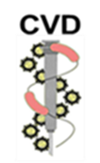
Tenacious endemic typhoid fever in Oceania
Myron M. (Mike) Levine, M.D., D.T.P.H.
Simon & Bessie Grollman Distinguished Professor
and
Associate Dean for Global Health, Vaccinology and Infectious Diseases
University of Maryland School of Medicine,
Baltimore, MD, USA
Institute for Disease Modeling
Seattle, April 17, 2018

Slide 2
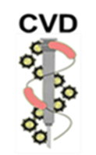
WHO Typhoid fever update, Wkly Epi Rec, 2018
4 key regions of typhoid endemicity
South Asia - India, Pakistan, Nepal, Bangladesh
Southeast Asia - Indonesia, Malaysia
Sub-Saharan Africa – Spotty in E, W, Central
Oceania - Samoa, Tonga, Fiji, Vanuatu

Slide 3

Primer on the epidemiology of typhoid fever
RESERVOIR
(chronic carriers)
VEHICLES OF TRANSMISSION
(contaminated food & water)
In many settings,
“amplification” of
transmission maintains endemicity
CLINICAL AND SUB-CLINICAL INFECTIONS
SUSCEPTIBLES

Slide 4
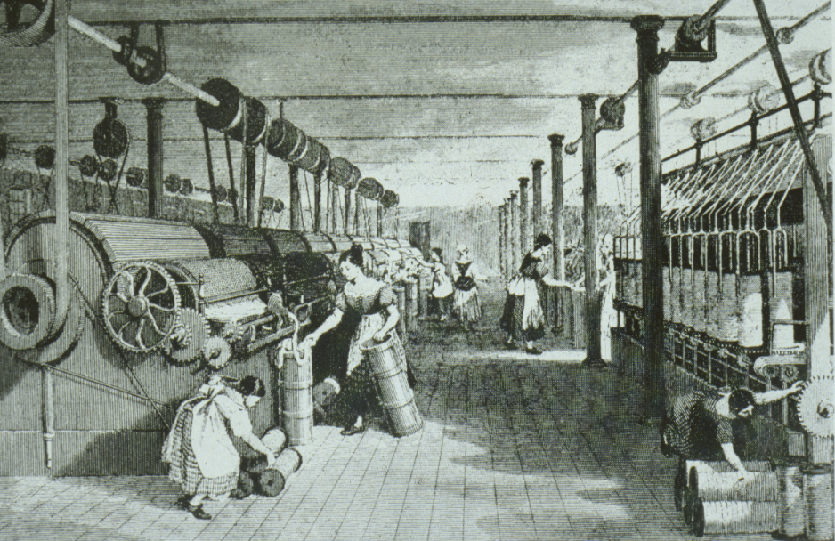
Industrial Revolution

Slide 5
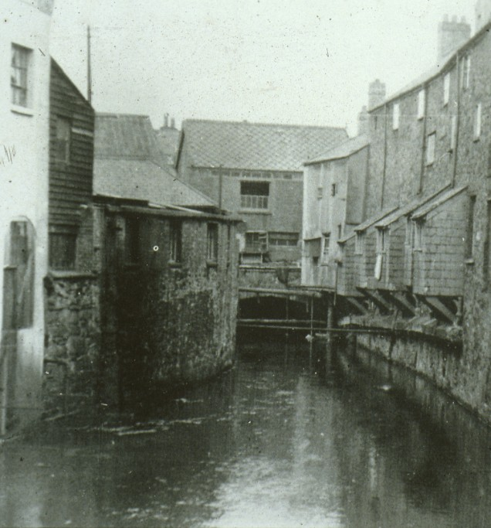
The epidemiology of typhoid fever
“Epidemiologic Amplification” sustains the hyper-endemicity of typhoid
The industrial revolution fostered large population centers along rivers (~1800 - 1850)
Reservoir of infection (carriers)
Sewage (human waste) discharged into rivers
Municipal water supply derived from river
Latrines fouling waterway,
Exeter, England, 1883

Slide 6
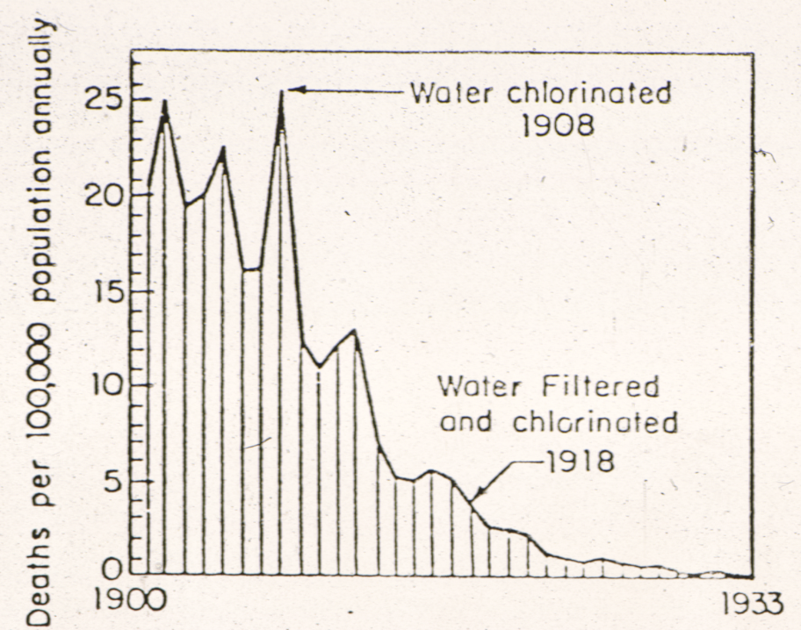
Impact of water treatment on typhoid fever mortality, Detroit, 1900-1933

Slide 7
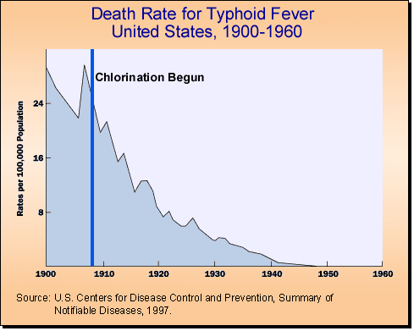

Slide 8
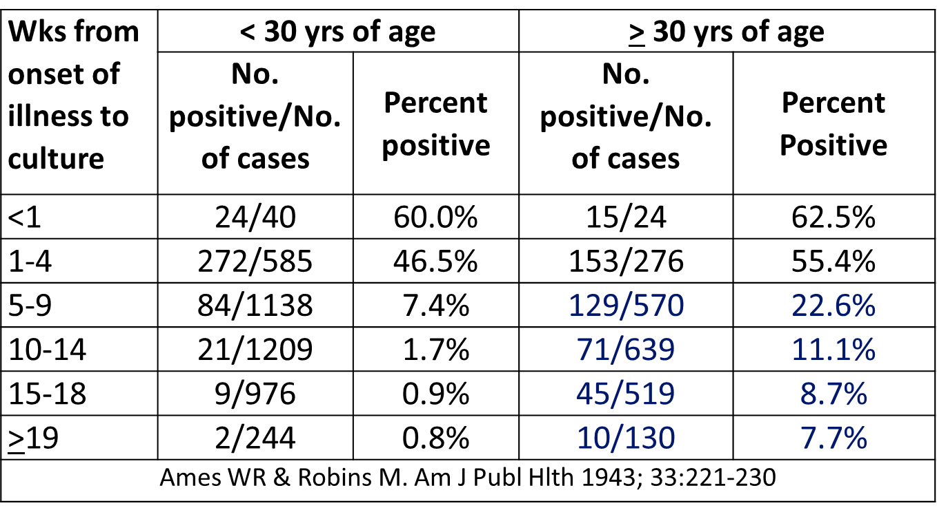
Percent of typhoid patients excreting typhoid bacilli in coprocultures, by age group and by week after onset of illness. (Based on 374 cases, New York State, 1938-39)

Slide 9
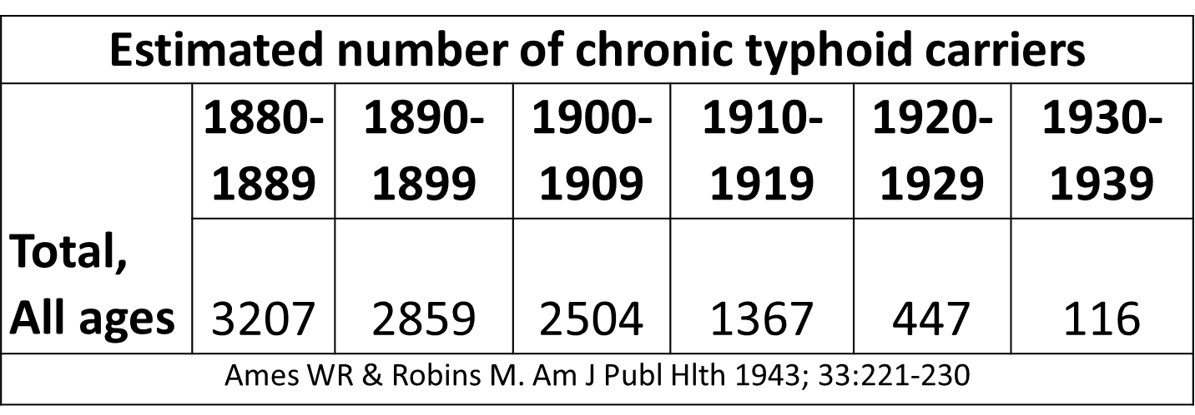
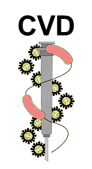
Die-off over time of chronic typhoid carriers in New York State (except NYC) as amplified transmission progressively disappeared

Slide 10
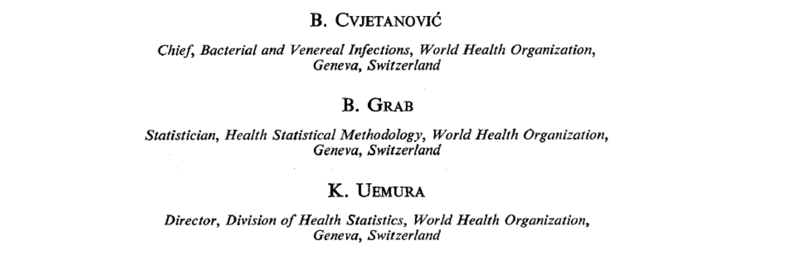

Slide 12
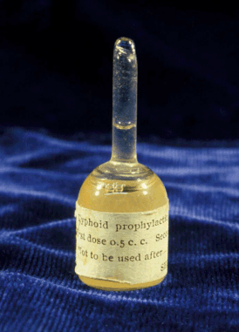
Typhoid incidence, U.S. Army, early 20th century
Mean Annual
Years Incidence/10⁵
1900-10 494
→ Typhoid vaccination routine from 1911
1911-21 55

Slide 14

Yugoslav Typhoid Commission, Bull WHO 1964

Slide 15
Efficacy of acetone-inactivated, dried parenteral typhoid vaccine in the
WHO-sponsored field trial in school children in Guyana
Field Efficacy
Site Doses Years (95% CI)
Guyana 2 1960-67 89% (82-93)
Guyana 1 1960-67 95% (64-99)
(Yugoslav Typhoid Commission, Bull WHO 1964;
Ashcroft M et al, Lancet 1967)

Slide 16
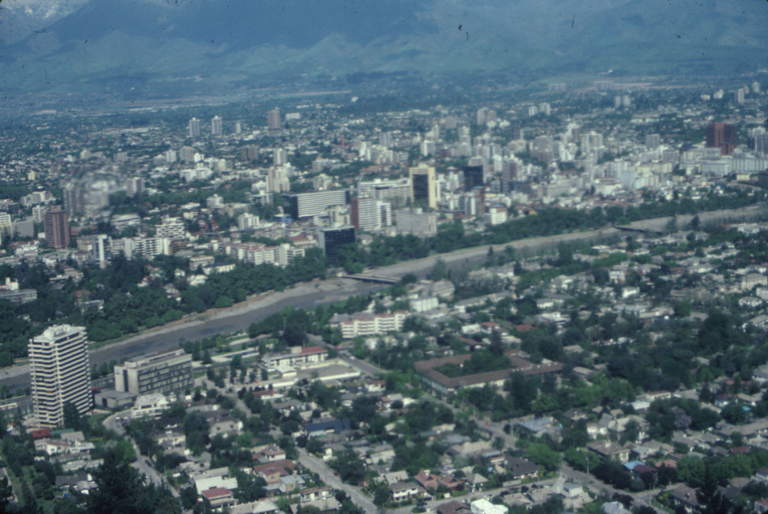
Santiago, Chile 1978, an epidemiologic anomaly

Slide 17
Epidemiology of endemic typhoid fever, Santiago, Chile, 1970s & 80s
High incidence of typhoid
2/3 of cases in school age children, age 6-19 yrs
Striking seasonality -- warm dry season disease with summer peak (during school vacation)
Prevalent in all neighborhoods of the city and in among
socioeconomic levels
96% of case households had potable water supply
80% of case households connected to sewage
system How can this be?

Slide 18
Typhoid morbidity, Chile 1960-1978
In 1977, the incidence
of typhoid fever doubled

Slide 19
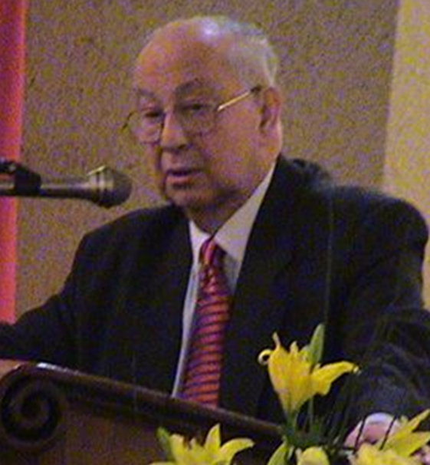
A Chilean Typhoid Fever Control Program was established
1978 - Dr. José Manuel Borgoño, Head of the Epidemiology Unit of the Ministry of Health of Chile, invited two external consultants (Dr. Branko Cvjetanovic of WHO & Dr. Myron M Levine of the Center for Vaccine Development, University of Maryland) to Chile to evaluate the endemicity of typhoid and make recommendations to control the disease
1st recommendation -- Establish a Typhoid Fever Control Program

Slide 20
A Chilean Typhoid Fever Control Program
1979 - Typhoid Fever Control Program (TFCP) was established
In the 1970s, Santiago was known to have one of the highest prevalences of cholelithiasis in the world
In the 1970s Chilean epidemiologists, microbiologists and clinicians considered it indisputable that chronic typhoid carriers in households were responsible for maintaining the endemicity of typhoid in Santiago

Slide 21
Typhoid morbidity, Chile 1960-2001
Ty21a live oral vaccine
Screening for carriers & Rx
Key WASH intervention

Slide 22
Indirect protection (herd immunity) from widespread use of Ty21a live oral typhoid vaccine, Area Norte, Santiago, Chile
Year of Incidence/10⁵ Effect of new
follow- controls in Site of new trial on Norte
up Area Norte field trial incidence
1 (1982) 227 None -
2 (1983) 139 Occidente ↓ 39%
3 (1984) 70 Sur ↓ 49%
4 (1985) 103 None ↑ 32%
5 (1986) 62 Suroriente/Norte ↓ 40%
(Levine et al 1989, Black et al 1990)

Slide 23
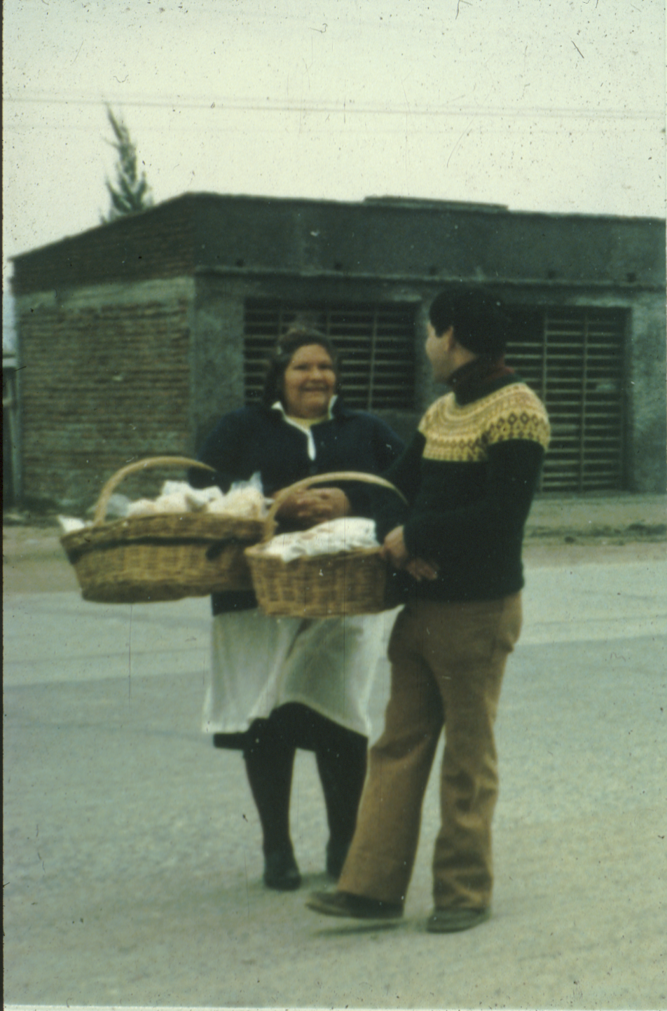
Chronic typhoid & paratyphoid carriers comprise the reservoir of endemic infection
Una de las “Marías Tifoideas” de Santiago, Chile
1-4% of typhoid & paratyphoid
infections become chronic gall
bladder carriers
The propensity to become a
carrier depends on sex (F>M) &
age (increases with age)
Same epidemiology as
cholelithiasis

Slide 24
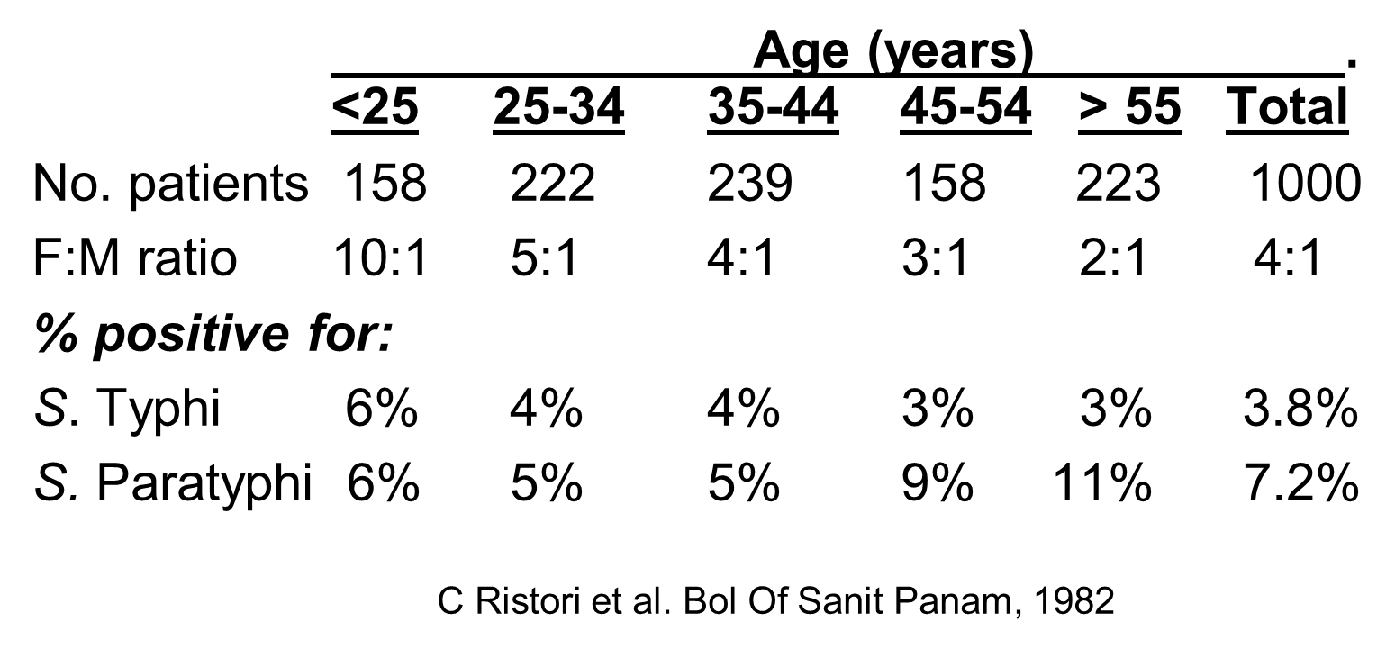
Age & sex distribution & frequency of isolation of S. Typhi & S. Paratyphi in bile from 1000 consecutive cholecystectomies, Santiago, 1970s

Slide 25
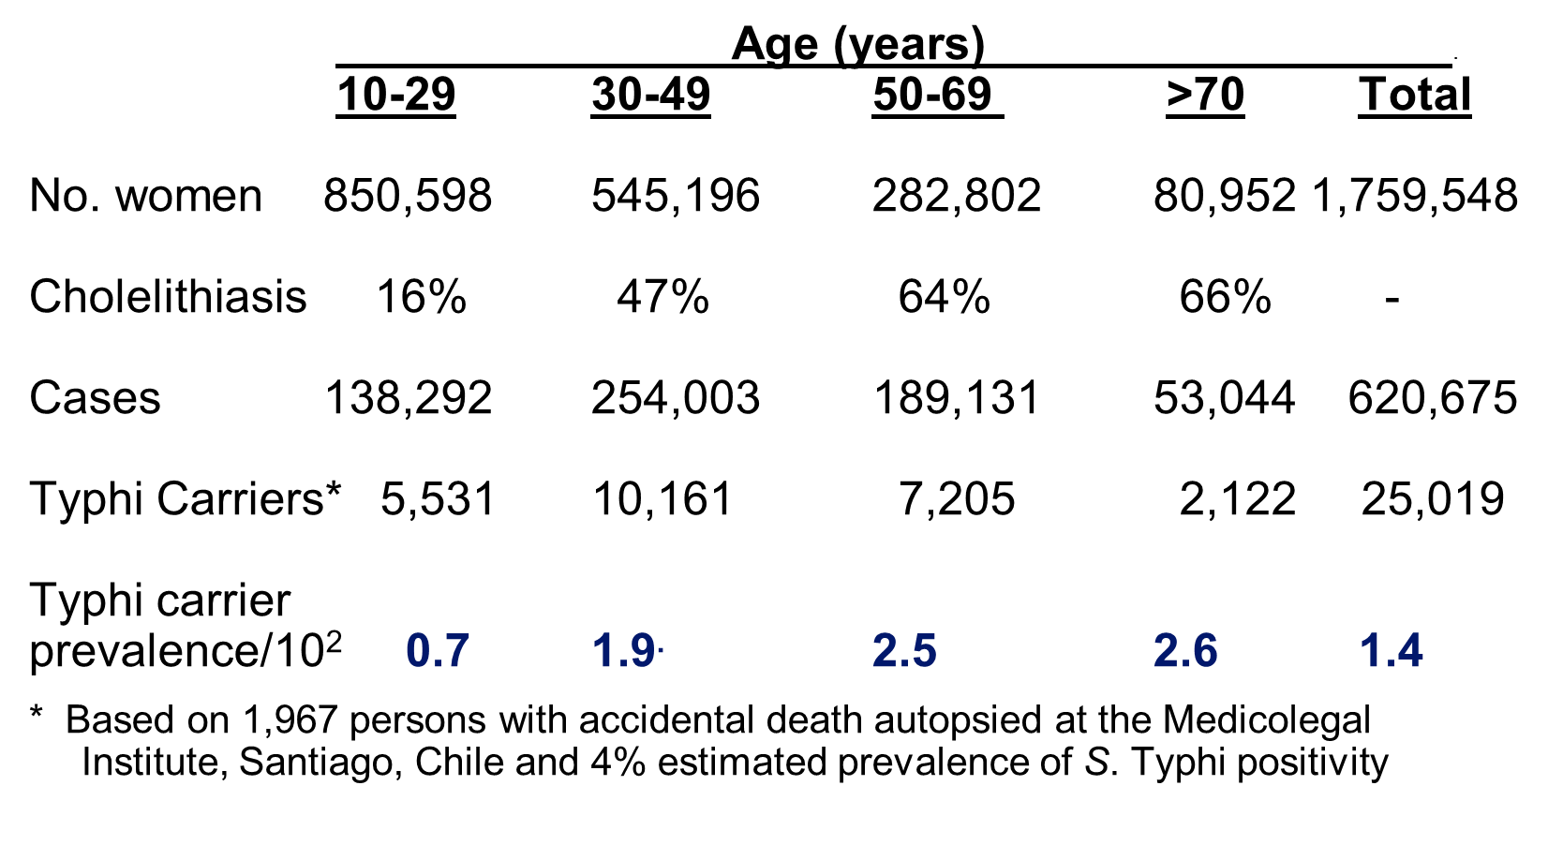
Estimated number of female chronic S. Typhi carriers in Santiago, Chile, 1980 (Levine MM et al. JID 1982)

Slide 26
Prevalence of chronic typhoid carriers of epidemiologic relevance in Santiago, Chile
Carriers among food handlers in case/control study
  2/78 case (2.6%) & 1/81 control (1.2%) households (Black R et al Bull WHO 1985)
  137 ♀ food handlers in 77 schools had 2 stool cultures and Vi serology. 2 elevated Vi titers were identified, one was a chronic typhoid carrier (0.73%) Ferreccio C et al. Rev Med Chile 1988;
  1006 food handlers in 65 food service locations in Central Santiago were screened for Vi antibody titer. 10 had elevated titers and 2 proved to be chronic carriers when cultured (0.2%) Ferreccio et al. Rev Med Chile 1990
Carriers treated with 4 weeks of oral ciprofloxacin.
11 of 12 carriers successfully treated (92%). (Ferreccio C, J I D 1988)

Slide 27
Year 1 incidence of culture-confirmed typhoid fever in schoolchildren 6-18 years of age who received placebo in the Area Norte, Santiago field trial, 1982
Year of Incidence/10⁵
trial Area Norte
1 (1982) 227
(Levine et al 1989, Black et al 1990)

Slide 28
Salmonella Typhi & S. Paratyphi isolates from pediatric enteric fever cases, Area Norte, Santiago, 2006-2015
 | Cases <15 years |  | Annual mean pop’n, age <15 yrs | Annual mean typhoid incidence, age <15 yrs/10⁵ | Annual mean paratyphoid B incidence, age <15 yrs/10⁵
2006-10 | 12 | 6 | 185,930 | 1.29* | 0.64
2011-15 | 5 | 0 | 194,873 | 0.51* | 0
There were no isolations of S. Paratyphi A. Occurrence of 18 cases of enteric fever in years 2006-2010 was higher than the 5 cases in years 2011-2015 (p=0.0089, corrected Chi square) * Down from ~ 220 cases/10⁵/year in Norte in the period 1979-1982

Slide 29
Used demographic and disease burden data from Samoa (1960s) for the model to predict the impact from use of vaccine and sanitation interventions.
Population ~150,000;
Annual crude typhoid incidence 7.2/10,000
Predicted high coverage with an effective vaccine would have a strong impact

Slide 31
Field trial, of acetone-killed WC typhoid vaccine, Tonga

Slide 32
Typhoid in paradise -- endemic typhoid on Western Samoa
WHO consultancy,
M. M. Levine, 2013
Country consultant
M. M. Levine, 2018

Slide 33
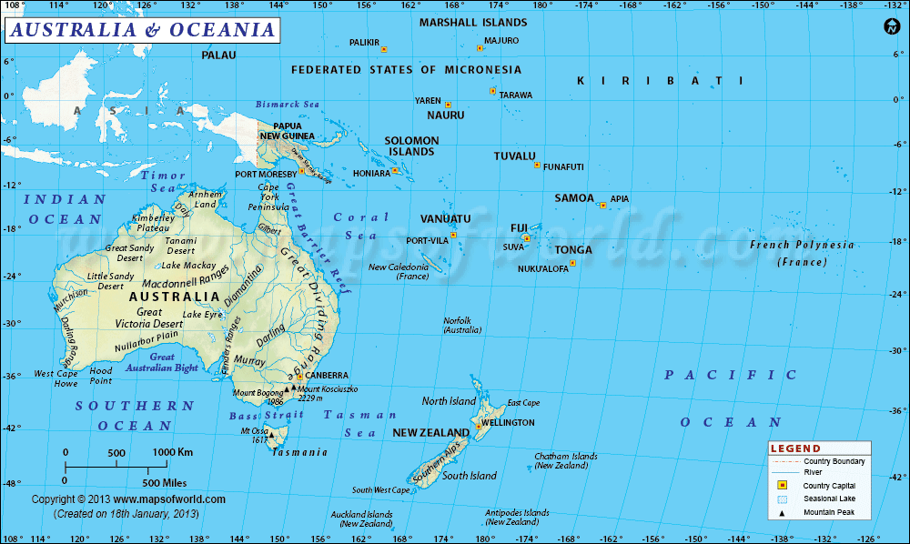
Western Samoa and Oceania

Slide 34
Samoa – typhoid consultancy - 1
2 inhabited islands, Upolu (pop’n ~ 143,418) and Savaii (pop’n ~ 44,402)
In 2012, the Samoan government became very concerned about endemic typhoid
  Tourism is a major industry
  Samoan typhoid carriers serving as seasonal workers in New Zealand have contaminated food sources. This has led to destruction of fruit exports with economic loss.
  Several US citizens who visited family in Samoa in 2013 developed typhoid fever
  Samoa asked WHO to send a Consultant

Slide 35
Typhoid in Samoa

Slide 36
Blood cultures drawn and yield of S. Typhi, Samoa, July 1, 2010 through June 30, 2011

Slide 37
Where is typhoid transmission occurring in Samoa?
Cases cluster in Apia urban area and west along the Northern coast of Upalu towards Nafoali. Is this because:
  Severe cases seek care at the main hospital?
  This is where the bacteriology lab is located?
  This is Samoa’s highest population density?
  There is an inordinate number of carriers?
  Or is amplified transmission is occurring there?

Slide 38
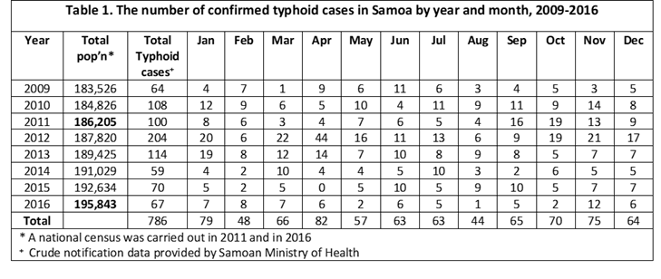
Typhoid by month, Samoa, 2009-2016

Slide 39
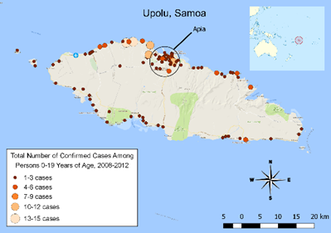
Spot map of typhoid cases, Upolu, Samoa,
2008-2012

Slide 40
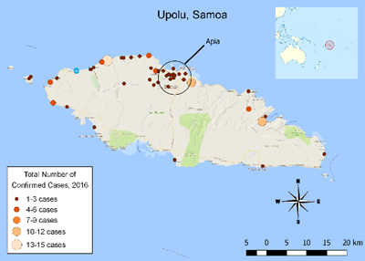
Spot map of typhoid cases, Upolu, Samoa,
2008-2012

Slide 41
Thank you

