Slide 1
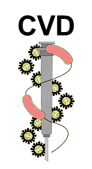
Experimental cholera studies in adult community volunteers – insights for epidemiology, immunity, vaccine development and disease control
Myron M. (Mike) Levine, MD, DTPH
Simon & Bessie Grollman Distinguished Professor;
Associate Dean for Global Health, Vaccinology and Infectious Diseases,
Center for Vaccine Development,
University of Maryland School of Medicine
Baltimore, MD
Bellevue, WA, April 18, 2017

Slide 2
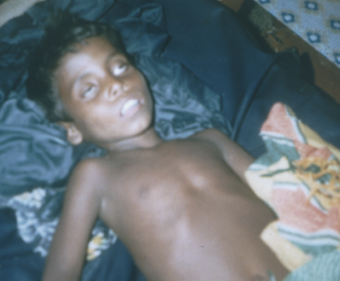
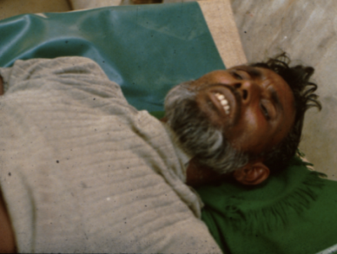
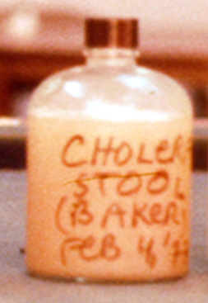
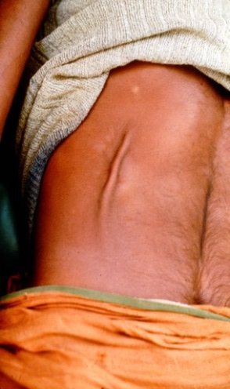
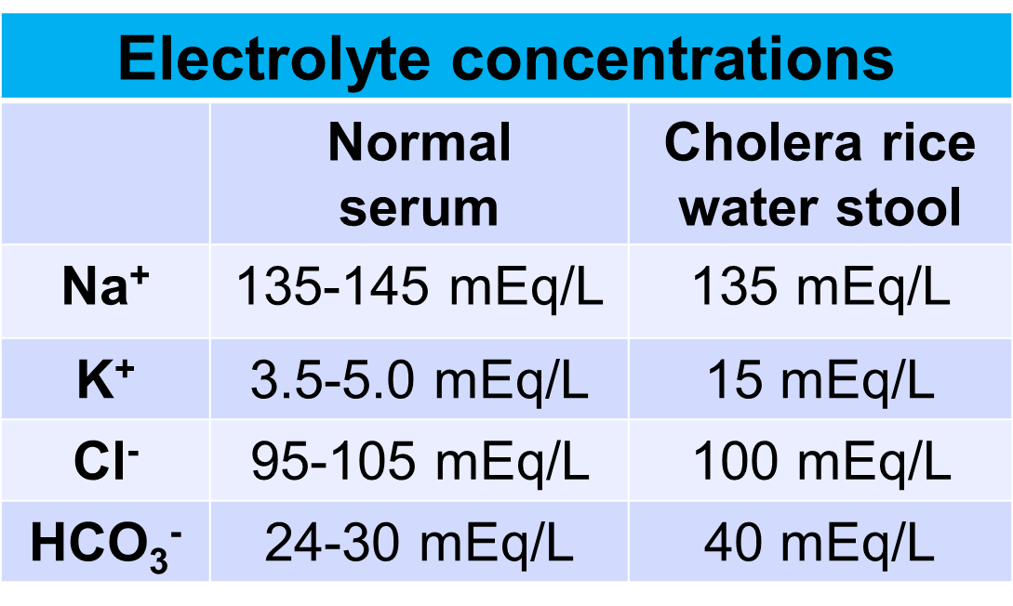
Cholera
Severe diarrheal disease (cholera gravis) that leads to dehydration, hypovolemic shock, renal failure and death if appropriate rehydration therapy is not promptly instituted
Rice water stools of cholera contain body water and concentrations of electrolytes resembling serum levels

Slide 3
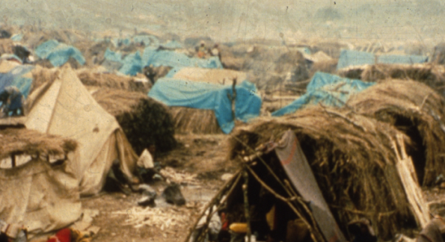
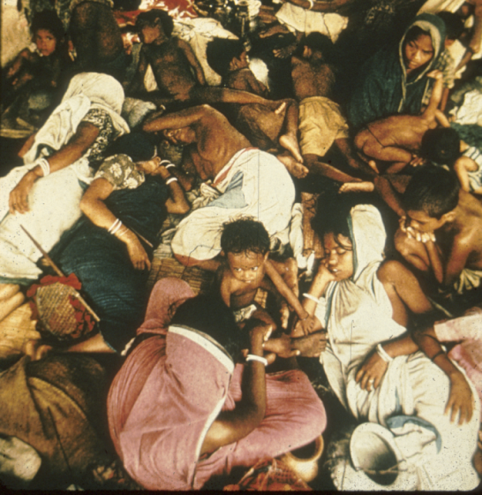
Epidemiologic behavior of cholera
Environmental reservoir (brackish water)
Transmitted by contaminated water & food
Exhibits true pandemic behavior (El Tor is the 7th pandemic)
Causes explosive epidemics
Highly seasonal in endemic areas
“Virgin soil epidemics” – Enormous disease burdens and high case when cholera first invades previously unaffected, immunologically-naïve, populations where the health infrastructure is unfamiliar with the treatment of cholera
Rwandan refugees,
Goma, Zaire, 1994
Bangladeshi refugees,
India, 1971

Slide 4
Vibrio cholerae
Autochthonous flora of brackish aquatic environments
> 200 O serogroups
Two serogroups cause epidemic cholera:
  O1 > 99% of all cases globally
    Biotypes
      El Tor & Classical
      Hybrid – El Tor expressing Classical cholera toxin
    Serotypes – Inaba, Ogawa (and, rarely, Hikojima)
  O139 (rare)

Slide 5
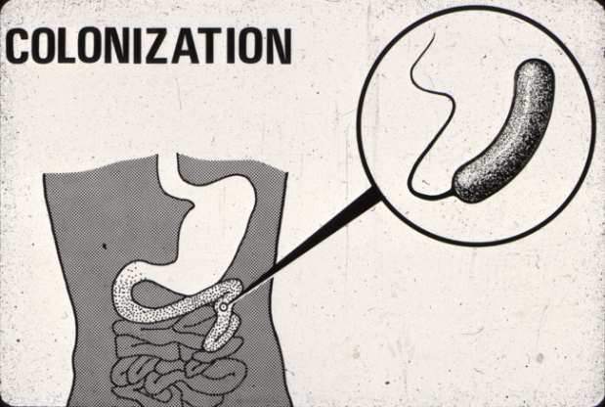
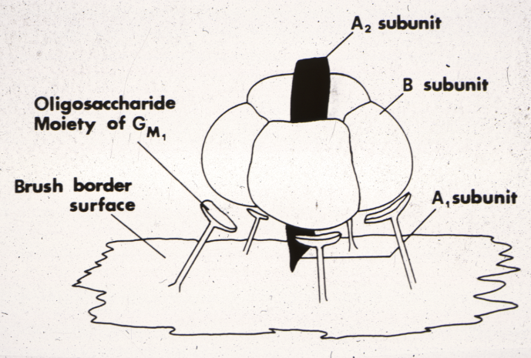
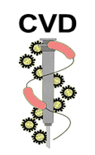
Pathogenesis of cholera
Passage through the gastric acid barrier to reach the proximal small intestine
Directed motility of vibrios (involves chemotaxis)
Attachment to enterocytes by means of Toxin Co-Regulated Pili (TCP)
Export of cholera enterotoxin (ctx)
Tight regulation of expression of TCP and CTX by toxR
SJ Krebs
&
RK Taylor
2011

Slide 6
CVD volunteer model of experimental cholera
Established in 1976 at the behest of the US Cholera Panel of NIH to test a toxoid vaccine.
Healthy adult community volunteers.
Performed on CVD Research Isolation Ward under QUARANTINE.
High attack rate of diarrhea.
Objective outcomes measured (diarrheal volume, vomiting, fever).
Precise quantitation of diarrheal stool volumes.
A proportion of subjects develop copious purging (0.5 - 1.1 liters per hour). (> 5 liter purge = “severe” cholera; > 3 liter purge = “moderate” cholera).
Aggressive oral & IV rehydration & early antibiotic therapy.
Prior cholera & some vaccines are highly protective in this model.
This model has proved invaluable for studying pathogenesis of and immunity to cholera, relevant to vaccine development.

Slide 7
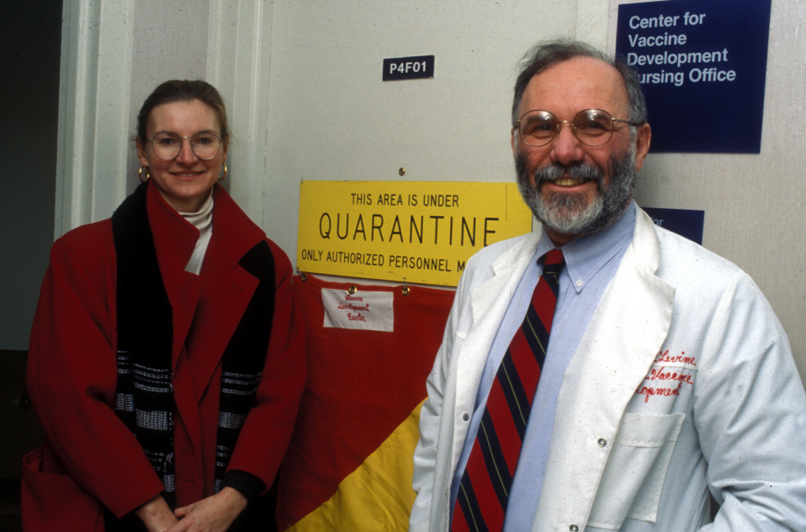
A cholera challenge study is underway at the CVD Research Isolation Ward

Slide 8
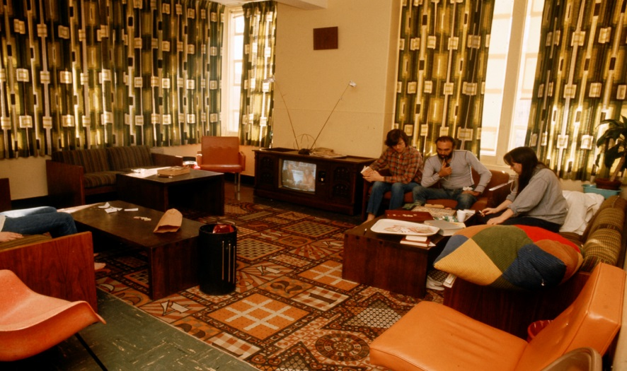
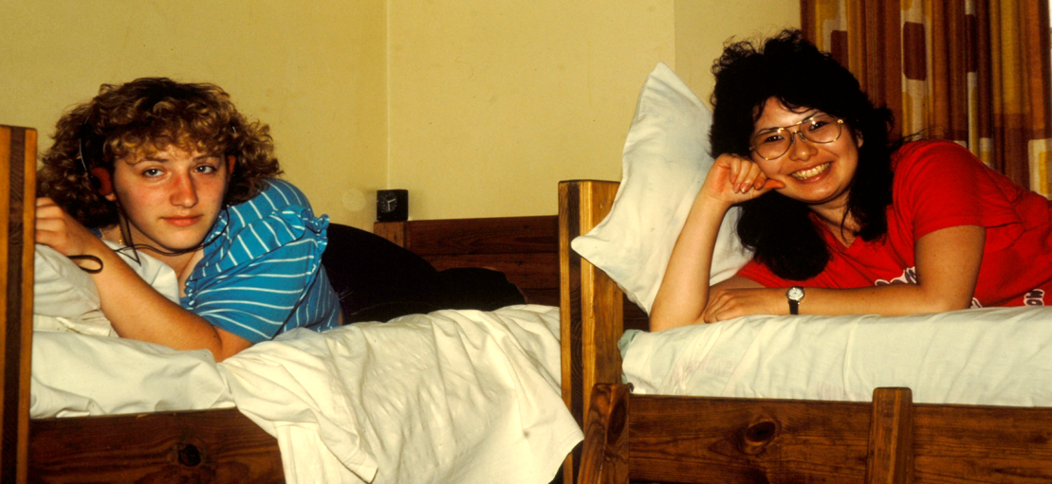
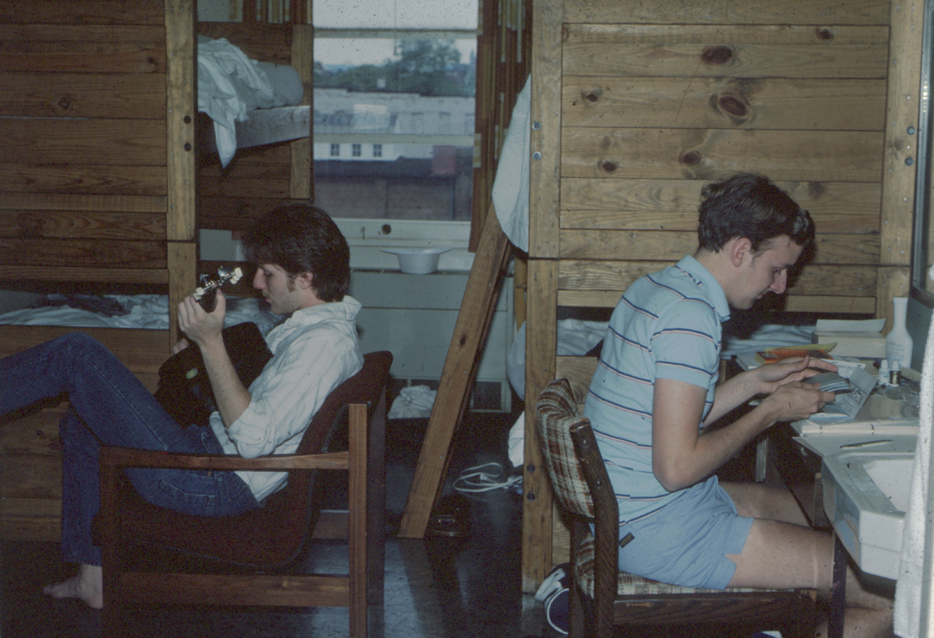
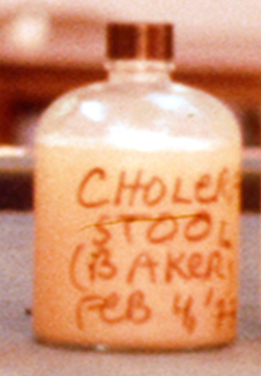
Original CVD Research Isolation Ward (1970s)

Slide 9
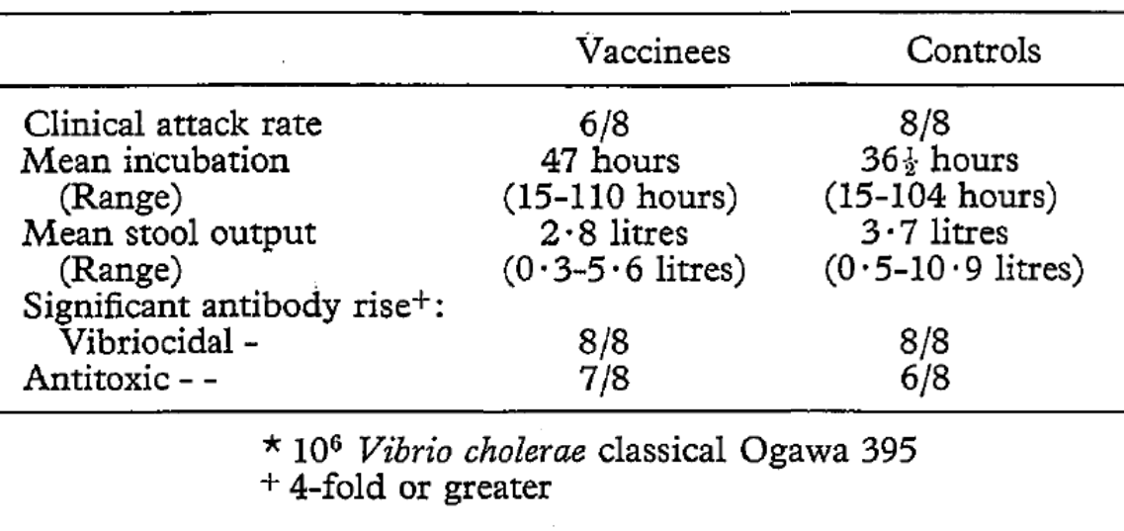
Experimental cholera challenge of US volunteers immunized with 3 monthly 8 mg enteral doses of purified glutaraldehyde-treated cholera toxoid
Levine MM et al, Trans Roy Soc Trop Med Hyg 1979

Slide 10

Dogma on disease-derived immunity
to cholera, circa 1970
JOURNAL OF INFECTIOUS DISEASES
1971; 123:61-65
“The duration of immunity derived from cholera infection is short, especially in persons whose subsequent reinfection is due to heterologous organisms. The risk of reinfection with V. cholerae is probably only slightly less than the risk of initial infection. The relatively high frequency of reinfection indicates that an effective cholera vaccine will need to stimulate greater immunity than does the natural disease.”

Slide 11
Relationship between serum reciprocal vibriocidal antibody titer and cholera case rate per 10³, Matlab Bazar
(Mosley WH et al, Bull WHO 1968; 38:327-334)

Slide 12
Bull WHO 1968; 38:777-785
Baseline vibriocidal titer | Total no. of family contacts | No. of contacts with culture-confirmed cholera diarrhea
<20 | 190 | 28 (14.7%)
20 | 65 | 4 (6.2%)
40 | 65 | 4 (6.2%)
80 | 42 | 1 (2.4%)
> 160 | 59 | 1 (1.7%)

Slide 13
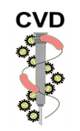
Protective immunity conferred by clinical classical Ogawa cholera upon subsequent homologous challenge of US volunteers with V. cholerae O1 classical biotype serotype Ogawa
Levine MM et al, Trans Roy Soc Trop Med Hyg 1979

Slide 14
Immunity following clinical cholera in U.S. volunteers
Positive
Attack Rate Coprocultures
Biotype Ctrls Vets Efficacy Ctrls Vets
Classical 24/27 0/16 100% 26/27 0/16
p = 0.012
El Tor 32/37 2/22 90% 34/37 8/22
* Levine et al, 1978, 1981, 1983

Slide 15
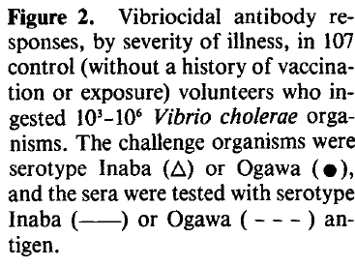
Serum vibriocidal antibody (Clements ML et al, J Infect Dis)

Slide 16
Long-term immunity in North Americans elicited by prior clinical cholera
Attack Rate*
Controls 4/5
p=0.04
Re-challenge veterans** 0/4 p<0.001
Cumulative controls 26/28
* Attack rate following challenge with 10⁶ classical Ogawa 395.
** These four subjects experienced classical biotype cholera 33-36 months earlier following experimental challenge (3 had Ogawa and 1 Inaba). (Data from Levine et al, J Infect Dis 1981)

Slide 17
Immunologic responses of cholera “veterans” & controls to challenge with 10⁶ V. cholerae O1 classical Ogawa
Serum Serum Intestinal
Diarrhea Excret. V’dal Titer IgG anti-CT SIgA anti-CT
Subj. Volume of V. ch. Pre Peak Pre Peak Pre Peak
Veterans (Levine et al, J Infect Dis 1981)
-5 0 0 80 80 0.36 0.39 <8 <8
-14 0 0 20 20 1.06 1.00 <8 <8
-10 0 0 80 320 0.18 0.89 <8 32
-9 0 10⁴ 160 5120 0.68 1.18 <8 >64
Controls
-1 7.1 liters 10⁷ <20 1280 0.06 1.35 <8 <8
-7 2.1 ” 10⁸ <20 1280 0.07 0.51 <8 <8
-8 7.2 ” 10⁷ <20 320 0.09 1.23 <8 <8
-13 5.3 ” 10⁶ 20 10240 0.12 1.13 <8 <8
-6 0 10⁵ 160 5120 0.40 1.34 <8 16

Slide 18
Natural infection-derived immunity in Bangladesh following clinical cholera caused by different biotypes: field studies corroborated volunteer data
Initial Subsequent Protective
Study Infection Infection Efficacy
Glass Mostly Mostly 90%
1982 Classical Classical
Clemens Classical Classical 100%
1991 Classical El Tor 100%
El Tor El Tor 29%
El Tor Classical 0%

Slide 19
Cholera enterotoxin alone can cause cholera gravis
MM Levine et al. Enteric infections and vaccine development. Micro Rev 1983
Volunteer Cholera toxin Incubation Total diarrheal No diarrheal Duration
dose (mcg) (hours) purge (ml) stools (hours)
Response of healthy adult volunteers after ingesting various doses of cholera toxin

Slide 20
Insights on mechanisms of immunity against cholera: anti-bacterial immunity is key

Slide 21
89% vaccine efficacy of V. cholerae O1 El Tor Inaba vaccine strain JBK 70 (ctx deletion) in protecting against challenge with virulent El Tor Inaba N16961
Group | Diarrhea Attack rate | Mean diarrheal stool volume per ill volunteer (range) | No. with positive direct stool cultures | Geometric mean excretion (vibrios per g stool)
Controls | 7/8 | 4.5 liters (1.1-7.9 l) | 8 | 4x10⁶
 | P<0.003 |  |  | P<0.001
Vaccinees | 1/10 | 1.6 liters | 2 | 4x10³
Challenge with 10⁶ cfu of virulent El Tor Inaba N16961 one month after ingestion of a single oral dose of vaccine Levine et al. Infect Immun 1988

Slide 22
Cholera challenges in volunteers to assess efficacy of candidate vaccines in preventing cholera

Slide 23
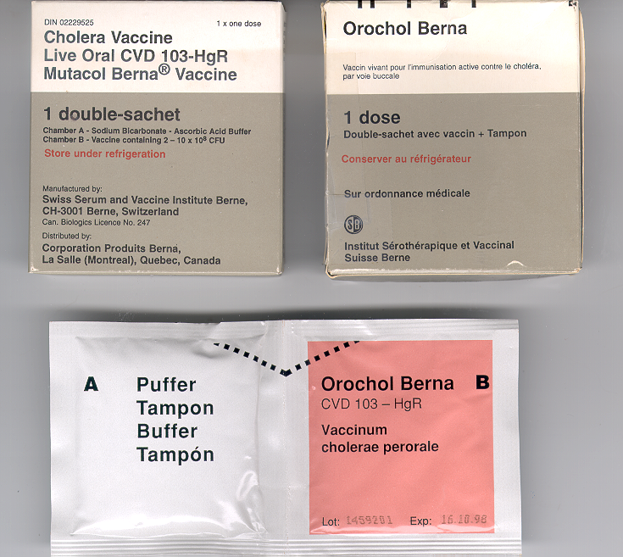

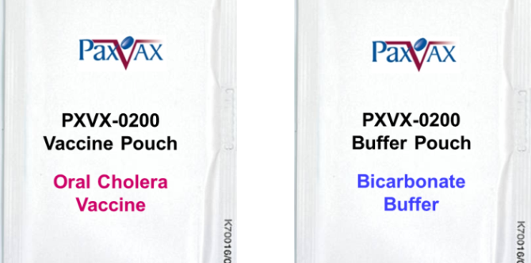
CVD 103-HgR live oral cholera vaccine
Vibrio cholerae O1
Classical biotype, Inaba serotype
ctxA deleted, ctxB intact
Hg++ resistance gene inserted into hlyA locus
Makes toxin co-regulated pili (TCP)
FDA licensure, June 2016

Slide 24
Efficacy of single-dose Orochol/Mutacol CVD 103-HgR in preventing cholera
Severity Vacc Ctrls Efficacy p
> 5.0 liters 1/103 10/86 92% <.002
> 3.0 liters 1/103 16/86 95% <.001
----------------------------------------------------------------------------------------------------------------------------------------
> 1.0 liter 7/103 41/86 86% <.001
Any 19/103 54/86 76% <.001
Composite of 8 separate challenges with El Tor Inaba, El Tor Ogawa, classical Inaba and classical Ogawa
Significant protection is already present 8 days after ingesting the single dose

Slide 25
PaxVax Vaxchora™ (CVD 103-HgR) protects against experimental challenge with V. cholerae O1
Parameter measured after challenge | Vaccine 10-Day post N=35 | Vaccine 3-Month post N=33 | Placebo N=66
Attack Rate ≥ 3 Liter liquid stool | 2/35 (6%) | 4/33 (12%) | 39/66 (59%)
Vaccine Efficacy | 90% | 80%
Lower Bound of 95% CI | 63% | 50%
Challenge with 10⁵ CFU of NIH El Tor Inaba N16961 frozen inoculum
This study was designed in conjunction with the FDA
Chen WH et al, Clin Infect Dis 2016

Slide 26
Vaxchora™ efficacy in human challenge correlates with vibriocidal antibody response

Slide 27
Situations where single-dose live oral cholera vaccine CVD 103-HgR fills a void in cholera control
The single-dose live oral vaccine shows strong efficacy as early as 8-10 days after immunization
Useful for travelers
Also potentially as an adjunct tool to help control explosive “virgin soil” outbreaks of cholera
Use of CVD 103-HgR in developing country populations requires a 1-log higher dosage level of vaccine organisms (10⁹ CFU) than is used in industrialized country travelers

Slide 28
Human host factors that determine severity of cholera illness:
1) O blood group
2) Hypochlorhydria

Slide 29
Clinical response of volunteers who ingest 10⁶ cfu of virulent V. cholerae O1 El Tor Inaba strain N16961 with NaHCO₃, food or water
Vehicle | Diarrhea Attack rate | Mean diarrheal stool volume per ill volunteer (range) | Mean no. of diarrheal stools per ill subject | No. with positive direct stool cultures
NaHCO₃ | 9/10 | 3.2 liters (0.4-13.1) | 12.9 (2-39) | 10/10
Foodª | 6/6 | 3.5 liters (0.2-9.1) | 13.8 (2-31) | 6/6
Water | 0/7 | - | - | 0/7
ª Standard meal: 4 oz. of fish, 4 oz. of rice, 4 oz. of custard, 8 oz. of skim milk. (MM Levine et al. 1981)

Slide 30
Dose-response with wild type V. cholerae O1 El Tor
Strain & inoculum (CFU) | Diarrhea Attack rate | Mean diarrheal stool volume per ill volunteer (range) | Mean no. of diarrheal stools per ill subject | Positive stool cultures
N16961
10⁶ | 9/10 | 3.2 liters (0.4-13.1) | 12.9 | 10/10
10⁵ | 3/5 | 3.1 liters (0.2-9.1) | 15.0 | 4/5
10⁴ | 4/5 | 1.1 (0.6-1.5) | 6.5 | 4/5
10³ | 4/6 | 0.9 (0.4-1.9) | 5.8 | 6/6

Slide 31
Acknowledgements
CVD
Wilbur Chen, James Kaper, Karen Kotloff
Carol Tacket, Marcela Pasetti, Lisa Chrisley
Genevieve Losonsky David Nalin, Charles Young, Mardi Reymann, Mary Lou Clements,
Robert Black, Marcelo Sztein,
Milagritos Tapia
CVD-Mali
Samba Sow
U. Cincinnati
Mitchell Cohen
David Galloway
Rebecca Brady
U of Vermont
Beth Kirkpatrick
Caroline Brady
Flora Szabo
PaxVax
Marc Gurwith
Jakub Simon
Lisa Danzig
Michael Lock
NIAID
Robert Hall
Notes:
31

Slide 32
Licensed cholera vaccines, old and new
Old parenteral vaccines Dosing regimen
Inactivated V. cholerae O1 1-2 doses
Modern oral vaccines
Inactivated whole V. cholerae O1 2 doses,
plus B subunit (Dukoral®) 2 weeks apart
Inactivated whole V. cholerae O1 2 doses,
& O139 without B subunit 2 weeks apart
(Shanchol™ & Euvichol®)
Engineered attenuated V. cholerae O1 Single-dose
strain CVD 103-HgR (Vaxchora®)
(previously Orochol®, Mutacol®, & OrocholE®)

