Slide 1
Optimizing a portfolio of tuberculosis investments to reach strategic goals
A ongoing BMGF collaboration with Cliff Kern and Romesh Abeysuriya, Burnet Institute
Per Liljenberg, Bill & Melinda Gates Foundation

Slide 2
Introduction
The TB team at BMGF can invest in
Risky projects – R&D interventions (new better interventions)
Risk-free projects – Delivery interventions (improving coverage and/or effectiveness of already launched interventions)
What does optimal mean for a portfolio of mainly R&D and some Delivery interventions?

Slide 3
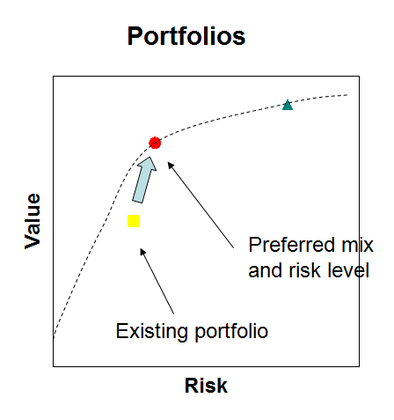
Optimizing A portfolio
The problem of portfolio management is to move the existing portfolio of interventions to an optimal portfolio (on the efficient frontier) consistent with the strategic direction of the organization
The TB team seeks to invest in a portfolio of interventions that maximizes the chances of reaching the strategic goal (reducing TB incidence) consistent with BMGF risk taking, budget constraints and other strategic considerations
© Bill & Melinda Gates Foundation |
3

Slide 4
Representing projects – outcome trees
Nodes : Events
Edges: Outcome of event w probability
PTRS: Probability of Technical and Regulatory Success
Success in R&D leading to Health Impact
HI
PTRS (%)
1 – PTRS (%)
Failure in R&D

Slide 5
Representing portfolios – outcome networks
P=0.3
HI
Health impact can be hard to compute
Dependencies between products
External events can prevent impact from being realized
Resource constraints may prevent impact from being realized
A portfolio can have several outcomes each characterized by
Probability
Health impact
Health impact distribution

Slide 6
Portfolio Risk and Value
P=0.3
HI
A portfolio value measure
Exp[ Health Impact ]
Several portfolio risk measures
Var[ Health Impact ]
SemiVar[ Health impact ]
VaR(x%)*
* VaR(50%) = Y means that there is a 50% chance that the Health impact is less than Y

Slide 7
Generating TB portfolios
Interventions
StandardOfCare
DeliveryIntervention
Rx_UniversalRegimen
Dx_CaseDetectionTest
Dx_TriageTest
Vx_PreventionOfInfection
Vx_PreventionOfDisease
All interventions have PTRS, Launch Year, Baseline R&D Costs, Baseline Coverage, Baseline Cascade Parameters
TPPs
Minimal
Optimal
Rx, Dx, Vx only
Countries
India
South Africa
Will assume that burden, coverage, cascade parameters, etc, vary by country
R&D Cost (change from baseline)
Min: -10%
Max: +50%
Rx, Dx, Vx only
Affects launch year
Coverage (change from baseline)
Min: -10%
Max: +50%
Rx, Dx, Vx only. Drives cost
X
X
X
X
Cascade parameters* (change from baseline)
Min: 0 %units
Max: +10 %units (all parameters < 100%)
Delivery intervention only. Drives cost
Discrete choices
Continuous choices
*Cascade parameters are, e.g. %with access to care, %diagnosed, %treated, %recovered

Slide 8
Generating portfolioS: Example
Set a budget constraint
Make discrete and continuous choices to generate a portfolio that will likely fit within budget
Generate the portfolio outcomes tree
      Four outcomes/branches
Example: Budget
Total cost to the world < 1500
Example: Portfolio
SOC
Dx_CDT_MIN (+20% R&D cost, +15% coverage)
Rx_UR_MIN (+0% R&D cost, +0% coverage)
Example: Outcomes/branches
1. SOC
2. Dx_CDT_MIN
3. Rx_UR_MIN
4. Dx_CDT_MIN + Rx_UR_MIN

Slide 9
Generating portfolioS: Model input
For each outcome/branch, understand dependencies and compute resulting model input parameters from portfolio interventions
      New interventions lead to change over time in demand for Standard of Care
      Delivery interventions assumed to affect all cascade parameters
      Dx affect %diagnosed
      Rx affect %recovered
      Vx POI affects number of susceptible that get infected
      Vx POD affects number of latent that get active disease
Example: Cascade parameters by outcome
1. SOC Cascade = (60%, 60%, 60%)
2. Dx Cascade = (70%, 60%, 60%)
3. Rx Cascade = (60%, 60%, 70%)
4. Dx+Rx Cascade = (70%, 60%, 70%)
(% diagnosed, % treated, % recovered)

Slide 10
Generating portfolioS: Value AND RISK
For each outcome/branch in outcome tree, run the health impact model (customized Optima TB model)
    Compute health impact
    Compute cost. If cost of any branch > budget -> discard entire portfolio / outcome tree
    Compute probability
Portfolio Value
Portfolio Risk
    Value at risk (VaR 50%).
    Downside variance of health impact
Example: Value and Risk per outcome
Outcome | PTRS | Health Impact | Cost (R&D + Del)
SOC | (1-50%)*(1-10%) | 0 | 200+0
Dx | 50%*(1-10%) | 10 | 200+400
Rx | (1-50%)*10% | 20 | 200+900
Dx + Rx | 50% * 10% | 40 | 200+1300
Exp[ Health Impact ] = 7.5
VaR(50%) = 10

Slide 11
Generating PortfolioS: PLOT REsults
Plot portfolio in diagram
Repeat for other portfolios
Value
10
(10, 7.5) - Portfolio Example
10
Risk

Slide 12
Generating portfolios: Efficient Frontier
Identify optimal portfolios
Value
Optimal portfolios
10
10
Risk

Slide 13
Analysis Questions
Should BMGF invest in a TB vaccine project?
      If not, at what level of PTRS should BMGF invest in a TB vaccine?
      Does the optimal portfolio ever contain both POI and POD vaccines?
For a reasonable range of portfolio risk what does the optimal portfolio look like?
How does the optimal portfolio vary with budget constraint?
If there were additional funds, what should one invest in?
Which intervention did not make it into the optimal portfolio?
      What would the TPP need to look like to make it part of the optimal portfolio again?
Investigate other budget constraints:
      Fixed BMGF TB budget = Fixed R&D budget
      Fixed Country level budgets

Slide 14
Acknowledgements
Cliff Kerr (Burnet)
Romesh Abeysuriya (Burnet)
Sarah Metzger (BMGF)
Geoff Garnett (BMGF)
David P. Wilson (BMGF)
Kathryn Heyert (Logic 20/20)
Alex Johnson (Logic 20/20)

