Slide 1
Recent Typhoid Incidence Decline in a Large Urban Slum | A look the typhoid burden in Kibera, Kenya
MARGARET LIND, ERIC NG’ENO, Jillian Gauld, Adam akullian, ALLAN AUDI, SAMUEL KIPLANGAT, CLIFFORD ODUOR,ALICE OUMA, GEOFFREY MASYONGO, NEWTON WAMOLA, CAROLINE OCHIENG, VICTOR OMBALLA, ELIZABETH HUNSPERGER, BONVENTURE JUMA, ERIC MINTZ, JENNIFER R VERANI
Notes:
Welcome and thank you for coming to my talk on Typhoid in Kibera, an urban slum in Kenya. The work I am presenting today is the result of a collaboration between IDM (for which I work a consultant while pursuing my PhD in epidemiology at the UW) and CDC Kenya.

Slide 2
Typhoid | Quick Overview
Enteric fever caused by Salmonella enterica serotype typhi
Two main transmission routes
Short: Person – Person (direct fecal to oral)
Long: Environmental (contaminated water)
Carriers are common in untreated populations (Typhoid Mary)
About 25% are asymptomatic
Effectively treated with antibiotics but resistant cases are commonly reported
Case fatality < 1% if treated properly
Vaccines available (new conjugate vaccines are safe in children and efficacy studies are positive)
Notes:
First, I will briefly walk through the disease profile and basic pathology of typhoid fever. Typhoid fever is a potentially deadly enteric fever caused by salmonella enterica serotype typhi, a gram negative, rod shaped bacteria. There are two main routes of typhoid transmission: short or direct human to human, fecal to oral transmission, and long or environmental transmission through contaminated water supply. Untreated individuals can shed bacteria through waste for more than a year and approximately 25% of untreated cases become chronic carries. Of this 25% up to a quarter may be asymptotic (think typhoid mary).
Typhoid can be effectively treated with antibiotics (including fluoroquinolones, cephalosporins, and azithromycin) and the estimated case fatality in properly treated individuals is less than 1%. However, resistance strains of s. typhi are becoming more prevalent and are of a large concern in current and recently high burden areas. Thankfully, there are multiple vaccines for typhi including a new conjugate vaccine which has been shown to be safe in children as young as 6 months old and for which effectiveness studies are promising.

Slide 3
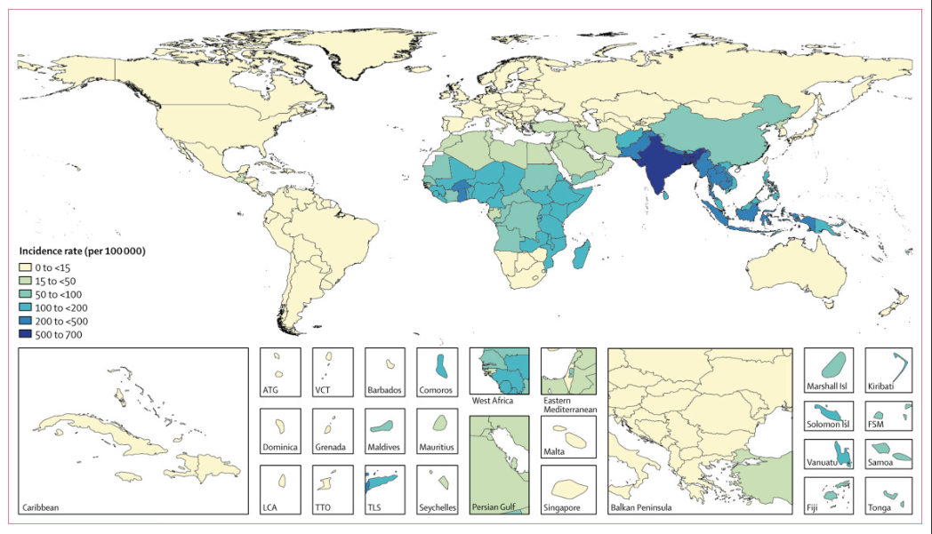
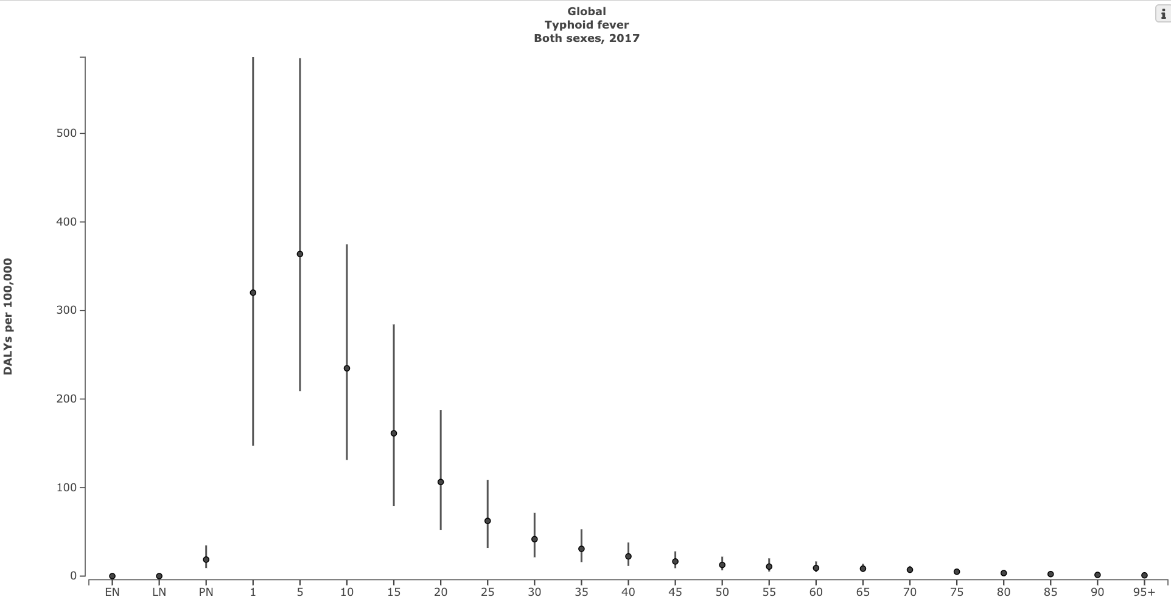
Typhoid | Burden
Affects for 11-21 million people annually
Causes an estimated 128,000 to 161,000 deaths annually
Burden is highest in Southern Asia and Sub-Saharan Africa
Most cases in children (almost a third of cases in children under five)
Risk factors include poverty, crowding, inadequate sanitation, and lack of clean water
GBD Estimates
GBD Estimates
Notes:
Typhoid is estimated to affect between 11 and 21 million individuals and lead to around 150,000 deaths around the world annually. From the GBD estimates shown in this Map you will see that typhoid burden is low in the majority of the world and high risk areas include southern Asia and sub-Saharan Africa. To the right of the map we have the GBD estimated global age distribution of typhoid for 2017. From this plot you can see that the typhoid has a strong age pattern and children 5 and under are are the highest risk for typhoid. Along with age, risk factors for typhoid include poverty, crowding, inadequate sanitation, and lack of clean water.

Slide 4
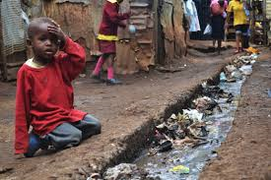
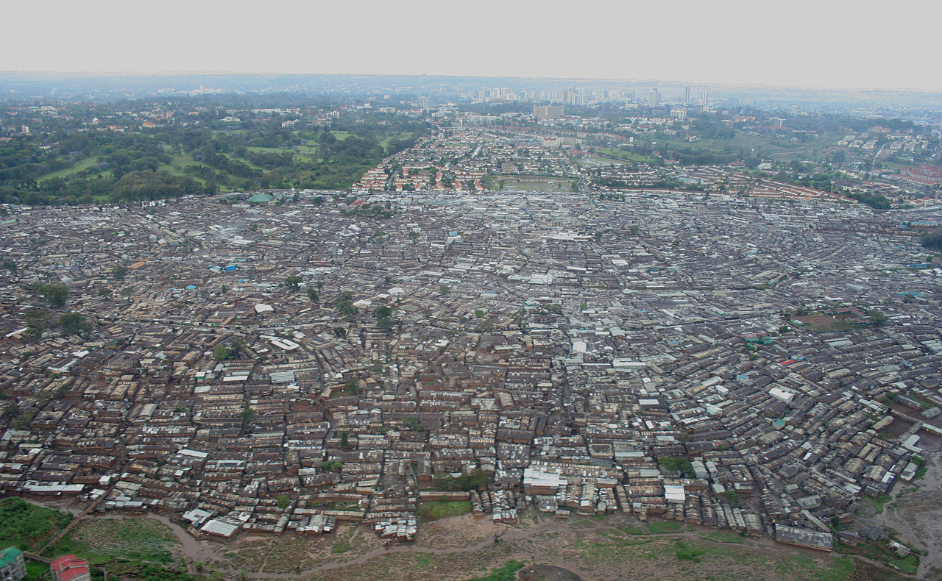
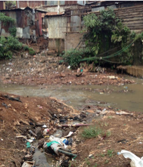
Typhoid Fever in Kibera
Large informal settlement in Nairobi, Kenya
Densely populated, poor sanitation, limited access to clean water
High burden of typhoid fever observed 03/2007-02/2009
Un-adjusted incidence 247/100,000 person-years; adjusted 822/100,000
Children at highest risk
2-4 years 2,242/100,000; 5-9 years 1,788/100/000
There has been an observed decline in reported cases since the last estimates
Photo Credit: Adam Akullian and Wikimedia commons
Notes:
Each of these risk factors are present in Kibera, a large urban slum located in Nairobi Kenya. Kibera is densely populated informal settlement of just over 170,000 individuals. Kibera has poor sanitation, and limited access to clean water. Unlike much of Nairobi, Kibera does not have legal access to municipal water and recent sanitation innovation led community toilets to drain into the adjacent river (see in the photo on the far right) instead of the streets. In 2012 Breiman et al published typhoid incidence estimates for mid 2007 through the beginning of 2009. They estimated a high crude burden at 250 cases per 100,000 py and an adjusted estimate of over 800 cases per 100,000 py. As a reference the GBD estimated global incidence of typhoid for 2017 was between 172 and 226 cases per 100,000 py. In agreement with the typical age distributoin of typhoid, children aged 5 and under had the highest burden followed by children aged 5 to 9. Since 2012 and Breiman et al.’s typhoid incidence estimates for Kibera, there has been a reported reduction in cases.

Slide 5
Study Aims
Update incidence estimates of typhoid in Kibera
Incidence over time and age distribution
Confirm that the decline seen in reported cases is a true decline in typhoid burden
If so, what does the decline look like?
Notes:
In the following work, we updated the incidence over time estimates for this population and worked to confirm that the decline seen in cases is a true decline in typhoid burden.

Slide 6
Study Overview and Population
Population-based infectious disease surveillance (PBIDS)
Analyzed data 2007 to 2017
Enumerated population ~20,000-25,000 Kibera residents
Household- and clinic-based surveillance
Household surveillance (Biweekly to Biannually)
Covers: Demographics and recent illness
Clinic surveillance
Free care provided at centrally located clinic
Clinicians instructed to collect blood in patients with
Acute febrile illness (AFI)
Severe acute respiratory infection (SARI)
PBIDS area
Notes:
This study was conducting using PBIDs data or the population-based infectious disease surveillance data from 2007 through July of 2017. This surveillence system includes approximately 20,000 to 25,000 enumated individuals at any given time. You can see you surveyed area in the light yellowish/brown. There are two forms of surveillence within PBIDs, Household and clinic. For the household survel, residences are visited on what started as a biweekly bases and has shifted to a biannual bases and are asked about items such as demographic chnages (such as births and deaths) and recent illness and care seeking behaviors. For the clinic surveillance, there is a free centrally located clinic (tabitha clinic) with clinicians who are trained to screen for acute febrile illness (AFI) and sever acute respiratory infection (SARI) and take blood tests in their presence.
Blood culture for patients with
Acute febrile illness (AFI)
Documented fever
Onset <14 days prior
Severe acute respiratory infection (SARI)
Cough or difficulty breathing, plus
< 5 years: indrawing or O2 saturation <90% or danger sign
≥ 5 years: documented fever or O2 saturation <90%

Slide 7
Laboratory Methods
Collected samples incubated in BACTEC System
Salmonella isolation and identification through standard microbiology techniques
Serotyping by Salmonella antisera and/or genomic sequencing
Notes:
The blood samples are collected and incubated in a BACTEC system and salmonella are identified through microbial techniques. All of the salmonella isolated are then serotyped prior to inclusion in final analyses.

Slide 8
Methods | Data Cleaning and Inclusion
Data issues
Data linking issues between new and old data collection/storage systems
Data collection changes over time
Changes in frequency of household surveillance (biweekly – weekly – biweekly – biannually)
Person time database for PBIDs – a lot of our work!
Wanted a person level estimate of person time for the length of data collection to account for large amount of migration
Residency was defined as a person having consistently lived in the residential area for 120+ days
Out migration was defined as a resident having been gone (not living in) surveillance area for 120+ days
Over 11 years of follow-up individuals moved in and out many times
Typhoid cases were limited to periods of residency
Notes:
As outlined, the PBIDs data are quite amazing. There is individual level household and clinic data collected at a semi consistent bases for the last 12 years and counting. However, as one would expect, with all these data and with data collection happening for this long, there are many data issues that may impact final estimates. There were three major changes to the data collection process. Two major changes in record collection and storage structures during data collection. The first, which occurred in 2010, was in the hospital data collection and differences included how laboratory records were recorded and how individual unique identified were entered. This change lead to much better data collection. The other data collection change was in the household survellence and occurred in 2015. Similary to the hospital records, the new system is cleaner and easier to work with. However, when re-enrolling individuals into the new system unique identified were not protected and individuals were provided new ones if not easy found in the system and ids that were previously owed by someone else would be given away if that individual was not at the house for enrollment that day. As you can image, linking individuals with non-unique identifiers can be a bit of a nightmare. The final change is one I have already mentioned but is the change in frequency of household visits. From a purely data cleaning perspective, we have had to develop unique assumptions for data inclusion for the different frequency periods. The development of these assumptions comes into play mainly in the development of the PBIDs person time database. For analyses done using PBIDs data, specific and consistent assumptions around a persons enrollment, birth/death dates, and numerous other components were developed and then implemented by myself along with Allan Audi at the Kenya Medical Research Institute. As an example of the type of assumptions implemented, I will quickly walk you through our migration assumptions for the 2007 – april 2015 period (household vsits on a biweekly/weekly schedule). A person living in the catchment area who was recorded to have been there for 120 plus days were able to enroll. If that person moved away and was away for more than 120 days then we considered that person to have outmigrated. This person is then required to stay within the catchment area for a minimum of 120s in order to be re-enrolled. Given that no household record was provided if no one was home, visits more than 120 days appart were considered periods of outmigration as well.

Slide 9
Methods| Unadjusted and Adjusted Incidence Estimation
Unadjusted:
Crude: Serotype confirmed typhi count / Person Time
Modeled Estimates with Confidence Intervals:
Time: Poisson regression with thin plate penalized smoothing spline for time
Age: Poisson regression with age group indicator variables
Adjusted (weighted): Two-level post estimation adjustment – (Breiman Weighting System)
Adjusted Estimate = (Unadjusted Modeled Estimates / Weight 1) / Weight 2
Weight 1 (Clinical practice weight): Year specific
Weight 2 (Care seeking behavior): Year specific
Uncertainty estimated using 1,000 draw posterior simulation
Number patients with blood cultures performed
Total eligible for blood culture
Number people with AFI/SARI at household visit who sought care at surveillance clinic
Total people with AFI/SARI at household visit who sought care (anywhere)
Notes:
Once clean, we were able to move forward with estimating the unadjusted and adjusted incidence estimates for typhoid from the PBIDs data. The crude estimates were estimated as serotype confirmed typhoid count / person time and modeled unadjusted estimates for for typhoid over time were estimated using a poisson regression with a thin plate penalized smoothing spline and for the age distribution we used a poisson distribution with age group indicators to estimate the modeled indicence.
From the unadjusted modeled estimates we developed an adjusted incidence using a two-level weighting system. First we divided the crude incidence by a clinicial practice weight. THIs weight was calculated as the number of patients with blood cultures performed / total eligible for blood cultures. Then we take this number and divide by a care seeking weight defined as the number of people who met SARI and AFI definitions during household visits and went to the tabitha clinic (survellence clinic) / the full number of people who met this illness definitions
We estimated uncertainty using posterior simulation in which we simulated the crude (unadjusted estimated) and weights 1000 times and applied the previously stated two-level system.
In the event of a question!!!!! – INITIALLY WE Set out to do the spline because of data scarcity within our model but are now happy that while our data is aggregated to the year level time is still continuous and non-linear and size of our bins is consistent. due to data scarcity at different time points, the smoothing spline allowed us to barrow data from across years
DO NOT READ!
Allows for: Time as a non-linear continuous predictor
use the thin plate spline penalty – default in the gam -- They are the default smooth for s terms because there is a defined sense in which they are the optimal smoother of any given basis dimension/rank --Thin plate regression splines do not have ‘knots’ (at least not in any conventional sense): a truncated eigen-decomposition is used to achieve the rank reduction

Slide 10
Results | Un-Adjustment Incidence Over Time
Notes:
Finally results: here you can see the crude point estimates for typhoid in black (dots).

Slide 11
Results | Un-Adjustment Incidence Over Time
Notes:
From this figure, it is clear that there is a large decline in incidence between 2012 and 2013 and that this low level of incidence holds relatively consistently for the next 4 years.

Slide 12
Results | Un-Adjustment Incidence Over Time
Notes:
You will see a slight bump in 2015 which is an artifact of the issues with the change in household data collection systems and the linking issues with unique ID I mentioned before. However, despite this small bump, the decline is quick clear.

Slide 13
Results | Unadjusted and Adjustment
Notes:
Next we will look at the unadjusted vs adjusted estimates. In the figure you will see the crude estimates in blue (with crude estimates over the time smoothed ribbon), the estimates from first weight (blood culture collection weight) in red and the fully weighted estimate in green. We see that for specific years (2007 and 2012) the weights have a large impact on the estimated burden of typhoid in Kibera. We can also see that the first applied weight is the primary driver of the increase.

Slide 14
Results | Age-Distribution of Incidence
Notes:
Here is the age distribution for typhoid in kibera for the years 2007-2017. From the estimates we see that the age distribution for typohid in kibera follows the expected distribution.

Slide 15
Results | Age-Distribution of Incidence
Notes:
We can also see that while similar the weights do lead to a slight change in the distribution pattern – driving the 2-4 year olds up in relation to the 5-9 year olds.

Slide 16
Discussion | Weights
Impact of the Weights
Why is the crude estimate in 2007 so much higher than in later years?
Very few cultures collection events recorded
Limitations with the weights
Assumes
People who are not cultured are the same as those cultured
People who go to other clinic are the same as those who go to surveillance clinic
Blood culture collection and clinical care seeking vary by time, age, and illness but data is very sparse when fully stratified
Future work
Using the baseline weighting system has some issues
Notes:
Finally, I would like to talk about the weights. The ewight have a much larger effect in 2007 than in other years. This is driving the number of blood cultures collected in people who met SRAI or AFI defintions. In other words, your probability of being tested given you met criteria to be tested was low. Given the large number of cases and the low blood culture rate, I speculate that the assumption that tested and non-tested individuals are the same is broken and future work should look into the health profiles of individuals who were tested in 2007 vs those who did not to determine if there are quantifiable differences in qualifying patients. As we move forward in time, we speculate that clinicians had better training and were more sensitive to the AFI and sari criteria and for that reason tested people more frequently.
From these results it is hard to say which estimate (the unadjusted) or adjusted estimate is better. Both have their limitations and rely on assumption we know or suspect to not hold. Moving forward, we think it is important to present both sets of results and state the limitations of each.

Slide 17
Conclusion
Typhoid incidence declined over the 11 years of follow-up
This is not sensitivity to the adjustment
Rich data can lead to many assumptions
Notes:
In conclusion – we see that typhoid incidence did decline in Kibera over the 11 years of follow-up and this conclusion is not sensitive to which estimates we select (unadjusted vs adjusted).
Further, we have concluded that working with rich data can be quite challenging and may require the development and implementation of numerous assumptions each of which has the potential to impact final results.

Slide 18
Acknowledgments
Eric Ng’eno from WSU and Kenya Medical Research Institute
IDM
Jillian Gauld
Adam Akullian
Dennis Choa
Hao Hu (former)
CDC Kenya and Kenya Medical Research Institute
Jennifer Verani
Allan Audi
Notes:
Should not bin time prior to model for smoothing
Should have a continuous age model (year) and smooth on that as well

