Slide 1
EasyVA Project
Easy Verbal Autopsy
demo
next steps
architecture
contact
intro
motivation
Qinghua Long
Notes:
Hello Everyone, this is Qinghua Long. Today I will give a talk about our EasyVA project. easy Verbal Autopsy is a user-friendly, web-based interface that enables clinicians and algorithm-based applications to accelerate certification of cause of death.
I will cover 5 aspects in this talk including first introduction to give some background information
Second, the motivation of doing this project.
Third, brief demo including some screenshots to go over the functionalities of the first version of this web UI
Followed by fourth, the architecture for developing this web application
And then last, Next steps we planed to make this tool smarter and more widely used

Slide 2
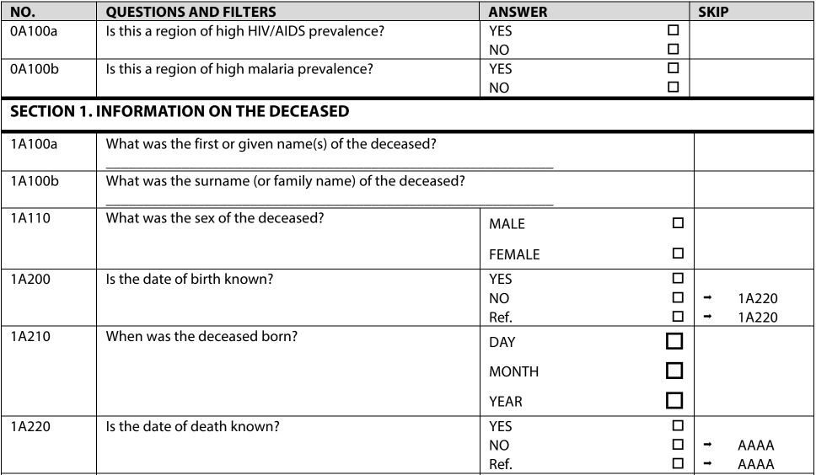
VA
(Verbal Autopsy)
INFORM
(Idm Network FOr the Reduction of disease Mortality)
next steps
demo
architecture
contact
motivation
intro
Challenge: Lack of Data
Notes:
From the previous talks we may already know verbal autopsy is a research method that helps determine probable causes of death in cases where there was no medical record or formal medical attention given.
INFORM. EasyVA comes as part of projects of INFORM to help death deduction. Briefly INFORM is using the data-driven method to help the strategy design. For example if we apply some interventions for malaria this year in one country to validate if the disease mortality decreases we need to look at the data of cause of death for this year and compare it to those from last year.
But one of the big challenge we have now is lack of data. From Navideh’s talk we noticed that we couldn’t draw a conclusive pattern of the data from year 2011 - 2013 because of the small sample size. We are waiting data from 2014 -2019 before me can conduct further analysis. Part of the main reasons for lack of data is the current way to determine cause of death is too slow.
By the way this determination process can be done by different formats of surveys. Who form is one of the formats that is widely used. Here is the sample of the 2014 who survey for neonate. The survey is actually very long with about 400 questions for a single subject and in paper format. Even working on excel on computer for 400 questions is still not easy
We were seeking a more convenient way to accelerate this process.

Slide 3
Reduce
Accelerate
Resolve
1
2
3
demo
Disease mortality
COD generating process
EasyVA website
motivation
next steps
architecture
contact
intro
Lack of data
Integrate smartVA tool
More efficient
Notes:
So the First motivation to start this project is to Reduce disease mortality, which is aligned with goal of INFORM. But we are lack of cause of death data for our decision making process as what I mentioned in the last slides. How can we get more data efficiently becomes the first priority.
It brings us the second motivation which is to Accelerate cause of death data generating process. The current process is very slow as what I mentioned before due to the fact that the standard form of verbal autopsy survey is very long and not convenient to view and also the fact that the clinicians who need to review those data and determine the cause of death have to spend more time on saving life. It will be ideal we can rely on a computer based way to determine cause of death and that’s why the SmartVA analyze tool introduced by Abraham from the first presentation draws our attention and I will talk about it again in Next Steps part to give more details about how we are going to integrate this tool later.
To resolve the problems we are facing now and integrate smartVA tool for the better visualization as the first step we decide to create a mobile friendly website which they can access from anywhere to review the survey and determine the cause of death in a cleaner, smarter and more efficient way.

Slide 4
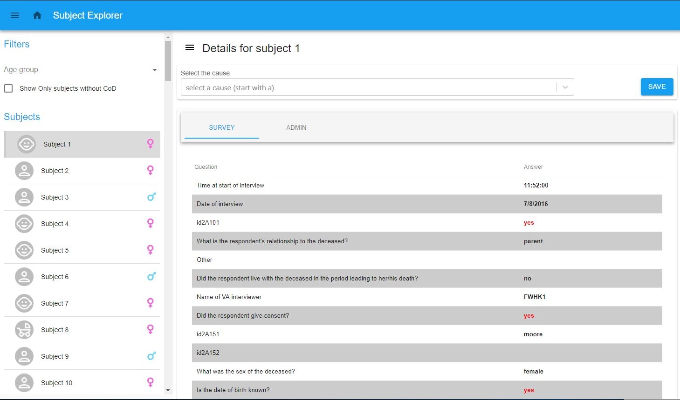
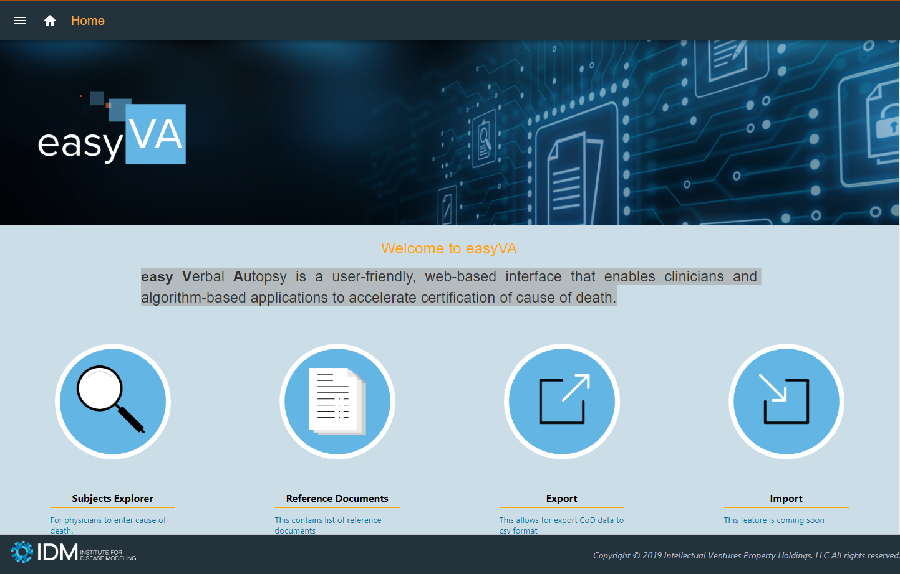
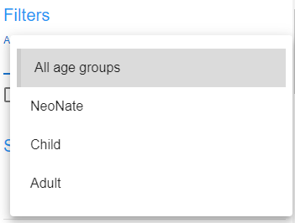
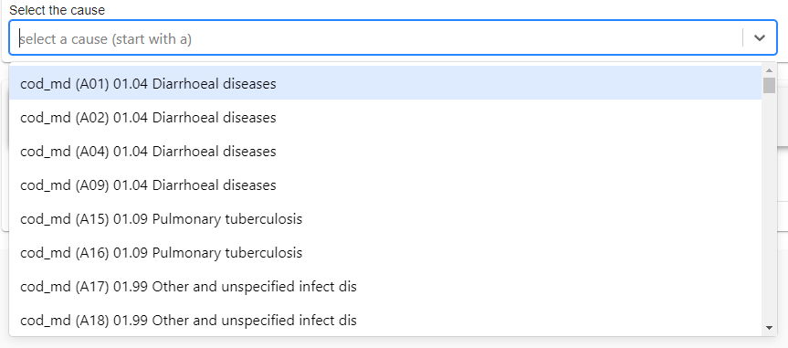
1
4
3
2
next steps
motivation
architecture
demo
contact
intro
Notes:
I’m gonna give a brief demo of the easyVA UI now. When you go to the website the landing page will look like this. Here you can select to explore the subjects. This is for clinician to enter cause of death, we will explore this page more. Also we can check the list of reference documents, export cause of death data into csv format or import survey as csv format which will come as a new feature in the next version.
The interface for subject explorer consists of 4 parts.
First, filters. Here users can filter all subjects by age groups of neonate, child, adult. Also the check box will allow users to hide/show subjects with cause of death determined
Second, subjects. This is the list displayed based on the selections of the filters. The little icons at the end indicates the genders of the subjects.
Third, the survey/admin panel. Depending on different user roles, the user as a clinician can either only see the survey tab and the admin role will be able to see both. Under the survey tab, users can browse all the survey questions and answers. Noticed that we toggle the colors for rows and also highlight the “yes” answer for more convenient reviewing process. Under admin tab, users with the admin role can check all the causes of deaths determined from different clinicians.
Last is the cause saving panel. We freeze it at top for the clinician to easily find it the moment they decide a cause of death for the given subject. And we are using a autocomplete dropdown here meaning once you start typing the cause of death code list will be filtered based on the input.
By they way feel free to stop by me or my team members if you would like to check out the live demo of this website anytime after this session.

Slide 5
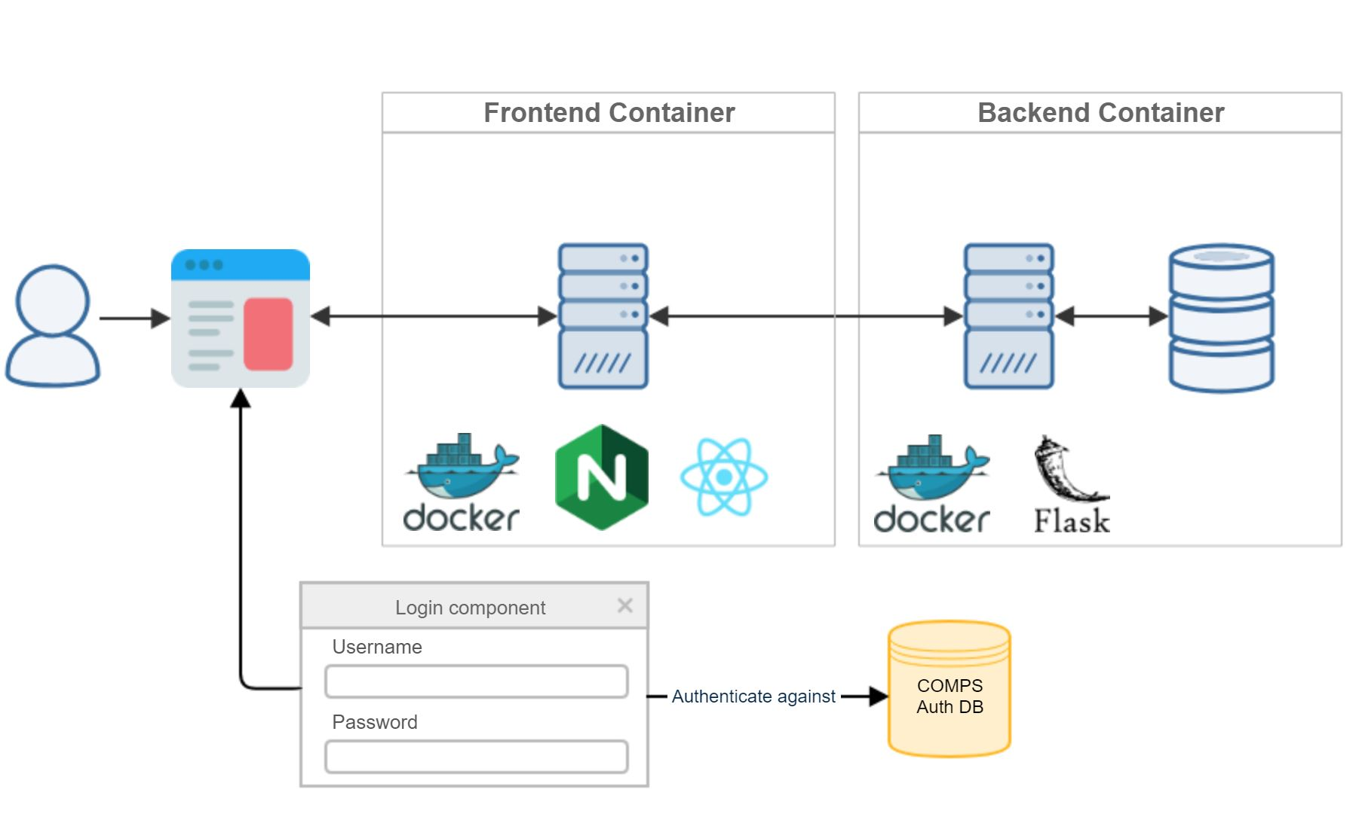
2
3
1
motivation
next steps
demo
contact
architecture
intro
4
Notes:
Now I want to show a little bit of the architecture behind the scene. Most of you here are researchers so maybe you may feel less interested in the technical part. But what interesting to point out here is that we make a robust and reusable template by abstracting the core parts of this multi-layers architecture from time to time developing the UI for a given dataset. Feel free to talk to us if you think about visualizing your data in an efficient way because this template is very easy to apply and will save a lot of time to create data visualization interface.
Back to the architecture. We have 4 main components. First, a user interacts with browser sending to and receiving data from the frontend server;
Second, a frontend server mainly responsible for generating the plots based on the data received from the backend;
Third, a backend server doing the processes and manage the data;
And fourth, an authentication server for user login which developed by the IDM internal team and we may need to change that if this project gets more scale and face more external collaborators later.
Now after we get to know about how the architecture looks like we can introduce a little bit more about the template we built. It is applied to easily build the second and third parts of this architecture and completely running inside docker containers. Using docker and nginx makes this website first, easier to deploy, meaning you can deploy it on any server running in different operating system linux or windows without noticing much difference; and second much more reliable and scalable with the load balancer, which means you don’t have to worry about that the performance will get worse if one day more users will visit this website. All the distribution and rebooting will be handled automatically with some simple configurations by docker plus nginx.

Slide 6
Smart VA
Integrate Smart VA
motivation
contact
demo
architecture
intro
next steps
More Countries
Support more users from different countries
Notes:
As I mentioned earlier the first priority of Our next step is to integrate Smart VA-Analyze app into our system. Remember? It is the analyze tool developed by IHME that automatically maps from verbal autopsy interviews to underlying cause of death. The way to integrate this app is planed like the following: on the Subject Detail page the prediction of cause of death results calculated by SmartVA will appear only after the clinician saves the cause of death for a given subject for comparison. The purpose of integrating it this way is to gradually find out the confidence level of how much we can rely on the smart VA tool and ideally if the confidence level is high enough we can free the clinician’s time for other important things like saving life from reviewing the VA survey.
And, more countries. If it turns out smartva can accelerate the whole process dramatically and later we get more users interested in using this tool we will make it more generic to support more countries besides just Burkina Faso. And to do that we may need to change the way we did now for the authentication part accordingly.

Slide 7
Acknowledgements
Andre Lin Ouedraogo
Edward Wenger
David Kong
Clinton Collins
Benoît Raybaud
demo
contact
motivation
architecture
intro
next steps
Email
support@idmod.org
Notes:
Thanks for the following people contributing and participating this project. Your efforts are what make this project successful. Also, If you have any comments or thoughts about this tool please don’t hesitate to stop by and talk to us, or shoot us an email to this email address.

Slide 8
Thank You!
Notes:
Thanks you!!! Any questions?

