Slide 1
Department of Epidemiology and Public Health
Causal models of the epidemiology of enteric pathogen co-infections among children < 59 months in Mirzapur, Bangladesh
Kurt Z Long, Abu.S.G Faruque, Tahmeed Ahmed, Inong R Gunanti, James P Nataro, Dilruba Nasrin, Karen Kotloff, Myron M Levine
Department of Epidemiology and Public Health, Swiss Tropical and Public Health Institute, Basel, Switzerland;
International Centre for Diarrhoeal Disease Research, Dhaka, Bangladesh;
Departments of Medicine and Pediatrics, Center for Vaccine Development, University of Maryland School of Medicine, Baltimore, USA;
Department of Pediatrics, School of Medicine, University of Virginia, Charlottesville, USA.
20 April 2016
Short Title of Presentation

Slide 2
Outline
Importance of co-infections among < 5 children
Prevalence of co-infections in Mirzapur, Bangladesh
Associations of specific co-infections
Causal models of co-infections
Conclusions

Slide 3
Burden of enteric co-infections among children in low-
to middle income countries
1•731 billion diarrheal episodes and 700 000 associated deaths reported among young children.
Greatest burden of diarrheal disease found in sub-Saharan Africa and South Asia.

Slide 4
Co-infections in low and middle income countires
Recent studies suggest co-infections may be contributing significantly to burden of childhood diarrheal disease.
Vasco et al., (2014) reported co-infections of rotavirus/G. lamblia associated with diarrhea (OR 24, CI 95%1.9-302)
Important to address what risk factors and mechanisms lead to co-infections in young children.

Slide 5
Possible drivers of co-infections
Co-infections occur due to shared transmission pathways
Infection by one pathogen predisposes host to infection by second pathogen

Slide 6
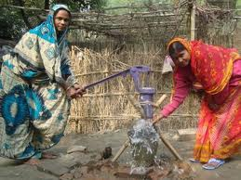
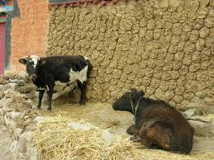
Objectives
Determine prevalence of enteric co-infections among children aged < 59 months with moderate-to-severe diarrhea (MSD) and matched controls enrolled in the Bangladeshi component of the Global Enteric Multicenter Study (GEMS).
Develop structural equation models (SEM) to identify underlying risk factors and causal pathways that determine high burden of co-infections in this population.

Slide 7
Methods
Data was collected in Mirzapur, Bangladesh a rural community located northwest of Dhaka as part of the Global Enteric Multicenter Study (GEMS) (Kotloff et al., 2013)
Stools collected form children < 5 years with moderate-to severe diarrhea (MSD) and matched controls screened for bacterial, viral and parasite enteric pathogens.
The prevalence of co-infection determined for pathogens identified as most important cause of MSD in GEMS.
S. flexneri,
Cryptosporidium spp,
Rotavirus
Aeromonas (important cause of MSD in Mirzapur)
Giardia intestinalis
.

Slide 8
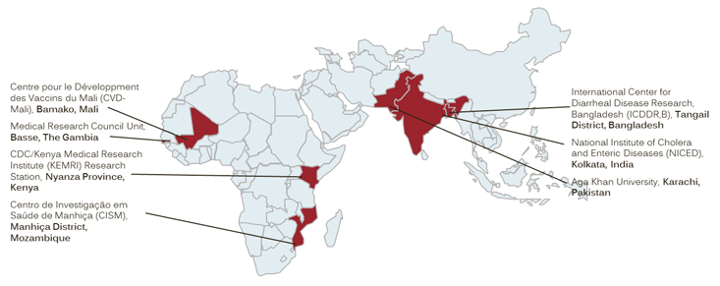
Global Enteric Multi-Center Study
Primary objective: measure the population-based burden, microbiological aetiology, and
adverse clinical effects of moderate-to-severe diarrhoea in developing countries
3-year, prospective, age-stratified, matched case-control study of moderate-to-severe diarrhoea
among children 0–59 months at four sites in Africa and three in Asia.
9439 children with moderate-to-severe diarrhoea and 13,129 control children
Clinical and epidemiological data, anthropometric measurements, and a faecal sample collected from
patients and controls
Center for Vaccine Development, University of Maryland Medical School

Slide 9
Methods
Structural equation models (SEM) of causal relations between pathogen transmission pathways and enteric pathogen co-infections
Paths specifying direct and indirect effects of household reservoirs and hygiene behaviors on co-infections evaluated using SEM.
Pathogen variable included in model as multinomial outcome of non-infection, asymptomatic infection and symptomatic infection
Direct, indirect and overall effects of co-infections were then determined
Co-
infection
Non-
infection
Non-
infection
X
Asymptomatic
infection
X
Asymptomatic
infection
Symptomatic
infection
Symptomatic
infection
Direct effect
Mediation effect of co-infection

Slide 10
Number of pathogen isolates/stool among children in the case and control groups

Slide 11
Associations of coinfections with asymptomatic and symptomatic S. flexeri infections

Slide 12
Causal pathways linking pathogen reservoirs, hygiene behaviors and coinfections with asymptomatic and symptomatic Shigella flexneri infections
Improved
latrine
-0.45
Giardia
0.57
-0.36
Asymptomatic
infection
HW X
Iatrine
0.40
Norovirus
GII
0.8
Symptomatic
infection
0.23
Caretaker
education
-0.30
0.11
-0.25
-0.55
0.85
Handwash
cook
Aeromonas
HW X Aero

Slide 13
Associations of coinfections with asymptomatic and symptomatic Cryptospoidium infections

Slide 14
Causal pathways linking household pathogen reservoirs, hygiene behaviors and coinfections with asymptomatic and symptomatic Crytosporidium infections
G. intenst.
Rotavirus
S.flexneri
.
0.76
-0.06
1.3
0.06
Asymptomatic
infection
Improved
latrine
0.06
-0.08
2.0
Handwash
before cook
-0.58
-2.2
Symptomatic
infection
Latrine X
handwash
2.1

Slide 15
Joint effect of sanitation and handwashing before cooking on Cryptosporidium infection
.08
.06
.04
Probability of Cryptosporidium diarrhea
.02
0
Open
pit latrine
Improved
VIP latrine
Type of sanitation facility
No handwashing before cooking
Handwashing before cooking

Slide 16
Associations of coinfections with asymptomatic and symptomatic rotavirus infections

Slide 17
Causal pathways linking household pathogen reservoirs, hygiene behaviors and coinfections with asymptomatic and symptomatic rotavirus infections
Caretaker
education
Giardia
1.20
-0.24
Asymptomatic
infection
HW X Aero
-0.37
0.85
Handwash
cook
Symptomatic
infection
Crypospo
-0.26
1.3
Aeromonas
-0.55

Slide 18
Risk of S. flexneri and rotavirus diarrehea by Aeromonas infections and handwashing before cooking
0.4
S. flexneri diarrhea
0.18
Rotavirus diarrhea
0.3
0.16
0.14
Predicted S. flexneri diarrhea risk
Predicted rotavirus diarrhea risk
0.2
0.12
0.1
0.1
0
0.08
No handwashing
before cooking
Handwashing
before cooking
No handwashing
before cooking
Handwashing
before cooking
Non-infected
Aeromonas
infection

Slide 19
Possible drivers of co-infections
Co-infections occur due to shared transmission pathways
Joint effect of sanitation and handwashing before cooking on Shigella flexneri and Cryptosporidium infections
Risk of S. flexneri and rotavirus diarrhea by Aeromonas infections and handwashing before cooking

Slide 20
Possible drivers of co-infections
Infection by one pathogen predisposes host to infection by second pathogen
Effect of G. lamblia on onset of infections but no effect or protective effective for symptomatic diarrhea
Risk of S. flexneri and rotavirus diarrhea increases when children co-infected by Aeromonas infections

Slide 21
Household factors are risk factors for childhood stunting through direct pathways or through effects on Cryptosporidium and Giardia lamblia infections
0.6
No handwash before cooking
Latrine X
0.5
handwash
Improved
Probability of stunting
latrine
Crypto. spp.
age
Crypt_Age
0.4
-
Hand wash
0.3
cook
Giardia
0.2
-
-
6
12
18
24
30
36
42
48
54
60
E
ducation
caretaker
0.6
Handwash before cooking
Handwash
stunting
0.5
nurse
0.4
Probability of stunting
Handwash
Direct Effect | Indirect Effect | Full Effect
_
0.3
child
Hand wash before cooking | 0.00 | 0.41 | 0.41
Improved latrine use | -0.56 | 0.16 | -0.40
Interaction: Latrine X hand wash before cooking | 0.00 | -0.48 | -0.48
0.2
6
12
18
24
30
36
42
48
54
60
Age in months
Giardia=0
Giardia=1

Slide 22
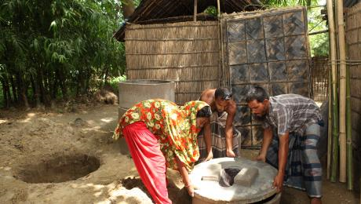
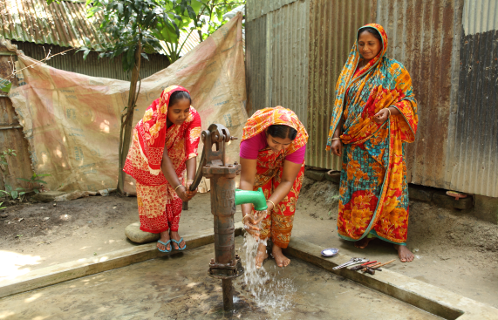

Causal models of co-infections
Analysis has identified factors that are critical points in enteric pathogen transmission pathways that contribute to risk of co-infections.
Models provide a systematic quantification of the contribution of the underlying risk factors and causal pathways to single infections and co-infections .
More complete understanding can indicate where single or combined interventions at different points in transmission pathways are the most effective in reducing burden of diarrheal disease.
Models can be an important tool in efforts to reduce the burden of diarrhea and stunting through targeting of household and communities

Slide 23
Acknowledgements
Shasha Jumbe
Healthy Birth, Growth and Development knowledge integration (HBGDki)
Initiative
Bill and Melinda Gates Foundation

