Slide 1

Risk Map Project
By Qinghua Long
Research Software Engineer
Institute For Disease Modeling
Notes:
Hello. My name is Qinghua Long. I’m the research software engineer from IDM and I’m also one of the key developers for this cool riskmap tool.
Today Ill give a talk about our this project, mainly focusing on the stories behind the scene.

Slide 2
Overview
Generate a predictive risk map
Workflow
  Cleaning
  Aggregation
  Model run
  Visualizations
Architecture
Challenges
Notes:
For those who missed our risk map tool demo session, in general it is a web tool used to generate a predictive risk map in an efficient way.
The workflow to use this tool is simplified into 4 steps after initial upload.
1 step Cleaning is to validate the location names of the use input file. 2 step Aggregation is to aggregate data into ideal period and admin level. 3 step Model run allows user to run predictive models. Ill talk about what models we currently support later. And last step visualization allows user to view the input data as well as the model output data, which is the risk map.
Ill also share the architecture of this project. I’m sure it will give you some inspirations or to help you create your own riskmap tool in case this one doesn't meet your specific needs
Last Ill share some challenges we encountered during the design and development phase which may also facilitate your similar process in the future.

Slide 3


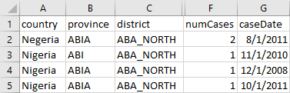
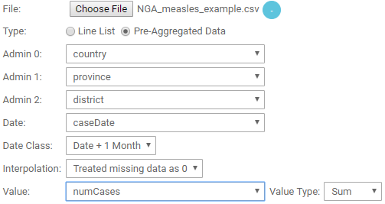
Initial Upload
Upload case and/or risk indicator file(s)
User Input
Upload Settings
Case and/or Risk indicator file(s)
Upload Page
Notes:
Let’s talk about the workflow.
Initial upload is the starting point of the workflow. We need to begin with choosing a csv file from the upload page.
In the latest version of risk map tool, besides line list file in which one line represents one case count, pre-aggregated file is also supported.
Also besides the case file we now accept extra risk indicators to upload along with the case file or separately.
Now Ill give an example of uploading pre-aggregated data. The 5 required types of data are admin 0, 1, and 2 to identify the location, number of cases happened in the pre-aggregated period, as well as case date
Notice we provide an easy way on the upload page for user to map the columns from user input to the corresponding names we required for file processing by reading the column names from the file and automatically show them as dropdown options for manual select.
In this way you don’t have to format the column names to the names we required before uploading the file.
Once we finish the mapping and a few more settings which are not showing in the screenshot but Ill talk about those later, we can finalize the upload and proceed to the cleaning step.

Slide 4
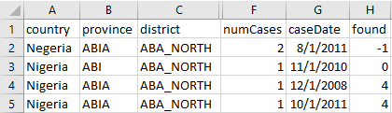

Step 1: Cleaning
()
Cleaning Output
Unique names and matches
Validate location information
User Input
Case and/or Risk indicator file(s)
Cleaned up data
(Unmatched removed)
Notes:
Cleaning step is the first step. It is necessary because we may make some spelling mistakes or have different naming convention. This step is to make sure that names appearing in the file match names in the shape
Why do we need the names in the file to match names in the shapes? It’s because we use the shapes to display the map. Only when the names match we can display the count from the file on the right place of the map.
This example here takes the user input of a csv file received from the initial upload. It has typos in country and province. After processing, this step will generate the cleaning output of 2 csv files and a statistic report of the total count of matched and unmatched records displayed on the web page directly. If you didn’t see the report before and are interested in how the report looks like you can always go to the website and try with our example file. Talking back about 2 csv file output. One is the Unique names and matches file and the other is the cleaned up data file.
In the unamf besides all the records from the original input file we add one extra column to indicate that if there is a match between the names of the shapes and the names in the csv. All the values that are less than or equal to 0 in the found column indicate we cannot find a match. Like what we show in this example the 2 records with typos either in country or province have values in found column of -1 and 0.
In the Cleaned up data notice those 2 unmatched records are removed. At this point either you can modify your original file by comparing with the match report and then re-upload the modified file or you can just use the cleaned up data to proceed. (May change!!!!)
Need to explain shape file

Slide 5
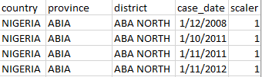


Step 2: Aggregation
Aggregate the data
Aggregation Input
Upload Settings
Cleaned up data
Upload Page
Aggregation Output
Aggregated data
Notes:
Aggregation step is to aggregate cleaned up data to the selected period and the selected admin level.
Options for the duration of period of aggregation are 3/6/9/12 months. District is the only option for admin level for now.
To be more clear, here is an example. At the initial upload we selected 6 month as the duration of period of aggregation and district as the admin level.
That means we will add up the count in the cleaned up data every fixed 6 month from jan-jun and from july-dec within the specific district.
Let’s check the aggregation output. Dot_name is the location. For the district ABA north from jan to jun 2011 we have total count of 2. That’s exactly what we expected when we looked at the cleaned up data
Once we have the aggregated data ready, we can move to the model run step

Slide 6

Step 3: Model Run
Run predictive models
Model Run Input
Model Run Output
Spatial Binomial
Logistic Regression
Model outputs
Random Forest
Aggregated data
AUC outputs
PDF visualizations
Notes:
The model run step is to run the predictive models. We can start those models in parallel. The three models we support so far are s,l,and r
The only input we take is the master aggregated data generated from aggregation step.
Model run output includes the model outputs, which are the risk rates calculated from the model for the selected period of aggregation and selected admin level.
Model run output also includes the AUC outputs. AUC stands for Area Under Curve and indicates the confident level for the corresponding predictive risk rate
The pdf visualizations contain risk maps for all aggregated periods. Basically it’s the same with what will get next step in pdf format. It allows you to review the risk map offline but not very practical
That’s why I will introduce you the next step visualizations

Slide 7
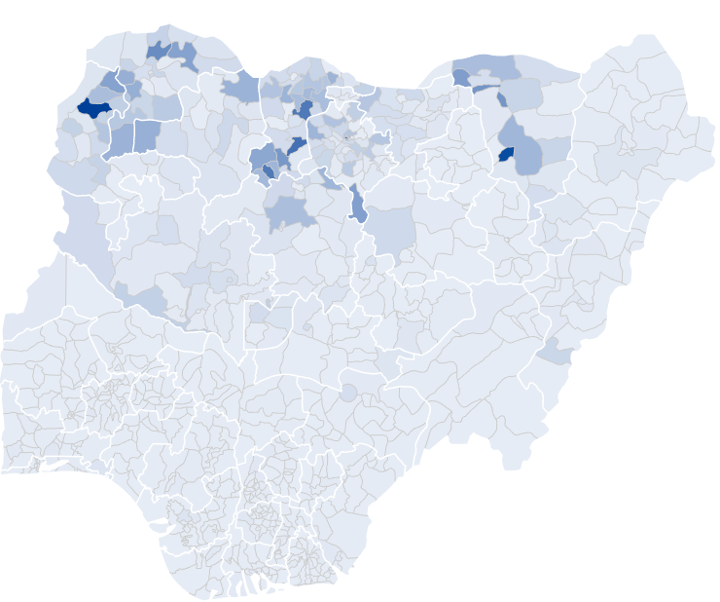
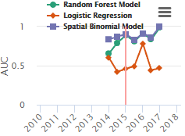
Step 4: Visualizations
Visualize the user input data, model outputs, and AUC outputs
Aggregated data
Model outputs
AUC outputs
Notes:
Visualizations step is to provide a convenient way for user to visualize input data, model outputs and AUC outputs.
We gather the outputs from the previous steps and integrate them into a single map tool. Here you can navigate through the map views of case data, risk indicator data if any, and risk maps generated from all the model runs along with the AUC charts.
This is how the AUC charts looks like. The red vertical line indicates which period of data we are looking at on the risk map. It’s now on top of year 2015 which indicates the map is showing the predictive risk rates for the period of jan-jun 2015. It’s obviously the confident level for logistic Regression model is much lower than other 2 models during the same period.
There are a lot more practical functionalities provided with in the map tool box. If you are interested please go and check out our cool risk map website.
So… that’s the four simple steps to build a risk map. First, cleaning. Second, aggregation, third, model run. And last visualizations.
Isn’t that awesome? In a few mouse clicks you can clean the file, generate aggregated data, run the model and visualize the risk map at one place.

Slide 8

















Behind the scenes
Architecture
Database
Worker
Worker
Worker
Webserver
Cleaning
Cleaning
Cleaning
Aggregation
Aggregation
Aggregation
File System
File System
File System
Model run
Visualization
…
Model run
Model run
…
Notes:
Now we will dig into the architecture for this project.
User interacts with the browser web pages. Those pages are served by our webserver written in python using a framework called Django deployed on Tornado server.
Once user clicks upload, the webserver will create a job into the postgres database and save the files for that job to a unique file system sitting in the azure drive for extra security. Each job will create a separate folder. Notice once the aggregation task is done all user input files will be deleted from the file system to protect your privacy.
Worker is a continuous running service written in python. It’s like a little robot online standing by to finish task one at a time. It will call different components based on which type of task it picks. Just like using an external tool instead of doing it by hand. Always getting job done faster if pick a right tool, isn’t it? Once it picks a task, then it will retrieve the job settings from the database and the input files from the file system to process the task. A lot workers are running at the same time.
For cleaning task, the worker will call an executable written in C#. For aggregation task it will call a python script. For the model run task it will call the script written in r.
Once each task is done, the worker will update the task status into the database and save the output files into the file system.
The webserver continuously queries the database to check if all the tasks for that job are done. If so the user will be able to go to the visualization page to view the map powered by highcharts.
All the webserver and workers are in azure environment.

Slide 9
Challenges
Prototype
  Limited Time
  Limited resources
Integrate different parts of IDM existing environment
  Cleaning executable written in C#
  Aggregation script in Python
  Model run scripts in R
  Webserver in Django framework and python
Performance
  Parallel running jobs
  Map loading
Notes:
Talking about the challenges we encountered during the design and development phase.
We have limited time and resources before we can really deliver this tool and demo it in the symposium.
Also due to the fact that we are not sure how many users will be interested in this tool and really use it we decided to create a prototype first with enough features and performance.
But trust me we had a hard time to choose which features are important to make this tool useful and also easy to use.
Another big challenge is to integrate different parts of IDM existing environment. We want to reuse the existing components that are very well tested and reliable as many as possible.
Like we talked about in the architecture, the cleaning executable is written in c#, aggregation script is written in Python both are provided by EMOD team, and the model run scripts provided by our scientists are written in R
To reuse those components we need to find a framework and language to code the webserver and worker that can interact with them easily. The answer came to Django framework and python.
For the performance part, the first major concern is when multiple users submit requests of jobs at the same time, how can we minimize their wait time or free their hands to do other stuff while waiting.
To do that, remember the workers we mentioned in the architecture, we have a lot of them running at the same time and they are smart enough to pick up the jobs based on the sequence they get submitted.
Workers and webserver are hosted on different azure servers to achieve the best processing performance. So now you can even close the website and do other stuff. Once your job is done, we will send an email to notify you if you provide an email address during the initial upload.
The architecture of parallel running workers resolved most of the performance issue and make this tool more useful.
Map loading is another big issue due to the fact that the shape file is usually very large. The map tool we use for the previous version is very good looking but very slow at the same time.
We have to find a tool that reads those shapes and renders them fast enough with good looking, of course.
And the one we are using now does reduce the loading time dramatically with a very clean look. It enhances the user experience a lot.

Slide 10
Thank You!
Notes:
So today we talked about workflow, architecture and challenges about our riskmap project. If have any question or concern please go the open forum session tomorrow.
Thank you very much for attending.

