Slide 1
Utilizing GPU Computational Resources for Disease Modeling
Christopher Lorton
clorton@idmod.org

Slide 2
Intro
Microsoft Surface Pro
2.8GHz * 2 cores + hyperthreading ≈ 11.2 Gflops (11.2e10⁹)
≈ $1,500
Nvidia Titan RTX
1.35GHz * 4608 cores ≈ 12.4 TFlops (12.4e10¹²)
≈ $2,500
Nvidia Geforce 2080 Ti
1.35GHz * 4352 cores ≈ 11.75 Tflops (11.75e10¹²)
≈ $1,400

Slide 3
Agenda
The why (where?) of GPUs
A survey of GPU tools for disease modeling
How IDM is utilizing GPU resources
Agent based modeling on GPU – two case studies
Caveats and considerations

Slide 4
Entertainment!
Global film industry revenues 2018 ~$42 billion
Global video game industry revenues 2018 ~$44 billion

Slide 5
Wayback Machine - 1981
Notes:
Castle Wolfenstein on Apple II

Slide 6
Wayback Machine - 1990
Notes:
Commander Keen

Slide 7
Wayback Machine - 1992
Notes:
Wolfenstein 3D

Slide 8
Wayback Machine - 1993

Slide 9
Wayback Machine - 1996

Slide 10
3D Models

Slide 11
Brief History of GPUs
Quake 1996
Halo Master Chief Collection 2014
Notes:
Enlarge for detail

Slide 12
Brief History of GPUs

Slide 13
2018/2019

Slide 14
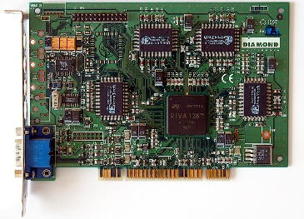
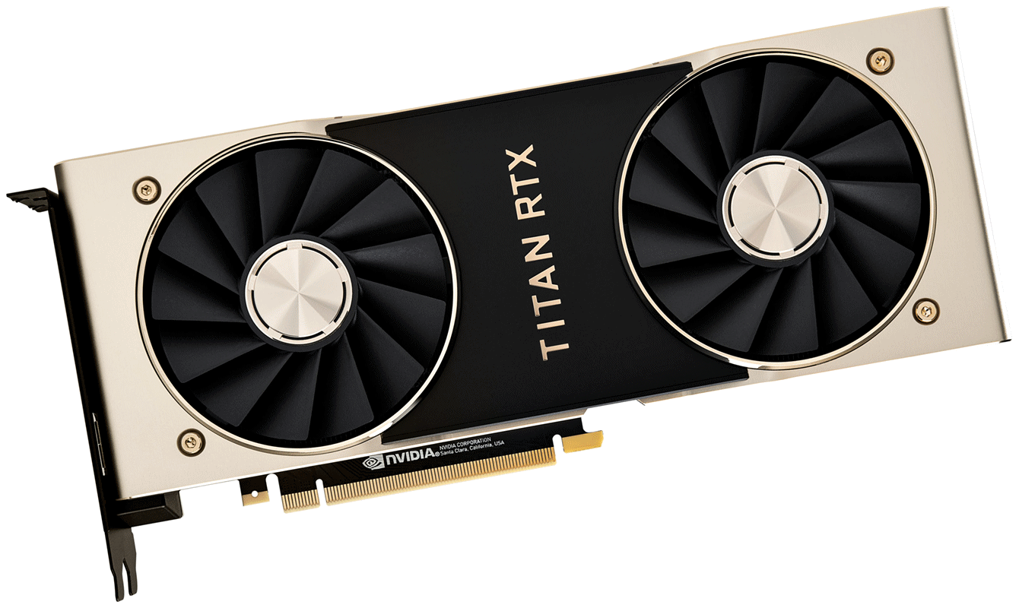
Brief History of GPUs
1996: 3Dfx Voodoo 1 (4MB/50MHz)
1997: Nvidia Riva 128 (4MB/100MHz)
2001 programmable shaders
…
2007: GeForce 8 (512MB/650MHz)
2007: CUDA!
…
2018: GeForce 20 (24GB/1.35GHz)
2018: CUDA 10
Notes:
* Fixed function to programmable to “general purpose”
* Video cards vs. dedicated GPU data processors
Tensor cores
Geforce 3, 2001 introduced programmable pixel (color) and vertex shaders (geometry), prior to this, fixed function pipeline
First version of CUDA, 2007

Slide 15
GPU Applications to Disease Modeling
Data manipulation and cleaning
Data analysis and statistical modeling
Machine learning
Genetic data – analysis and modeling
Modeling – compartmental and agent based
Notes:
“solver”?
Explicit code for GPU vs. “configuration only”.

Slide 16
GPU Applications to Disease Modeling
Linear algebra (cuBLAS)
Graph analytics (nvgraph)
DNA sequencing
ML I: PyTorch/Theano/Keras/TensorFlow
ML II: SVD/PCA/K-Means/XGBoost (cuML / RAPIDS)
Data manipulation (think PANDAS) – (cuDF / RAPIDS)
Cholesky/LU/SVD/QR solvers (cuSOLVER)
Phylogenetics – BEAST/BEAGLE
Agent Based Modeling
Notes:
“solver”?
Explicit code for GPU vs. “configuration only”.

Slide 17
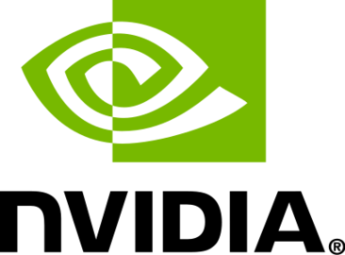
Linear Algebra - cuBLAS
https://developer.nvidia.com/cublas
“The NVIDIA cuBLAS library is a fast GPU-accelerated implementation of the standard basic linear algebra subroutines (BLAS).”
C/C++ and FORTRAN
“cuBLAS performs up to 35X faster than the latest version of the MKL BLAS on common benchmarks” –Nvidia

Slide 18
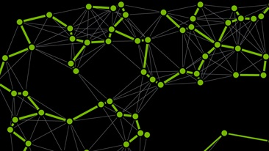
Graph Analytics - nvgraph
https://www.developer.nvidia.com/nvgraph
“The NVIDIA Graph Analytics library (nvGRAPH) comprises of parallel algorithms for high performance analytics on graphs with up to 2 billion edges.”
“3x faster than 24 core Xeon E5 v2 on PageRank” – Nvidia
“Data analytics is a growing application of high-performance computing. Many advanced data analytics problems can be couched as graph problems. In turn, many of the common graph problems today can be couched as sparse linear algebra. This is the motivation for nvGRAPH, new in NVIDIA® CUDA™ 8.0, which harnesses the power of GPUs for linear algebra to handle the largest graph analytics and big data analytics problems.”

Slide 19
DNA Sequencing
“What’s in Your Genome? Startup Speeds DNA Analysis with GPUs”
“GPU Computing for the Analysis of DNA Sequencing Data”
The BarraCUDA Project – “Started in 2009, the aim of the BarraCUDA project is to develop a sequence mapping software that utilizes the massive parallelism of graphics processing units (GPUs) to accelerate the inexact alignment of short sequence reads to a particular location on a reference genome. ”

Slide 20
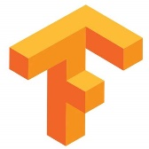
ML I – PyTorch/Theano/Keras/TensorFlow
PyTorch – “an open-source machine learning library for Python, based on Torch.”
Theano – “a Python library and optimizing compiler for manipulating and evaluating mathematical expressions, especially matrix-valued ones. In Theano, computations are expressed using a NumPy-esque syntax and compiled to run efficiently on either CPU or GPU architectures.”
Keras – “an open-source neural-network library written in Python. It is capable of running on top of TensorFlow, Microsoft Cognitive Toolkit, Theano, or PlaidML.”
TensorFlow – “a free and open-source software library for dataflow and differentiable programming across a range of tasks. It is a symbolic math library, and is also used for machine learning applications such as neural networks.”

Slide 21
ML II – SVD/PCA/K-Means/XGBoost (RAPIDS / cuML)
“The RAPIDS suite of open source software libraries gives you the freedom to execute end-to-end data science and analytics pipelines entirely on GPUs.”
“The RAPIDS cuDF library is a … library … that accelerates loading, filtering, and manipulation of data for model training data preparation. The … primitives mirror the pandas interface...”
“RAPIDS cuML is a collection of GPU-accelerated machine learning libraries that will provide GPU versions of all machine learning algorithms available in scikit-learn.”
“[cuGRAPH] is a framework and collection of graph analytics libraries that seamlessly integrate into the RAPIDS data science platform.”

Slide 22
Data manipulation – (RAPIDS / cuDF)
“The RAPIDS cuDF library is a … library … that accelerates loading, filtering, and manipulation of data for model training data preparation. The … primitives mirror the pandas interface...”

Slide 23
Cholesky/LU/SVD/QR solvers (cuSOLVER)
“The NVIDIA cuSOLVER library provides a collection of dense and sparse direct solvers which deliver significant acceleration for Computer Vision, CFD, Computational Chemistry, and Linear Optimization applications.”

Slide 24
Phylogenetics – BEAST/BEAGLE
Bayesian Evolutionary Analysis Sampling Trees
“BEAST is a cross-platform program for Bayesian analysis of molecular sequences using MCMC.”
BEAGLE: An Application Programming Interface and High-Performance Computing Library for Statistical Phylogenetics
“[a] library for high-performance statistical phylogenetic inference. The API provides a uniform interface for performing phylogenetic likelihood calculations on a variety of compute hardware platforms. The library includes a set of efficient implementations and can currently exploit hardware including GPUs using NVIDIA CUDA…”

Slide 25
IDM’s Utilization of GPU Resources
Machine Learning
Polio vaccination economics
Measles campaign modeling
Bayesian History Matching
Separatrix
Calibration
ABM Emulator
BEAST/BEAGLE
Polio phylogenetics
Data Manipulation
cSPARSE
Agent Based Modeling
Notes:
Polio vaccination economics: “Given a dataset of the real world costs of polio surveillance and intervention programs in various regions (and for a given year), and various pieces of potentially correlated data about those regions at those times (e.g., total population, under 5 population, number of doctors per capita, GDP per capita), can you use ML techniques that find the strongest correlates (aka most important drivers) of campaign costs beyond what linear regression would give you?”
Measles campaign modeling – machine learning, but not yet utilizing GPU resources

Slide 26
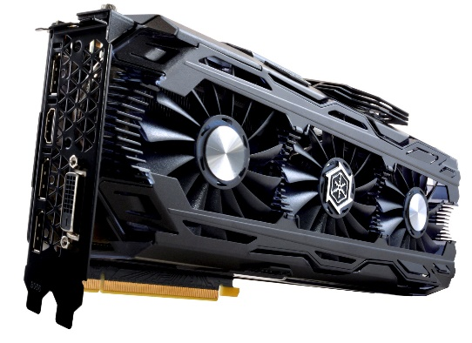
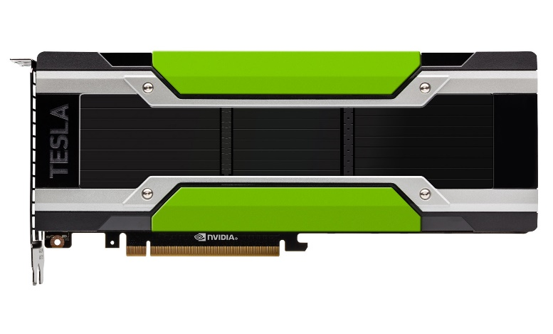
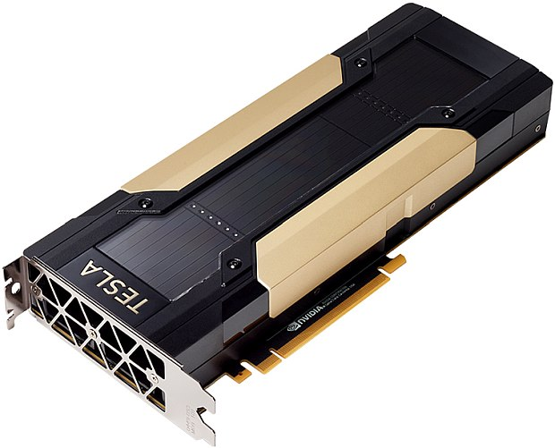
IDM’s Utilization of GPU Resources
Nvidia GTX 1080 Ti
3584 cores
10.6 Tflops
11GB RAM
Compute capability 6.1
Nvidia Tesla P100
3584 cores
8 Tflops
12GB RAM
Compute capability 6.0
Nvidia V100 – 4/DGX Station
5120 cores
14 Tflops
16GB RAM
Compute capability 7.0
Notes:
K80, 4992, 5.6 Tflops, 2x12GB RAM, CC 3.7

Slide 27
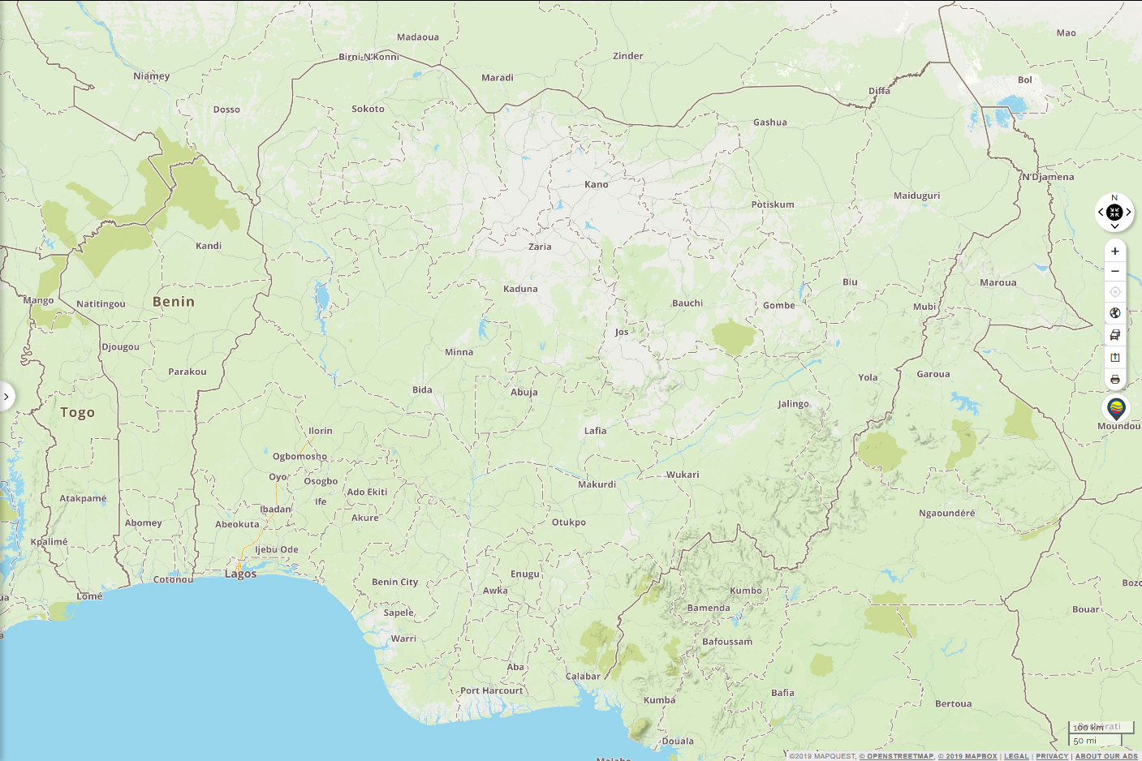
Measles Model for Nigeria

Slide 28
Agent Based Modeling on GPU
Measles model:
Up to 256 million agents
Epidemiological status
Infection
Immunity
Age
Location
SEIR progression for each agent
Duration of exposure drawn from a distribution
Duration of infectiousness drawn from a distribution
Infectiousness constant or dynamic during infection
Homogeneous mixing within spatial locations
Transmission (“migration”) of contagion between spatial locations
Notes:
“hold your breath”
Value of speed – keep context, more parameters, more scenarios

Slide 29
Agent Based Modeling on GPU
Measles model:
Maternal immunity, with duration drawn from distribution
Vital dynamics – births and mortality
All transmission events recorded
Post-processing to aggregate by time period (week, month, year)
Calculate average age at infection
365 time steps, 183 million agents, 774 locations ⇒ <20 seconds on V100
Notes:
Kurt average age at infection to differentiate between imported cases and endemic transmission.
C.f. DTK time steps, # agents, and sub-sampling on CPU

Slide 30
Measles Model for Nigeria
183 million individuals
774 admin 2 districts

Slide 31
Seattle Flu Study
Notes:
Check with Mike if okay…

Slide 32
Seattle Flu Study

Slide 33
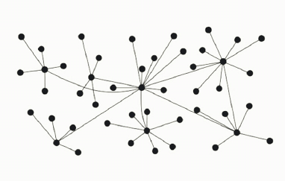
Agent Based Modeling on GPU
Influenza model:
Up to 4 million agents
Up to 512 connections per agent
Track duration of infectiousness (drawn from a distribution)
Track susceptible/recovered state
Record individual transmission events to build phylogenetic tree
365 time steps, 4 million agents, 32 connections per agent ⇒ <500ms on P100
Notes:
Consider live demo - # sims during elapsed time | single simulation.

Slide 34
Agent Based Modeling on GPU
Measles model:
Per individual/agent infection status and immunity
Homogeneous mixing in each district
Spatial transmission of contagion between districts
Record of time, location, and age of individual for each transmission event
Influenza model:
Per individual/agent infection status and immunity
Per individual contact network
Record of time, source, and target of each transmission event

Slide 35
Technical Considerations
SIMD – single (same) instruction, multiple data
10s, 100s, 1000s of data points, same codes
Minimal branching
All cores in a warp (cohort of 32 threads) process same instructions
Compute bound vs. memory bound
Is processing limited by CPU cycles calculating results?
Is processing limited by waiting for data to be read from memory?
CPU/GPU communication
Does data have to be transferred often between CPU RAM and GPU RAM or vice versa?
Data reduction
Notes:
Graphics for SIMD?
Graphic for branching? Relate back to original table and # of cores.
Compute bound vs. Memory bound - optimization

Slide 36
Conclusion
Very powerful hardware available today
Many libraries for common data processing tasks
Reasonable for coding custom models and applications

Slide 37
The End
das Ende
la fin
el fin
la fine
結束
הסוף
(finis)

