Slide 1
Stochastic compartmental modeling with IDM-CMS
Min K. Roh and Christopher Lorton

Slide 2
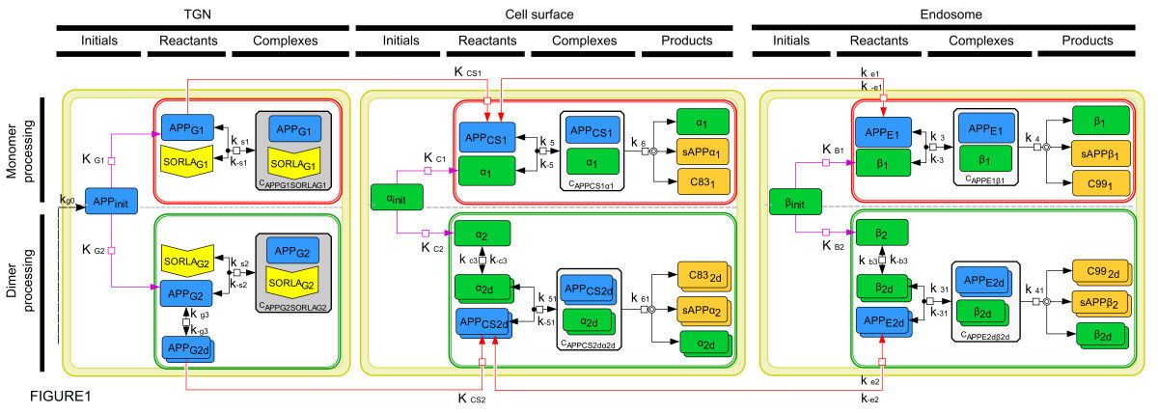
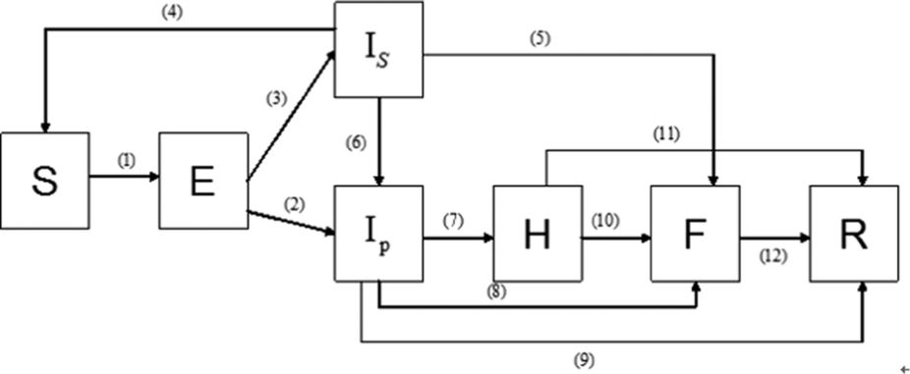
IDM’s Compartmental Modeling Software (IDM-CMS)
CMS
  Framework
  Motivation
  Types of solvers
  Special features
Software Demo
  Construct SEIR model with CMS using EMODL
  Run simulations
  Output analysis
Multi-compartmental modeling of SORLA’s influence on amyloidogenic processing in Alzheimer’s disease
A Lao, V Schmidt, Y Schmitz, TE Willnow, O Wolkenhauer
BMC Systems Biology 6 (1), 74 2012
Modeling the transmission dynamics of Ebola virus disease in Liberia. Xia ZQ, Wang SF, Li SL, Huang LY, Zhang WY, Sun GQ, et al. Scientific Reports. Sep 2015
Notes:
This talk is largely divided into two parts. In the first half, I will give a brief overview of CMS and when and why a modeler might want to use it. Then Chis will lead the more fun part, where he will demonstrate how to create input files and run simulations to obtain an output file using the CMS.
These models are from the literature. Although we use simple models in this talk, CMS can handle much more complex models.

Slide 3





CMS framework
EMODL
Species
Reactions
Events
Functions
*
CONFIG
Solver
Sim duration
Runs
Output
solvers
input
output
Notes:
CMS requires two inputs (can be fancier but 2 is minimum) – EMODL and CONFIG files.
EMODL file contains description of model (species, reactions, events)
CONFIG file contains specifics of simulation (solver, duration, sampling frequency…)
These two files are fed into the specified solver to produce an output, which is in CSV format by default.
JSON and MATLAB files are also supported as valid output format.
All functionalities are built with unit test!

Slide 4



Mathematical Simulation Framework
Exact, discrete
Approximate, continuous
Molecular dynamics
Discrete population, continuous time
Deterministic (ODE, PDE)
Slow
I
Fast
S
S
S
I
I
S
I
R
S
S
S
S
I
I
I
S
I
S
S
I
S
R
I
R
R
S
R
R
R
R
R
R
I
R
R
R
R
R
Ω(t_{i}) = ([x₁,y₁,z₁]; v₁)
…
([x_{N},y_{N},z_{N}]; v_{N})
Ω(t_{i}) = [S(t_{i}), I(t_{i}), R(t_{i})]
Ω(t_{i}) = [S(t_{i}), I(t_{i}), R(t_{i})]
Notes:
Molecular dynamics – exact but slowest. Tracks position and velocity of every individual and their interactions.
Deterministic – ODE PDE. Approximate but fastest. Given an initial condition, outcome is determined.
CMS – middle in terms of simulation speed as well as accuracy. Using well-stirred assumption, position is randomized and not tracked.

Slide 5




When and why to use CMS?
Model can be split into a reasonable number of homogenous groups.
  All objects in a particular compartment will behave in the same manner.
S₁
S₂
S
R
S
R
I
R
I
I
Notes:
Extending from the previous slide, it is important that compartments are created to represent disease dynamics.
Everyone in a given compartment is treated in the same manner.
EX1: S, I, R assumes disease affects everyone equally and recovery rate is also same among everyone
EX2: Susceptibility is considerably different between adults and children.
When is too many compartments? No hard line but usually the number of compartments in the same order as population -> use another modeling approach (e.g. agent-based)

Slide 6
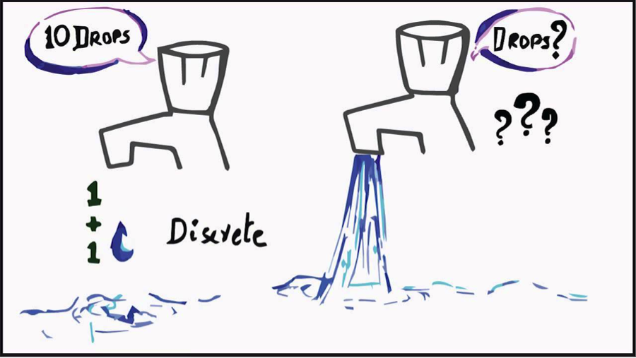
When and why to use CMS?
Population stochasticity
  Discrete population matters, even just in one compartment.
Notes:
Given a reasonable number of compartments, does stochasticity caused by discreteness of population matter? Usually does when there is at least one compartment whose population is in hundreds or less. Sometimes thousands will create very different behavior. Depends on the system.
Probabilistic events are only possible with stochastic simulations, so use CMS if these are important (e.g. eradication, outbreak)
Easy conversion if ODE/PDE model already exists.

Slide 7
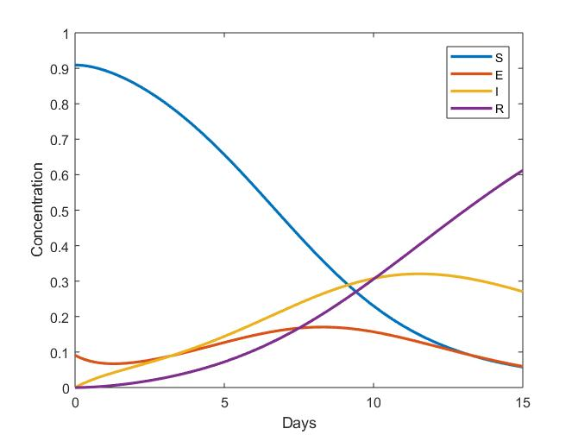
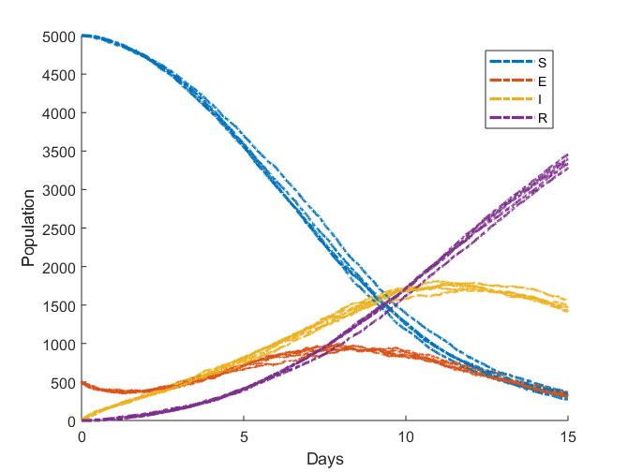
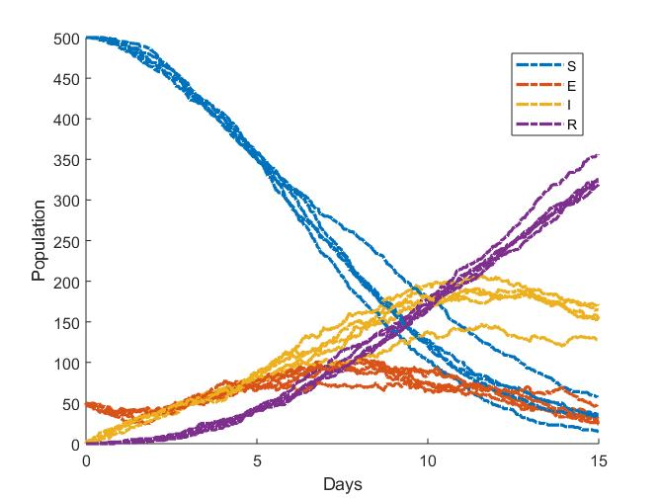
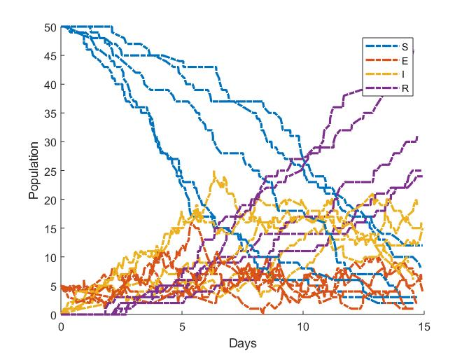
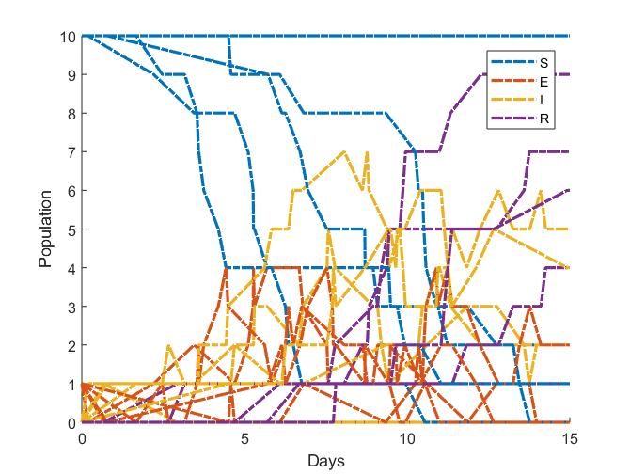




Different modes of modeling
  Deterministic vs. Stochastic
Example: SEIR
ODE
SSA/Gillespie Algorithm
$$x_{0}=\left[10 1 0 0\right] or [5000 500 0 0]$$
$$x_{0}=\left[500 50 0 0\right]$$
$$x_{0}=\left[50 5 0 0\right]$$
$$x_{0}=\left[10 1 0 0\right]$$
$$x_{0}=[5000 500 0 0]$$
Notes:
SEIR system to illustrate how stochasticity matters by population size.
ODE is deterministic and gives the same answer as long as proportions are preserved in initial population. So these two very different initial populations give the same answer.
Using one of the stochastic solvers called “stochastic simulation algorithm”, which is also known as Gillespie algorithm, we see how the relative amount of stochasticity increases with decreasing population size. Each initial condition were simulated five times, and their trajectories are plotted.
When the initial population is high, its results are very close to ODE’s. But the dynamics quickly change as we decrease the initial condition. When there are only 10 susceptible and one exposed, we see an extinction behavior in one of the trajectories. This happened because the single exposed individual became infectious then recovered without infecting another person. And at this level, the SSA trajectories look very different from the ODE trajectory. Although it is ultimately up to the modeler to decide when to incorporate stochasticity, it plays an important role in disease dynamics when at least one compartment contains small population.

Slide 8


Summary of CMS and its features
Gillespie/SSA
GillespieFirstReaction
Gibson-Bruck Next Reaction
BLeaping
Hybrid SSA
Midpoint Tau-Leaping
RLeaping
RLeapingFast
Tau-Leaping
Different modes of modeling
  Deterministic vs. Stochastic
  Agent-based vs. Compartmental
  Spatial vs. Nonspatial
  Exact vs. Approximate
CMS is
  Stochastic
  Compartmental
  Both
  Both
  Specialty methods
  Time and state-based events
First passage time
DFSP
FractionalDiffusion
OptimalTransportSSA
TransportSSA
Gillespie
GillespieFirstReaction
Gibson-Bruck Next Reaction
ExitTimes
dwSSA
sdwSSA
Time-based events
Seasonal vaccination
Rare event probability
State-based events
Outbreak response
Notes:
So far, we saw that CMS is stochastic and compartmental.
In addition, CMS can handle both spatial and nonspatial systems
And it contains multiple solvers for both exact and approximate but fast solvers
Several specialty methods are included for specialized simulations for first time passage and rare events.
And since disease modeling often include time and state-based events, such as SIA and outbreak response, we incorporated these features in the CMS as well.

Slide 9

Software Demo by Chris

Slide 10
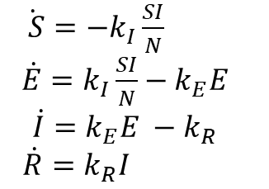
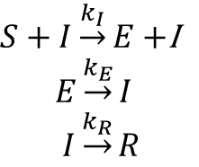
EMODL Example: SEIR
ODE
SSA
$\dot{ S}={−k}_{I}\frac{SI}{N}$
$\dot{E}=k_{I}\frac{SI}{N}−k_{E}E$
$$\dot{I}=k_{E}E −k_{R}$$
$$\dot{R}=k_{R}I$$
$S+I\underset{→}{k_{I}}E+$I
$$E\underset{→}{k_{E}}I$$
$I\underset{→}{k_{R}}R$
param
EMODL file
(species S 990)
(species E)
(species I 10)
(species R)
(param kI 0.0005)
(param kE (/ 1 7))
(param kR 0.5)
(reaction exposure (S) (E) (* kI S I))
(reaction progression (E) (I) (* kE E))
(reaction recovery (I) (R) (* kR I))
species
reaction
Notes:
species
species defines a species (population counter) in the current locale. If initial-population is not specified, the initial population of the species is zero at the beginning of each realization.
(species name [initial-population])
reaction
reaction defines a reaction converting zero or more species, listed in reactant-list, to zero or more species, list in product-list. A delay expression is optional. If present, the products of the reaction are not created until delay time units after the reaction fires.
(reaction name (reactant-list) (product-list) (rate-expression) [delay])
param
Uses a random number drawn uniformly from (0, 1) to sample from the CDF specified in the file.
uniform minimum maximum
Uses a random number drawn uniformly from (0, 1) to sample from the interval (minimum, maximum).
normal|gaussian mean variance
Uses a random number drawn uniformly from (0, 1) to sample from a normal distribution with the specified mean and variance.

Slide 11
CMS software
Download “compartments.zip” from GitHub:
https://github.com/InstituteforDiseaseModeling/IDM-CMS/releases
Place compartments.zip in an appropriate location (perhaps not “Downloads”) and unzip/expand the contents.
Reference compartments.exe from the ZIP package when running CMS,
e.g. C:\CMS\compartments.exe
Alternatively, add the path to compartments.exe to your PATH environment variable, e.g. set PATH=%PATH%;C:\CMS
Documentation can be found at:
www.idmod.org/docs/cms/index.html

