Slide 1


Introduction
Study Overview
Results
Dissemination Process
In Conclusion
End
The Seven Deadly Diseases
From Mortality Data to Disease Identification
A SAVVY Experience in Tanzania
5th Annual Disease Modeling Symposium
Bellevue, WA, USA
April 18th - 20th, 2017
Isaac Lyatuu

Slide 2
Introduction
Study Overview
Results
Dissemination Process
In Conclusion
End
Overview of the presentation
Study overview, approach and experiences
Share results (leading causes of death)
Emerging opportunities

Slide 3



Introduction
Study Overview
Results
Dissemination Process
In Conclusion
End
Overview: From Death to Statistics
1
2
3
4
Death occurs
ICD-10
ANALYSIS
Death gets verified it is within the study area
Conduct Verbal Autopsies
Physicians assign causes of death using ICD-10,
Analysis to produce statistics
Notes:
For quite sometime, most motality statistics comes from Health Facility deaths, through the national HMIS.
It does not include statistics from underserved community, hard to reach community, people who die at home, deaths that are never reported.
Alternative are the National Census, every 10 years or health and demographic surveys, every 5 years. However, both of these does not tell causes of death from deaths that occurs outside HF
OR HDSS -> but not national representative

Slide 4
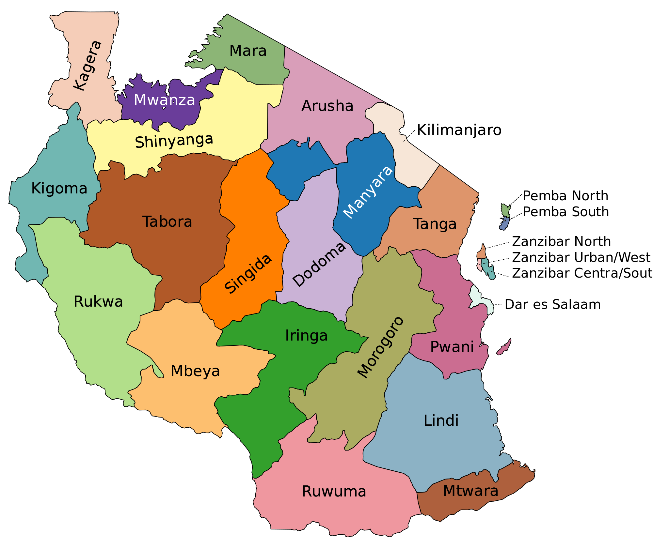
Introduction
Study Overview
Results
Dissemination Process
In Conclusion
End
Study Motivation
Tanzania
~ 50M Population
~ 947K Km² Area
~ 50/50 Urban/Rural Residence
~ 50 % HF Utilization
No comprehensive vital events registration system
Notes:
For quite sometime, most motality statistics comes from Health Facility deaths, through the national HMIS.
It does not include statistics from underserved community, hard to reach community, people who die at home, deaths that are never reported.
Alternative are the National Census, every 10 years or health and demographic surveys, every 5 years. However, both of these does not tell causes of death from deaths that occurs outside HF
OR HDSS -> but not national representative

Slide 5
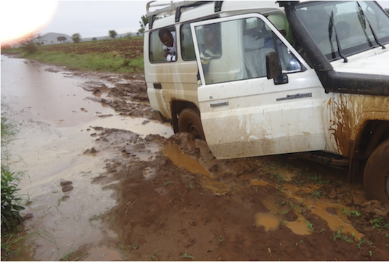

Introduction
Study Overview
Results
Dissemination Process
Opportunities ahead
End
Question
How to capture death events (the seven deadly diseases) in a large population with no complete & comprehensive civil registration and vital statistics,
that is diverse
and has hard to reach areas
Notes:
In a country, despite of variation in SES (own a house or own rent), Wealth Index (reach or poor), Residency Status (leave in Urban or Rural), when you can afford to go to hospital or die at home, when it comes to National vital statistics, everyone counts.
Lack of comprehensive vital registration system

Slide 6
Introduction
Study Overview
Results
Dissemination Process
In Conclusion
End
Response
Ifakara Health Institute, in collaboration with Ministry of Health and Social Welfare, The National Bureau of Statistics, and the National Institute for Medical Research embarked into a study named it SAVVY
SAVVY : SAmple Vital events registration with Verbal autopSY.
Funding came from CDC, the Global Fund

Slide 7
Introduction
Study Overview
Results
Dissemination Process
In Conclusion
End
Study Objectives
To strengthen the capacity of the United Republic of Tanzania (Mainland) to collect and use mortality surveillance data to assist managing national HIV/AIDS programs by expanding community based identification and reporting of HIV/AIDS deaths
Complementary Goals
Produce identification of changes in the proportion of children dying from AIDS-related conditions
Produce other major causes of death and monitoring trends in other mortality indicators relevant to MDGs

Slide 8
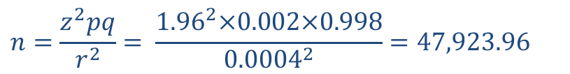
Introduction
Study Overview
Results
Dissemination Process
In Conclusion
End
Study Design
The goal was to obtain National Representative Sample.
$$n=\frac{z^{2}pq}{r^{2}}= \frac{{1.96}^{2}×0.002×0.998}{{0.0004}^{2}}=47,923.96$$
persons to be interviewed
Adjusted for 10% non-response rate, gender, household size (based on 2002 census population),
We ended up with 20,881.90 ~ 20,900 households
Adjusted for 8 zones stratification,
We ended up with 167,200 households for the whole study
Notes:
Reference Cochran (1977), Kish (1966), Sarndall (1937)
N = sample size
Z = standard normal
P = probability of interest. We assume that the dominant characteristics of the study (Crude death rate & HIV deaths) occurs at 1% and 20% respectively)
R = relative error margin at 4% and 95% confidence interval
Assuming that the Crude Death Rate (CDR) is 0.01 (10 deaths per thousand persons), and the proportion of people experiencing an AIDS death is 20% then to get a death report in one year the P in the formula above is adjusted by the CDR to obtain 0.002 (= 0.01 x 0.2). The tolerance for the precision on this estimate is set to be between 16% and 24% of all deaths (that is 4%) to be able to detect a fall or rise of 20% of 20% = 4%), then the relative error r is again re-adjusted by CDR to 0.0004 (=0.01 x 0.04). Substituting these values into the formula we obtain

Slide 9
Introduction
Study Overview
Results
Dissemination Process
In Conclusion
End
Study Design
2 Stage Sampling using PPS
Stage 1: Selection of 23 districts sampled with no replacement using PPS. Out of 119 districts, 23 districts were selected
Stage 2: Selected districts stratified by zone, and grouped by ward, village/EA and streets, number of household and number of households.
(Some exclusion criteria such as existing HDSS sites)

Slide 10
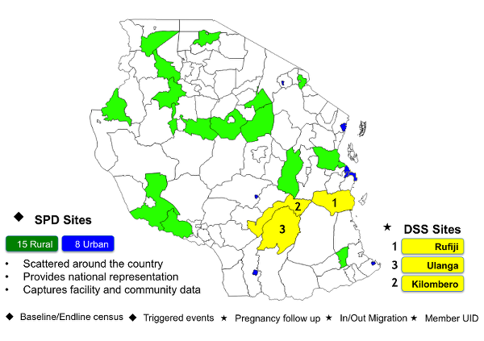





Introduction
Study Overview
Results
Dissemination Process
In Conclusion
End
Community Level
District Level

Slide 11
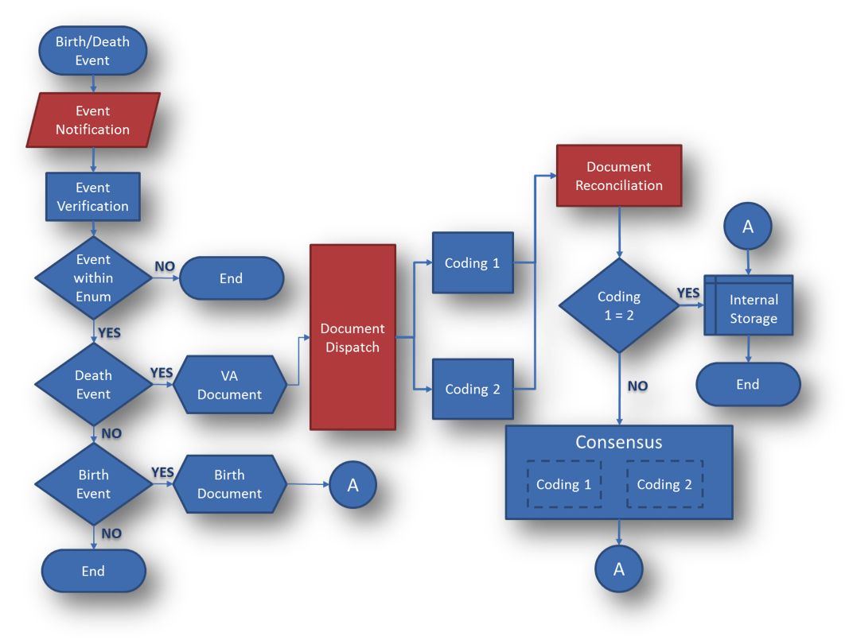
Introduction
Study Overview
Results
Dissemination Process
In Conclusion
End
Process
Mapping

Slide 12
Introduction
Study Overview
Results
Dissemination Process
In Conclusion
End
Results

Slide 13
Introduction
Study Overview
Results
Dissemination Process
In Conclusion
End
Results: Baseline Census
644,382
individuals
154,911
households

Slide 14
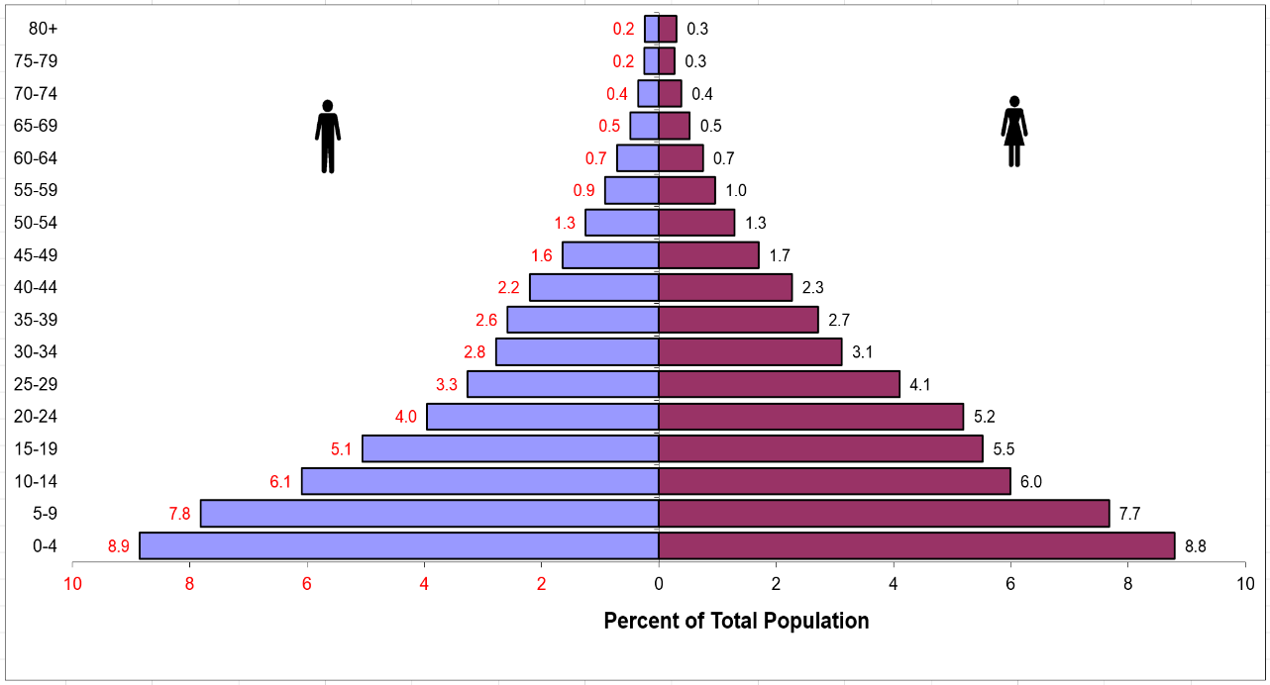
Introduction
Study Overview
Results
Dissemination Process
In Conclusion
End
Results: Population Pyramid
48.5%
National Census 48.7%
51.5%
National Census 51.3%

Slide 15

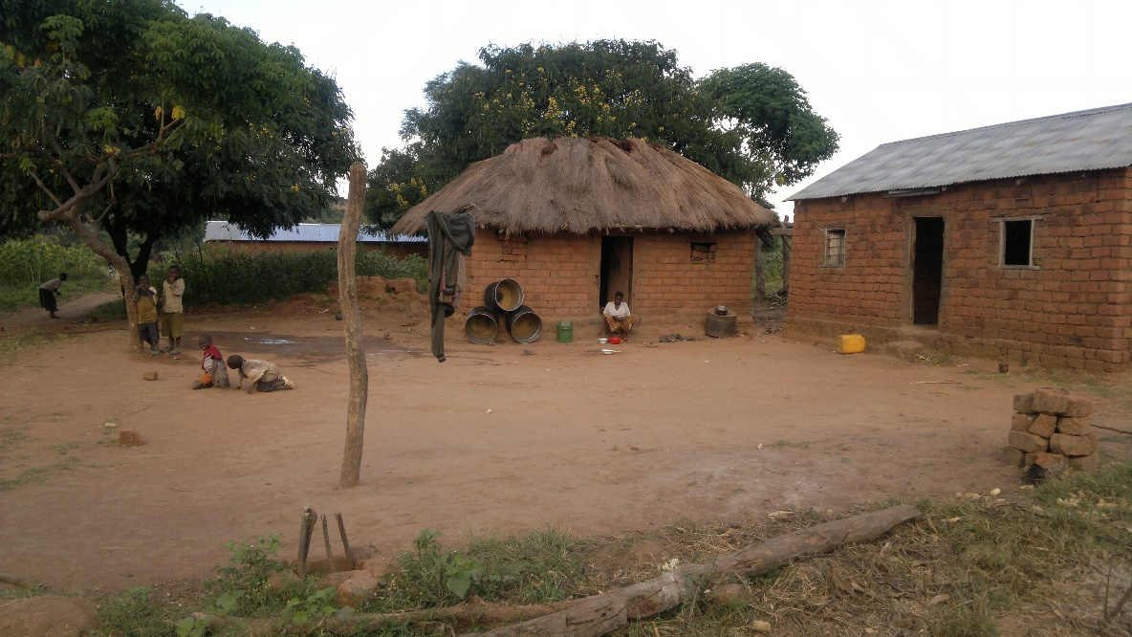
Introduction
Study Overview
Results
Dissemination Process
In Conclusion
End
Results: Residency
33%
Compared to
National Census: 29%
67%
Compared to
National Census: 71%

Slide 16
Introduction
Study Overview
Results
Dissemination Process
In Conclusion
End
Results: Number of Deaths
17,221
All deaths
8,655
Deaths reported in 2013-2014

Slide 17
Introduction
Study Overview
Results
Dissemination Process
In Conclusion
End
Results: The Seven Deadly Diseases
0 – 4 Years
5 – 14 Years
Notes:
Fetus or newborn affected by maternal complications

Slide 18
Introduction
Study Overview
Results
Dissemination Process
Opportunities ahead
End
Results: The Seven Deadly Diseases
15 - 49 Years
50+ Years
Notes:
Disease of the Circulatory System
Ill-defined & Undetermined

Slide 19


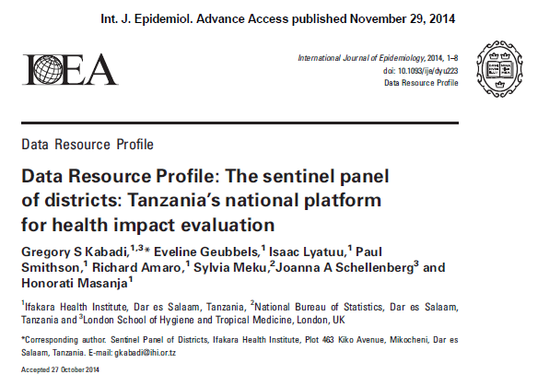
Introduction
Study Overview
Results
Dissemination Process
In Conclusion
End
Results Dissemination
Integrated with routine structure and it provides feedback to district health authorities
Helps to produce district DHP and HSSP documents and other health sector indicators
Internal processes of reporting (funders, IHI and MoH)
Publication: Int.J. Epid. Data Resource Profile (2014)
Full report including (2013 & 2014 data)
Knowledge gained help to build models for determining causes of deaths given the verbal autopsy document

Slide 20
Introduction
Study Overview
Results
Dissemination Process
In Conclusion
End
Notes:
A Tariff score measures the relative likelihood that a given symptom results in a specific cause of death.

Slide 21


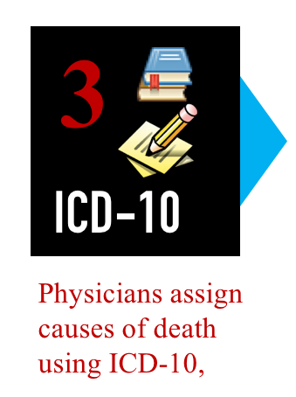
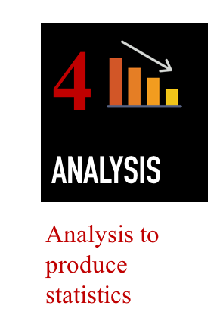
Introduction
Study Overview
Results
Dissemination Process
In Conclusion
End
Opportunities ahead?
Death occurs
Challenges
Time consuming
Bias
Delayed availability of prediction
Notes:
A Tariff score measures the relative likelihood that a given symptom results in a specific cause of death.

Slide 22
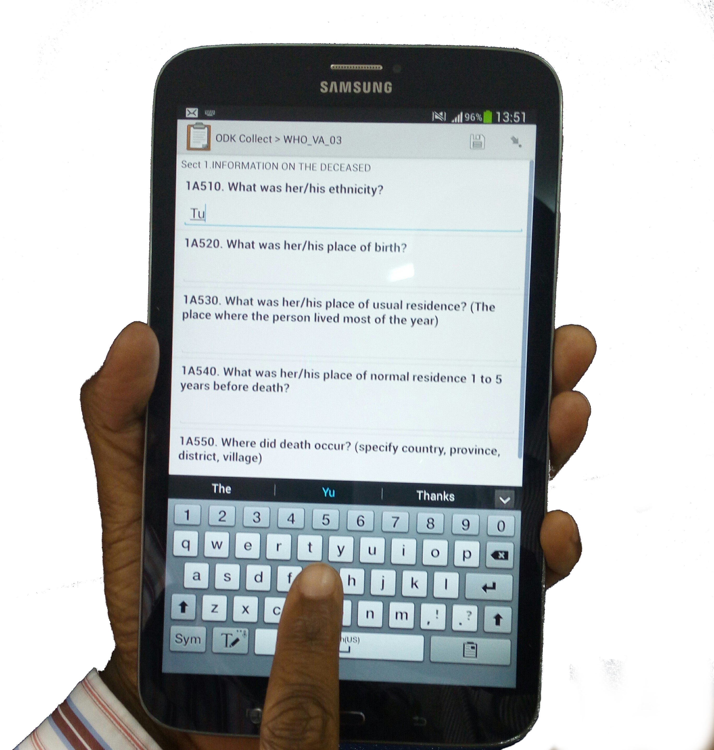
Introduction
Study Overview
Results
Dissemination Process
In Conclusion
End
Opportunities ahead?
Death occurs
Math models & Computational Approaches
InterVA (Statistical & Bayesian model)
SmartVA (Tariff Model)
InsilicoVA (Hierarchical Bayesian Model)
Notes:
A Tariff score measures the relative likelihood that a given symptom results in a specific cause of death.
InterVA (http://www.interva-4.net/)
SmartVA analytics (Tariff) (https://www.healthdata.org/verbal-autopsy/tools)
InsilicoVA (https://cran.r-project.org/web/packages/CrossVA/index.html)

Slide 23
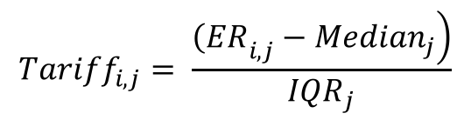
Introduction
Study Overview
Results
Dissemination Process
Opportunities ahead
End
So what has this taught us?
Death occurs
Math Models
$${Tariff}_{i,j}= \frac{\left.{\left(ER\right.}_{i,j}−{Median}_{j}\right)}{{IQR}_{j}}$$
Notes:
A Tariff score measures the relative likelihood that a given symptom results in a specific cause of death.

Slide 24
Introduction
Study Overview
Results
Dissemination Process
In Conclusion
End
Thank you
Thank the SAVVY team

