Slide 1
Drivers of infectious disease dynamics:
Childhood infections in Mexico
Ayesha Mahmud
(with Rachel Baker, C. Jessica Metcalf, and Bryan Grenfell)
April 18, 2017
mahmud@princeton.edu
Notes:
Hi everyone. Thank you to IDM for organizing this session. Today I will be talking about some work that we’ve been doing looking at the drivers of common childhood infectious diseases in mexico. This work is in collaboration with Rachel Baker, who is also a graduate student at princeton, and my advisors, Jess Metcalf and Bryan Grenfell.

Slide 2
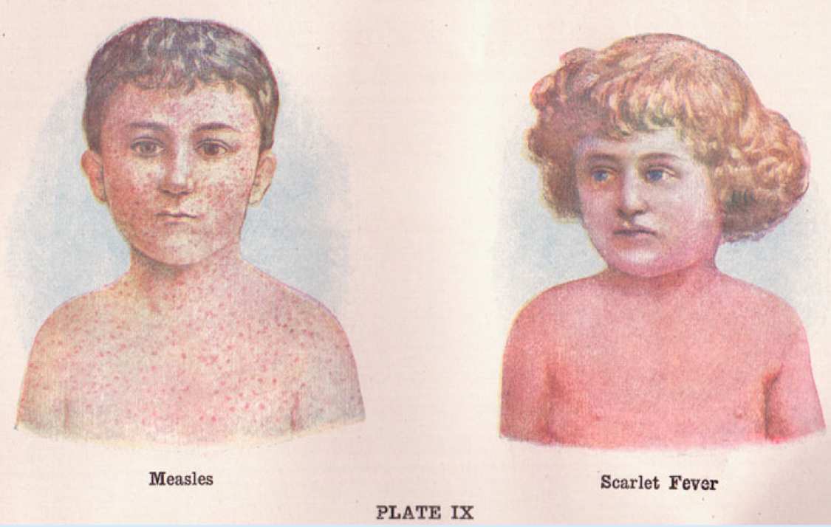
Introduction
In the absence of vaccination, directly-transmitted, acute, immunizing childhood infections often exhibit recurrent outbreak cycles, with a marked seasonal pattern in incidence.
Notes:
Directly-transmitted, acute, childhood infectious diseases, so these are diseases such as measles and rubella and scarlet fever, remain a major cause of mortality and morbidity around the world. Studies of historical incidence data, shows that these infections often exhibit a marked seasonal pattern in incidence and outbreaks occur regularly in annual or multi annual cycles. For example, this is varicella incidence in one state in Mexico from 1985 to about the end of 2015, and you can see the recurrent outbreak pattern.
Much of what we know about the dynamical behavior of childhood infections comes from studies of measles epidemics in major European and American cities prior to the introduction of vaccination.

Slide 3
Drivers of disease dynamics
Notes:
So what drives these observed dynamics?

Slide 4
Drivers of disease dynamics
Socioeconomic and demographic factors
Notes:
We know from past literature that there are many factors that affect infectious disease dynamics. We know that demography affects diseases dynamics. And for childhood infections such as measles, there is a rich body of literature showing that the aggregation of children in schools is a key factor driving the observed dynamics in countries with high schooling rates. Other factors include seasonal changes in human behavior, such as migration patterns, or various socioeconomic factors, such as the access to care and control measures.

Slide 5
Drivers of disease dynamics
Socioeconomic and demographic factors
Environmental factors
Notes:
There is a smaller literature that has examined the effect of environmental or climate variables on the transmission of directly-transmitted pathogens. The most direct evidence comes from lab studies done with guinea pigs that suggests that lower humidity and cooler conditions is more favorable for the dispersal of the influenza virus. And the link between humidity and incidence has also been shown for influenza in population based studies.
One proposed mechanism for this observed relationship is that lower humidity increases the stability of viruses within aerosols and allows them to be carried for longer and for greater distances. Another proposed mechanism is that lower humidity means more evaporation, which in turn means smaller droplet size, which again increases the distance and time over which transmission can occur.
Understanding the effect of environmental drivers on other directly transmitted infections is increasingly important given that climate conditions are predicted to change considerably in the future, and this may alter burden in ways that are potentially of public health importance.

Slide 6
Drivers of disease dynamics
Socioeconomic and demographic factors
Disentangling these various factors is challenging!
Environmental factors
Notes:
But as you can imagine, disentangling these various factors, is really hard because all of these things are probably going on at the same time albeit at different temporal scales.

Slide 7
Common childhood infections in Mexico, 1985-2007
Notes:
So while measles has been studied extensively, we know a lot less about the dynamics of other childhood infections, particularly outside the US and Europe. So we decided to use a unique historical dataset from Mexico to examine the degree to which six common childhood infections behave in accordance with canonical expectations from the classic SIR model, and also the degree to which the aggregation of children in schools could explain seasonal fluctuations in transmission for an array of childhood infections across the country.
We have monthly incidence data for six infections - measles, mumps, rubella, varicella, scarlet fever and pertussis, for each state in Mexico from 1985 to 2007. These plots show the time series of reported cases for all states combined. The red line indicates when a vaccine was introduced.

Slide 8
Seasonal transmission rates
Mahmud, Metcalf, and Grenfell. Epidemiology and Infection (2017)
Notes:
We use the discrete time version of the classic SIR model (the TSIR model) to estimate the transmission rate for each month of the year for each state. These plots show the inferred underlying transmission rates for each infection. We have mean centered the transmission rates to make them easier to compare. Each black line represents the transmission rate for a state. The red line indicates the seasonal transmission coefficient averaged over all states. Approximate school holidays are shown in grey. As you can see, there is a reduction in the transmission during the summer months for all infections except pertussis, where the estimates are really noisy. And for measles and pertussis, we only have a few years of data before the start of vaccination, which may be one reason why those estimates have greater variance. But overall, for five of the six infections, we see a decline in transmission that corresponds with the summer school holidays.

Slide 9
Spatial pattern in mean age of infection
R₀ = μ⁻¹ / A,
μ = per capita birth rate
A = mean age of infection
Notes:
We also see an interesting spatial pattern – the mean age is higher in the eastern and southern states, particularly in the Yucatan peninsula. The red dots here are just showing where Mexico city is as a reference. so the lighter color here indicates a higher mean age of infection. And the mean age of infection is important because it is inversely related to the basic reproductive number, R0.

Slide 10
Environmental drivers?
R₀ = μ⁻¹ / A,
μ = per capita birth rate
A = mean age of infection
Notes:
You see this pattern for varicella quite clearly, where there is a significant difference in the mean age by latitude and longitude. And this suggests that R0 is possibly lower in the southern and eastern states. And we know that the climate in those states is different from the northern states. And this led us to start thinking about potential environmental drivers.
So we decided to take a look a closer look at varicella dynamics in mexico. Just to give you a quick background - varicella, more commonly known as chickenpox, is a highly contagious childhood disease that is caused by the varicella-zoster virus. VZV is spread primarily through air droplets or aerosols.

Slide 11
Varicella: spatial and temporal variation
Notes:
so we decided to examine the effect of humidity and temperature on chickenpox in Mexico, primarily because we found some interesting spatiotemporal variation that hinted at a possible link. so in the top panel, the first plot shows the spatial variation in humidity across states. and the second plot (b) shows the variation in the basic reproductive number across states. And you can see that R_0 is higher in states that have a lower average humidity.

Slide 12
Varicella: spatial and temporal variation
Notes:
And the bottom panel shows the mean number of cases by month, and you can see the peak is in April. And on the right, you can see that this is when humidity is lowest. So these are just some hints in the data, but of course many other things could be going on that could explain this. So we have to be very careful about how we model transmission and the effect of humidity and temperature, to make sure we are not picking up a spurious correlation.

Slide 13
Reported cases over time
Notes:
This is what our incidence data looks like. Each row is a state in Mexico, and its arranged from lowest population at the top to highest pop at the bottom. And then at the very bottom, I’ve just plotted the last row again but as a line plot just to show you what the time series looks like. the red colors here indicate more cases. So as you would expect we see more cases in the more populated states. but you can also see how synchronized these epidemics are across the whole country. and you can see the annual cycles, and the outbreaks happening at the same time each year.

Slide 14
Humidity and temperature time series
Notes:
And here we can see the humidity time series in green and the temperature time series in blue for just one state. And in the background in grey you can see the incidence. So you can see that all of these things are going up and down seasonally.

Slide 15
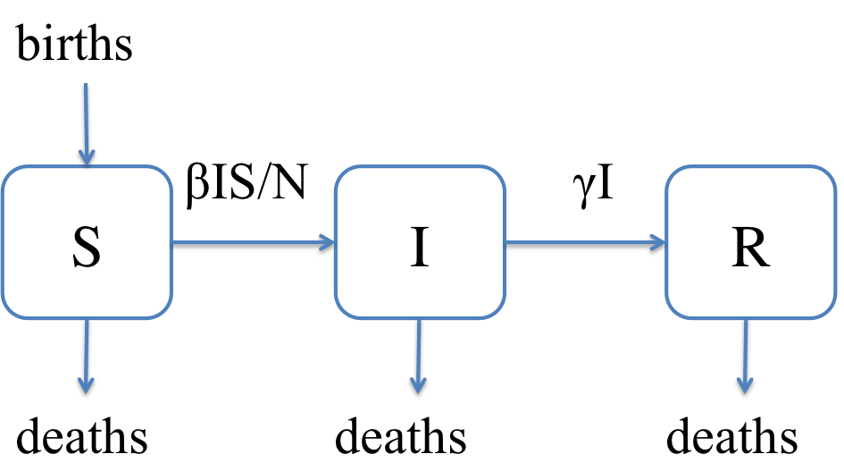
Modeling approach
Combine two methods:
Time series SIR (TSIR) model with environmental drivers
  Reconstruct the unobserved susceptible population
Notes:
Ok so now onto our modeling approach. we use a mechanistic model, the time-series SIR model, to reconstruct the susceptible population from data on reported cases and demographics, and we use this to get empirical estimates of the transmission rate.

Slide 16
Modeling approach
Combine two methods:
Time series SIR (TSIR) model with environmental drivers
  Reconstruct the unobserved susceptible population
Panel regression with “month x state” and “year x state” fixed effects
  Identify the effect of environmental drivers from variations at the monthly level within a state
Notes:
And we combine this with standard panel regression techniques which allows us to estimate the underlying relationship between environmental drivers and transmission across multiple time series. And this allows us to be careful about how we identify the effect of environmental drivers, to ensure that we’re not just picking up the correlations between seasonal trends in incidence and seasonal trends in environmental drivers.

Slide 17
Estimated effect of environmental drivers
Humidity has a significant negative effect on transmission
  10% increase in humidity leads to ~1% decrease in transmission
Temperature has no significant effect
Notes:
We find that humidity decreases transmission. And this is consistent with findings for influenza. We find that a 10% increase in humidity leads to a 1% decrease in transmission. This isn’t huge, but it still is meaningful since such large numbers of children contract chicken pox annually in Mexico and also worldwide.
And we find no significant effect of temperature on varicella transmission.

Slide 18
Model robustness
Extensive simulations to test our model
Able to recover the “known” effect of humidity on transmission
Actual incidence
Simulated incidence
Notes:
One of the advantages of using a mechanistic model, is that we can simulate incidence, assuming some relationship between humidity and transmission, and we can use this to test the robustness of our model. Just as an example, this is the simulated incidence for four states in mexico. The actual incidence is shown in red. The black line is the median of 500 simulations, and the shaded region is the 10 and 90th percentiles of the simulation runs. This is just to show you that our simulations are producing incidence that looks reasonable, although we do a lot worse for states with smaller population sizes like the two plots in the bottom row. But the bottom line here is that we can recover the underlying effect of humidity under various simulation scenarios where we make different assumptions about underlying demographics, time trends in the transmission, and reporting rates.

Slide 19
Model robustness
Extensive simulations to validate our model
Able to recover the “known” effect of humidity on transmission
Our method outperforms:
standard econometric methods that do not account for changes in the underlying susceptible population X
TSIR models fit to a single time series
Notes:
Each plot here is for a different simulation scenario. In all these simulations, we assume that humidity has an effect on transmission. The x axis here is the true or known effect of humidity on transmission that we use in our simulation. The y axis is the estimated effect. And the dashed line is the x=y line. So we want all the points to be on the x=y line. The blue dots is our proposed method. We find that our model outperforms models that do not take into account the nonlinear transmission dynamics, and also models that are fit to a single time series.

Slide 20
Climate predictions, 2070-2100
Notes:
We also wanted to explore the potential effect of climate change on incidence of varicella in Mexico. Because our modeling is semi-mechanistic, we can simulate varicella incidence under different climate forcing scenarios. We use climate projection data from 2070-2100, and our estimated effect of humidity on transmission. And these are just hypothetical projections, assuming that all else remains constant. In reality we know that the demographics will change, and healthcare will change, but this hypothetical exercise gives us a sense of how the magnitude and variability of varicella incidence could change.
In this plot, each state is a red line, and the black line is the average across the country. This plot shows how humidity is predicted to change in Mexico. This is monthly changes in humidity for the years 2070-2100 compared to 1985-2015. As you can see, on average, all states in Mexico are predicted to get a lot drier, so all states are below the no change or zero line.

Slide 21
Climate predictions, 2070-2100
mean predicted change in incidence for each state
Notes:
What does this mean for incidence? So the plots on the left are showing the mean change in monthly incidence between our current time period and 2070-2100. There are two plots because we tested two different functional forms to represent the relationship between humidity and transmission, but the results are essentially the same. Again, in these plots, each state is a colored line, and the black line is the average across the country. And these are changes calculated from the median of 500 stochastic simulation runs. So what we find is that incidence goes up in the summer months, and overall annually we see between 1000-2000 additional cases.

Slide 22
Predicted seasonal changes in varicella incidence
monthly percentage change in incidence for each state
Notes:
This plot is also showing the predicted monthly change in incidence, and this time, the states are arranged from left to right in order of how large the predicted change in humidity is expected to be. so for the states on the left, that are expected to experience the largest change in humidity, we see this increase in cases in the summer months and a decrease during other times of the year. For the states on the right, with lower predicted changes in humidity, the pattern is not quite as clear. Again, it is important to keep in mind that these are just hypothetical scenarios. however, it still gives us a sense of how varicella incidence may change as climate conditions in Mexico change.

Slide 23
Conclusion and implications for public health
Evidence of school-term time forcing for five of the six childhood infections
Lower humidity is associated with higher transmission for varicella (and possibly other pathogens)
Public health implications
  Effectiveness of control interventions
  Predictability of outbreaks
  Climate change could lead to a seasonal shift in varicella cases
Notes:
So overall we find that transmission is lower in the summer for five common childhood infections in Mexico, which corresponds well with the summer school holidays.
And we find an effect of humidity and not of temperature on transmission of varicella.
We also extensively test our proposed method which combines methods from epidemiology and the climate impacts field. We think our method may be particularly useful in the absence of an animal model for testing these causal relationships in the lab.

Slide 24
Conclusion and implications for public health
Evidence of school-term time forcing for five of the six childhood infections
Lower humidity is associated with higher transmission for varicella (and possibly other pathogens)
Public health implications
  Effectiveness of control interventions
  Predictability of outbreaks
  Climate change could lead to a seasonal shift in varicella cases
Notes:
Why is this important? We think that our findings have a few potential public health implications. So understanding the drivers behind the observed dynamics can help us design better control strategies. Our results suggest that for almost all these infections, aggregation of children in schools seem to be important. If there are schools where vaccination rates are low, even if population level coverage is high, there could be disastrous consequences if an outbreak occurs.
Understanding these drivers is also important for improving our ability to predict and prepare for outbreaks. In particular, environmental variables could give us hints about the timing of outbreaks within the year. And we also show that predicted changes in climate, holding all else equal, could shift the burden of varicella incidence towards the summer months.

Slide 25
Acknowledgements
Notes:
I want to acknowledge my co-authors, the great data sources that we used which are all publicly available, and also my funding sources. Thank you!

