Slide 1
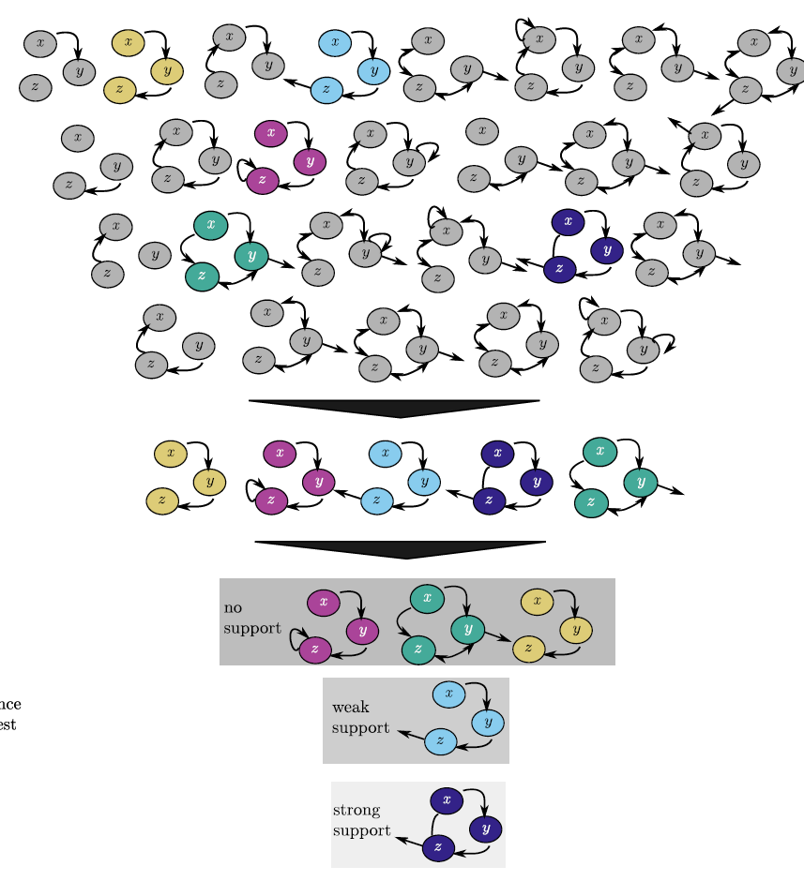


Sparse model selection for structurally challenging infectious disease systems
Niall M. Mangan
Eng. Sci. Applied Math,
Northwestern University
In collaboration with:
Travis Askham (NJIT)
Nathan Kutz (UW, Seattle)
Steve Brunton (UW, Seattle)
Josh Proctor (IDM, Bellevue WA)
IDM 7th Annual Symposium
April 15th 2019
​N. M. Mangan, T. Askham, S. L. Brunton, J. N. Kutz, J. L. Proctor, "Model Selection for hybrid dynamical systems via sparse regression," Proc. R. Soc. London A Math. Phys. Eng. Sci. Vol 475, No 2223 (2019).

Slide 2
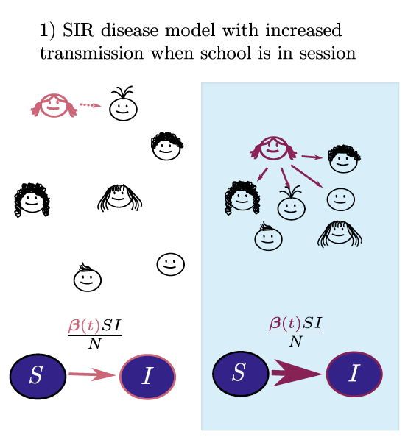
Disease Dynamics as a Hybrid System
School break
School session
​N. M. Mangan, T. Askham, S. L. Brunton, J. N. Kutz, J. L. Proctor, "Model Selection for hybrid dynamical systems via sparse regression," Proc. R. Soc. London A Math. Phys. Eng. Sci. Vol 475, No 2223 (2019).

Slide 3
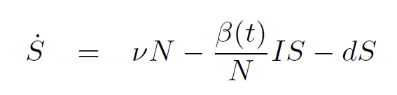
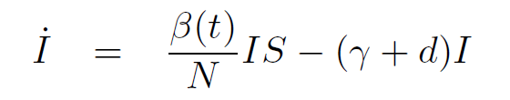

Disease Dynamics as a Hybrid System
School break
School session
​N. M. Mangan, T. Askham, S. L. Brunton, J. N. Kutz, J. L. Proctor, "Model Selection for hybrid dynamical systems via sparse regression," Proc. R. Soc. London A Math. Phys. Eng. Sci. Vol 475, No 2223 (2019).

Slide 4
Disease Dynamics as a Hybrid System
School break
School session
State changes or events:
Sharp parameter changes in time
Sharp structural (equation) changes in time
  Equivalent to setting parameters = 0
Triggered by internal dynamics or external forcing
​N. M. Mangan, T. Askham, S. L. Brunton, J. N. Kutz, J. L. Proctor, "Model Selection for hybrid dynamical systems via sparse regression," Proc. R. Soc. London A Math. Phys. Eng. Sci. Vol 475, No 2223 (2019).

Slide 5
Data-driven selection of hybrid systems
School break
School session
​N. M. Mangan, T. Askham, S. L. Brunton, J. N. Kutz, J. L. Proctor, "Model Selection for hybrid dynamical systems via sparse regression," Proc. R. Soc. London A Math. Phys. Eng. Sci. Vol 475, No 2223 (2019).

Slide 6
Data-driven selection of hybrid systems
School break
School session
​N. M. Mangan, T. Askham, S. L. Brunton, J. N. Kutz, J. L. Proctor, "Model Selection for hybrid dynamical systems via sparse regression," Proc. R. Soc. London A Math. Phys. Eng. Sci. Vol 475, No 2223 (2019).

Slide 7
Data-driven selection of hybrid systems
School break
School session
Detection of switching points
Identification of dynamics within regimes
​N. M. Mangan, T. Askham, S. L. Brunton, J. N. Kutz, J. L. Proctor, "Model Selection for hybrid dynamical systems via sparse regression," Proc. R. Soc. London A Math. Phys. Eng. Sci. Vol 475, No 2223 (2019).

Slide 8
Combine Sparse Identification of Nonlinear Dynamics for model selection and AIC for ranking
Combinatorial models represented in library
SINDy: Sparse regression selects models that best fit time series data
Rank models using information criteria
Mangan, N. M., Kutz, J. N., Brunton, S. L. & Proctor, J. L. Model selection for dynamical systems via sparse regression and information criteria. Proc. R. Soc. London A Math. Phys. Eng. Sci. 473, (2017).
Notes:
Still a few challenges

Slide 9
Problem: data comes from multiple models
​N. M. Mangan, T. Askham, S. L. Brunton, J. N. Kutz, J. L. Proctor, "Model Selection for hybrid dynamical systems via sparse regression," Proc. R. Soc. London A Math. Phys. Eng. Sci. Vol 475, No 2223 (2019).

Slide 10
Time vs Data-driven coordinate frame:
​N. M. Mangan, T. Askham, S. L. Brunton, J. N. Kutz, J. L. Proctor, "Model Selection for hybrid dynamical systems via sparse regression," Proc. R. Soc. London A Math. Phys. Eng. Sci. Vol 475, No 2223 (2019).

Slide 11
Time vs Data-driven coordinate frame:
Data from same model far apart
Data from same model close together
​N. M. Mangan, T. Askham, S. L. Brunton, J. N. Kutz, J. L. Proctor, "Model Selection for hybrid dynamical systems via sparse regression," Proc. R. Soc. London A Math. Phys. Eng. Sci. Vol 475, No 2223 (2019).

Slide 12
Time vs Data-driven coordinate frame:
Data from same model far apart
Data from same model close together
Cluster in data-driven coordinates -> sparsely select models
​N. M. Mangan, T. Askham, S. L. Brunton, J. N. Kutz, J. L. Proctor, "Model Selection for hybrid dynamical systems via sparse regression," Proc. R. Soc. London A Math. Phys. Eng. Sci. Vol 475, No 2223 (2019).

Slide 13
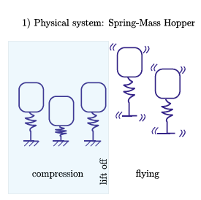
Hybrid Systems – Model Selection
1) Find cluster
​N. M. Mangan, T. Askham, S. L. Brunton, J. N. Kutz, J. L. Proctor, "Model Selection for hybrid dynamical systems via sparse regression," Proc. R. Soc. London A Math. Phys. Eng. Sci. Vol 475, No 2223 (2019).

Slide 14
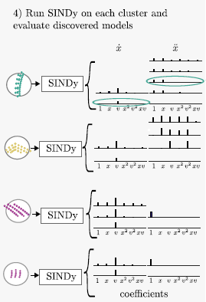
Hybrid Systems – Model Selection
1) Find cluster
2) Use SINDy to select models
​N. M. Mangan, T. Askham, S. L. Brunton, J. N. Kutz, J. L. Proctor, "Model Selection for hybrid dynamical systems via sparse regression," Proc. R. Soc. London A Math. Phys. Eng. Sci. Vol 475, No 2223 (2019).

Slide 15
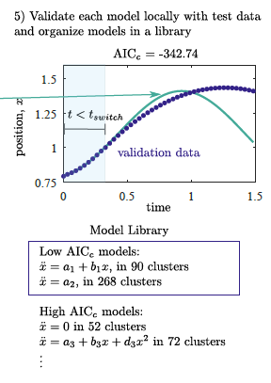
Hybrid Systems – Model Selection
1) Find cluster
2) Use SINDy to select models
3) Validate Models (new data)
​N. M. Mangan, T. Askham, S. L. Brunton, J. N. Kutz, J. L. Proctor, "Model Selection for hybrid dynamical systems via sparse regression," Proc. R. Soc. London A Math. Phys. Eng. Sci. Vol 475, No 2223 (2019).

Slide 16
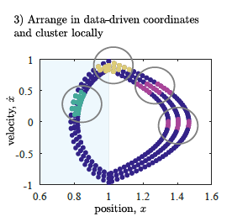
Hybrid Systems – Model Selection
1) Find clusters
2) Use SINDy to select models
3) Validate Models
4) Build Library across clusters
​N. M. Mangan, T. Askham, S. L. Brunton, J. N. Kutz, J. L. Proctor, "Model Selection for hybrid dynamical systems via sparse regression," Proc. R. Soc. London A Math. Phys. Eng. Sci. Vol 475, No 2223 (2019).

Slide 17
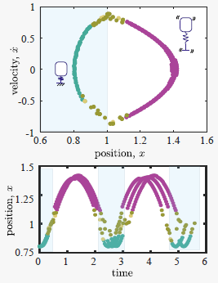
Hybrid Systems – Model Selection
1) Find clusters
2) Use SINDy to select models
3) Validate Models
5) Analyze location of high
frequency models
4) Build Library across clusters
​N. M. Mangan, T. Askham, S. L. Brunton, J. N. Kutz, J. L. Proctor, "Model Selection for hybrid dynamical systems via sparse regression," Proc. R. Soc. London A Math. Phys. Eng. Sci. Vol 475, No 2223 (2019).

Slide 18
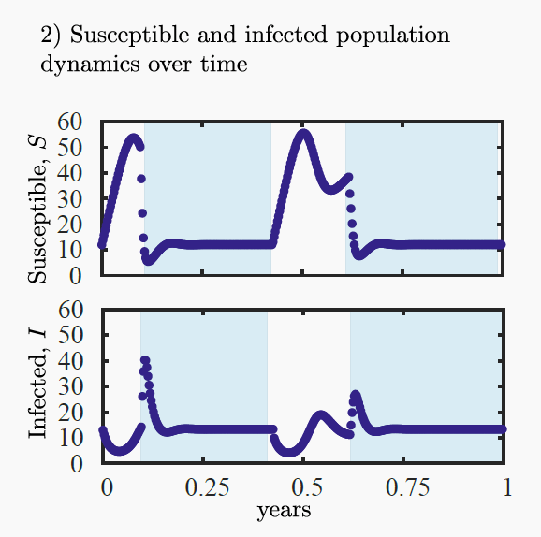
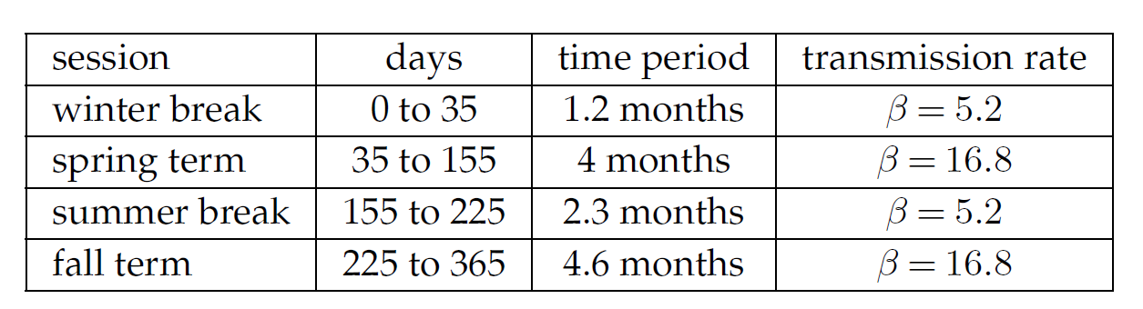




Hybrid Systems – Disease Transmission
​N. M. Mangan, T. Askham, S. L. Brunton, J. N. Kutz, J. L. Proctor, "Model Selection for hybrid dynamical systems via sparse regression," Proc. R. Soc. London A Math. Phys. Eng. Sci. Vol 475, No 2223 (2019).

Slide 19
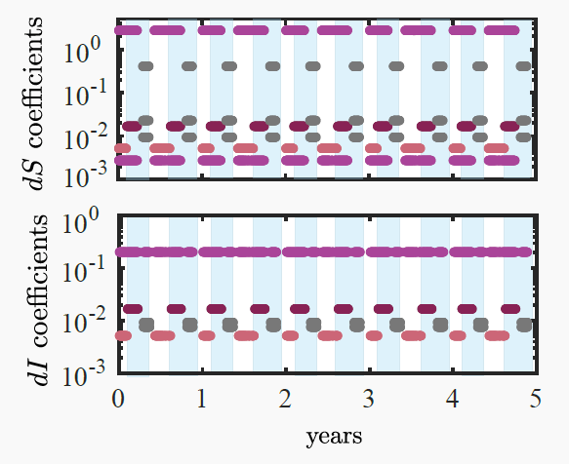
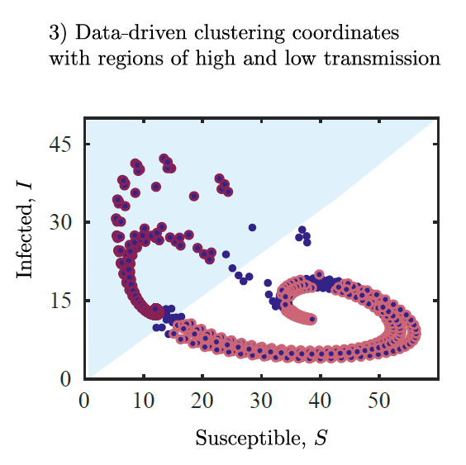
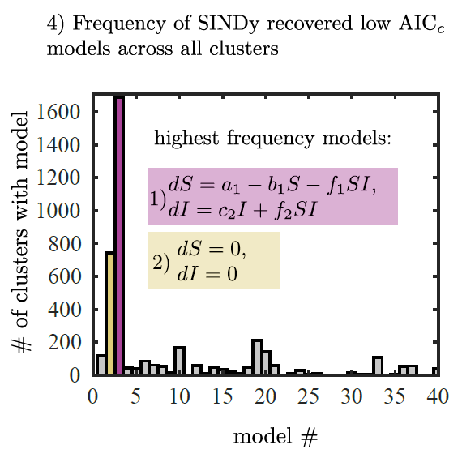
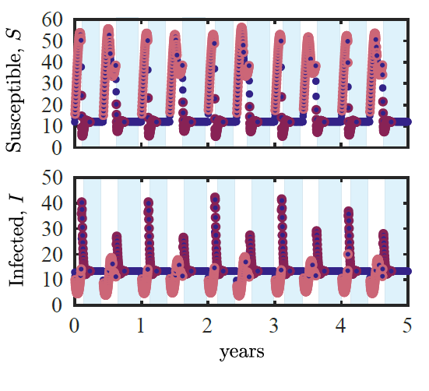
Hybrid Systems – Disease Transmission
​N. M. Mangan, T. Askham, S. L. Brunton, J. N. Kutz, J. L. Proctor, "Model Selection for hybrid dynamical systems via sparse regression," Proc. R. Soc. London A Math. Phys. Eng. Sci. Vol 475, No 2223 (2019).

Slide 20
Dynamical systems identification:
Challenges Moving forward:
  Selecting data-driven coordinates
  Can we differentiate between
    insufficient data ?
    incomplete function library?
    Hidden variables
  Noise robustness/Stochasticity

Slide 21

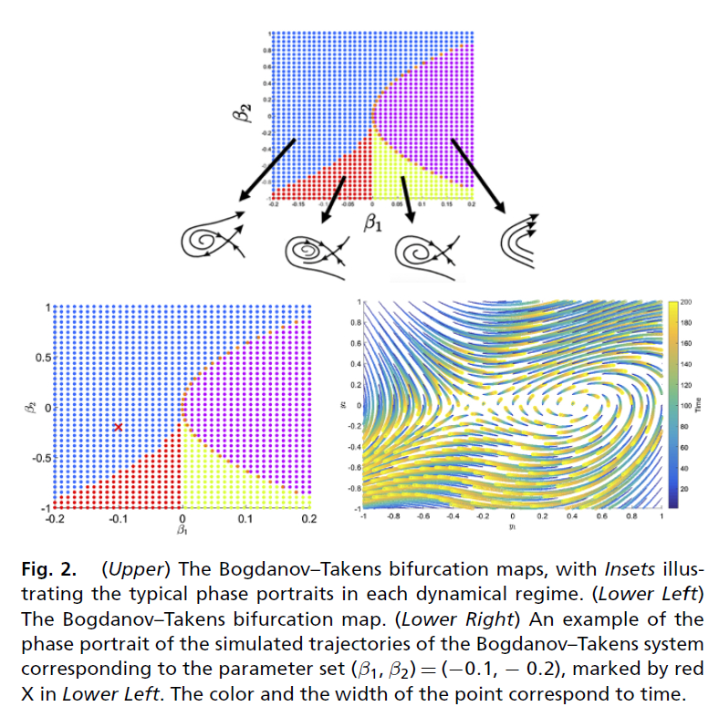
Equation free methods for data characterization
Construct data-driven coordinates using clustering
In a label-free way!

Slide 22

Thank you.. and thanks to
Travis Askham
NJIT
Steve Brunton
University of Washington
Nathan Kutz
University of Washington
Josh Proctor
Institute for Disease Modeling
The Institute for Disease Modeling and funding from the Bill and Malinda Gates foundation through
Air Force Office of Scientific Research
Defense Advanced Research Projects Agency
Read more here: niallmangan.com
​N. M. Mangan, T. Askham, S. L. Brunton, J. N. Kutz, J. L. Proctor, "Model Selection for hybrid dynamical systems via sparse regression," Proc. R. Soc. London A Math. Phys. Eng. Sci. Vol 475, No 2223 (2019).

Slide 23
Data-driven selection of hybrid systems
School break
School session
May not be enough information content in single time series!
​N. M. Mangan, T. Askham, S. L. Brunton, J. N. Kutz, J. L. Proctor, "Model Selection for hybrid dynamical systems via sparse regression," Proc. R. Soc. London A Math. Phys. Eng. Sci. Vol 475, No 2223 (2019).

Slide 24
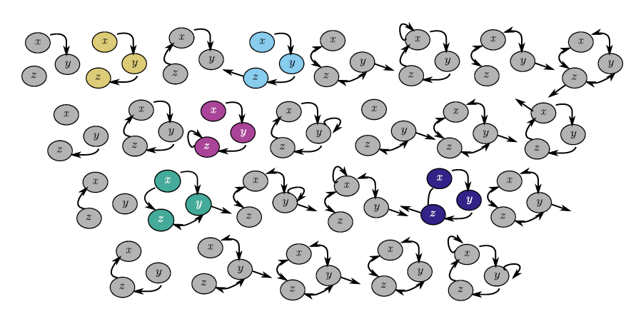
Problem: testing models is expensive
Would be nice to have all possible models for:
connectivity of network
dynamical interactions on network

Slide 25
Problem: testing models is expensive
Would be nice to have all possible models for:
connectivity of network
dynamical interactions on network
If we tried enumerating all possible compartmental population models:
If we wrote out every possible model for
5 populations
2nd order polynomials
….that would be ~10¹³ models…

Slide 26


Hybrid Systems – Hopping System
​N. M. Mangan, T. Askham, S. L. Brunton, J. N. Kutz, J. L. Proctor, "Model Selection for hybrid dynamical systems via sparse regression," Proc. R. Soc. London A Math. Phys. Eng. Sci. Vol 475, No 2223 (2019).

Slide 27
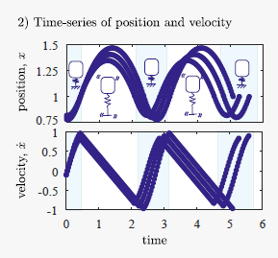
Hybrid Systems – Hopping System
​N. M. Mangan, T. Askham, S. L. Brunton, J. N. Kutz, J. L. Proctor, "Model Selection for hybrid dynamical systems via sparse regression," Proc. R. Soc. London A Math. Phys. Eng. Sci. Vol 475, No 2223 (2019).

Slide 28
Hybrid Systems – Hopping System
​N. M. Mangan, T. Askham, S. L. Brunton, J. N. Kutz, J. L. Proctor, "Model Selection for hybrid dynamical systems via sparse regression," Proc. R. Soc. London A Math. Phys. Eng. Sci. Vol 475, No 2223 (2019).

Slide 29
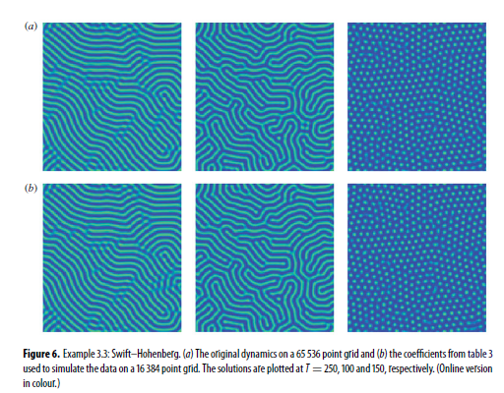
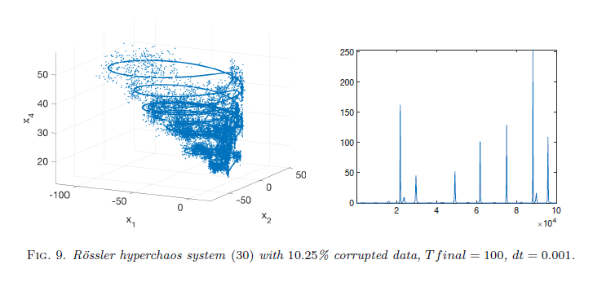
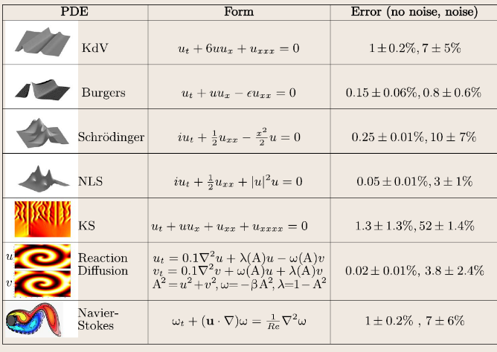
Recent advances in dynamical systems ID:
TRAN, G., & WARD, R. (2017). Multiscale Modeling & Simulation, 15(3), 1108–1129.
Schaeffer, H. Learning partial differential equations via data discovery and sparse optimization. Proc. Royal Soc. A. (2017).
Weak-formulation to improve robustness to noise:
Schaeffer, Hayden, and Scott G. McCalla. "Sparse model selection via integral terms." Physical Review E 96.2 (2017): 023302.
Pantazis, Yannis, and Ioannis Tsamardinos. "A Unified Approach for Sparse Dynamical System Inference from Temporal Measurements." arXiv preprint arXiv:1710.00718(2017).
Rudy, S. H., Brunton, S. L., Proctor, J. L., & Kutz, J. N. Data-driven discovery of partial differential equations. Science Advances. (2016)

Slide 30
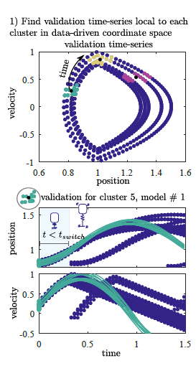
Hybrid Systems – validation step

Slide 31
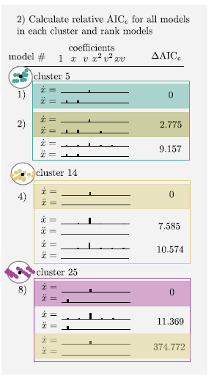
Hybrid Systems – validation step

Slide 32
Hybrid Systems – validation step

Slide 33
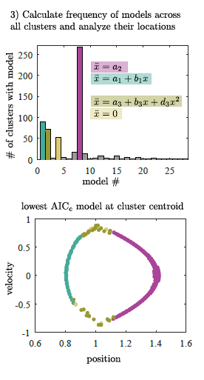
Hybrid Systems – validation step

Slide 34
Hybrid Systems – validation step

Slide 35
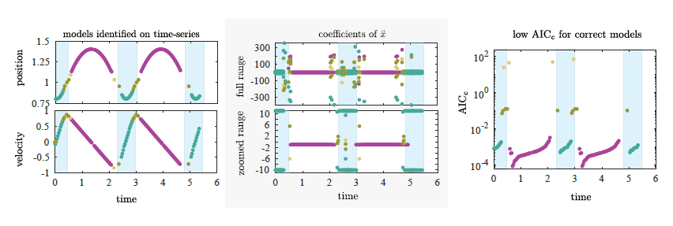
Hybrid Systems – Hopping System

Slide 36
Hybrid Systems – Disease Transmission

Slide 37
Hybrid Systems – Disease Transmission

Slide 38
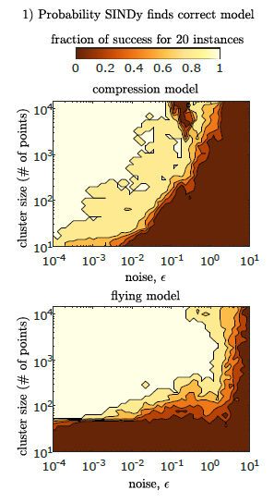
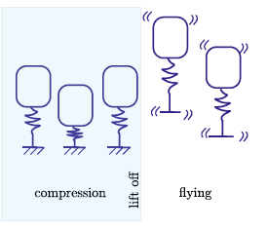
Hopper-system: noise and cluster size

Slide 39
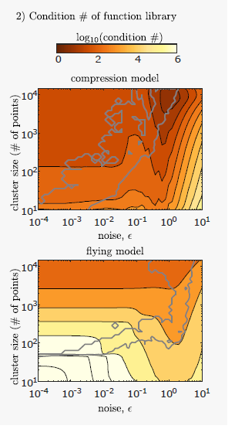
Hopper-system: noise and cluster size

Slide 40
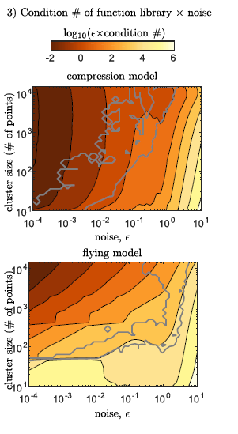
Hopper-system: noise and cluster size

Slide 41
Statistical methods for data-driven model selection
$y_{1=}\frac{dx_{1}}{dt}=ξ_{0}+ξ_{1}x_{1}+ξ_{2}x_{2}+ξ_{3}x_{3}+ξ_{4}x_{1}x_{2}+ξ_{5}x_{1}x_{3}+ξ_{5}x_{2}x_{3}+ξ_{6}x_{1}^{2}$+ $ξ_{7}x_{2}^{2}+ …$
If we can’t examine all terms at once, how can we explore model space?
Stepwise regression – start with 1st order, add 2nd order, 3rd order
Forward selection – ‘add one in’
Backward elimination – ‘take one out’
Bi-directional – test forward and backward at each step
Use statistical test such as F-test, t-test, R², AIC, or Bayesian IC

Slide 42
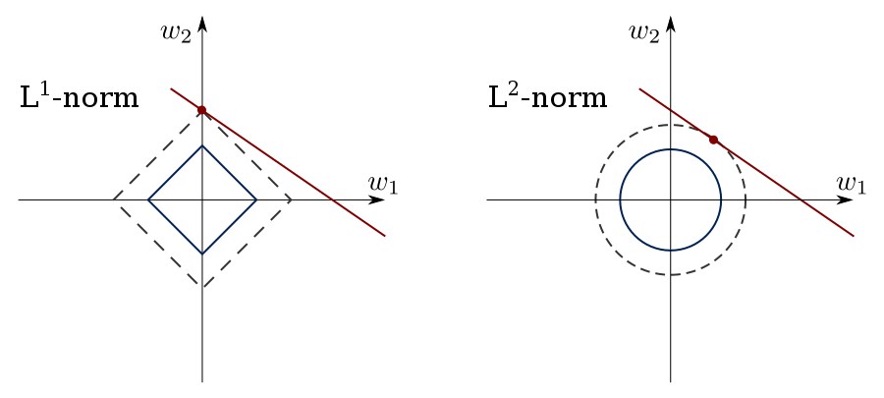
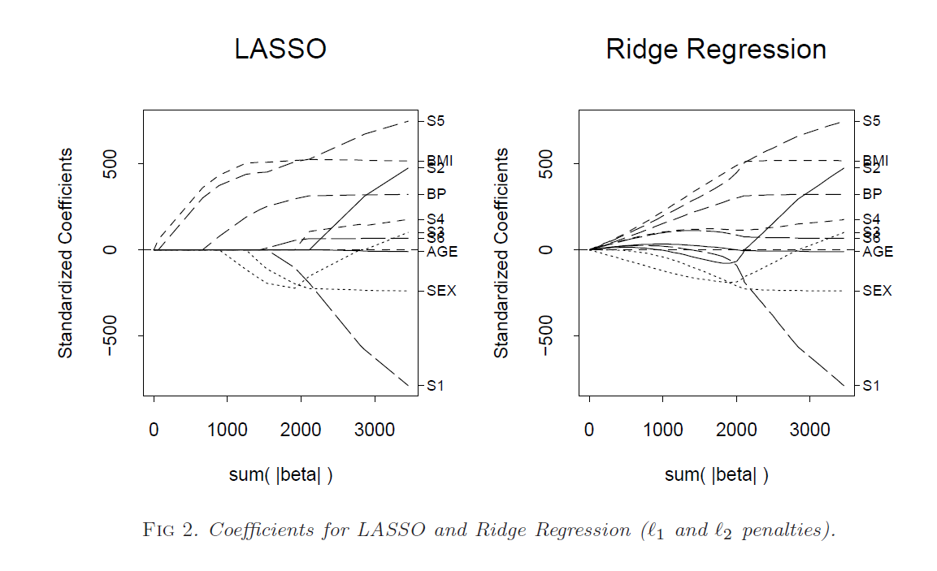

Sparse selection of variables, terms, features
Sparse regression methods:
LASSO
Ridge
Elastic Net
$$\hat{ξ}=\min_{ξ}{({\left\|y−Xξ\right\|}^{2}+λ_{1}{\left\|ξ\right\|}^{2}+λ_{2}{\left\|ξ\right\|}_{1} })$$
Has been applied to many, many systems for variable selection!
T. Hesterberg, N. H. Choi, L. Meier, and C. Fraley, “Least angle and ℓ 1 penalized regression: A review *,” Stat. Surv., vol. 2, pp. 61–93, 2008.

Slide 43

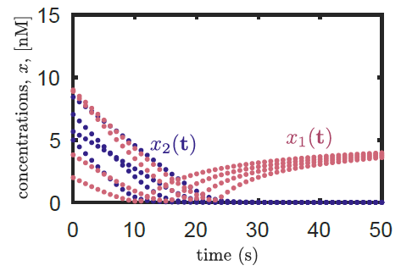
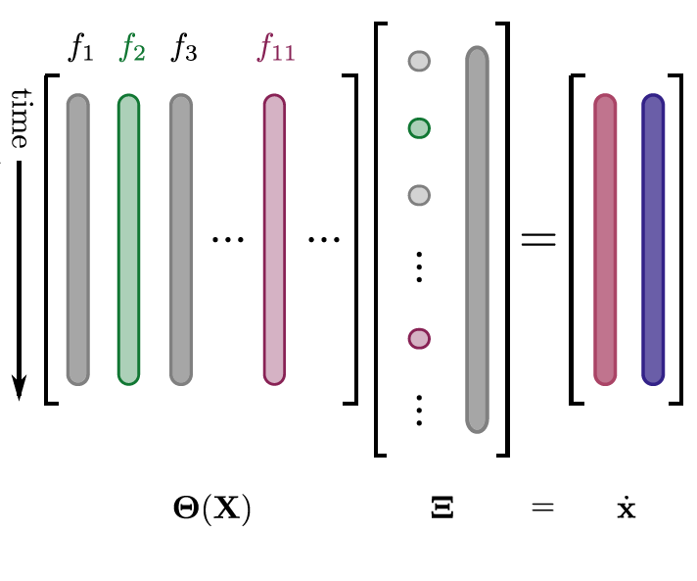


Sparse Identification of Nonlinear Dynamics (SINDy)
1) Generate data from system
2) Build a nonlinear library of candidate
functions and formulate regression to
select terms
$$1 { x}_{1} x_{2}$$
$${{ x}_{1}x}_{2}$$
S. L. Brunton, J. L. Proctor, and J. N. Kutz, Proc. Natl. Acad. Sci., 2016.

Slide 44
Sparse Identification of Nonlinear Dynamics (SINDy)
1) Generate data from system
2) Build a nonlinear library of candidate
functions and formulate regression to
select terms
3) Determine sparse coefficients
and evaluate identified model
$$1 { x}_{1} x_{2}$$
$${{ x}_{1}x}_{2}$$
S. L. Brunton, J. L. Proctor, and J. N. Kutz, Proc. Natl. Acad. Sci., 2016.

Slide 45
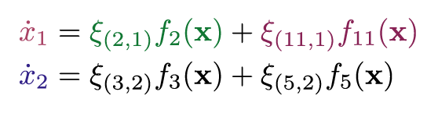
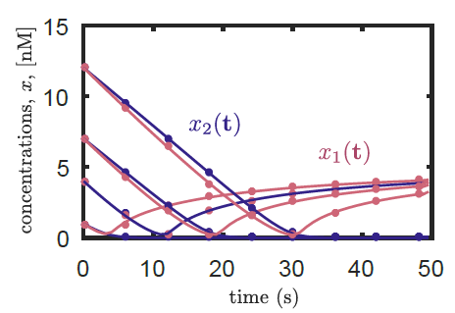



Sparse Identification of Nonlinear Dynamics (SINDy)
1) Generate data from system
2) Build a nonlinear library of candidate
functions and formulate regression to
select terms
3) Determine sparse coefficients
and evaluate identified model
$${ x}_{1}$$
$$x_{1}^{2}x_{2}$$
$$1 { x}_{1} x_{2}$$
$$x_{1}^{2}x_{2}$$
S. L. Brunton, J. L. Proctor, and J. N. Kutz, Proc. Natl. Acad. Sci., 2016.

Slide 46
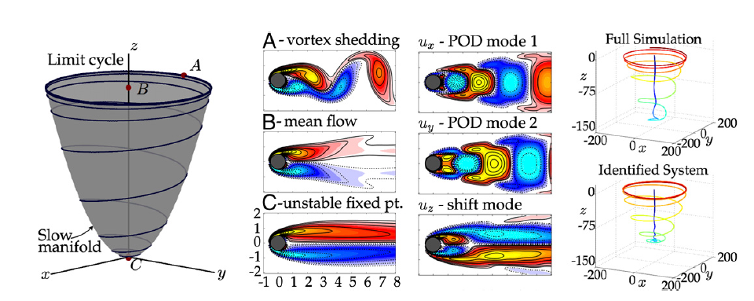
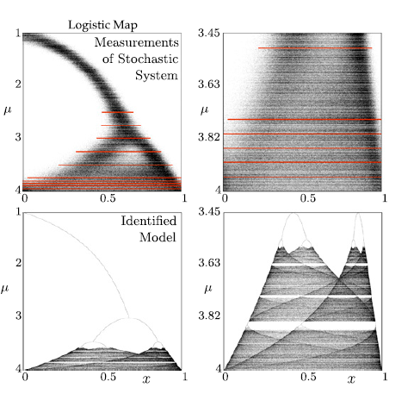
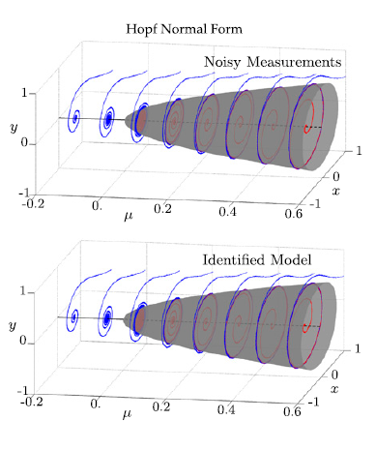
Sparse Identification of Nonlinear Dynamics (SINDy)
Flow around a cylinder:
Hopf Normal form:
Logistic Map form:
S. L. Brunton, J. L. Proctor, and J. N. Kutz, Proc. Natl. Acad. Sci., 2016.

Slide 47
Finding parsimonious models: information criteria

Slide 48
Finding parsimonious models: information criteria

Slide 49
Combine SINDy for model selection and AIC for ranking
Combinatorial models represented in library
SINDy: Sparse regression selects models that best fit time series data
Rank models using information criteria
Mangan, N. M., Kutz, J. N., Brunton, S. L. & Proctor, J. L. Model selection for dynamical systems via sparse regression and information criteria. Proc. R. Soc. London A Math. Phys. Eng. Sci. 473, (2017).

Slide 50
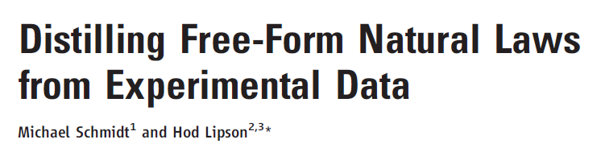
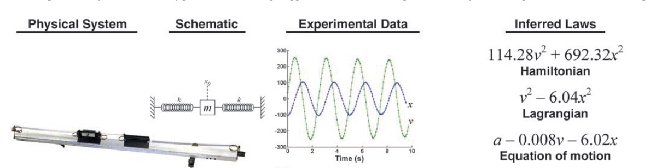
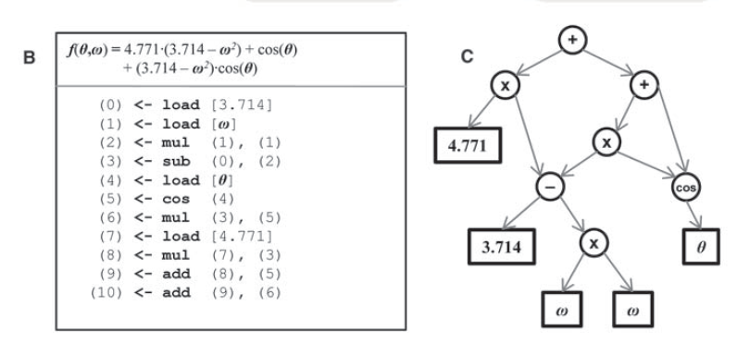
Expanding the number of variables, terms, features
Genetic
programming
What if we have a constrained set of functions?

Slide 51
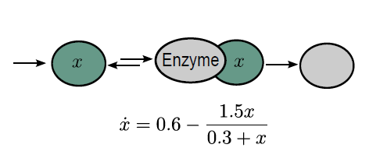

Rational functions in biological networks:
With time-scale separation there are rational functions

Slide 52
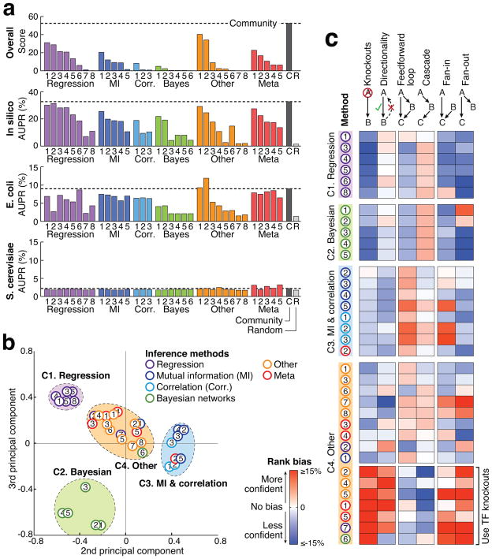
Rational functions in biological networks:
Dream Challenge: Infer biological networks with
1000s of components
Different methods:
Linear/nonlinear
Binary/functional
Work to varying degrees
w/ perturbations is always better
Dream Challenge: D. Marbach, et. al. “Wisdom of crowds for robust gene network inference,” Nat Methods, vol. 9, no. 8, pp. 796–804, 2012.
Notes:
Noah Simon

Slide 53
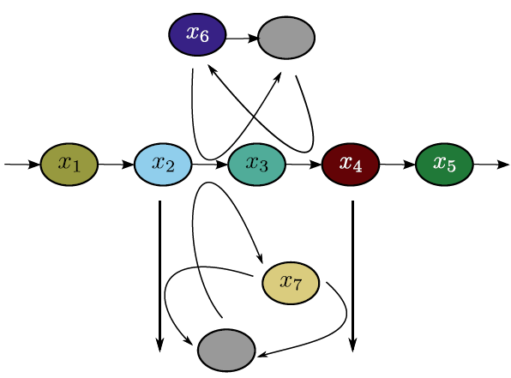
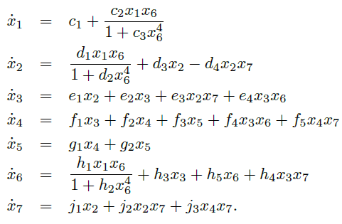
Rational functions are not compact:
With time-scale separation there are rational functions
No compact way to write out rational functions as linearly additive.
Including combinatorial cross terms.. back to >10³⁸ functions in library

Slide 54
Rational functions -> implicit formulation:
With time-scale separation there are rational functions
need a compact way to formulate the library.
Write as implicit equation:
N. M. Mangan, S. L. Brunton, J. L. Proctor, and J. N. Kutz, “Inferring biological networks by sparse identification of nonlinear dynamics,” IEEE Transactions on Mol. And Biol. and Multi-Scale Comm. Vol 2, No 1, (2017).

Slide 55

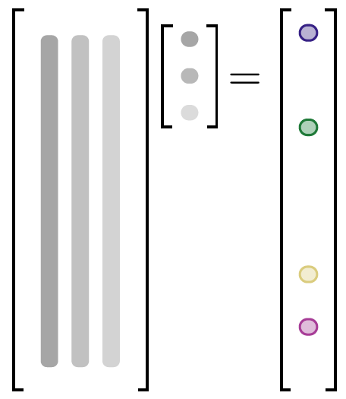
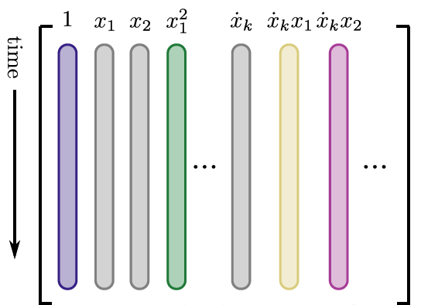
Implicit formulation:
Build function library from data
, such that
2) Calculate
Find such that is sparse:
alternating directions method
Assemble
inferred model
N. M. Mangan, S. L. Brunton, J. L. Proctor, and J. N. Kutz, “Inferring biological networks by sparse identification of nonlinear dynamics,” IEEE Transactions on Mol. And Biol. and Multi-Scale Comm. Vol 2, No 1, (2017).
Notes:
Not just useful for rational functions… implicit formulation could be used to expand to include higher order derivatives and mixed terms.

Slide 56
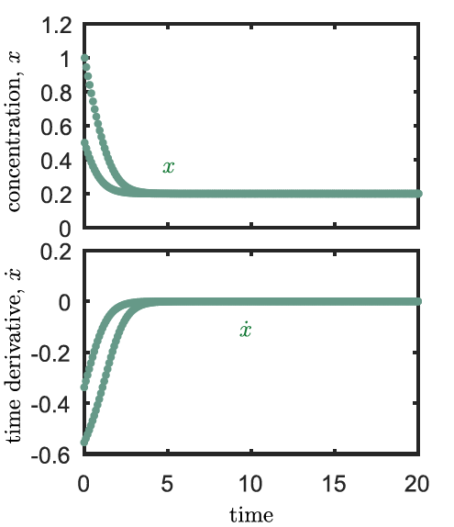
simple, single state variable example
1) Generate test data from system
Michaelis-Menten kinetics
N. M. Mangan, S. L. Brunton, J. L. Proctor, and J. N. Kutz, “Inferring biological networks by sparse identification of nonlinear dynamics,” IEEE Transactions on Mol. And Biol. and Multi-Scale Comm. Vol 2, No 1, (2017).

Slide 57
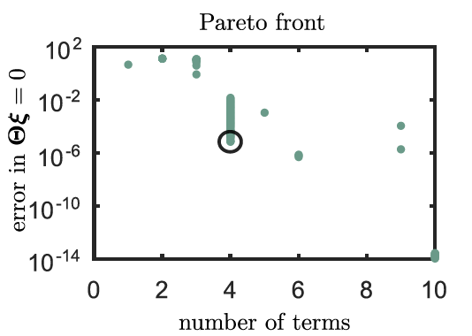
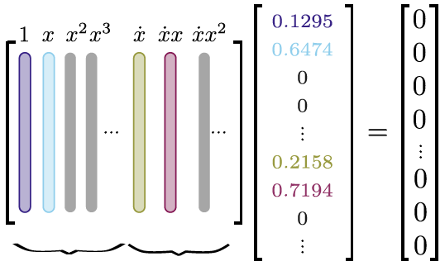
simple, single state variable example
1) Generate test data from system
2) Build functional library. Sparsely select terms:
Michaelis-Menten kinetics
N. M. Mangan, S. L. Brunton, J. L. Proctor, and J. N. Kutz, “Inferring biological networks by sparse identification of nonlinear dynamics,” IEEE Transactions on Mol. And Biol. and Multi-Scale Comm. Vol 2, No 1, (2017).

Slide 58


simple, single state variable example
1) Generate test data from system
2) Build functional library. Sparsely select terms:
Michaelis-Menten kinetics
3) Evaluate reconstructed model
N. M. Mangan, S. L. Brunton, J. L. Proctor, and J. N. Kutz, “Inferring biological networks by sparse identification of nonlinear dynamics,” IEEE Transactions on Mol. And Biol. and Multi-Scale Comm. Vol 2, No 1, (2017).

Slide 59


7 state variable system: recovered equations
3) Evaluate reconstructed model
Correctly recovers
network structure
functional form
coefficients within 2%
N. M. Mangan, S. L. Brunton, J. L. Proctor, and J. N. Kutz, “Inferring biological networks by sparse identification of nonlinear dynamics,” IEEE Transactions on Mol. And Biol. and Multi-Scale Comm. Vol 2, No 1, (2017).

Slide 60
Core take-aways from this framework:
Equation discovery is easier in a linear framework
Sparse regression is faster than other techniques (Bayesian, combinatorial, greedy searches, genetic algorithms)
It works for ODEs (and PDEs) sometimes
Data-driven coordinates may be a good framework for data-clustering
Core problems:
Robustness to noise, especially for calculating derivatives (PDEs)
No framework for evaluating how variables are correlated, what the likelihood of different combinations might be
No evaluation of the type of data we need
Need more understanding of the relationship between equation structure, data sampling, and regression method
How do we select data-driven coordinates and state variables?

Slide 61



2 state variable regulatory network:
1) Generate test data from system
G. M. Süel, et al. Nature, vol. 440, no. 7083, pp. 545–550, 2006.

Slide 62


2 state variable regulatory network:
1) Generate test data from system
2) Build functional library. Sparsely select terms:
N. M. Mangan, S. L. Brunton, J. L. Proctor, and J. N. Kutz, “Inferring biological networks by sparse identification of nonlinear dynamics,” IEEE Transactions on Mol. And Biol. and Multi-Scale Comm. Vol 2, No 1, (2017).

Slide 63


2 state variable regulatory network:
1) Generate test data from system
2) Build functional library. Sparsely select terms:
3) Evaluate reconstructed model
N. M. Mangan, S. L. Brunton, J. L. Proctor, and J. N. Kutz, “Inferring biological networks by sparse identification of nonlinear dynamics,” IEEE Transactions on Mol. And Biol. and Multi-Scale Comm. Vol 2, No 1, (2017).

Slide 64



7 state variable yeast metabolism model:
1) Generate test data from system
2) Build functional library. Sparsely select terms:
N. M. Mangan, S. L. Brunton, J. L. Proctor, and J. N. Kutz, “Inferring biological networks by sparse identification of nonlinear dynamics,” IEEE Transactions on Mol. And Biol. and Multi-Scale Comm. Vol 2, No 1, (2017).

