Slide 1
OPTIONS
Optimizing Prevention Technology Introduction On Schedule
Modeling Oral HIV Pre-exposure Prophylaxis in Zimbabwe
Zindoga Mukandavire¹, Graham F. Medley¹, Fern Terris-Prestholt¹, Daniel J. Klein², Anna Bershteyn², Katharine Kripke³, Joseph Murungu⁴, Definate Nhamo⁴, Taurai Bhatasara⁵, Lawrance Nyazema⁵, Getrude Ncube⁵, Kudakwashe Takarinda⁵, OPTIONS Consortium
¹Social and Mathematical Epidemiology Group, London School of Hygiene & Tropical Medicine
²Institute for Disease Modeling
³Avenir Health
⁴Pangaea Zimbabwe
⁵Ministry of Health and Child Care Zimbabwe
April 2018

Slide 2

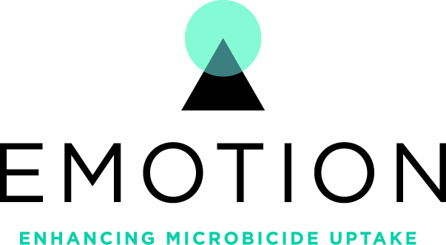



Microbicide Product Introduction Initiative (MPii)
Systems Thinking,
Technical Assistance
National/Sub-national
Cost Effective,
Scalable Delivery
Facility Level
Intimate
Partner Violence
Human
Centered Design
Resistance
Monitoring
End User Level
Notes:
The Microbicide Product Introduction Initiative (MPii) includes five cooperative agreements within the Annual Program Statement for Microbicide Research, Development, and Introduction. These five-year awards continue and expand USAID's support, in partnership with PEPFAR, for microbicide introduction and access with advances in biomedical technologies and new approaches for HIV prevention.

Slide 3










The OPTIONS Consortium objective is to develop a streamlined, adaptable product delivery platform for current and future microbicide and ARV-based HIV prevention options, with a particular focus on women.
Leadership
KENYA
Modeling
Communication
ZIMBABWE
Strategy
SOUTH AFRICA

Slide 4
Pre-Exposure Prophylaxis

Slide 5
PrEP
(Temporary) vaccination (with adherence)
  Expensive
  Recruitment vs. adherence
Two immediate health benefits
  Direct protection: prevent transmission
  Indirect protection: prevent/break transmission chains
Additional benefits related to health care pathways

Slide 6
Direct protection: cost-effectiveness
Depends on the cost of delivery vs. number of infections prevented
  Person-Years of PrEP needed to prevent one infection
  Infections prevented < Transmissions blocked
    PrEP depends on adherence, therefore temporary
Determined by accuracy of targeting to high risk
  Known risk: Discordant couples
  Imputed risk: FSW & “high risk AGYW”

Slide 7
Indirect protection
In a sense, compensates for inaccurate allocation
Includes the benefit of the added time free of HIV that PrEP buys
  PrEP delays infection
Much more difficult to measure/predict
  Needs full transmission dynamic model

Slide 8
Questions
Can oral PrEP be used by some proportion of young women in specific epidemic settings that result in epidemic impact for a reasonable cost?
  Population perspective
If so:
  What is the epidemic setting?
    Background HIV incidence
    Sexual network structure
  How does scale-up of ART, VMMC, and other HIV prevention interventions affect the impact and cost-effectiveness of oral PrEP in different settings?

Slide 9
Choice of EMOD-HIV
Comprehensive framework
  Saves coding etc.
Extensive calibration tools
Access to Dan, Anna and a team of software developers (Benoit, Dan B.)
Hopefully a useful collaboration…

Slide 10
Introducing EMOD-HIV

Slide 11
EMOD-HIV model overview
Created by the Institute for Disease Modeling (IDM)
Individual-based network model
Dynamic network of relationships
Heterosexual transmission from coital acts
Highly configurable interventions
  Treatment and prevention cascades, targeting
Calibrated using curve fitting algorithm
Publicly available at idmod.org, GitHub

Slide 12
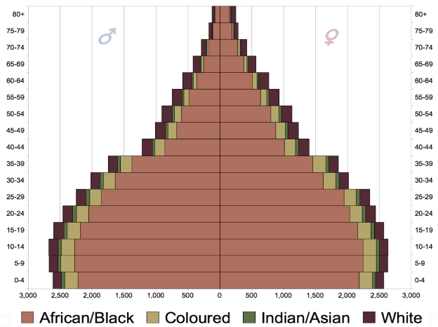
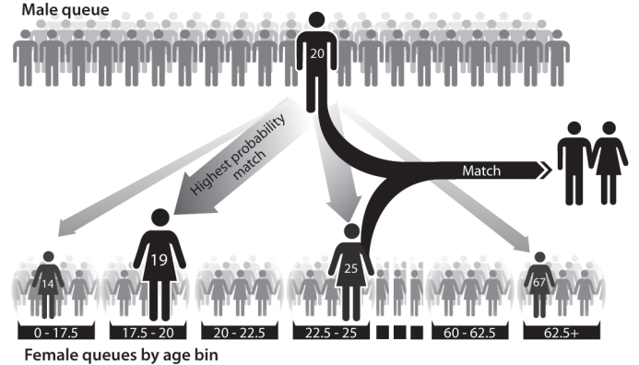
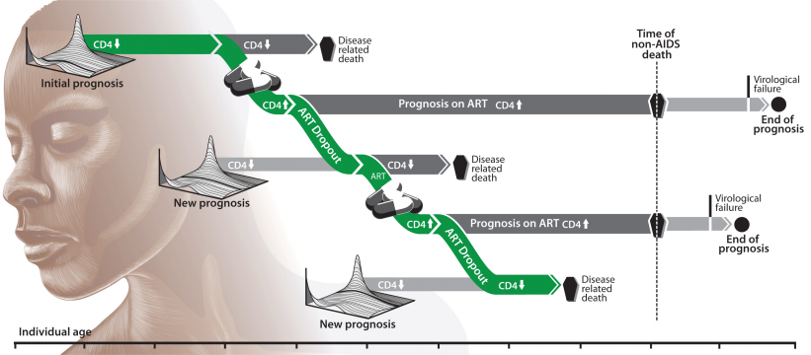
EMOD-HIV model components
Demographics
Sexual Behavior & Network
"South Africa Population Pyramid 2011 estimates"
by Underlying lk - Own work. Licensed under CC0 via Commons.
Within-Host Biology
Interventions

Slide 13
EMOD-HIV: sexual behavior and network
Individuals are paired into relationships
  Currently only heterosexual relationships are modeled
  The model knows which specific individuals are in the relationship
  The relationship is remembered over time
  Some relationship types are longer, others are shorter on average
Marital
Informal
Transitory
Commercial
Longest duration
Oldest age at formation
Large gap, women younger than men
Lowest probability of multiple partnerships
Medium duration
Intermediate age
Medium probability of multiple partnerships
Shorter duration (~1 year)
Young age at formation
Small age gap
High probability of multiple partnerships
Very short, only one to two liasons per relationship
Young women, broad age range of men
Variable age gap
Many different partners
Medium age gap, women younger than men
Notes:
EMOD-HIV is an individual-based network model of HIV transmission. The model represents 1 in 50 people in Kenya, including their birthday, gender, infection, partners, and interventions. Relationships are formed between individuals of similar age, risk, and geographical location. Transmission is the result of modeling individual coital acts, condoms, and co-factors like STI co-infection.
Within each infected host, the model simulates their CD4 count, disease stage, WHO stage, weight, and progression towards AIDS. CD4 reconstitutes while on ART.
The treatment cascade is fully configurable without needing to edit any model source code. Users can specify treatment and prevention cascades.
Another feature the model supports is geography. We hope to eventually connect the counties via migration.
Model fitting uses curve fitting algorithms that aim to maximize likelihood.
Importantly, the model source code, documentation, and tutorials are available online at our website and on GitHub.

Slide 14


EMOD-HIV: HIV transmission and network
Marital
Relationships change over time
Must have a relationship to transmit disease
Marital
Informal
Marital
Transitory
Transitory
Transitory
Transitory
Informal
Informal

Slide 15
EMOD-HIV: population risk groups
The EMOD software can handle any number of risk groups
We are including three risk groups
Low Risk
Medium Risk
High Risk
High STI (30%)
High STI (30%)
Low STI (10%)
Low concurrency
High concurrency
Universal concurrency
General population
General population
FSW and male clients
Notes:
AGYW are defined as women ages 15 to 24

Slide 16
First draft model analyses
Zimbabwe (currently working on Kenya)

Slide 17
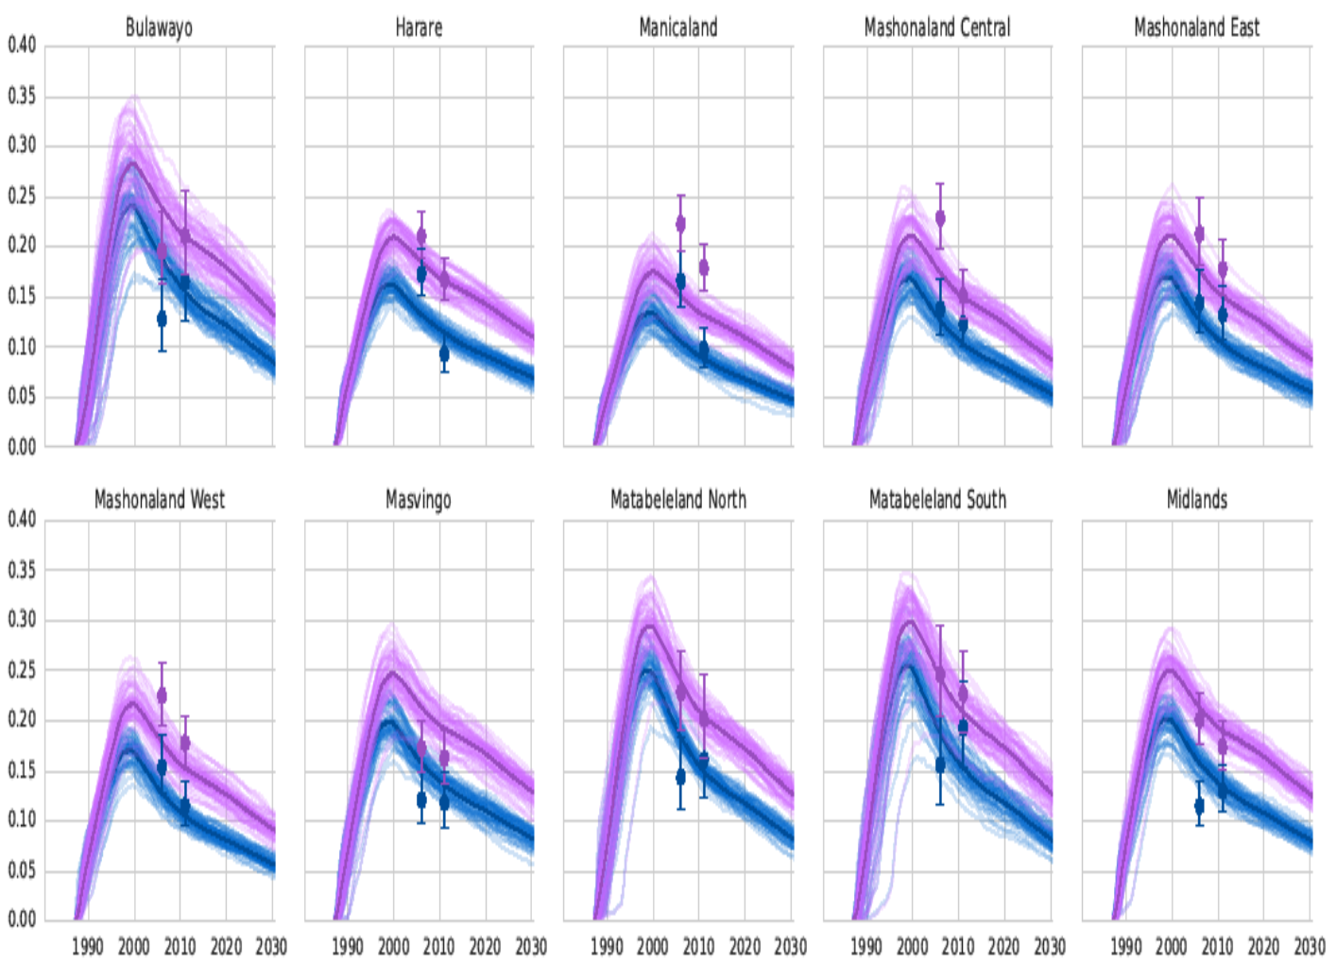
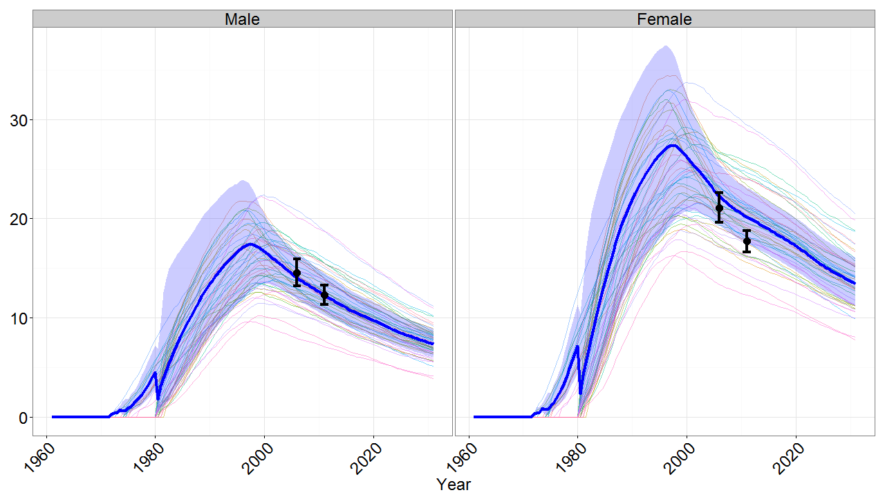
EMOD-HIV: fitting HIV prevalence by province
HIV Prevalence 15-49

Slide 18
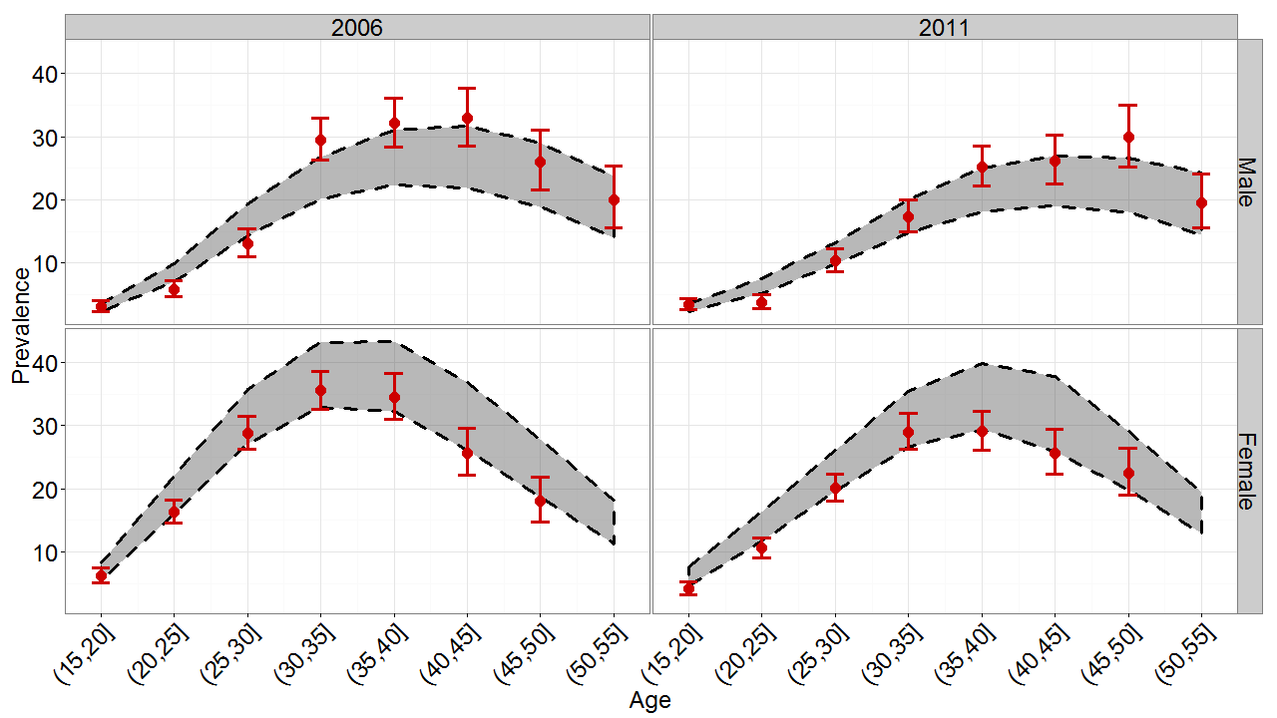
EMOD-HIV: fitting HIV prevalence by age
Notes:
these fits are based on DHS 2006 and 2011 data only

Slide 19
Oral PrEP subpopulation analysis: scenarios considered
Population groups: Female sex workers and other females with multiple partners (2+, “medium risk”)
Age groups: adolescent girls (15-20) and young women (20-25)
Coverage scenario: 40% (oral PrEP) and 90% (ART) of the target population
ART scenarios:
  Maintain current level of coverage.
  Scale up to reach UNAIDS 90-90-90 targets.

Slide 20
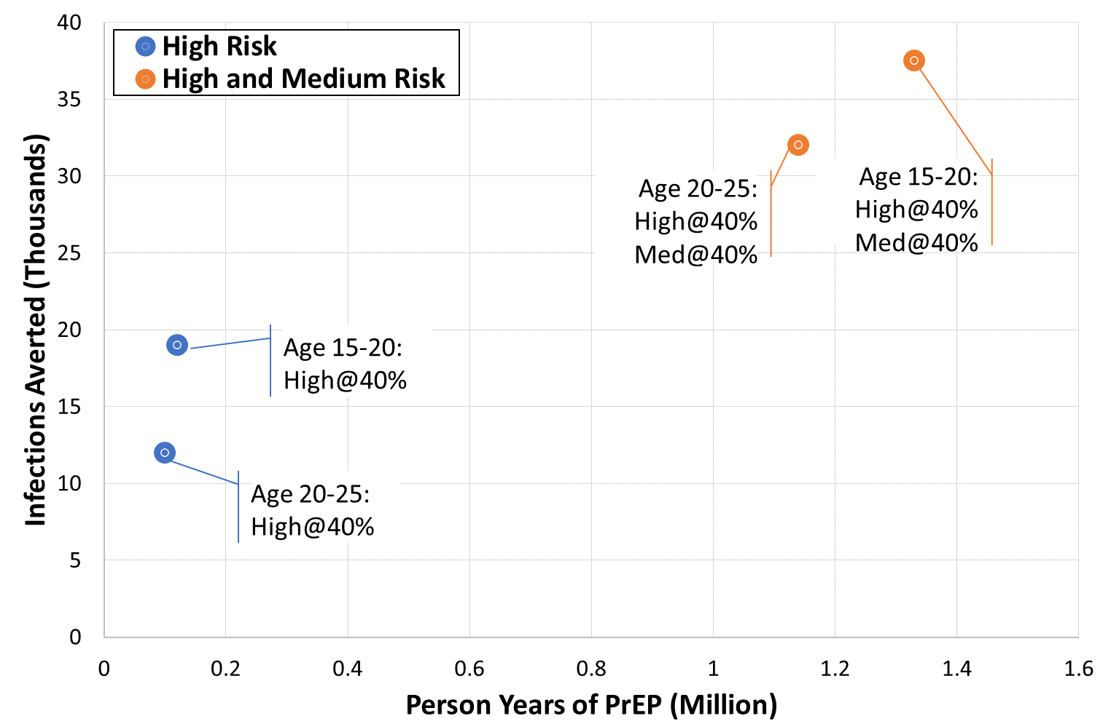
Impact: oral PrEP for different subpopulations
2017-2030
Oral PrEP for 5yrs
Oral PrEP for ages 15-20 averts more HIV infections than oral PrEP for ages 20-25
Addition of medium risk women averts additional HIV infections
HIV treatment scale-up slightly reduces oral PrEP effectiveness (not shown)

Slide 21
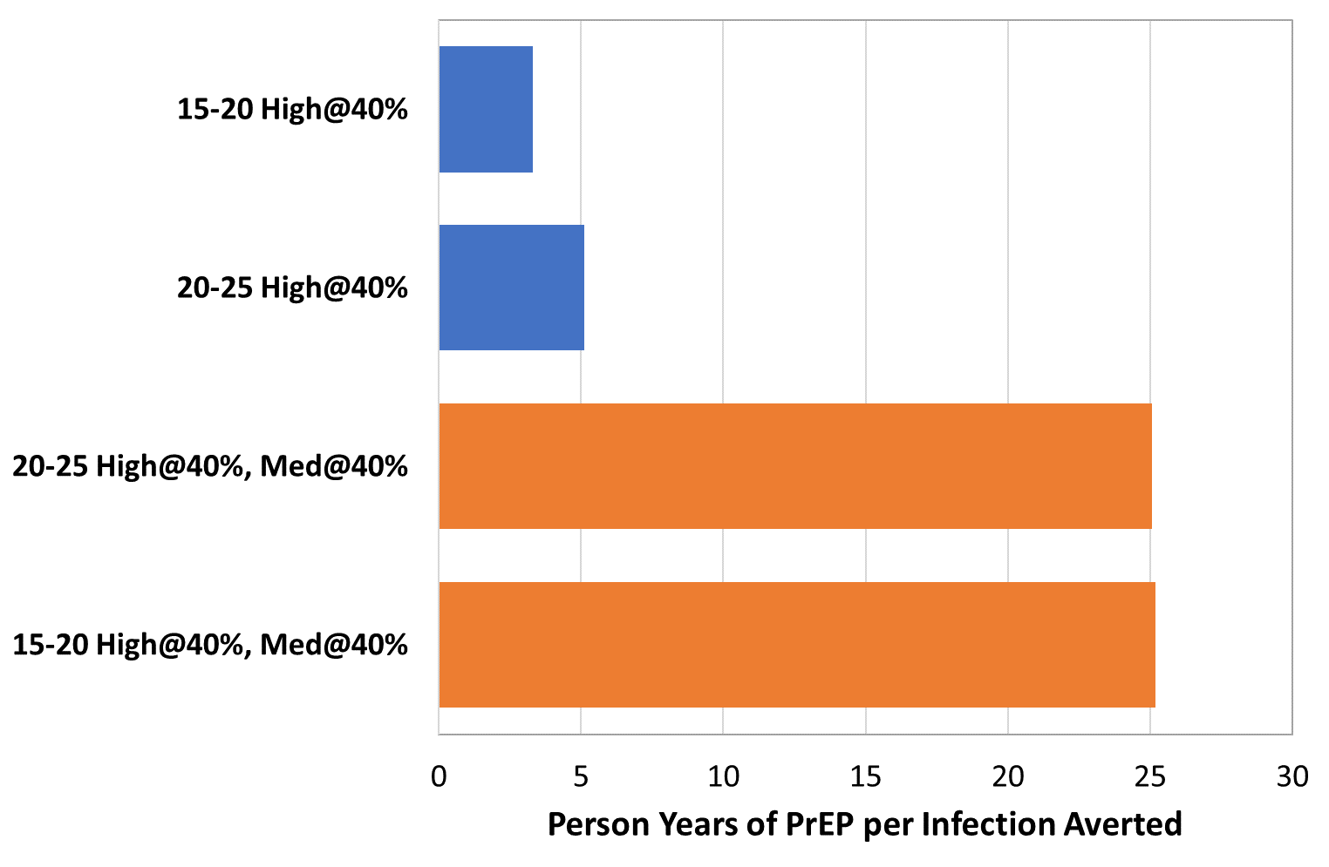
Cost-effectiveness: oral PrEP for different subpopulations in Zimbabwe

Slide 22
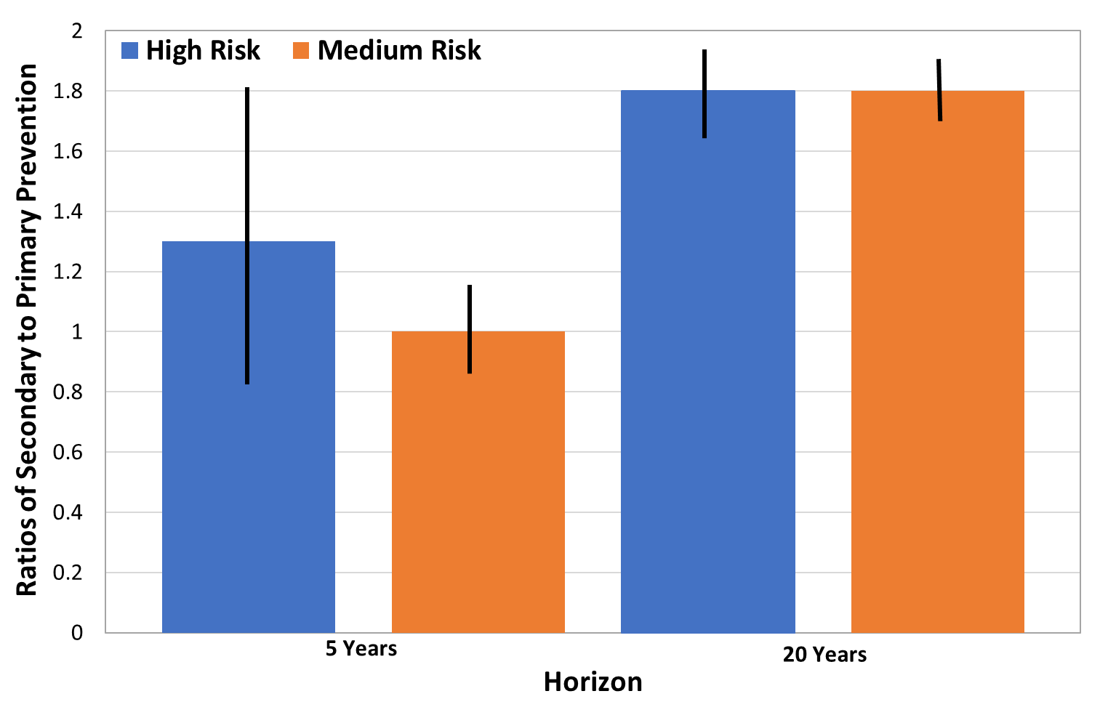
Results: community benefit of oral PrEP
Results for 5- and 20-year horizons were averaged over 1000 replicates.
Figure: Ratios of secondary to primary HIV infections averted in each risk group for 5 and 20 years.

Slide 23
Preliminary conclusions
Among high risk women, providing oral PrEP to younger age groups is both more impactful and more cost-effective
  The highest risk individuals get infected first…
Providing oral PrEP to higher risk individuals is more cost-effective but may produce a lower overall impact
  A lot more PrEP
  Although FSW are the most likely to be infected and most likely to infect, what proportion of transmission do they contribute at endemicity?

Slide 24
How to use the results
Modelling tends to produces specific results for specific populations (at specific times)
  Long, arduous, data-hungry process
We plan to fit to Zimbabwe and Kenya sub-nationally and use the variability within the fits to generate a catalogue of outcomes
Search the catalogue for the (measurable) drivers of PrEP effectiveness and cost-effectiveness
Derive a relatively simple tool for deciding PrEP strategy
  E.g. if prevalence in AGYW is >2%, and <75% of known male infections on ART, then PrEP targeted to women with 2+ partners will likely have the following effects…

Slide 25

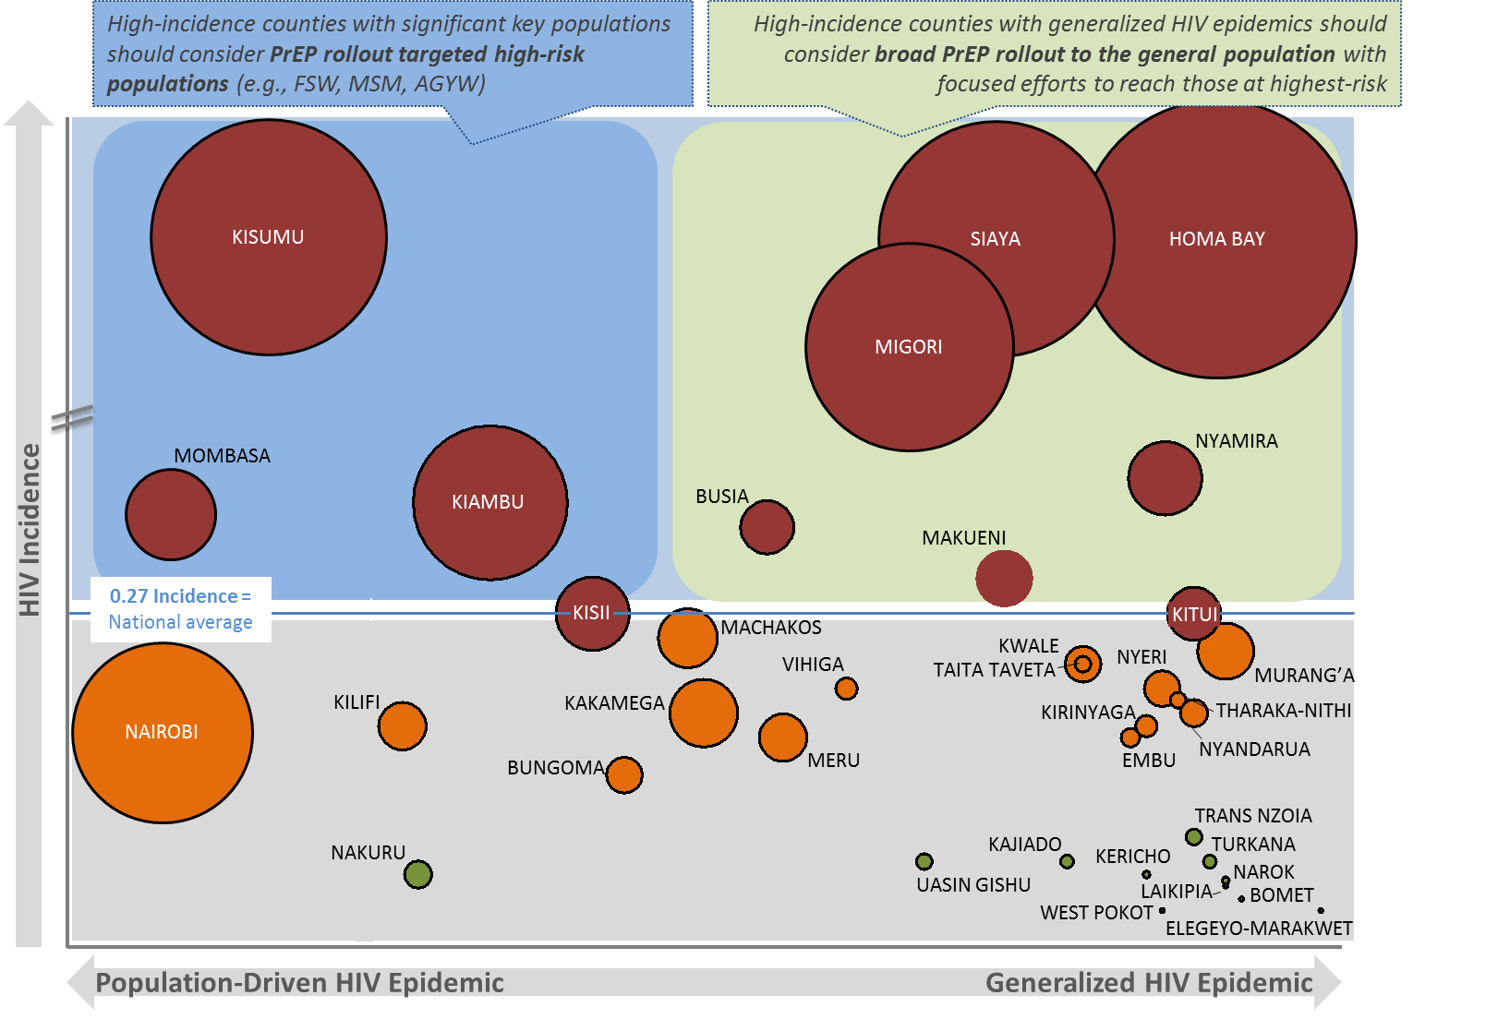
Rollout Scenarios – Approach 1
Completed Example of Kenya
Completed example from Kenya
Counties mapped by incidence and presence of key populations, 2015
Circle size represents number of 2015 adult new infections
Counties for “general population” rollout
Homa Bay, Siaya, and Migori have few key populations but high rates of HIV incidence amongst sero discordant couples, AGYW, and bridging populations
Nyamira, Makueni, Busia, and Kitui have similar profiles but comprise far fewer new infections
Counties for “targeted population” rollout
Kisumu is a significant contributor of new infections driven by key populations (MSM, FSW) and bridging populations (e.g., fisherfolk)
Mombasa, Kiambu, and Kisii have similar profiles but comprise far fewer new infections
Nairobi has a moderate rate of incidence, but contributes significantly to new infections and may also be prioritized for targeted oral PrEP rollout

Slide 26
Resources and Tools available on PrEPWatch.org*
Visit www.prepwatch.org
MPii Tools and Resources
  Plan 4 PrEP: Toolkit for Oral PrEP Implemenation
  Dapivirine Ring: The Case for Action
  Oral PrEP Private Sector Landscape Analyses: Summary, Kenya, South Africa, Zimbabwe
PrEP Trials, Demonstration, and Implementation Projects
* Hyperlinks are active in slideshow mode
Notes:
Note: links only work in slideshow mode

