Slide 1


Visceral Leishmaniasis in India – a problem of projection
Graham Medley, Lloyd Chapman & Emily Nightingale
Centre for Mathematical Modelling of Infectious Disease
London School of Hygiene and Tropical Medicine

Slide 2
VL in India
Vector-borne parasitic disease
  Seasonal vectors
Transmission timescale ~~1yr
”Invariably fatal” but most infections are asymptomatic
Geographically confined

Slide 4
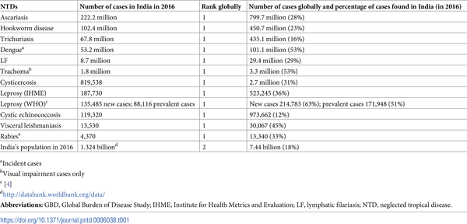

Table 1. India’s major NTDs and rank.
Hotez PJ, Damania A (2018) India’s neglected tropical diseases. PLOS Neglected Tropical Diseases 12(3): e0006038. https://doi.org/10.1371/journal.pntd.0006038
http://journals.plos.org/plosntds/article?id=10.1371/journal.pntd.0006038

Slide 5
Control
“Elimination as a public health problem” by 2020
Indoor Residual Spraying (IRS)
  Reduce the vector population biting humans
Active Case Detection (ACD)
  More rapid diagnosis and treatment reducing the time each case is infectious
These are working…
  But heterogeneity and epidemic potential remain problems

Slide 6
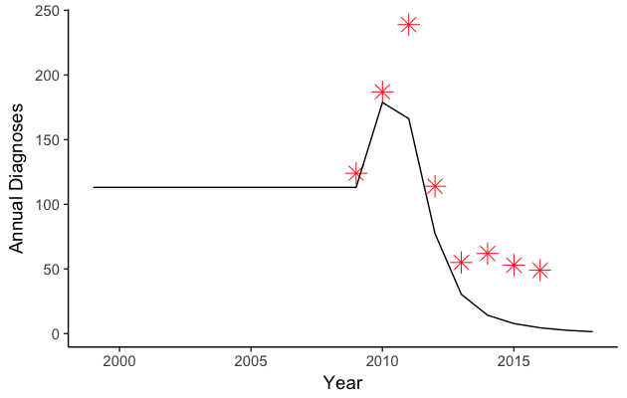
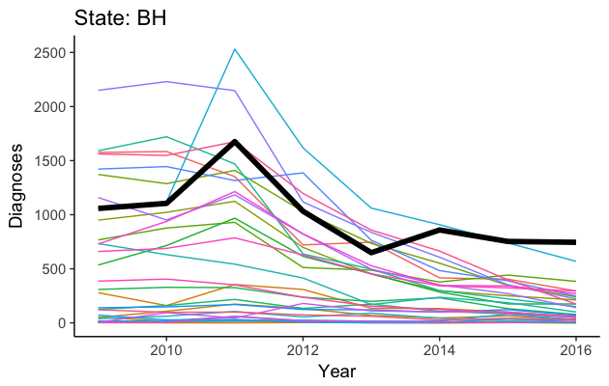

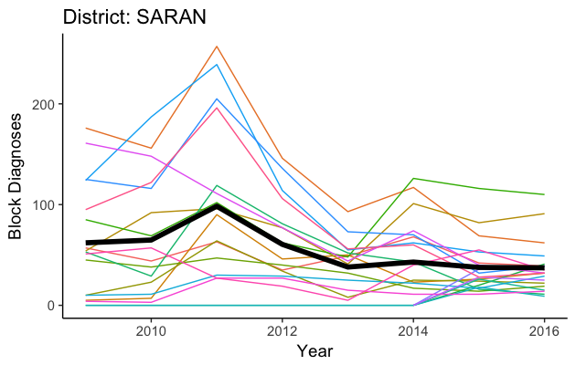
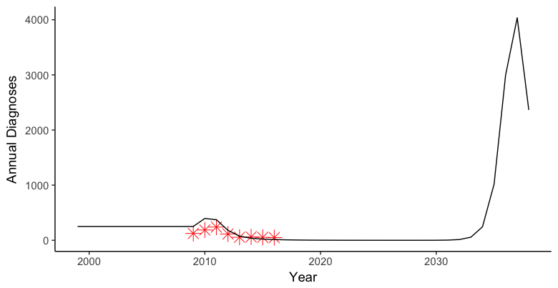
Modeling insights on heterogeneity of case incidence will help to predict outbreaks and test approaches to break transmission
While decline in case incidence has been consistent at block and district levels, incidence is highly heterogenous
1.a) What are the sources of spatio-temporal heterogeneity?
(e.g. differences in access to care, sandfly density or other interactions)
2) Can we develop a data-driven, model-based support tool for short-term prediction of likely areas of flare-up and outbreaks?
Block: Marhoura
Actual data
District: Saran
We are collaborating with IDM to use RiskMapper platform as the basis for moving the technical capacity into NVBDCP
1.b) What are the drivers of case reduction?
(e.g. IRS or Active case management)
3) Can we model transmission dynamics to work out strategies to interrupt transmission using current tools (or newer approaches informed by operational research)?
Block: Marhoura
VL diagnosed cases
Block: Marhoura
Risk of epidemic/ outbreaks due to reduction in herd immunity and increase in susceptible population
Saran block-level average
Notes:
Slide presenter: Graham
The current challenge for the modelling is to explain the observed spatial heterogeneity in incidence.
The previous slide showed that even an apparently homogeneous decline in case incidence at the District-level could conceal major heterogeneity at the Block-level. This heterogeneity is a crucial determinant of the likelihood of achieving elimination or of interrupting transmission. Population dynamic modeling can provide insights into both these outcomes and so help identify the crucial variables to be measured.
Figure 1a demonstrates spatio-temporal heterogeneity. The figure shows the way in which case diagnoses at the District-level have changed for all endemic districts in Bihar over the period 2009 to 2016. Each line is a separate District, and the solid black line is for the District of Saran. The majority of cases in Bihar arise from a few districts. All Districts show a decline in incidence but some, like Saran remain unusually high.
Figure 1b demonstrates spatio-temporal heterogeneity at a finer spatial scale. Each line is a block within Saran, and the black line is the mean. The majority of cases in Saran arise from a few blocks. All blocks show a decline in incidence but some remain unusually high. There is evidence that this pattern continues down to the village level (i.e. that within a block the majority of cases arise from a few villages).
What are the characteristics of the high incidence Districts/Blocks/villages that might be associated with this outcome: sandfly density, population structure, socio-economic status, health-care services? An alternative is that it is just “Saran’s turn” to be high, and that the pattern will continue with different districts taking turns to be high because of transmission dynamic effects. Reality is likely to be a combination of the two.
Insight into the drivers of heterogeneity will give us deep insight into the drivers of VL incidence and 1) tell us what to look for (surveillance) and 2) tell what to do to interrupt transmission.
Figure 2 goes further into the Block-level analysis for Marhoura (the blue line in Figure 1b), to explore whether it is possible to develop a data-driven, model-based support tool for short-term prediction of likely areas of flare-up and outbreaks. The figure shows the real data points for Marhoura in Figure 1b (ie for the period 2009 to 2016), and compares this with a simple model that shows how case finding might change with more efficient Dx/Rx (e.g., with ACD). We are collaborating with IDM to use the RiskMapper platform to provide a near real-time prediction of risk (e.g. a traffic light system at the block level). The challenge will be to transfer the technical capacity to NVBDCP to predict outbreaks. CARE is an essential partner.
Figure 3 illustrates an important consideration in deciding future control of VL post-elimination. The data are the same as the previous figure.
The current low levels of incidence are due to the intervention – in particular the Dx/Rx effort means that very few people die of VL. If this intervention is relaxed, the VL will come back to precontrol levels. Epidemiologically, VL is more like polio than guinea worm, so that the resurgence has the potential to be an epidemic. All the models demonstrate this potential. This figure is not intended to be predictive, but to illustrate this danger inherent in failing to sustain elimination at current levels. Whilst the vertical scale might seem extreme, in an outbreak in Kosra, a single village in southern Bihar, 55 cases of VL were identified in a population of 1758 (~3%).
[Additional information about epidemic potential: Whilst the details of the projection are not accurate, they demonstrate the principal shown by ALL the models – that suppressing incidence by IRS and/or case finding, and then reducing that suppression, will result in epidemics of VL. Current interventions against VL reduces exposure, resulting in a reduction in individual and herd immunity and an increase in the size of the susceptible population. These factors in turn lead to a significant risk of local outbreaks and even major epidemics, as seen in India in the 1960s when there were thousands of deaths associated with Kala Azar post the malaria DDT campaigns. The figure shows this pattern, with a significant increase in cases and mortality some 20 years after the introduction, and then cessation, of effective Dx/Rx. This result highlights the importance of short-term predictions (to be able to control outbreaks before they are epidemic), and of the importance of continued control (if elimination of infection is not feasible or adopted). Modelling here is used to define the future risks of attaining the current target.]
[Additional information about the IDM platform – the user interface provides a solid platform for data handling and output of results, and we will use this interface. The main development activity will be in adding to the prediction algorithms. Currently these are “disease agnostic”, i.e. they use the past history of cases to provide statistical forecasts of risk. The SPEAK modelling will be developing more VL specific algorithms using both relevant environmental variables (e.g. climate, population) and transmission dynamics.]

Slide 7
Post-Elimination
Political intensity wanes
Resources reduce
Targeting of resources for maximum impact
Highlighting areas of highest risk

Slide 8
Targeting
What is the correct spatial scale?
District too large
Block too large – but it is the most reliable source of incidence data

Slide 9
Mandal, R. et al.: Parasites & Vectors, 11(1), 220, 2018.

Slide 10
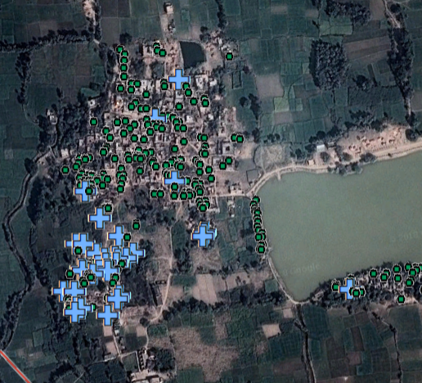

Slide 11
Forecasting
Risk ~
  Susceptibility x (time since last case)
  Suitability x (environmental indices)
  Infectiousness x (cases last year, or next door)
Statistical & machine-learning approaches will potentially fail to predict outbreaks
  Until we have seen a lot of them
Include transmission dynamic models
  Spatial aggregation

Slide 12
Notes:
More on the cases next door aspect…
VL shows clustering at all spatial scales
Inference of spatial scale of transmission using old data from a population study in a highly endemic village in Bangladesh

Slide 13
Notes:
Spatial locations of cases over time in para 1

Slide 18
Notes:
Fitted an individual-level SEIR spatial kernel model to the disease status data
Force of infection experienced by an individual is sum of forces of infection of cases around them weighted by distance (spatial kernel)
Estimated parameters using MCMC

Slide 19
Notes:
Estimated transmission kernel and 95% HPDI, horizontal dotted line is background transmission from other sources (asymptomatics, human migration etc.)
Suggests risk decreases fairly rapidly with distance from a case and cases drive transmission, at least in a highly endemic setting
Situation may be different in India where incidence is currently much lower than it was here
(Issues: static kernel etc.)

Slide 20
Notes:
Map showing decrease in annual subdistrict-level incidence from 2009-2016.

Slide 28
Subdistrict-level KA incidence predictions up to 2020
Notes:
Left of vertical dotted line is reported incidence from 2009-2016
Lots of heterogeneity in incidence (as well as case numbers) across subdistricts
Right of vertical line is mean predicted incidence (over 1000 simulations) for 2017-2020 based on negative binomial spatiotemporal model fitted to 2009-2016 data in R package surveillance
Lack of variation in predicted incidence is due to taking average across many simulations
Nearly all subdistricts predicted to reach <1/10,000/yr target, but some only just
1 subdistrict that had high incidence in 2014-2016 is predicted to still be above target in 2020

Slide 29
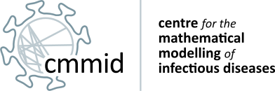




Thank you!
Modelling infectious disease dynamics to improve global health
E-mail: graham.medley@lshtm.ac.uk; lloyd.chapman@lshtm.ac.uk
Website: http://cmmid.lshtm.ac.uk/
Website: https://speakindia.org.in
Twitter: @cmmid_lshtm
Twitter: @SPEAKIndiaLSHTM

