Slide 1
Risk Modeling for District Prioritization in Pakistan
Laina Mercer
Steve Kroiss, Hil Lyons, Guillaume Chabot-Couture
20 April, 2016
Notes:
My name is Laina Mercer. I am a statistician at IDM. I am presenting work that is very much joint work with other members of the polio team, namely Steve Kroiss, Hil Lyons, and Guillaume.

Slide 2
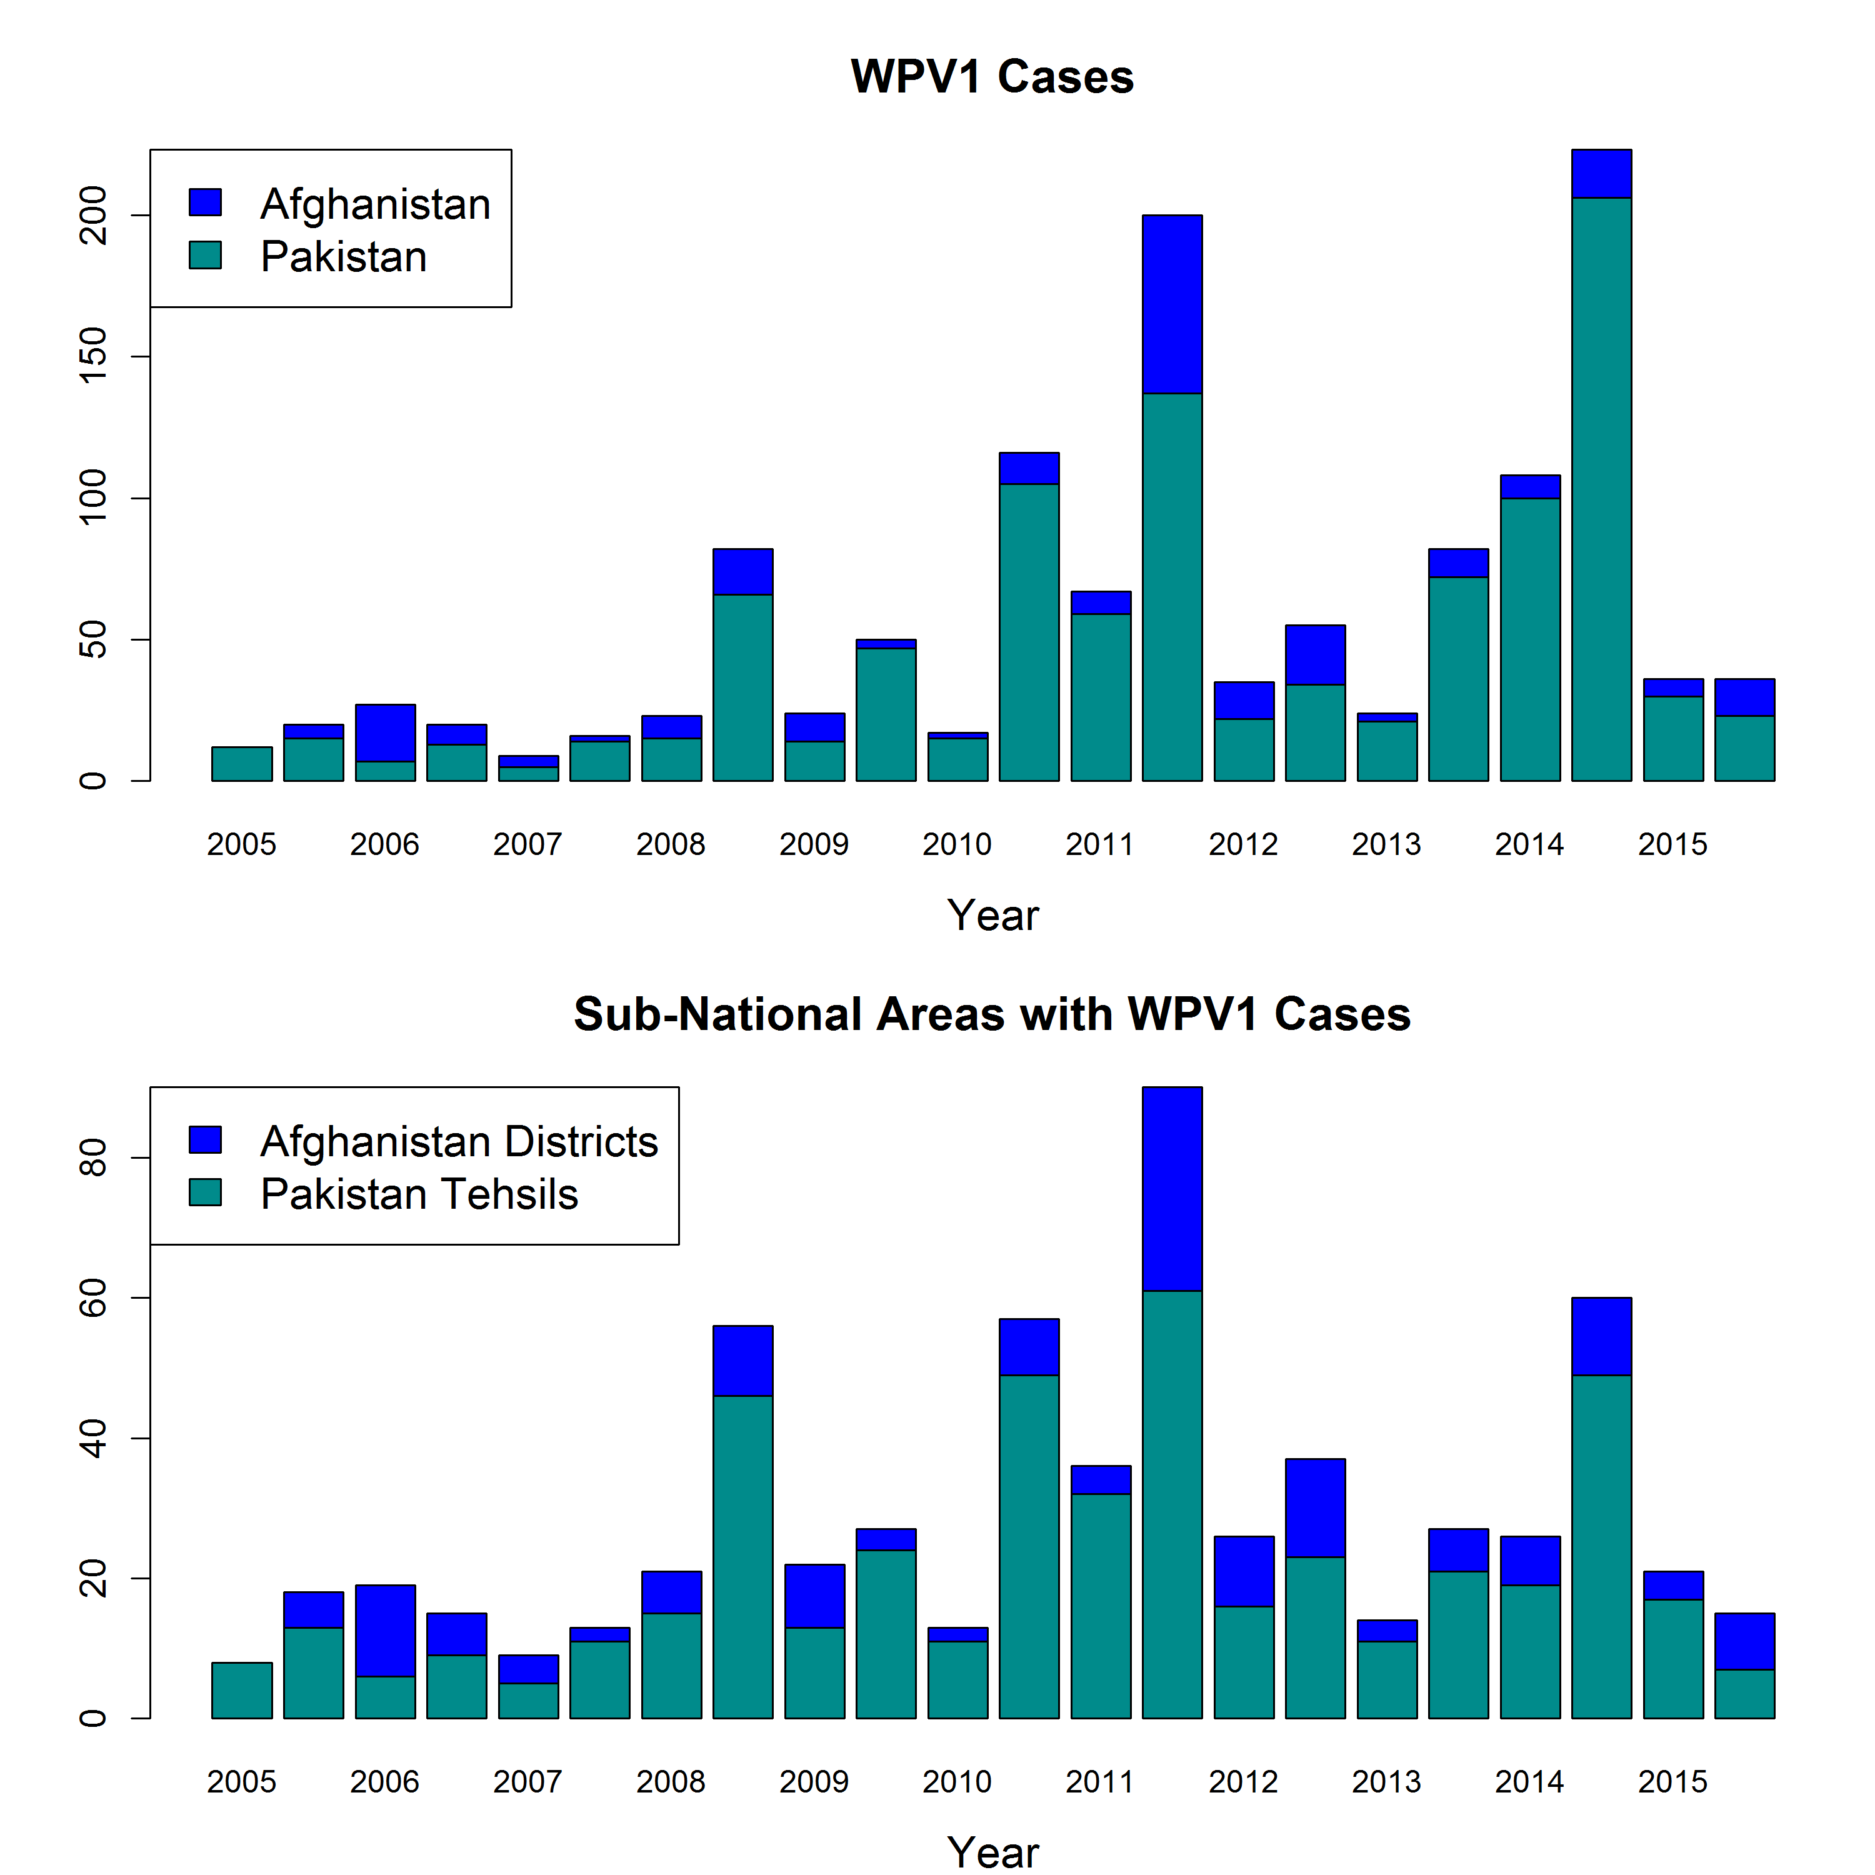
Recent History
WPV1 cases in 2016:
  Afghanistan: 4 cases in 3 districts
  Pakistan: 8 cases in 8 districts
Last 6 months represent the lowest high season since 2007 in Pakistan.
Where and how should the program intervene?
Notes:
There are a lot of very interesting questions one could ask about what is currently happening and what will happen in Pakistan, but the issue I’m going to address is how to estimate the areas at the highest risk for cases to aid in resource allocation and intervention planning for the Pakistan polio program.

Slide 3
We Want a Framework for Prioritizing Sub-National Areas
Why?
The Pakistan polio program plans their vaccination campaigns annually
They need to decide how and where to allocate resources and target special interventions

Slide 4
We Want a Framework for Prioritizing Sub-National Areas
Why?
The Pakistan polio program plans their vaccination campaigns annually
They need to decide how to allocate resources and where to target special interventions
What information do we have to study risk in space and time?
The most geographically and temporally rich data is the Acute Flaccid Paralysis (AFP) surveillance data
In addition to providing information about WPV1 cases, the non-polio AFP cases provide us with routine and campaign dose histories from a sample from the population

Slide 5
A Framework for Prioritizing Districts Based on Risk
Estimate a risk score based on both the probability of a case and the number of cases over 6 months in each district
Risk is modeled as a function of
  Zero dose routine immunization (RI) fraction
  Under immunized fraction
  Vaccine derived type 1 population immunity
  Recent WPV1 cases
  High season (Jan-June vs. July-Dec)

Slide 6
Dose History Data Is Noisy

Slide 7
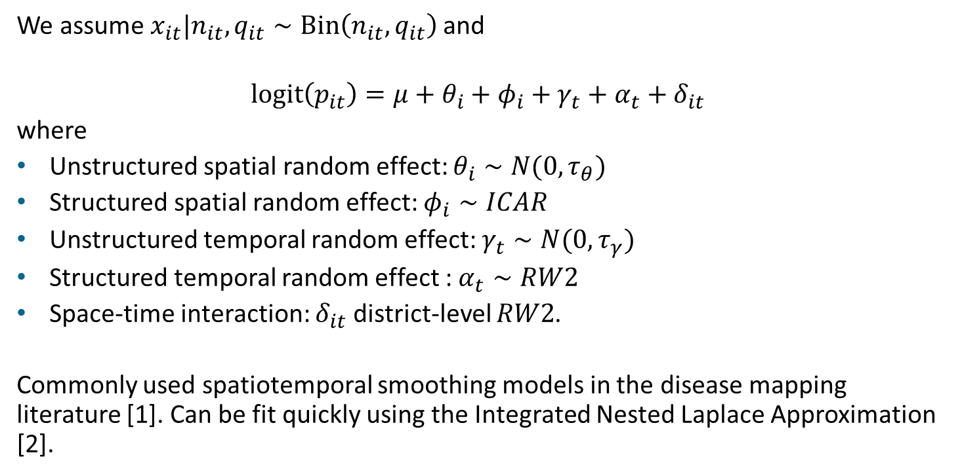
Space-time Smoothing Model for Covariates
We assume $x_{it}|n_{it},q_{it}∼Bin\left(n_{it},q_{it}\right)$and
$$logit\left(p_{it}\right)=μ+θ_{i}+φ_{i}+γ_{t}+α_{t}+δ_{it}$$
where
Unstructured spatial random effect: $θ_{i}∼N(0,τ_{θ})$
Structured spatial random effect: $φ_{i}∼ICAR$
Unstructured temporal random effect: $γ_{t}∼N(0,τ_{γ})$
Structured temporal random effect : $α_{t}∼RW2$
Space-time interaction: $δ_{it}$ district-level $RW2$.
Commonly used spatiotemporal smoothing models in the disease mapping literature [1]. Can be fit quickly using the Integrated Nested Laplace Approximation [2].

Slide 8
Impact of Smoothing Covariates – Independent Interaction

Slide 9
Impact of Smoothing Covariates – Structured Interaction

Slide 10
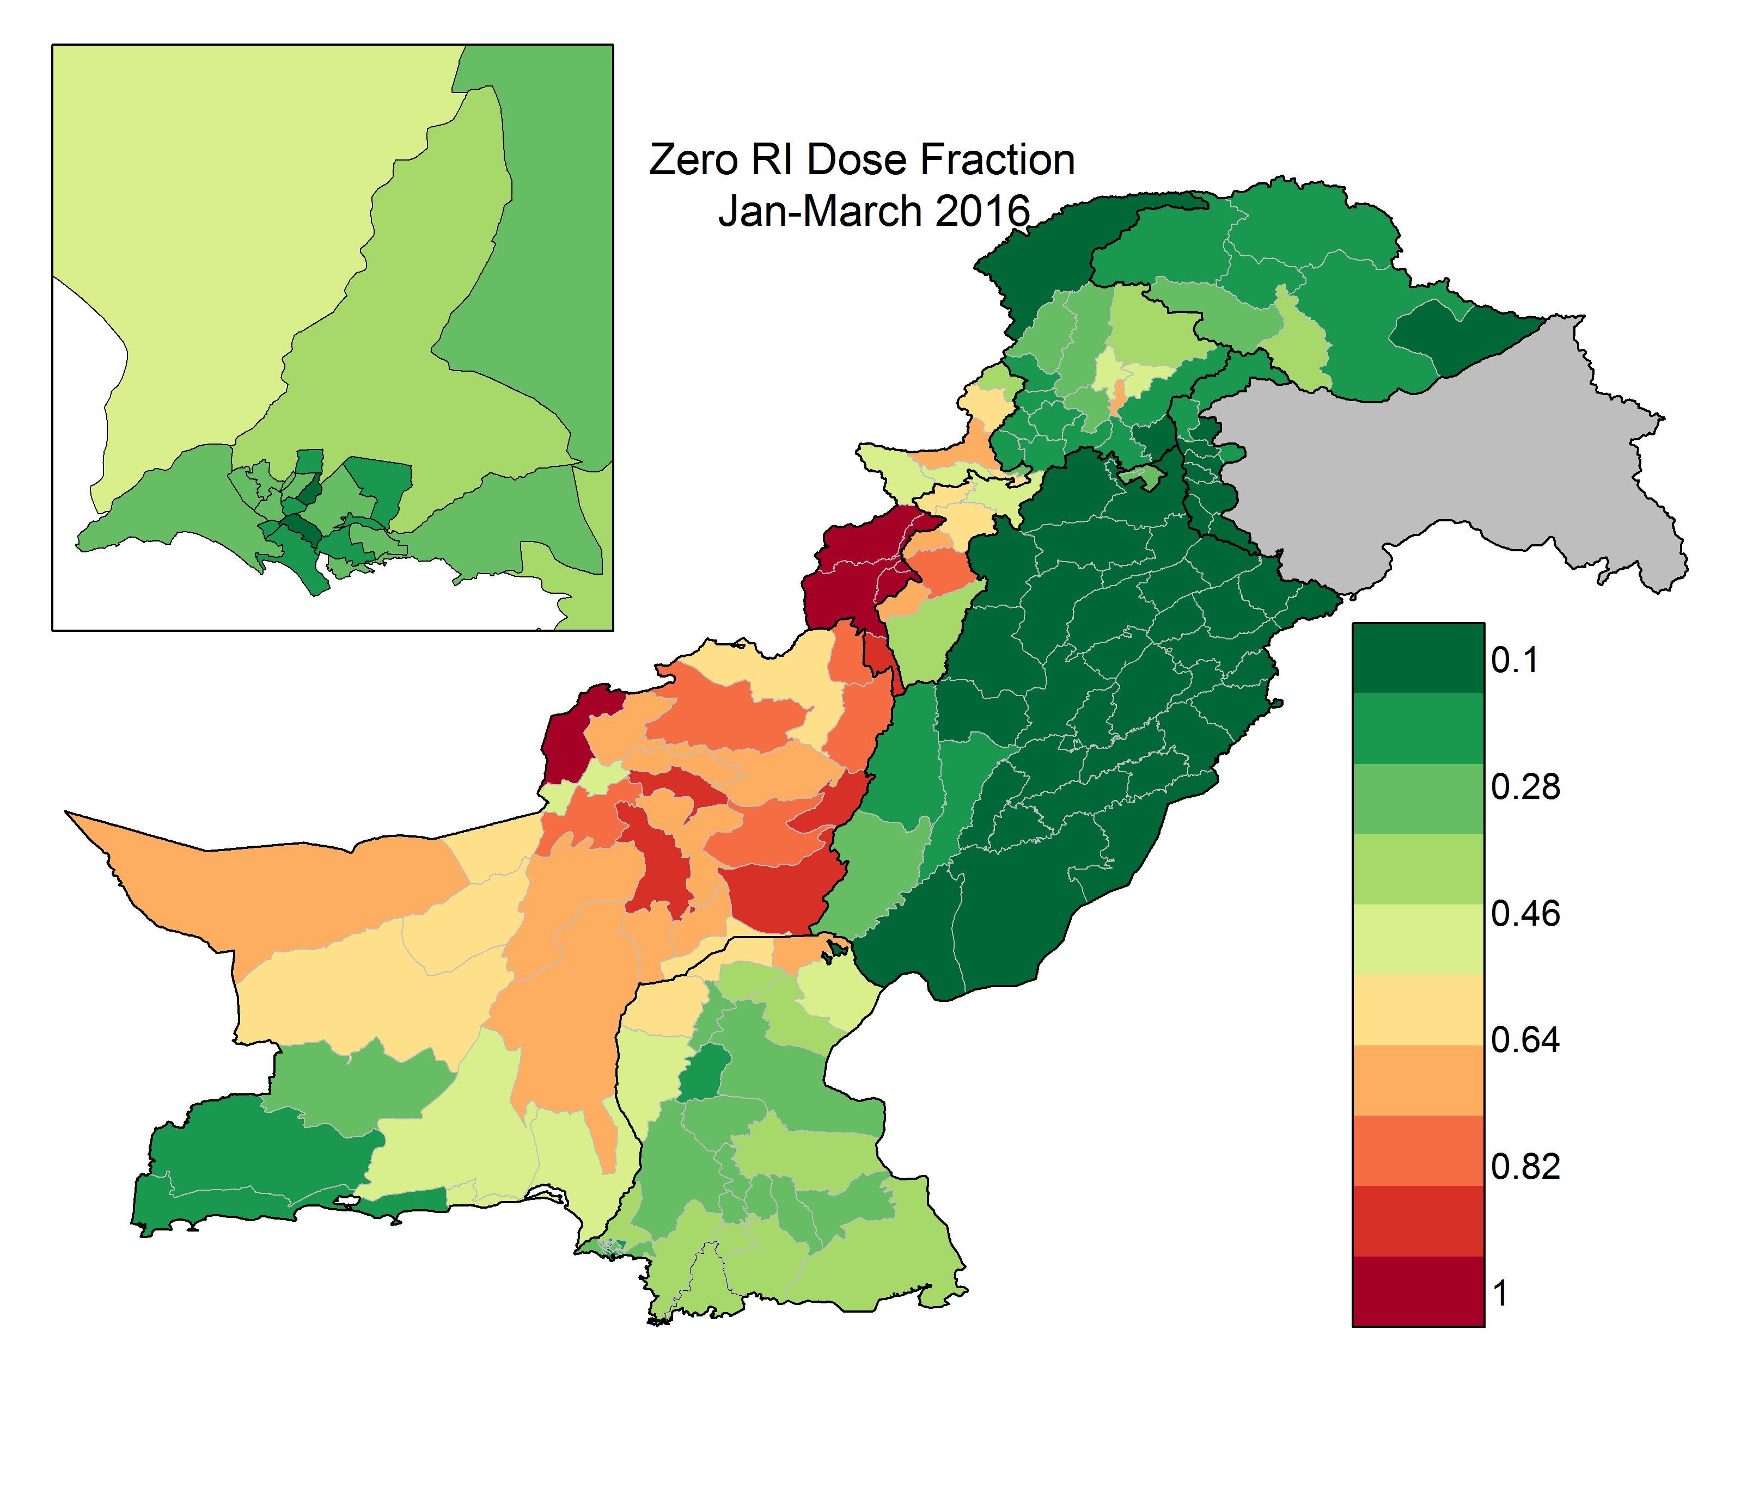
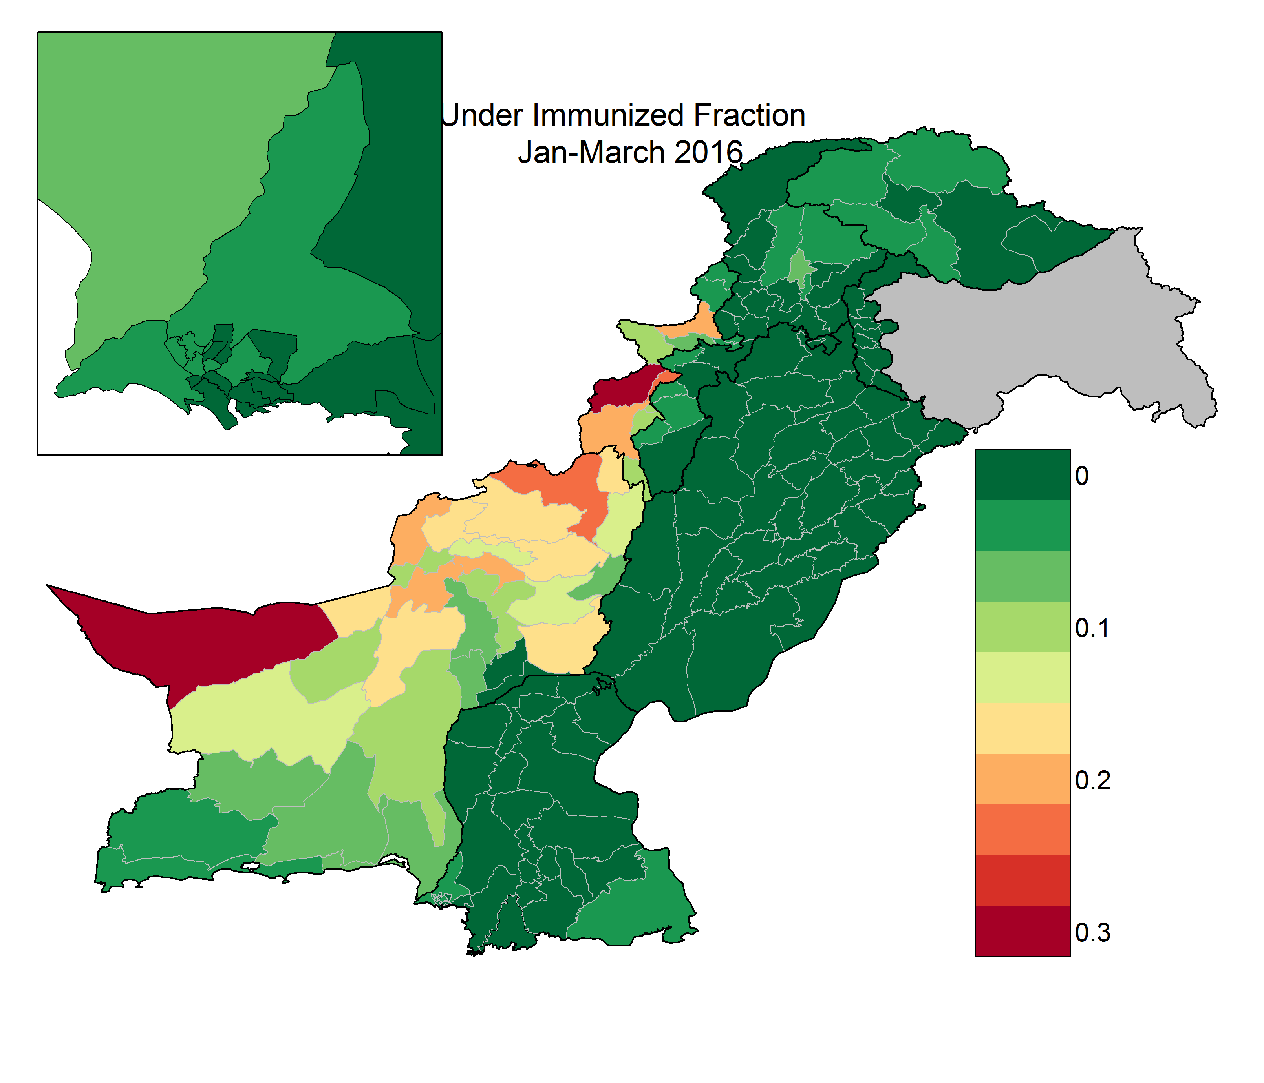
Smoothed Zero Dose RI and Under Immunized Rate

Slide 11
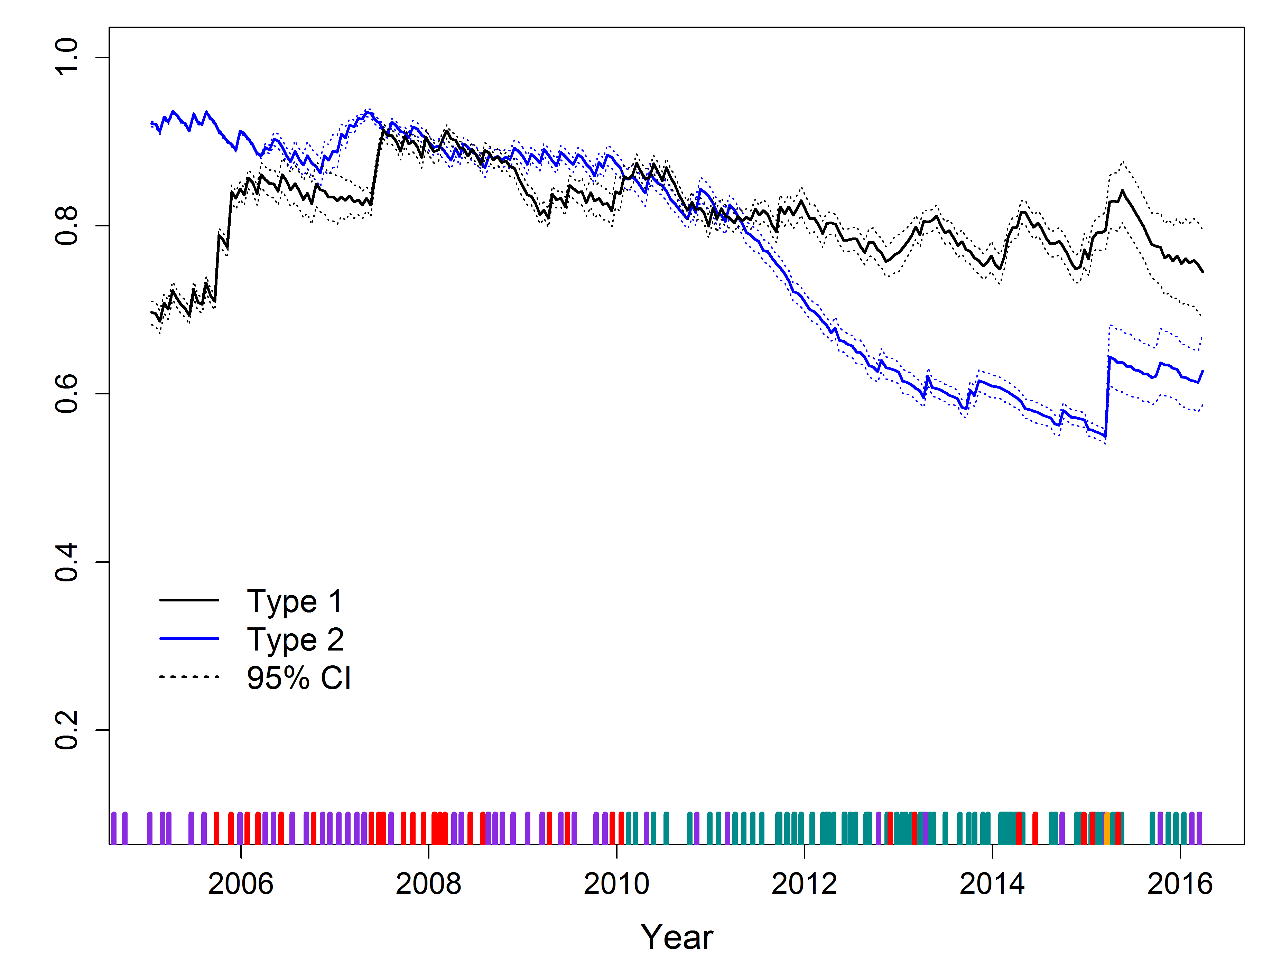
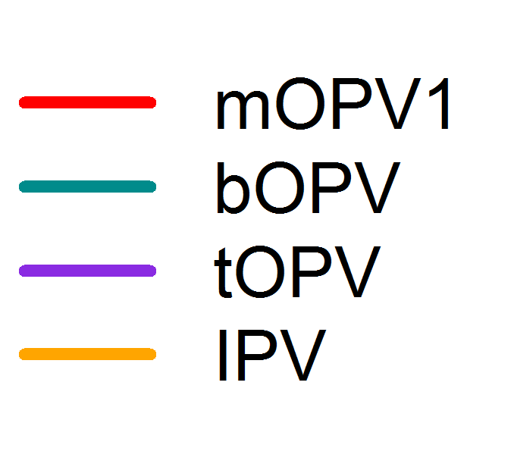
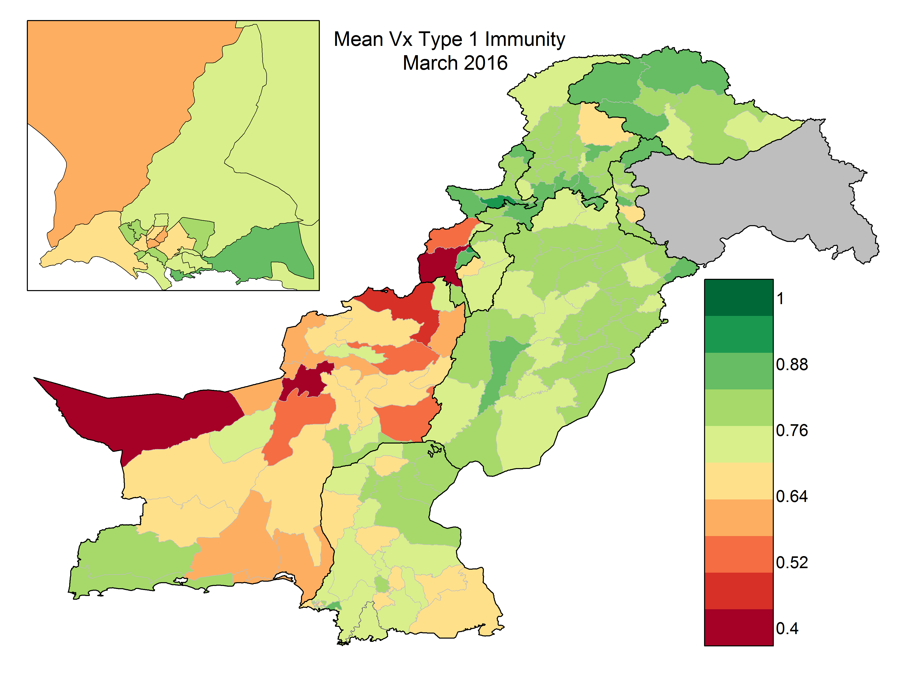
Vaccine Derived Type 1 Immunity Calculations
Annual age-specific campaign quality is estimated with a Bayesian spatiotemporal model [3]
Population Immunity projected based on campaign type and quality.
Peshawar
[3] Upfill-Brown, Voorman, Chabot-Couture, Shuaib, Lyons (2016)

Slide 12

Poisson Hurdle Model
We assume $y_{it}$ is the number of confirmed WPV1 cases $z_{it}$ is an indicator of
$y_{it}>0$.
We model $z_{it}∼Bern(p_{it})$ with
$$logit(p_{it})=φ_{1}+β_{1}X_{i,t−1,1}+u_{i1}+v_{i1}$$

Slide 13
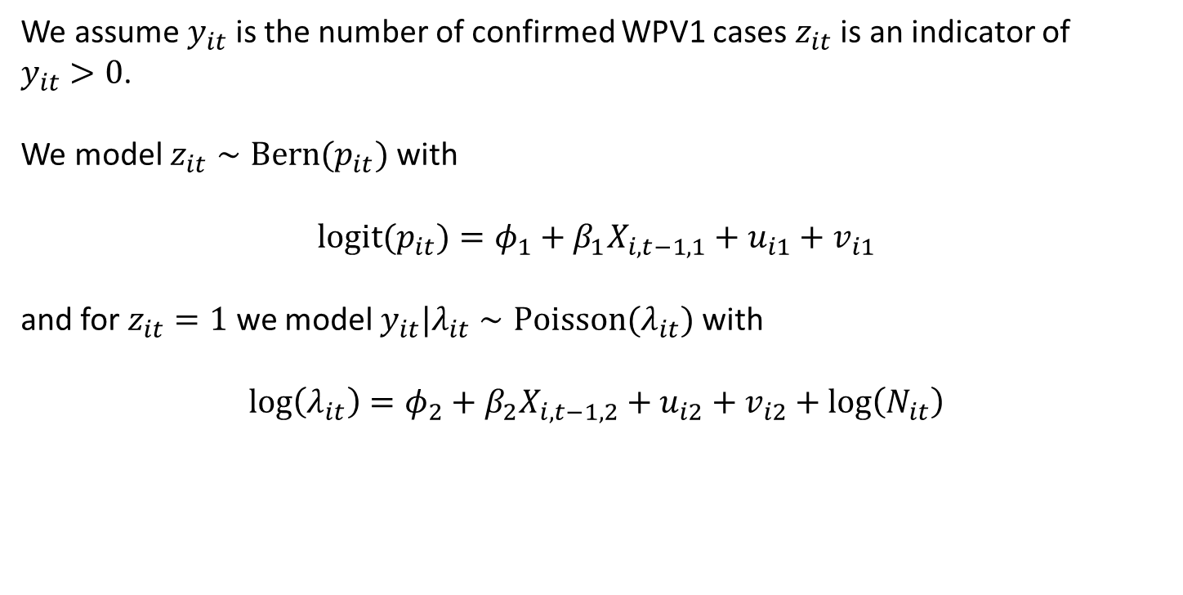
Poisson Hurdle Model
We assume $y_{it}$ is the number of confirmed WPV1 cases $z_{it}$ is an indicator of
$y_{it}>0$.
We model $z_{it}∼Bern(p_{it})$ with
$$logit(p_{it})=φ_{1}+β_{1}X_{i,t−1,1}+u_{i1}+v_{i1}$$
and for $z_{it}=1$ we model $y_{it}|λ_{it}∼Poisson(λ_{it})$ with
$$log\left(λ_{it}\right)=φ_{2}+β_{2}X_{i,t−1,2}+u_{i2}+v_{i2}+log\left(N_{it}\right)$$

Slide 14
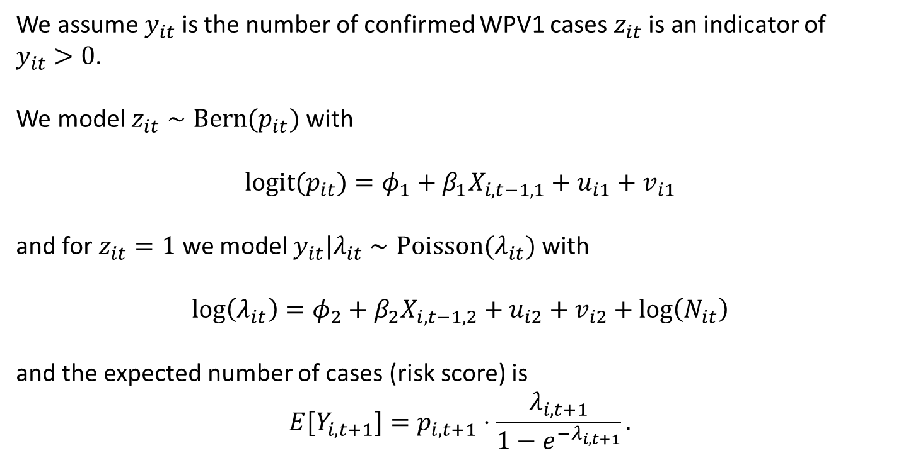
Poisson Hurdle Model
We assume $y_{it}$ is the number of confirmed WPV1 cases $z_{it}$ is an indicator of
$y_{it}>0$.
We model $z_{it}∼Bern(p_{it})$ with
$$logit(p_{it})=φ_{1}+β_{1}X_{i,t−1,1}+u_{i1}+v_{i1}$$
and for $z_{it}=1$ we model $y_{it}|λ_{it}∼Poisson(λ_{it})$ with
$$log\left(λ_{it}\right)=φ_{2}+β_{2}X_{i,t−1,2}+u_{i2}+v_{i2}+log\left(N_{it}\right)$$
and the expected number of cases (risk score) is
$$E[Y_{i,t+1}]=p_{i,t+1}⋅\frac{λ_{i,t+1}}{1−e^{−λ_{i,t+1}}}.$$

Slide 15
Final Model
The probability of having at least one case in a 6 month period
Type 1 immunity - negatively associated
Under immunized fraction - positively associated
Zero dose RI – positively associated
Recent cases – positively associated
High Season
The number of cases expected given at least one case
Type 1 immunity – negatively associated
High Season

Slide 16
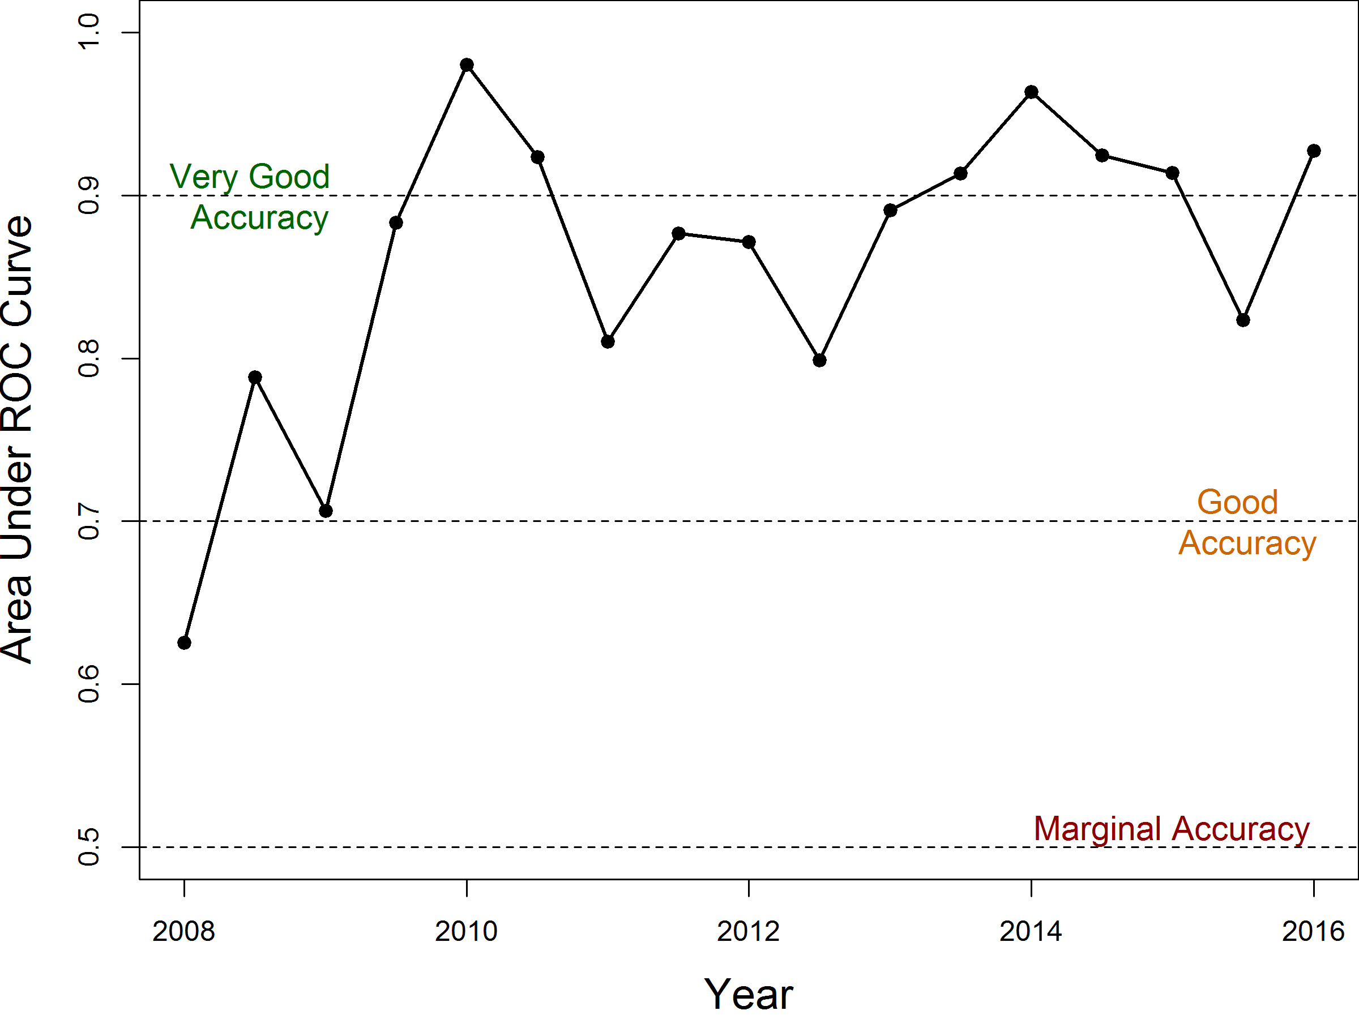
Model Validation
Very good predictive accuracy at the district level as measured by area under the curve.
Approximately 80% sensitivity for top 50 ranked districts over time.

Slide 17
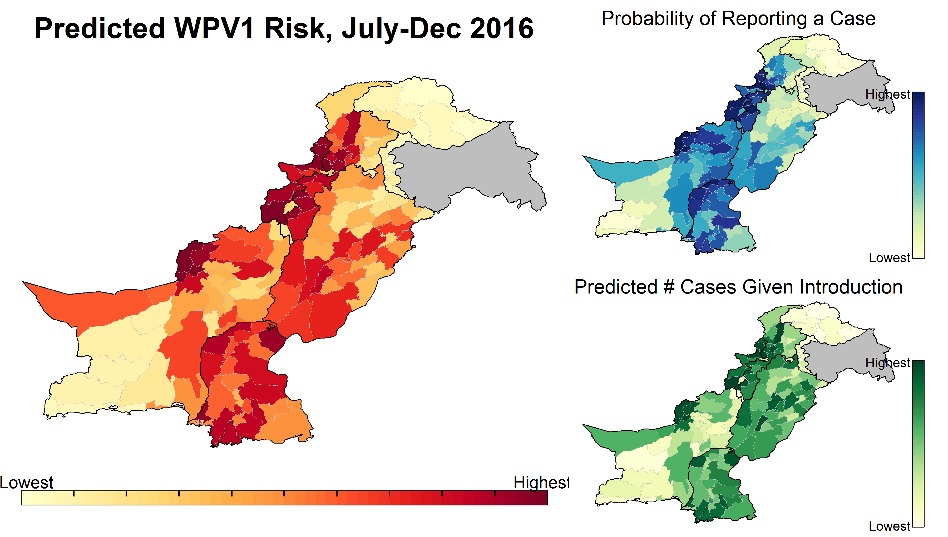

Slide 18
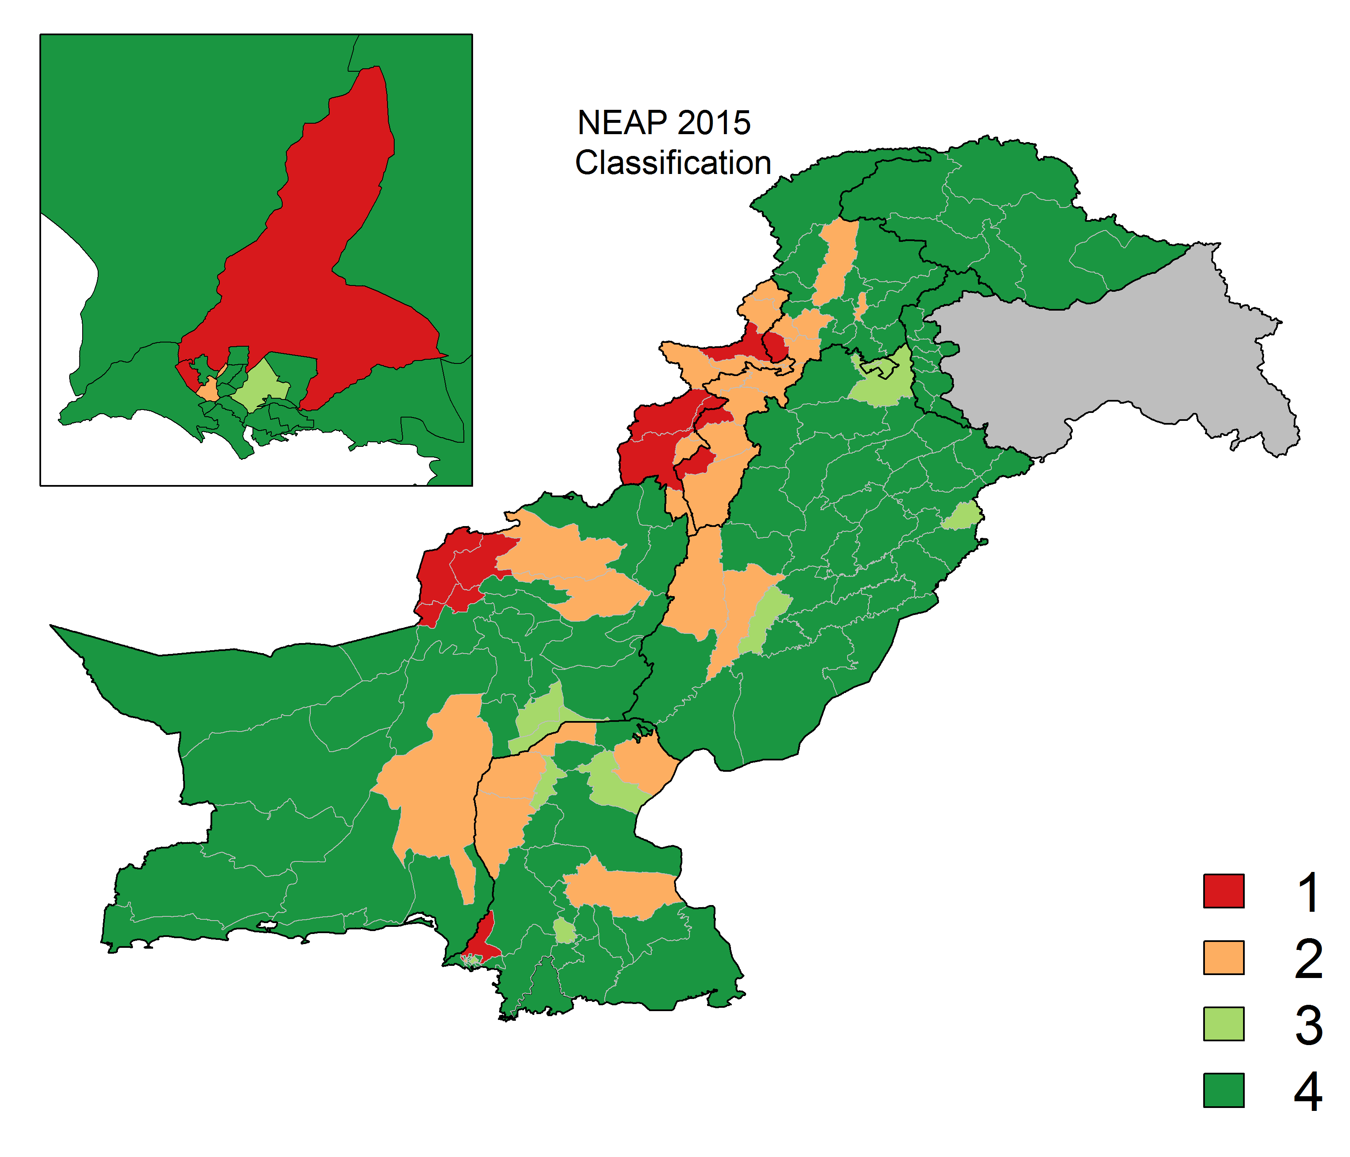
Impact and Future Directions
Pakistan polio program uses these results to help inform their tiered district prioritizations.
Helps to inform on the number and location of sub-national vaccination campaigns.
Work is ongoing for the 2016 classifications.
Considering risk analysis for sub-district geographies.

Slide 19
Acknowledgements
IDM Polio Team
Steve Kroiss
Hil Lyons
Mike Famulare
Kevin McCarthy
Guillaume Chabot-Couture
Alex Upfill-Brown
National Emergency Operating
Center – Islamabad, Pakistan
Jamal Ahmed
Abdirahman Mahamud
Ashraf Wahdan
And many others
The Gates Foundation
Arie Voorman
Sue Gerber
Sidney Brown
And many others

Slide 20
References
Knorr-Held, Leonhard. "Bayesian modelling of inseparable space-time variation in disease risk." Statistics in medicine 19.1718 (2000): 2555-2567.
Schrödle, Birgit, and Leonhard Held. "Spatio‐temporal disease mapping using INLA." Environmetrics 22.6 (2011): 725-734.
Upfill-Brown Alexander, Voorman Arend, Chabot-Couture Guillaume, Shuaib Faisal, Lyons Hil. “Analysis of vaccination campaign effectiveness and population immunity to support and sustain polio elimination in Nigeria.” To appear in BMC Medicine. (2016)

Slide 21
Additional Slides

Slide 22
Impact of Smoothing Covariates – No Interaction

Slide 23
Observed Cases and Smoothed Risk

Slide 24
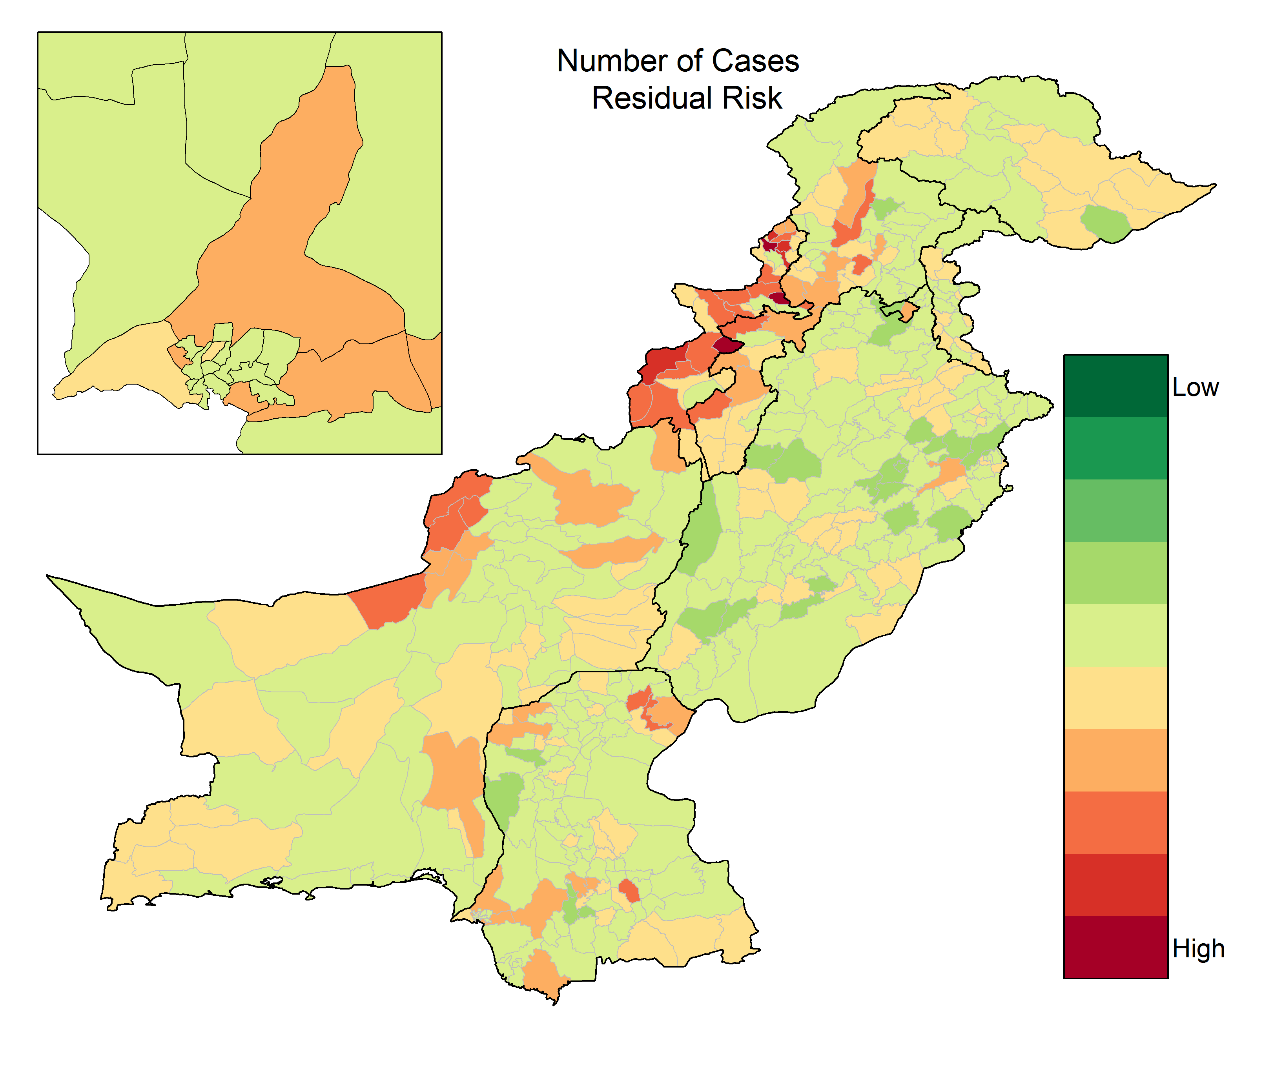
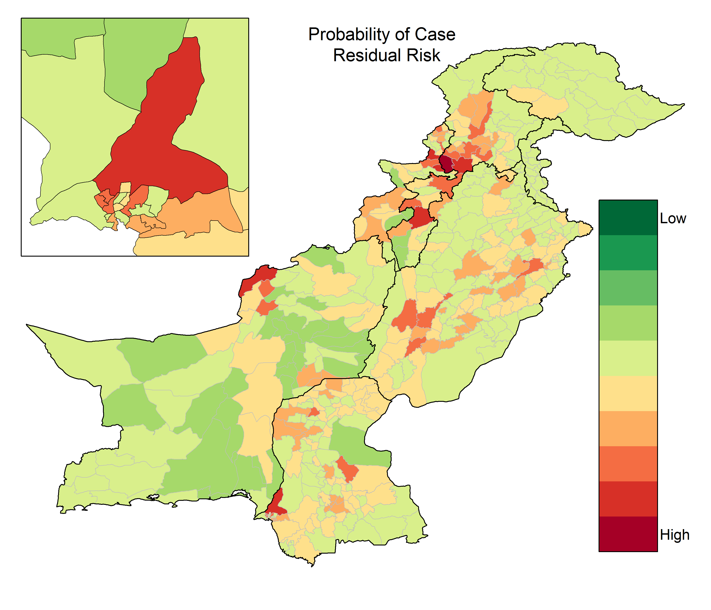
Residual Risk

Slide 25
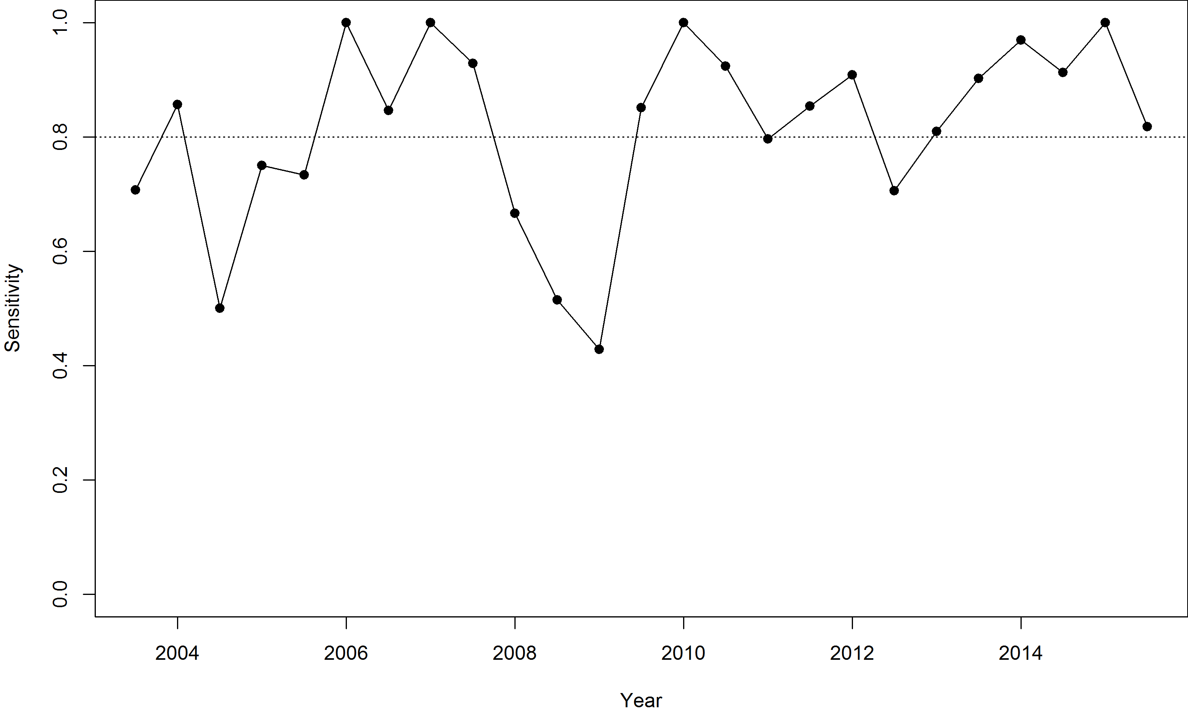
Sensitivity of List
Sensitivity of list (T1-T3) generally near 80%.
Poor predictive performance during outbreaks in Punjab province in 2008 and 2009.

Slide 26
District Prioritization Framework
Tier 1: Reservoir Districts (10-15)
  These area the areas that must be fixed if the program is to succeed.
  Targeted with national and sub-national vaccination campaigns.
Tier 2: High Risk/Vulnerability Districts (15-30) – NIDs + SNIDs
  These area areas that are frequent recipients of virus and have known quality & immunity problems
  These areas may harbor virus even if eliminated from reservoirs and subsequently re-infect them
  Targeted with national and sub-national vaccination campaigns.
Tier 3: Outbreak Districts (Flexible) – NIDs + SNIDs, with SNIDs for 6 months following case/isolate
  Areas not at high risk to report a case or become problematic
  Areas to be added to the sub-national vaccination calendar for a few rounds
Tier 4: Rest of Pakistan
  Areas where RI is strong, quality is known to be high and/or risk is known to be low.
  Will be included in national vaccination campaigns.

Slide 27
Final Classification in Collaboration with Pakistani Program
Approximately 80% sensitivity for T1-T3 districts.
Process in ongoing for planning the 2016-2017 campaign calendar.

Slide 28
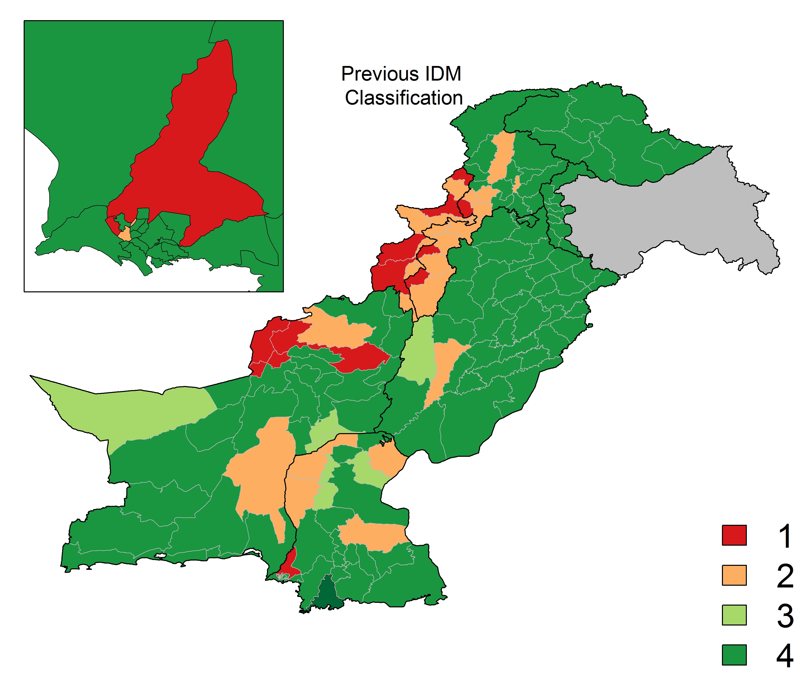
Final Classification

