Slide 1
Modeling Driving-Y Gene Drive
to
Eliminate Malaria
in
the Democratic Republic of Congo (DRC)
Nawaphan Metchanun
Center for Development Research (ZEF)
16.04.2019

Slide 2
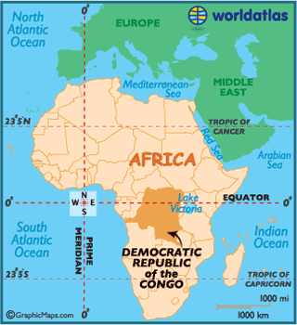
DRC is facing challenges in malaria control
The second highest malaria burden country
Nearly all of the DRC population lives in high malaria transmission zones
The difficulty in access to malaria control methods has been prominent in this complex operating environment
Notes:
Baseline transmission is high
Huge country: area, population number ranked 3rd in sub-sahara Africa (81 million) – 30 million (40%) people lived within 1km of political violence in 2018
Mass unrest – both the number of events and the number of locations have steadily risen over the last 20 years
Lack of traditional infrastruction, insufficient capacity for complex programs
Limited in resource, information, funding
DRC continues to experience challenges in access to preventive and curative malaria interventions, as well as an environment that supports very high transmission rates. Funding, infrastructure challenges and insecurity are all key obstacles to achieving the intervention coverage needed to protect populations at risk

Slide 3
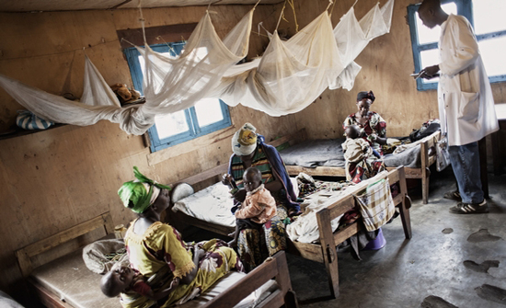
Ongoing challenges in the management of malaria
Current methods for malaria control focus on
Drug therapy
Vector control
Key challenges
Resistance to anti-malarial drugs
Insecticide resistance
Residual and outdoor transmission
Notes:
Anti-malarial drug resistance, as defined by WHO was often documented decades after the events of emergence or spread, leading to a gap between the information gathered by researchers and actions taken by program managers and implementers.
The emergence of artemisinin and insecticide resistance
Malaria vectors have heterogeneous behaviours (early biting or outdoor versus indoor biting) varying by species, but not only, as some species may have a different biting behaviour depending on the geographical location, all those variations illustrating behavioural plasticity. Mosquito behaviours and population might be selected over the long term by interventions/vector control measures, leading to: (1) a shift of species, as documented in Kenya where increasing coverage of LLINs led to an increasing proportion of Anopheles arabiensis, replacing progressively Anopheles gambiae; (2) a shift to early biting, as in Benin, where scale-up of LLINs to universal coverage and replacement of LLINs led to selection of early biting mosquitoes; (3) a shift to outdoor and early biting, as in Solomon islands, where after use of IRS with DDT, the relative proportion of Anopheles farauti with outdoor and early biting behaviour has increased.
Further scale-ups in coverage of these methods may be driving malaria to a new low equilibrium but not to zero (resurgence).

Slide 4
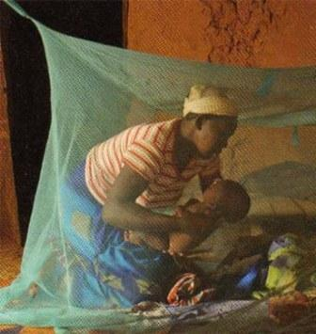
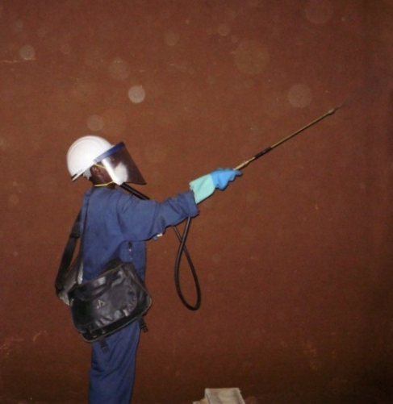
Difficult to implement core vector control methods
Core vector control methods
Long-lasting insecticidal nets (LLINs)
Indoor residual spraying (IRS)
There are limitations to LLINs/IRS, and that we need to look beyond these tools to find novel vector control interventions
One proposed set of tools relies on the release of genetically modified mosquitoes
Notes:
Challenging to implement current core vector control methods and if implement, will it achieve elimination?
Current methods for malaria control focus on two themes, drug therapy and vector control.
ITN deployments have made great gains in reducing transmission due to vector species tha feed indoors at night. There are levels of outdoor biting by An. gambiae (primary vector species in DRC, the most important vector of malaria in Africa) throughout the night, including during the early evening and morning hours when human hosts are often outdoors resulting in substantial residual transmission
For DRC, the most recent WHO reported that the national IRS coverage was less than 1%.

Slide 5
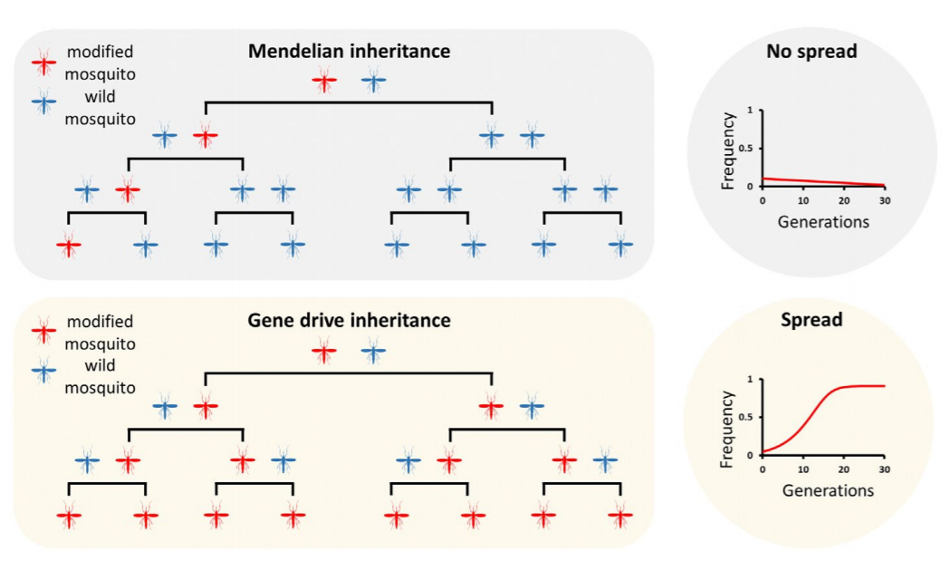
Gene drive allows some genes to spread rapidly through populations
Mendelian inheritance versus Gene drive inheritance
Notes:
Drive is a process of accelerated inheritance from one generation to the next that allows some genes to spread rapidly through populations even if they do not contribute to—or indeed even if they detract from—organismal survival and reproduction.
Upper panel: In mosquitoes, as for any other sexually reproducing organism, genetic elements in heterozygosis have a 50 percent chance of being inherited by the progeny and therefore its frequency remains constant in the population, or more likely, it is gradually lost if the transgene carries a cost.
Lower panel: A gene drive results in most or all progeny of heterozygotes receiving the driving genetic element, this allows the modification to spread rapidly throughout the population over a few generations.

Slide 6
Three approaches are considered and developed for using gene drive in the context of malaria
Mosquito population replacement
Moving an anti-parasite transgene through the mosquito population, rendering it refractory to Plasmodium infection or ineffective at transmission
Mosquito population suppression
Targeting fertility genes in mosquitoes leads to population suppression or collapse
Driving-Y system: Y chromosome in the modified male mosquito damages the X chromosomes in the germline, resulting in gametes that predominantly carry a Y chromosome and a distorted sex ratio in viable offspring

Slide 7
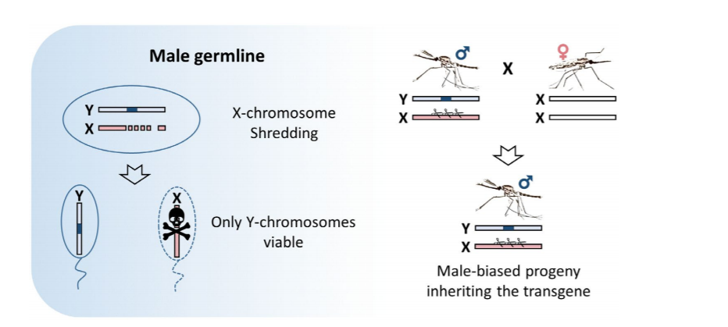
Driving-Y gene drive as a new intervention?
Driving-Y gene drive
Modified males have predominantly male offspring
Under certain parameters for X-shredding and fecundity reduction, this could lead to local population collapse
Notes:
Driving-Y system: An endonuclease (blue block) which is a sex distorter placed onto the mosquito Y-chromosome is expressed during male meiosis to cut a multicopy target sequence on the X-chromosome. The shredding of the X-chromosome favors the unaffected Y-carrying sperm and results in the production of a male-biased progeny.
In Aedes and Culex mosquitoes, there is a naturally occurring driving Y chromosome that, in some crosses, is transmitted to more than 90% of a male’s progeny.
How far have we gotten? What are the recent lab successes?
In laboratory study, the expression of selectively targeted X chromosome carrying spermatozoa, thereby causing transmission ratio distortion. These results demonstrate that synthetic sex distortion mechanisms can be developed. Both mathematical modelling and the study of naturally occurring sex distorters in some insect species including predict that, if linked to the Y chromosome, such distorters would represent extremely powerful tools to knock down a target population in a relatively short time.

Slide 8
Driving-Y parameters
X-shredding rate: The shredding rate of the X chromosome in which favors the unaffected Y-bearing sperm and results in the production of a male-biased progeny.
Fecundity reduction: The reduction of the potential to reproduce offspring
Notes:
Fecundity reduction: females that mate with a driving-Y male have their fertility reduced. They lay fewer eggs reducing the total egg batch size.
Note:
Fecundity is an important component of both sexual and asexual reproduction, and it can be viewed as a direct (production of offspring) or an indirect (assisting in the reproduction of related individuals) process.
From a genetic perspective, reproductive fitness is the combination of fecundity and survival and is used to measure the effects of inbreeding depression on populations.

Slide 9
WHO targets malaria elimination by 2030
Elimination:
Reduction to zero (or a very low defined target rate) of new cases of an infectious disease in a defined geographical area
Requires continued measures to prevent re-establishment of disease transmission
Eradication:
The complete and permanent worldwide reduction to zero new cases of an infectious disease
No further control measures are required
Notes:
Elimination: Reduction to zero (or a very low defined target rate) of new cases of an infectious disease in a defined geographical area as a result of deliberate efforts; continued measures to prevent re-establishment of transmission are required. refers to the reduction to zero (or a very low defined target rate) of new cases in a defined geographical area.
Elimination requires continued measures to prevent re-establishment of disease transmission.
Eradication: The complete and permanent worldwide reduction to zero new cases of an infectious disease through deliberate efforts; no further control measures are required. refers to the complete and permanent worldwide reduction to zero new cases of the disease through deliberate efforts.
If a disease has been eradicated, no further control measures are required e.g. Smallpox

Slide 10
Applying Driving-Y model: could gene drives help the DRC achieve malaria elimination by 2030?
Simulation framework
Planning gene-drive mosquito release strategy in non-spatial setup:
Assessed X-shredding rate and fecundity reduction
Determined potential mosquito release patterns (frequency and number)
Evaluating interventions in spatial setup:
Built 8 models of 8 DRC provinces capturing transmission intensities, transmission seasonality, and demographics
Identified current core malaria control methods that could help eliminate malaria for each province
Added driving-Y gene drive in packages that failed to achieve elimination to see if it could help achieve elimination
Notes:
New tech
Parameters
Could gene drive help DRC eliminate malaria?
How many mosq should be released?
What are parameters on the driving-Y gene drive that would result in elimination?
Note:
Spatial data: information about the locations and shapes of geographic features and the relationship between them, usually stored as coordinates and topology

Slide 11
Modeling Driving-Y gene drives
Simulations were carried out using Epidemiological MODeling software (EMOD) version 2.18
The mechanisms to implement gene drive were added to the basic EMOD model applying genetic variable:
All females were wildtype while modified males carried a driving Y-chromosome
→ mating produced offspring
For each female that mated with a modified male, the total egg batch size was reduced by the parameter fecundity reduction
Only females that mated with a driving-Y male had their fertility reduced
Notes:
EMOD: an agent-based, discrete time, Monte Carlo simulator of malaria transmission with vector life cycle and within-host parasite and immune dynamics.
How the gene drive model works?
Females that mated with a driving-Y male would have wildtype females and males carrying the driving-Y chromosome offsprings
The fraction of offspring that were driving-Y males: 0.5+0.5(Xshredding)
The fraction of offspring that were wildtype females: 0.5-0.5(Xshredding)
Note:
If it is desired to have 65% of the original egg batch size to be driving-Y male and 35% fertile female
X-shredding should be 0.3 and fecundiy reduction 0
Driving-Y offspring: 0.5+0.5(0.3) = 0.5+0.15 = 0.65
Female offspring: 0.5-0.5(0.3) = 0.5-0.15 = 0.35
If it is desired to have 65% of the original egg batch size to be driving-Y male and no female
X-shredding should be 1 and fecundiy reduction 0.35
Driving-Y offspring: 0.5+0.5(1) = 0.5+0.5 = 1
Female offspring: 0.5-0.5(1) = 0.5-0.5 = 0

Slide 12
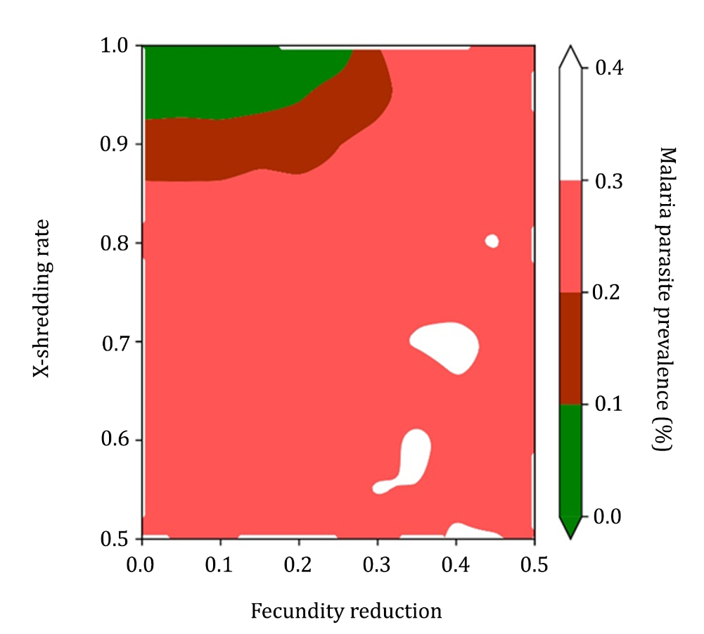
Effective gene drives required high X-shredding rate and low fecundity reduction
Driving-Y parameters of 200 gene-drive mosquitoes
in Kinshasa province
Driving-Y parameters that would later applied:
Fecundity reduction: 0.05, 0.1, 0.15
X-shredding rate: 0.9, 0.95, 1.0
Notes:
Explain why the corner:
fecundity reduction affects the egg batch size while X-shredding rate affects the number of driving-Y offspring in each egg batch.
If the fecundity reduction is too high-> females mated with driving-Y males produce much smaller egg batch size (even though the X-shredding is 100%) -> fewer driving-Y males will be produced in an egg batch compared with wild-type males in a wild-type-mated egg batch -> the driving-Y construct will disappear (not sustain) -> upper limit of fecundity reduction = 0.5
The X-shredding value needs to be sufficient to prevent wild-type female offspring to be born in each egg batch because enough wild-type females will sustain the local population and stave off collapse.
Why are we seeing the corner of this space be the effective one?
driving-Y diagram

Slide 13
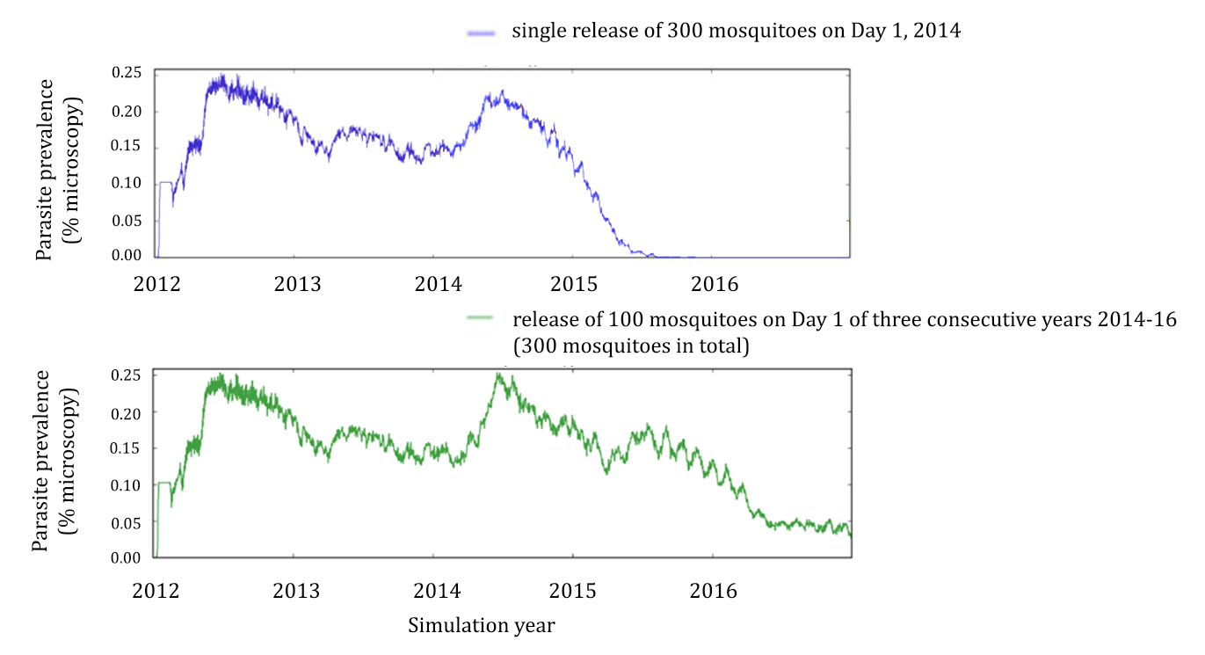
Single release of sufficient amount worked faster
Kinshasa province
Notes:
Remove the baseline

Slide 14
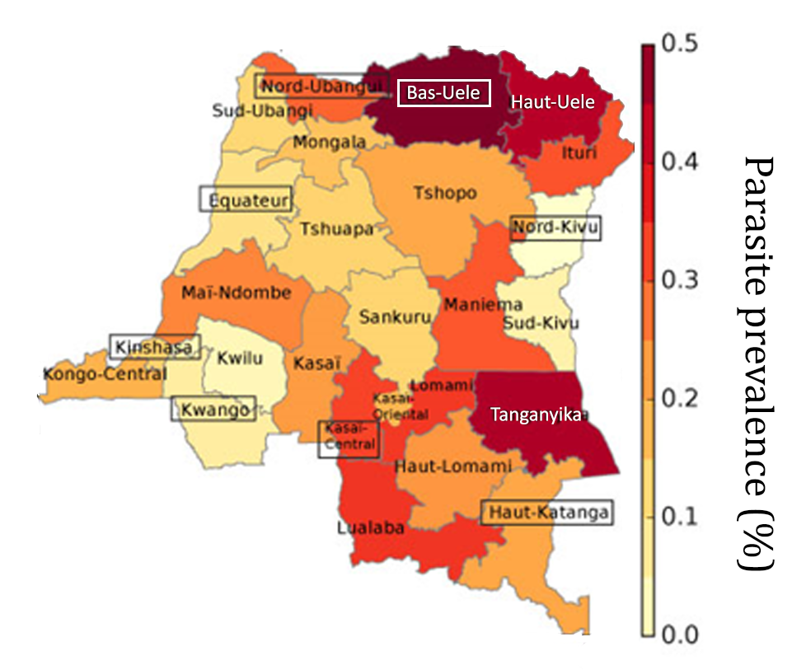
Target locations are representatives of what could happen everywhere in DRC
Provincial stratification based on reported malaria parasite prevalence* (%)
The selected provinces span the range of transmission intensities across the whole countries
Larval habitat was calibrated to the reported parasite prevalence data
*From prevalence data presented in DRC-Demographic and Health Survey (DHS) II 2013-2014
Notes:
Develop strategies for DRC
->DRC has diff transmission seasonality, transmission intensity -> we‘re trying to develop strategies for the DRC
The selected provinces span the range of transmission intensities across the whole countries, so insight into these 8 locations are representatives of what could happen everywhere in DRC.
Larval habitat:
a primary driver of local mosquito populations
determines the amount of vectors through the year and hence biting intensity and transmission
DRC-Demographic and Health Survey (DHS) II 2013-2014

Slide 15
Applying interventions
Schematic of scenario description for EMOD simulations conducted
Interventions evaluated:
• ITNs
• IRS
• ACT: Artemether + Lumefantrine
• Driving-Y gene drive mosquitoes
Simulated 25 nodes (observation points) per province
5km between nodes
→ 25km*25km grid
Vector migration
300 gene drive mosquitoes were single released at central node of each location in scenarios that failed to reach elimination
Other interventions were implemented in all nodes
Coverage: 50%, 80%, and 95%
ITN: Insecticide-Treated Net
IRS: Indoor Residual Spraying
ACT: treatment of symptomatic cases with Artemisinin-based Combination Therapy
Notes:
ACT: treatment of symptomatic cases**
21 scenarios with intervention + 1 null scenario
Note:
Run-in: The 50-year run-in was applied to give the population correct immune system. At the beginning of the simulation the model assumed the population had no immune to malaria and they have been exposed to malaria possibly multiple times over 50 years. Therefore, they have become immuned.

Slide 16
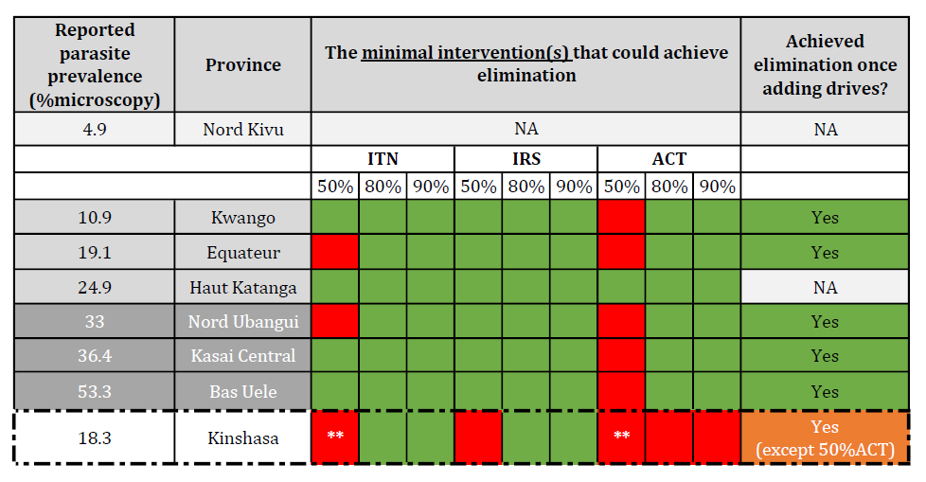
Gene drives could help eliminate malaria in target locations within 15 years
NA = Not Applicable
** = both single and 2-combination (50% ITN+ACT) failed to eliminate malaria
Notes:
Haut Katanga
Kinshasa

Slide 17
Limitations and future work
The present simulations focused on a single species
Can be generalized in setting with multiple local Anopheles vectors
(highest vectorial capacity → insufficient summed vectorial capacity to sustain malaria)
Models
Assumed no resistance
Assumed no human migration
Used mean transmission seasonality of year 2000-2015 for every node within the same province
Used mean parasite prevalence of estimated parasite rate in children between the ages of two and ten (PfPR2-10) year 2000-2015 for each node
The spatial simulations were performed within 25km*25km grid
Notes:
Why these matter and how they might change the results if they have been included in the model?
Single vector species:
Our present results for a single species can be generalized to the case of malaria elimination in settings with multiple local Anopheles vectors. Starting by selecting the species with the highest vectorial capacity and continue with the next highest in sequence until the summed vectorial capacity of the remaining species is insufficient to sustain malaria.
The single-species results help define critical construct parameters and release strategies for each species, noting that different species may exhibit different seasonality and thus have different required X-shredding rate and fecundity reduction and different optimal release times. This saves on logistics and delivery, even if it requires more released mosquitoes of at least one species, compared with its optimal strategy.
Resistance:
Gene drives can be used in case of insecticide and/or antimalarial drug resistance. The higher baseline transmission or higher dry season transmission make it easier for gene drive to succeed. Dry-season transmission is both good for gene drive success AND leads to bigger human infectious reservoir.
Human migration:
The immigration of infected people could reintroduce the disease to the previously cleared areas and an increased number of infected people could facilitate malaria transmission and result in an increase of malaria transmission in the area. The higher number of population in the area can also make it more difficult for malaria control and elimination.
Mean seasonality:
Seasonality matters, and the recurring annual low season is crucial in allowing mosquito population collapse. A higher dry-season transmission, when there is little mixing between localities with the construct and those where it has not yet reached, can actually make the gene drive construct more able to succeed. On the contrary, the low-transmission, poor-mixing, extended–dry-season setting is among the most difficult settings for gene drive.
Looking closely at seasonality patterns of the geographic locations could result in more effective gene-drive mosquito release strategies.
Mean parasite prevalence:
The actual parasite prevalence could be better reflected in the model taking into account the current interventions already applied in the area.
Note:
Single species → the model can easily simultaneously handle multiple local species with varying habitat and seasonal responses
Generalization from single species: starting by selecting the species with the highest vectorial capacity and continue with the next highest in sequence until the summed vectotrial capacity of the remaining species is insufficient to sustain malaria.
Used mean transmission seasonality from United States Geological Survey’s vectorial capacity data year 2000-2015 for every node within the same province
Used mean parasite prevalence of estimated parasite rate in children between the ages of two and ten (PfPR2-10) year 2000-2015 extracted from Malaria Atlas Project raster data for each node

Slide 18
Acknowledgement
Center for Development Research (ZEF), University of Bonn
Christian Borgemeister
Joachim von Braun
The German Academic Exchange Service (DAAD)
The Institute for Disease Modeling (IDM)
Jaline Gerardin
Benoit Raybaud

Slide 19
Supplement 1: intervention coverage (DRC’s current national status)
Source: WHO Malaria report 2018.

Slide 20
Supplement 2: intervention parameters applied
Intervention | Parameter | Value
ITN | Adherence | 65%
 | Probability of success when not fully compliant | 0%
IRS | Adherence | 100%
 | Probability of success when not fully compliant | 0%
ACT (Artemether + Lumefrantrine) | Parameters and values used in the model followed (source)

Slide 21
Supplement 2: intervention parameters applied (2)
ITNs
initial strength of the blocking effect for indoor mosquito fed on an individual with an ITN was 0.9
blocking decayed at an exponential rate in 730 days
initial strength of the killing effect that the mosquitoes were killed, conditionally on a successfully blocked feed was 0.6.
killing effect decayed at an exponential rate in 1,460 days
The model assumed an individual who received a bednet used it and the bednet was replaced every 3 years.
Since the ITN coverage was varied, the fraction of individuals in the target demographics received ITNs varied
IRS
The model assumed no blocking effect though IRS also has a repellency effect which decayed over the period of 730 days
The initial killing effect was 0.7
The initial killing efficacy is held 30 days, then the efficacy decays at an exponential rate over 120 days.

