Slide 1
Evaluating the impact of HIV pre-exposure prophylaxis (PrEP) and condom use among female sex workers
Zindoga Mukandavire
Social and Mathematical Epidemiology Group
London School of Hygiene and Tropical Medicine, UK
Improving health worldwide
www.lshtm.ac.uk

Slide 2
SaME-http://blogs.lshtm.ac.uk/samegroup/
Social and Mathematical Epidemiology
Interdisciplinary group working on the quantitative and qualitative processes that determine patterns and distribution of diseases in populations
  Focus on HIV and GBV and their interaction (Lori Heise, Charlotte Watts)
  International expertise on migration (Cathy Zimmerman) and health economics (Anna Vassall)
  Rebuilding mathematical modelling expertise (Graham Medley)
Interdisciplinarity is a means to defining / framing the “real” problem to be addressed rather than defining the problems that can be solved

Slide 3
Modelling
A key question for mathematical modelling is how to incorporate social processes into mathematical models of infectious disease
  Behaviour determines risk of infection, adherence to treatment etc
  Behaviour is determined by social norms, economic resources etc
  Currently included as “groups” (FSW, clients etc.)
How should groups be defined?
  Demography of groups – individuals enter & leave groups; what determines these rates?
  Should group definitions be changed as epidemics progress?
  How do interventions change groups and their interactions?

Slide 4
Background
Despite numerous modelling efforts assessing the utility of PrEP in preventing HIV transmission, few studies have considered impact among FSWs.
PrEP use could be very effective in this group.
However, condom interventions can reduce HIV transmission in commercial sex:
  -But may not be used in some partnerships such as ‘pimps’
Is there a place for PrEP in FSW targeted interventions or are condoms always a better choice

Slide 5
Study aims
Develop model to explore possible impact of PrEP amongst FSWs in epidemic scenarios where pimps either do or do not contribute to HIV transmission.
Compare the relative impact of increasing condom use to scaling up coverage of PrEP:
  Impact assessed in terms of decreases in HIV prevalence or HIV infections averted

Slide 6
Methods
Developed a dynamic deterministic compartmental model
Used a combination of analytical and numerical tools
Behavioural data from West Africa and South Asia

Slide 7
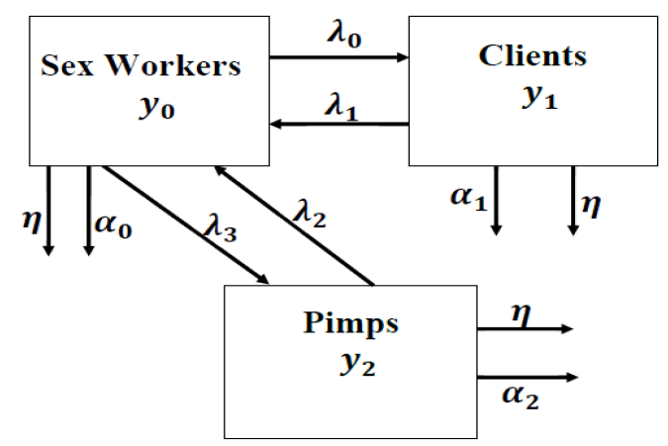
Compartmental model

Slide 8
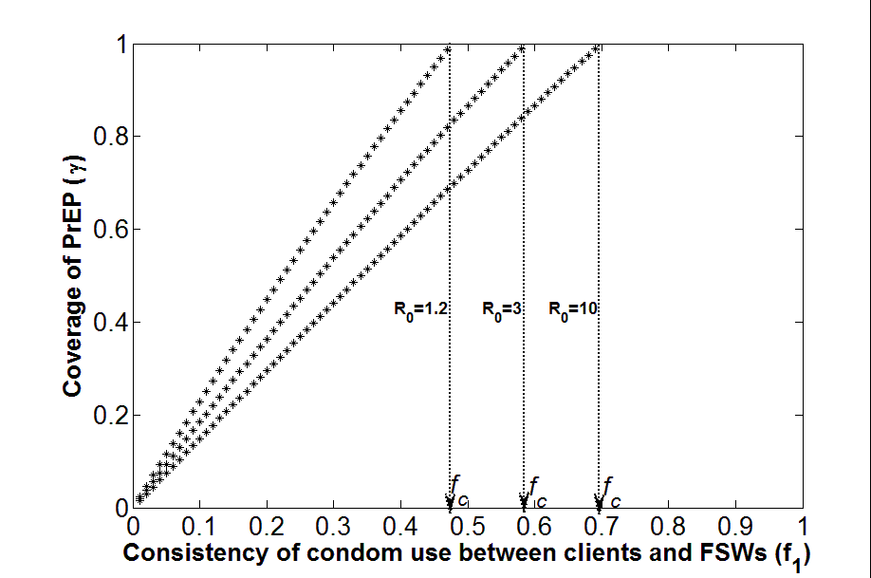
Results-model without pimps
To achieve the same impact on FSW HIV prevalence as increasing condom use by 1%, the coverage of PrEP has to increase by>2%.

Slide 9
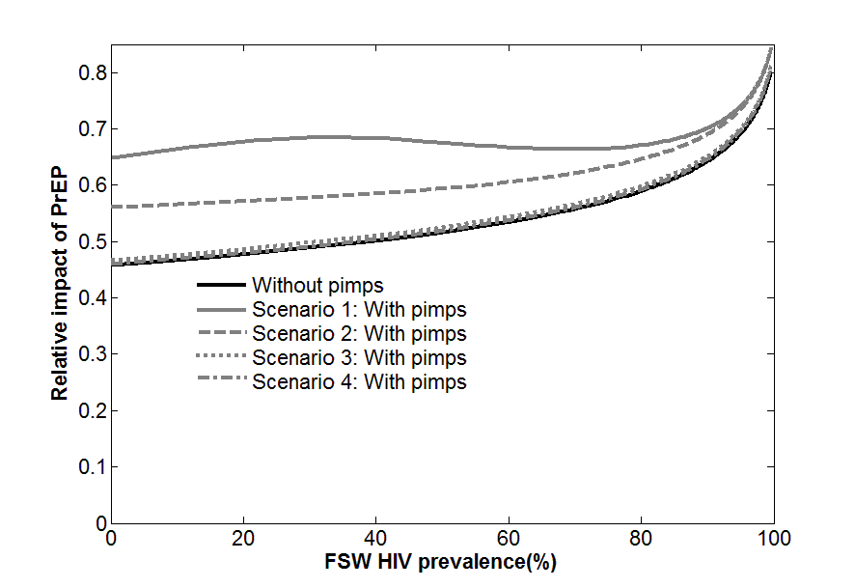
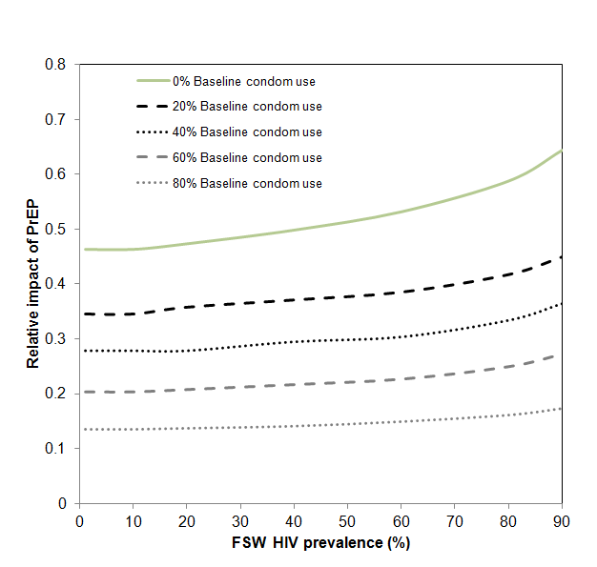
Results-model with pimps
The relative impact of PrEP increases for scenarios where pimps contribute to HIV transmission-and decreases with higher baseline condom use.

Slide 10
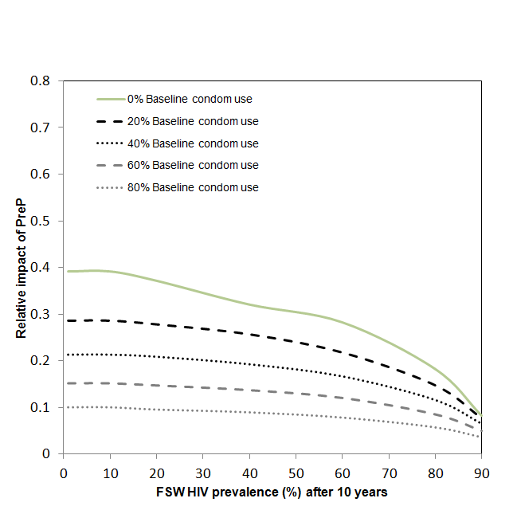
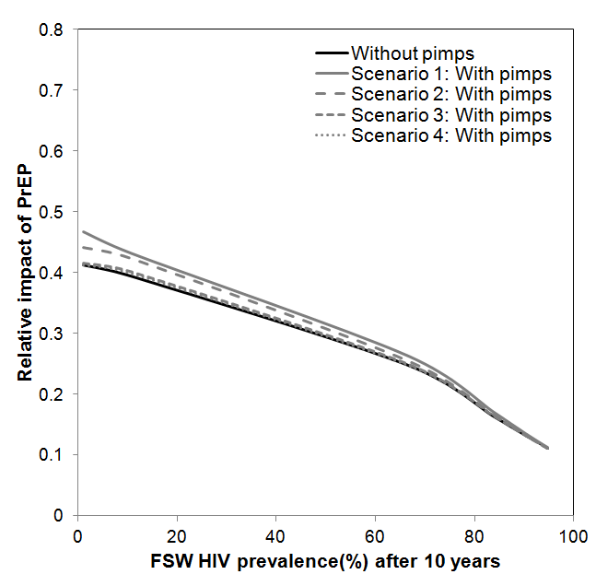
Results-model with pimps
In terms of HIV infections averted over 10 years, the, relative impact of PrEP compared to condoms was reduced, with a >3% increase in PrEP coverage achieving the same impact as a 1% increase in condom use.

Slide 11
Conclusions
Condom promotion interventions should remain the mainstay HIV prevention strategy for FSWs.
PrEP should only be implemented once condom interventions have been maximised or to fill prevention gaps where condoms cannot be used.
Mukandavire et al. Comparing the impact of increasing condom use or HIV pre-exposure prophylaxis (PrEP) use among female sex workers, Epidemics, Volume 14, 2016, 62-70.

Slide 12
Acknowledgements
Prof Graham Medley: Head, Social and Mathematical Epidemiology Group London School of Hygiene and Tropical Medicine, UK
Prof Peter Vickerman: School of Social and Community Medicine, University of Bristol, Bristol, UK
Dr Kate M. Mitchell: Department of Infectious Disease Epidemiology, Imperial College London, London, UK
This research was funded by the Bill and Melinda Gates Foundation project: ARV-Based Prevention Technologies: Developing the Capacity and Needed Tools to Deliver New Prevention Products

