Slide 1

Fulfilling the potential of genomic epidemiology of malaria
Daniel Neafsey
April 19th, 2017
Institute for Disease Modeling Symposium

Slide 2
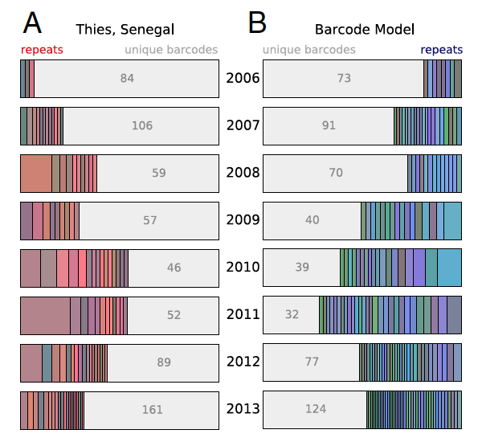
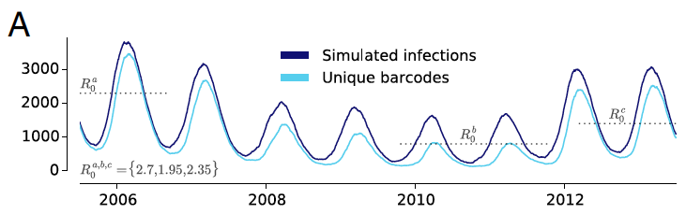






Malaria Genomic Epidemiology
COIL (Complexity of Infection by Likelihood)
New data types and technologies
New investments in modeling needed

Slide 3
Malaria Genomic Epidemiology Use Cases
Changes in disease transmission level
Population connectivity
Drug resistance monitoring

Slide 4
A segment of sequence is identical by descent (IBD) between two samples if they both inherit it unchanged by mutation or recombination from a common ancestor.
HMM code: https://github.com/glipsnort/hmmIBD
Steve Schaffner and Aimee Taylor
Notes:
Need models to inform each of these applications

Slide 5
The genetic composition of polygenomic infections is influenced by how strains are transmitted
Superinfections result from multiple mosquito bites.
Strains assumed to be randomly sampled and thus unrelated.
Cotransmitted infections result from the transmission of multiple strains from a single mosquito bite.
Strains can be genetically related (IBD) to one another due to meiosis.
Notes:
we (I) have started using genetic epidemiology models to understand how transmission affects parasite genetics, with an emphasis on polygenomic infections. Transmission is split into two concepts: the intensity (frequency of transmission) and the topology (how infections are transmitted to other individuals).

Slide 6

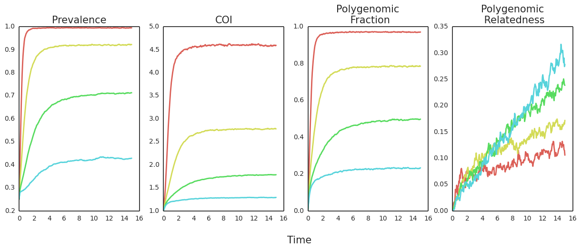
Modeling the effects of transmission intensity on the genomic infection profiles
Prevalence
COI (no. strains)
Intra-infection IBD
Transmission
Intensity
Stochastic agent-based genetic epidemiology model
Time
Wes Wong, Edward Wenger
Wes Wong, Edward Wenger
Notes:
Slide 1 is about differences in transmission intensity. Epidemics were simulated on a complete mixing network (all individuals can transmit to anyone in the population; which is a common assumption in simplistic models) at different transmission intensities.

Slide 7
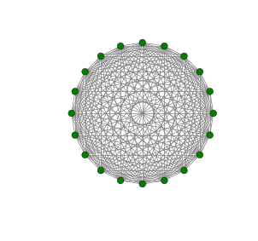
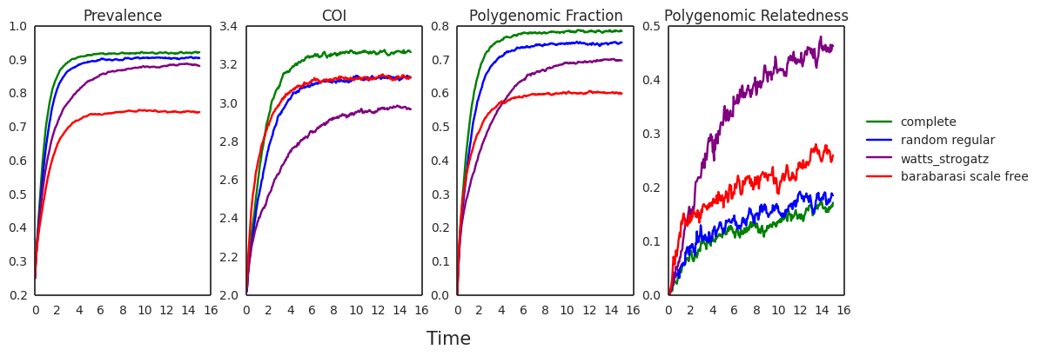
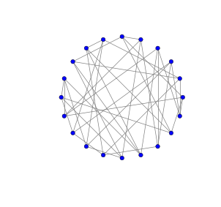
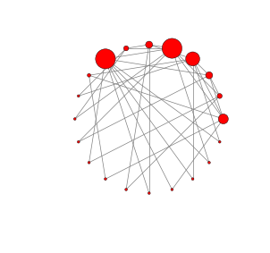
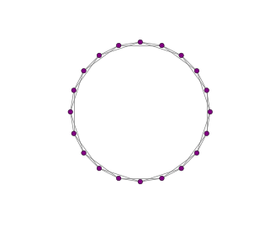
Transmission topology impacts genomic infection profiles
Complete Mixing
Prevalence
COI (no. strains)
Intra-infection IBD
Random Regular
Barabasi Scale Free
Time
Wes Wong, Edward Wenger
Watts Strogatz Small World
Notes:
Using networks with different topologies (defined by the degree (# of connections), the degree heterogeneity (variance of the degree), and the clustering coefficient) to determine how differences in population structure can affect the genetic composition of polygenomic infections.
Slide 2 is about transmission topology. Epidemics were simulated on the 4 networks depicted there. The different networks try to capture some aspect of actual transmission (like limited transmission potential, transmission heterogeneity aka superspreader, and clustered transmission). The lines represent results from epidemics simulated on different networks but using the same transmission intensity.

Slide 8
Malaria Genomic Epidemiology Use Cases
Changes in disease transmission level
Population connectivity
Drug resistance monitoring

Slide 9
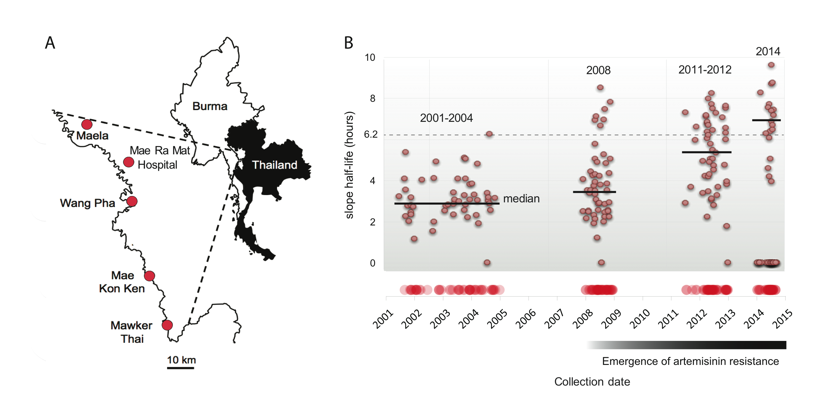



Thailand: 178 sequenced genomes spanning the rise of ART resistance
…and 1731 samples with
93-SNP
barcodes
(Nkhoma et al. 2013)
Clearance rate half-life (h)
Collaborators: Tim Anderson & Ian Cheeseman (Texas Biomed) & François Nosten (SMRU)

Slide 10

No significant allelic differentiation between clinics
93 genotyped SNPs
1731 samples
Whole genome sequence
178 samples
Aimee Taylor

Slide 11
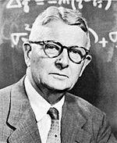
The ‘OMPG’ Rule
One Migrant Per Generation will stop neutral divergence (drift) between populations, regardless of population census size.
(Population divergence)
Sewall Wright
Mills & Allendorf (1986)

Slide 12
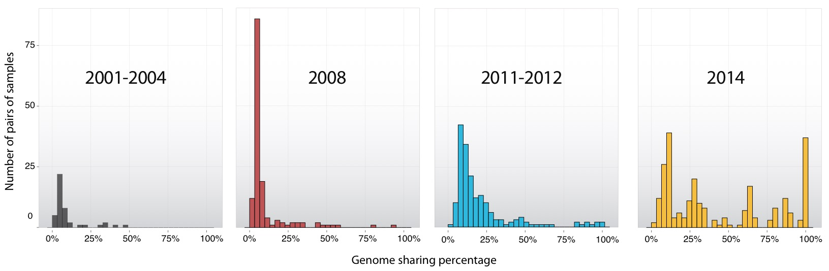

Increase in recent common ancestry over time
Number of sample pairs
% genome shared (IBD)
Gustavo Cerqueira et al. Genome Biology (in press)

Slide 13
Recent common ancestry correlates negatively with clinic distance
93 genotyped SNPs
1731 samples
Whole genome sequence
178 samples

Slide 14
IBD proportion can quantify parasite population connectivity at very small geographic scales

Slide 15
Malaria Genomic Epidemiology Use Cases
Changes in disease transmission level
Population connectivity
Drug resistance monitoring

Slide 16
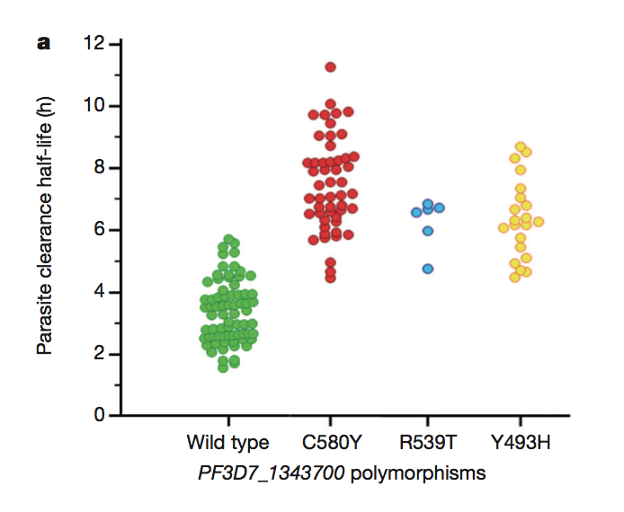
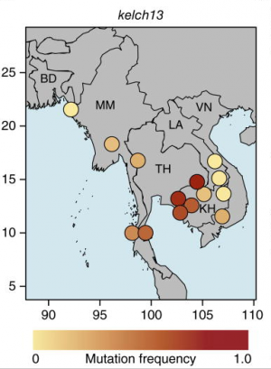

Artemisinin resistance in SE Asia is mediated by Kelch13
Ariey et al. 2014
Miotto et al. 2015
Notes:
What do we know about artemisinin? So far we only have solid resistance markers from one locus.

Slide 17
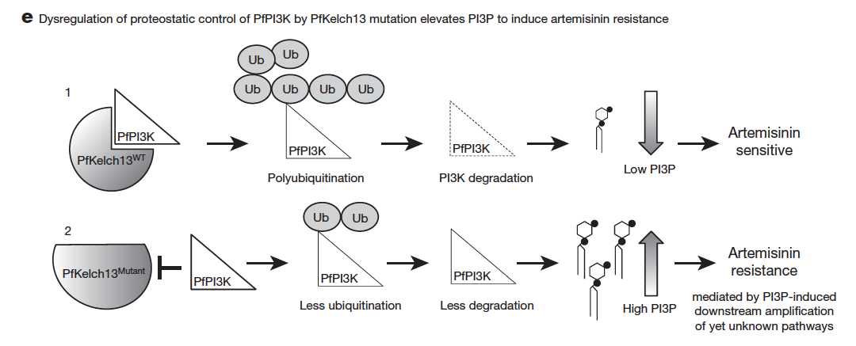
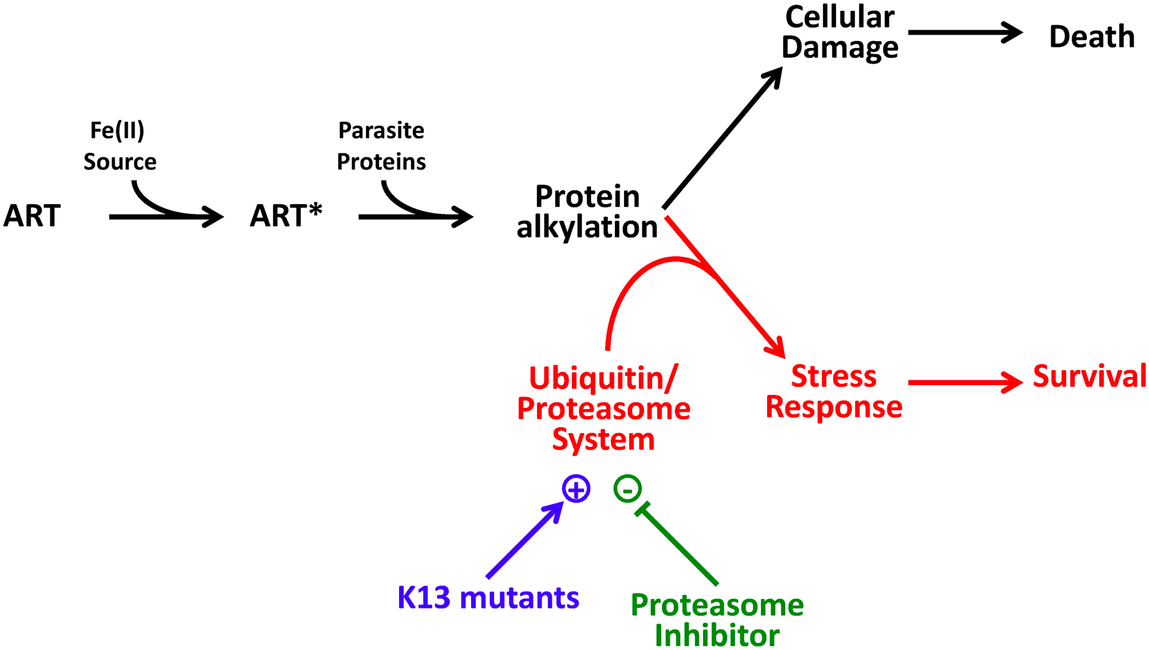
Mechanism of resistance?
Cell stress response (proteasome/ubiquitination)
Modulation of PI3P
Mbengue et al 2015 (Nature)
Dogovski et al 2015 (PLoS Genetics)
Notes:
ART treatment induces enhanced ubiquitination.
Resistant parasites have less ubiquitination.
Proteasome inhibitors can confer ART sensitivity and overcome the stress response.

Slide 18
Do mutations at other loci contribute to artemisinin resistance?
Chloroquine resistance: pfcrt and pfmdr1 (Duraisingh et al. 2000)
Pyrimethamine resistance: pfdhfr and gtp-cyclohydrolase (Nair et al. 2008)
Artemisinin combination therapy resistance:
Miotto et al. (2015)
GWAS: fd, arps10, mdr2, pfcrt
Amato et al. (2017), Witkowski et al. (2017)
GWAS: plasmepsin 2-3 amplification confers partner drug (piperaquine) resistance

Slide 19
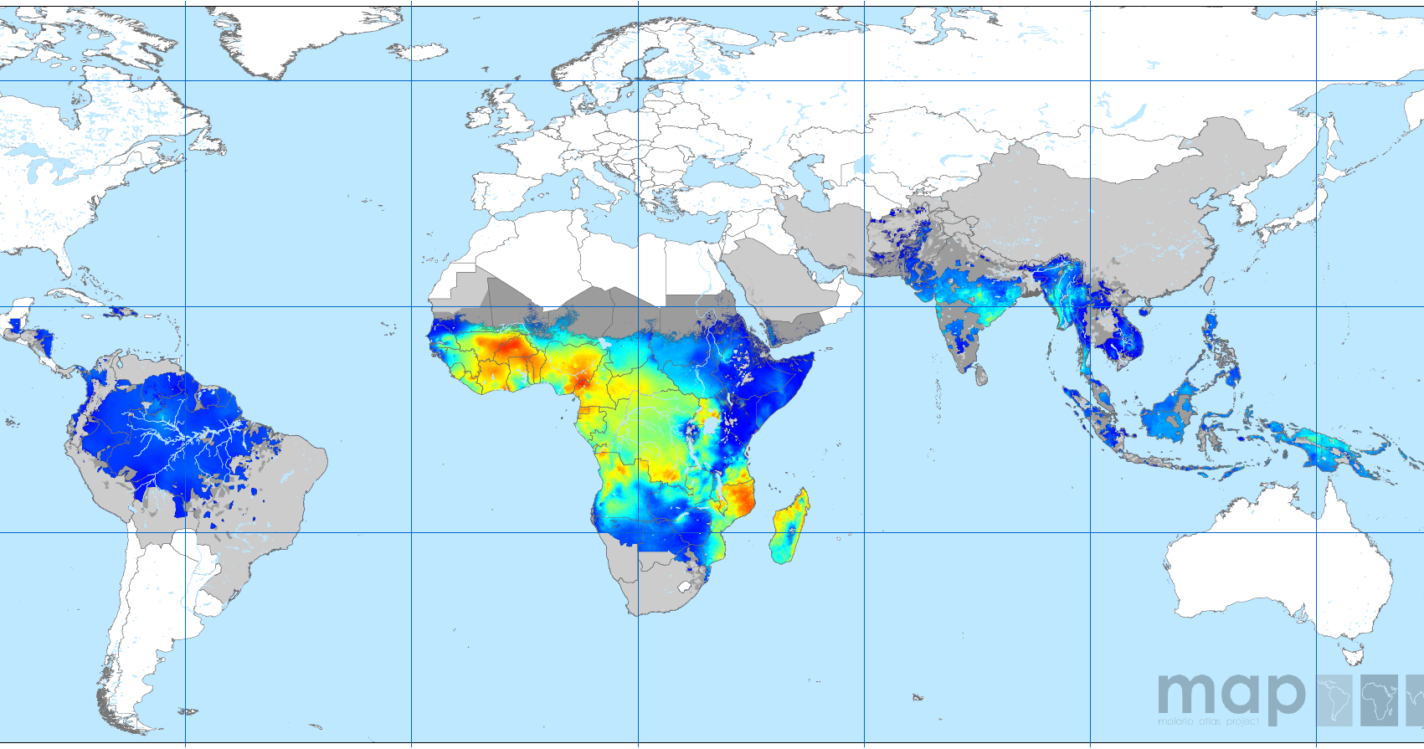
Disease prevalence does not predict de novo drug resistance
CQ
ART
SP
CQ
CQ
CQ
CQ
SP
SP
P. falciparum prevalence in 2-10 year olds (2010)
Notes:
One question about artemisinin resistance is where it will develop next, and if it will follow the pattern of CQ and PYR resistance.
Falciparum endemicity 2010 (prevalence in 2-10 year olds)
CQ resistance exported to Africa in ~1978 (Wooton et al. 2002)
DHR triple mutant exported to Africa in (Roper et al. 2004)
Why does high fitness resistance routinely arise in lower-endemic regions? Classic popgen says large sexual populations should be most efficient for selection.

Slide 20
Resistance mutations arise in every individual infection, in every population
3 x 10⁻⁹ x 10¹¹ = 300
Mutations per base pair per 48 hr cycle
Parasites at peak of blood stage infection
Number of times each base is mutated in one generation within a single infection
(Bopp et al. 2013)
Notes:
Genomic background and context may be important for elevating resistance to a functional level

Slide 21
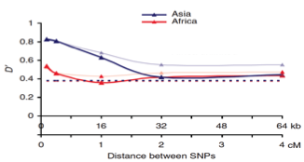
Why has high fitness resistance not evolved in Africa?
Higher transmission
Greater immunity (less drug treatment)
More multi-strain infections
  Greater competition
  More recombination
Linkage disequilibrium
Volkman et al, 2007 (Nature Genetics)

Slide 22
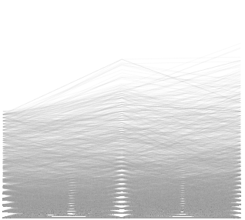
Variants with highest net change in frequency
Proteasome regulatory subunit
P=0.03
Inositol polyphosphate 5P (IP5P)
Clearance rate
High mobility group protein B3
Δ > 40%
Allele frequency
ALT
REF
(99.9 %tile)
No. SNPs
Frequency change 2001-2012
Year
Notes:
Other nonsyn variants are conserved hypothetical proteins

Slide 23
Modeling gap: origin and spread of multi-locus resistance in a facultatively outcrossing sexual eukaryote
How likely is de novo resistance to evolve given local endemicity and given the number of mutations required for high fitness resistance?
How likely is high-fitness resistance to spread to higher-endemicity settings? Is containment impossible or important?
Notes:
Longitudinal WGS data will give us an unprecedented opportunity to understand the genomic architecture of resistance.

Slide 24
Routine Sampling:
Malaria Indicator Surveys
Demographic and Health Surveys
Therapeutic Efficacy Studies
Decisions based on aggregate analysis:
Changes in Transmission Intensity
Infection connectivity
Certification of Elimination
Drug Resistance Surveillance
Decision Support System

Slide 25


Acknowledgements
Broad Institute Genomic Center for Infectious Disease
Texas Biomedical Research Institute
Standwell Nkhoma
Ian H. Cheeseman
Marina McDew-White
Shalini Nair
Timothy J.C. Anderson
Shoklo Malaria Research Unit, Thailand
François Nosten
Institute for Disease Modeling
Edward Wenger
Joshua Proctor
Philip Welkhoff
Gustavo Cerqueira
Seth Redmond
Angela Early
Aimee Taylor
Stephen Schaffner
Bronwyn MacInnis
Bruce Birren
University Cheikh Anta Diop
Daouda Ndiaye
Harvard University
Dan Hartl
Harvard T.H. Chan School of Public Health
Dyann Wirth
Sarah Volkman
Rachel Daniels
Wes Wong
Caroline Buckee
The malaria patients who contributed samples.

Slide 27
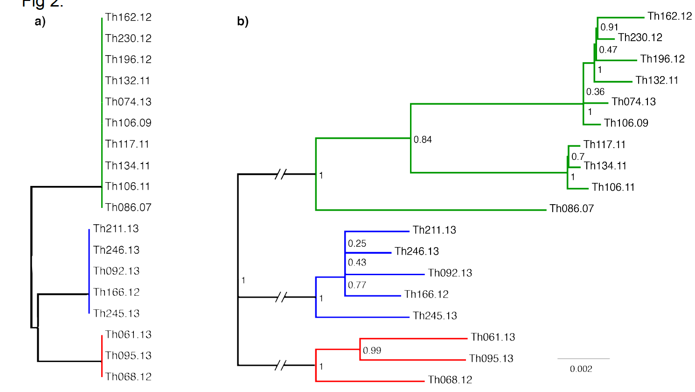

Resolving the transmission history of nominally clonal isolates
Seth Redmond

Slide 28

IBD within & between populations
Steve Schaffner
Senegal
Senegal
vs.
Thailand
???
Pfcrt
???
Pfcrt
Dhfr

Slide 29
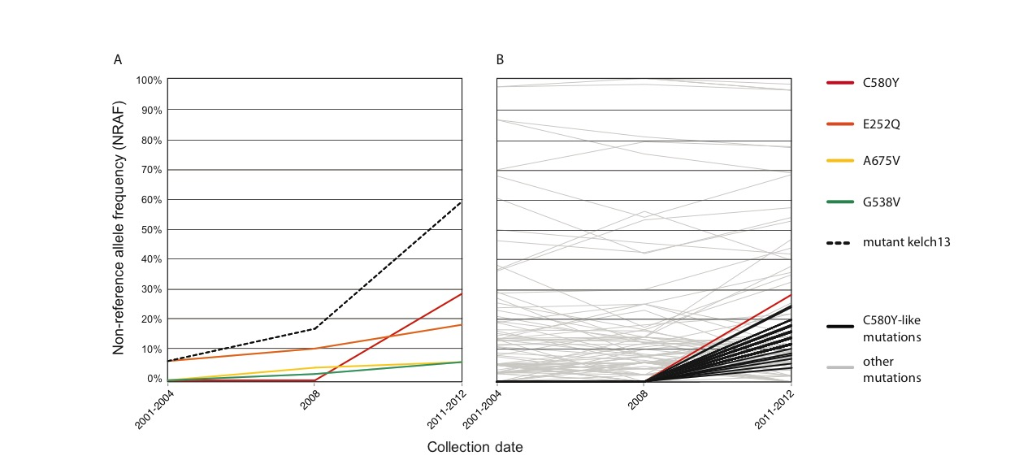
Look for SNPs with K13-like trajectory
K13 mutations over time
Other SNPs over time
Allele frequency
Gustavo
Cerqueira
Year
Cerqueira et al. Genome Biology 2017

Slide 30
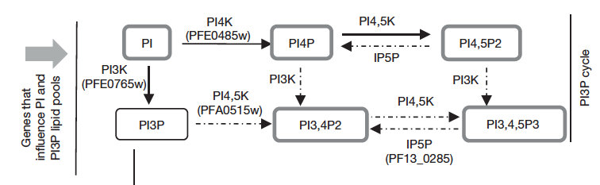
Top hit: PI4K alpha
?
Allele frequency
Mbengue et al 2015, Nature
PI4K
Notes:
Check association with mutant K13
PI4K beta is a major drug target (McNamara 2013: Resistance to imidazopyrazine and quinoxaline compounds is mediated by gene variations in PfPI(4)K)

