Slide 1

Indirect effect of 10-valent pneumococcal vaccine on nasopharyngeal carriage in children under 2 years of age in a rural community in Pakistan
Dr M Imran Nisar
MBBS, MSc , PhD Candidate
Senior Instructor (Research)
Aga Khan University , Pakistan

Slide 2
Pneumococcal Disease –Definition
A group of diseases caused by a bacterium called Streptococcus pneumoniae
There are more than 90 known serotypes of Pneumococcus
https://www.cdc.gov/vaccines/pubs/pinkbook/pneumo.html

Slide 3
Pneumococcal Disease –Burden
14.5 million episodes of serious pneumococcal disease were reported globally in year 2000.
An estimate of 541,000 child deaths under 5 years due to pneumococcal infections in year 2008
http://apps.who.int/iris/bitstream/10665/90378/1/WHO_IVB_13.09_eng.pdf

Slide 4
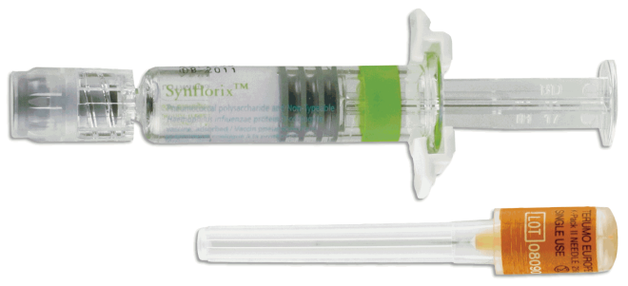
Pneumococcal Vaccines
Highly effective vaccines are available globally against pneumococcus and its different serotypes
  Synflorix™ (PCV 10) by GlaxoSmithKline
  Prevnar 13® (PCV 13) by Pfizer
Sero types 1, 4, 5, 6B, 7F, 9V, 14, 18C, 19F, 23F
Sero types 3, 6A, 19A
Synflorix

Slide 5
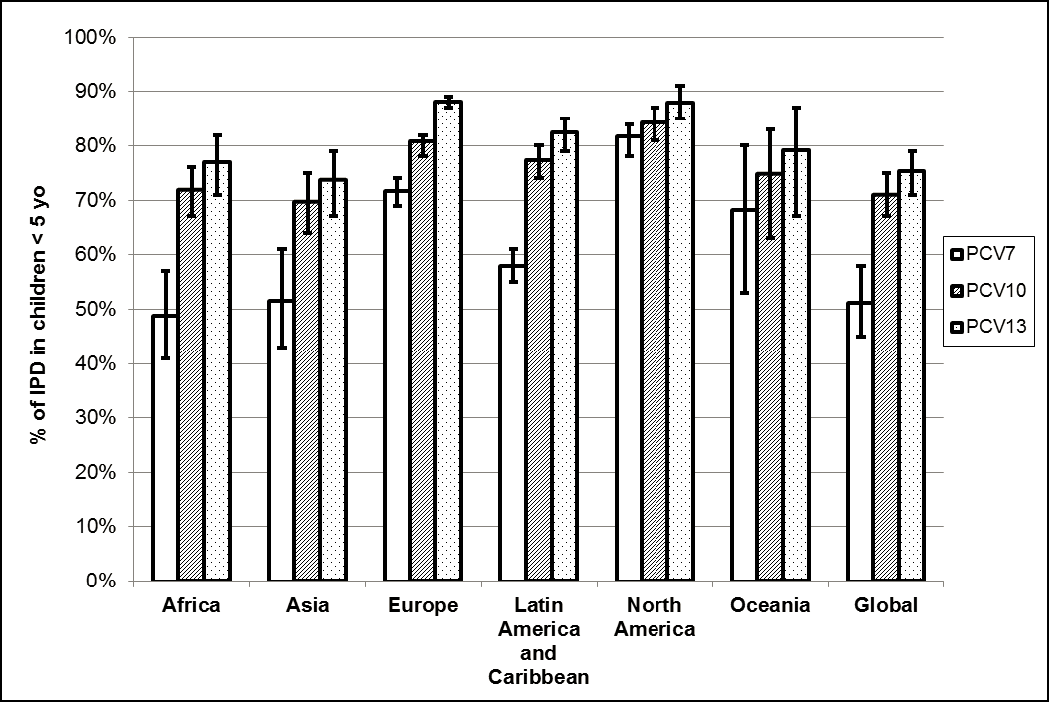

Vaccines and serotype coverage
PCV 7
PCV 10
PCV 13
Johnson HL et al. Systematic evaluation of serotypes causing invasive pneumococcal disease among children under five: the pneumococcal global serotype project. PLoS Med. 2010;7(10).
Notes:
The current 10-valent and 13-valent formulations of the pneumococcal conjugate vaccine
include pneumococcal serotypes which cause over 70% of serious pneumococcal
disease in children in all geographic regions. Below is a bar graph that shows the global
distribution of pneumococcal serotypes and the different vaccine formulations currently
available with the serotypes included in the vaccines.

Slide 6
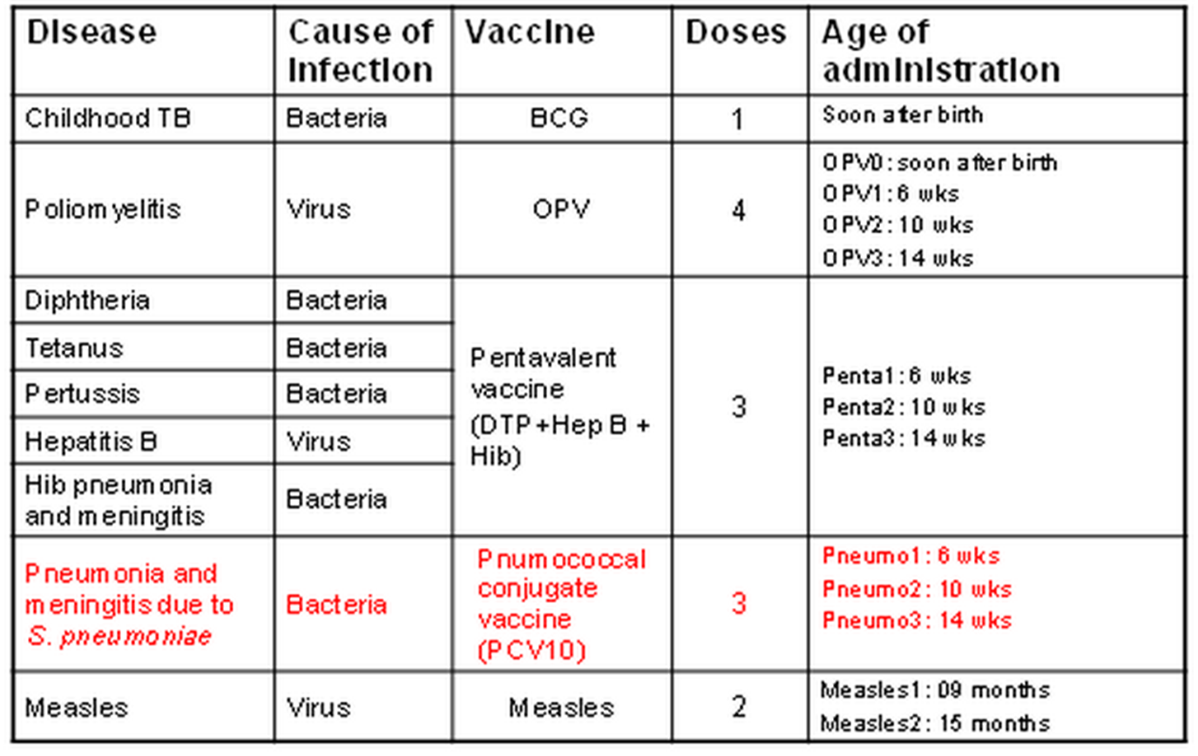
Expanded Program on Immunization (EPI) in Pakistan
Pneumococcal
Conjugate Vaccine
(PCV10)
Notes:
In Pakistan, following the introduction of Hib vaccine in year 2009, PCV 10 was included in the country’s Expanded Program for Immunization (EPI) in year 2012 (23). In the southern province of Sindh, PCV 10 was included in EPI in April 2013(24). All children born on or after 15th February 2013 were eligible to receive the vaccine at 6, 10 and 14 weeks of age. No catch-up vaccination was offered

Slide 7
Direct and Indirect immunity
Vaccines provide
  direct protection to those who are vaccinated
  indirect protection to those who are unvaccinated
To provide indirect protection, it is necessary that a significant proportion of the population be vaccinated to decrease the infection reservoir
Notes:
by decreasing population’s infection reservoir

Slide 8
Natural progression of Infectious diseases
a “naïve” (susceptible ) population

Slide 9
Natural progression of Infectious diseases
An infection is introduced in a susceptible population

Slide 10

Natural progression of Infectious diseases
Susceptible individuals are exposed!!!

Slide 11
Natural progression of Infectious diseases
Transmission occurs

Slide 12
Natural progression of Infectious diseases
Transmission progresses

Slide 13
Natural progression of Infectious diseases
Disease spreads

Slide 14
Natural progression of Infectious diseases
After some time --Recover to immunity

Slide 15

Natural progression of Infectious diseases
No transmission

Slide 16

How Vaccines work?
a “naïve” (susceptible ) population

Slide 17
How Vaccines Work ?
Immunity without the disease

Slide 18
How Vaccines work ?
No transmission- Immunity without the disease

Slide 19
Vaccines & Pneumococcal Carriage
Normal commensal or habitat of nasopharynx is known as “carriage”
Carriage may or may not lead to pneumococcal disease
Carriage is an obligate precursor of disease in susceptible individuals
Carriage (infective reservoir) can be decreased by vaccinating children by pneumococcal vaccines
Vaccines are known to decrease the carriage in both vaccinated and unvaccinated children.
Simell B, Auranen K, Käyhty H, Goldblatt D, Dagan R, O’Brien KL. The fundamental link
between pneumococcal carriage and disease. Expert review of vaccines. 2012;11(7):841-55.
Notes:
Fro pneumoccoal disease

Slide 20
Pre vaccine introduction Pneumococcal carriage survey
Source: unpublished data from GAVI PCV Impact study
Notes:
We carried out as part og a GAVI funded project in jan feb 2013 before the onrtrustion of vacicne……….in 2 union cuncils

Slide 21
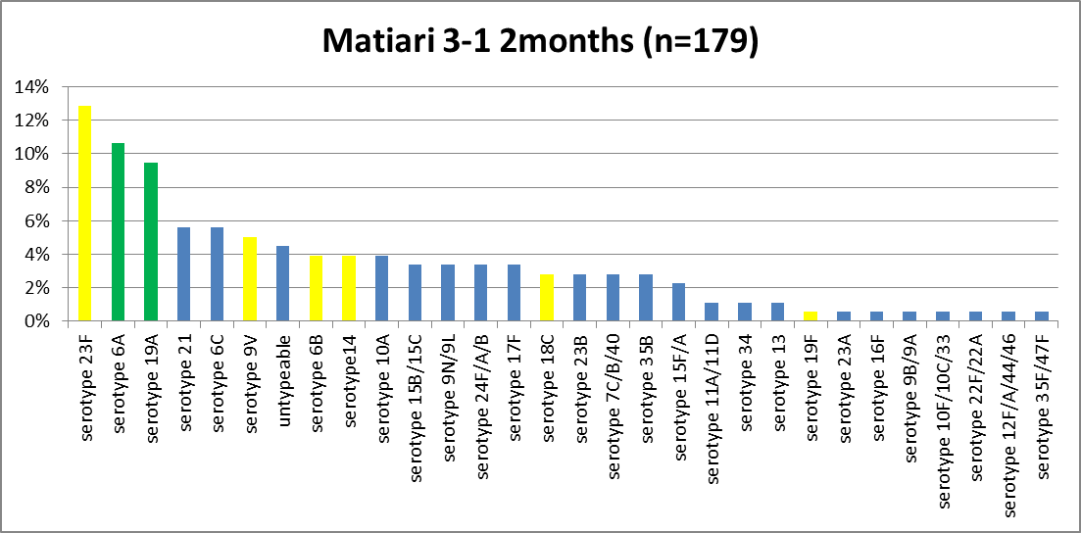
Overall serotype distribution
Source: unpublished data from GAVI PCV Impact study

Slide 22
Vaccine coverage-Matiari
Source: unpublished data from Indirect effect study
Notes:
In same two unon councils

Slide 23
This combination of high burden of carriage and low vaccine coverage provided an opportunity to test the impact of increasing vaccine coverage on pneumococcal carriage in both vaccinated and unvaccinated children.

Slide 24
Research Questions
What is the vaccine coverage required to impart indirect protection against pneumococcal carriage in children less than two years of age in a rural community in Matiari, Sindh?
What are the factors associated with carriage of vaccine type (VT) serotype in children less than two years of age in a rural community in Matiari, Sindh?
Notes:
Which leads to itr research questions

Slide 25
Hypotheses
With increasing vaccine coverage, the pneumococcal carriage will decrease in both vaccinated and unvaccinated children
Child’s age, gender, crowding, indoor air pollution and vaccination status are associated with carriage of PCV 10 serotypes

Slide 26
Primary Objectives
To demonstrate the direct and indirect effect of PCV10 on nasopharyngeal carriage
To identify factors associated with carriage of VT serotypes
To increase vaccine coverage in the two union councils of Matiari, Sindh

Slide 27
Secondary objectives
To describe serotype distribution of various VT and NVT serotypes
To evaluate carriage rate in (a) fully vs. (b) partially vs. (c) non vaccinated children
To describe seroreplacement by non-vaccine type (NVT) serotypes.
To describe antibiotic sensitivity patterns over time for pneumococcal isolates

Slide 28
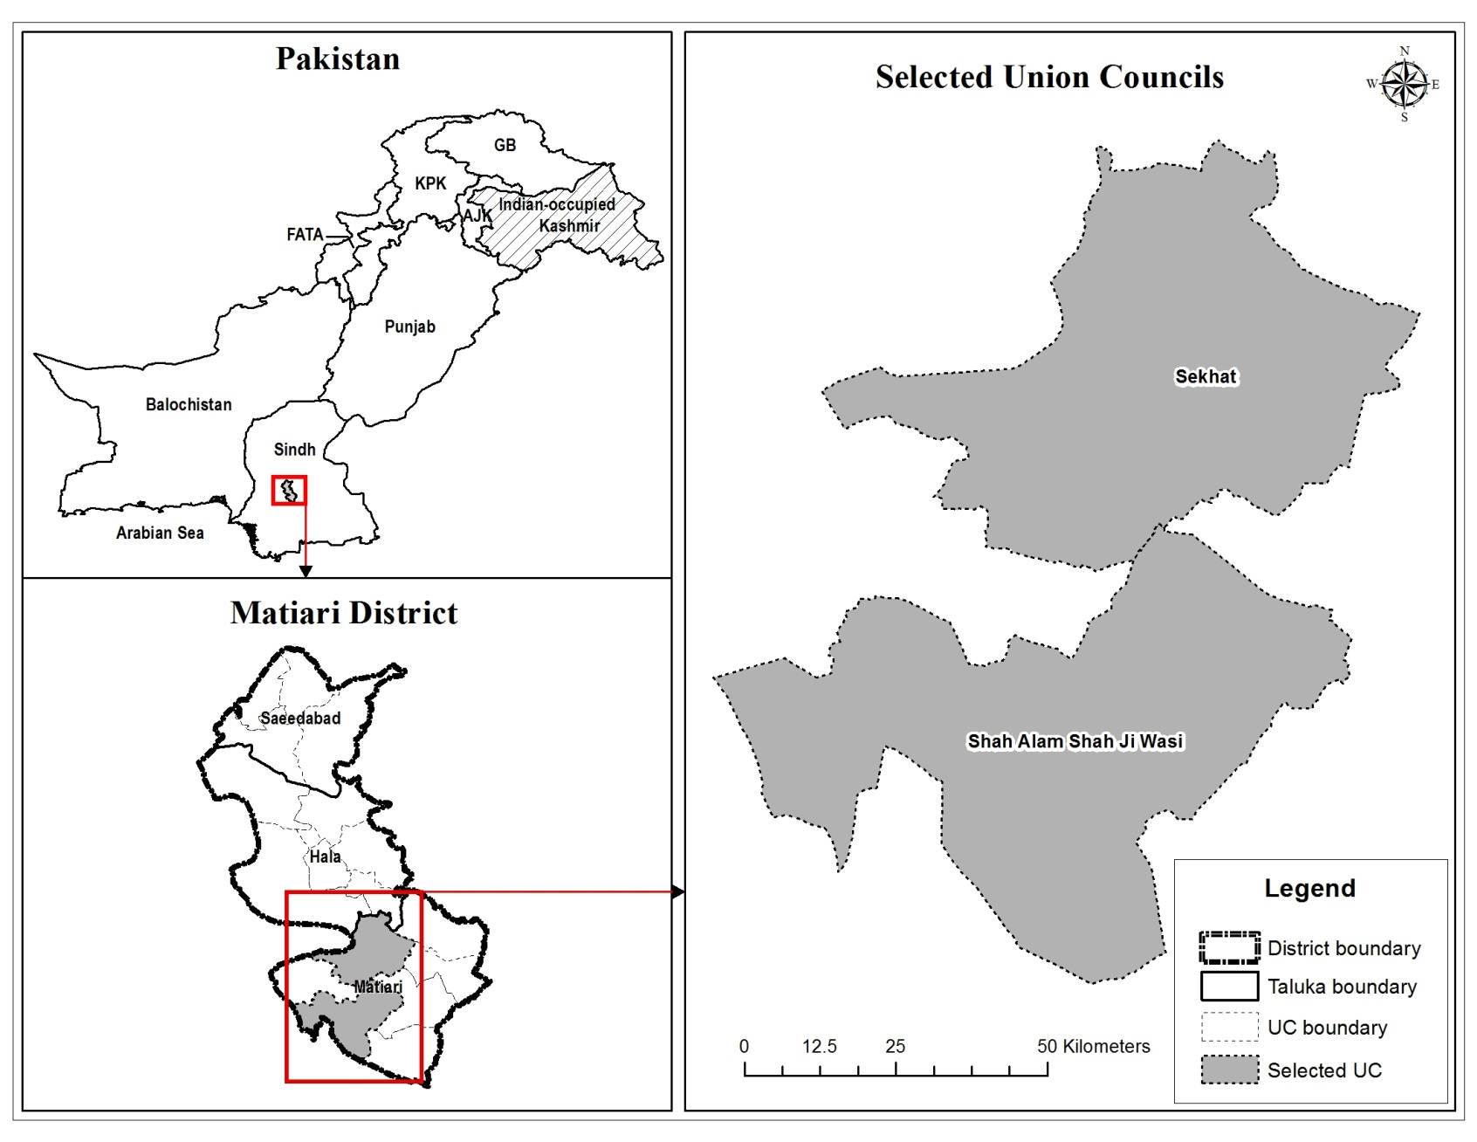
Study area
Notes:
Two union councils which are the smallest administrative unit with a cumulative population of around 60,000

Slide 29
Study Design
This is a time series/serial cross sectional in which children under the age of two years will be enrolled every over a period of 4 years
Each child will be enrolled only once
At the time of enrollment
  Information on socio-demographic and clinical characteristics is being collected
  Nasopharyngeal specimen are collected

Slide 30
Inclusion and Exclusion criteria
Inclusion :
  All children under the age of 2 years are eligible to be enrolled in the study.
  Resident of the two UCs
  Parents agree to provide a nasopharyngeal specimen of the child
Exclusion :
  Children with Nose and throat abnormalities
  Those not providing consent
  Previously enrolled in the study

Slide 31
Sample size
Sample size: 3120 over a period of 4 years
15 children per week are being enrolled
Children are selected randomly from a line listing of households on a monthly basis.

Slide 32
Increasing vaccine coverage
Two monthly household surveillance to numerate all new births in the area.
A line listing of all children eligible to receive the vaccine
Mobile phone numbers of primary caretakers are taken.
The caretakers are contacted on the due dates of the vaccination to encourage taking their children for vaccination.
Where possible, transport is provided.

Slide 33
Increasing vaccine coverage
Identify low coverage areas
Hire social mobilization team to sensitize the communities to vaccinations.
Provide transport to the vaccinator for uncovered areas
Notes:
Vaccination in these communities is either through LHWs in the so called covered areas and through vaccinators in the uncovered areas.

Slide 34
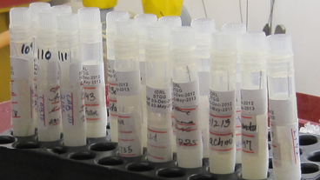
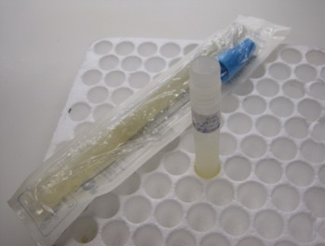
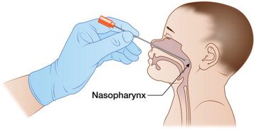
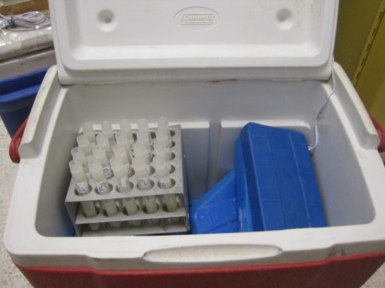
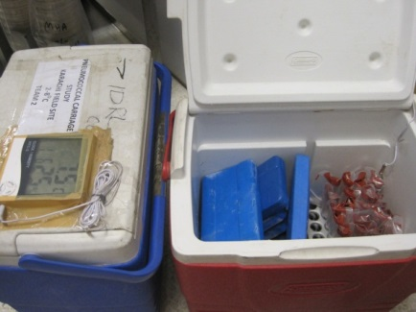
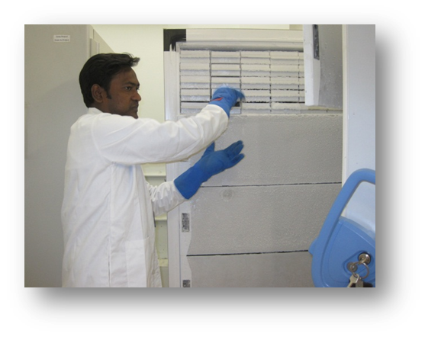
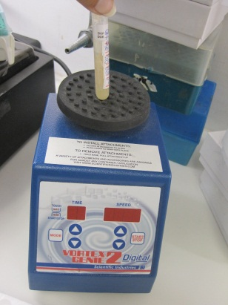
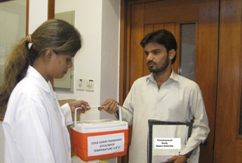
Specimen collection

Slide 35
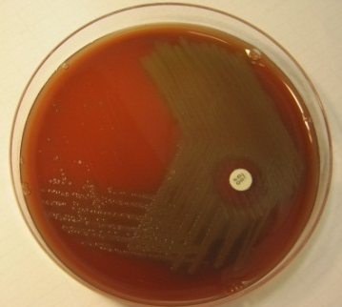
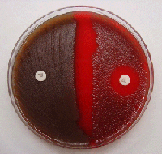
Pneumococcal isolation
NPO Swab in STGG media is transferred to 200 ul to Todd Hewitt broth
Todd Hewitt broth (5 ml of Todd Hewitt broth +1 ml of rabbit serum)
and incubate at 37°C in CO2 incubator for 6 hours
Inoculate one loop (10 ul) of the Todd Hewitt broth an streak on SBA and incubated for 18‐24 hours at 37°C in CO2‐incubator.
After 18‐24 hours incubation, observe the growth for typical pneumococcal colonies, small, grayish, moist, watery surrounded by a greenish zone of alpha‐hemolysis.
Pick single isolated typical pneumococcal colony with a sterile swab and streak on a fresh 5% Sheep Blood Agar Plate with Optochin disc, plate is incubated at 37°C/CO₂ incubator
With sterile disposable loop the pure growth is scrapped into Labeled Cryovials, containing 1.0 ml of STGG medium and stored at ‐80°C for Pneumococcal Serotyping using Molecular Techniques.
Notes:
NPO swab in STGG meida is tranferred to 200ul TH broth
TH broth is incubated at 37C for 6 hours
Inoculate 10ul of TH broth and streak it on SBA and plates are incubated afor 18-24 hrs at 37C in CO2 incubator
Observe the typical growth of pneumococcal colonies, small grayish, with green zone of alpha hemolysis
Pick single colony with sterile swab and streak on to SBA plate with optochin disc and incubate at 37 in Co2
With sterile disposable loop, scrap the growth in to cyryovials containing STGG medium and stored at -80C for pneumococcal serotyping.

Slide 36
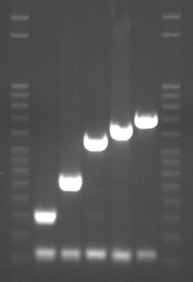
SEQUENTIAL CONVENTIONAL MULTIPLEX PCR FOR Streptococcal pneumoniae SEROGROUPING
DNA was extracted through boiling method
Remove DNA templates from -20°C to allow them to thaw completely at room temperature.
Sequential multiplex PCR reactions are prepared in standard 25 μl reaction using 2X PCR Buffer-Qiagen Multiplex PCR Kit & 1-8 set of primers for Multiplex PCR Reaction
Cycling conditions
Reaction 1
Reactions | Serotypes
1 | 6A/6B/6C/6D, 3, 19A, 22F/22A,16F
2 | 8, 33F/33A/37, 15A/15F, 7F/7A, 23A
3 | 19F, 12F/12A/44/46 ,11A/11D, 38/25F/25A,35B
4 | 24F/24A/24B, 7C/7B/40, 4, 18C/18F/18B/18A, 9V/9A
5 | 14, 1, 23F, 15B/15C, 10A
6 | 39, 10F/10C/33C, 5, 35F/47F, 17F
7 | 23B, 35A/35C/42, 34,9N/9L, 31
8 | 21, 2, 20,13
Thermal Cycling Parameters
1X | 95°C for 15 min
35X | 94°C for 30 sec
 | 54°C for 90 sec
 | 72°C for 60 sec
1 X | 72°C for 10 min
infinite | 4°C
Further confirmation of serotype/group positivity is done by Monoplex PCR
Notes:
200uM
25uM working concentration

Slide 37
Initial results

Slide 38
Samples processed
Number of children enrolled , case record form filled and specimens collected and processed = 1744

Slide 39
Monthly enrollments (n= 1744)
Notes:
55 enrollments in Sep 2015

Slide 41
Age distribution by gender

Slide 44
Any of the following illness during last 2 weeks

Slide 45


Slide 46
On Examination

Slide 47
Vaccine coverage

Slide 48
Notes:
Add a line graph by months as well

Slide 50
Vaccination card availability over months

Slide 51
PCV 10 coverage in children > 4 months
(card or verbal ) n=1551

Slide 52
PCV 10 coverage in children > 4 months
(card verified ) n=1551

Slide 53
PCV10 & 13 type carriage

Slide 58
PCV 10 and 13 type carriage over time (n= 1350)
Notes:
Check if it includes negatives

Slide 59
P-value =0.019

Slide 60
P-value =0.056
Notes:
Exclude those are verbal

Slide 61
P-value =0.073
Notes:
Age at vaccination . Dosing by age .

Slide 62
P-value =0.199

Slide 63
P-value =0.44

Slide 64
P-value =0.22
P-value =0.42

Slide 65
Pneumococcal carriage across age groups
Age groups

Slide 66
Serotype distribution

Slide 67
Serotype distribution (n=1350)

Slide 68
Serotype distribution unimmunized
(n=690)

Slide 69
Serotype distribution Immunized
(n=660)

Slide 70
 | 1 | 4 | 5 | 6B | 9V | 14 | 18C | 19F | 23F
non-Immunized | 1 | 2 | 1 | 25 | 19 | 7 | 10 | 18 | 20
immunized | 1 | 0 | 0 | 11 | 6 | 7 | 9 | 6 | 15
V.E | -50% | 100% | 100% | 44% | 60% | -30% | -18% | 58% | 0%

Slide 71
PCR Code | 3 | 6A | 19A
non-Immunized | 1 | 42 | 21
immunized | 1 | 27 | 18
VE | 40% | 15.2% | -13%

Slide 72
Predictors of PCV10 serotype carriage
Variables | Adjusted Model aOR (95% CI)
Runny nose | 1.57 (1.11-2.21)
People 1-5 years | 1.14 (1.02-1.27)
Vaccination status
Unvaccinated | Ref
Vaccinated | 0.60 (0.43-0.85)

Slide 73
Strengths
To the best of our knowledge this is the first of its kind study carried out in the region
This is a community based study
All laboratory protocols for detection of pneumococcal serotypes using PCR follow standardized CDC methods.

Slide 74
Limitations
Study being done in one small part of the country
Vaccine coverage will be raised in a research setting which will be challenging to replicate in real life setting.

Slide 75
Way forward
Continue enrollment till September 2018
Increase vaccine coverage to around 70% to 80%
Demonstrate indirect effect of PCV 10 on nasopharyngeal carriage

Slide 76
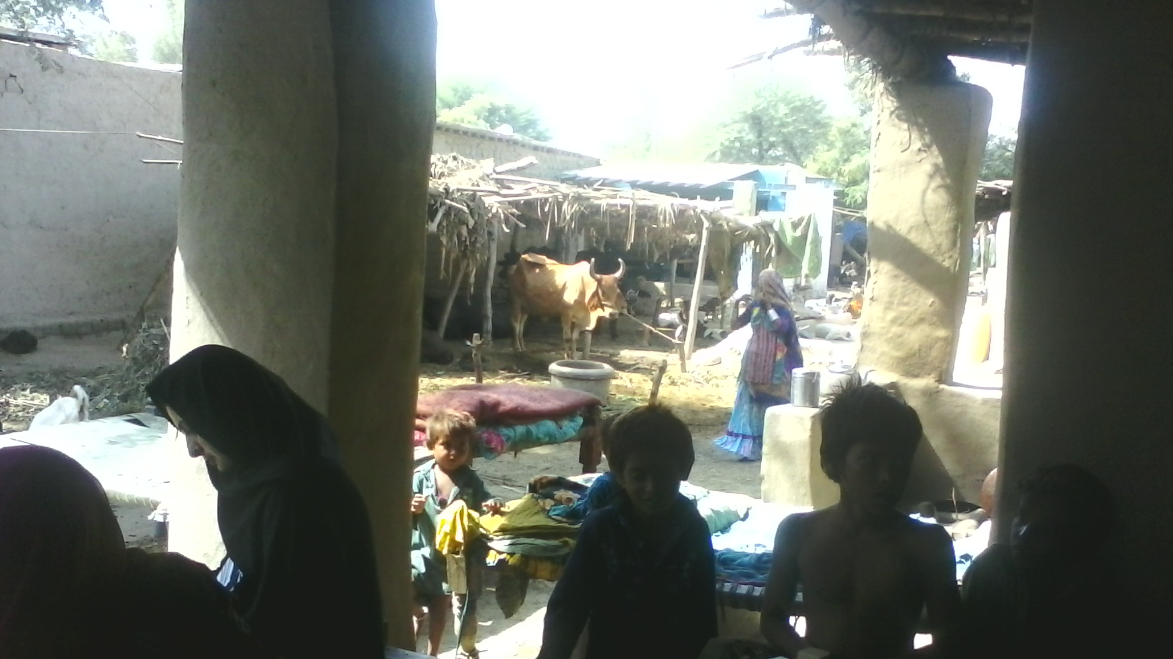

Slide 77
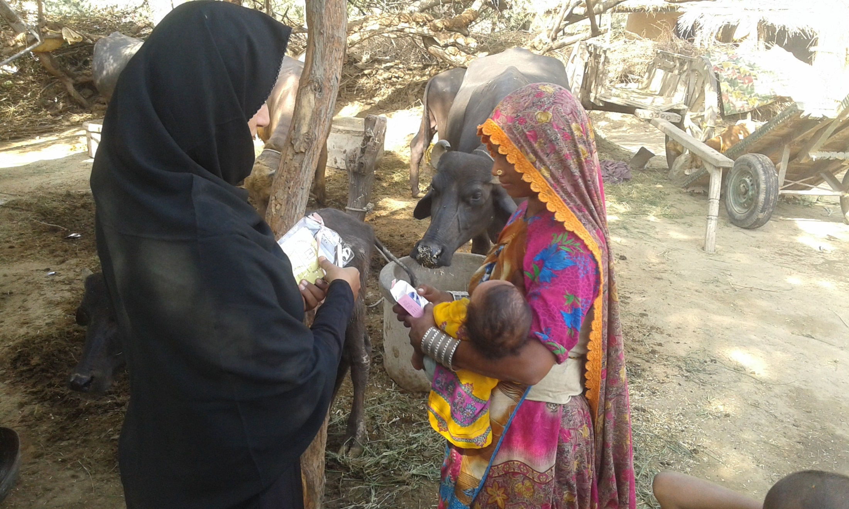

Slide 78
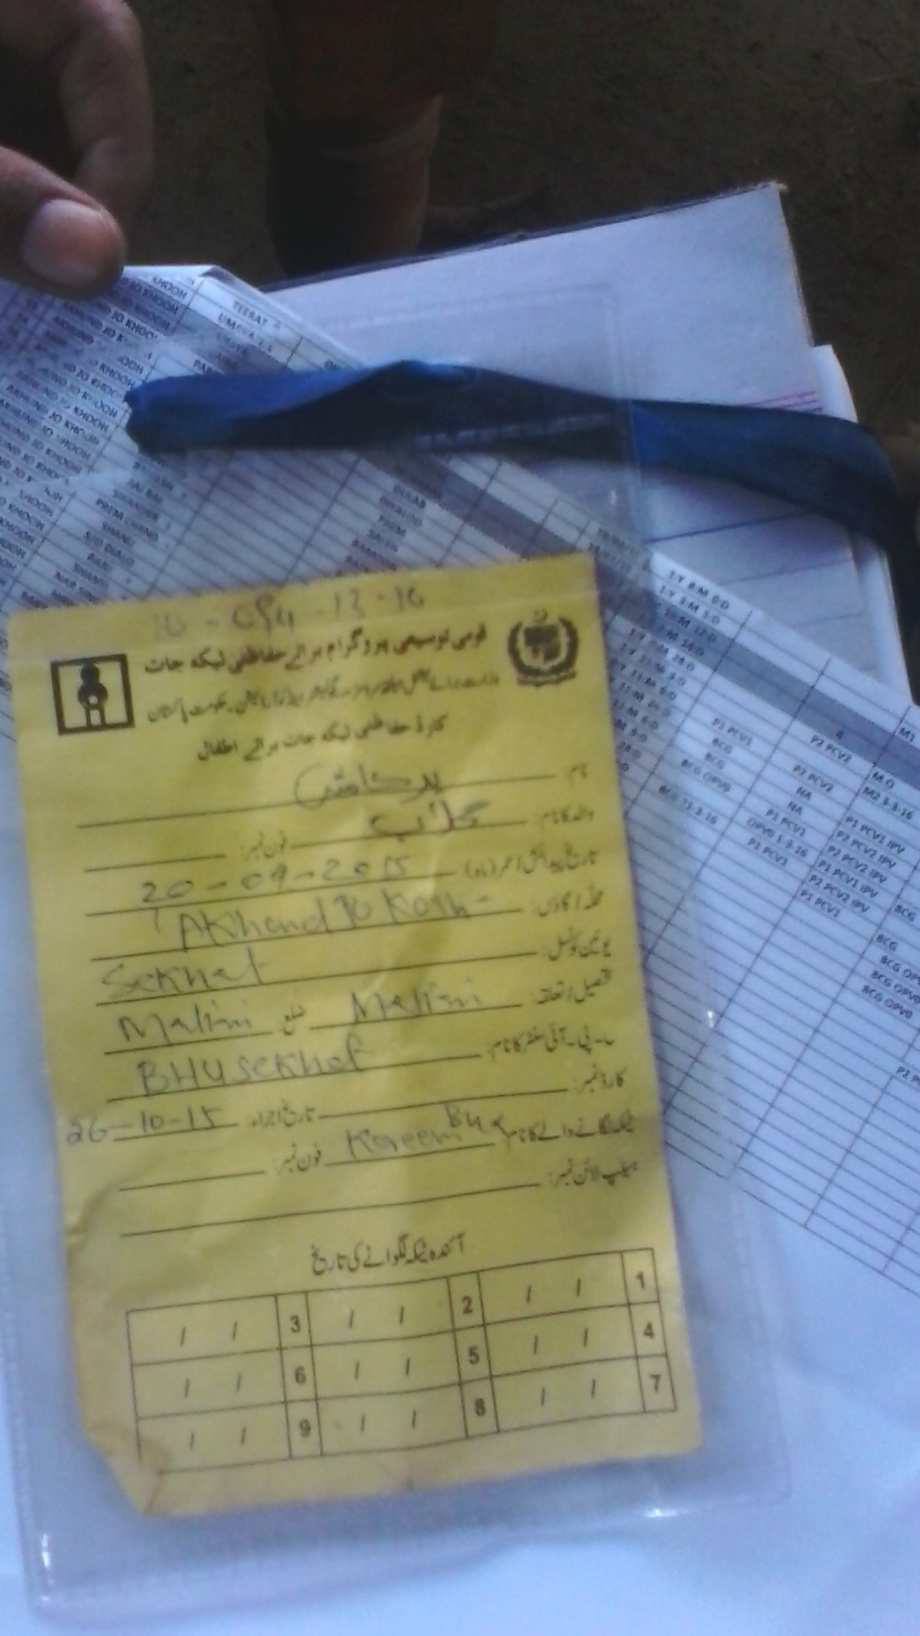
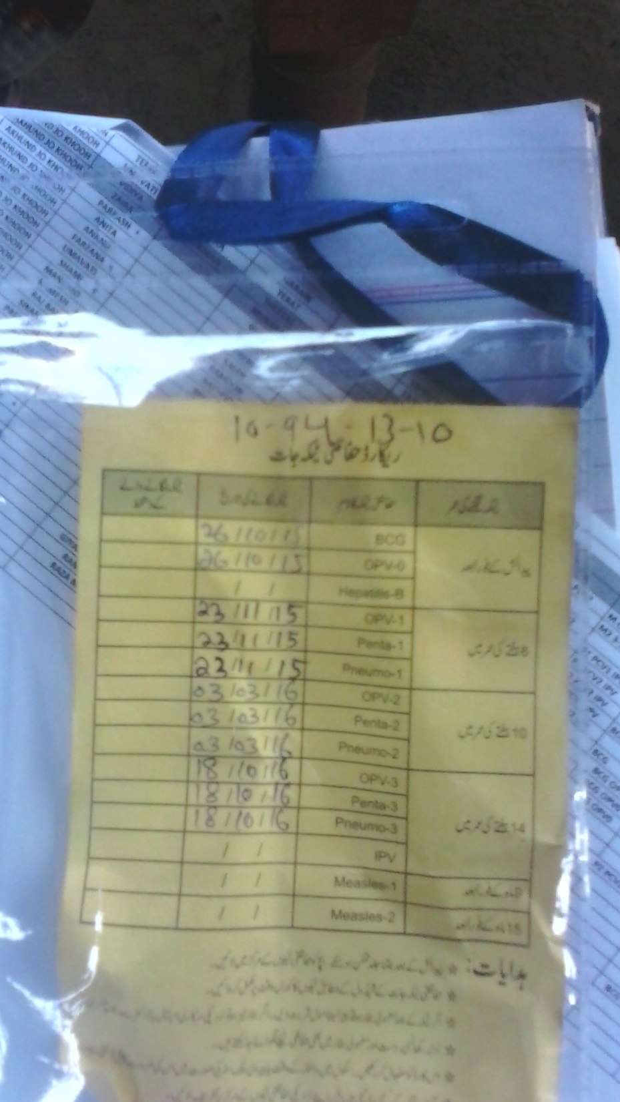

Slide 79

Acknowledgements
Aga Khan University
  Najeeha Iqbal
  Sheraz Ahmed
  Fyezah Jehan
  Sadia Shakoor
  Syed Asad Ali
Emory University
  Saad Bin Omer
Centre for Disease Control
  Cynthia Whitney
Bill & Melinda Gates Foundation
  Gail Rodgers
Funded by

Slide 82
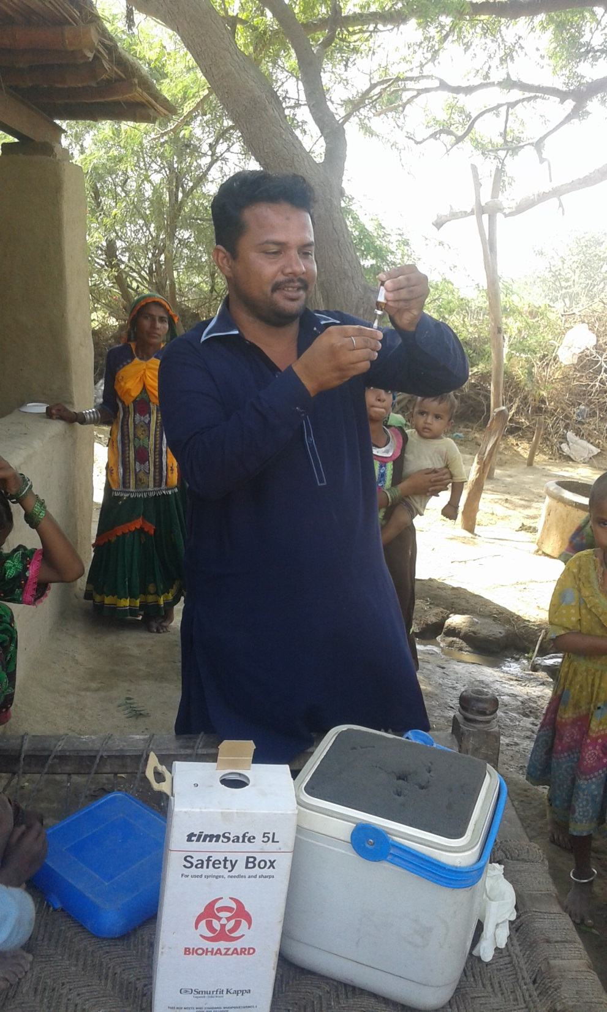
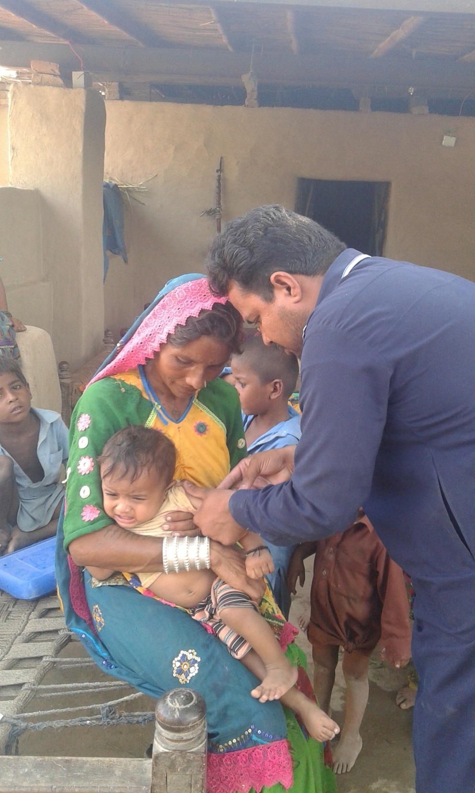

Slide 83
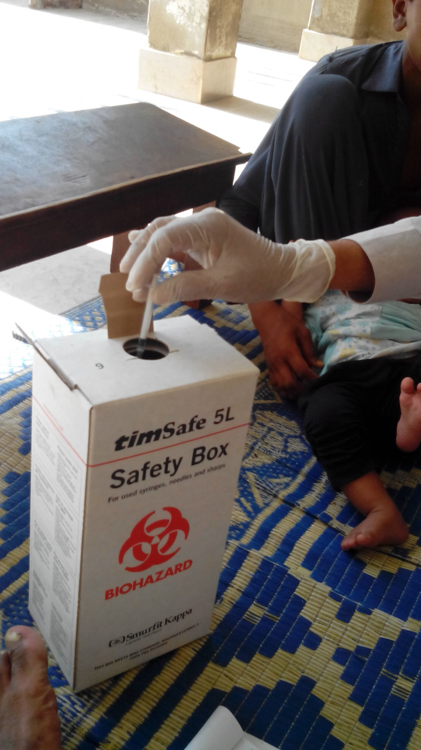
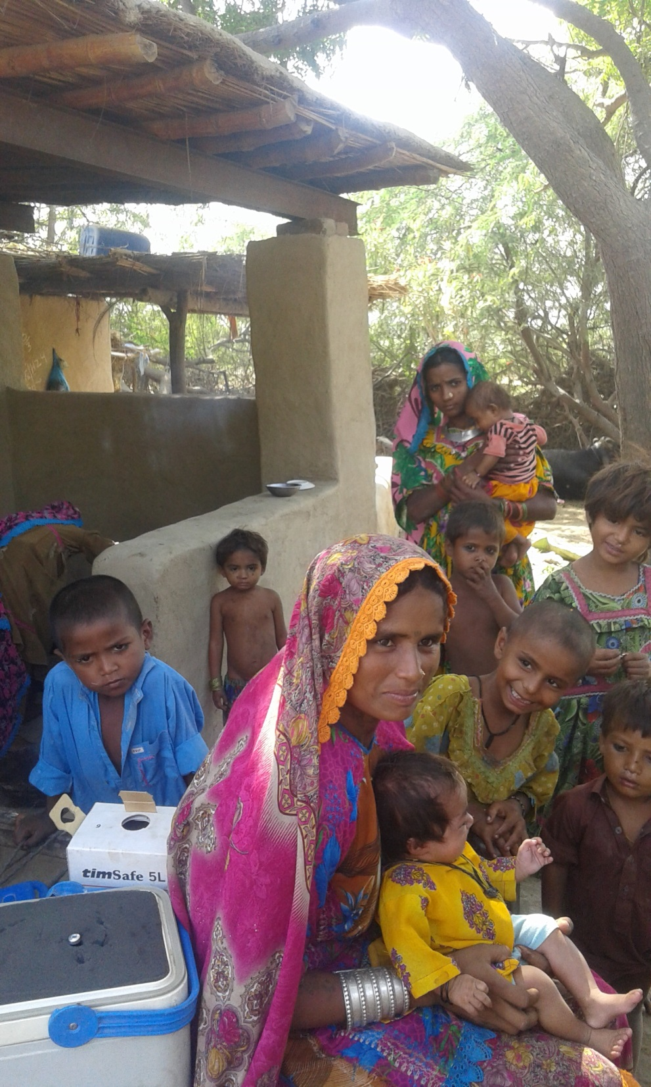

Slide 85
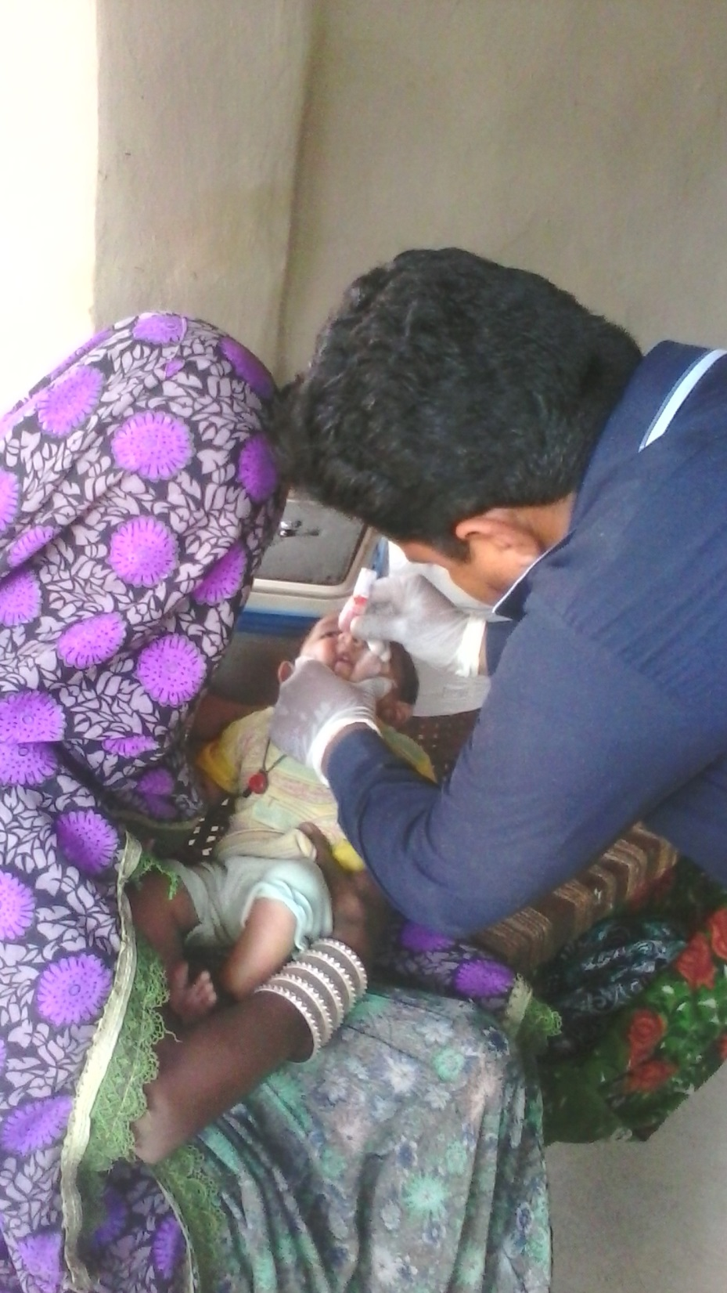
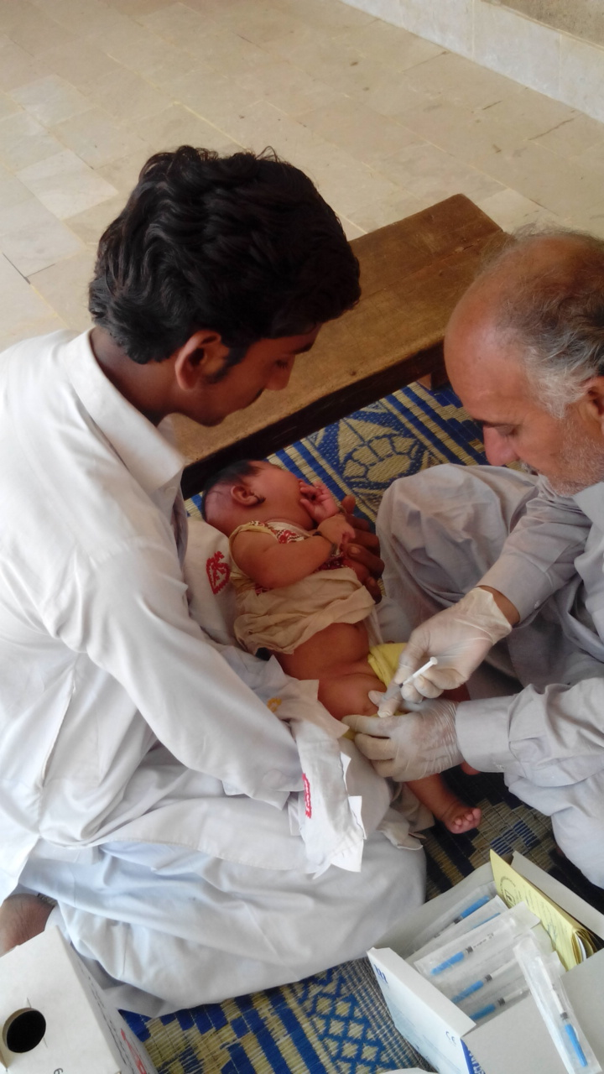

Slide 87
Serotype distribution (n=802)
20 %
14 %
66%

Slide 88
Serotype distribution unimmunized
(n=456)
23 %
14 %
63%

Slide 89
Serotype distribution Immunized
(n=346)
16 %
13 %
71%

Slide 90
Prevalence of PCV 10 serotypes

Slide 101
Prevalence of PCV 13 specific serotypes

Slide 105
Predictors of PCV10 carriage

Slide 106
Please see world file

Slide 107
Field Pics

Slide 112
Thanks !

Slide 113
Baseline and Risk factor data

Slide 114
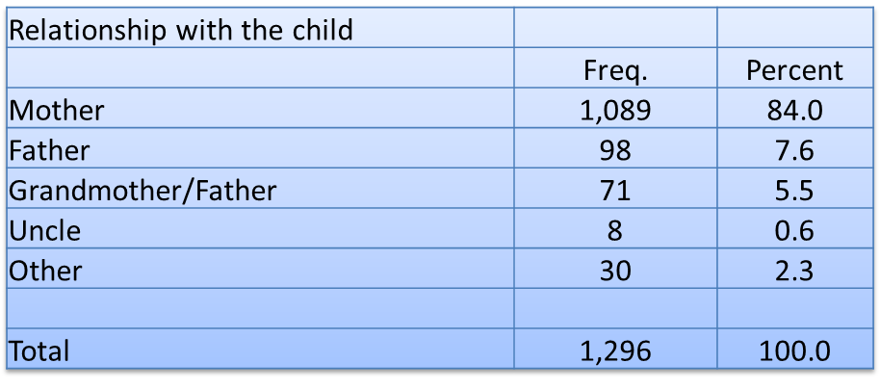
Interviewee relationship

Slide 116
Does the child have any neurological disorder | Freq. | Percent
No. | 1,296 | 100.0
Total | 1,296 | 100.0
Has consent been given | Freq. | Percent
Yes | 1,296 | 100.0
Total | 1,296 | 100.0
Does the child have any nose or throat abnormality | Freq. | Percent
No. | 1,296 | 100.0
Total | 1,296 | 100.0

Slide 120
Are you the primary caretaker for the child | Freq. | Percent
Yes | 1,166 | 90.0
No. | 130 | 10.0
Total | 1,296 | 100.0
Who is the primary wage earner in the child family | Freq. | Percent
Father | 1,016 | 78.4
Guardian | 3 | 0.2
Other | 277 | 21.4
Total | 1,296 | 100.0
Education of Primary care taker | Freq. | Percent
no education | 1,086 | 84.3
1-5 years | 140 | 10.9
6 to 16 years | 63 | 4.9
Total | 1,289 | 100.0
Education of Primary wage earner | Freq. | Percent
no education | 729 | 56.9
1-5 years | 306 | 23.9
6 to 16 years | 247 | 19.3
Total | 1,282 | 100.0

Slide 121
Average household size

Slide 122
No of rooms in house

Slide 123
No of times Hospitalized in last one year | Freq. | Percent
0 | 1,246 | 96.14
1 | 48 | 3.7
2 | 2 | 0.15
Total | 1,296 | 100
Does anyone smoke in HH | Freq. | Percent
Yes | 486 | 37.5
No. | 809 | 62.42
Dont Know | 1 | 0.08
Total | 1,296 | 100
No of OPD visits in lasts one year | Freq. | Percent
0 | 532 | 41.05
1 | 324 | 25
2 | 270 | 20.83
3 | 102 | 7.87
4 | 49 | 3.78
5 | 12 | 0.93
6 | 7 | 0.54
Total | 1,296 | 100

Slide 124
Fuel used for cooking
What kind of fuel is used for cooking in the child’s home? | Freq. | Percent
Natural Gas | 146 | 11.27
Kerosene/liquid fuel | 2 | 0.15
Wood/paper/straw/crop residue/animal du | 1,139 | 87.89
Charcoal/coal | 1 | 0.08
Other specify | 8 | 0.62
Total | 1,296 | 100
Child exposed to smoke | Freq. | Percent
Yes | 461 | 35.57
No. | 835 | 64.43
Total | 1,296 | 100

Slide 125
Fuel used for heating
What kind of fuel is used to heat the child’s home? | Freq. | Percent
Natural Gas | 54 | 4.18
Electric | 13 | 1.01
Kerosene/liquid fuel | 1 | 0.08
Wood/paper/straw/crop residue/animal du | 521 | 40.29
Charcoal/coal | 35 | 2.71
None | 665 | 51.43
Other specify | 4 | 0.31
Total | 1,293 | 100

Slide 126
Year round carriage

Slide 127
PCV10 serotype carriage

Slide 128
PCV13 serotype carriage
Notes:
Months and by immunized and unimmunized .

Slide 129
BCG coverage

Slide 130
BCG and OPV 0 coverage-Verbal or card

Slide 131
BCG and OPV 0 coverage-Card verified

Slide 132
6 week doses- verbal or card

Slide 133
6 week doses-card verified

Slide 134
10 week doses –card/verbal

Slide 135
10 week doses –card verified

Slide 136
14 week doses –card/verbal

Slide 137
14 week doses –card verified

Slide 138
Carriage in immunized versus unimmunized n=1180

Slide 139
PCV10 carriage by doses
No of Doses

Slide 140
PCV10 carriage by doses- card verified
No of doses

Slide 141
Carriage by no of doses and age group

