Slide 1
Strengthening One Health Coordination Using Participatory-Based Tabletop Exercises
Todd Noel
Carrie McNeil DVM MPH
Notes:
Carrie and I work at Sandia National Laboratories and have been collaborating to develop technologies and methodologies to improve how we help other countries become prepared for biological incidents at every level– from laboratory spills and bioterrorism issues to large-scale pandemics.
Carrie is a vet epidemiologist with IBCTR and brings her background in human and animal public health preparedness;
I am the lead developer on all our software applications. My background is in developing virtual applications for training and exercises.
Today, I am going to share our exercise methods and how we’ve developed web-based applications to streamline exercise design and implementation.
We’ll go through an example of one of our recent series of One Health exercises. I’ll also discuss how our software not only helps our team but also give in-country partners the tools they need to develop their own sustainable readiness programs.
We’ll do some demos as long as we have time. Please feel free to ask questions any time.

Slide 2
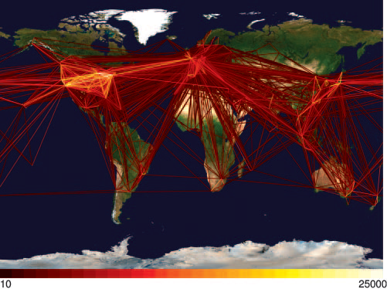
Global Health: It’s a Small World
Biological incidents, public and animal health emergencies
do not recognize or stop at international borders
http://www.onehealthinitiative.com/
Notes:
Hufnagel, et al. Forecast and control of epidemics in a globalized world. Proc Natl Acad Sci USA. 2004.
Oct 19, 2004; 101 (42):15124-15129
Figure 1. Global aviation network. A geographical representation of the civil aviation traffic among the 500 largest international airports in >100 different countries is shown. Each line represents a direct connection between airports. The color encodes the number of passengers per day (see color code at the bottom) traveling between two airports. The network accounts for >95% of the international civil aviation traffic. For each pair (i,j) of airports, we checked all flights departing from airport j and arriving at airport i. The amount of passengers carried by a specific flight within 1 week can be estimated by the size of the aircraft (We used manufacturer capacity information on >150 different aircraft types) times the number of days the flight operates in 1 week. The sum of all flights yields the passengers per week, i.e., M_{ij} in Eq. 7. We computed the total passenger capacity ∑ M_{ij} of each airport j per week and found very good agreement with independently obtained airport capacities.
Global air traffic from 6 years ago. Doesn’t take much to spread diseases

Slide 3
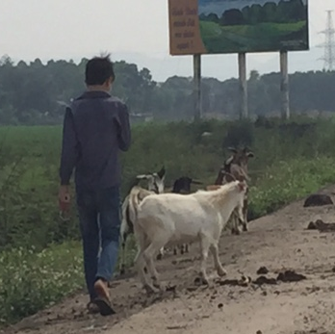
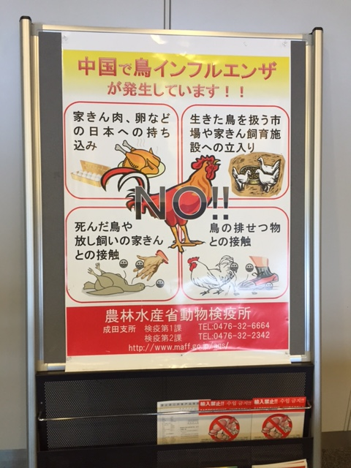
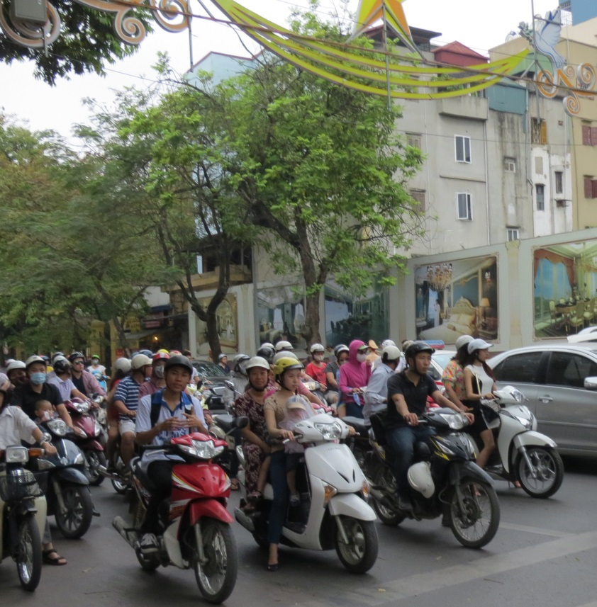
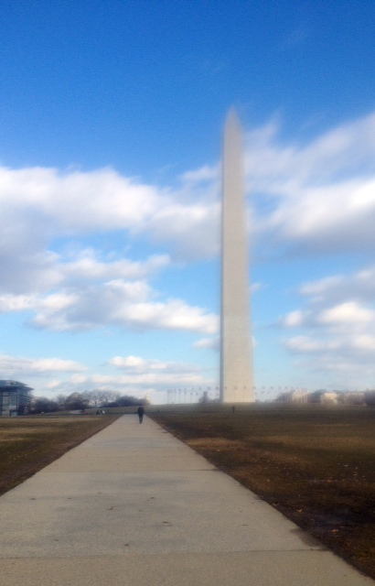
Global One Health
IBCTR works with other countries to improve readiness for all types of disease outbreaks
Culturally and politically aware
For One-Health, there is a need for coordination among public and animal health sectors
Notes:
Over the past few days, we’ve seen how challenging addressing deadly disease transmission can be in developing countries. Many of you have seen firsthand the devastating impacts of diseases like malaria, HIV, polio and others.
At the same time, we’ve seen a growing global focus on emerging diseases like zika, Ebola, MERS, etc.
Our role has been to work with countries to improve readiness for addressing all types of disease outbreaks—including intentional release—in a way that works for their country, their culture and their medical systems.
For One-Health, we have really seen the need for coordination among public and animal health sectors to address outbreaks that affect animals and people.

Slide 4
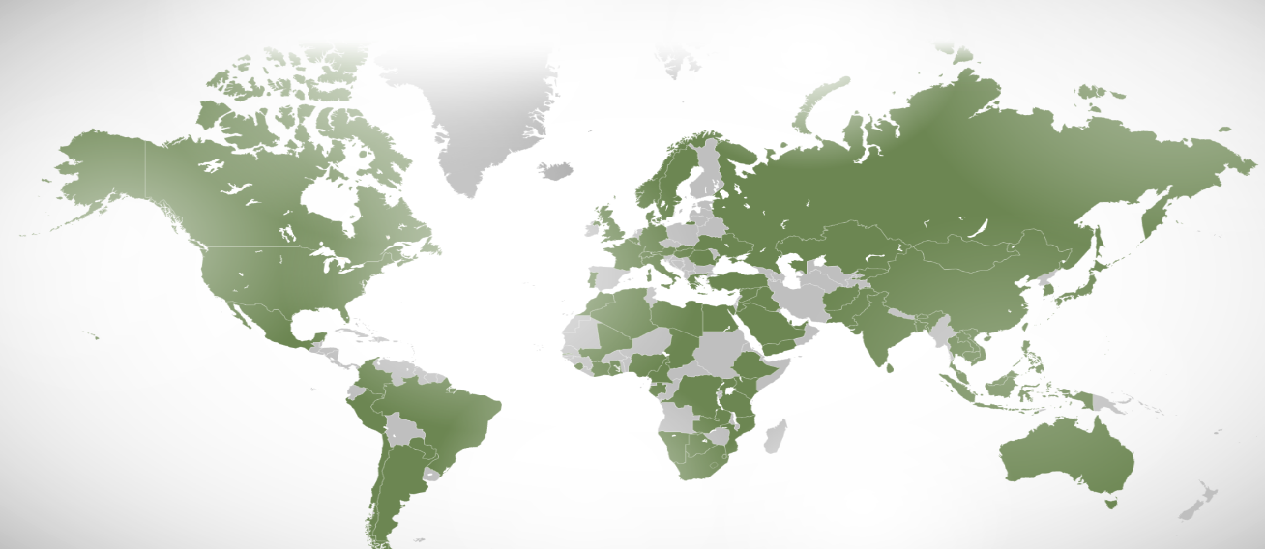
Need for One Health Readiness Internationally
Preparedness
Continuous cycle of planning, organizing, training, equipping, exercising, evaluating, and taking corrective action in an effort to ensure effective coordination during incident response.
Readiness
Condition of being prepared and capable to act or respond as required.
Notes:
One health readiness is need everywhere we go. this map shows the countries in which IBCTR has been working
We like to focus on readiness as a term as it encompasses more than being just prepared– but truly ready to get out the door
(DHS, Lexicon: Terms and Definitions , October 19, 2007, p. 22)

Slide 5
Tabletop Exercises (TTX)
A tabletop exercise is an activity in which key personnel assigned emergency management roles and responsibilities are gathered to discuss various simulated emergency situations.
Examples
  Officials from Ministries of Health and Agriculture to evaluate roles, responsibilities, and communication in a fictitious outbreak of a disease transmitted between animals and people
  Laboratory lead and head of security in a scenario involving an attempted theft during work hours.

Slide 6
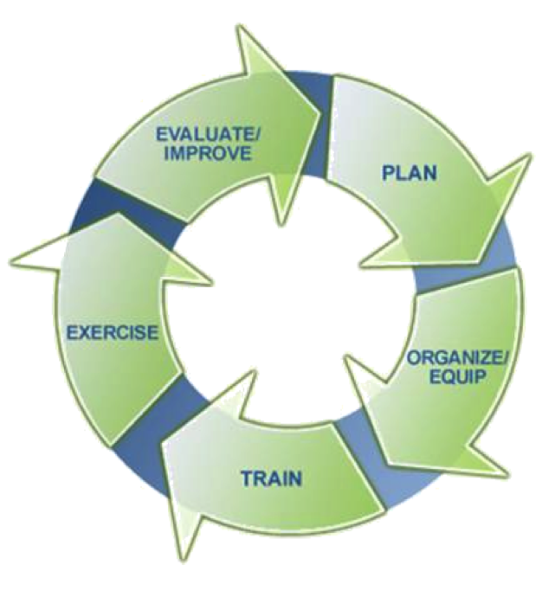
Developing Country-level Readiness
Sustainable Biothreat Readiness Programs
and Biothreat Readiness Leadership Development
Identify needs (facility, ministry, country, multi-country)
  Scenario-based workshops/TTX
Create Multi-Year Strategy
Develop Readiness Plans
Trainings
Evaluate Plans with Exercises
… Repeat
Notes:
Our overall approach to Country-level readiness fits well with the classic “preparedness cycle” you may have seen from CDC, FEMA and others.
We recently added the first component– BTR Leadership Development-- which is training readiness leaders in-country on how to design and implement exercises & planning workshops;
We use scenario-based workshops—which are pretty much like exercises—to identify needs and outline draft plans
We guide them to develop multiyear strategies on how to build readiness capabilities—for example– what plans, trainings and exercises are needed for rapid response, risk communication, etc
Again we can use the exercise tools for creating plans
Today, we will focus on the exercise methodologies– either for scenario-based planning workshops or classic tabletop exercises

Slide 7
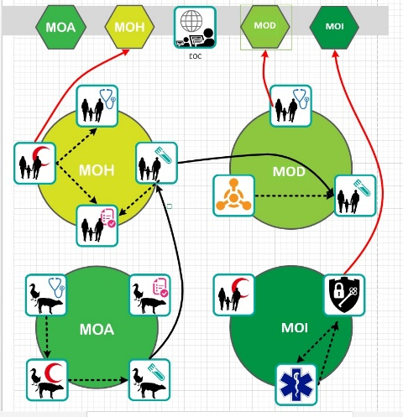
IBCTR Tabletop Methodology
Role-Based Data Collection
  Assessment based on qualitative data collection
  Systems-level communication mapping tools
Participant Driven
  Community-based participatory research (CBPR) methods applied
  Participants develop AAR and Improvement Plan
    Result: Politically, culturally appropriate solutions
Novel technology
  PREP™ Real-time data collection for TTX & Planning Events
  Videogame Simulation for One Health Readiness
Notes:
Topic 1: We’ve found one of the most effective ways to helping ministries and entities prepare is to give each participant a chance to walk through a fictitious scenario in the role he or she actually plays during an outbreak. Like a first-person character in a movie, each participant receives role- specific scenarios to walk through and we can see what decisions they make, whom they reach out to for help, and- in general—guide them to determine what is working and how they need to improve. For example, a public health epidemiologist would never know about the concurrent animal outbreaks unless there is communication across the sectors (or press etc).
Talk through topic 2: No one size fits all approach. While we may invite experts, the participants are the experts. Do we really know what works best in someone else’s country
Topic 3: At Sandia, we use a systems-analysis approach to help assess the system as a whole: for example: how public health and animal health work together; how lab and epi work together. So, we made a web-based platform that makes it easy to design and conduct these types of exercises and analyses.

Slide 8
PREP™: Portal for Readiness Exercises & Planning
PREP is an online platform that provides simple, easy-to-use templates & tools for emergency managers, health, & security professionals to design and conduct:
  Tabletop exercises and drills
  Strategic and operational planning workshops
Features
  Multi-Lingual capabilities
  Automatic, immediate report development
  In-exercise communication and email notifications
  Secure data collection
  Flexible adaptable templates
  Video Game activity
  Remote and in-person usability
Notes:
The web application we developed is called PREP. Here are a few of its functions. We’ll walk through some hands-on examples in just a bit.

Slide 9

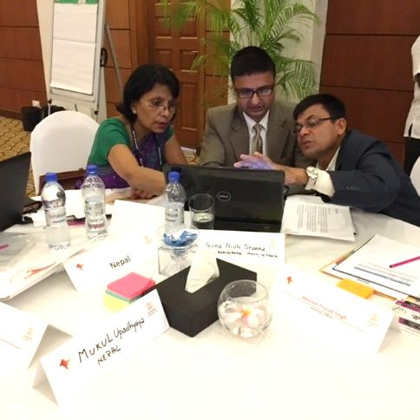
South Asia Pandemic TTX 2016
Sponsor’s Goal: Create a Regional Disease Surveillance Network
Objective: Evaluate Cross-Sector, Cross-Border One Health Readiness
to address a Pandemic of an Emerging, Unknown Disease
Participants
  Bhutan, Bangladesh, India, Nepal, Pakistan, Sri Lanka
    Representatives from Ministries of Health, and Agriculture
  External evaluators: FAO, OIE, SAARC, USDOS
  Sponsor: Skoll Global Threats Fund
Results
  Participant-driven After Action Report
  Discussions on a regional surveillance network
Notes:
In 2016, we were approached by Skoll Global Threats Fund to conduct a tabletop exercise with 6-7 South Asia countries (MOH and MOA). The concept being that they wanted to create a regional disease surveillance network. Through a tabletop, we were able to facilitate participants in describing existing surveillance capabilities within and among countries, identifying the need for a regional One Health Surveillance Network and assessing the gaps that network could fill.

Slide 10
South Asia Pandemic TTX 2016
Design
Participant Criteria & Selection
  Developed by the sponsor & IBCTR planning team
  Coordinated with regional contacts and leads (FAO, DOS, other)
Scenario
  Objective-based, specific to each ministry and country (14 narratives)
  Kept focus on disease surveillance
  Primary agent: emerging (side narratives of known agents)
  MSEL created to progressively evaluate within-in ministry,
  cross-sector and cross-border interactions
  Incorporate “coins” (injects) to help track communication
Notes:
As many of you know who work in disease surveillance, lab and clinical reporting systems often focus only on known diseases. So, in order to really evaluate how “ready” this region is for any type of incident, we chose an unknown disease agent.
Each country and each role were only provided data that they would receive normally during an outbreak. We included not only data about this emerging outbreak—but also other background outbreaks (measles, fish die-offs, etc) because in public health no one is ever dealing with one outbreak at a time. We design the scenarios based on recent and prior outbreaks and geospatial data on where our fictitious outbreak would actually have occurred—(for example, this was a novel coronavirus impacting goats, ducks and people– so, many of the scenarios took place in regions along migratory bird flyways and areas where goats were raised.

Slide 11


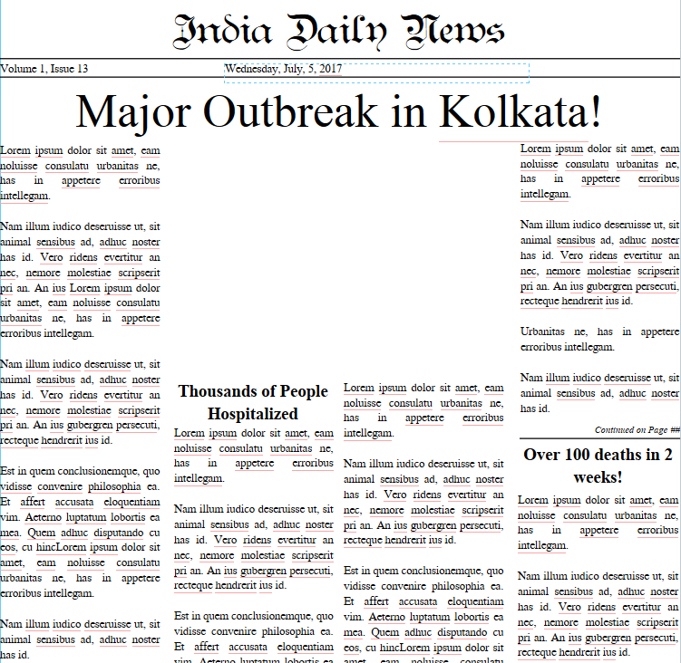
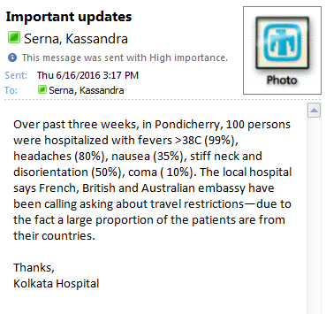
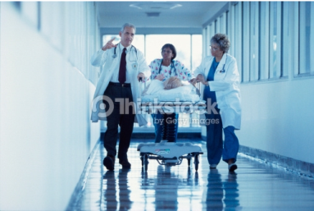
India Phase #2:
Public Health
Time: 1200 5/07/2017 Weather: 20 C, Partly cloudy, afternoon rains
KolkataHospital@gmail.com
Sun 7/5/2017 12:00 PM
India@ministry.gov
  Kolkata faces major outbreak with 1000s of hospitalized adults and children exhibiting mostly signs of fever, coughing and trouble breathing. Over 100 deaths have been attributed to this cause over past 2 weeks. Similar cases are being reported in Mumbai, Hyderbad, Ranchi, New Delhi and Bangalore.
Notes:
Newspaper is the true situation, cases are coming from both animal exposure and travelers. Email is the “false flag” for japanese encephalitis- possible in this region during this time of the year esp with high mosquitos in background
http://www.thinkstockphotos.com/image/stock-photo-doctors-and-a-nurse-pushing-a-patient-through/79085828/popup?sq=K|hospital|65526/f=CPIHVX/s=DynamicRank

Slide 12
What steps do you take when you receive this information?
i._______________________________________________________________________________________________
ii. ______________________________________________________________________________________________
iii.______________________________________________________________________________________________
iv.______________________________________________________________________________________________
v. ______________________________________________________________________________________________
How would you would normally receive this information from a hospital? (Phone, Fax, Email, Other)
Is there a policy specifying how soon a hospital is required to notify your ministry of a possible outbreak? (Yes/No)
How long does it normally take your office to receive the information? (___ days or ___hours)
Would your ministry investigate this situation, based on the information provided?________________
What type of advice would you give the hospital about keeping staff safe?___________________________
Would you contact any other ministry, lab, hospital, or other entity regarding this information at this time?
(If so, please note what was discussed, with whom, and the expected actions to been taken.)
________________________________________________________________________________________________________________________________________________________________________________________________
Would your office recommend or conduct any specific testing? Which tests? Which lab would conduct the tests?
________________________________________________________________________________________________________________________________________________________________________________________________

Slide 13
Respiratory cases: Bacterial cultures negative, TB tests negative
Pondicherry cases: CSF consistent with Japanese encephalitis
20% of hospitalized cases, 2% of deaths among respiratory cases are healthcare workers
Rainy season has led to increase in mosquito abundance across Southern India. 80% of patients are visiting from Europe or Australia

Slide 14


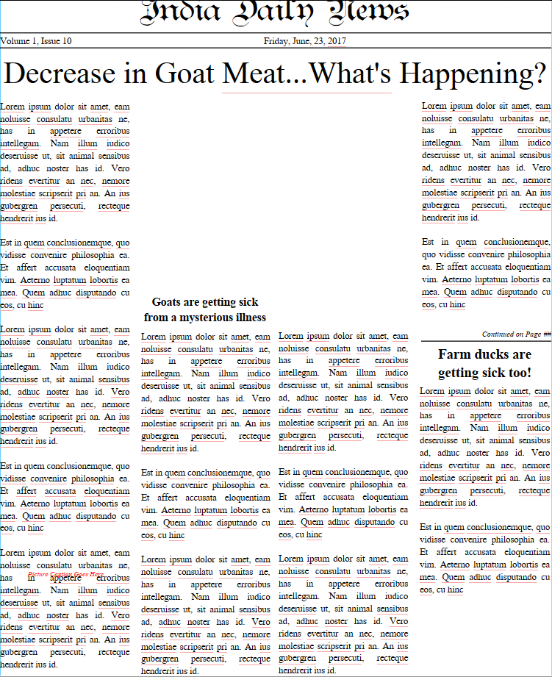
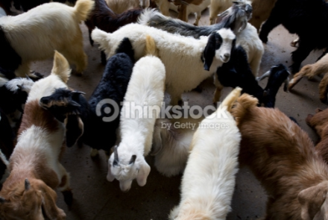
India Phase #1:
Animal Health
Time: 1200 23/06/2017 Weather: 24 C, Partly cloudy
  Local concerns rise about goat meat availability during Hajj rise as 1000s of goats acutely ill and dying from a mysterious illness in Nadia district of West Bengal.
  Local farmers note increased number of sick goats and farmed ducks.
Notes:
These are also true cases. The animal cases start in the eastern part of the country in this district which is known for summer bird migration as well as goat (not large farms, family operations). It is not unheard of for health agencies to learn about outbreaks from newspaper– with Hajj going on, seems possible.
http://www.thinkstockphotos.com/image/stock-photo-dubai-uae-goats-for-sale-at-shindagha-market/85451607/popup?sq=goats/f=CPIHVX/s=DynamicRank

Slide 15
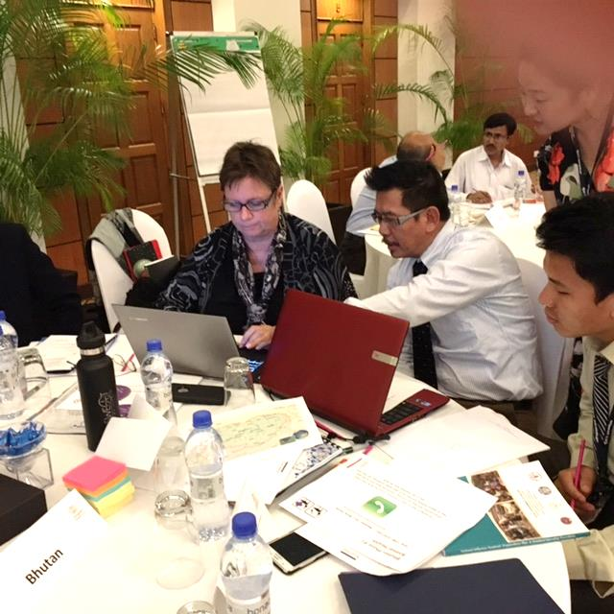
South Asia Pandemic TTX 2016:
Benefits of PREP™ during this TTX
  Provided evaluators real-time data
    Addresses challenge evaluators faced tracking 12 scenarios in many languages
    Organized qualitative data for participants to assess during AAR
  Timely completion of country-level & Regional level reports
  Tracked all communication
Notes:
We designed PREP to capture data but we found there were other unexpected benefits.
Let me show you what this looks like when designing the PREP tool.
During demo:
In order to make the exercise work, it was critical to have the right people playing the roles.
As it was our first exercise using PREP, we’ve found it is very helpful to have the tool ensure our design team type in objectives before jumping ahead to the scenario. As an evaluation tool, we need clear objectives and not just- let’s do another flu exercise or something. People often focus on the scenario, but sometimes forget to ensure it addresses the objectives.

Slide 16
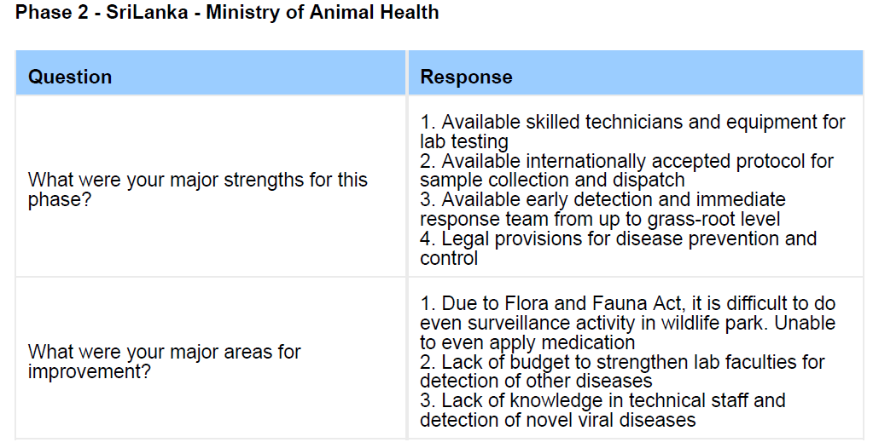
Hotwash data collection informs AAR
Able to print using
the data collection tool for evaluators and participants at end of each phase

Slide 17
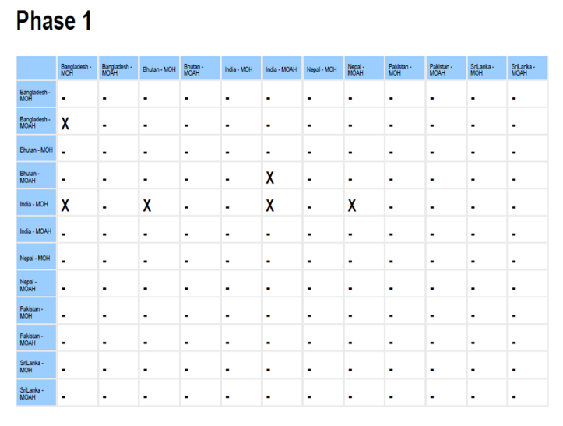

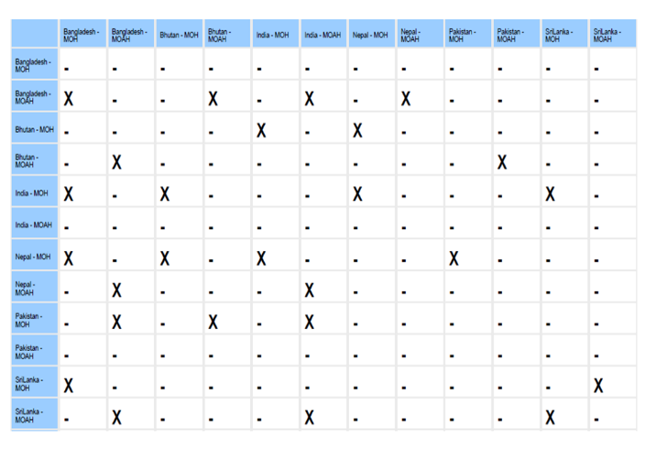
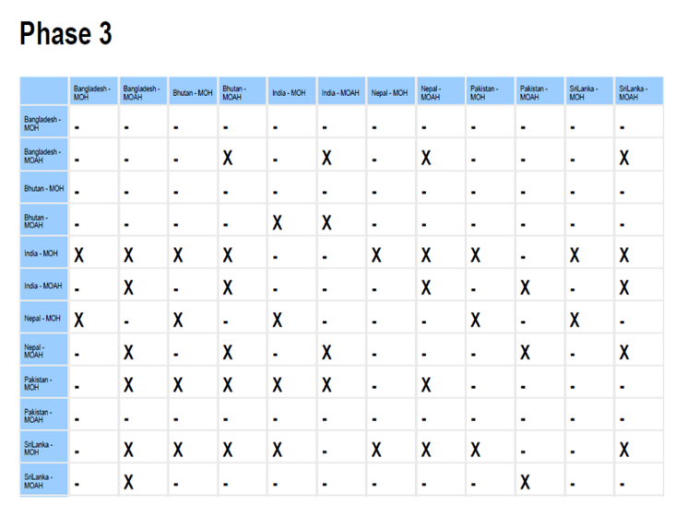
Tracking Comms: Who Talked to Whom

Slide 18
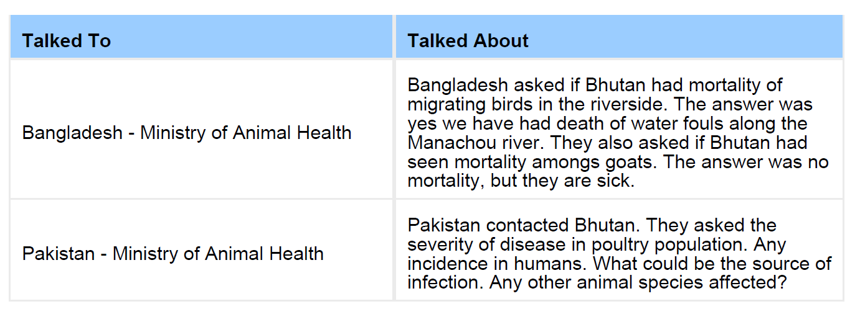
Tracking Comm: What was said

Slide 19
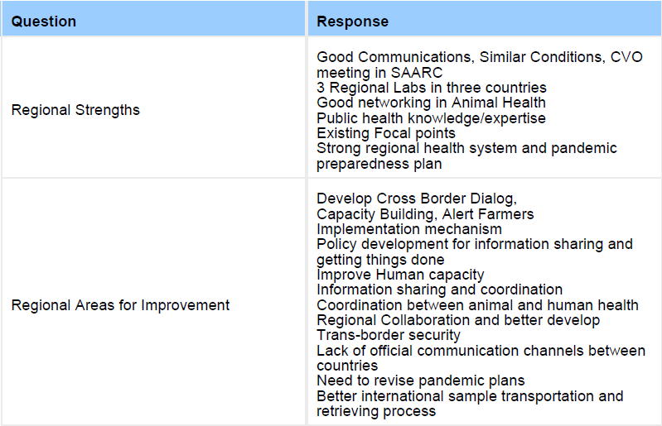
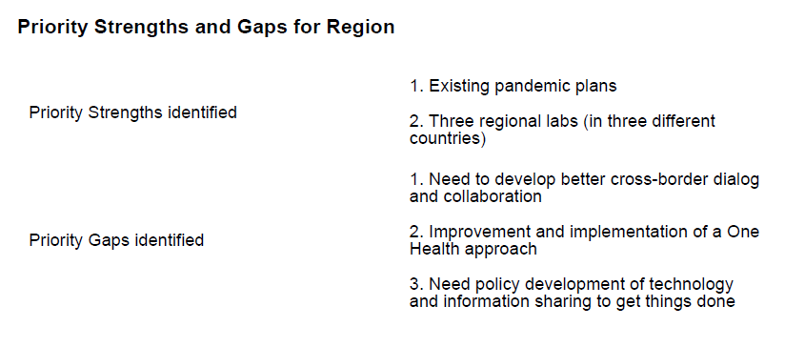
AAR Strength & Gap Prioritization
→

Slide 20
Follow-up Activities for South Asia TTX
Remote Web-based TTX—Fall 2016
A follow-up “phase 5” where cases re-emerge
  Scenarios written to address gaps identified in first TTX
  All 12 functional roles (25 people from 6 countries) played
  Communication tracked using email-based notifications
Remote Web-based After Action of Real Events—Spring 2017
  Using Pro-Med, we identified true outbreaks with potential cross-border, cross-sector coordination
  Questions focused on coordination during these real events
Notes:
Due to PREP™, we had the unique ability to follow-up with 2 different activities to help the sponsor maintain communication with and among the participating countries.
We gave log-ins based in their functional roles (we actually had groups playing individual roles, and they were able to coordinate responses), they emailed each other using the comm tool which—when used remotely—is tied to an email-based notification system.

Slide 21
Demonstration
How PREP™ can be used to
  Design an exercise
  Conduct an exercise
  Create a multiyear strategy
  Videogame

Slide 22
Concluding Remarks
ICBTR TTX Methodology provides a unique approach for participant-led evaluation of One Health readiness
Development and implementation of PREP™ has proven it to be:
  Simple, easy-to-use format to conduct & design exercises and planning sessions
  Effective means for real-time participant-driven data collection
  Complex enough to capture systems-level coordination, multiple data streams and consolidate into concise, timely reports
Next steps
  Continue sustainable capacity building with Biothreat Readiness Leadership
  Integrate in dynamic scenarios based on models
  Any thoughts?

Slide 23
Questions?

