Slide 1
WHO Methods for the Estimation of Malaria Mortality
Abdisalan M Noor,
Team Lead, Surveillance
IDM Symposium
15-18 April 2019, Seattle, WA, USA

Slide 2

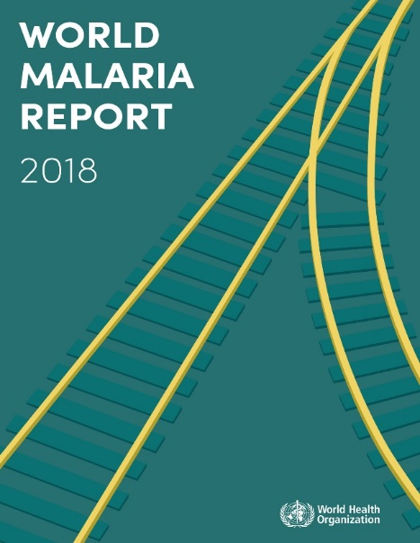
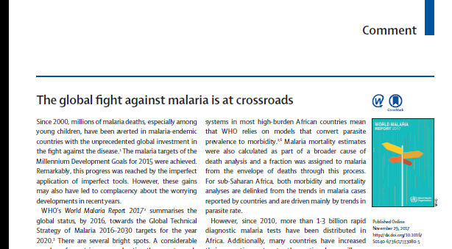
Tracking global malaria progress

Slide 3
Number of malaria cases worldwide, 2000–17
(millions)
Cases

Slide 4
Number of malaria deaths worldwide, 2000–17
Deaths

Slide 5
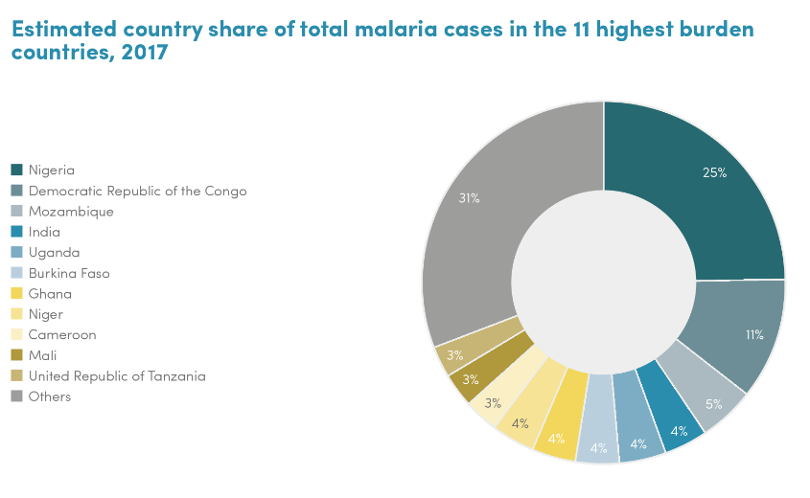
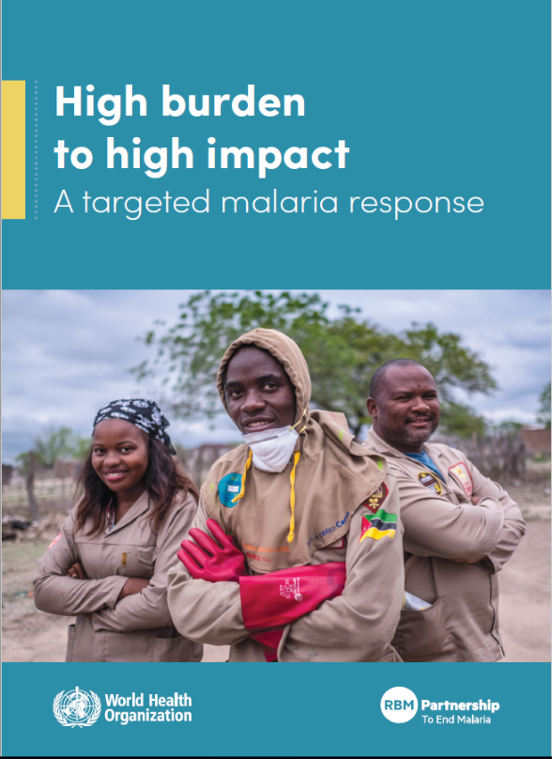
High Burden to High Impact: a targeted response

Slide 6
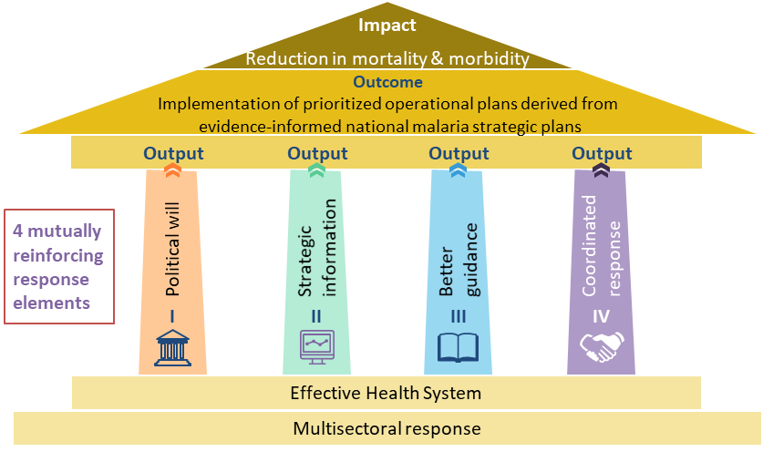
High Burden to High Impact: a targeted response

Slide 7
The burden of malaria
Death
Severe disease
Mild disease
Infection
Increasing estimation uncertainty

Slide 8
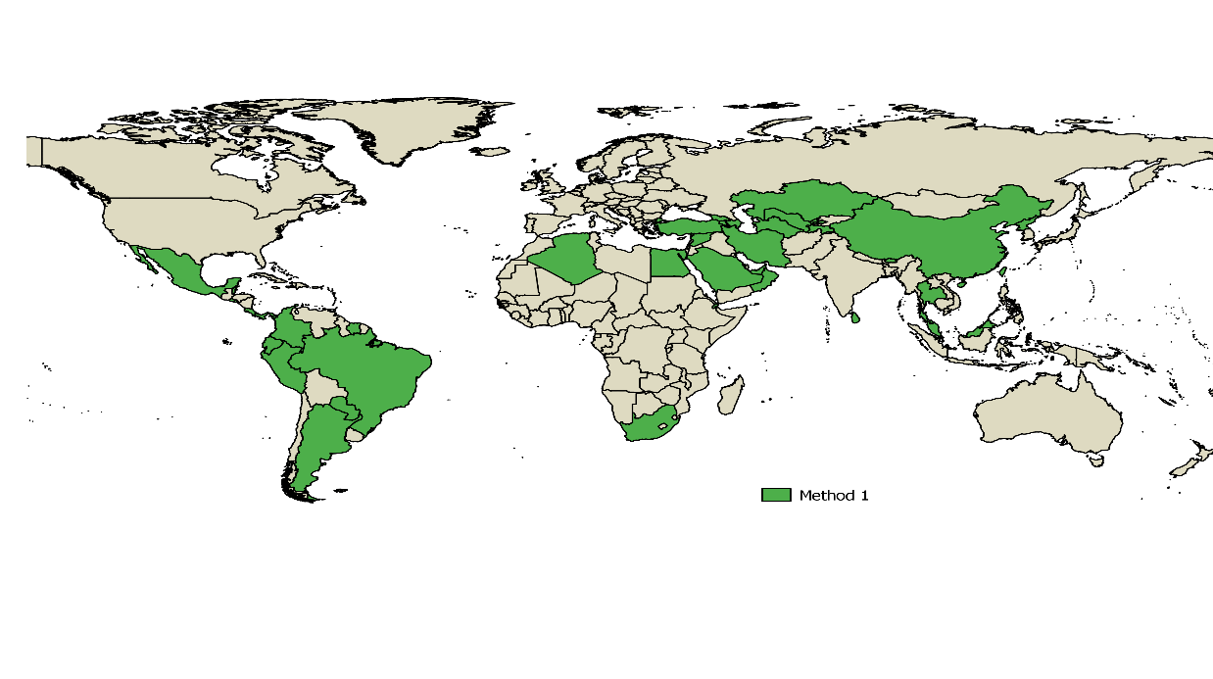
Method 1:
Reported deaths
WHO methods for estimating malaria mortality
Unadjusted national data
(37 elimination or certified countries)
>0.01% of global malaria deaths in 2017

Slide 9
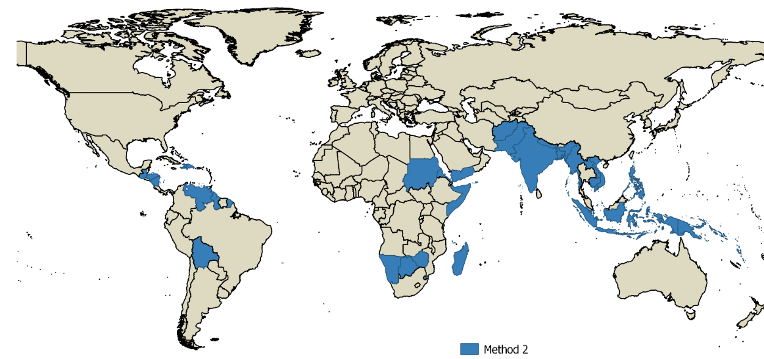
WHO methods for estimating malaria mortality
Adjusted routine incidence data x species specific case fatality rates
(35 low transmission countries in southern Africa & outside Africa)
11% of global malaria deaths in 2017

Slide 10
WHO methods for estimating malaria mortality
Adjusted routine incidence data x species specific case fatality rates
(46 low transmission countries in southern Africa & outside Africa)
P. falciparum
CFR, P. falciparum: 0.256%
11% of global malaria deaths in 2017

Slide 11
Case fatality rate estimation – P. vivax
  Morbidity and mortality in travelers returning to non-endemic countries
    Number of studies: 15 (13 countries)
    CFR: Weighted average 0.059% (range 0% – 0.087%) 1 in 1700 cases
  Case fatality rates calculated from routine case and death reporting 2000 – 2012
    Number of countries where death registration >80%: 3 (Brazil, Colombia and Venezuela)
    CFR: 0.012% – 0.018%. 1 in 5,560 to 1 in 8,300 cases
  Population-based estimates of mortality from P. vivax in malaria endemic countries
    Number of studies: 2 (both from the same study site)
    CFR: 0.012% – 0.063%. 1 in 1,500 to 1 in 8,300 cases
CFR, P. vivax: 0.0375%

Slide 12

Limitation 1: Self reported treatment seeking based on history of fever for adjustment of routine data
Household survey self reported fever in U5 in the last two weeks
Is the probability of being a malaria case similar by treatment seeking groups?
Have they been tested for malaria?
Have they been treated with the right drugs?
How accurate is self reported fever as proxy for malaria fever?
What does this mean for estimating malaria attributable fevers?
Is U5 treatment seeking for fever a good proxy for over 5 patterns?
No action
Delayed action?
Shop
Private health facility
Public health facility

Slide 13
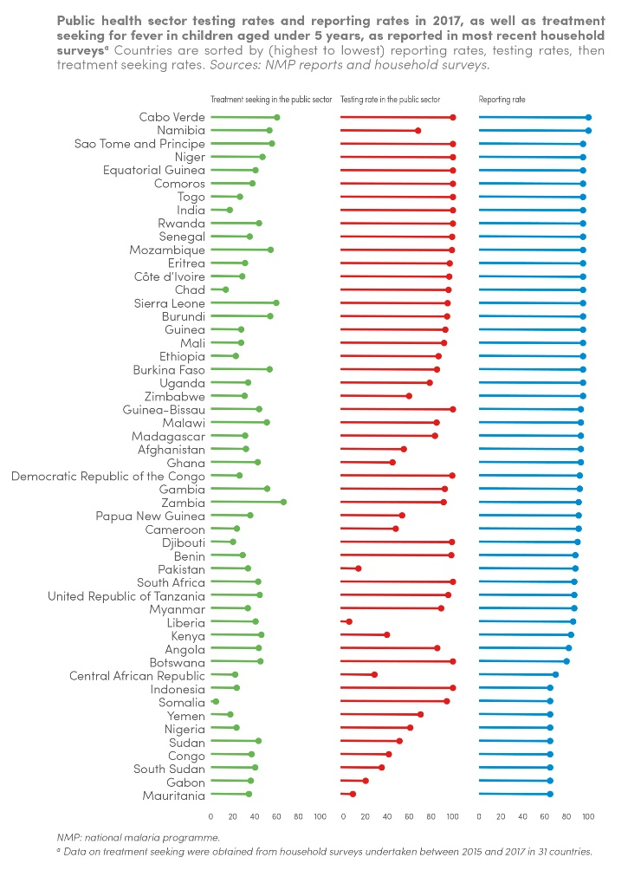
Limitation 2: optimistic self reported routine data completeness
Regular national surveillance system assessments required

Slide 14
Limitation 3: Old and sparse case fatality rate date
Few and old P. falciparum CFR data. Data from highest burden countries are mainly hospital CFR
Majority of P vivax CFR data come from travellers coming to non-endemic countries

Slide 15
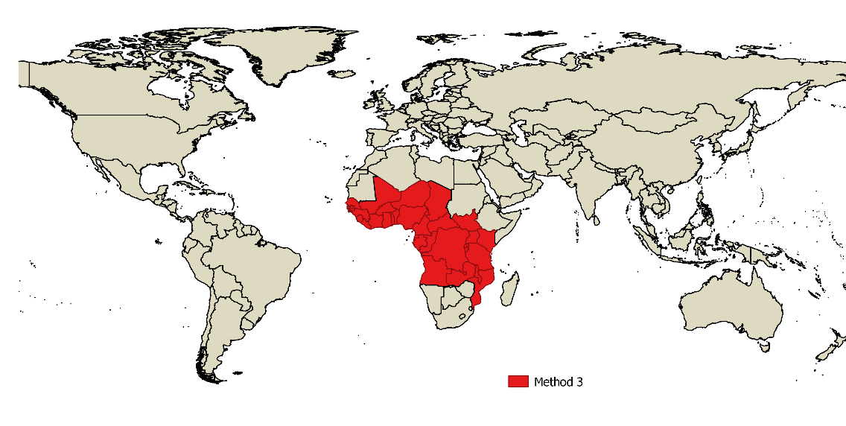
WHO methods for estimating malaria mortality
U5 mortality data x malaria CoD fraction + fraction over 5,
31 Sub Saharan African countries
89% of global malaria deaths in 2017

Slide 16
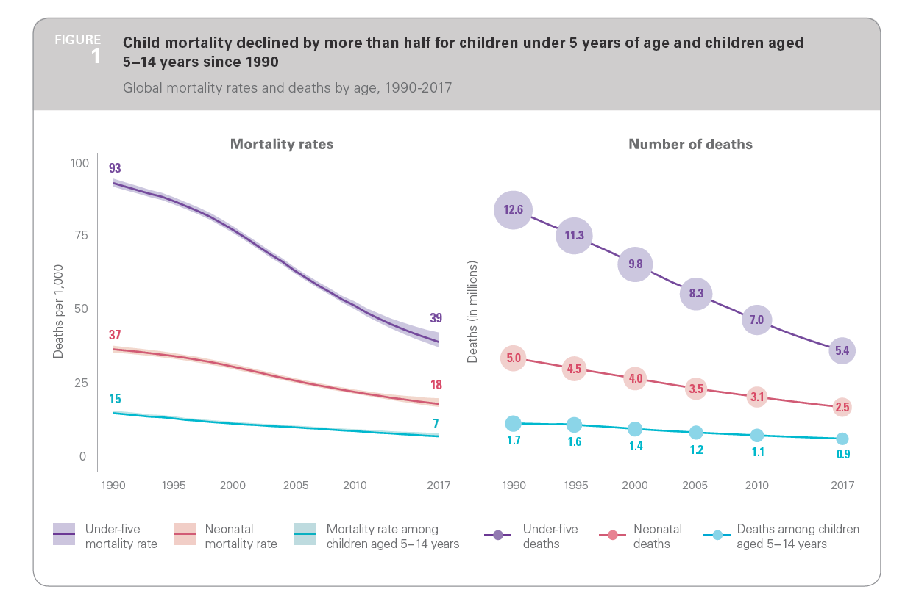
Estimating malaria mortality in SSA: Step 1
UN-IGME estimate of overall envelope for under 5 mortality
Estimates are based on:
nationally representative data from censuses, surveys or vital registration systems
covariates are not used to derive its estimates
survey data used are a mix of full and summary birth histories
https://childmortality.org/reports

Slide 17
Estimating malaria mortality in SSA: Step 2
WHO-MCEE estimate of cause of death (CoD) fraction
Countries with high-quality vital registration (VR) systems, death distribution is estimated directly
Countries with low-quality VR but low mortality, death distribution is estimated from a regression fit to data from countries with high-quality VR
Countries with low-quality VR and high mortality, death distribution is estimated from a regression fit to data assembled from studies of cause of deaths in high mortality countries, typically relied on verbal autopsies
https://www.who.int/healthinfo/global_burden_disease/childcod_methods_2000_2016.pdf?ua=1

Slide 18
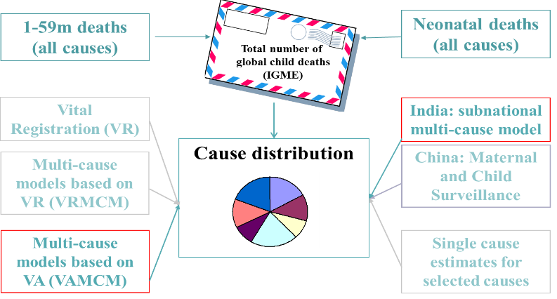
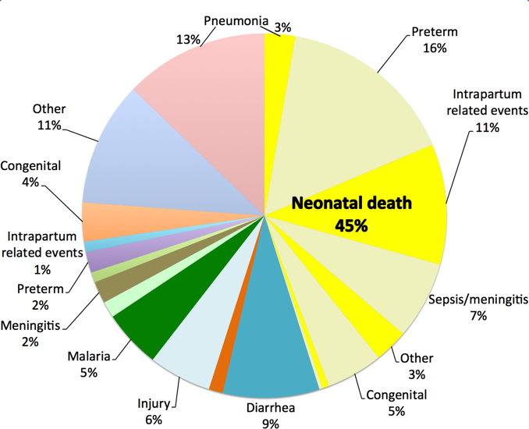
Estimating malaria mortality in SSA: Step 2
WHO-MCEE estimate of cause of death (CoD) fraction
https://www.who.int/healthinfo/global_burden_disease/childcod_methods_2000_2016.pdf?ua=1

Slide 19
MCEE-WHO multinomial method to estimate CoD in low quality VR and high mortality
Use of Verbal Autopsy (VA) data from research studies
  218 sets of data point from 129 VA studies in 41 countries
  Deaths are categorized into 8 causes:
  Pneumonia, Diarrhoea, Malaria, Meningitis, injuries, congenital malformations, causes arising in the perinatal period (prematurity, birth asphixia, and trauma, sepsis and other conditions of new born) and other causes.
  Measles and HIV are estimated separately
Use of covariates (selected via cross-validation):
  Under five mortality rate
  presence of meningits epidemic,
  GNI per capita (PPP, $international),
  measles vaccine coverage,
  skilled birth attendance coverage,
  percent of the population living in urban areas,
  percent of children who are underweight and year
  malaria parasite prevalence rate (PfPR)
Adjustment for intervention coverage
  Pneumonia and meningitis for the use and effectiveness of HIB and pneumococcal vaccines,
  Diarrhoea estimates for the use and effectivenes of rotavirus vaccine
Compute number of deaths by cause by multiplying the UN-IGME envelope with the estimated CoD. (Measles and HIV are exceptions)

Slide 20

Estimating malaria deaths in over 5 years
Estimating malaria mortality in SSA: Step 3
Ross A, Maire N, Molineaux L, Smith T. An epidemiologic model of severe morbidity and mortality caused by Plasmodium falciparum. Am J Trop Med Hyg. 2006;75(2 Suppl):63–73..
Relationship also used to infer % of deaths <5 outside of Africa
$$y=−0.2288x^{2}+0.823x+0.2239$$

Slide 21
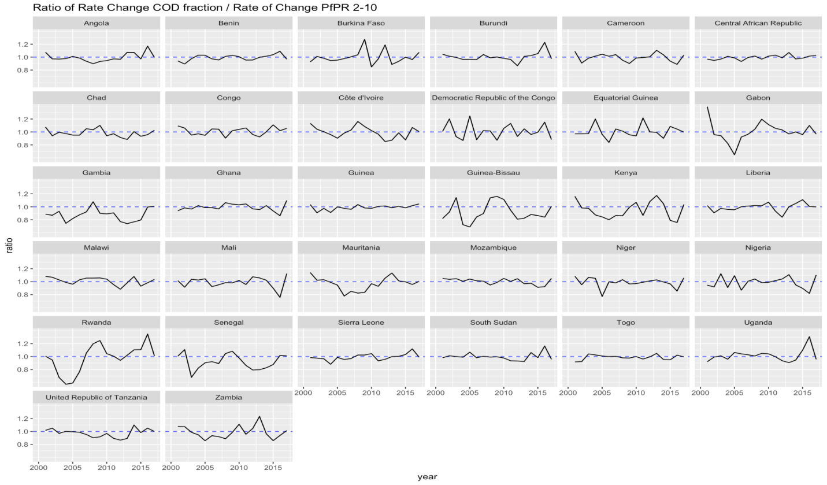
Limitation 4: substantial smoothing in quantifying CoD
Ratio of rate of change of malaria CoD fraction:PfPR₂₋₁₀

Slide 22
Limitation 5: absence of malaria interventions in models
Not treated
Severe disease
Death
Infected
Mild disease
Treated with effective medicines

Slide 23
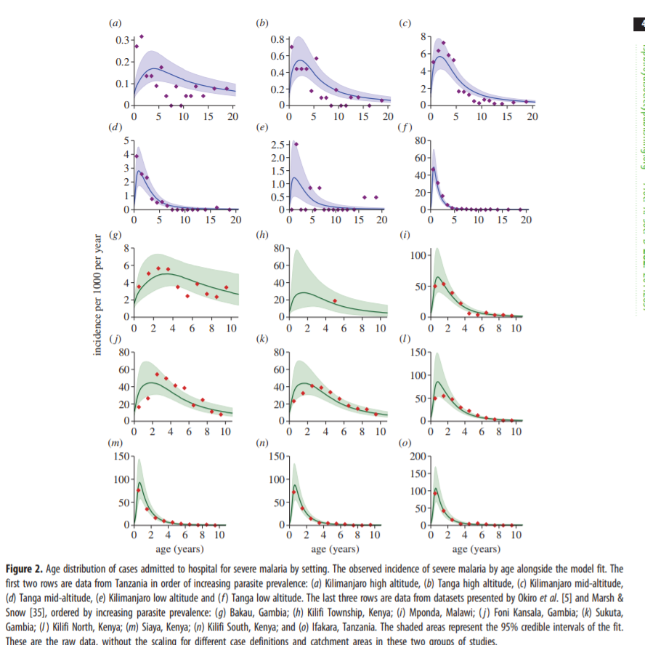
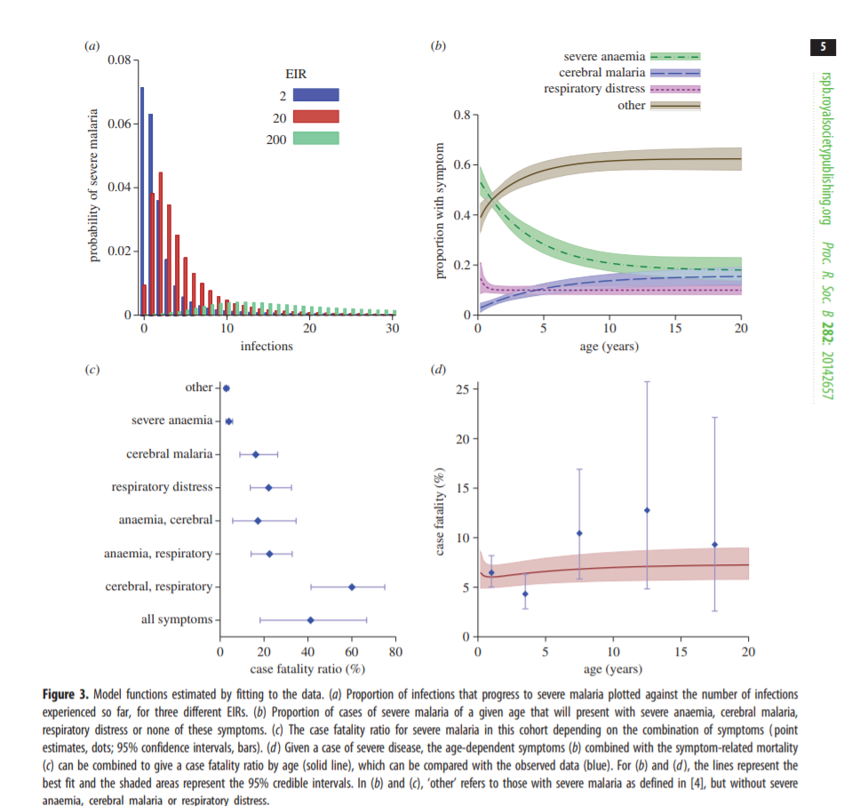
Limitation 5: no adjustment for changing age related immunity
Griffin et al 2014

Slide 24
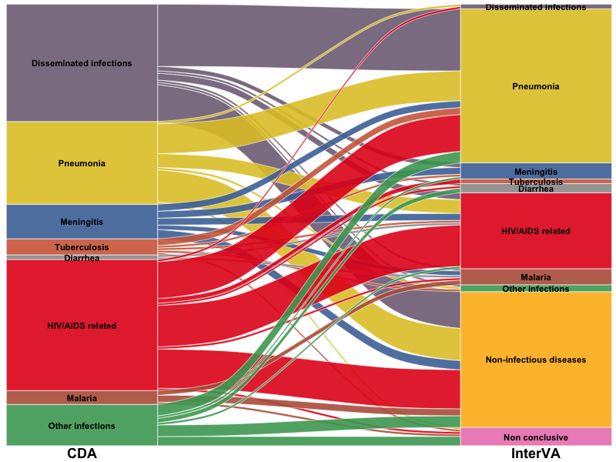
Limitation 6: low specificity of verbal autopsies
Menendez et al (2019), submitted

Slide 25
Improving the estimation of malaria burden
http://www.who.int/malaria/mpac/mpac-april2018-erg-report-malaria-burden-session6.pdf

Slide 26
Improving the estimation of malaria burden
Death at home due to lack of treatment
Death at home post discharge
Death in hospital

Slide 27
1. Better understanding of severe disease phenotype
Griffin et al 2014
Source: Andre Lin Ouédraogo

Slide 28
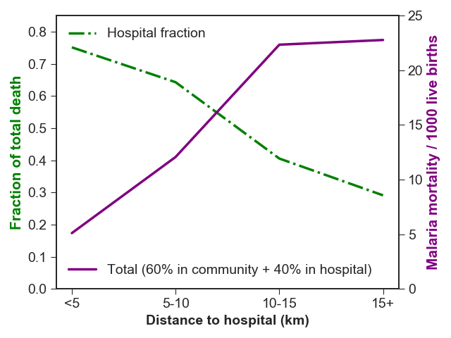
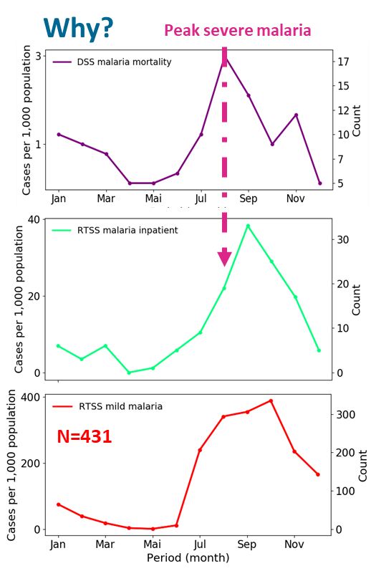
2. Better measurement of treatment seeking
Data from Nanoro DSS, Burkina Faso
Source: Andre Lin Ouédraogo, IDM

Slide 29
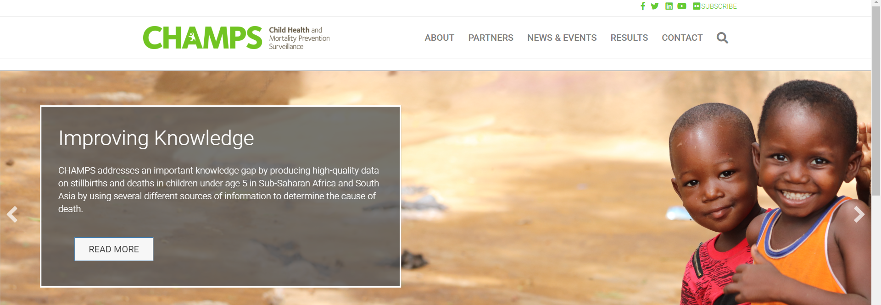
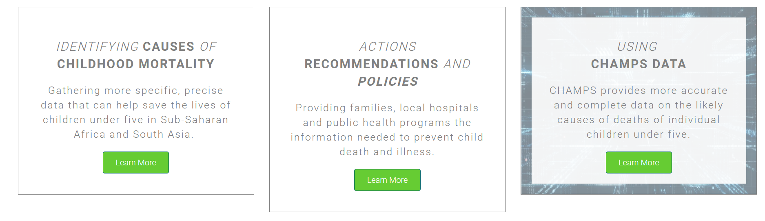
3. Better understanding of CoD and validation of VA data
https://champshealth.org/

Slide 30
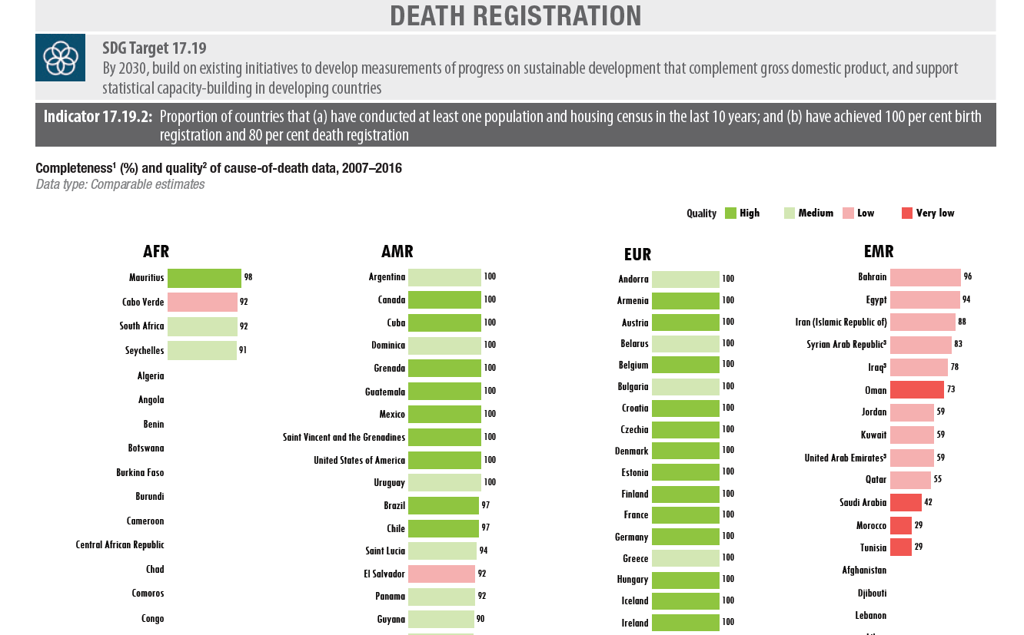
4. Better surveillance
https://apps.who.int/iris/bitstream/handle/10665/272596/9789241565585-eng.pdf?ua=1

Slide 31
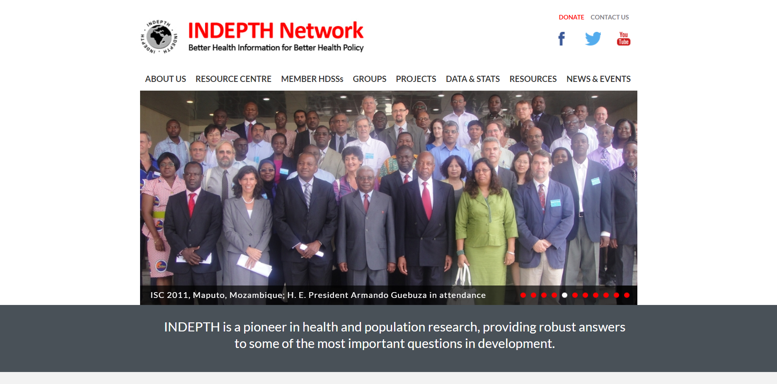
5. Data sharing

