Slide 1
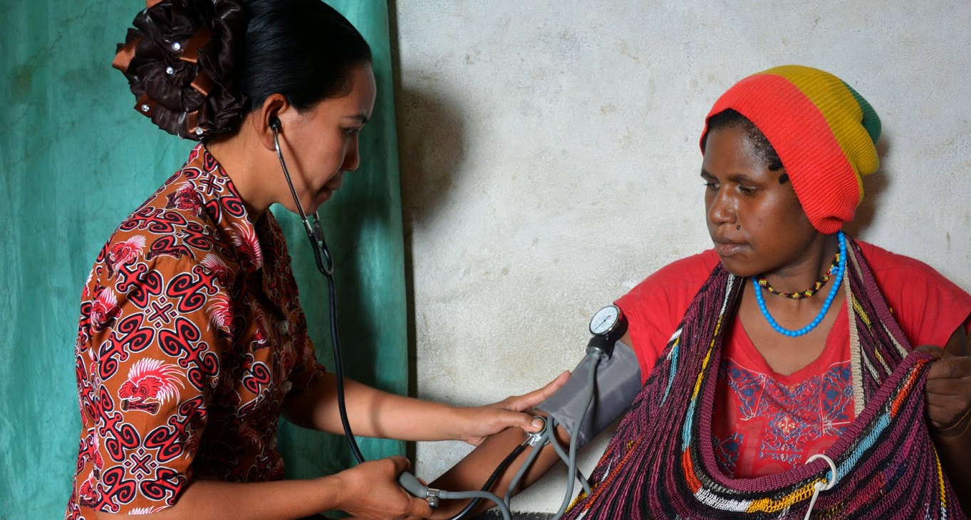
Using Economic Modeling to Open Policy Windows for Non-communicable Disease Investment
The Investment Case
Rachel Nugent, Vice-President, Global Non-communicable Diseases
Rachel Nugent, Nathan Mann, Brian Hutchinson, Grant King
Institute for Disease Modeling Symposium
16 April 2019, Redmond WA

Slide 2

Investing in NCDs prevention and control

Slide 3
Agenda
What are NCDs?
The health and economic burden of NCDs
The investment case as a tool to catalyze change
Presenting the results – analyst as advocate
Final points and discussion

Slide 4
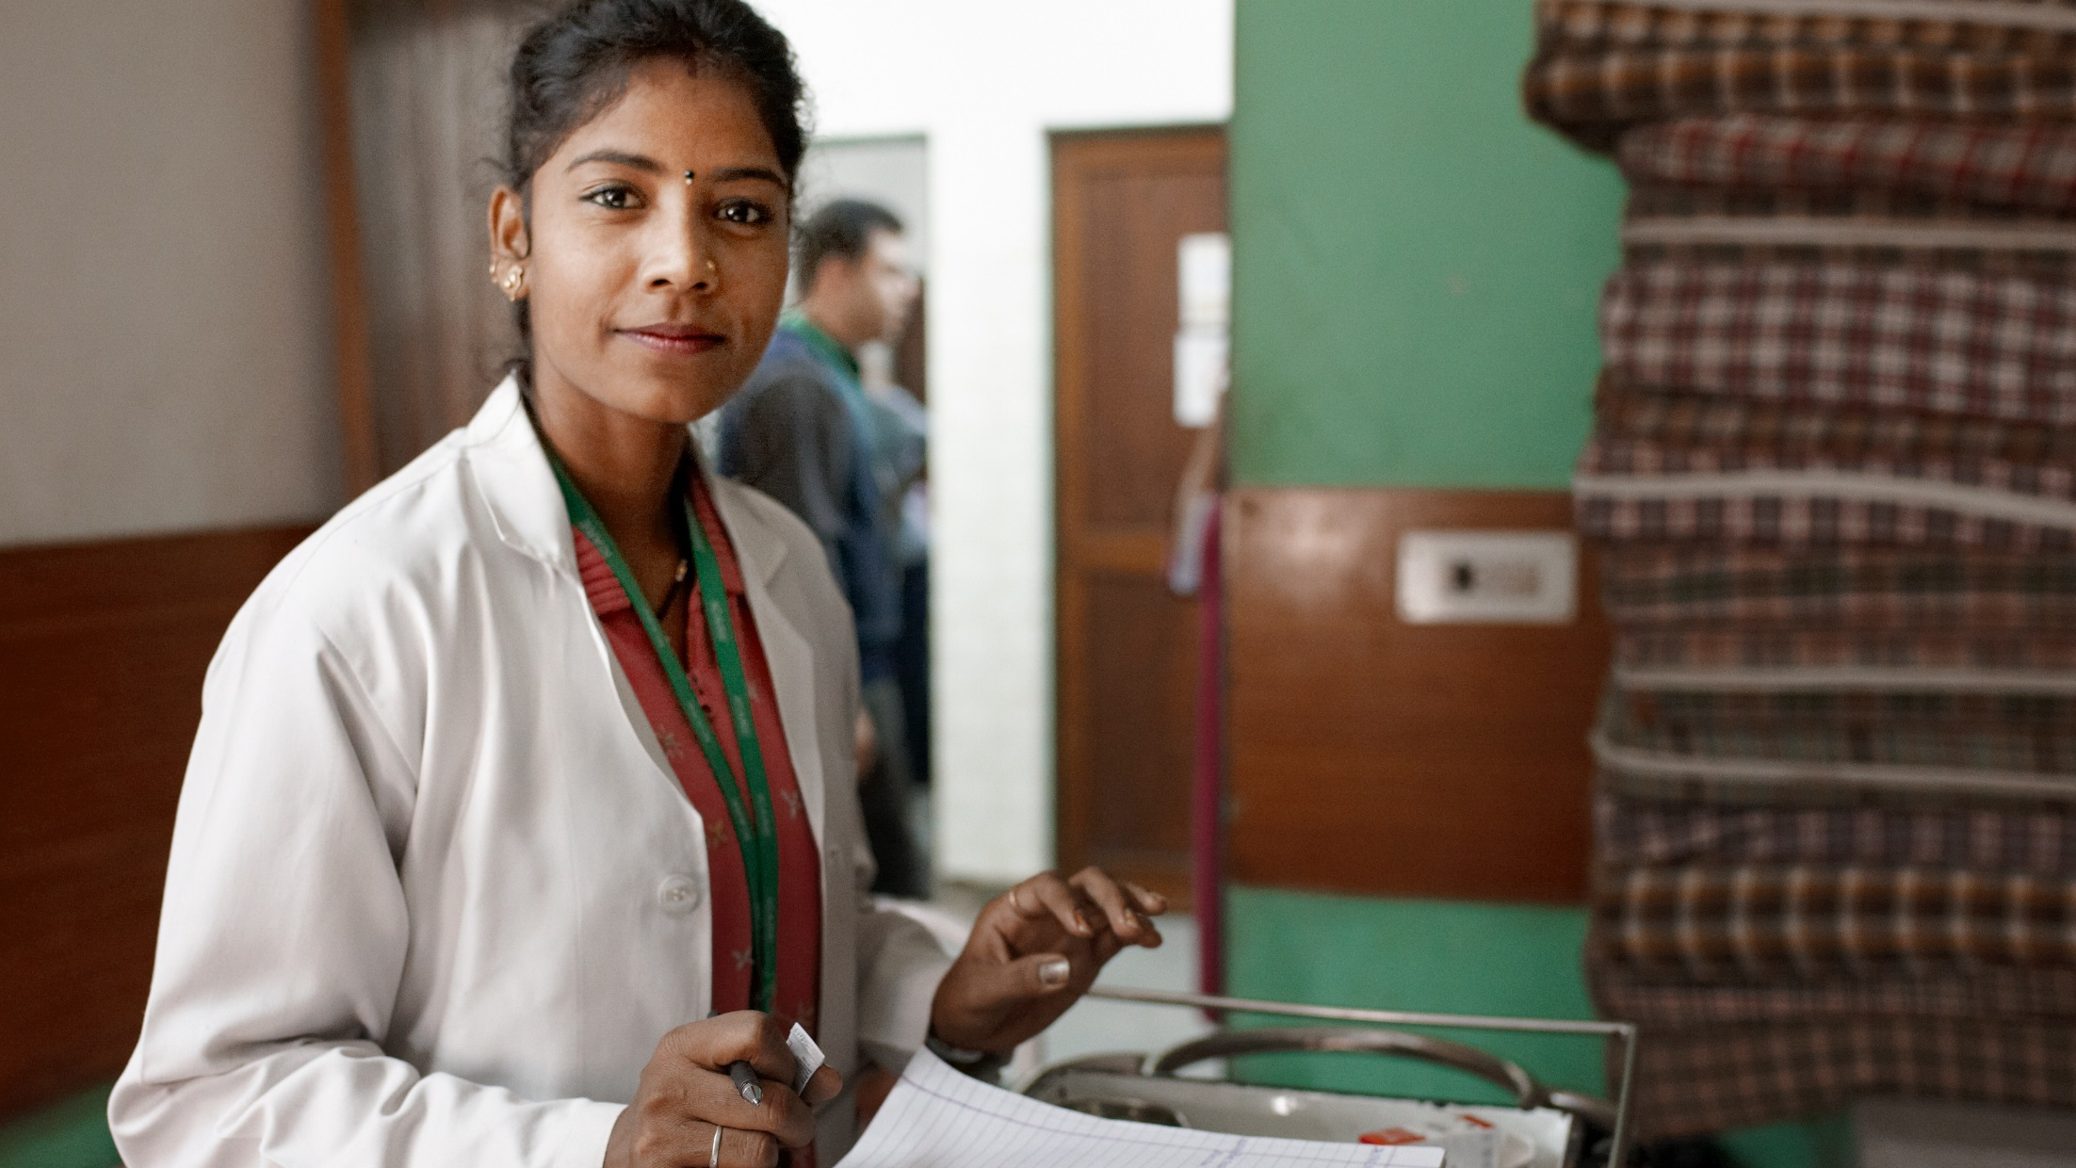
What are Non-communicable Diseases?
Notes:
WHAT ARE NCDs?
-------------------------------------------------------------------
The four major NCDs and four major risk factors appear in bold. These are from what WHO calls the 4 x 4 approach to looking at NCDs. majohttp://www.who.int/ncdnet/about/4diseases/en/
NCDs include a wide range of diseases and risk factors, ranging from cancer, mental health, to what people call “lifestyle diseases” (obesity, stroke, hypertension, etc.). Globally, NCDs are the leading cause of death. And the burden from NCDs continues to grow.

Slide 5
NCDs are non-infectious, non-transmittable medical conditions.
They are the leading cause of death globally
NCDS INCLUDE:
Cardiovascular diseases
Cancer
Diabetes
Chronic respiratory diseases
Kidney disease
Mental health
Substance abuse
Neurological diseases
Disability
RISK FACTORS CONTRIBUTING TO NCDS:
Tobacco use
Excessive alcohol intake
Diet
Lack of exercise
Ageing
Obesity
Air pollution
Genetic makeup
73%
of all deaths
are attributed to NCDs
Notes:
-------------------------------------------------------------------
72 percent of all deaths stat updated with latest information from GBD – year 2016

Slide 6
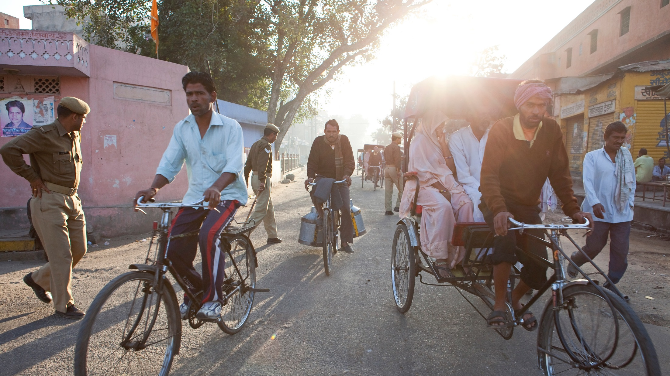
8 out of every 10 NCD deaths occur in LMICs
Notes:
85% of NCD deaths occur in LMICs

Slide 7
The global burden of NCDs
Death rates by cause, 2016
World Bank
Country Category
High Income
Upper Middle Income
Lower Middle Income
Low Income
Communicable, maternal, neonatal, and nutritional diseases Injuries Non-communicable diseases
Notes:
WHAT ARE NCDs?
-------------------------------------------------------------------
This slide shows the global burden of disease by World Bank country income level categories: low, lower middle, upper middle, and high.
NCDs are now common across high-, middle-, and low-income countries. The spread and proportion of these diseases looks somewhat different from between the three, but they are becoming more visibly similar. NCDs are growing faster in LMICs than rich countries due to economic development and globalization/urbanization among other factors. While mortality due to NCDs continues to increase, LMIC health systems are less capable than the systems of high income countries of identifying risk factors, diagnosing NCDs, treating NCDs, or preventing them.

Slide 8

Global economic burden of NCDs
More than 43% of NCD deaths are premature deaths under the age of 70
Mortality and morbidity among people in their most productive years has a significant impact on economic development and can undermine progress
This far outweighs the estimated
11.2 billion USD
cost of implementing a set of high-impact, cost-effective interventions to reduce the burden of NCDs
The projected cumulative lost output due to NCDs in LMICs for 2011–2025 is 7 trillion USD
Source: NCD Alliance
Notes:
WHY IS NOW THE TIME TO ACT ON GLOBAL NCDs?
-------------------------------------------------------------------
In addition to the burden of disease caused by NCDs, there is also a great economic burden due to NCDs.
Premature death = death under the age of 70

Slide 9




Valuing the Economic Costs of NCDs
DIRECT COSTS
INDIRECT COSTS
GOVERNMENT
Government expenditure on prevention, screening, and treatment
Higher disability and retiree payments
ECONOMY
Output lost due to absenteeism
Output lost due to presenteeism
Cost to replace workers who drop out of workforce due to chronic disease
INDIVIDUALS
Increased personal medical expenditures
Transport costs
Caregiver expense
INDIVIDUALS
Decreased human capital
Lost income
Lost time due to caretaking responsibilities
PRIVATE SECTOR
Private sector expenditure on health
Non-health sector expenditures

Slide 10
, Dollars per DALY from donors, by disease, 2015
10
$166.41/
DALY
8
$44.33/
DALY
6
Dollars (USD billions)
$309.33/
DALY
4
$42.67/
DALY
2
$32.89/
DALY
$1.04/
DALY
0
0
10,000,000
100,000,000
1,000,000,000
DALYs
Donor funding by NCD
World map: donors and recipients
Type of funder: bilaterals, multilaterals, foundations, and non-profits
Notes:
What about foreign assistance for the countries with the least ability to fully fund their health care needs?
Yes, donors have made great contributions, especially for MCH and infectious diseases.
However, less than 3 percent of all global donor funding is dedicated to NCDs
Looking at the circles illustrates the disproportionality in funding trends and disease burden. Of the six health areas receiving donor funding, NCDs make up 80% of total DALYs, yet only receive 3% of the funding. Alternatively, HIV/AIDS makes up only 4% of total DALYs and receives 39% of the funding.

Slide 11
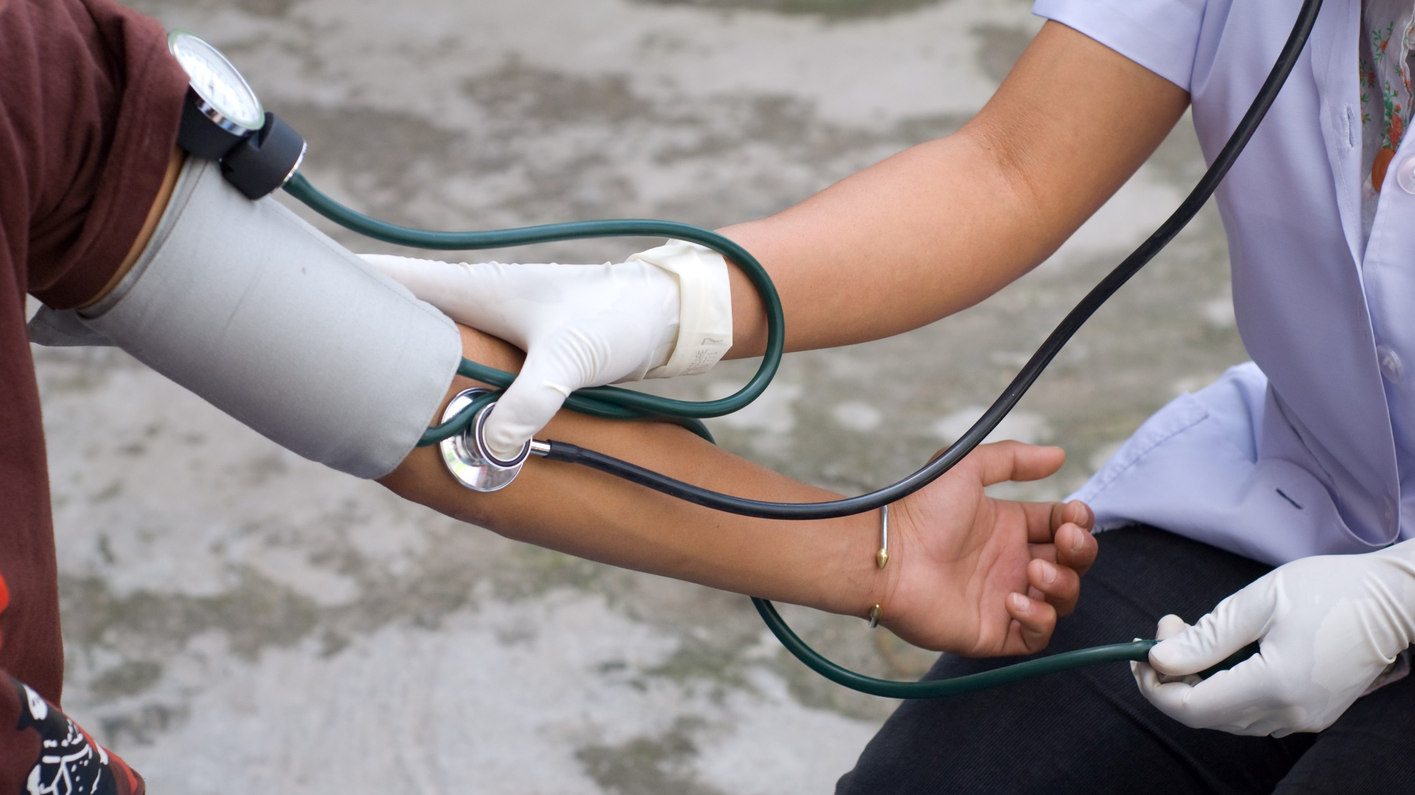
Making the case for investment

Slide 12
What is an Investment Case?
“An investment case is an argument that is intended to convince a decision maker to approve some kind of action. As a rule, an investment case has to articulate a clear path to an attractive return on investment. It should examine benefits and risks involved with both taking the action and, conversely, not taking the action.”
Country-specific investment cases that substantiate costs and benefits of NCD interventions
Use findings to make the case for increased prioritization of NCDS
Improvements in fund allocation and service delivery for NCDs
Improved health outcomes and economic outlook

Slide 13
Investment Cases – Moving toward a Definition
Wish list for an Investment Case:
Describes the current disease state within a given country;
Identifies feasible, effective, and locally relevant interventions for analysis;
Provides analysis of the costs and benefits of intervening;
Identifies access, delivery, quality, and efficiency issues that exist within the health system, and;
Frames current levels of health spending against the cost of intervention packages, and analyzes how to close the funding gap
Analyzes the policy environment for feasibility, and provides a roadmap for implementation
Session Goal: To examine the scope and applications of models that can analyze the costs and benefits of scaling up interventions for NCDs.
Notes:
Definition from UNICEF: An investment involves results-based analysis to inform planning, budgeting and policies, spelling out the costs and benefits of scaling-up packages of high impact interventions for addressing maternal, newborn, and child health (MNCH) and nutrition. The IC aims to address the main health and nutrition problems of the most deprived children and families; identify bottlenecks and barriers that contribute to this deprivation (using the Tanahashi model); and identify specific strategies to overcome the barriers that have created disparities. Discrete components of the IC approach contribute to achieving these goals: bottleneck analysis, estimates of potential lives saved through scale-up and reorientation of interventions, costing of interventions, modeling of cost-effectiveness, and budgeting. While bottleneck analysis will occur in all districts where the IC approach is used, use of the other components will depend on their usefulness in each context. Tanahashi T. Health service coverage and its evaluation. Bull World Health Organ 1978; 56:295-303.
Definition from The Global Fund: “An investment case is a description of returns on investment in a country’s optimized disease response over the long-term (typically 10+ years). It summarizes the state of the epidemic and the response, and describes the prioritized interventions, populations, and geographic areas to be implemented to achieve the greatest impact over the long term and the resources required. It also outlines the main access, delivery, quality and efficiency issues to be addressed to improve [disease] services and describes what will be done to address these issues. It includes an analysis of, and plan for, realistic and more sustainable financing of the [disease] response, including increases in domestic financing where relevant.”
An investment case:
Describes the current disease state within a given country and the response - a situational analysis
Disease state is optimally broken down by age, gender, socio-economic status, and geography
Develops a planned response (priority interventions)
The response and identified interventions are usually based on national strategies and consultations with stakeholders, and also are subject to the ability to use existing models to simulate the intervention)
Biomedical interventions (screenings, drugs, etc.)
Behavioral/Policy interventions (e.g., conditional cash transfers, school-based disease risk reduction programs, taxes, subsidies, public bans on smoking, advertising or food labeling measures, etc.)
Provides analysis of the costs and benefits (epidemiological and economic improvement) over the long term, should a given intervention(s) be implemented. Most investment cases calculate:
Benefits
The intrinsic value of the health benefit, sometimes using a VSL approach (Reductions in incidence, prevalence, and deaths)
The instrumental value of improved labor-market outcomes as measured in GDP (e.g., gains in productivity (reduction in absenteeism and presenteeism
Costs to implement
Identifies access, delivery, quality, and efficiency issues that exist within a health system, and how they can be addressed in order to facilitate the introduction of proposed interventions
Frames current levels of health spending against the cost of intervention packages, and analyzes how to close the funding gap.
Projected economic growth
National revenue and public spending
Health budget trends
NCD specific funding, including donor commitments.
Additional components of an investment case may include: policy analysis (feasibility)

Slide 14
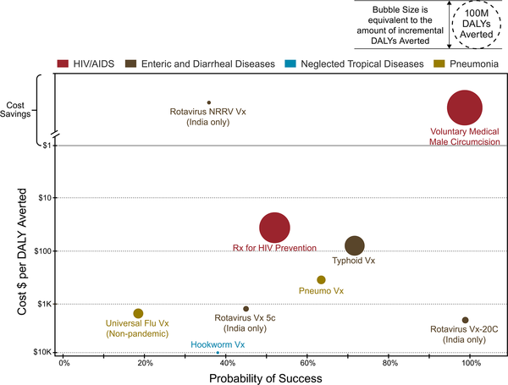
Portfolio Analysis for Global Health Impact
Notes:
The Gates Foundation is using a simple analysis for investment decisions that mimics the basic definition of an investment case. “The framework we use to evaluate [data in order to arrive at investment decisions] has a few simple dimensions: cost per disability-adjusted life year (DALY) averted, probability of technical success, and, at a more strategic level, whether our resources fill a real gap in the funding landscape.”
Figure explanation: Cost per disability-adjusted life year (DALY) averted is the incremental cost to deliver incremental DALY savings versus only the standard of care. Probability of success is the estimate of probability of technical and regulatory success (PTRS) informed by industry benchmarks and expert opinion. NRRV: Non-replicating rotavirus vaccine. Both the cost and the probability of success are dynamic values and subject to change with information that is constantly evolving

Slide 15
What kinds of things might we want a model to tell us?
∆ Population Health
Risk factors (e.g., ↓ consumption of alcohol, ↑ fruit/vegetable intake)
Incidence and prevalence of disease
Avoided deaths, healthy life years gained
∆ Social or other benefits
Human capital
Social ties
Time gained
∆ Household-level indicators
Consumption of non-health items
Savings and investment
Benefits
Monetization of health and social benefits (e.g., QALYs)
Effect on labor (avoided premature mortality and early retirement, absenteeism, presenteeism)
Change in total economic output (GDP)
Costs
Breakdowns of intervention and health system costs
Cost-effectiveness estimates (e.g., cost per life year gained)
Household OOP expenditures, including costs to access care (e.g., travel)

Slide 16
Models Used for Economic Analysis of NCDs
Seven NCD models
The Cardiovascular Disease Model
The OECD/WHO Chronic Disease Prevention Model
OneHealth Tool
Blakely’s Multi-state Life Table
Global Trade Analysis Project (GTAP)
Impact of Health on Worker Attendance and Productivity calculations
WHO EPIC Model and EPIC-H Plus
Economic
4 models produce net cost, cost savings, and/or cost-effectiveness estimates (blue)
3 models have a macroeconomic or non-health sector focus (gold)
e.g., analysis of lost economic output--∆GDP--as a result of NCDs; labor market outcomes (∆ absenteeism & presenteeism)
Notes:
Interventions
Some models are built specifically to model policy/behavioral interventions. For example, the Chronic Disease Prevention model has been adapted to model mass media campaigns and worksite interventions for obesity, and Blakely’s life-state table models tobacco and food taxes, and subsidies for vegetable and fruit. On the other hand, the OHT focuses more heavily on biomedical interventions (e.g., treatment for high blood pressure or stage 1 breast cancer treatment). Still others do not incorporate specific interventions at all. In one paper, for instance, authors using the EPIC Model insert a hypothetical NCD intervention (e.g., a five percent reduction in mortality from cancer) to estimate resulting reductions in economic losses.

Slide 17
Considerations for economic models
Does the model incorporate:
Long-term health impacts;
Wider societal costs and consequences;
Multicomponent interventions;
Interactions with non-health sector systems.
Impact on inequalities;
Notes:
Long-term health impact (model has a long time horizon)
This category denotes whether a model incorporates a method of allowing for an intervention's impact over time. On a second level, it includes consideration of whether a model contains built in parameters to allow the effect of an intervention to vary or fluctuate over time according to conditions. (e.g., the effects on cardiovascular disease burden and health expenditure of increasing the price of unhealthy foods may manifest and persist for many years after the intervention is introduced)
Wider societal costs and consequences
(e.g., “transport policies to improve physical activity have social costs and outcomes beyond health; and different social costs and outcomes are relevant to different modeled scenarios, for example, influencing alcohol use has an important effect on crime whereas reducing stroke incidence has amore important effect on social care”)
Impact on inequalities
Does the model allow for a breakdown of impact and analysis: across categories like geography, gender, socioeconomic status, age, etc. (e.g., “more deprived population groups may respond differently to those who are less deprived following a price increase on unhealthy food”)
Multicomponent interventions
Can interventions be modeled as packages, or only individually? (e.g., “a policy aimed at increasing physical activity may include both additional bicycle lanes and subsidized gym membership”)
Interactions with non-health sector systems
Are interactions within complex non-health sector systems included? (e.g., if simulating the effect of upgrading home insulation to reduce winter deaths, it may be important to consider interactions with the housing sector, energy sector, and social care)"
All examples from Briggs, A., Wolstenholme, J., Blakely, T., & Scarborough, P. (2016). Choosing an epidemiological model structure for the economic evaluation of non-communicable disease public health interventions. Population Health Metrics, 14, Population Health Metrics, 2016, Vol.14.

Slide 18
Comparison of Characteristics
 | Long-term health impacts | Wider societal costs and consequences | Impact on Inequalities | Multicomponent interventions | Interactions with non-health-sector systems
CVD Policy Model | X |  | X
CDP Model | X* |  | X | X
OHT | X |  | X | X | X
Blakely’s Life Table | X* |  | X
Models with a macroeconomic focus
GTAP Model | X |  | X | X | X
APEC Calculations | X |  |  | X
WHO EPIC Model | X
Notes:
Asterisks on “long-term health impacts” indicate whether the model allows for an intervention's effect to vary (e.g., recede) over a long time span.

Slide 19
Questions – in three buckets
What essential core components should be included in an investment case to support policy-making?
What bells and whistles are desired for policy questions in specific country contexts?
What improvement should be made to existing models that we have identified for NCDs?
Each model has unique methods and perspectives; can any one model make the entire economic case for NCD investment?
If new models are developed, what should they provide?
Do users of these models have insights that they can share about applying the models in different contexts?
What is missing (if anything) for models to be more widely used in LMICs?

Slide 20
Example of Results

Slide 21
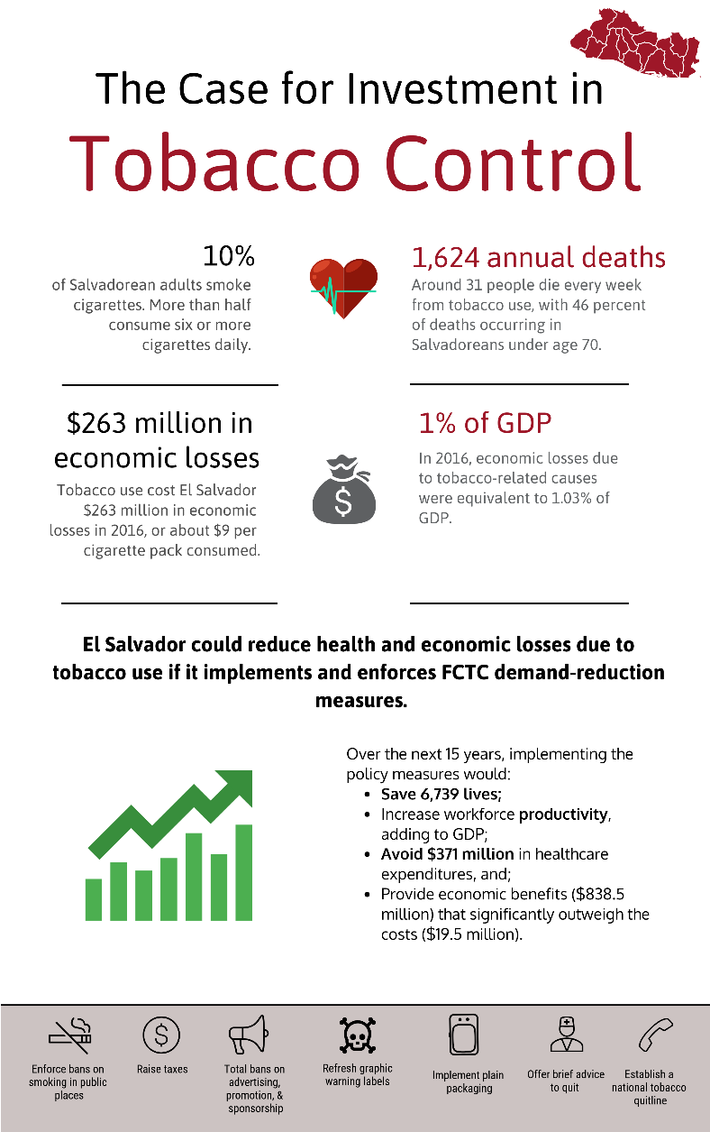
Presenting results and communicating the story
Outputs – Report, PPT, infographics, illustrated videos.
Presentation of the results in country.
Results have (or will be) used to inform consideration of new legislation (Republic of Georgia; Zambia).
Featured in speeches by the Ministers of Health and Finance to Parliament, and in local news media (Jamaica).
Planned or ongoing investment cases in 14 countries (e.g., Peru, Jordan, El Salvador, Sri Lanka, Zambia)
Notes:
Outputs – Report, PPT, infographics, illustrated videos.
Presentation of the results in country.
Results have (or will be) used to inform consideration of new legislation (Republic of Georgia; Zambia).
Featured in speeches by the Ministers of Health and Finance to Parliament, and in local news media (Jamaica).
Planned or ongoing investment cases in 14 countries (e.g., Peru, Jordan, El Salvador, Sri Lanka, Zambia)

Slide 22
Catalyzing change requires strong evidence, but also thoughtful framing.
Factors that can help move evidence into action
Building from the ground up by using local data, resources, and initiatives as the foundation for empirical studies, in order to gain credibility.
Prepare for normative positions that can undermine trust in evidence (e.g., national, religious, cultural, and value beliefs).
Use strong international evidence to propel direction, but not at the expense of subsuming local context and priorities.
Find “sweet spots” where health and political priorities overlap.
Develop compelling stories to articulate and sell those overlaps.

Slide 23


d
Rachel A. Nugent
Vice President of Global Non-communicable Diseases
rnugent@rti.org
@RachelNugent
Special thanks to:
Nathan Mann
Public Health Economist
Brian Hutchinson
Research Public Health Analyst

Slide 24
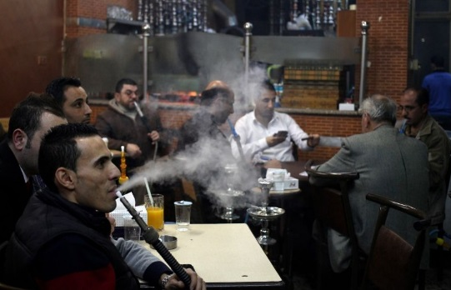
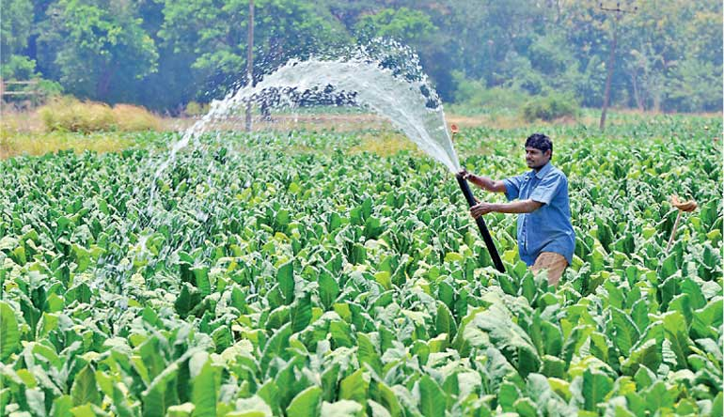

.
Jordan
“Even many nurses and doctors smoke, and the Jordanian soccer team was once fined for smoking at halftime of a game in Australia” – Public health expert
“It’s very important to include water pipes. They’re almost as prevalent as smoking, and unlike cigarettes, are widely used by women.
Sri Lanka
The President has announced a plan to stop tobacco cultivation by 2020, but we need to know the cost and benefits of eradication…what is the revenue of tobacco versus other crops? What is the environmental impact of tobacco compared to other crops?
Jamaica
“We can’t get the medicines to people and when we do, they don’t adhere. All we can do is try to educate and prevent.”
“Men like fluffy women.”
Notes:
We conduct a stakeholder analysis: who if for and against? Key informants are asked questions such as:
The process allows the team to map overlapping priorities between government sectors, identify bottlenecks/challenges, and find opportunities for how to frame results.
In Jamaica we learned:
NCD action must be tied to the “bottom line”, considering the current government’s emphasis on job creation and economic growth;
NCD action must also be tied to Jamaica’s leading social priorities: reducing crime and violence (Alcohol)
In Jordan: Tobacco industry undermining through illicit trade arguments; chamber of commerce concerned about impact of banning smoking/shisha on service industry;
Failures: not including Jamaica Moves, results stretched sometimes to push physical activity and nutrition perogatives – lesson about targeting results to needs. Smoke breaks and shisha use in Jordan.

