Slide 1

Serious Gaming
Notes:
Introduce Gene and John

Slide 2
DTK – Serious Gaming
Gene Oates

Slide 3
IDM Learning Challenge
Exploring Options:
Wizard based UI
Quickstart installer
Excel FrontEnd
Quickstart zip (non-install)
Documentation
Computational Modeling Platform Service
Source Code
Serious Gaming?
Challenges:
Understanding assumptions in the multi-dimensional parameter space
Engaging
Fun
No barrier to entry

Slide 4
Proof of Concept
Questions to Answer:
Technically feasible to use DTK as game engine?
Does Serious Gaming appear to be a valid option for learning the DTK?
What does the longer term resource commitment look like?
What are the risks associated with this approach?

Slide 5
Phase I Architecture
User Interface
NodeJS
Python
EMOD
Service
Service

Slide 6
Phase I User Interface
Notes:
Pull up UI in real time

Slide 7
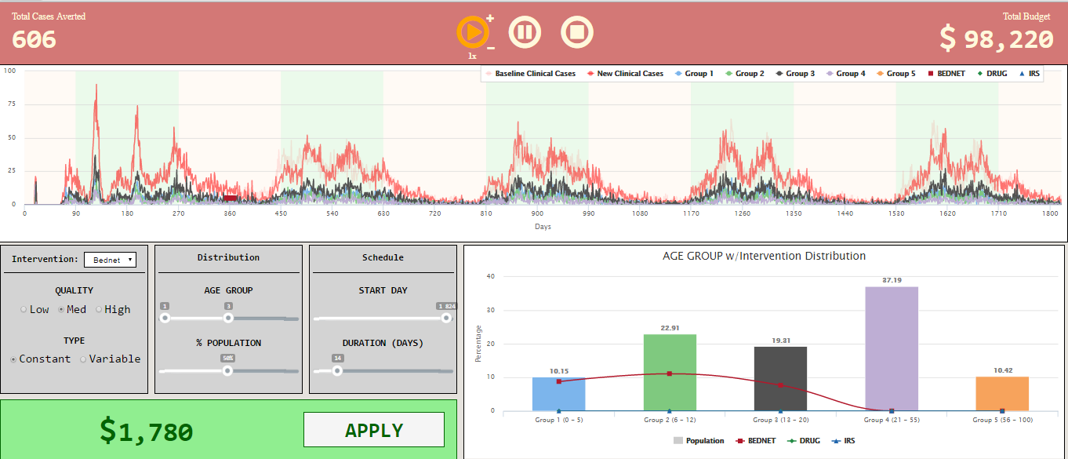
Simple Bednet
Cases Averted
Lots of Remaining Budget
Bednet Intervention
Medium quality
Ages 0 – 20
50% population

Slide 8
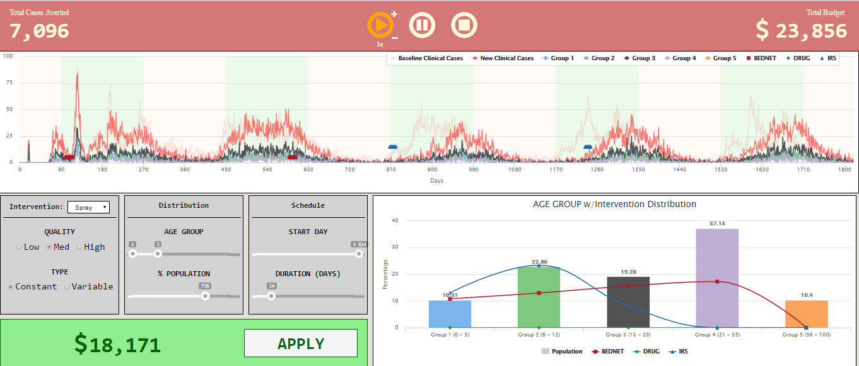
Bednet & Spray
Cases Averted
Bednets
Spray

Slide 9
Spoiler Alert

Slide 10
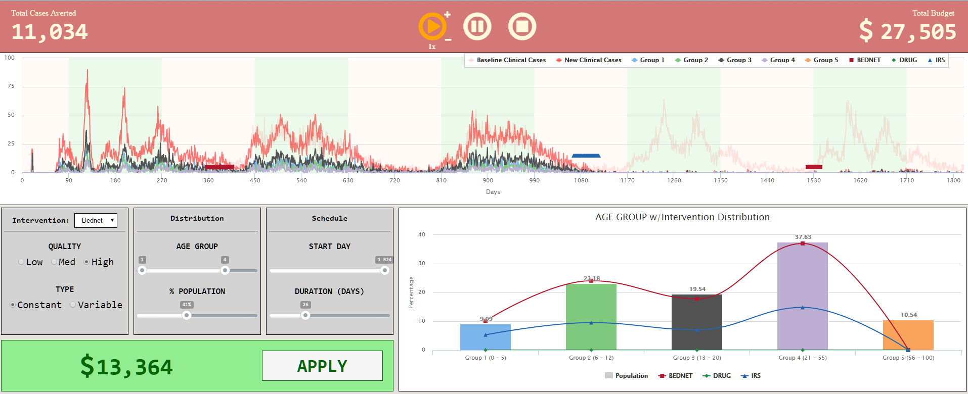
Achieving the level…
Good Job!
Bednets
Medium quality
Ages 0 - 55
67% popluation
Spray
Bednets
High quality
Ages 0 - 55
41% popluation
High quality
Ages 0 - 55
41% popluation

Slide 11
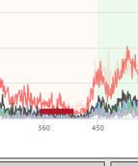
Campaign.json Bednet Intervention
"Event_Coordinator_Config": {
"Demographic_Coverage": 1.0,
"Duration": 1,
"Intervention_Config": {
"Cost_To_Consumer": 1.0,
"Durability_Time_Profile": "DECAYDURABILITY",
"Primary_Decay_Time_Constant": 1460,
"Secondary_Decay_Time_Constant": 730,
"class": "SimpleBednet"
},
"Target_Age_Max": 5,
"Target_Age_Min": 0,
"Target_Demographic": "ExplicitAgeRanges",
"Time_Value_Map": {
.
.
.
},
"Start_Day": 358,
"class": "CampaignEvent"
},
"Event_Coordinator_Config": {
"Demographic_Coverage": 1.0,
"Duration": 1,
"Intervention_Config": {
"Cost_To_Consumer": 1.0,
"Durability_Time_Profile": "DECAYDURABILITY",
"Primary_Decay_Time_Constant": 1460,
"Secondary_Decay_Time_Constant": 730,
"class": "SimpleBednet"
},
"Target_Age_Max": 12,
"Target_Age_Min": 06
"Target_Demographic": "ExplicitAgeRanges",
"Time_Value_Map": {
.
.
.
},
"Start_Day": 358,
"class": "CampaignEvent"
},
Bednet Intervention
Etc.

Slide 12
Phase II
The primary goal is to provide a learning path for an undergraduate, or higher college level individual to learn the DTK parameter space’s cause and effect while providing a fun and motivating environment to learn.
Alternate Educational Objectives:
Education of complexity of infectious disease control
Managing a budget
Biology of disease
Human immune system
Notes:
Advanced high school student
Undergraduate student
PhD student
Post-doctoral student
IDM new employees

Slide 13
Core Principles / Game Guidelines
What is the educational aspect?
How does feature change as we advance through game levels?
How does the feature affect game play?
How does the feature affect the news feed / ticker?
Can we measure player knowledge?
  Achievement unlocked?
  Mini-quiz?
How is the feature incorporated into the UI?
Does this help learn the DTK?

Slide 14
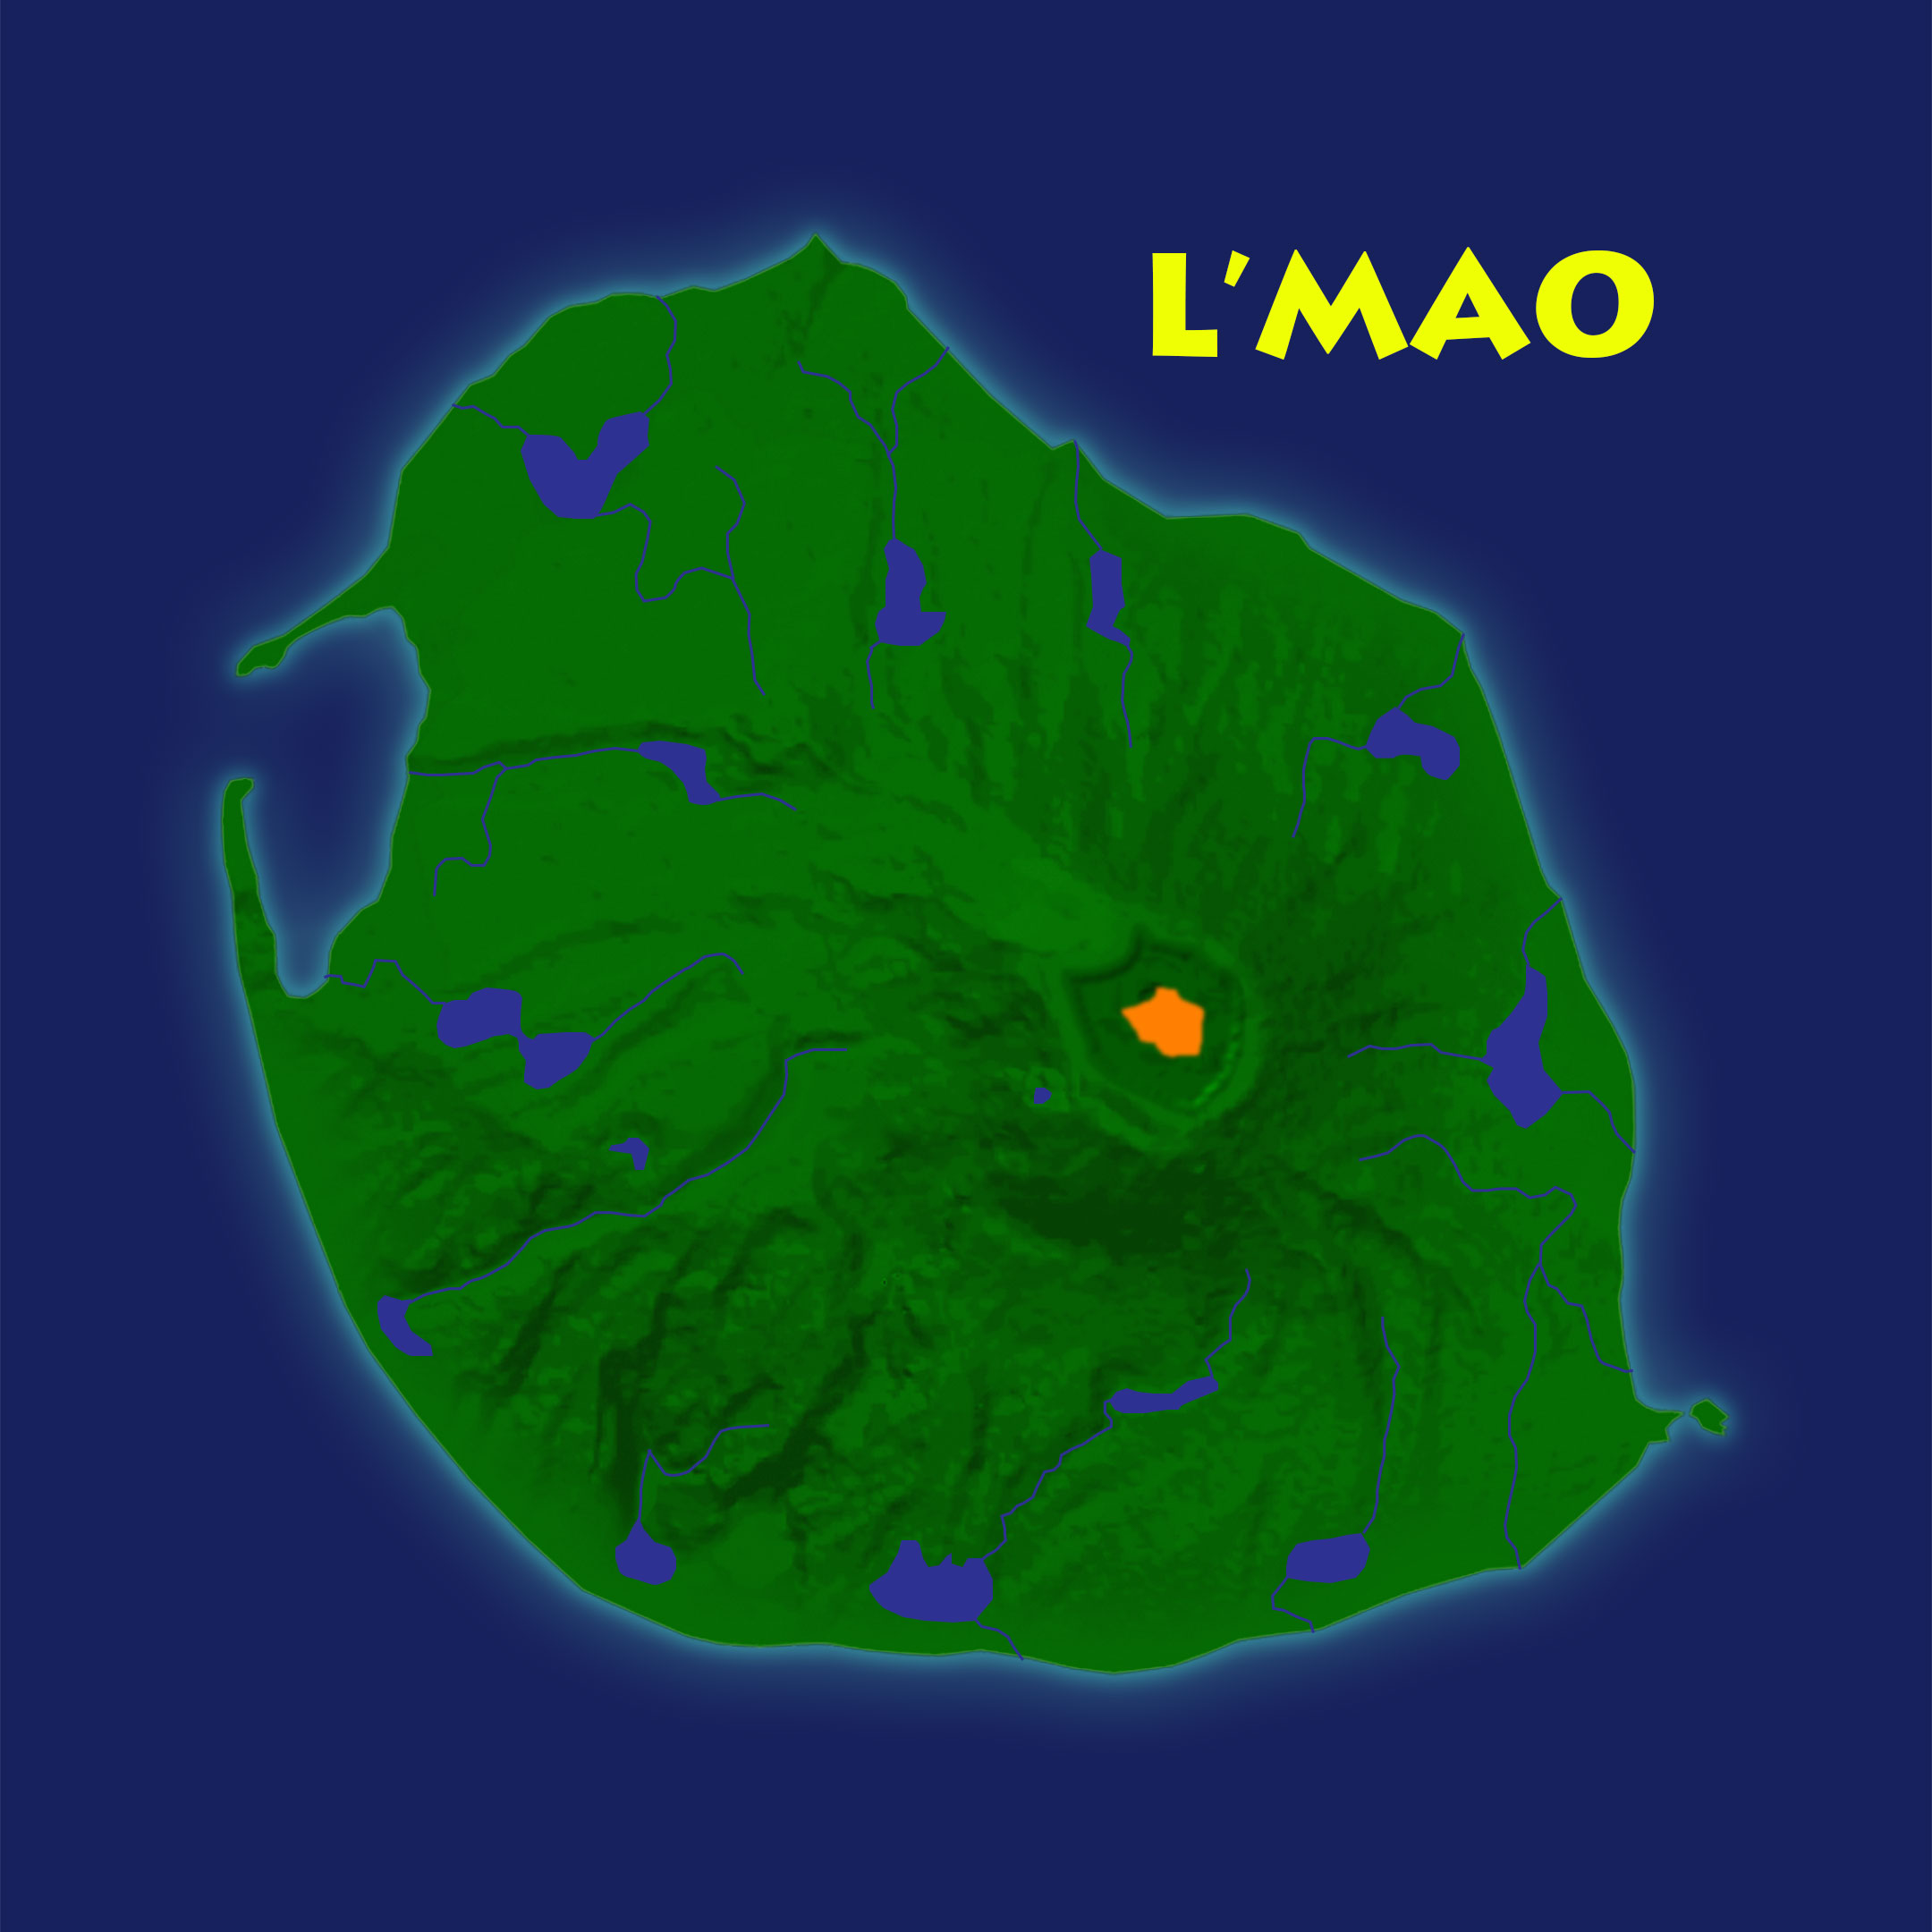
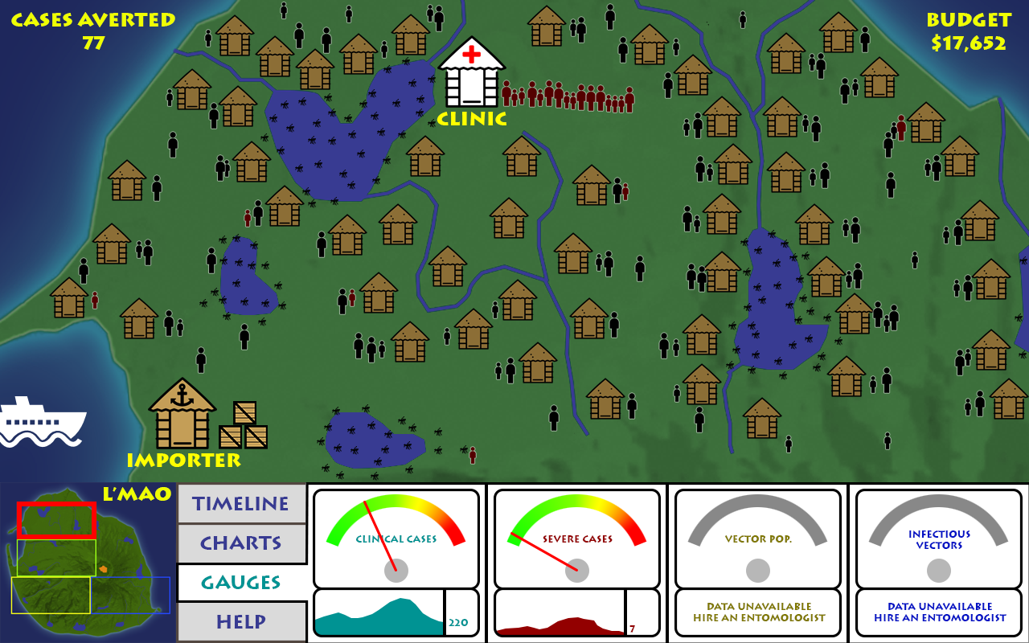

The island of L’Mao is a peaceful island with lush tropical landscapes
replenished by seasonal rains creating a humid climate. The beautiful sunsets
are one of the many natural attractions making this location an ideal spot for
the islanders that reside here. Based on your research about the island, the
island has been inhabited for over 2,000 years preserving its rich cultural
and sense of community with little external cultural influence.
The island hosts several small communities sustaining a total island
population of approximately 30,000 people. Exports provide a meager
income for the families barely sustaining the simple lifestyle of the
island's inhabitants. The growing trade in the past 50 years has created
an unwanted side effect with the importation of malaria infected
mosquitoes.
Your assignment as an intern is to be
the city's Public Health Program Officer. This is a small but necessary step in
your career plan to someday be a Regional Director managing hundreds of teams
dedicated to the control of infectious disease. Your job as an intern is part of
an experimental program sponsored by the World Health Organization to control
and eradicate malaria on the entire island, starting in Jimjambo. The few
courses you passed in epidemiology will help with this challenge but you'll soon
understand there's much to learn to eradicate a complicated disease, malaria.

Slide 15
Skill Levels
Intern
Intern 1
Resident
Resident 1
Resident 2
Public Health Program Officer
Senior Public Health Program Officer
Regional PHPO
Director

Slide 16
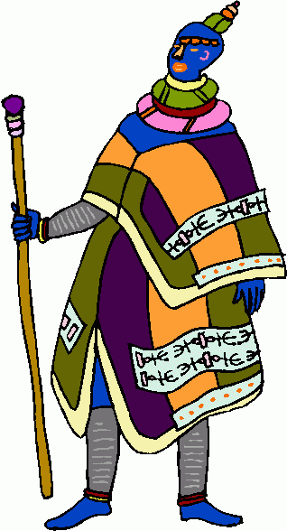
First Day at Jimjambo
Objective
To disseminate the observed state of the health of the Jimjambo community residence
To impress upon the player, if you do nothing, you’ll have similar results
Provide basic humanized observational data
Skill Points
Acknowledged observation
None for this level
Exit Criteria
Concepts of Malaria, climate, sick, mosquitoes,
User acknowledged observations indicating acceptance
Notes:
UI graphic
Show people lined up at clinic to represent number of cases increasing and decreasing via sim data
Mosquito habitat(s) show mosquito volume increasing and decreasing via sim data
Rainy – Sunny graphics
User has little control in this historical view
Observations occur that are not well informed nor scientific in nature, humanized
Obtaining information is achieved by clicking on objects (perhaps community members or locations such as clinic, habitats, shaman, etc.)
Have some sort of literary narrative of the past year(s).
Some mechanism to indicate first day level complete and to move on

Slide 17
Jimjambo Surveillance
Objective
You need a clinical health director to get reports on age groups, severe cases, averted cases
Entry Criteria
Location: Jimjambo
Annual Budget: $10,00
Exit Criteria
Hired clinical health director
Budget increases to cover cost of clinical health director
Notes:
UI graphic
Show people lined up at clinic to represent number of cases increasing and decreasing via sim data
Mosquito habitat(s) show mosquito volume increasing and decreasing via sim data
Hit play level starts, after year, game pauses and you receive your first year's performance review, review provides a checklist of questions to gauge whether you get promoted
The performance review contains clues on what you should have done
You can interact with the clinic, mosquito habitats, weather and new object the supplier of interventions
Budget has to be such that if you hire all experts your budget is reduced to not allow interventions in the next level
If you hired more people you need a performance review that informs you, there is no budget to proceed, you need to go through the level again and make wiser choices of what you really need

Slide 18
Questions

