Slide 1
Azithromycin for the Prevention of Child, Infant, and Neonatal Mortality in Burkina Faso
Catie Oldenburg, ScD, MPH
Francis I. Proctor Foundation, UCSF
IDM Disease Modeling Symposium 2019
April 16, 2019

Slide 2
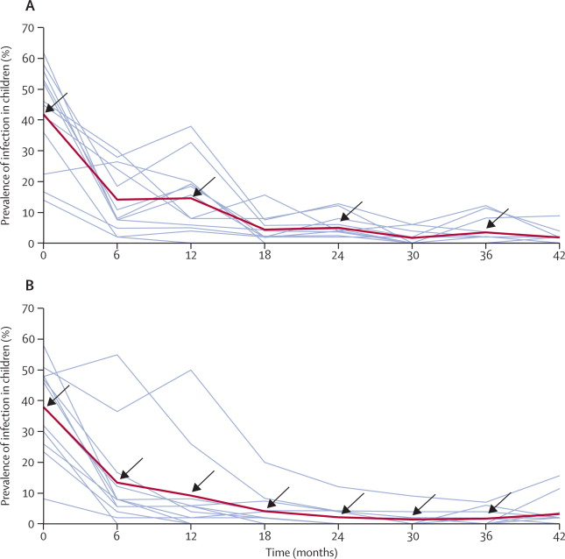
Mass azithromycin for trachoma control
Gebre et al, Lancet 2012

Slide 3
Mass azithromycin and infectious disease
Disease | Studies | Countries | Results
Diarrhea | 2 | Tanzania Nepal | Reductions in treated
Malaria | 6 | The Gambia Niger Tanzania | 2 studies: no difference 4 studies: reductions in treated
Respiratory infections | 2 | Tanzania Nepal | Reductions in treated
Notes:
Trachoma studies on azithro have found ID effects
Diarrhea and RI: 2, TZ, NP, reductions in reported diarrhea among children in treated vs untreated communities
Malaria: 6 mixed, different settings, range from no difference to 73% reduction within 1st month, 4/6 found reductions
Overall, evidence of efficacy noted within first 3-6 months, effects waning over time, none after 6 months
*Selected, focused on major causes of child mortality
Others: genital chlamydia infection, yaws, azithro+SMC

Slide 4
JAMA, 2009
Notes:
Trachoma studies have looked directly at mortality
2009, cluster RCT in Ethiopia comparing distribution frequencies

Slide 5
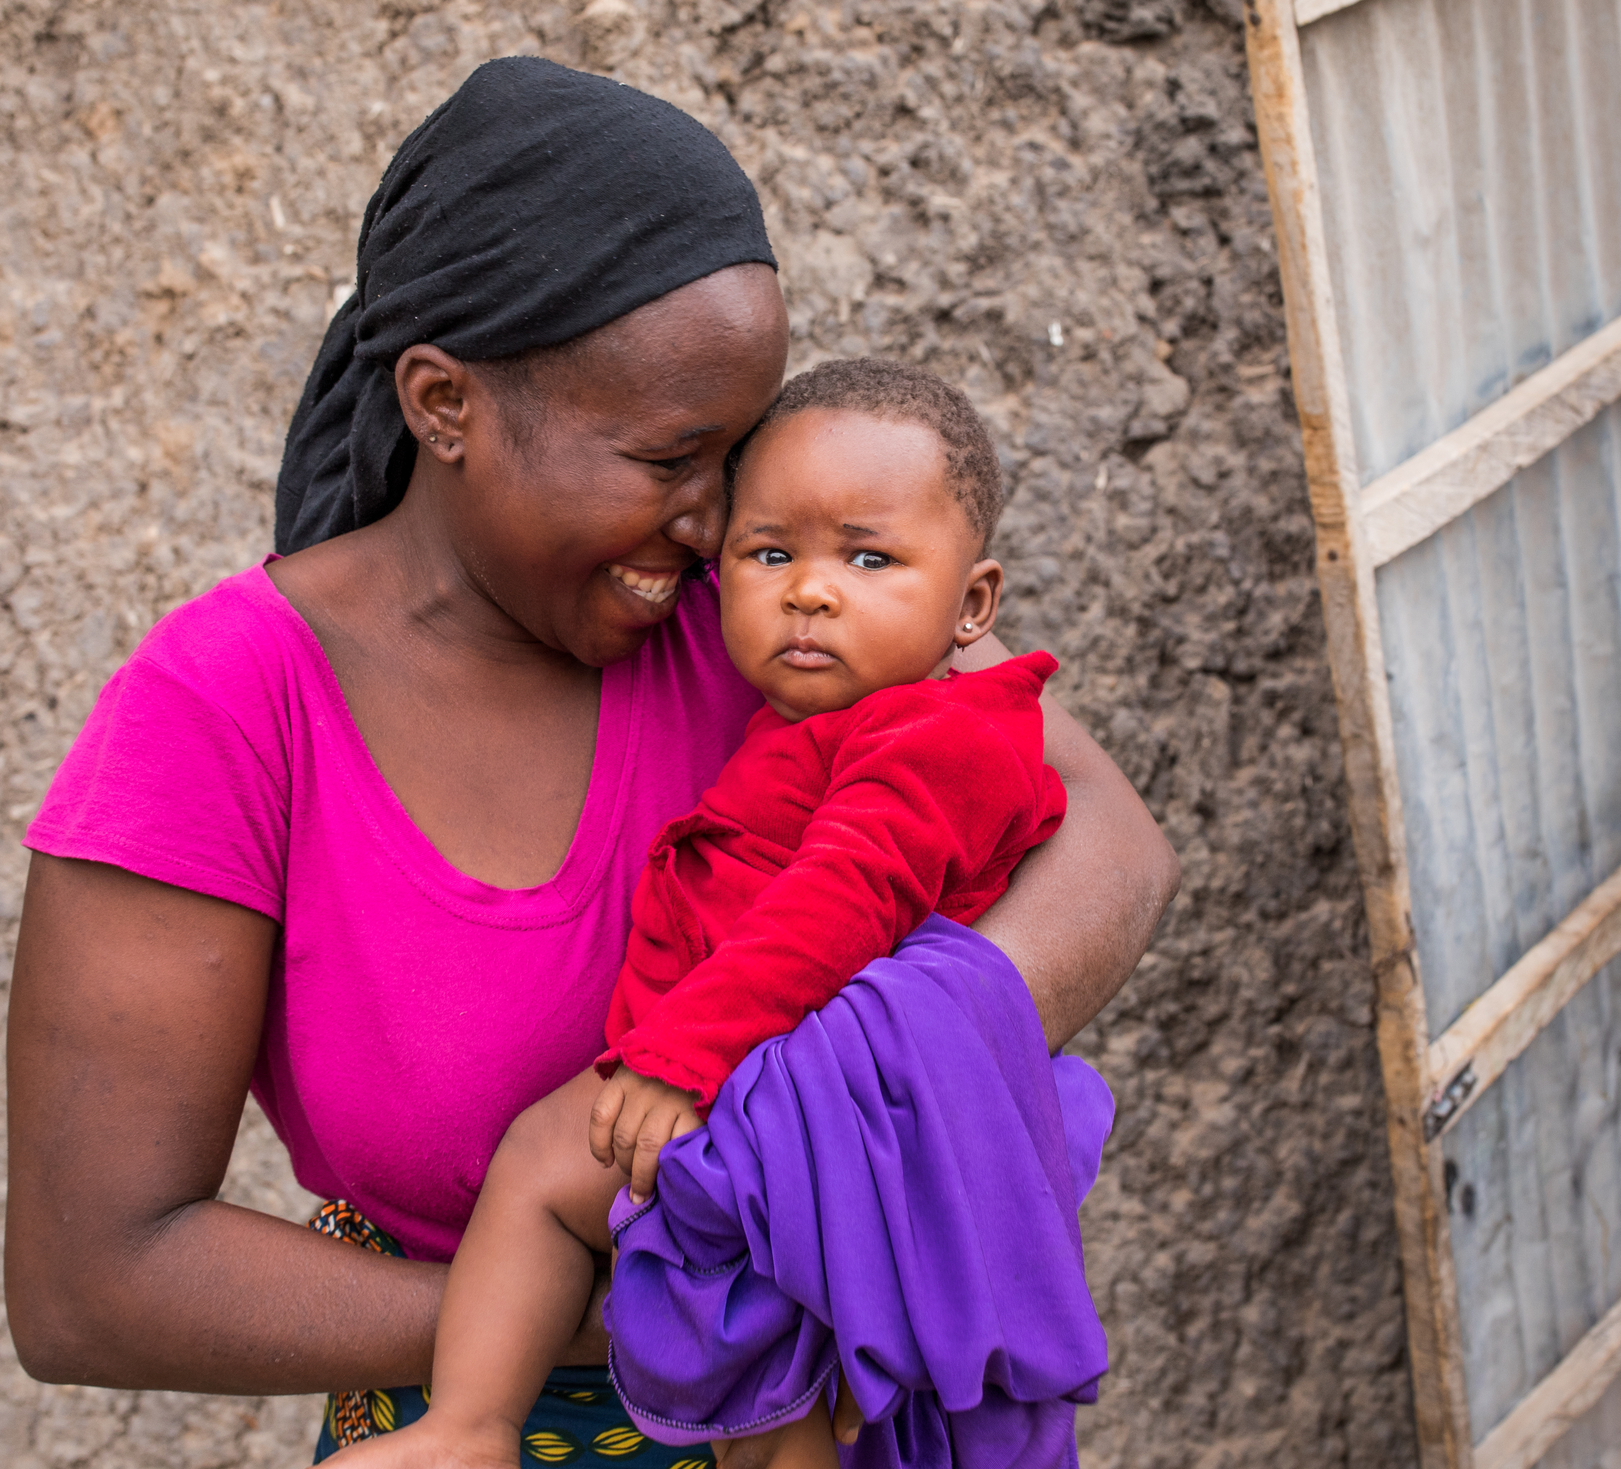
MORDOR: Design
2015-17
1512 communities in Malawi, Niger, Tanzania
Intervention: biannual azithromycin
Control: biannual placebo
24 months of follow-up
Deaths/1000 py control:
5.5 (Tanzania)
9.6 (Malawi)
27.5 (Niger)
Notes:
We randomized 1500 communities to… over 2 years – children 1-59 months
Baseline, biannual census to monitor mortality
Range of mortality rates, from 5.5 in TZ to 27.5 in Niger

Slide 6
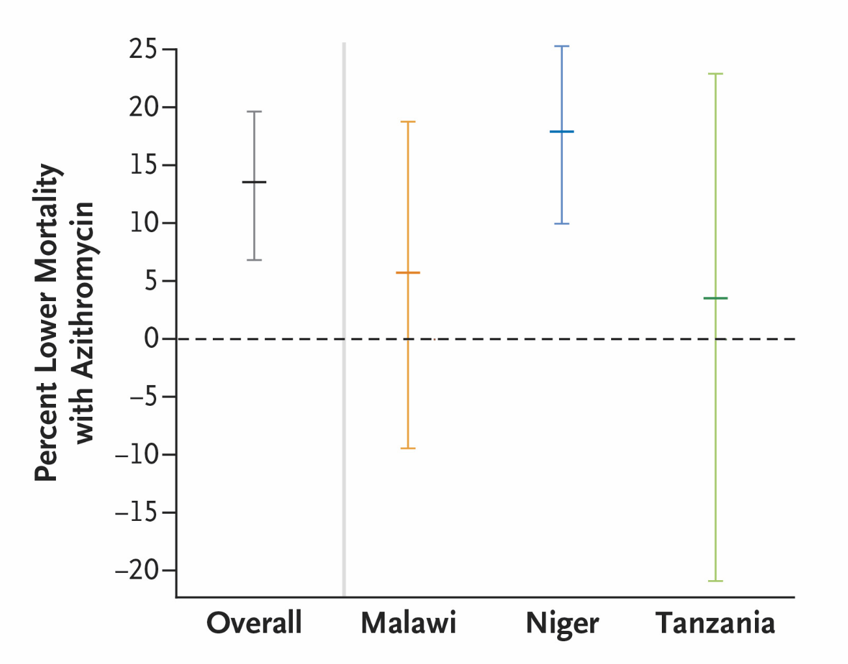
MORDOR: Primary Outcome
Overall 13.5% reduction in mortality in biannual compared to placebo communities (95% CI 6.7 to 19.8)
Notes:
Primary outcome, describe graph
Overall 13.5%
Niger 18.1%

Slide 7
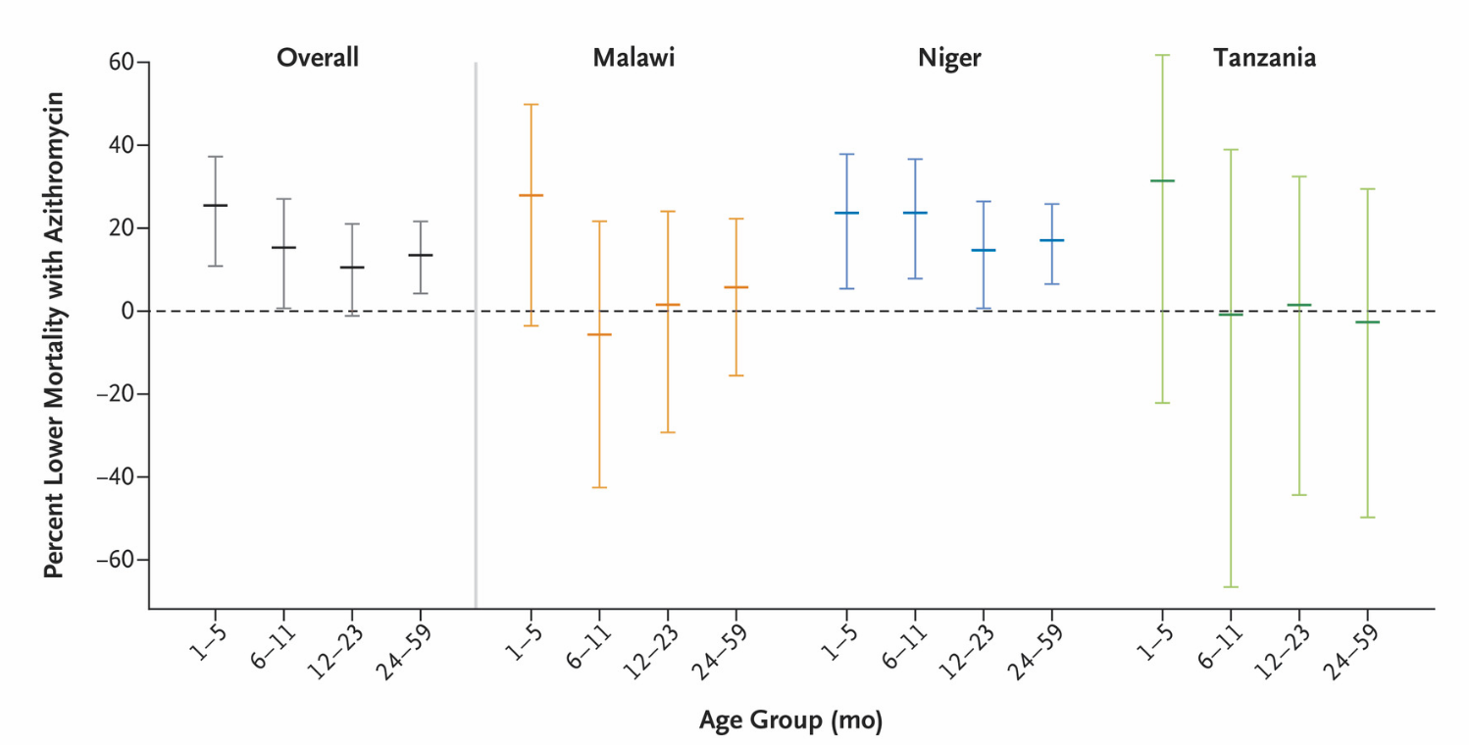
MORDOR: Mortality by Age
Notes:
Results by age
Describe age group
Overall, strongest in 1-5 months, ~25% reduction

Slide 8
Deaths Averted
 | Placebo |  |  |  | Azithromycin
Age | Deaths | Person-years | Mortality rate per 1,000 py (95%CI) |  | Deaths | Person-years | Mortality rate per 1,000 py (95%CI) | IRD per 1,000 py (95%CI) | No. deaths averted (95%CI)
1-5 m | 244 | 5,152 | 47.4 (41.6 to 53.6) |  | 202 | 5,657 | 35.7 (31.0 to 40.9) | -11.7 (-19.4 to -3.9) | 126 (43 to 209)
1-11 m | 584 | 12,299 | 47.5 (43.7 to 51.4) |  | 488 | 13,563 | 36.0 (32.9 to 39.3) | -11.5 (-16.0 to -5.4) | 297 (168 to 427)
1-59 m | 1,888 | 68,769 | 27.5 (26.2 to 28.7) |  | 1,727 | 76,924 | 22.5 (21.4 to 23.5) | -5.0 (-6.6 to -3.4) | 729 (492 to 966)

Slide 9
Research Gaps
Is targeting the youngest children effective?
Are there effective alternative health system delivery approaches?

Slide 10
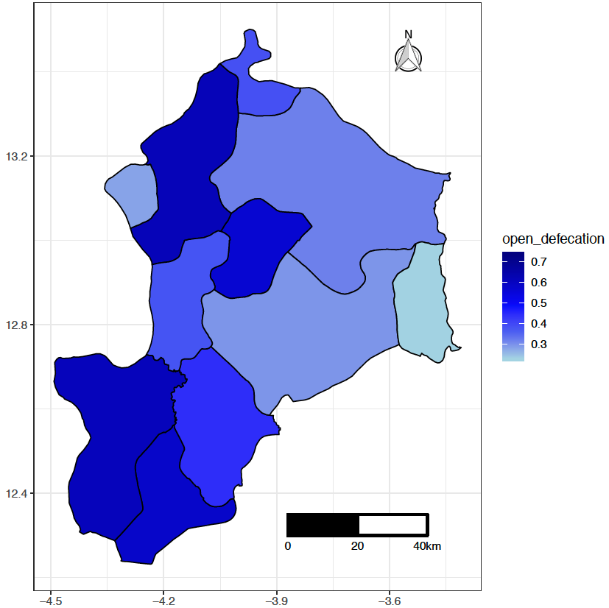
MORDOR Replication Study
Nouna District, Northwestern Burkina Faso
Includes Nouna HDSS plus remainder of district
Pre-study mapping completed in April 2019
Census
Bed net coverage
WASH indicators
Household SES

Slide 11
Health System Integration
Multilevel factorial randomized controlled trial
Azithromycin
Placebo
Community Randomization
1-59 months old
Communities censused every 6 months
N=312 communities
Individual Randomization
28 days – 12 weeks
Individuals followed longitudinally
N=25,000 babies
Notes:
CO

Slide 12
Health Facility Recruitment
Day 42 postnatal visit
EPI vaccine visit (week 6-12)
BCG vaccine* (after day 28)
Other healthy child visit before week 12
Assess for eligibility
Notes:
EL

Slide 13
Primary outcome
Replication: all-cause mortality measured in each biannual census
Individual randomization: mortality at age 6 months
Pre-specified subgroup analysis by community treatment scheme

Slide 14
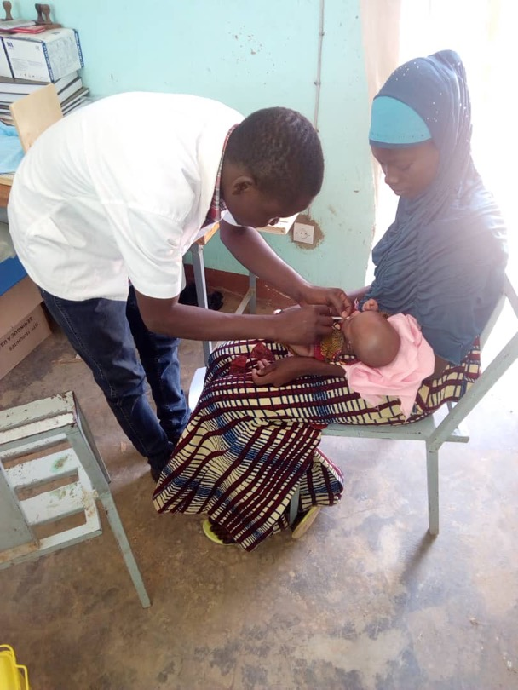
Azithromycin Administration During the Neonatal Period to Reduce Infant Mortality
Randomize newborns aged 8-27 days to a single dose of azithromycin or placebo (N=21,712)
Evaluate safety outcomes weekly for 3 weeks
Primary outcome: mortality at 6 months
Final endpoint: mortality at 12 months

Slide 15
Study sites

Slide 16
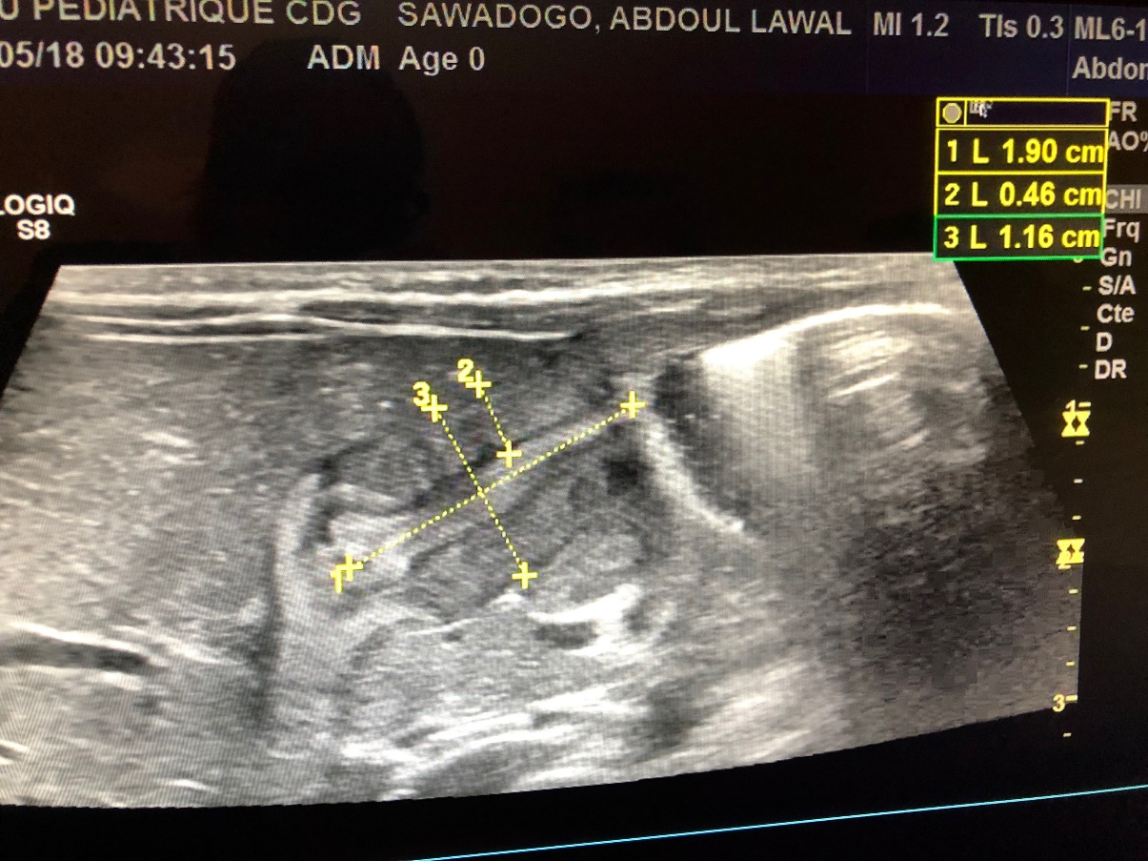
Trachoma programs do not treat <6 months with oral azithromycin
Adverse events
Infantile hypertrophic pyloric stenosis
Lack of safety data
Notes:
Male infant from Ouagadougou (not in study), can see features on the ultrasound of IHPS including width (2) and length (1) which are both larger than normal

Slide 17
Infantile Hypertrophic Pyloric Stenosis (IHPS)
Incidence approximately 2 per 1,000 in U.S. general population
Risk factors based on U.S. and European data include:
Male sex
Genetics
Higher birth order
Prone sleeping position
Preterm birth
C-section delivery
Formula/bottle feeding
Macrolide use
Must be cured surgically

Slide 18
Infantile Hypertrophic Pyloric Stenosis (IHPS)
>1,000,000 infants in TRICARE database
Evaluated macrolide exposure and IHPS in first 90 days of life
No association after 42 days of life
 | Azithromycin |  | Erythromycin |  | Cephalexin
0-14 days 15-42 days 43-90 days Overall | 3/148 5/729 0/3,998 8/4,875 | 20.3 (4.2-59.2) 6.9 (2.2-16.1) 0 (0-0.9) 1.6 (0.7-3.2) | 9/291 5/535 3/1,076 17/1,902 | 30.9 (14.1-58.7) 9.3 (3.0-21.8) 2.8 (0.6-8.1) 8.9 (5.2-14.3) | 1/453 5/1,614 0/2,271 6/4,338 | 2.2 (0.05-12.2) 3.1 (1.0-7.2) 0 (0-1.6) 1.4 (0.5-3.0)
Eberly et al, Pediatrics, 2015
Notes:
Raw numbers and rates per 1,000 children; note about confounding by indication

Slide 19
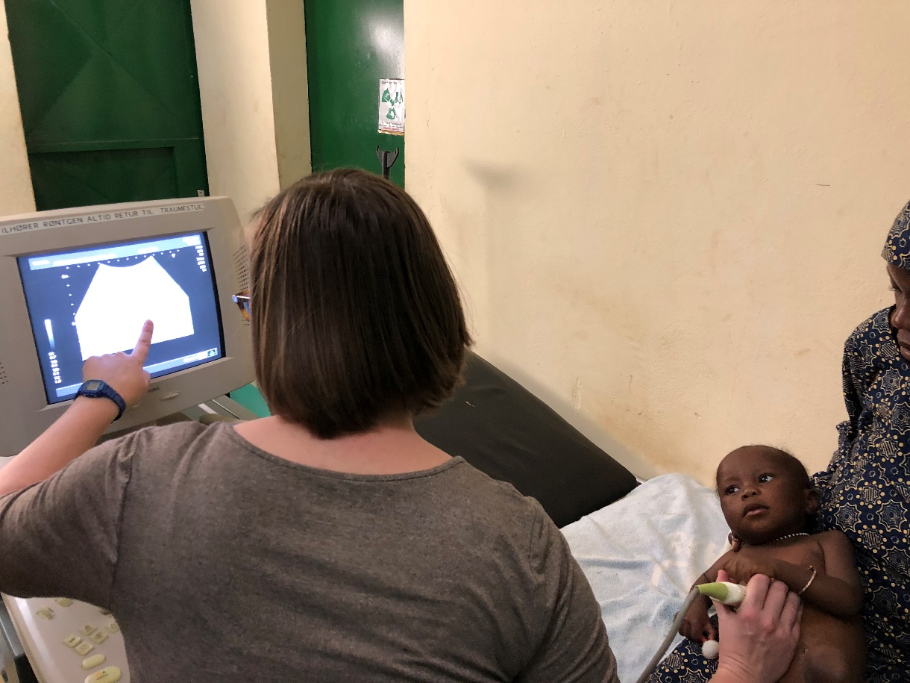
Active IHPS Screening
Weekly follow-up after treatment
If vomiting, IHPS follow-up questions and pediatrician exam
If clinical indication of IHPS, refer for ultrasound
If ultrasound indicates IHPS, refer for surgery

Slide 20
Timeline
Timepoint
Replication
Neonatal
Jan-June 2019
Pre-study prep
1st enrollment: April
June-Dec 2019
Implementation
Recruiting
2020
Implementation
Recruiting
2021
Implementation
Recruiting
Mid/Late 2022
Primary Results
Primary Results

Slide 21
Acknowledgements

Slide 22
MORDOR Burkina Study Group
University of California, San Francisco, San Francisco, CA, USA –Jessica Brogdon, Catherine Cook, Susie Cummings, Thuy Doan, Will Godwin, Jeremy Keenan, Elodie Lebas, Thomas Lietman, Ying Ling, Kieran O’Brien, Catie Oldenburg, Travis Porco
Centre de Recherche en Santé de Nouna, Burkina Faso- Cheikh Bagagnan, Mamadou Bountogo, Boubacar Coulibaly, Eric Nebie, Mamadou Ouattara, Aristide Ouedraogo, Lucienne Ouermi, Ali Sié, Ouedraogo Andiyam Thierry, Alphonse Zakane
Data and Safety Monitoring Committee: Programme National de Santé Oculaire (PNSO), Niamey, Niger-Amza Abdou; Liverpool School of Tropical Medicine, Liverpool, UK – Allen W Hightower; University of Colorado Denver, Denver, CO, USA- Jackie Glover; Harvard University, Cambridge, MA, USA– Wafaie Fawzi; University of Maryland, College Park, MD, USA – Miriam Laufer
Heidelberg University, Heidelberg, Germany- Till Bärnighausen
Bill & Melinda Gates Foundation, Seattle, WA, USA – Rasa Izadnegahdar, Aditi Sarangi, Sara Vernam, Laura Lamberti
Pfizer, New York, NY, USA –Joshua Malkasian, John Schenkel, Carol Grant, Bharat Shah, Sharon Corr
Evolving Concepts, Gauting, Germany- Klaus Blass

