Slide 1
Surveillance and Survey:
Child Mortality Patterns from Africa
IDM Symposium Talk
Assaf Oron, April 2019

Slide 2
Contents
Introduction
Regional Patterns: East Africa
Regional Patterns: West Africa
Combining, and Zooming In
Discussion

Slide 3
1. Introduction

Slide 4
Talk Goal
The talk’s goal is to point out:
Patterns that are common <-> contradictory across regions and locales.
Patterns that are common <-> contradictory between surveys and surveillance.
This can hopefully motivate and help prioritize future studies, both into the methodology of surveillance, and into best health practices that can be proliferated more broadly.

Slide 5
Data Credits
This talk relies heavily upon quality-checked micro datasets from the InDepth repository (http://www.indepth-ishare.org/index.php/catalog/central).
Specifically, I used INDEPTH Network data with contribution from member centres Arba Minch, Dabat, Gilgel Gibe, Kersa, Kilite Awlaelo (Ethiopia); Ifakara, Magu, Rufiji (Tanzania); Kombewa and Mbita (Kenya); Karonga (Malawi); Iganga/Mayuge (Uganda); Ougadougou, Nanoro, Nouna (Burkina Faso); Kintampo, Navrongo (Ghana); Bandafassi, Niakhar (Senegal); Taabo (Cote d’Ivoire); Farafenni (Gambia); Nahuche (Nigeria).
A special thanks to Nanoro and Nouna centre leaderships, for sharing household locations.
In addition, raw data from the MORDOR study, courtesy of Travis Porco (UCSF-Proctor) was used, as well as published data from the AMANHI neonatal mortality study.
Demographic and Health Survey (DHS) and Multiple Indicator Cluster Survey (MICS) estimates from all countries above published in the past decade, were also used.

Slide 6
HDSSs and InDepth
A key obstacle to reducing maternal and child mortality, is that the highest-burden parts of the world also lack a reliable civil registration and vital statistics (CRVS) system.
Health and Demographic Surveillance Systems (HDSSs) aim to provide some insight into this gap, via continuous, reliable vital statistics from a pre-defined region.
Many HDSSs are integrated with a research centre, often a longstanding, established one.
A few dozen HDSSs participate in the InDepth network, which is a loose federation rather than a centrally controlled system. All “micro” datasets available from InDepth have passed a series of standard quality checks, and have standard format. Not all member HDSSs deposit their micro data. In fact, some leading ones (e.g., Kilifi, Vadu) do not.
InDepth HDSS populations range from ~50k to >200k residents (one much smaller center was excluded from this work).

Slide 7
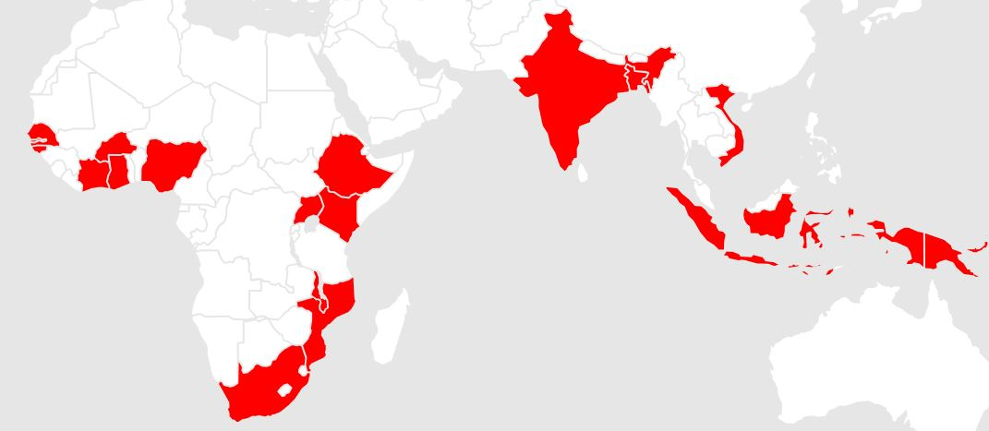
InDepth: Map of Currently Participating Countries
Asian data are not shown in this talk, since too few South Asian HDSSs deposit their raw “micro” data into InDepth.
For most plots, I used only rural or predominantly-rural HDSSs.

Slide 8
Example for Micro Data (site name Redacted)
IndividualId | Sex | DoB | EventCount | EventNr | EventCode | EventDate | LocationId | MotherId | DeliveryId
27313 | 1 | 10/15/2003 | 4 | 3 | ENT | 6/15/2015 | 10 | NA | NA
27313 | 1 | 10/15/2003 | 4 | 4 | OBE | 1/1/2017 | 10 | NA | NA
27314 | 1 | 6/15/1978 | 4 | 1 | ENU | 1/1/1980 | 44 | NA | NA
27314 | 1 | 6/15/1978 | 4 | 2 | EXT | 1/1/1982 | 44 | NA | NA
27314 | 1 | 6/15/1978 | 4 | 3 | ENT | 1/1/1982 | 44 | NA | NA
27314 | 1 | 6/15/1978 | 4 | 4 | OBE | 1/1/2017 | 44 | NA | NA
27315 | 2 | 11/15/2011 | 2 | 1 | BTH | 11/15/2011 | 43 | 6417 | 13797
27315 | 2 | 11/15/2011 | 2 | 2 | OBE | 1/1/2017 | 43 | NA | NA
27316 | 2 | 4/15/2001 | 2 | 1 | BTH | 4/15/2001 | 3 | 7977 | 492
27316 | 2 | 4/15/2001 | 2 | 2 | OBE | 1/1/2017 | 3 | NA | NA
27317 | 1 | 3/28/2009 | 2 | 1 | BTH | 3/28/2009 | 10 | 5672 | 10708
27317 | 1 | 3/28/2009 | 2 | 2 | OBE | 1/1/2017 | 10 | NA | NA
27318 | 2 | 12/9/2003 | 2 | 1 | BTH | 12/9/2003 | 38 | 11969 | 4081
27318 | 2 | 12/9/2003 | 2 | 2 | OBE | 1/1/2017 | 38 | NA | NA
27319 | 1 | 6/15/2006 | 2 | 1 | BTH | 6/15/2006 | 6 | 14270 | 14979
27319 | 1 | 6/15/2006 | 2 | 2 | OBE | 1/1/2017 | 6 | NA | NA
27320 | 2 | 4/15/2008 | 4 | 1 | BTH | 4/15/2008 | 21 | 7011 | 16438
27320 | 2 | 4/15/2008 | 4 | 2 | EXT | 7/15/2012 | 21 | NA | NA
27320 | 2 | 4/15/2008 | 4 | 3 | ENT | 7/15/2012 | 42 | NA | NA
27320 | 2 | 4/15/2008 | 4 | 4 | OBE | 1/1/2017 | 42 | NA | NA

Slide 9
HDSSs vs. Surveys
Generally, in countries lacking an established CRVS, the DHS/MICS surveys are considered gold standard for child mortality estimates. The official UN-IGME estimates essentially smooth the survey estimates over time.
HDSSs are all but ignored, by UN-IGME and even by more sophisticated efforts such as IHME local-burden.
Understandable, as an arbitrary handful of relatively small HDSS districts is not representative.
However, HDSSs are a substantial investment, and provide the only truly longitudinal population tracking. They are also likely on the pathway from the current situation to CRVS. In view of that, HDSS data are not examined enough in a systematic manner.

Slide 10
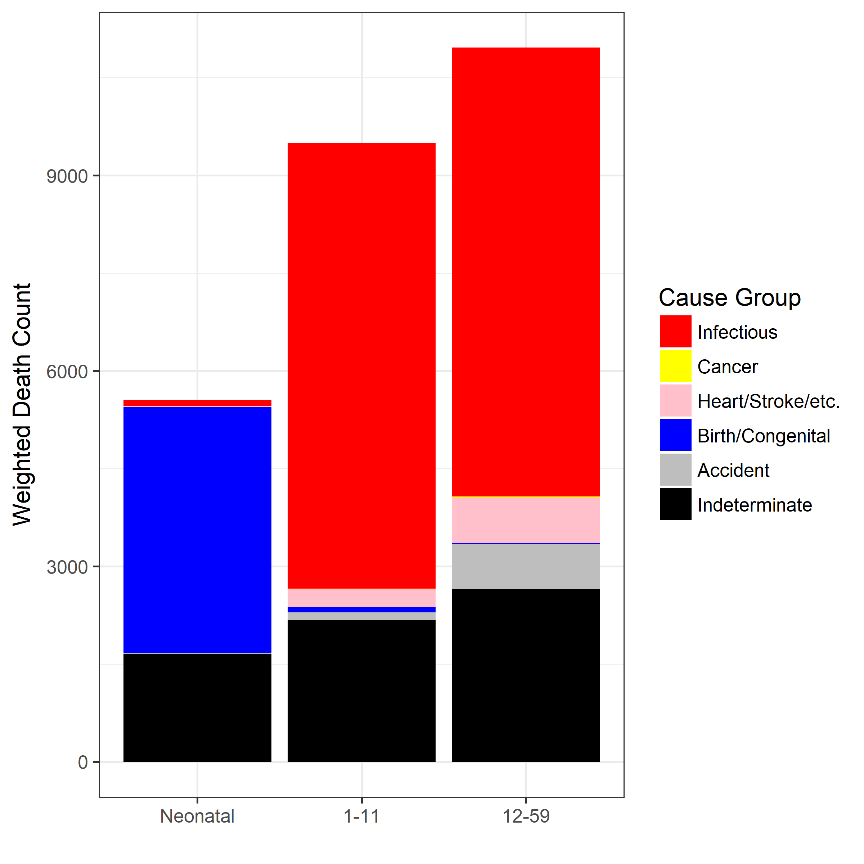
What Indices to Use?
Standard child-mortality indices reported and tracked by pretty much everyone, are
Neonatal (under 1 month)
Post-Neonatal (implicitly, infant post-neonatal; 1-11 months)
Infant (#1 and #2 combined)
Child (1-4 years)
Overall Under-5 mortality
Even basic familiarity with child death causes in high-burden settings, suggests that only Index 1 makes optimal use of raw data. From 1 month to 5 years, death causes remain rather similar.
Therefore, I prefer looking at 2 indices: neonatal mortality, and mortality from 1 to 59 months.
INDEPTH Network. INDEPTH Network Cause-Specific Mortality - Release 2014. Oct 2014. Provided by the INDEPTH Network Data Repository.

Slide 11
2. Regional Patterns: East Africa

Slide 12
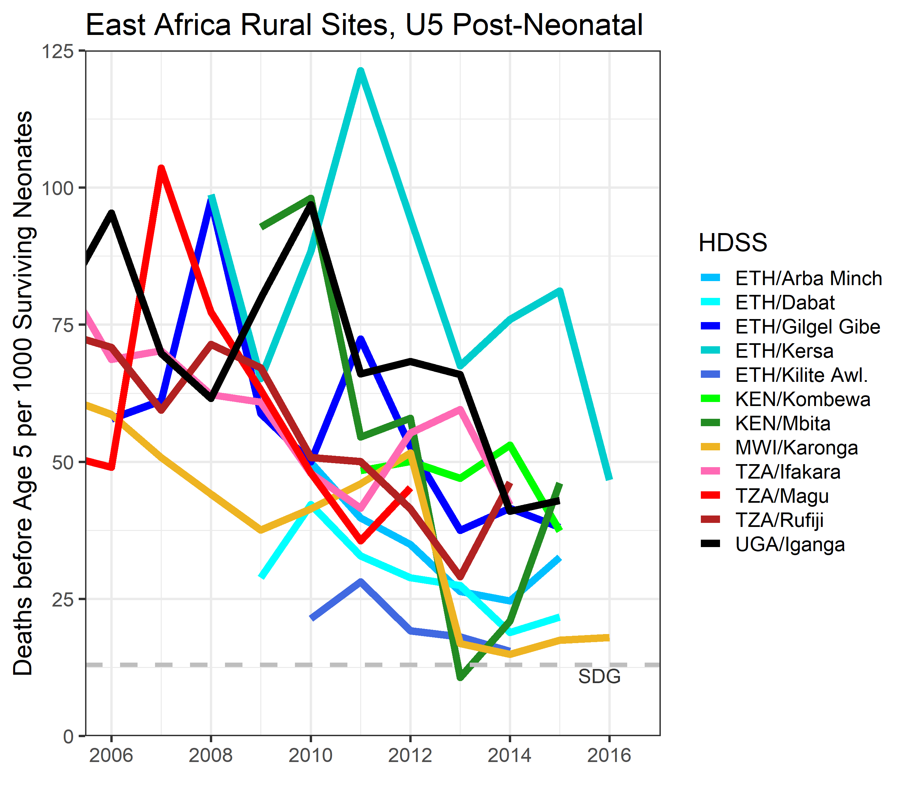
Mortality from 1 through 59 months shows a clear downward trend across East African sites.
However, inter-site variability is great (particularly in Ethiopia), and very few sites are close to the SDG.

Slide 13
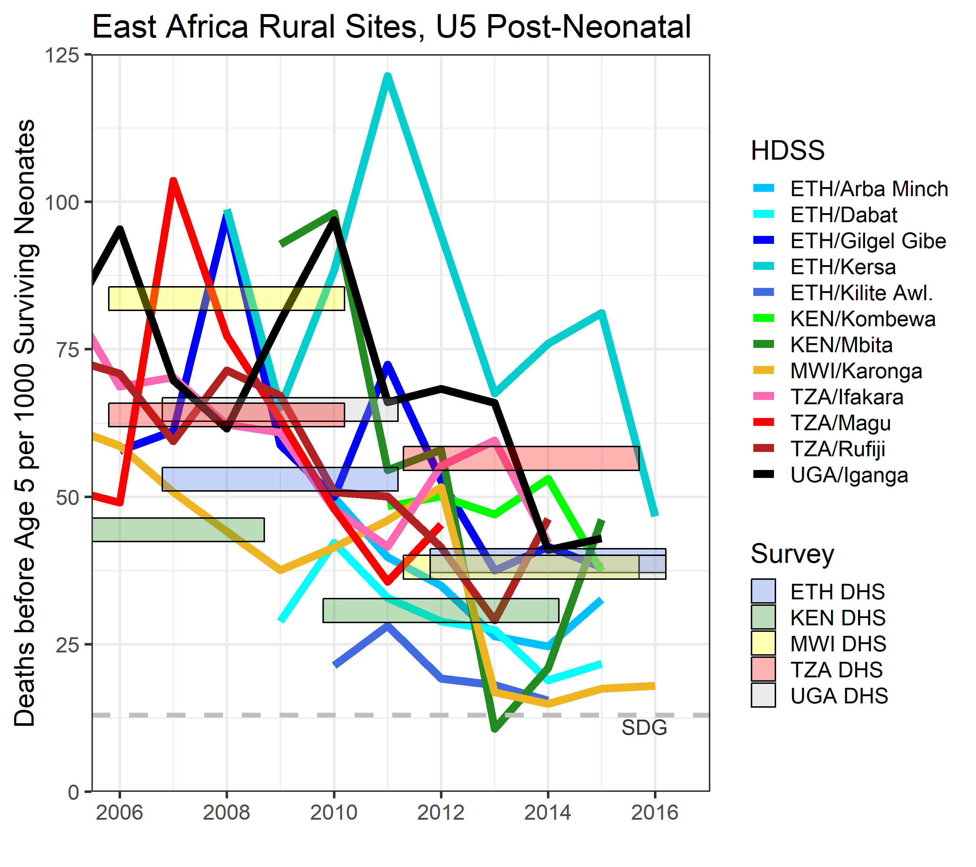
Adding survey estimates for comparison, there seems to be a general agreement, except:
Tanzania HDSS trends disagree with the slow progress seen by DHS.
Karonga consistently outperforms Malawi averages.
Let us add another interesting surveillance dataset.

Slide 14
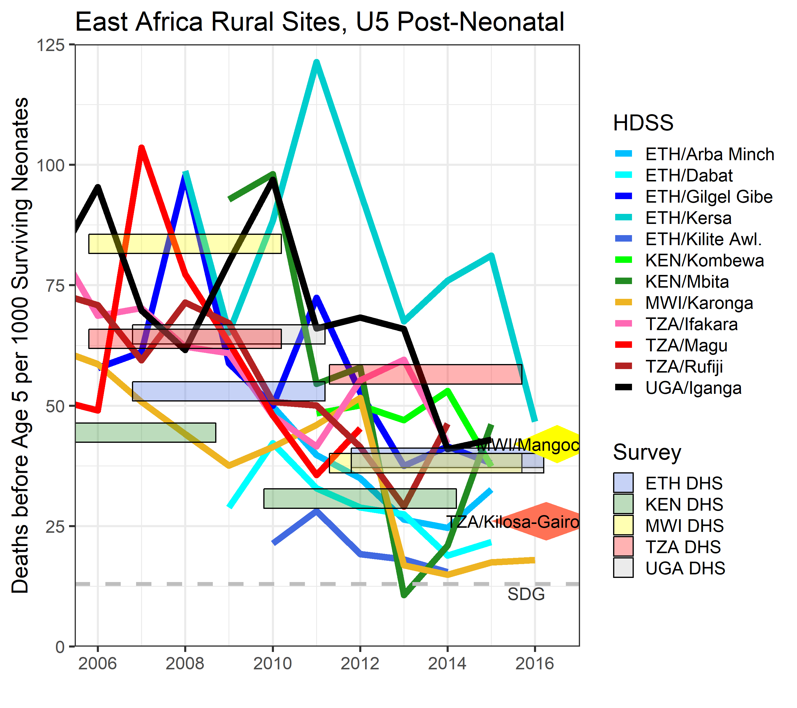
Tanzania MORDOR site (representing 67k person-years over 2+ years) corroborates the faster improvement seen across Tanzanian HDSSs.
Malawi site (119k person-years) is very close to national DHS.
Let us now look at neonatal mortality patterns.

Slide 15
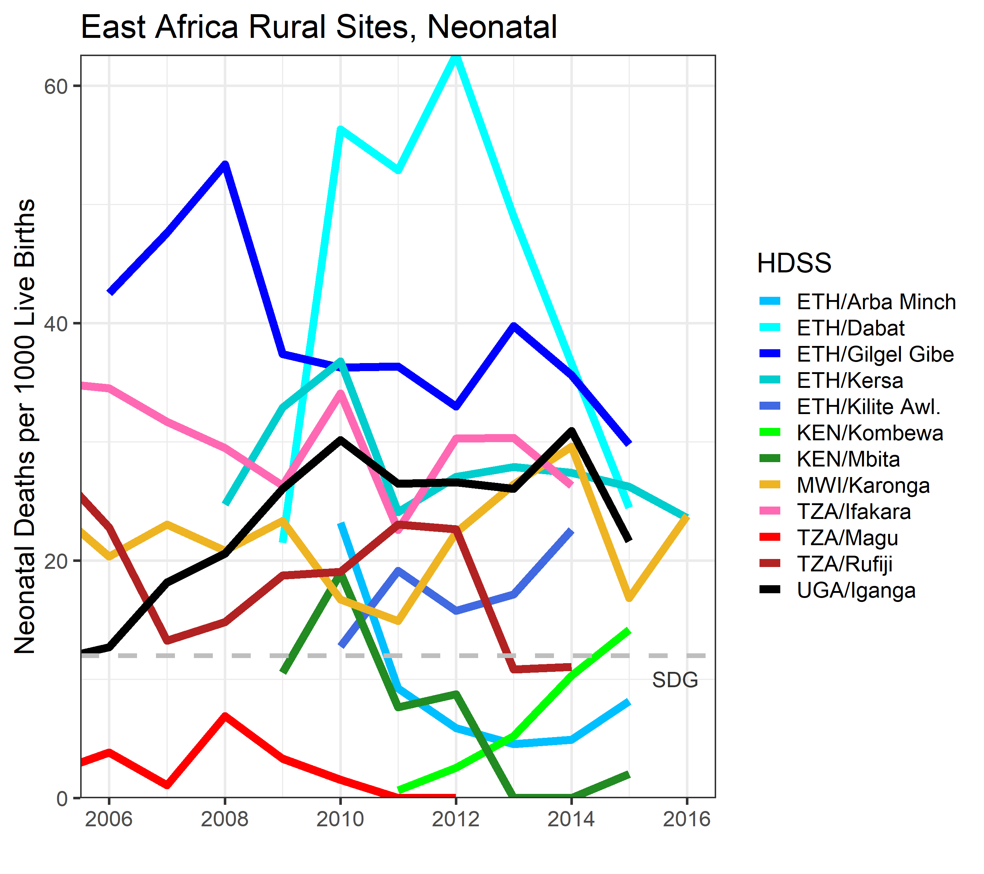
Strongly divergent neonatal (NN) mortality patterns. They also do not coincide, in general, with the 1-59m patterns:
Many sites seem to approach/meet SDG.
Yet, curiously, no clear improvement trend overall.
Best/worst performers are generally different (note e.g., Dabat, Magu)
Odd trend in Kombewa.

Slide 16
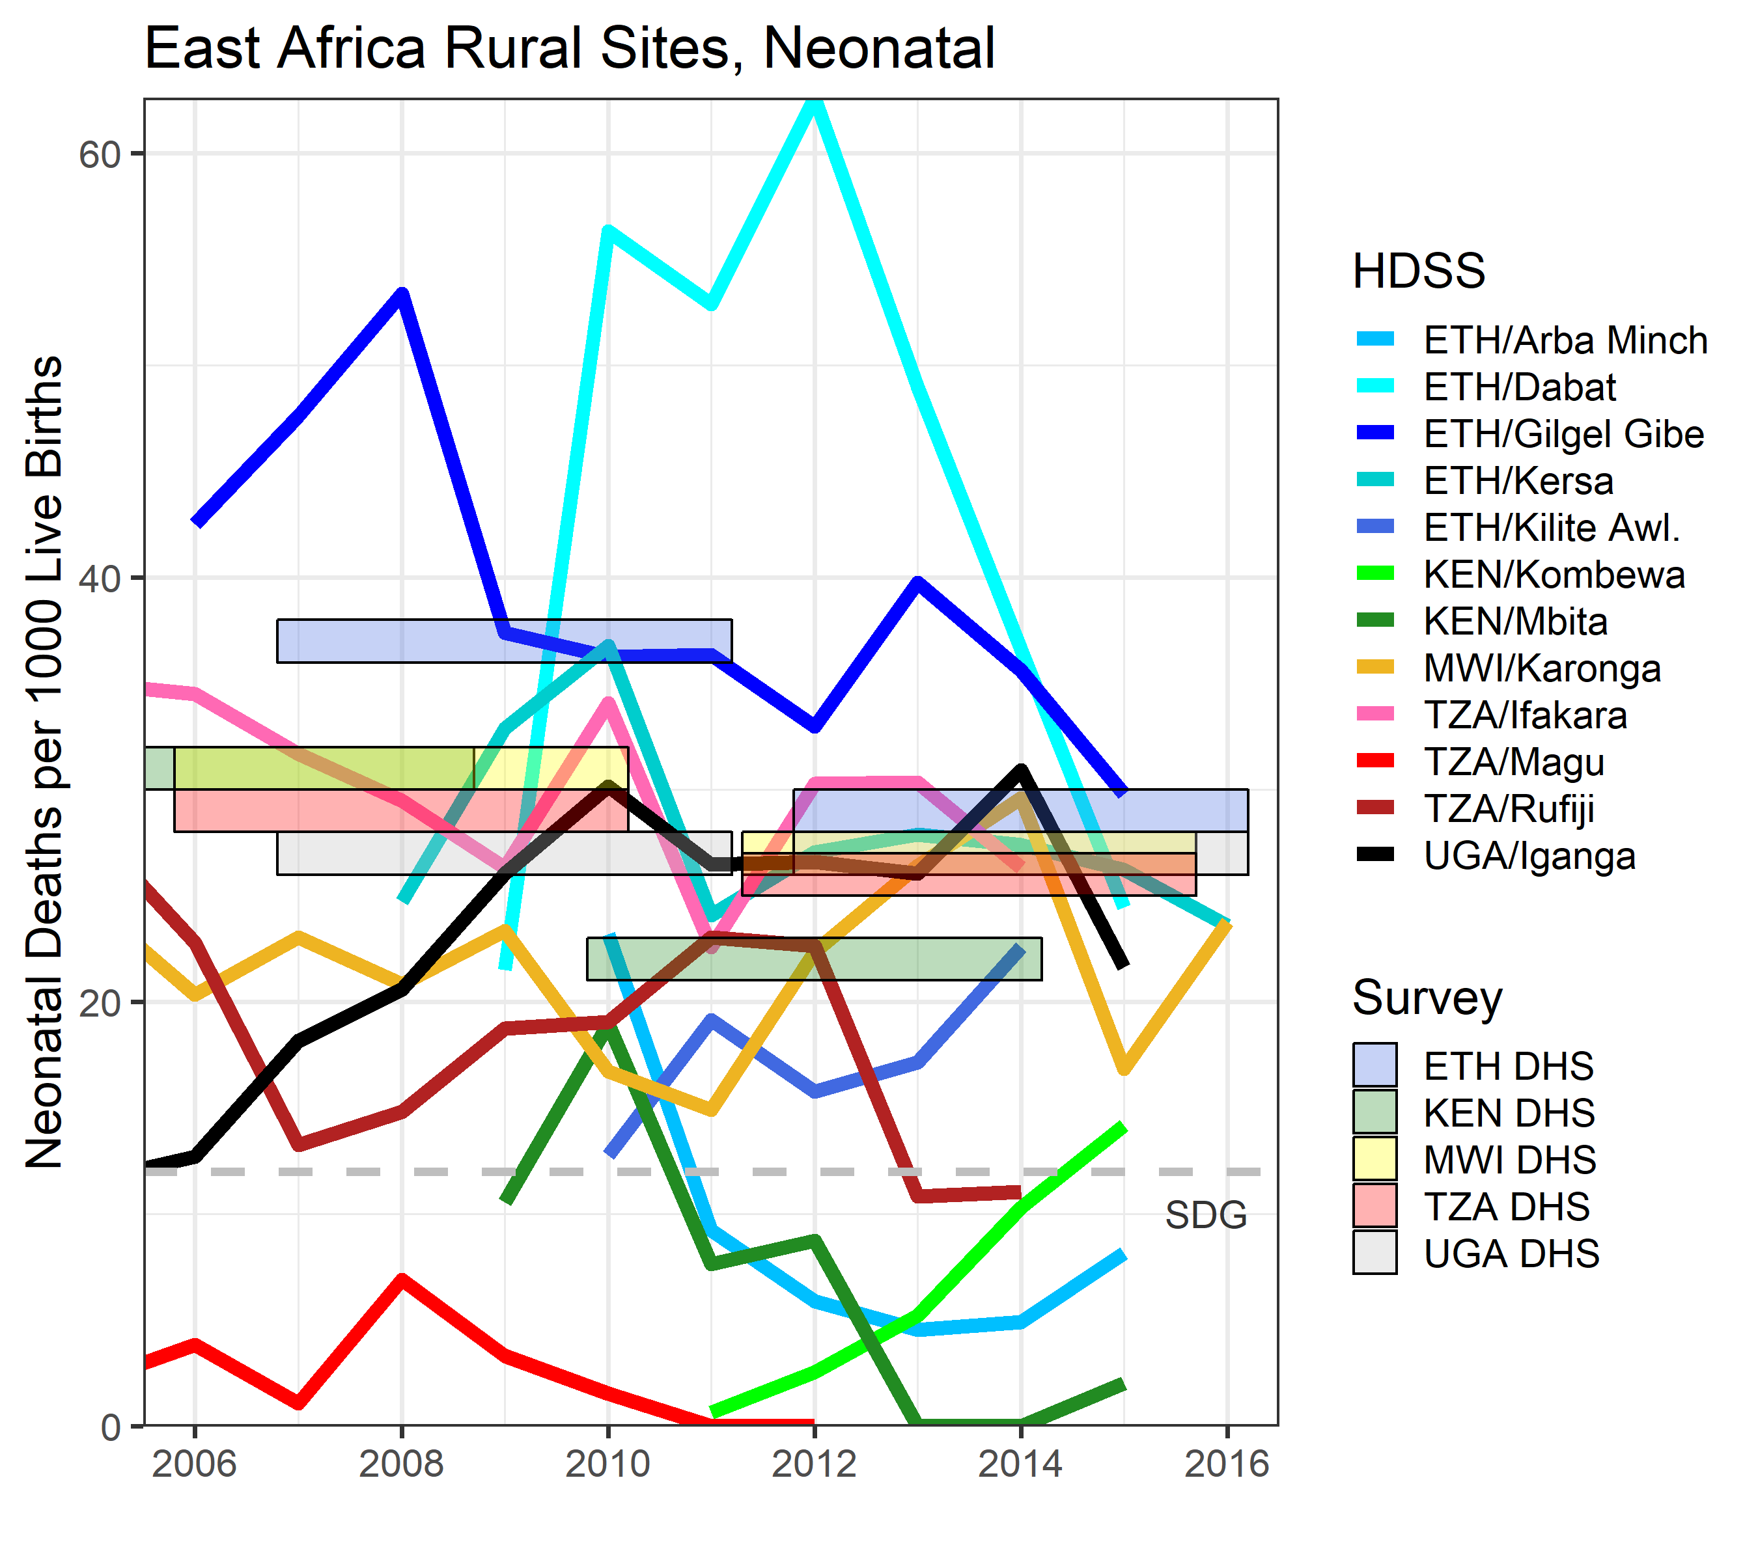
In contrast to HDSSs, DHS does show some improvement over time.
However, except possibly Kenya, no country is anywhere near SDG yet.
Overall, more HDSS sites run below their national estimates, than above.
Here, too, there is another surveillance dataset to help shed more light.

Slide 17
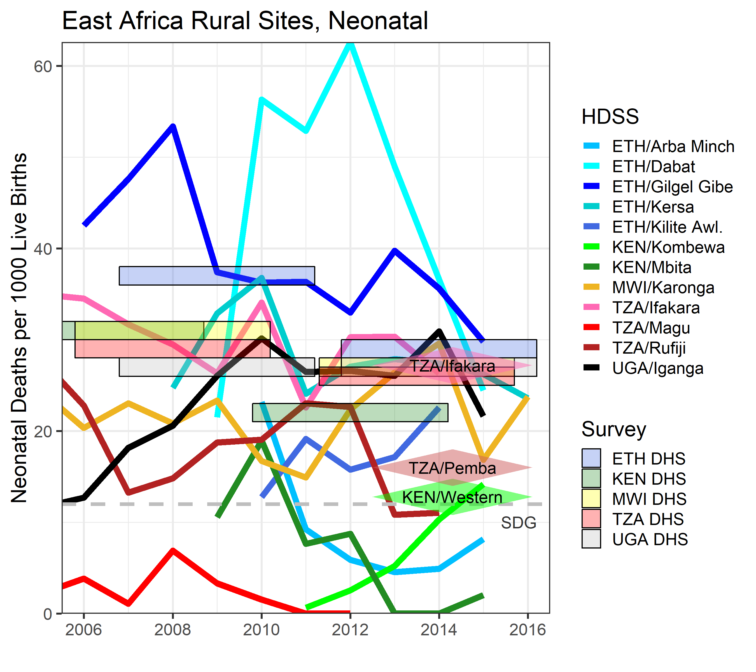
AMANHI study sites were mostly based on HDSSs.
Western Kenya AMANHI data (31k births over 3.5 years) suggest that Kombewa’s reverse trend is due to improving surveillance coverage.
The main story with NN mortality in HDSSs might be data quality: routinely missed deaths in some sites, vs. possibly overcounting (e.g., adding stillbirths) in other sites.

Slide 18
3. Regional Patterns: West Africa

Slide 19
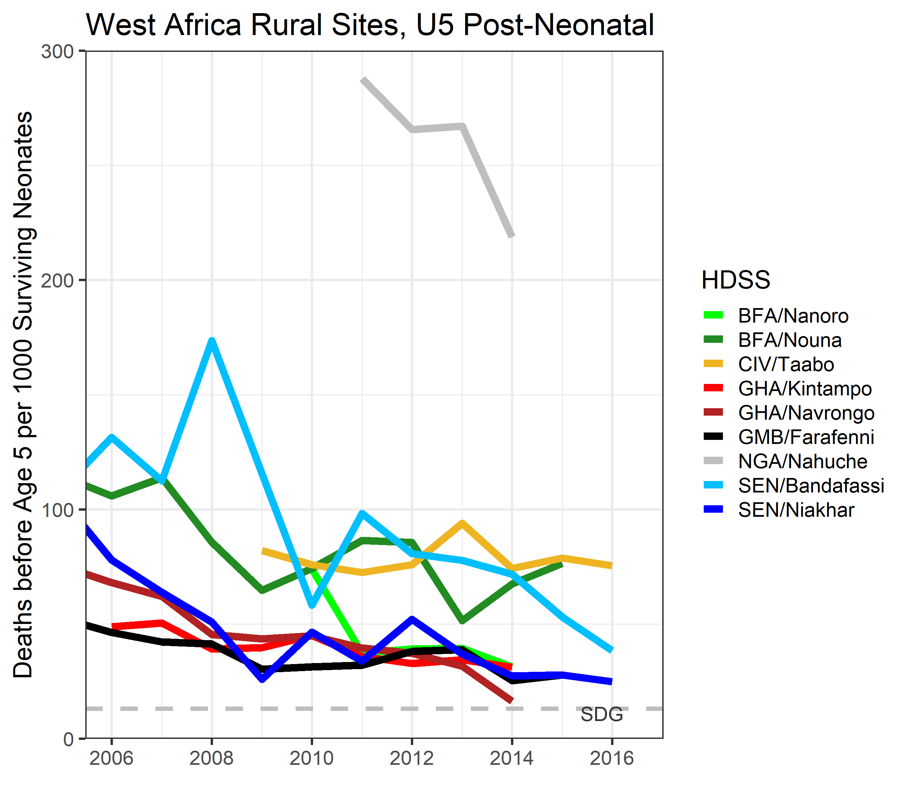
Nigeria’s Nahuche site (grey) is completely rural and situated in Zamfara State (2016 MICS: U5MR 210 and NNMR 53, including cities). So these sad 1-59m mortality numbers seem legit.
We exclude Nahuche from subsequent slides, in order to be able to see patterns among the rest.

Slide 20
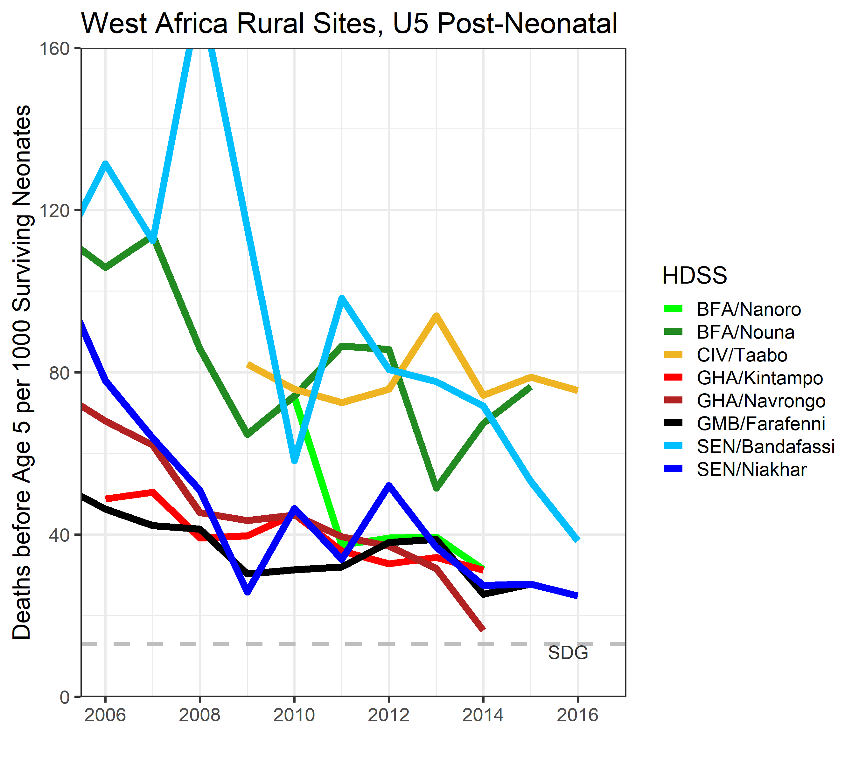
Same data without Nahuche.
We see a general improvement trend, but less steep than in the East. Like in the East, large variability within countries (Burkina Faso, Senegal).

Slide 21
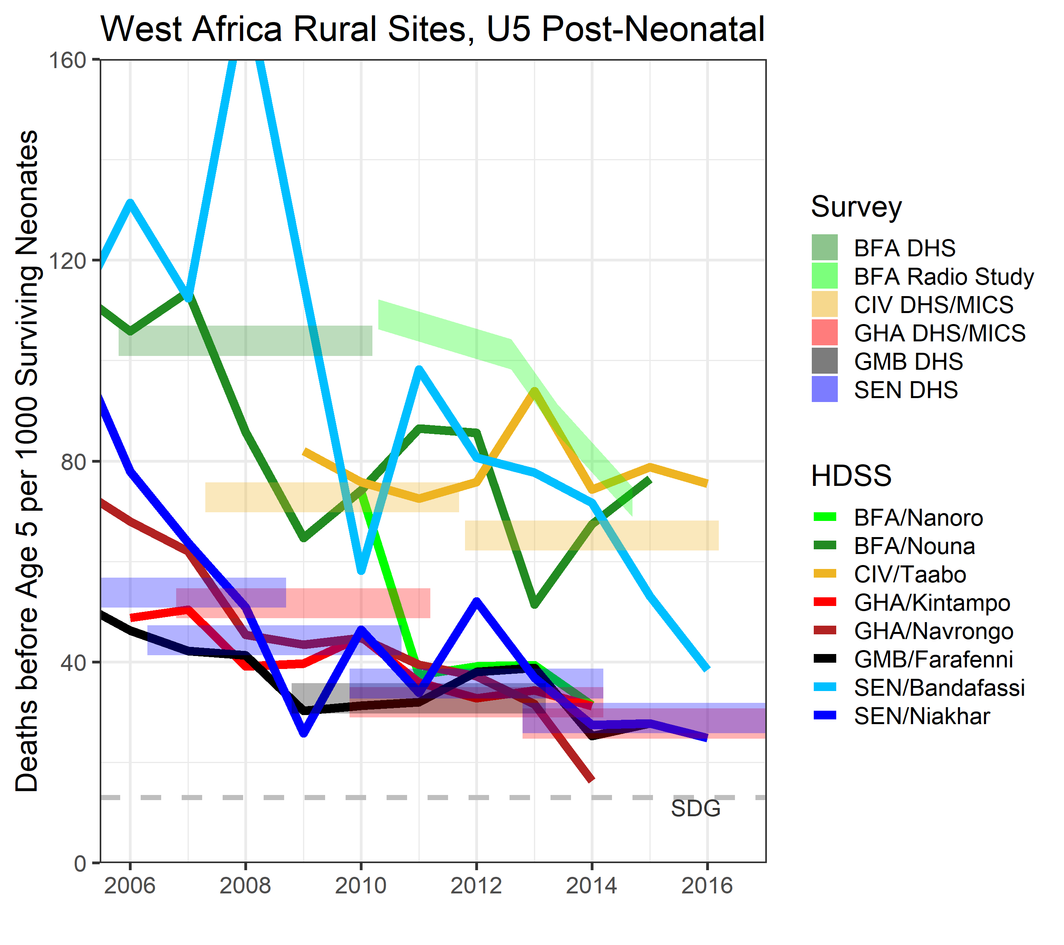
Survey data generally agree with HDSS trends.
Nanoro outperforms its country averages; Bandafassi lags behind, with recent signs of catching up.
On to neonatal trends.

Slide 22
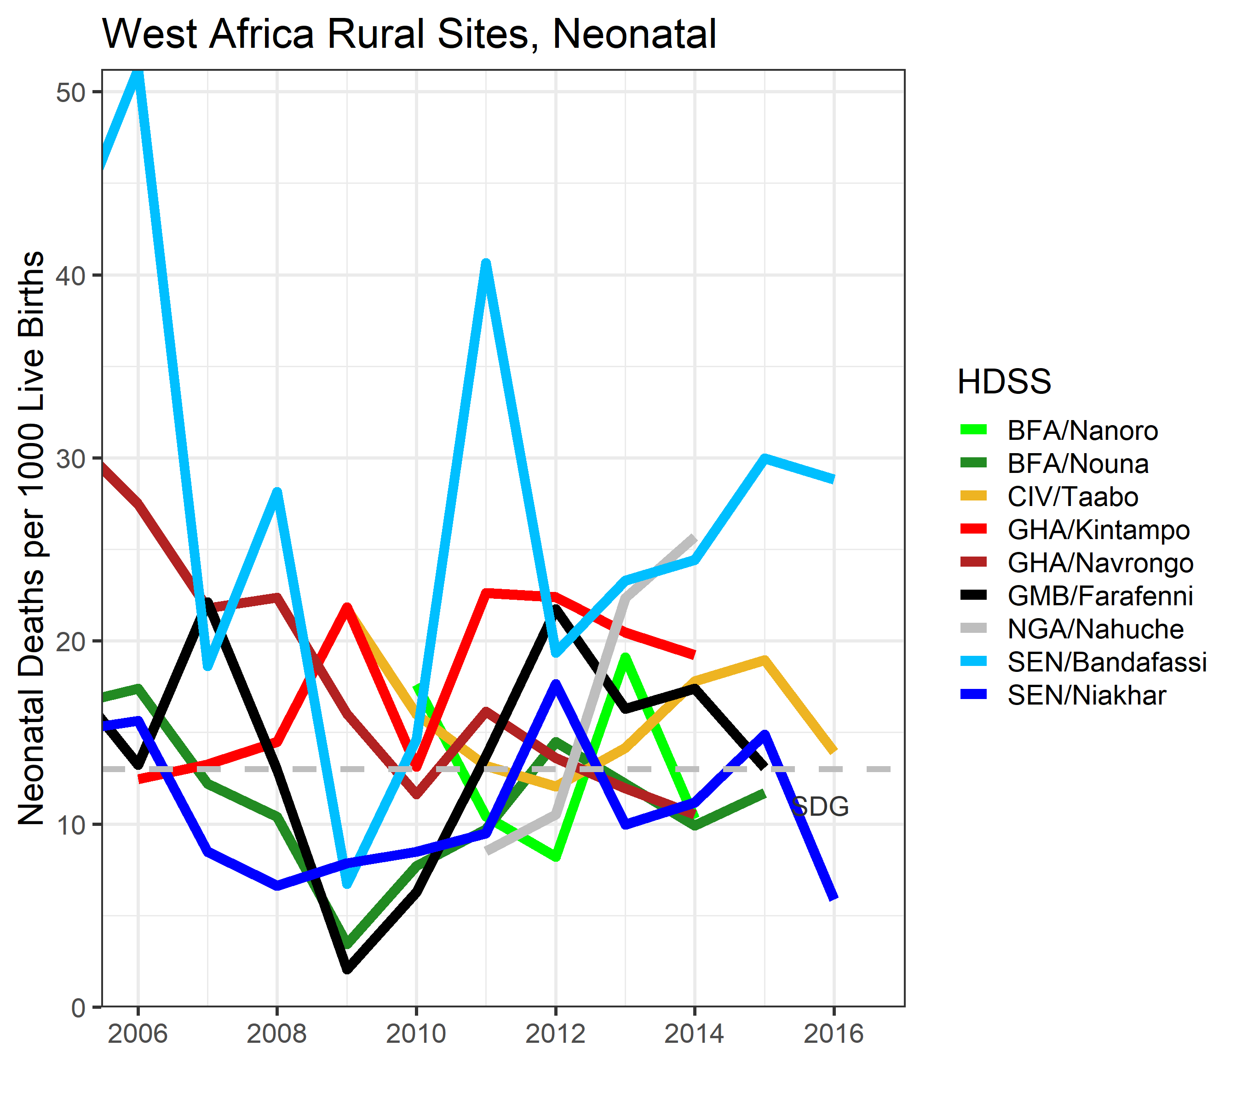
On Neonatal mortality, Nahuche numbers similar to rest, far below Zamfara DHS estimate, and trending up. All are signs pointing to potential event-capture issues.
Other than that, patterns are similar to East:
Face-value numbers approach SDG.
No clear improvement trend.

Slide 23
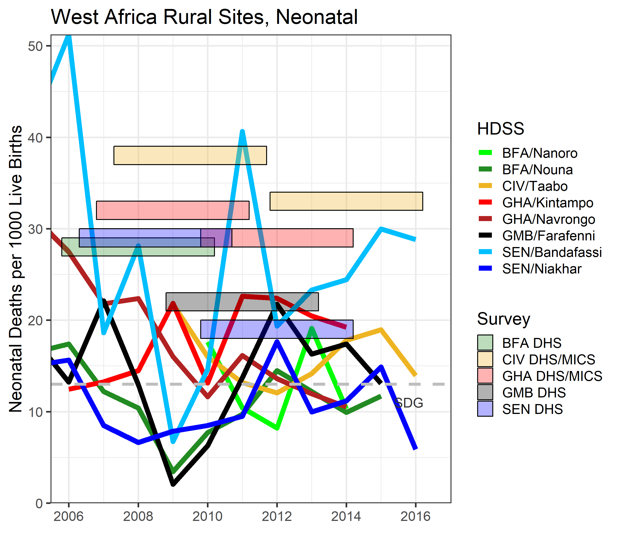
Adding survey estimates, again similar patterns to East, but more dramatic:
Survey data does show improvement, even more so than in East.
However, HDSS estimates far lower than surveys.
Here too we can add some AMANHI data.

Slide 24
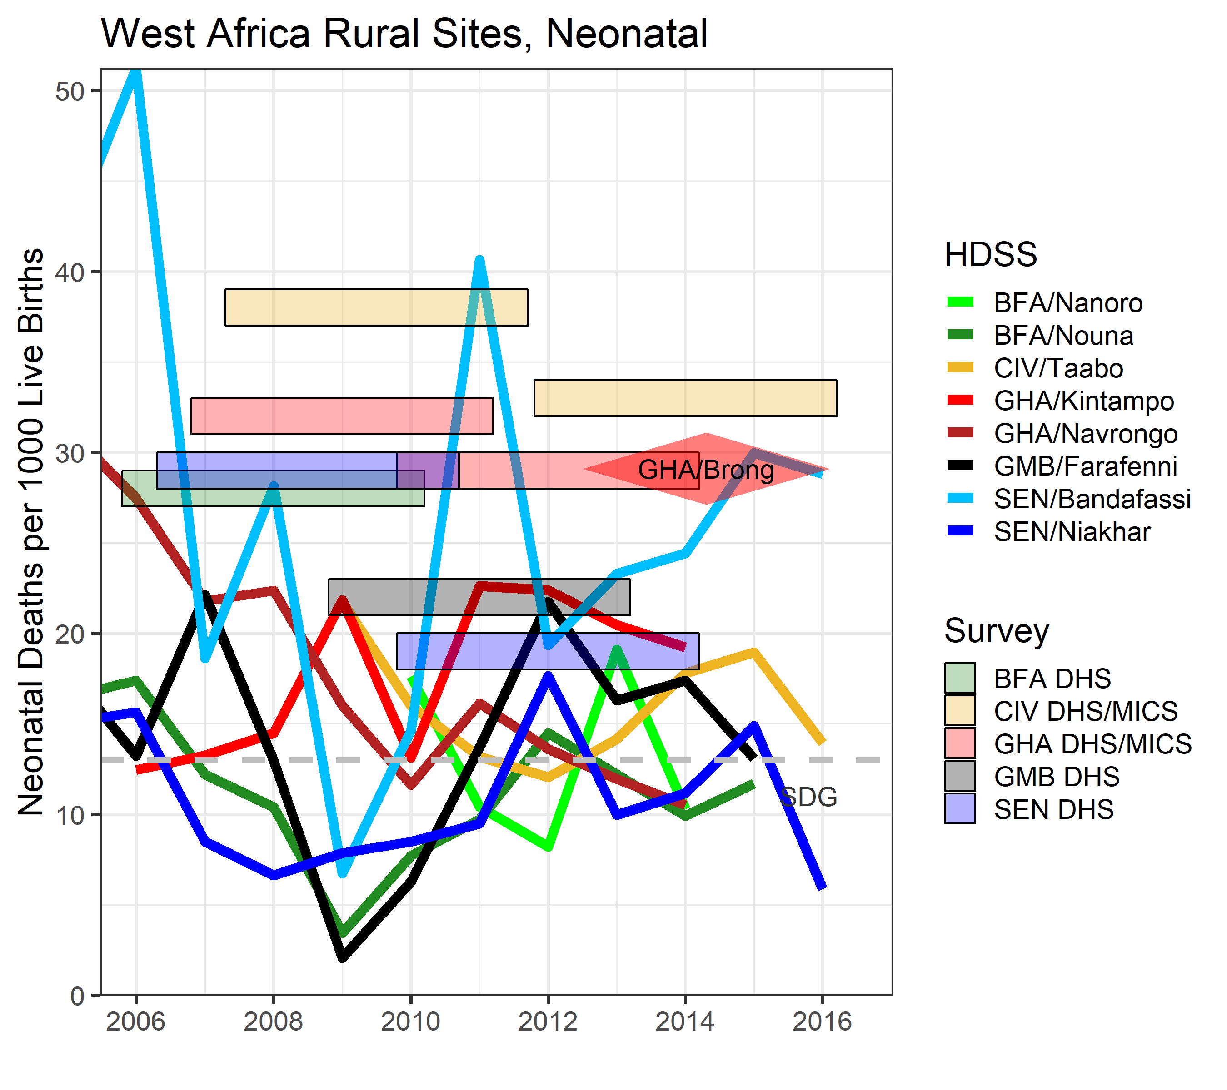
Brong Ahafo AMANHI site was apparently an extension of Kintampo onto a ~5x larger population.
Numbers almost identical to national average, ~50% higher than “Kintampo proper” estimates.
The gap is plausible, given Kintampo residents likely enjoys better healthcare.

Slide 25
4. Combining, and Zooming In

Slide 26
Emerging Common Patterns between East and West
HDSS 1-59m mortality rates and trends are generally aligned with their country’s survey estimates, with minor yet notable exceptions.
By contrast, HDSS neonatal mortality tends to be lower than national survey estimates, often dramatically so, and lacks clear trends.
In countries with several sites, there is substantial inter-site variability, most prominently in Ethiopia.
There seems to be little rhyme or reason regarding a site’s relative neonatal mortality (high/low, etc.), and its relative 1-59m mortality rate.
The next slide attempts to combine and visualize these patterns. For each HDSS, we calculated average mortality rates for the 4-5 years covered by each available survey.

Slide 27
Systematically lower HDSS neonatal mortality (left), contrasts with reasonable HDSS:survey alignment on 1-59m mortality (center).
There is no association between how high/low a site’s neonatal mortality is compared to its national survey estimates, vs. how high/low its 1-59m mortality is (right).
It seems there is reason to suspect data issues with HDSS neonatal rates.
What about 1-59m? Can differences from national rates tell us any local lesson?

Slide 28
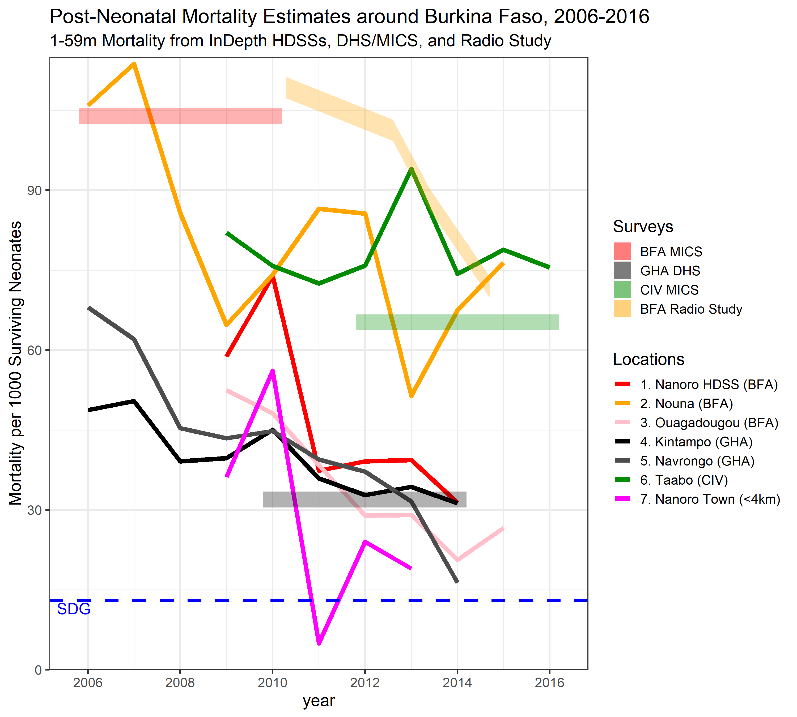
We get even more local thanks to Nanoro HDSS, where we received local household GPS.
Nanoro town 1-59m mortality rate dramatically lower than the HDSS as a whole; the gap apparently increasing with time.
Nanoro is a new HDSS with modest means. The town is fairly small.

Slide 29
5. Discussion

Slide 30
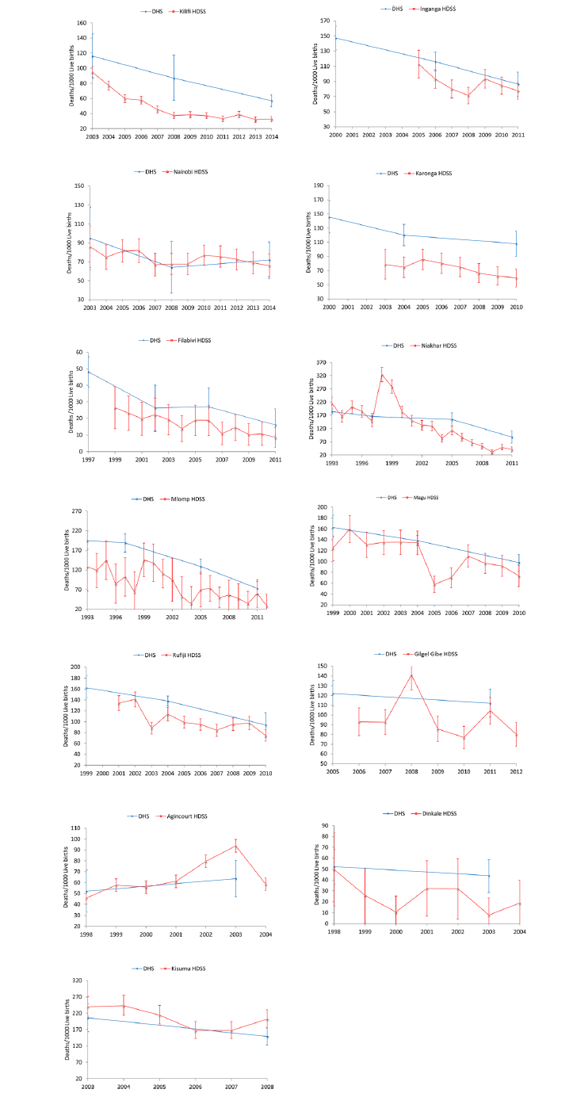
Existing Work on Surveillance vs. Survey
Deribew et al. (BMC Public Health, 2016) compared U5MR trends in 12 African and one Asian HDSS with analogous Admin-1 DHS estimates (right).
They found that most HDSSs had lower U5MR. However, I am not sure they accounted for the 10-year averaging window factored into Admin-1 estimates (one reason why I didn’t use Admin-1).
They also found that HDSSs were trending down faster than DHS.
More recently, Baschieri et al. (J. Global Health, 2019) have launched the “Every Newborn-INDEPTH” study. It will run in 5 HDSSs (Bandim, Dabat, Iganga/Mayuge, Kintampo, Matlab).
EN-INDEPTH will compare two survey approaches to estimate mortality around birth, and also compare them with the HDSS estimates.

Slide 31
Surveillance vs. Survey: Neonatal
The standardized surveys are de facto gold standards in the absence of complete CRVS. Indeed the diverging and often unrealistic NNMR patterns across HDSS sites raise doubts about their reliability.
However, we must keep in mind that surveys, too, are not fully verified by ground truth. That truth might be somewhere in the middle, even on neonatal deaths.
Unlike surveys that interview mothers years after the events surrounding birth, HDSSs visit households 2-4x times/year, identifying most pregnancies in real time. That said, some pregnancies will not be identified, and most neonatal deaths (as well as, by definition, stillbirths) occurring in the community would represent neonates whom the surveillance and medical center teams never had the chance to see directly.
I am not familiar with field procedures beyond that, but investigation into potential gaps in surveillance, as well as into social barriers to reporting and how to handle them, seems warranted.

Slide 32
Surveillance vs. Survey: 1-59m
By contrast, most post-neonatal mortalities would be of infants and children who were met by surveillance teams. Hence there are likely fewer gaps in tracking them.
Here, differences between sites in the same country, above and beyond diverging Admin-1 survey estimates, may hold keys to effective policies and interventions.
Locations like Nanoro (in particular Nanoro town), Navrongo, Dabat, Kilita Awlaelo or Karonga, face public-health challenges typical of rural Africa, and are not as renowned and well-equipped as, e.g., Kilifi or Matlab. So whatever it is that seems to work in those districts, can be translated more readily into greater rural regions.
In other words, these patterns can help identify Exemplar Sites and contrast them with other sites via detailed study, as done recently on the national level by Nadia Akseer and colleagues.

Slide 33
General Conclusions Regarding HDSS Data (if time allows)
HDSSs vary greatly in their tenure, from many decades to a few years.
They also vary greatly in the amount of resources, but many if not most are cash-strapped, and find it a challenge to prepare the standard “micro” dataset for sharing, let alone perform verbal autopsy.
As recent efforts in surveillance expansion (AMANHI, COMSA, EN-INDEPTH), as well as the patterns shown here suggest, strengthening the InDepth network and HDSSs in general might be an very cost-effective investment in local and global health.

