Slide 1
Spatiotemporal dynamics and determinants of leptospirosis in northeastern Thailand, 2000-2014
Katharine A. Owers¹, Soawapak Hinjoy², James E. Childs¹, Vincent Herbreteau³, Peter J. Diggle⁴, & Albert I. Ko^{1,5}
¹Epidemiology of Microbial Diseases, Yale University School of Public Health, New Haven, CT, USA
²Bureau of Epidemiology, Department of Disease Control, Ministry of Public Health, Nonthaburi, Thailand
³IRD, ESPACE-DEV (IRD, UM2, UR, UAG), Saint-Pierre, France
⁴Division of Medicine, Lancaster University, Lancaster, United Kingdom
⁵Instituto Moniz, Fundação Oswaldo Cruz, Ministério da Saúde, Salvador, Brazil
Institute for Disease Modeling Symposium | 16 April 2018

Slide 2
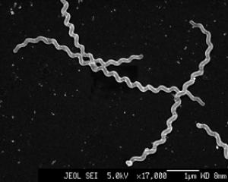
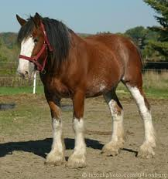
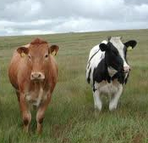

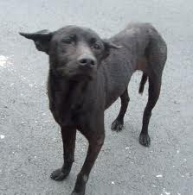
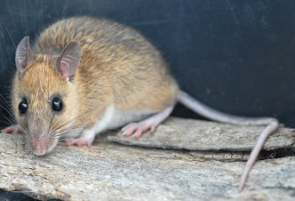
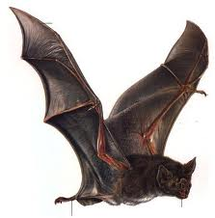

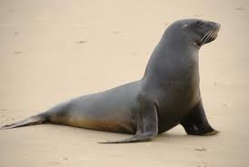
Leptospirosis
10 species and >200 serovars of pathogenic Leptospira spirochetes
Environmentally transmitted via contact of cut or abraded skin with urine-contaminated soil or water
  Wide range of mammalian hosts
Most infections mild or asymptomatic, but severe manifestations have high fatality rates
High burden in rural farmers (particularly rice)

Slide 3
An explosive emergence of leptospirosis in Thailand
Before 1995, <300 cases per year
In 2000, there were 14,285 cases
Established endemic transmission
Emergence remains unexplained
Not a unique phenomenon—similar explosive emergence in Sri Lanka
Tangkanakul, W., et al. (2005) Southeast Asian J Trop Med Public Health

Slide 4
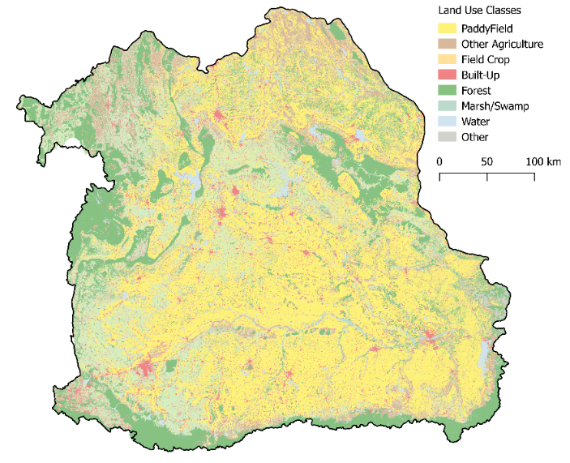
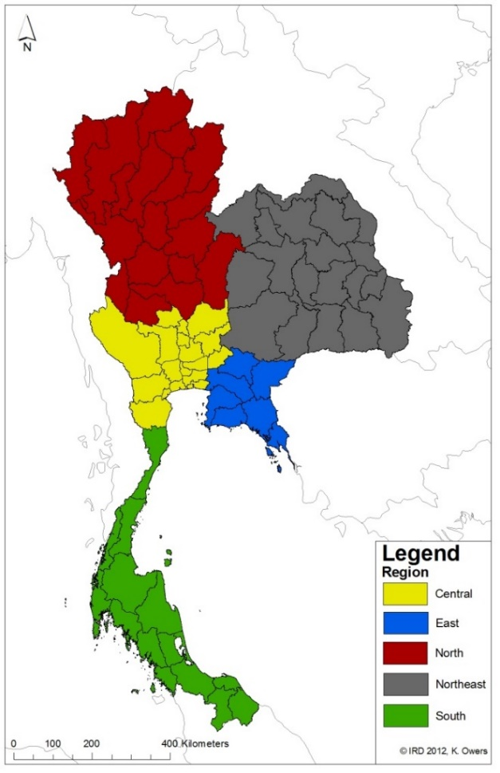
Leptospirosis in northeastern Thailand
Site of >75% of cases during and since the emergence
Major rice farming region
  Other crops and livestock present
Heterogeneous leptospirosis distribution
Transmission difficult to manage

Slide 5
Motivations, Objective, & Hypothesis
Motivating questions
  What are the drivers of the spatiotemporally heterogeneous leptospirosis incidence?
  Is this a rice-driven system?
Objective: Formally characterize leptospirosis transmission dynamics and determinants in northeastern Thailand to guide public health interventions
Hypothesis: Agricultural and environmental features are important determinants of incidence

Slide 6
Surveillance Data
Leptospirosis is reportable in Thailand
  Thai Ministry of Public Health, form R506
56,223 reported cases of leptospirosis in NE Thailand from 2000-2014
  Data before 2000 unavailable
  Data includes date of symptom onset & demographic features

Slide 7
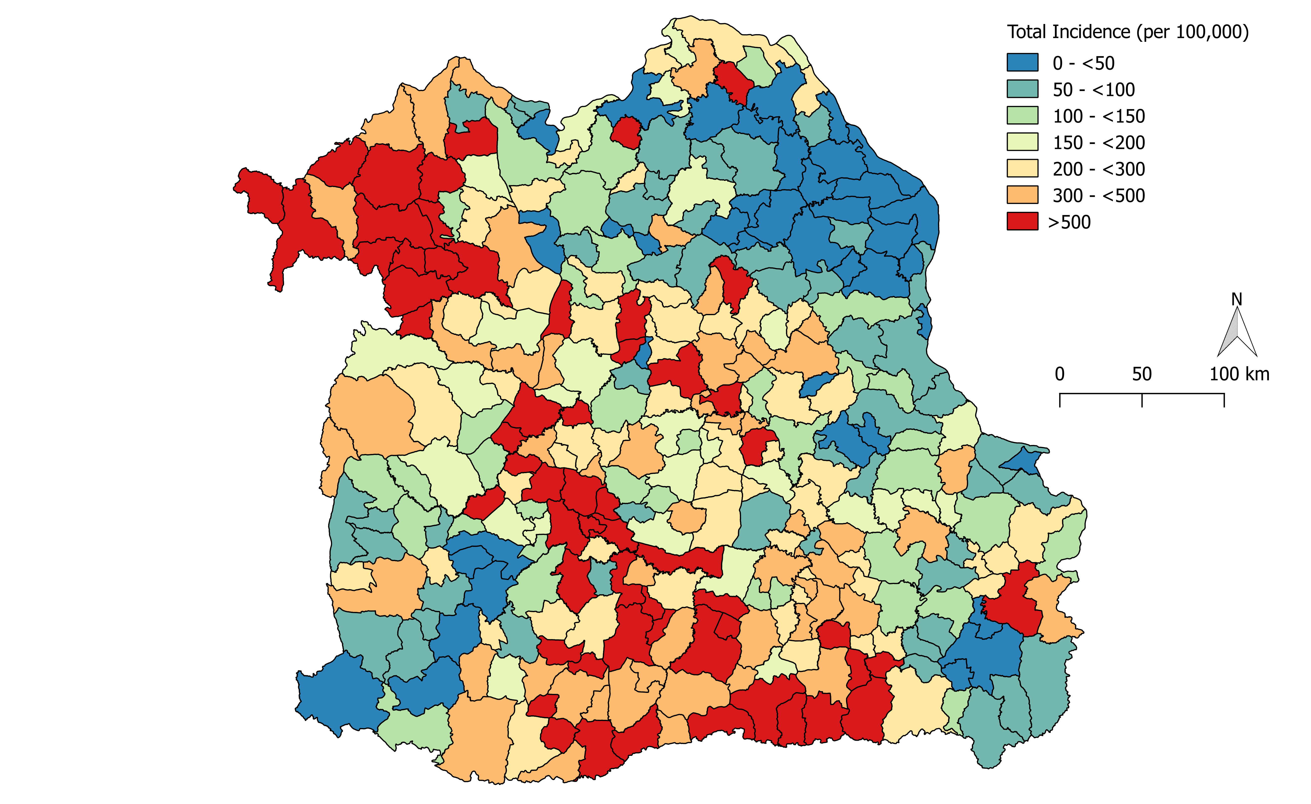
Spatially heterogeneous incidence

Slide 8
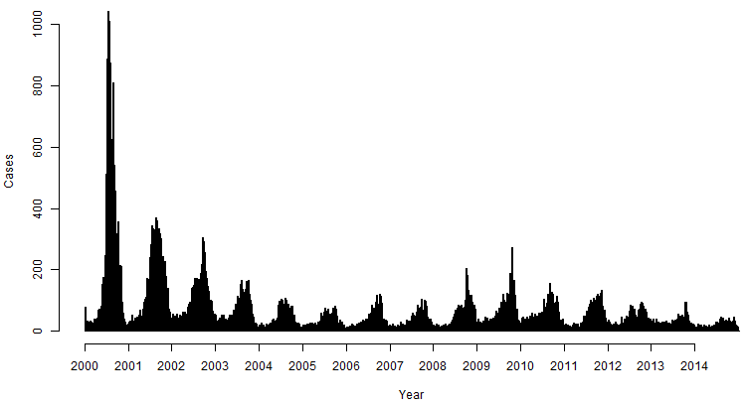
Temporally heterogeneous incidence
Three Periods
  Emergence (2000)
  Transition (2001-2002)
  Endemic (2003-2014)
Seasonal cases

Slide 9
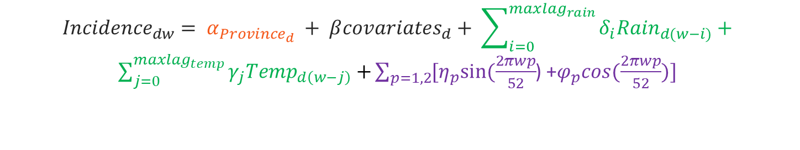
Modeling Strategy
Spatiotemporally explicit quasipoisson generalized linear model for incidence in district d (n=320) in week w (n=717)
Province: A province-level factor to account for variation above the district scale
District-level covariates
Rainfall & Temperature
Seasonal sine-cosine waves: Capture seasonal fluctuations in incidence (6- & 12-month cycle lengths)
$${Incidence}_{dw}= α_{{Province}_{d}} + β{covariates}_{d}+ \sum_{i=0}^{{maxlag}_{rain}}{δ_{i}{Rain}_{d(w−i)}}+$$
$\sum_{j=0}^{{maxlag}_{temp}}{γ_{j}{Temp}_{d\left(w−j\right)}+}\sum_{p=1,2}{{[η}_{p}sin⁡(\frac{2πwp}{52}}$) +$φ_{p}cos⁡(\frac{2πwp}{52})]$

Slide 10
Separate models by epidemiologic period
Emergence: Data from 2000
Endemic: Data from 2003-2014

Slide 11
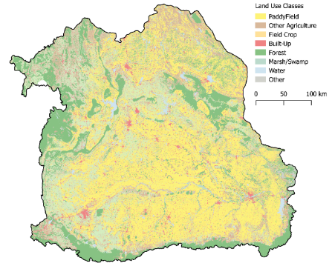
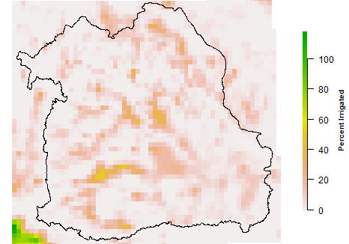
Covariates
Agriculture & Land Use
  Land Use (% district area): Rice paddy, urban, field crop, other agriculture, forest, water, marsh/swamp, other
  Average parcel size
  Livestock density: Buffalo, cattle, pigs, poultry
  Irrigation
Physical features
  Elevation
  NDVI
  NDWI (Gao)
  NDWI (McFeeters)
Socioeconomic characteristics
  Percent rural population
  Education*
  Income*
  Household size*
  Households with access to safe water*
  Public physicians per 100km²*
Land Use
Irrigation
* Variable available at province-level (n=19) instead of district (n=320)

Slide 12
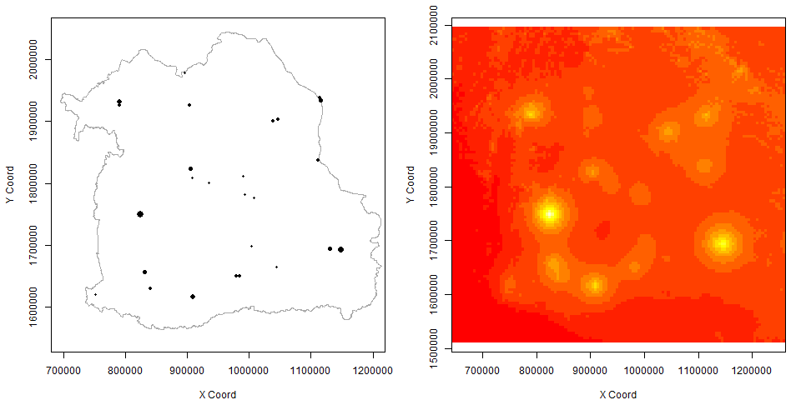
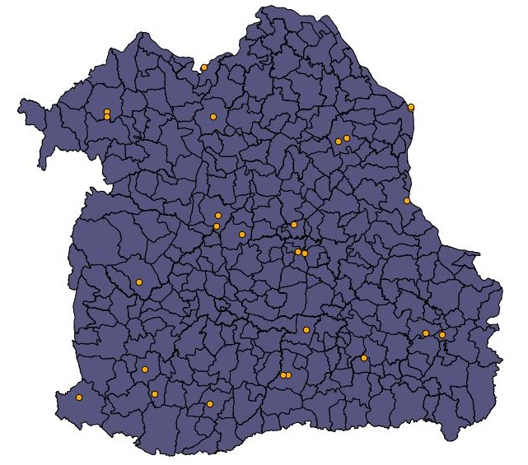
Spatiotemporally varying weather
Weekly data from 28 stations
  Total rain
  Mean temperature
Geostatistically modeled to generate a weekly predicted surface over the study area at a 5km resolution
Current and lagged weather

Slide 13
Effects of recent rainfall and temperature
 | RR (95% CI)
Variable | Emergence (2000) | Endemic (2003-2014)
Rainfall (cm)
Current week | 0.985 (0.961 - 1.008) | 0.979 (0.971 - 0.988)
1 Week Lag | 0.983 (0.960 - 1.006) | 0.995 (0.985 - 1.005)
2 Week Lag | 1.012 (0.994 - 1.030) | 1.012 (1.002 - 1.022)
3 Week Lag | 0.992 (0.975 - 1.009) | 1.018 (1.009 - 1.028)
4 Week Lag | 0.974 (0.958 - 0.991) | 1.001 (0.992 - 1.011)
5 Week Lag | 0.977 (0.961 - 0.993) | 0.997 (0.989 - 1.005)
Temperature (° Celsius)
Current Week | 1.177 (1.043 - 1.330) | 1.088 (1.039 - 1.140)
1 Week Lag | 1.168 (1.012 - 1.349) | 1.045 (0.982 - 1.112)
2 Week Lag | 0.827 (0.736 - 0.929) | 0.865 (0.826 - 0.905)
Emergence
  Rain 4-5 weeks ago
    Note: Similar but non-significant point estimates for 0-2 weeks of lag
  Stronger relationship with temperature
Endemic
  Recent rainfall (0, 2-3)
Note: Non-significant associations are in grey

Slide 14
Consistent landscape and agricultural associations
A rural disease
  High rural population
  Low % urban or marsh
Landscape fragmentation
 | RR (95% CI)
Variable | Emergence (2000) | Endemic (2003-2014)
Rural population (%) | 1.004 (1.001 - 1.008) | 1.006 (1.004 - 1.008)
Land Use (% district area)
Urban | 0.970 (0.959 - 0.981) | 0.961 (0.955 - 0.968)
Marsh/Swamp | 0.902 (0.872 - 0.931) | 0.960 (0.949 - 0.972)
Average Patch Size (10,000 m²) | 1.012 (1.009 - 1.016) | 1.011 (1.009 - 1.013)
Note: Non-significant associations are in grey

Slide 15
Certain landscape and agricultural determinants vary by period
Emergence show the expected association with rice, but little else
Endemic leptospirosis
  Rice paddy protective
  Irrigation→ risk heterogeneity
  Unexpected other associations
 | RR (95% CI)
Variable | Emergence (2000) | Endemic (2003-2014)
Land Use (% district area)
Rice Paddy | 1.011 (1.008 - 1.014) | 0.995 (0.994 - 0.997)
Other Agriculture | 0.995 (0.989 - 1.000) | 1.005 (1.002 - 1.008)
Livestock Density/km²
Poultry (per 100) | 0.989 (0.978 - 0.999) | 0.997 (0.989 - 1.005)
Pigs | 1.001 (0.994 - 1.008) | 0.993 (0.990 - 0.997)
Cattle | 1.002 (0.994 - 1.009) | 0.981 (0.977 - 0.985)
Irrigation (% area) | 0.994 (0.987 - 1.001) | 1.026 (1.022 - 1.030)
Note: Non-significant associations are in grey

Slide 16
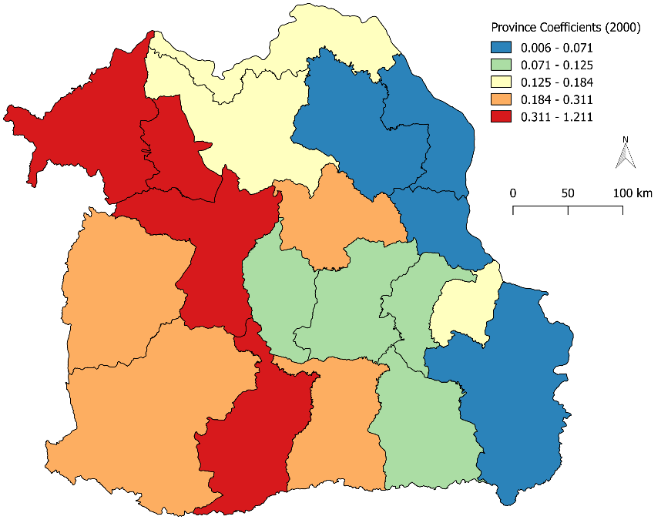
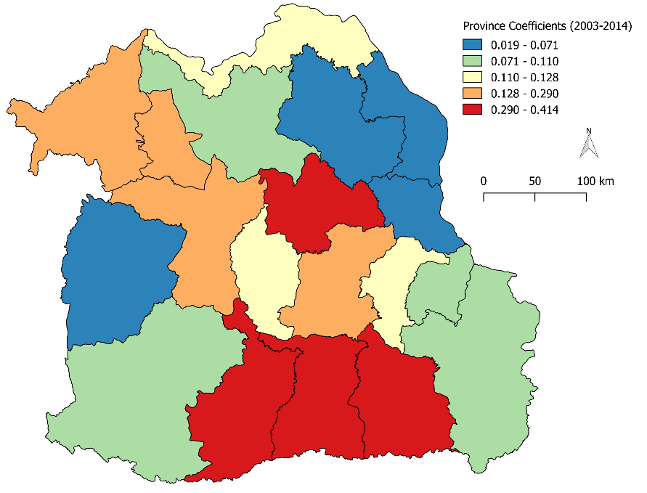
Significant inter-province variation
The province factor was highly significant
Possible marker of
  True risk heterogeneity
  Reporting variation
  Socio-economic status or other factors
Emergence
Endemic

Slide 17
Limitations
Ecologic analysis of district-level data
Passive surveillance data
Limited data availability & resolution
Existing data at a policy-relevant scale

Slide 18
Public health recommendations
Endemic leptospirosis in this setting is not a simple disease of rice farming
  Important to think more broadly when planning public health interventions
In the absence of the rice guiding principle, public health practitioners can use other information to allocate prevention resources
  Persistent spatial risk variation is associated with agricultural characteristics
    High: Irrigation, Other Agriculture
    Low: Pigs, Cattle
  Weather can be used to determine temporally-varying risk

Slide 19





Acknowledgements
  Thai Ministry of Public Health
  Thai Meteorological Department
  Thai Land Development Department
  Peter Diggle
  Vincent Herbreteau
  Soawapak Hinjoy
  Albert Ko
  James Childs
  Kanchana Nakhapakorn
  Ricardo Soares Magalhães
Financial support from the Yale Institute for Biospheric Studies and the National Institutes of Health

Slide 20
Questions?

Slide 21
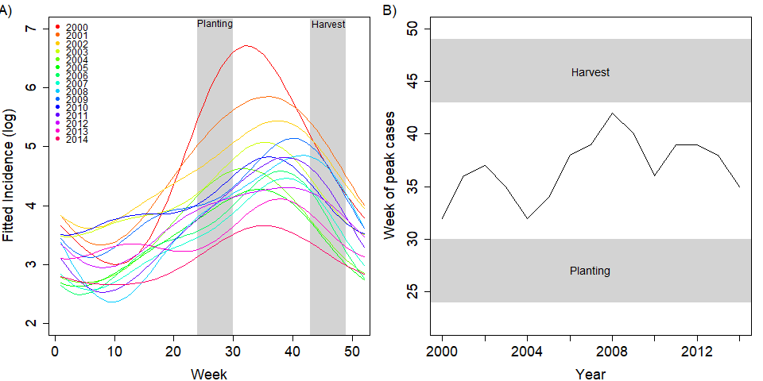
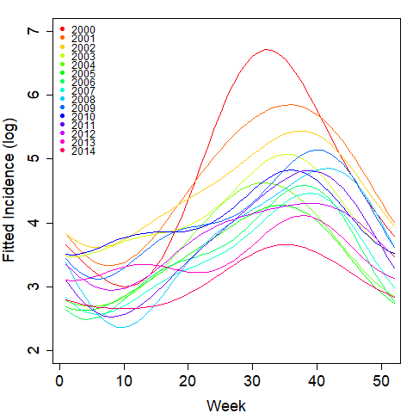
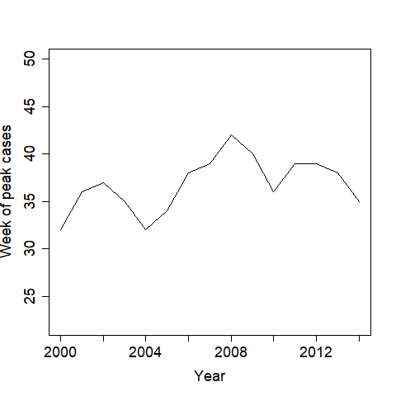
Case timing varies by year and is not associated with major rice farming events
Rice data from Sawano et al., Paddy Water Environment (2008) 6:83-90

Slide 22
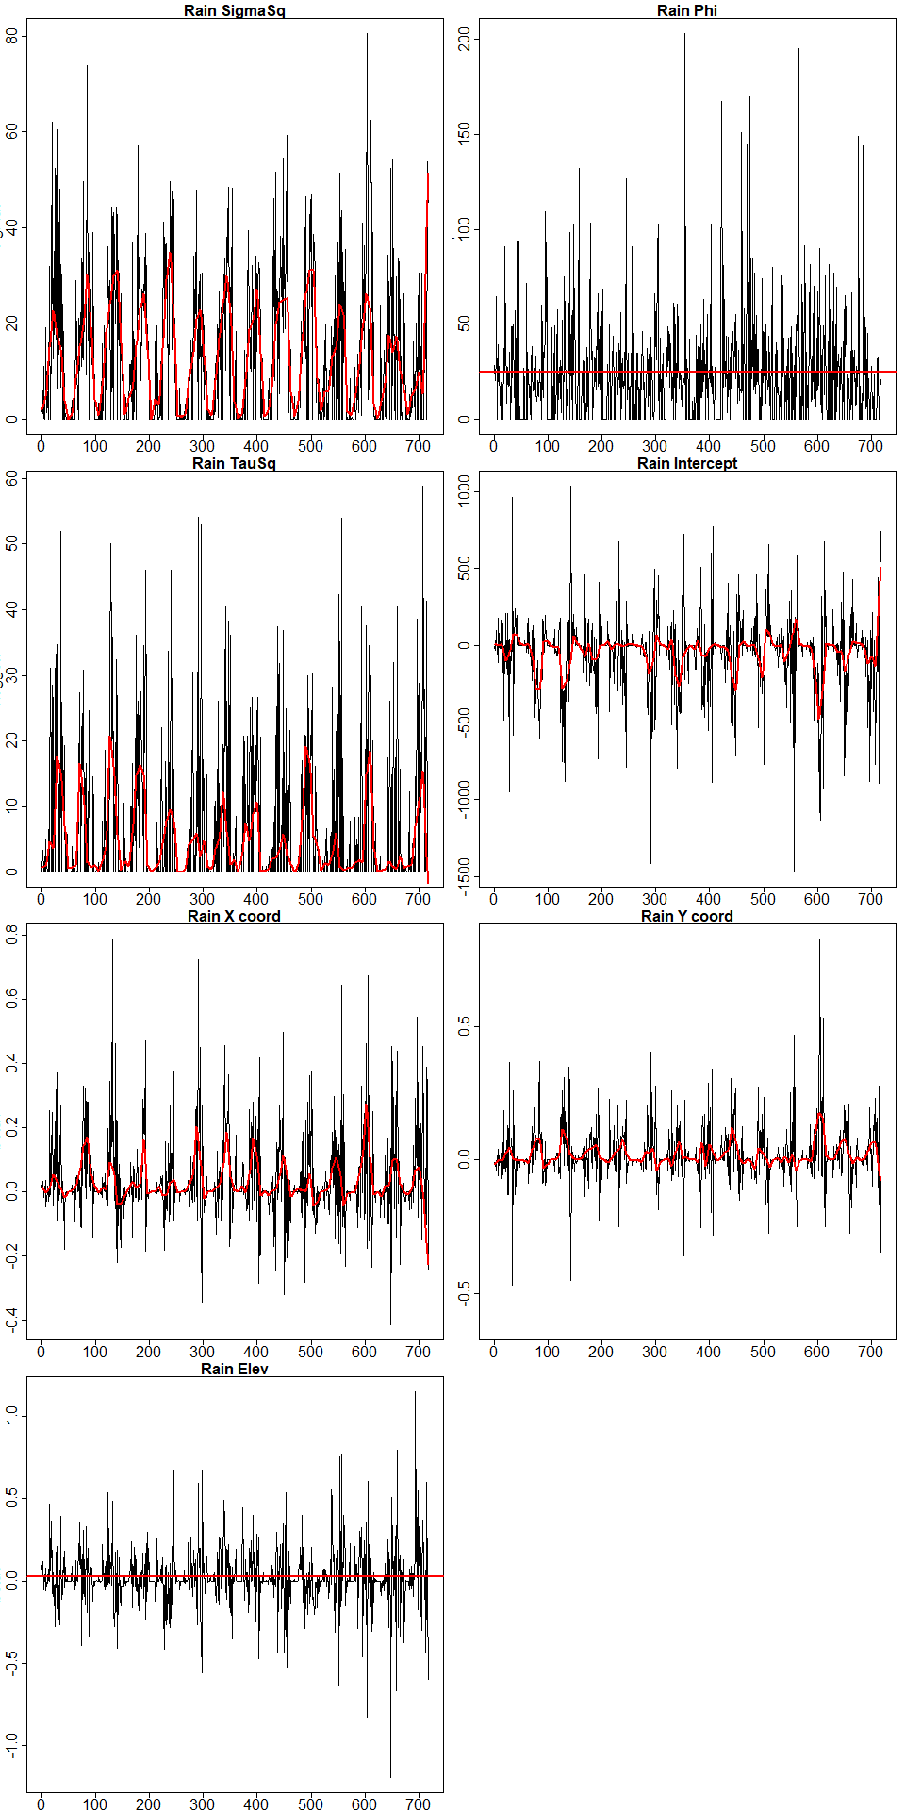
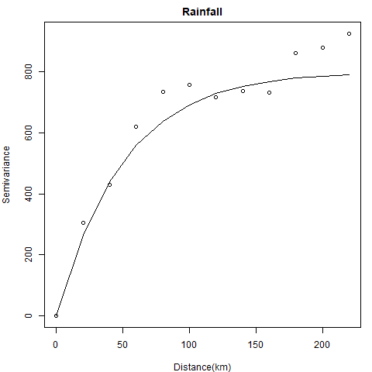
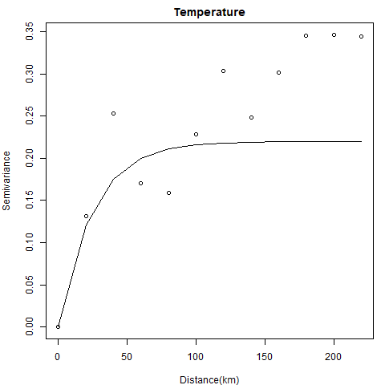

Geostatistically modeling weather
Geostatistically modeled to generate a weekly predicted surface over the whole area at a 5km resolution
    Model weekly station weather as a linear function of the station coordinates (X,Y) and elevation
    Extract residuals & plot as variogram
      Choose model family (exponential)
      Use visual best-fit line to initialize maximization
    Fit a geostatistical model with station latitude, longitude, and elevation as covariates and an exponential correlation structure
    Smooth weekly time series of model parameters
    Use smoothed parameters to generate weekly predicted values
  We then constructed weather anomalies by modeling the predicted weather as a function of the region-wide seasonal sine and cosine waves with 6- and 12-month cycle lengths
$$Y_{i}=b\left(x_{i}\right)′β+S\left(x_{i}\right)+Z_{i}$$

Slide 23
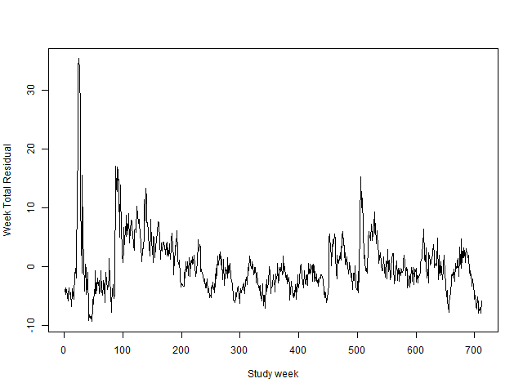
Residual temporal correlation
The model’s temporal residuals capture notable data features
Correlated residuals during the endemic phase indicate additional time-varying factors play a role
Emergence Peak
Case Definition Change
Endemic Transmission

Slide 24
Leptospiral determinants by period
Some variables have a consistent effect over time
  Rural population, Urban land, and Marshland
  Landscape fragmentation
Others vary by epidemiologic period
  Emergence
    Less influenced by recent rainfall
    Significant positive association with rice paddy
    Fewer associations with agricultural variables
  Endemic transmission
    Rice paddy is negatively associated with incidence
    Recent rainfall & agricultural/landscape features are important
← Expected association with rural population
← Unexpected relationship
← The expected association with rice, but few other variables
← Importance of non-rice agricultural and weather-related determinants

Slide 25
Spatially-varying covariate details
Variable | Data Spatial Resolution | How used in model | Source
Social Features
Percent rural population | District | District value | National Statistical Office of Thailand
Education | Province | Province value | National Statistical Office of Thailand
Income | Province | Province value | National Statistical Office of Thailand
Household Size | Province | Province value | National Statistical Office of Thailand
Households with safe water access | Province | Province value | National Statistical Office of Thailand
Public physicians per 100 km² | Province | Province value | Ministry of Public Health, Thailand
Physical Features
Elevation | 90m | District mean | STRM (Google Earth Engine)
NDVI | 30m | District mean | Landsat 7 (Google Earth Engine)
NDWI (Gao), Vegetation Water Content | 30m | District mean | Landsat 7 (Google Earth Engine)
NDWI (McFeeters) Flooding Propensity | 500m | District mean | USGS Forecast Mekong Project
Agricultural Features & Land Use
Irrigation | 5 arc-minutes (~ 8.3km) | District mean | FAO
Livestock density: Buffalo, cattle, pigs, poultry (per square kilometer) | 3 arc-minutes (~ 5km) | District mean | FAO
Land use: Rice Paddy, Field crop, Other agriculture, Forest, Built-up, Water, Swamp/Marsh, and Other | Continuous (polygons) | Percent of district in each class | Land Development Department, Thailand
Average Patch Size | Continuous (polygons) | District mean | Land Development Department, Thailand

Slide 26
Spatial covariates
Agriculture & Land Use
  Land Use (% district area): Rice paddy, field crop, other agriculture, forest, built-up, water, marsh/swamp, other
  Average parcel size
  Livestock density: Buffalo, cattle, pigs, poultry
  Irrigation
Physical features
  Elevation
  NDVI
  NDWI (Gao)
  NDWI (McFeeters)
Socioeconomic characteristics
  Percent rural population
  Education*
  Income*
  Household size*
  Households with access to safe water*
  Public physicians per 100km²*
Variable notes
Rice paddy, field crop, forest, and all the physical features (red circles) were highly correlated, so we excluded all variables in this group except Rice Paddy, since that was the variable we thought would be most interesting.
The province-level socioeconomic features (blue box) could not be included in the model at the same time as a province-level factor, so we tested both.
* Variable available at province-level (n=19) instead of district (n=320)
Cattle Density

