Slide 1

Azithromycin to prevent post-discharge morbidity & mortality

Slide 2

Number needed to treat-MDA
Number needed to treat via MDA to avert 1 death
  = $\frac{1}{{Mortality Rate}_{placebo}−{Mortality Rate}_{AZM}}$
  = $\frac{1}{0.0165−0.0146}$ = 526
Keenan, NEJM, 2018
MDA

Slide 3


Number needed to treat-Targeted
Number needed to treat via MDA to avert 1 death
  = $\frac{1}{{Mortality Rate}_{placebo}−{Mortality Rate}_{AZM}}$
  = $\frac{1}{0.0165−0.0146}$ = 526
  = $\frac{1}{0.0330−0.0292}$ = 263
Targeted
MDA

Slide 4

Hospital discharge-a time of high mortality risk
Study | Country | Year | Age Range | PDM
All admissions
Moisi, Bull WHO, 2011 | Kenya | 2004-2008 | <15 | 5.2%
Wiens, BMJ Open, 2015 | Uganda | 2012-2013 | 6-15y | 4.9%
Malnutrition admissions
Berkley, Lancet GH, 2016 | Kenya | 2009-2013 | 2-59m | 11.1%
Grenov, J Ped Gast Nut, 2017 | Uganda | 2014-2015 | 6-59m | 2.4%
Kerac, PLoS One, 2014 | Malawi | 2006-2007 | 5-168m | 24%
Respiratory Infection Admissions
Newberry, Ped Int Chi Health, 2017 | Malawi | 2008-2012 | 2-6m | 35%
Ngari, Perinat Epi, 2017 | Kenya | 2007-2012 | 1-59m | 3.1%
Nemetchek, BMJ Open, 2018
Notes:
PDM rates often match or exceed in-hospital rates
Highest risk in first 6 months
Highest risk in under 6 month olds

Slide 5
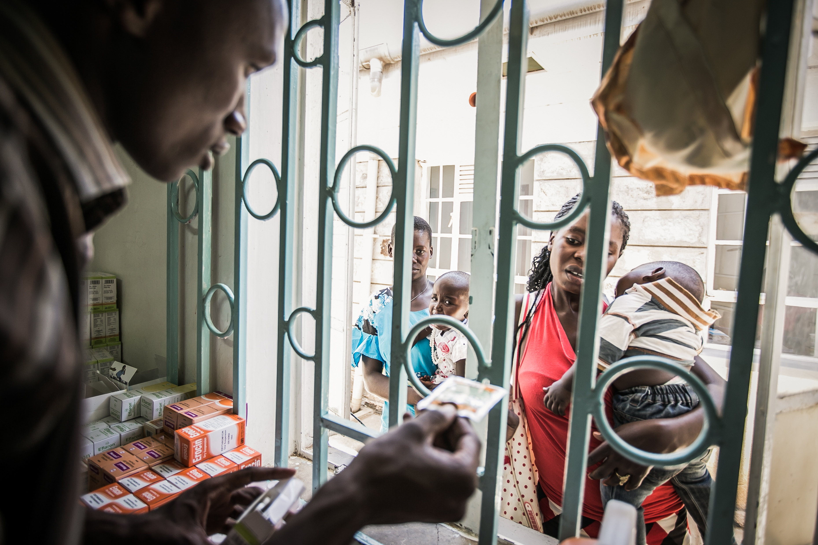
Hospital discharge might be an ideal “targeting” strategy
High-risk of death
Large number of children
Easily identifiable
Leverages existing infrastructure/ program
Missed by existing guidelines/ interventions

Slide 6
Potential mechanisms of post-discharge mortality & morbidity
Admission
Discharge
6 months
Hospitalization
At-home recovery
Untreated infections
Nosocomial infections
Community acquired infections
Acute inflammatory processes
Chronic inflammatory processes and repair

Slide 7
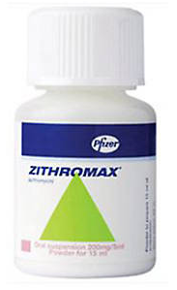
Azithromycin may reduce post-discharge period through multiple pathways
Treatment
Immunomodulatory
Prophylaxis
Gram positive bacteria
Gram negative bacteria
Streptococcus pneumoniae & Staphylococcus aureus
Chlamydia trachomatis, Shigella spp., Haemophilus spp.
Malaria
Labor & Delivery
HIV-infected individuals
Chronic obstructive pulmonary disease
Cystic fibrosis
Malaria
Roca, Clin micro & infect, 2016; Valery Lancet ID, 2013; Solomon, NEJM, 2004; Basauldo, PIDJ, 2003; Gaynor, AJTMH, 2-14
Tita, NEJM, 2016; Oluwalana, Pediatrics, 2017; Hakim, NEJM, 2017
Schogler, Euro Resp J, 2015; Cramer, Postgraduate Medicine, 2017; Southern, Cochrane, 2012; Saiman, JAMA, 2010
Notes:
It’s anti-anflammatory and immunomodulatory effects are evidenced by its use and benefit in a variety of chronic lung conditions such as chronic obstructive pulmonary disease and cystic fibrosis

Slide 8
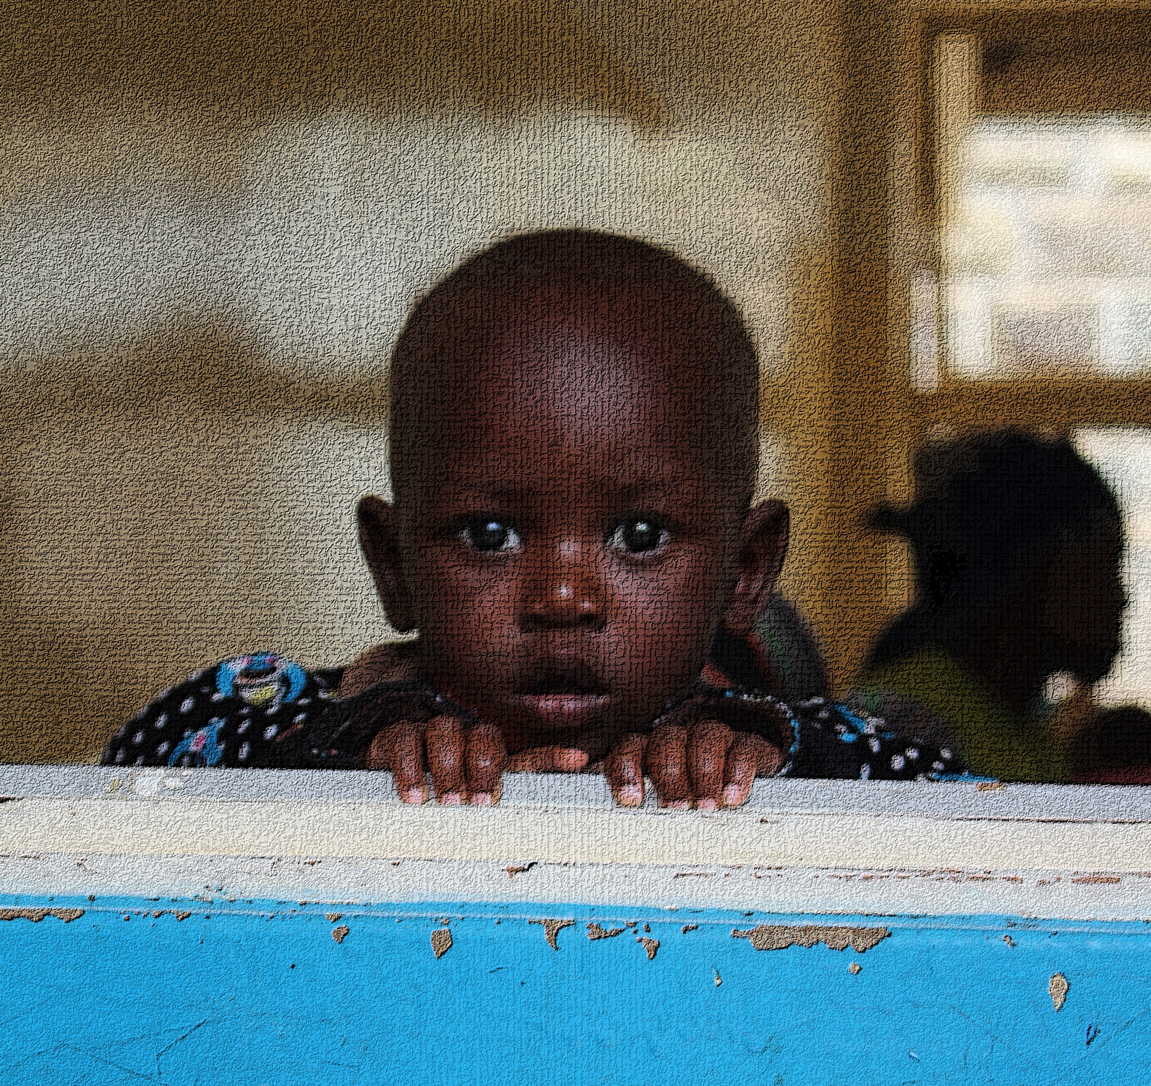
Toto Bora Objective
To determine the benefit and risk of azithromycin use in children age 1 to 59 months discharged from hospital in western Kenya

Slide 9
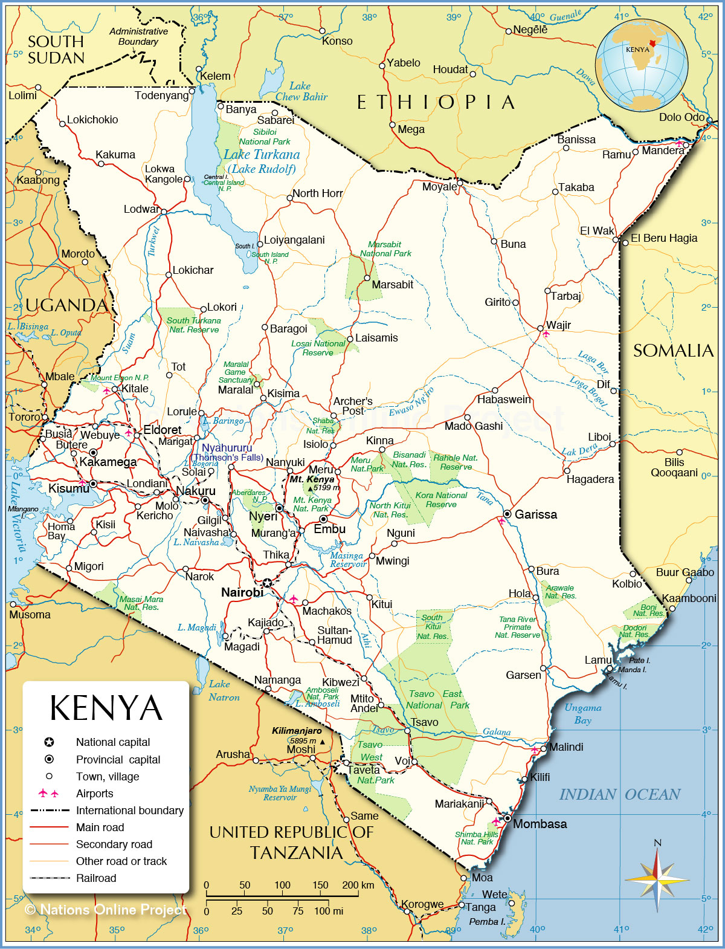
Study details
Design: Double-blind, placebo-controlled, randomized controlled trial
Intervention: 5 day course of oral suspension formulation azithromycin (10 mg/kg on day 1, followed by 5mg/kg/day on days 2-5) or placebo
Outcome: Re-hospitalization or death, linear & ponderal growth, pathogen carriage, antibiotic resistance
Period: June 2016 – September 2019
Population: 1400 children aged 1m-59m recently discharged from hospital (400 caregivers)

Slide 10


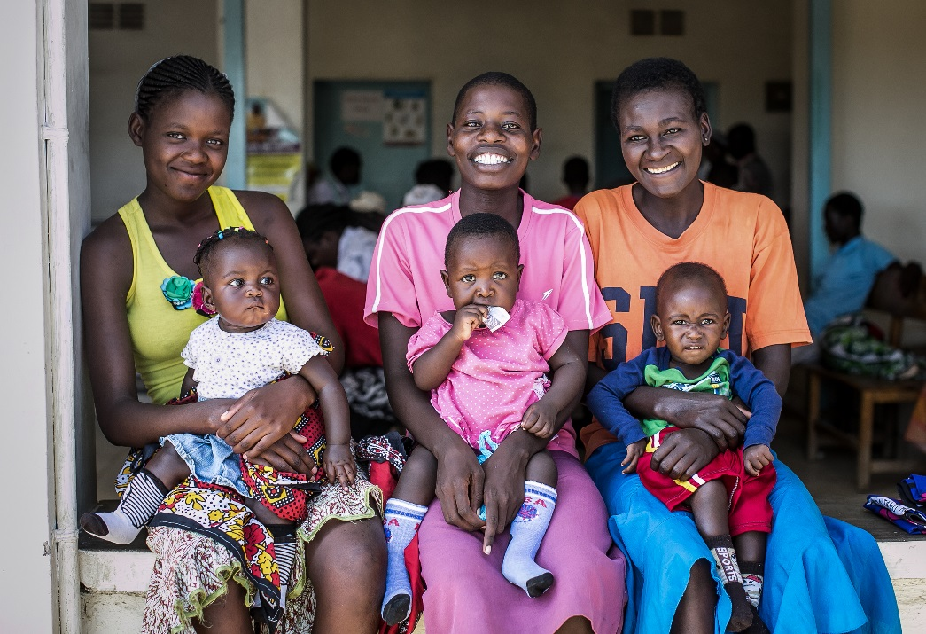

Trial design
Child
N=1400
Caregiver
(n=400)
Hospital Discharge
Randomized
Azithromycin Arm
700 Children
1st dose directly observed
Placebo Arm
700 Children
1st dose directly observed
3-Month Follow Up
Re-hospitalization, Death, Growth
6-Month Follow Up
Re-hospitalization, Death, Growth

Slide 11
Characteristics of enrolled participants (N=991)
Characteristic at Discharge | N or median | % or IQR
Age (months) 1m to 11m 12m to 23m 24m to 59m | 332 290 369 | (34%) (29%) (37%)
Female | 391 | (40%)
HIV infected | 16 | (2%)
HIV-exposed, uninfected | 94 | (10%)
Stunted (< -2 HAZ) | 240 | (24%)
Wasted (< -2 WHZ) | 58 | (6%)
Underweight (< -2 WAZ) | 123 | (12%)

Slide 12
Characteristics of enrolled participants (N=991)
Characteristic at Discharge | N or median | % or IQR
Final clinical diagnosis
Malaria | 273 | (28%)
Pneumonia | 291 | (30%)
Diarrhea | 173 | (18%)
Anemia | 131 | (13%)
Sickle cell | 68 | (7%)
Malnutrition | 57 | (6%)
Other | 254 | (26%)
≥2 Diagnosis | 442 | (45%)
Length of admission | 3 days | (2-5)
Received abx in hospital | 892 | (91%)
Prescribed abx at discharge | 621 | (62%)
Notes:
ABX received in-hospital: Penicillin is about 61% and gentamicin is about 55% followed by ceftriaxone (37%)
ABX prescribed at discharge: Amoxicillin is about 70% of those prescriptions, followed by cefuroxime & penicillin

Slide 13
Previous hospitalizations among enrolled participants (N=991)

Slide 14
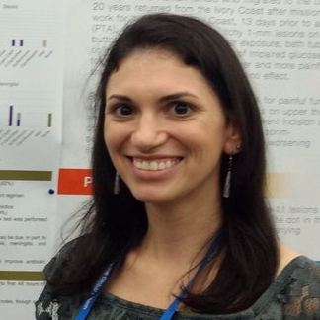
Proportion of E. coli isolates not susceptible to antibiotics at hospital discharge
Stephanie Belanger, MS PhDc

Slide 15

Post-discharge vs. MDA
Treat fewer children (reduce abx pressure)
High event rate
Potential drug interactions with other prescribed ABX
Antibiotic resistance already present
Cost savings
Conditioned on child seeking care
Modeling Targeted vs. MDA approaches
Various underlying mortality rates and efficacies
Cost-effectiveness of MDA vs. targeted
Threshold efficacy, underlying mortality, and effects on morbidity to result in cost-savings
Rebecca Brander, MPH PhDc

Slide 16
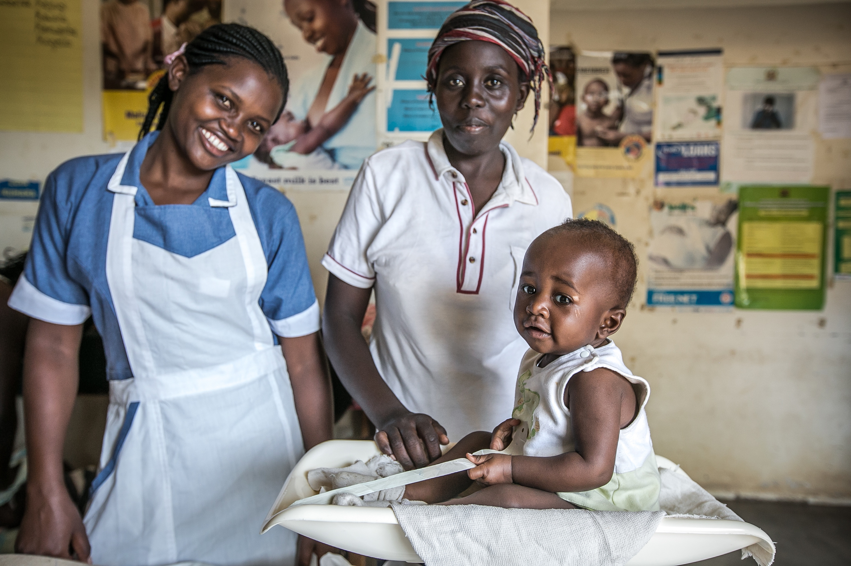
More to come….
March 2020

Slide 17
Acknowledgements
Investigative Team
Implementing Team
Funding
Other Support
Judd Walson (PI)
Benson Singa
Grace John-Stewart
Barbra Richardson
Joseph Babigumira
Ruth Nduati
Samuel Kariuki
Rebecca Brander
Christine McGrath
Kirkby Tickell
Hannah Atlas
Stephanie Belanger
Mary Amondi
Doreen Rwigi
Liru Meshack
George Bogonko
Michael Mugo
Lynnete Kitheka
Kevin Kariuki
Elizabeth Mutuku
Kisii Site Staff
Homa Bay Staff
National Institutes of Health Eunice Kennedy Shriver National Institute of Child Health & Human Development (R01 HD079695)
Kenya Medical Research Institute
Childhood Acute Illness Network
Kenya Research & Training Center
Global WACh
KEMRI CDC
Richard Omore
Alex Awuor
Caleb Okonji
KEMRI/Wellcome
Jay Berkley
Anthony Scott
Joseph Waichungo
Angela Karani
Donald Akech
Horace Gumba
Donations
Drug donation by Pfizer IIR #WI201906
Flocked rectal swabs & Cary-Blair media donated by Copan Diagnostics Inc.

Slide 18
Additional slides

Slide 19
Antibiotic prescription at discharge
Of 991 enrolled children, 621 (61.7%) were prescribed an antibiotic at discharge
Antibiotic | N | % of 621 prescribed
Amoxicillin | 430 | (69.2%)
Cefuroxime | 59 | (9.5%)
Penicillin | 54 | (8.7%)
Augmentin/Co-amoxiclav | 50 | (8.1%)
Other* | 35 | (5.6%)
Includes metronidazole(n=1), ciprofloxacin (n=7), cotrimoxazole (n=12), ampicillin (n=4), chloramphenicol (n=4), phenoxymethylpenicillin (n=2), cefixime (n=2), ceftriaxone (n=1), gentamicin (n=2))
**Note: 27 children received prescriptions for 2 antibiotics

Slide 20
Antibiotic use during hospitalization
Of 986 enrolled children with medical records available for abstraction, 892 (90.5%) received an antibiotic during hospitalization per medical records
Antibiotic | N | % of 892
Penicillin | 601 | 60.9%
Gentamicin | 540 | 54.8%
Ceftriaxone | 361 | 36.6%
Metronidazole | 45 | 4.6%
Amoxicillin | 27 | 2.7%
Clarithromycin | 19 | 1.9%
Other* | 89 | 9.0%
*Includes cotrimoxazole (n=17), ciprofloxacin (n=8), tetracycline (n=5), amikacin (n=3), flucloxacillin (n=2), azithromycin (n=16), ampicillin (n=2), cefuroxime (n=10), erythromycin (n=7)
**Note: 256 children (25.8%) received only one antibiotic, 459 (46.3%) received two, 161 (18.0%) received three or more
Notes:
5 enrolled children did not have medical records for abstraction

Slide 21
Number of co-morbidities
Number of final diagnoses | N(%)
≥2 diagnoses | 38.1%
2 | 33.0%
3 | 4.4%
4 | 0.6%

Slide 22
Most common diagnoses of co-morbidities
Final diagnosis (per medical record) | N(%)
Malaria and anemia | 37 (28.7%)
Malaria and gastroenteritis/diarrhea | 14 (10.9%)
Anemia and sickle cell | 11 (8.5%)
Pneumonia and gastroenteritis/diarrhea | 9 (7.0%)
Malaria and pneumonia | 9 (7.0%)
Anemia and pneumonia | 7 (5.45)
Of the 96 diagnosed with malaria, 67 (69.7%) tested positive for malaria (58 were smear positive, and 9 were rdt positive) and 7 (7.3%)were not tested

