Slide 1

Modeling a Partially Effective HIV Vaccine in South Africa: Viral Adaptation, Risk Compensation, and Cost-effectiveness
Kathryn Peebles, MPH
Institute for Disease Modeling Symposium
April 16, 2018
Notes:
Good morning, everyone. Anna, thank you for that introduction. Today, I’ll be talking about modeling a partially effective HIV vaccine in South Africa.

Slide 2
The RV144 trial
Phase 3 HIV vaccine trial
  31% efficacy at 3.5 years
Rerks-Ngarm, 2009; Hankins, 2011
Notes:
To date, there has been one vaccine trial that has shown a modest protective effect in preventing HIV infections. The RV144 trial was conducted in Thailand from 2003-2006, and showed a 31% reduction in risk of HIV acquisition over 3.5 years of follow-up.

Slide 3
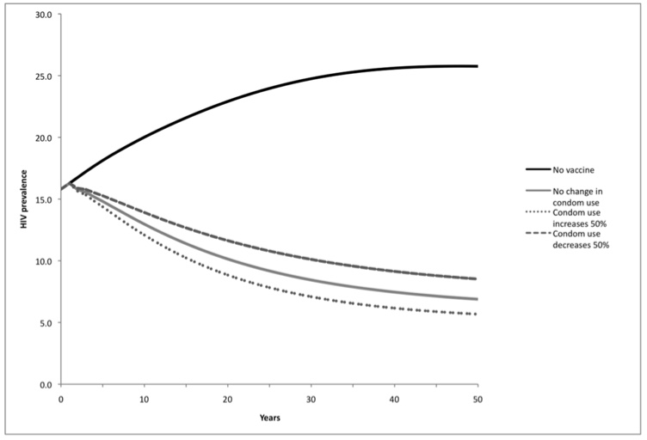
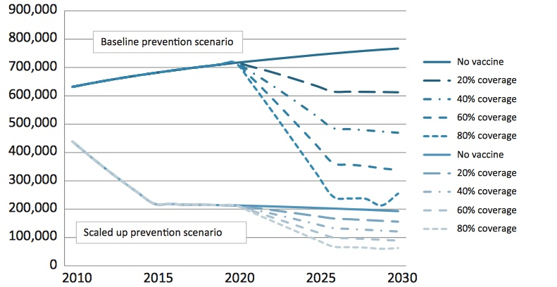
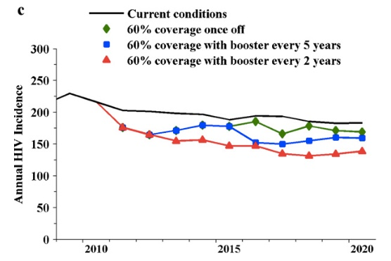
Model-based predictions of an RV144-like vaccine
Andersson, et al., 2011
Andersson & Stover, 2011
Gray, et al., 2011
Notes:
Multiple models of a vaccine with characteristics similar to the RV144 vaccine have shown that

Slide 4
Model-based predictions of an RV144-like vaccine
Andersson, et al., 2011
Andersson & Stover, 2011
Gray, et al., 2011
Notes:
relative to a null scenario in which there is no vaccine,

Slide 5
Model-based predictions of an RV144-like vaccine
Andersson, et al., 2011
Andersson & Stover, 2011
Gray, et al., 2011
Notes:
introduction of an RV144-like vaccine with 60% continuous coverage may reduce incidence of new HIV infections by up to 50%.
Andersson, et al., 2011: 60% coverage. Soweto, South Africa.
Andersson & Stover, 2011: 60% coverage. New adult infections in South Africa.
Gray: 60% coverage with booster every 2 years. MSM in New South Wales.

Slide 6
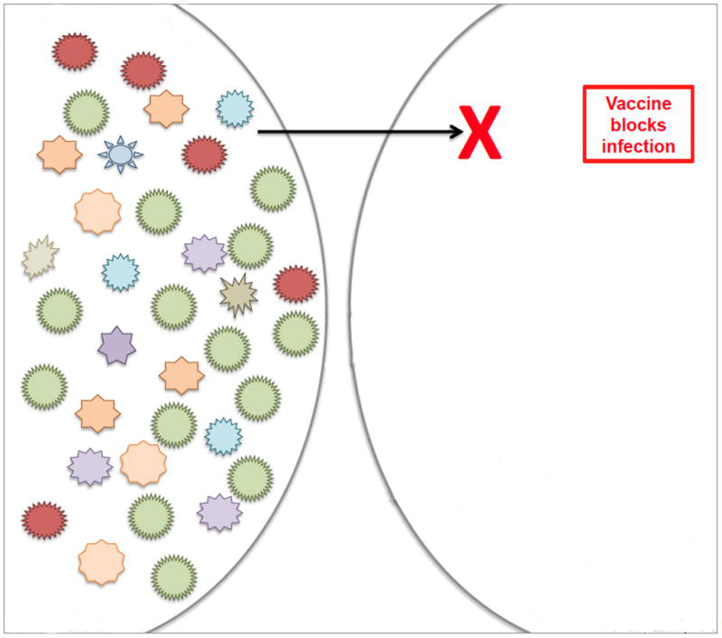
Sieve analysis in the RV144 trial
Vaccine blocks all viral variants
Transmitting partner
Vaccinated, HIV-susceptible partner
Edlefsen, 2013
Notes:
These models modeled a scenario similar to the one shown at the top of this figure, where the vaccine blocks all viral variants with equal probability.

Slide 7
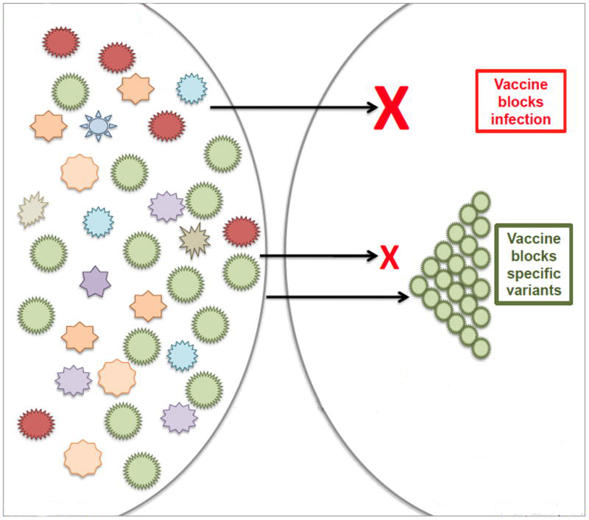
Sieve analysis in the RV144 trial
Vaccine blocks all viral variants
Vaccine blocks specific viral variants
Transmitting partner
Vaccinated, HIV-susceptible partner
Edlefsen, 2013; Rolland, 2012
Notes:
However, sieve analyses of the RV144 trial showed that the vaccine had 50-80% efficacy against specific viral variants, while not having a statistically significant effect in preventing infection with other viral variants, like those shown in green here. This suggests that the partial vaccine efficacy of 31% observed in RV144 may be partly explained by standing viral diversity.

Slide 8
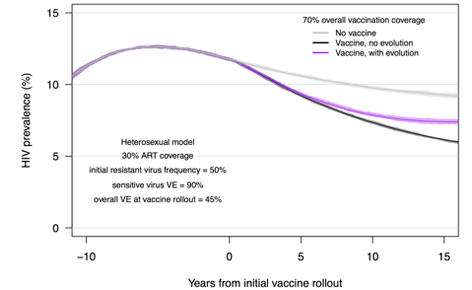
Model-based predictions of an RV144-like vaccine
Herbeck, et al., 2018
Andersson, et al., 2011
Andersson & Stover, 2011
Gray, et al., 2011
Notes:
In previous work led by Josh Herbeck at the University of Washington, our group modeled such sieve-like effects at the population level, hypothesizing that differential efficacy against viral strains would result in viral adaptation upon implementation of an RV144-like vaccine in the general population.

Slide 9
Model-based predictions of an RV144-like vaccine
Herbeck, et al., 2018
Andersson, et al., 2011
Andersson & Stover, 2011
Gray, et al., 2011
Notes:
We show here that a vaccine effective against all viral strains, as in previous models, may reduce prevalence in the South African population over 15 years of continuous coverage to about 6%,

Slide 10
Model-based predictions of an RV144-like vaccine
Herbeck, et al., 2018
Andersson, et al., 2011
Andersson & Stover, 2011
Gray, et al., 2011
Notes:
while viral adaptation in response to vaccine pressure, shown in purple, may reduce prevalence to about 7.5%, a 50% smaller reduction relative to the null scenario of no vaccine.
In the work that I’ll focus on today, we’ll build on our previous results to assess the effect of risk compensation on rates of viral adaptation, and the effect of both viral adaptation and risk compensation on the potential cost-effectiveness of an HIV vaccine in South Africa.

Slide 11
Methods
Mathematical model
EvoNet modeling package
  https://github.com/EvoNetHIV/EvoNetHIV/tree/vaccine_rc_cea
Agent-based stochastic network model of HIV transmission in South Africa
  30,000 agents
  64 simulations per model scenario
Notes:
We used the EvoNet modeling package to construct an agent-based, stochastic network model of HIV transmission. The model reproduces sexual network characteristics collected in surveillance data in South Africa, as well as changes in behavior over time, including condom use and male circumcision.

Slide 12
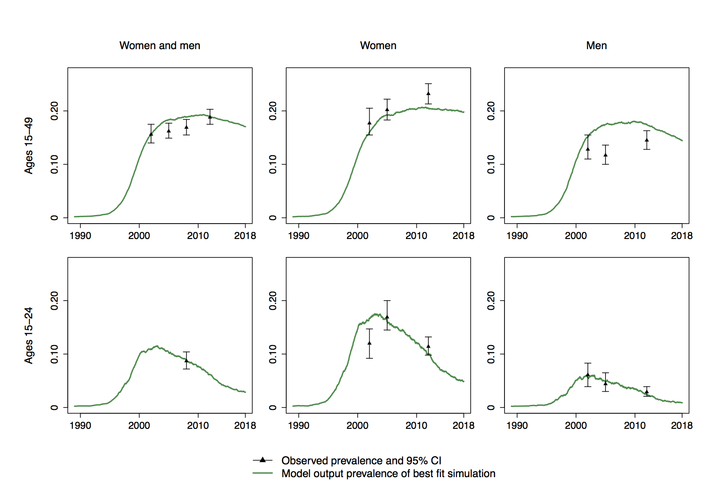
Methods
Model calibration
South African National HIV Prevalence, Incidence and Behavior Survey, 2002-2012
Notes:
We calibrated the model to observed age- and sex-specific prevalence reported in nationally representative surveys in 2002 to 2012 in an approximate Bayesian computation model selection procedure. Using parameters selected in this process, we then selected from among 500 simulations the simulation that best fit observed prevalence data, resulting in a reasonable model fit to data, shown here. On the top row is the population ages 15-49, with ages 15-24 in the bottom row. The first column shows the total population, followed by only women in the middle column and only men in the third column. We use this single simulation for the first 28 years of each modeling scenario, representing the years 1990-2018.

Slide 13
Methods
Modeling scenarios
Vaccine similar to hypothesized characteristics of HVTN 702 vaccine
  Efficacy duration of 5 years
  Waning efficacy over 5 years, with re-vaccination at 5 years
  Population coverage over 3 years
  60 USD per vaccine series
Two viral strains: vaccine-sensitive and vaccine-resistant
ClinicalTrials.gov Identifier NCT02968849
Notes:
The vaccine in our model is based on the hypothesized characteristics of the vaccine currently being tested in the HVTN 702 trial in South Africa, and includes waning efficacy over five years of efficacy duration, after which individuals remaining HIV-negative are re-vaccinated. Vaccination begins in year 2018 in the model, and user-specified vaccine coverage in the susceptible population is achieved gradually over three years from first rollout of the vaccine. We assumed a cost of $60 per vaccine series.
We represent viral diversity with two strains, one which is sensitive to the vaccine, and another that is resistant to the vaccine effect. We assumed equal transmission fitness in both strains.

Slide 14
Methods
Modeling scenarios
Risk compensation
  30% reduction in probability of condom use
Crepaz, 2004; Sullivan, 2017; Nguyen, 2018; Lal, 2017
Notes:
Evidence from both self-reported data and STI incidence rates among men who have sex with men in high-income countries suggests that individuals may engage in risk compensation in response to perceived protection from a newly introduced HIV prevention modality. We therefore model potential risk compensation in response to perceived protection from vaccination as a 30% reduction in the probability of condom use among vaccinated individuals.

Slide 15
Methods
Modeling scenarios
Sensitive virus proportion | VE against sensitive virus
1.000 | 0.50
0.833 | 0.60
0.714 | 0.70
0.625 | 0.80
Notes:
HVTN 702 is powered to detect a 50% relative reduction in risk following two years since receipt of the first dose in the vaccine series. We therefore modeled four scenarios where the weighted vaccine efficacy would be 50%, where the weights are the relative proportions of vaccine-sensitive and vaccine-resistant viral strains.

Slide 16
Methods
Modeling scenarios
Sensitive virus proportion | VE against sensitive virus
1.000 | 0.50
0.833 | 0.60
0.714 | 0.70
0.625 | 0.80
Notes:
For example, with 62.5% sensitive virus and vaccine efficacy against sensitive virus of 80%, overall vaccine efficacy would be 50%.

Slide 17
Methods
Modeling scenarios
Sensitive virus proportion | VE against sensitive virus
1.000 | 0.50
0.833 | 0.60
0.714 | 0.70
0.625 | 0.80
Vaccine coverage
50%
70%
90%
x
Notes:
We further assess three coverage levels, 50%, 70%, and 90%,

Slide 18
Methods
Modeling scenarios
Sensitive virus proportion | VE against sensitive virus
1.000 | 0.50
0.833 | 0.60
0.714 | 0.70
0.625 | 0.80
Risk compensation
None
30% reduction in probability of condom use
Vaccine coverage
50%
70%
90%
x
x
Notes:
and within each combination of sensitive virus, vaccine efficacy, and coverage, we consider a scenario in which vaccinated individuals engage in risk compensation such that they have a 30% reduced probability of condom use.

Slide 19
Methods
Modeling scenarios
Sensitive virus proportion | VE against sensitive virus
1.000 | 0.50
0.833 | 0.60
0.714 | 0.70
0.625 | 0.80
Risk compensation
None
30% reduction in probability of condom use
Vaccine coverage
50%
70%
90%
x
x
Notes:
In the following slides, I’ll focus first on results from a model in which 83.3% of virus is vaccine-sensitive, the vaccine has 60% efficacy against vaccine-sensitive viral strains, and population vaccine coverage is 70%. I’ll then make comparisons across additional modeling scenarios.

Slide 20
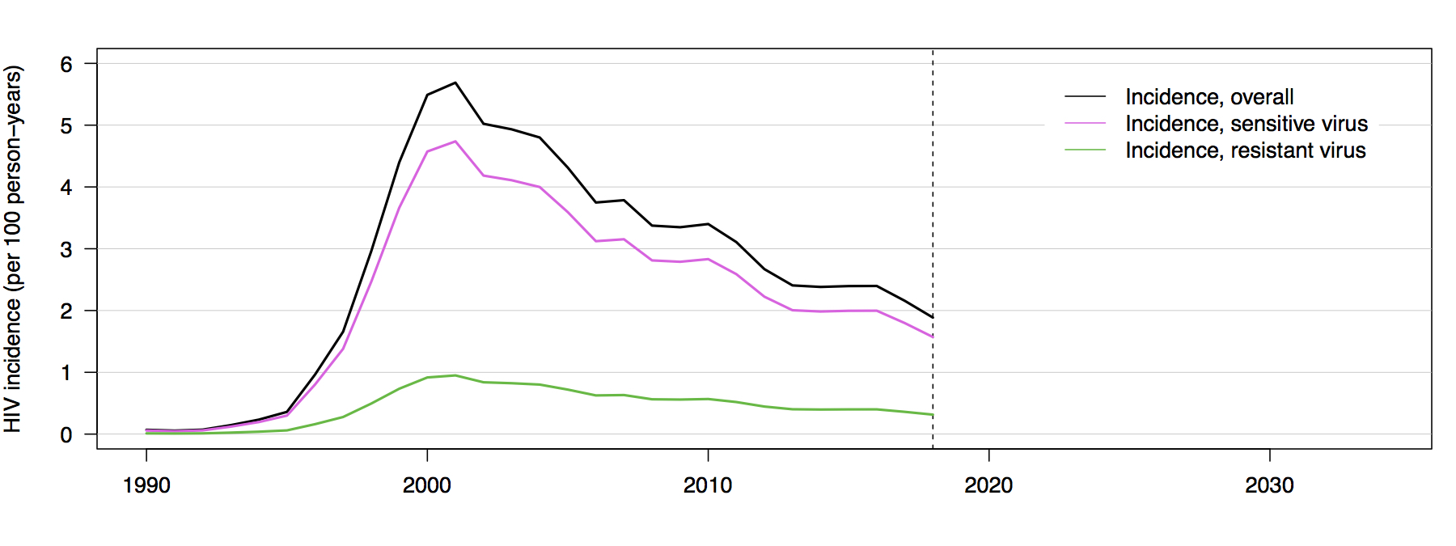
Results
HIV incidence and resistant virus frequency
Notes:
Here, we show incidence up to the year of vaccine rollout in 2018, where overall incidence is shown in black, incidence of vaccine-sensitive viral infections is in pink, and incidence of vaccine-resistant viral infections is in green. In the absence of any fitness advantage, the ratio of vaccine-sensitive to vaccine-resistant incidence remains stable,

Slide 21
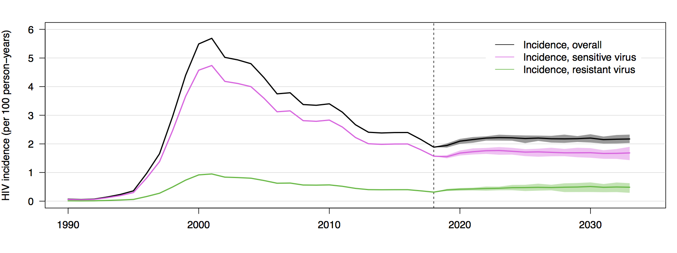
Results
HIV incidence and resistant virus frequency
Notes:
, a pattern that is consistent when projecting forward in the absence of a vaccine.

Slide 22
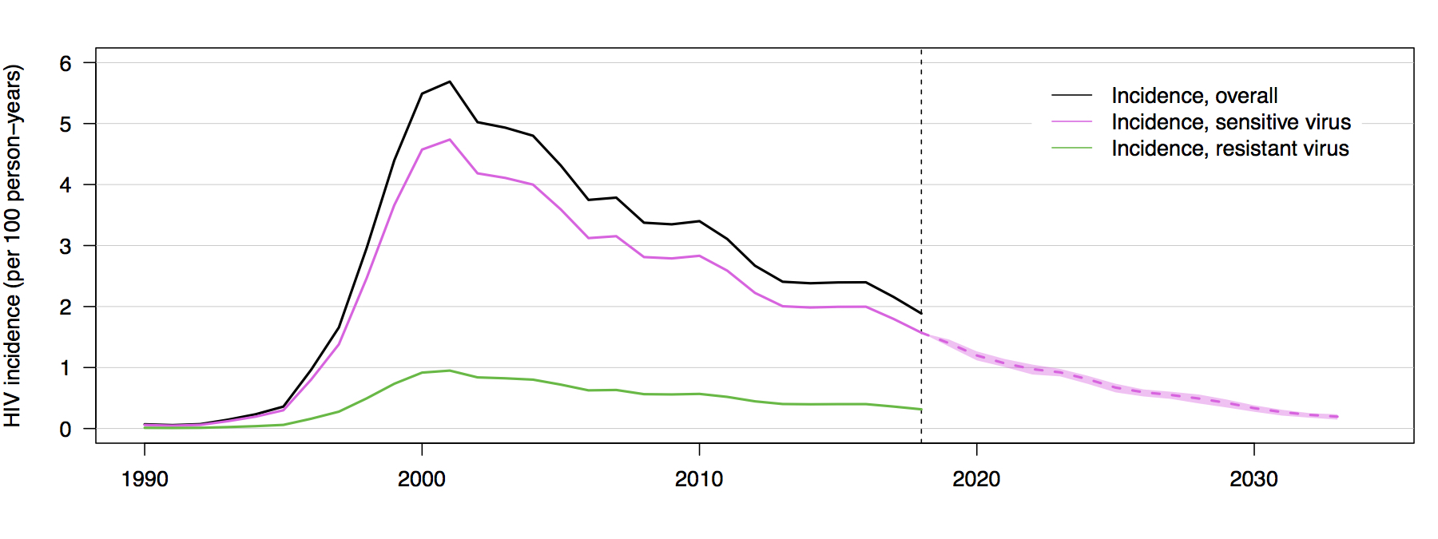
Results
HIV incidence and resistant virus frequency
Notes:
However, following vaccine rollout in 2018, we see that incidence of infections with vaccine-sensitive viral strains in pink declines rapidly,

Slide 23
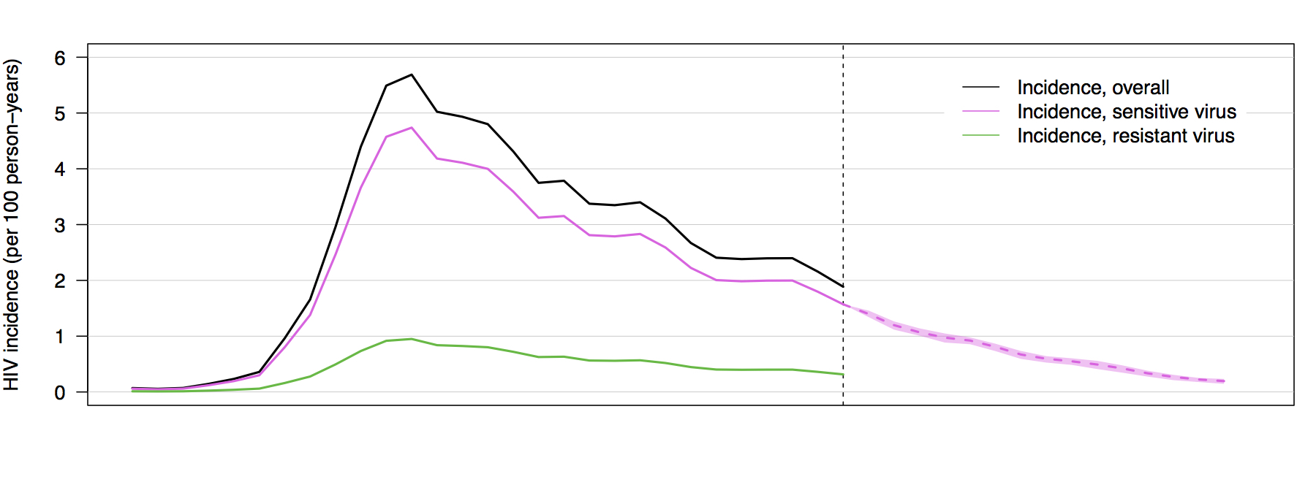
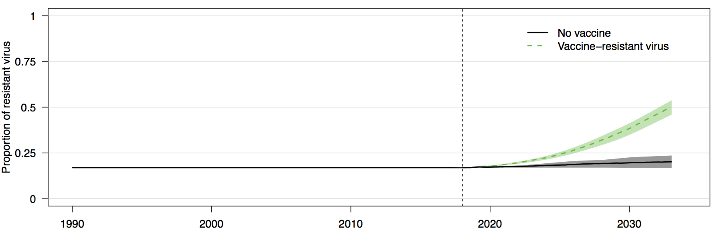
Results
HIV incidence and resistant virus frequency
Notes:
allowing the proportion of resistant virus in the population, shown in the bottom panel in green, to increase from 17% at vaccine rollout to over 50% within 15 years following rollout,

Slide 24
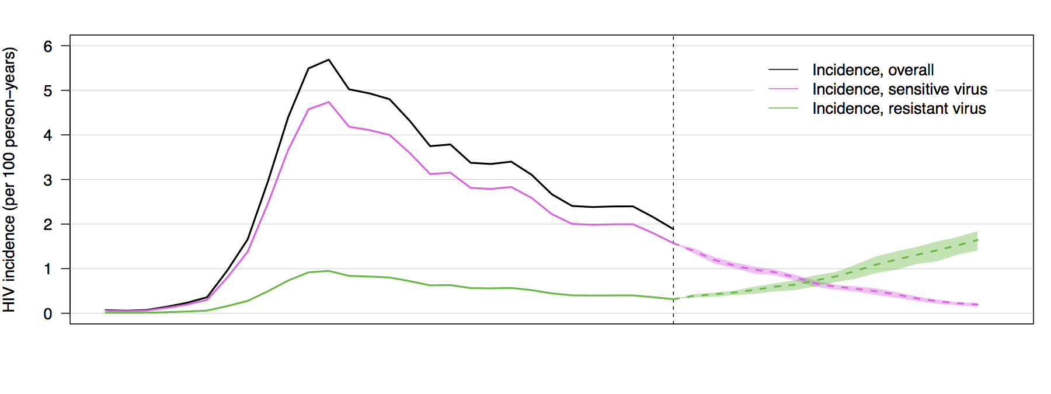
Results
HIV incidence and resistant virus frequency
Notes:
, with a concomitant increase in incidence of vaccine-resistant viral strains in the top panel in green.

Slide 25
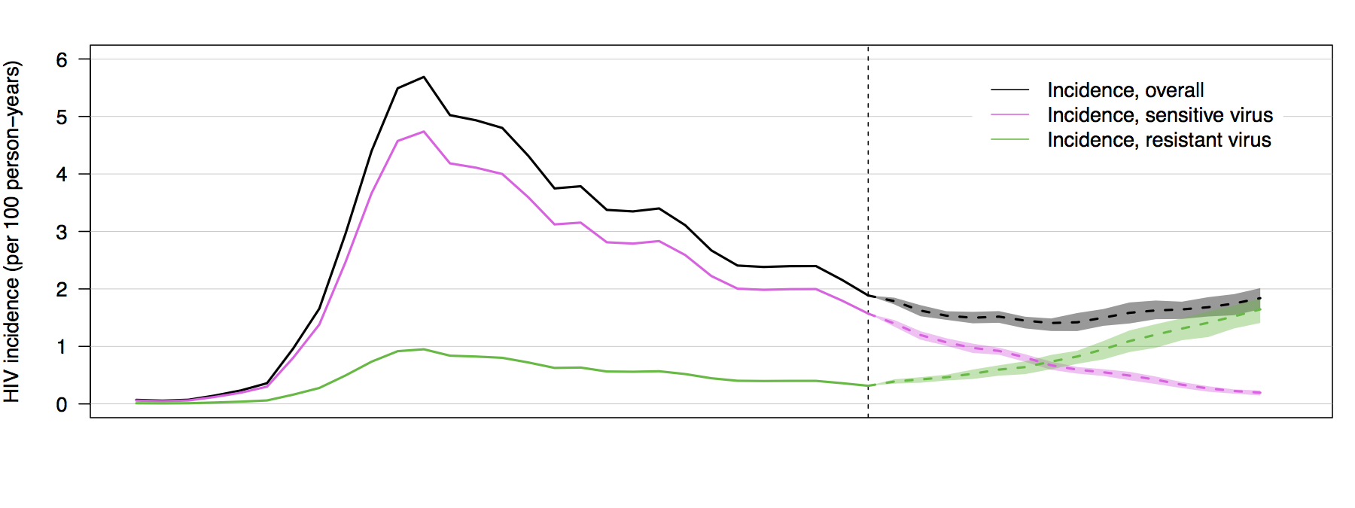
Results
HIV incidence and resistant virus frequency
Notes:
Overall incidence in black declines by about half a percent over 7 years, before slowly increasing again due to the higher incidence of vaccine-resistant infections.

Slide 26
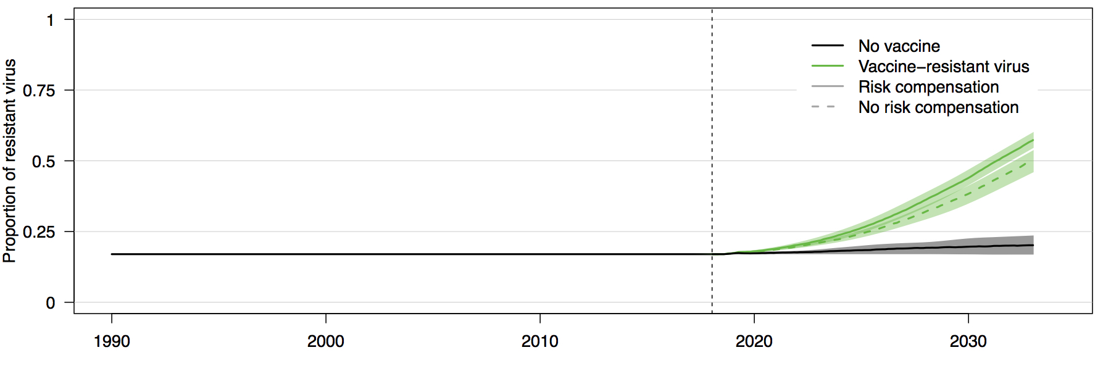
Results
HIV incidence and resistant virus frequency
Notes:
When we consider the effect of risk compensation on viral adaptation, in the bottom panel, we see that the rate of increase in the proportion of vaccine-resistant viral strains is somewhat higher, comparing the solid green line in which there is risk compensation to the dashed green line in which there is no risk compensation.

Slide 27
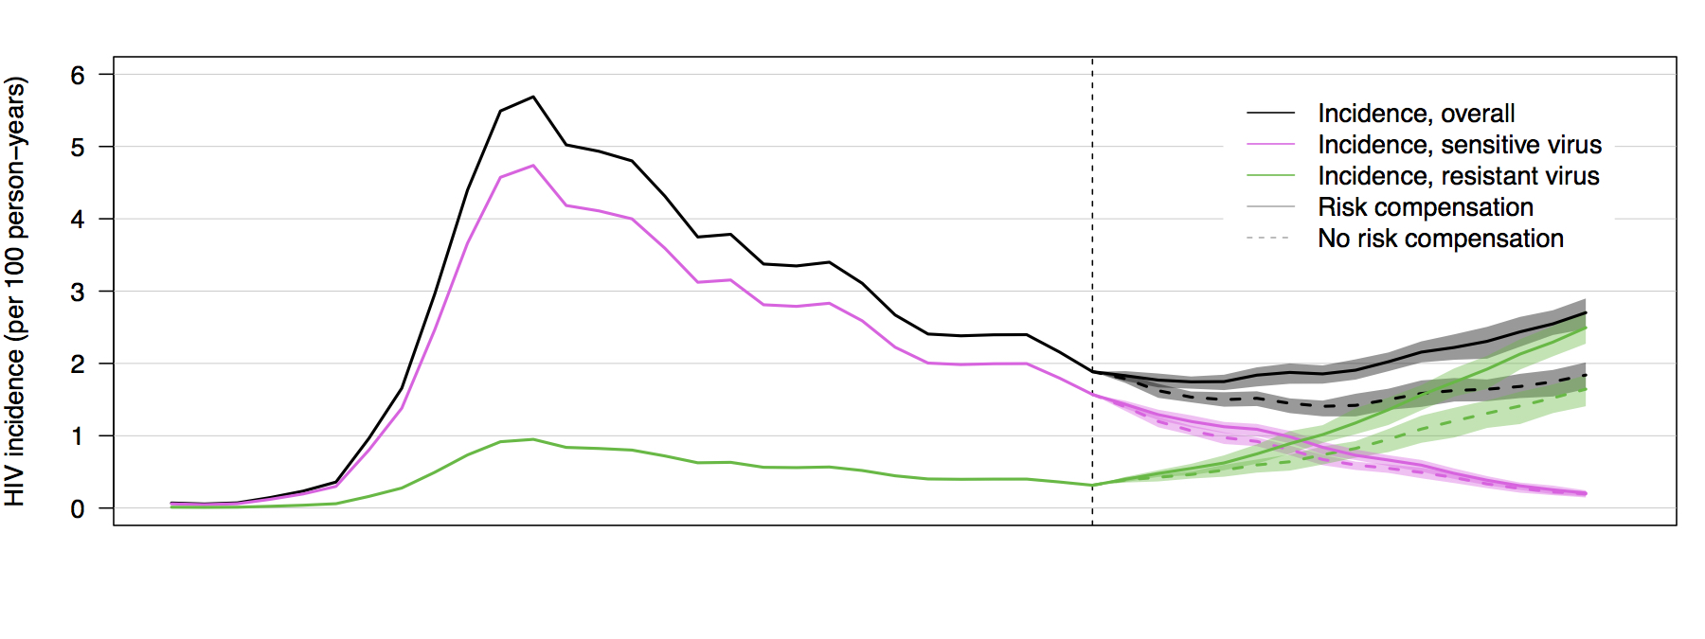
Results
HIV incidence and resistant virus frequency
Notes:
With respect to incidence, we can see in the top panel that incidence of resistant strains is about 1% percent higher if there is risk compensation, again in the solid green line, than if there is no risk compensation, in the dashed green line. The combined effect of risk compensation and viral adaptation on overall incidence in the solid black line results in HIV incidence under the vaccine scenario that is greater than incidence at rollout within about 10 years.

Slide 28
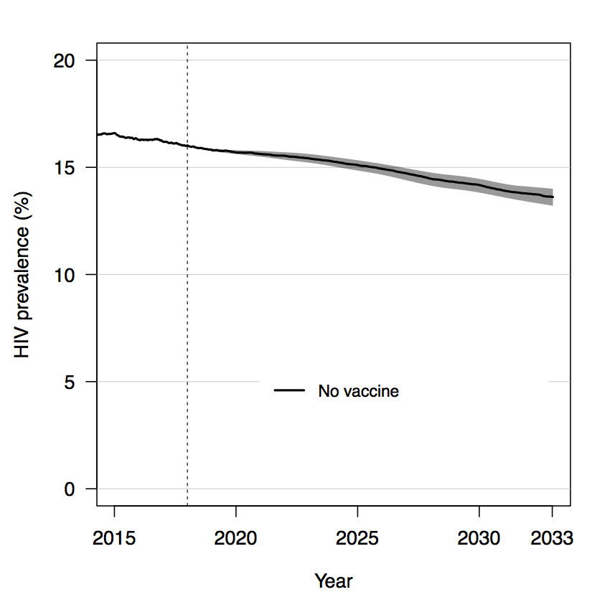
Results
HIV prevalence
Notes:
We see a similar pattern in HIV prevalence. The black line here shows prevalence under the null of no vaccine.

Slide 29
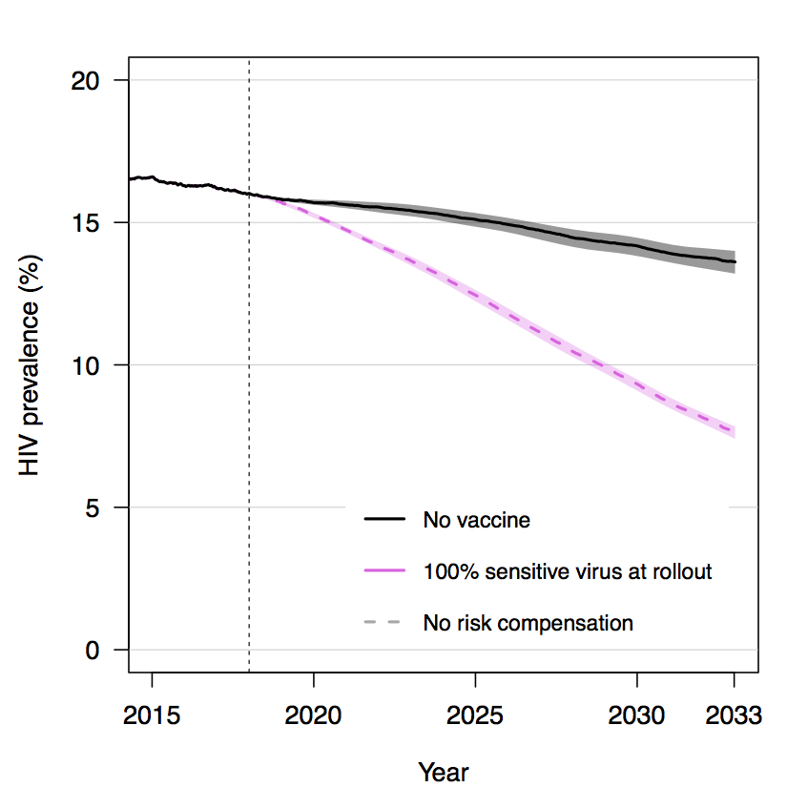
Results
HIV prevalence
Notes:
Assuming 100% sensitive virus as in previous models of an RV144-like HIV vaccine, we see a monotonic decline in prevalence in response to an HIV vaccine in the dashed pink line,

Slide 30
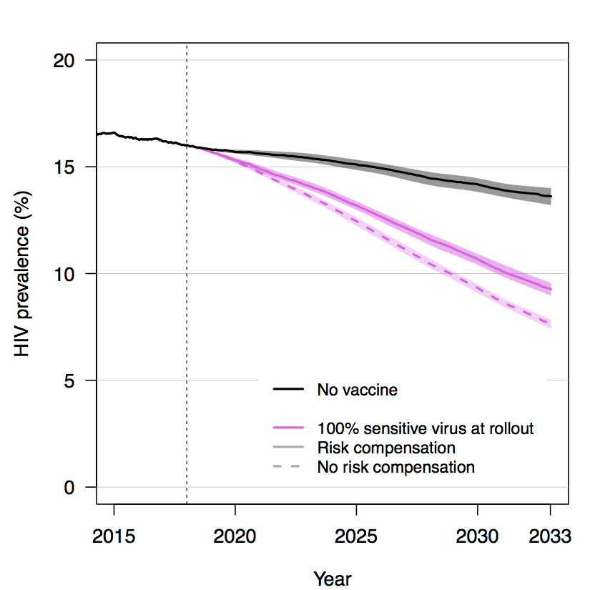
Results
HIV prevalence
Notes:
while risk compensation, in the solid pink line, results in a smaller decline in prevalence.

Slide 31
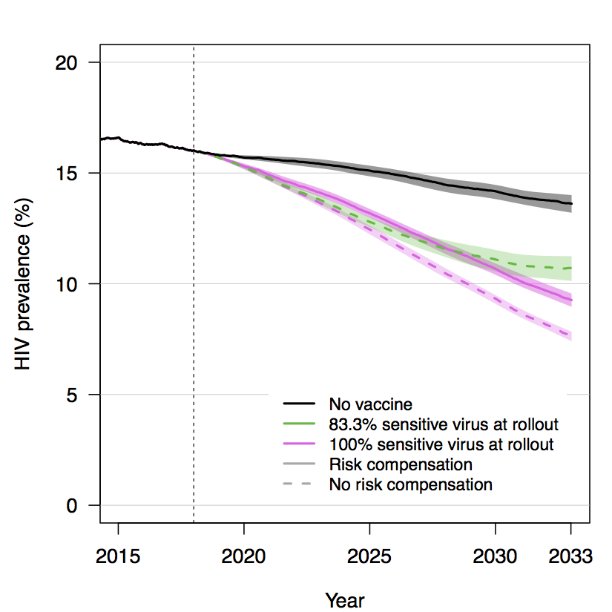
Results
HIV prevalence
Notes:
However, in a scenario in which there is viral diversity at vaccine rollout, but no risk compensation, in the dashed green line, there is an initial decline in prevalence, but gains plateau as the vaccine effectiveness against the changing viral population declines.

Slide 32
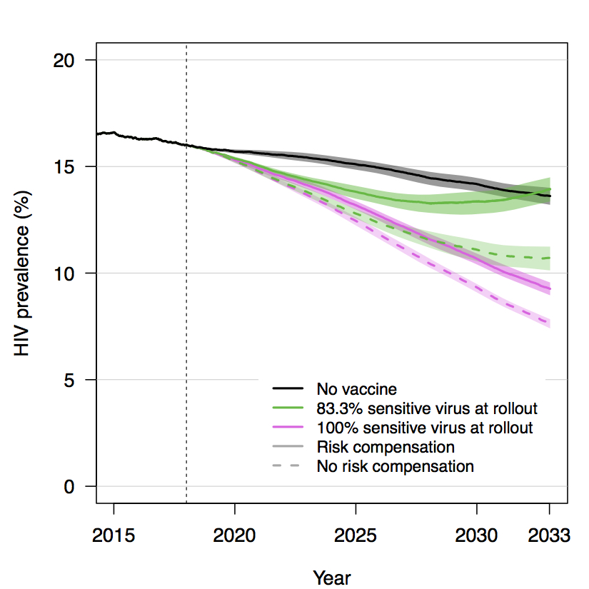
Results
HIV prevalence
Notes:
We see the combined effect of viral adaptation and risk compensation in the solid green line, where an initial decline in prevalence is reversed in later years, resulting in prevalence that matches or exceeds prevalence in the absence of a vaccine.

Slide 33
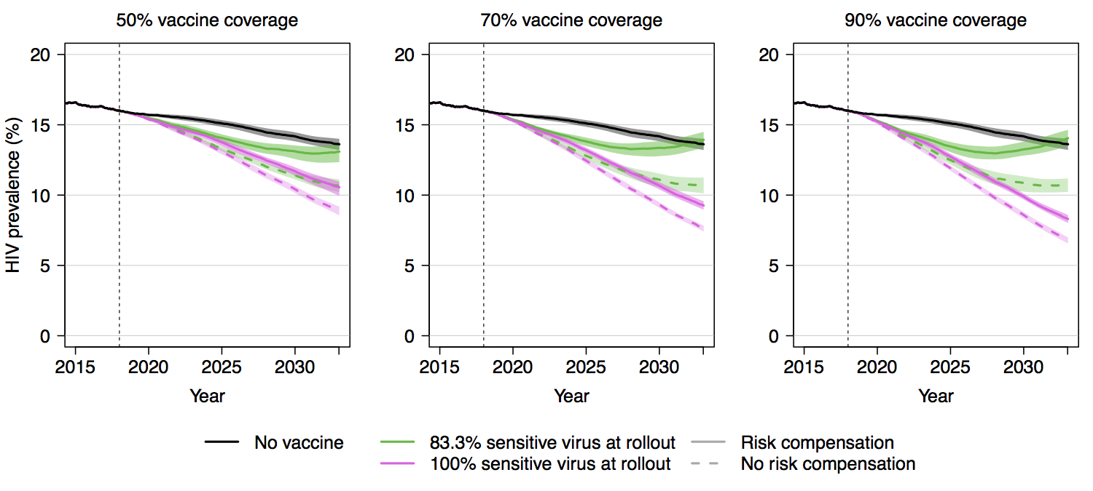
Results
HIV prevalence
Notes:
The previous figure showed a scenario in which there was 70% population coverage of vaccination, shown in the middle figure here. We see a similar trend across coverage levels of 50% and 90% as well, with stronger effects predicted by higher coverage.

Slide 34
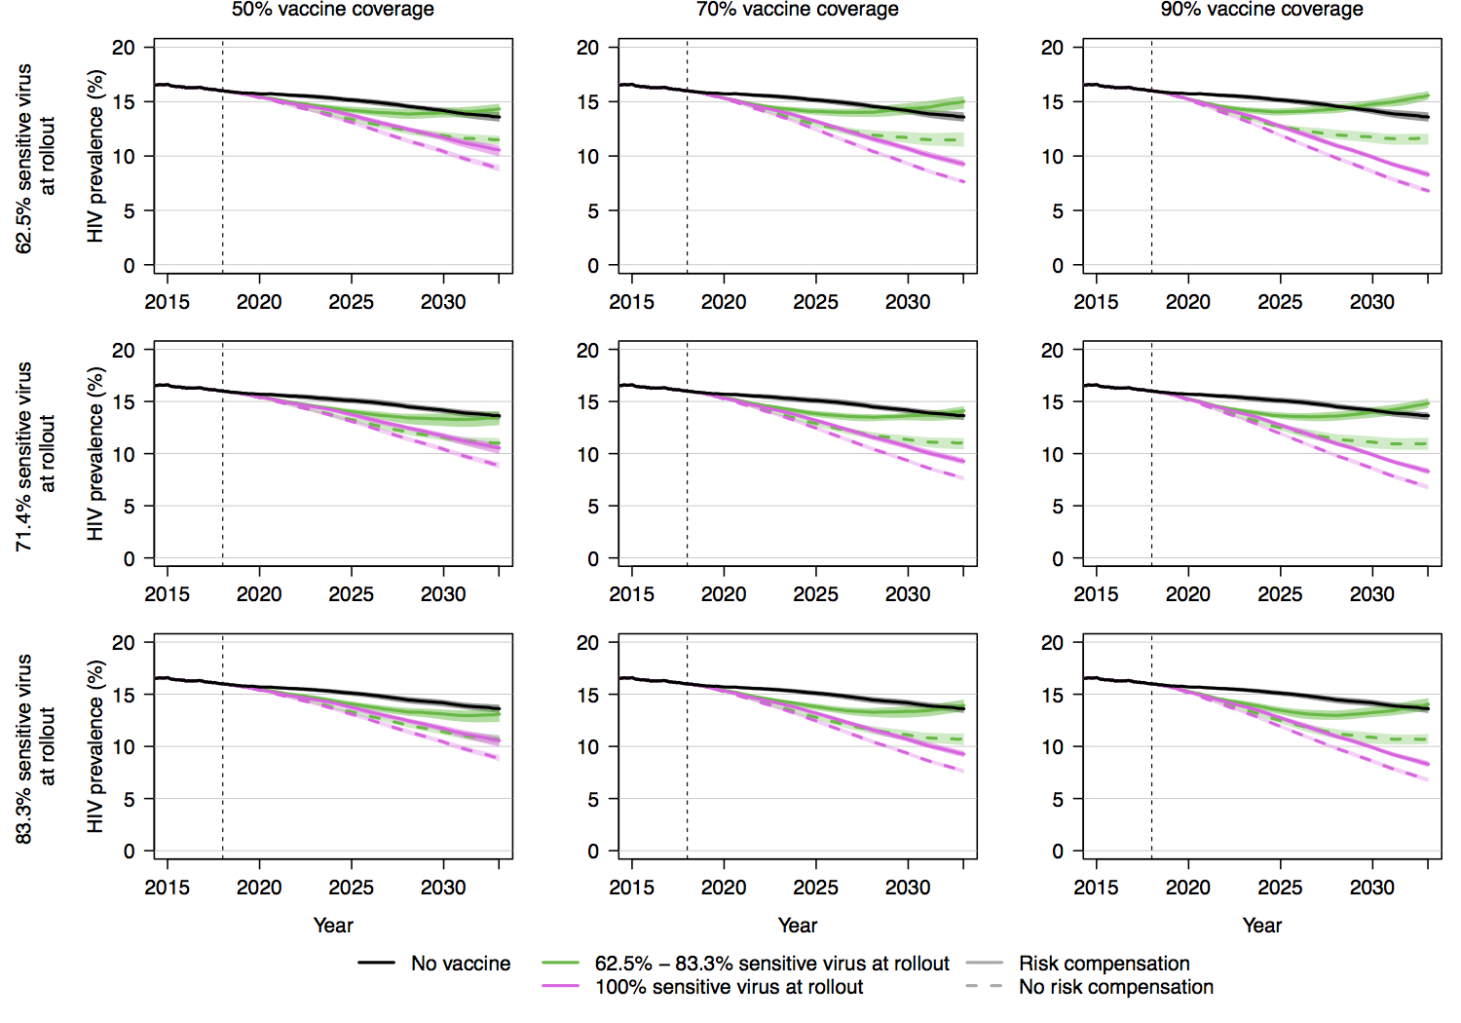
Notes:
The prior slide compared three coverage levels, all with 83.3% sensitive virus at rollout. We also modeled scenarios in which the proportion of sensitive virus is lower,

Slide 35
Notes:
with 71.4% sensitive virus at rollout in the middle row,

Slide 36
Notes:
and 62.5% sensitive virus at rollout in the top row, each with weighted efficacy of 50% at rollout. Comparing across rows, we see that the general pattern is consistent, but that the combined effects of viral adaptation and risk compensation result in smaller vaccine impact when there is a smaller proportion of sensitive virus at rollout.

Slide 37
Notes:
We can highlight this by focusing on the left-hand column, where coverage is 50%. We see that when 83.3% of virus is sensitive at rollout, as in the bottom figure,

Slide 38
Notes:
vaccine impact on prevalence is close to null after 15 years of implementation if there is both viral adaptation and risk compensation,

Slide 39
Notes:
while in the top figure, where 62.5% of virus is sensitive at rollout, prevalence is higher with vaccination than without under otherwise equal conditions.

Slide 40
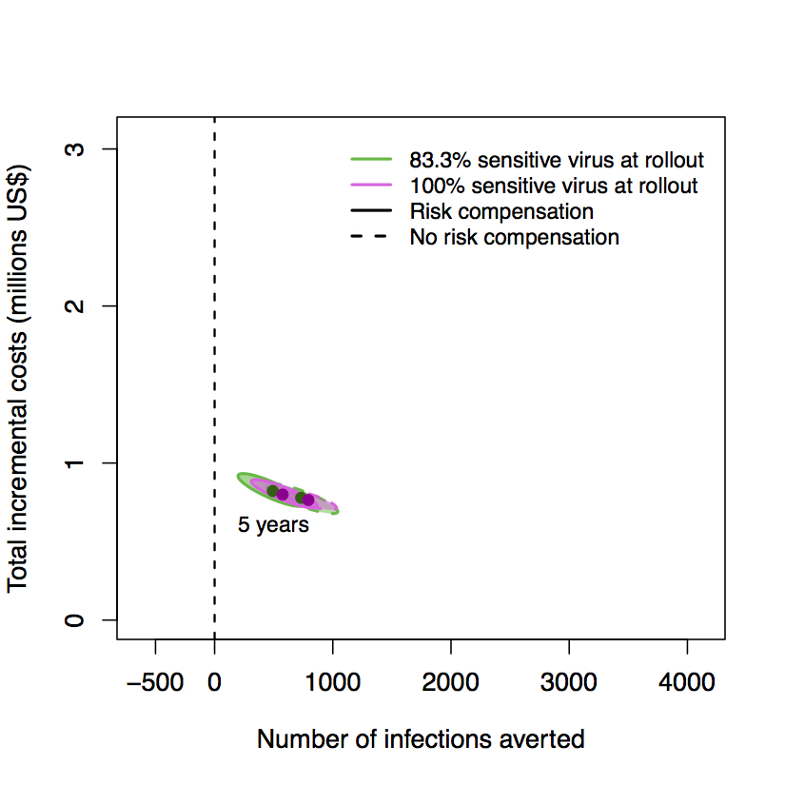
Results
Cost-effectiveness: 5-year time horizon
Notes:
The impact of viral adaptation and risk compensation on cost-effectiveness is not readily apparent when taking a short-term time horizon of 5 years. This plot shows the number of infections averted on the x-axis against the total incremental costs of the vaccine program on the y-axis, comparing scenarios of 100% and 83.3% sensitive virus at rollout, and risk compensation vs. no risk compensation. We can see that at five years, point estimates of infections averted and incremental costs are similar across scenarios, and ellipses of the 90% credible interval of simulations closely overlap one another.

Slide 41
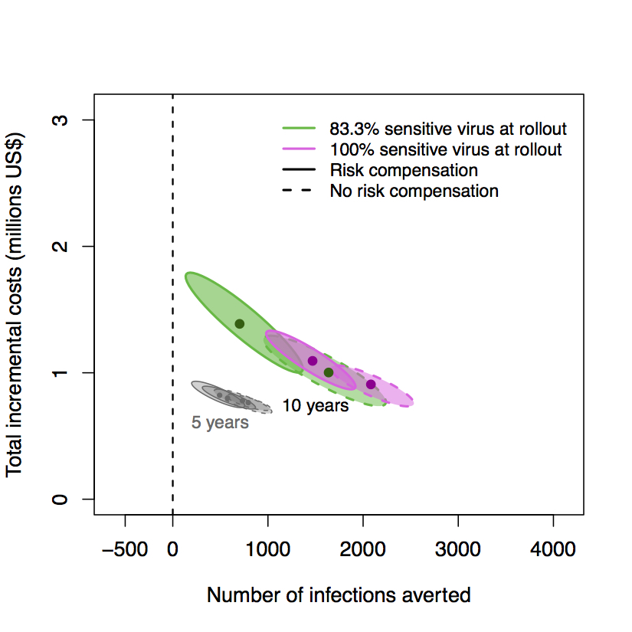
Results
Cost-effectiveness: 10-year time horizon
Notes:
Using a 10-year time horizon, we begin to see divergence in the relative costs and infections averted across scenarios,

Slide 42
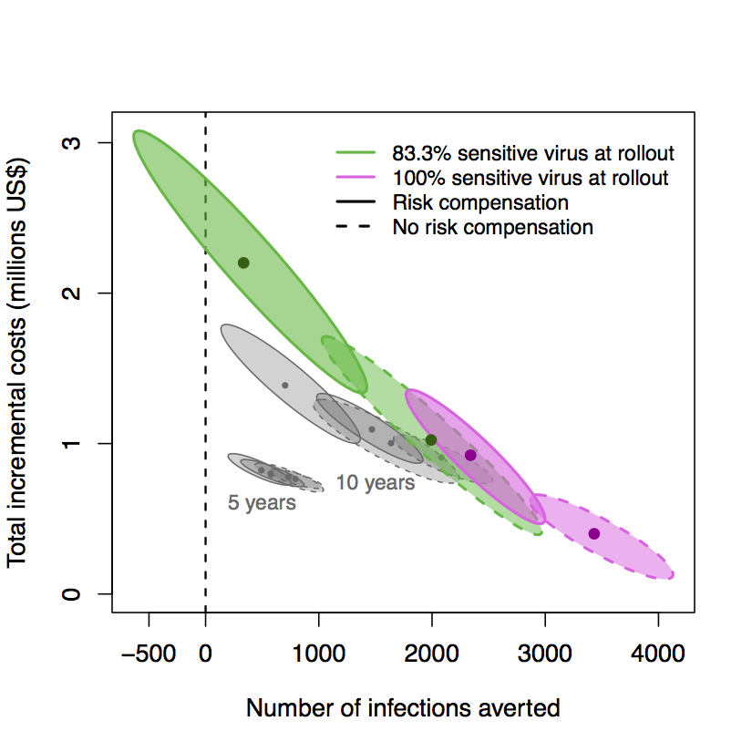
Results
Cost-effectiveness: 15-year time horizon
Notes:
, and at fifteen years, the differences across scenarios are pronounced,

Slide 43
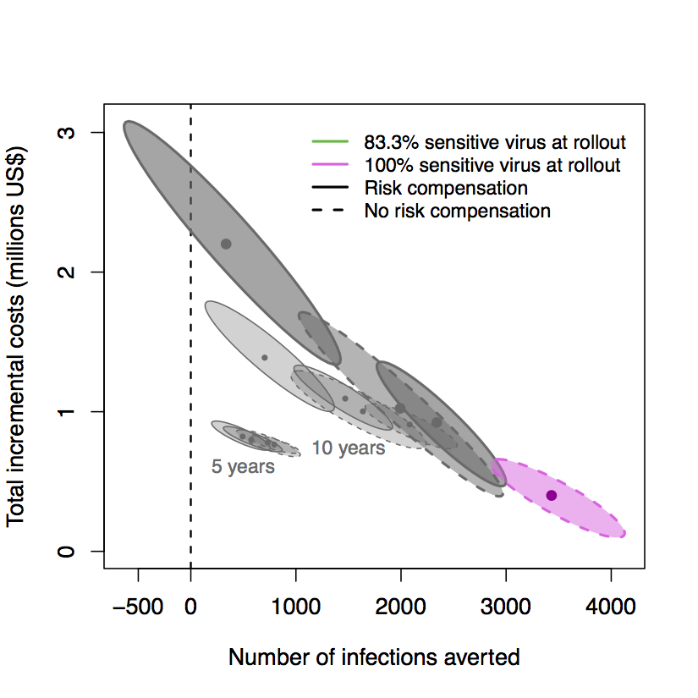
Results
Cost-effectiveness: 15-year time horizon
Notes:
with greatest cost-effectiveness predicted for the scenario in which there is 100% sensitive virus and no risk compensation, shown in pink with a dashed ellipse line. Here, the incremental costs of the vaccine program decline over time as cumulative infections averted translate to reductions in HIV care spending.

Slide 44
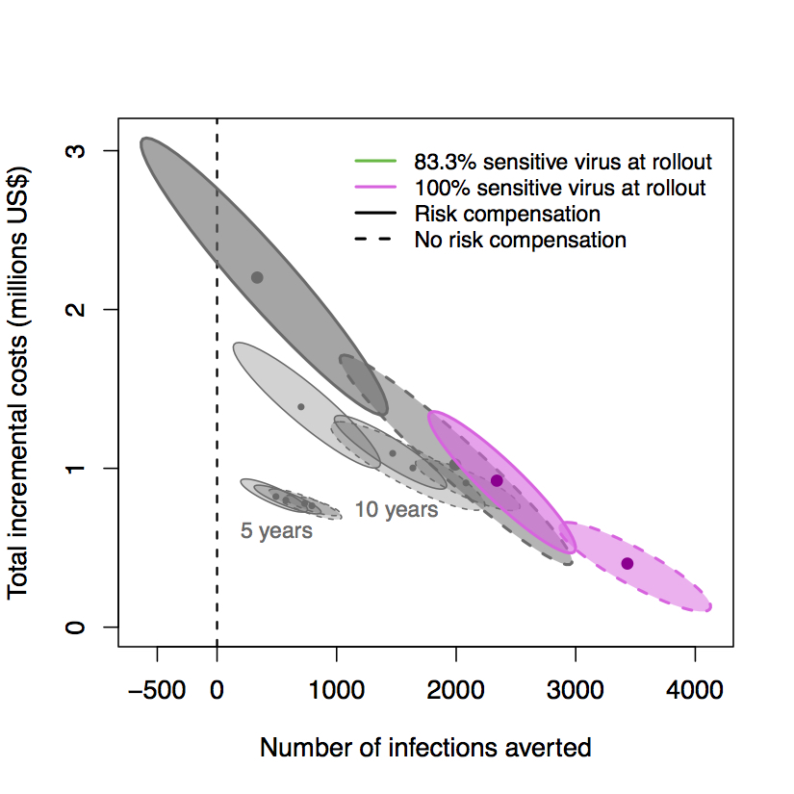
Results
Cost-effectiveness: 15-year time horizon
Notes:
Cost-effectiveness is attenuated in the presence of risk compensation,

Slide 45
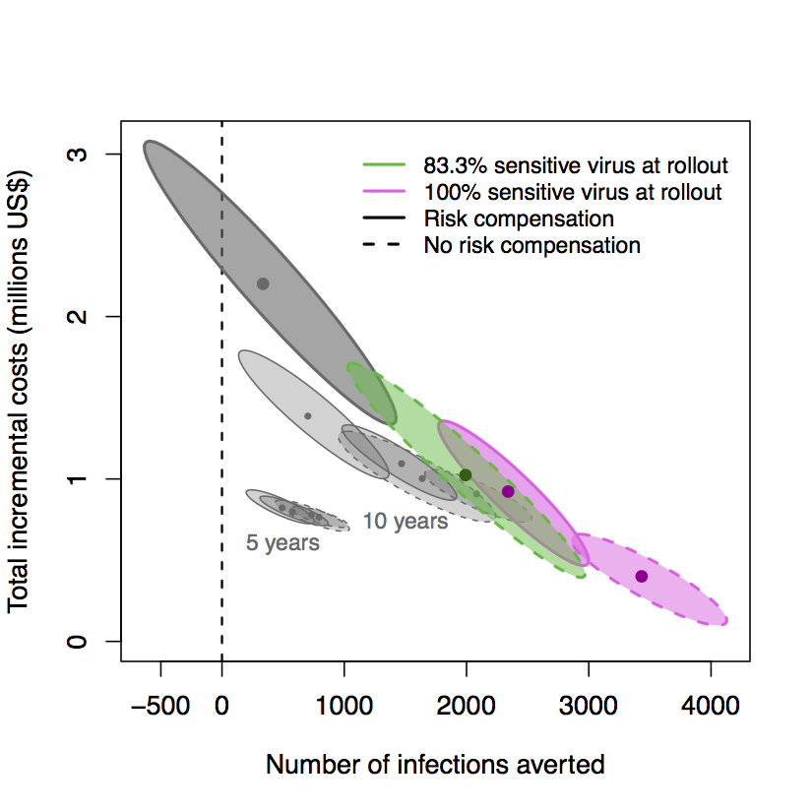
Results
Cost-effectiveness: 15-year time horizon
Notes:
or if there is viral adaptation.

Slide 46
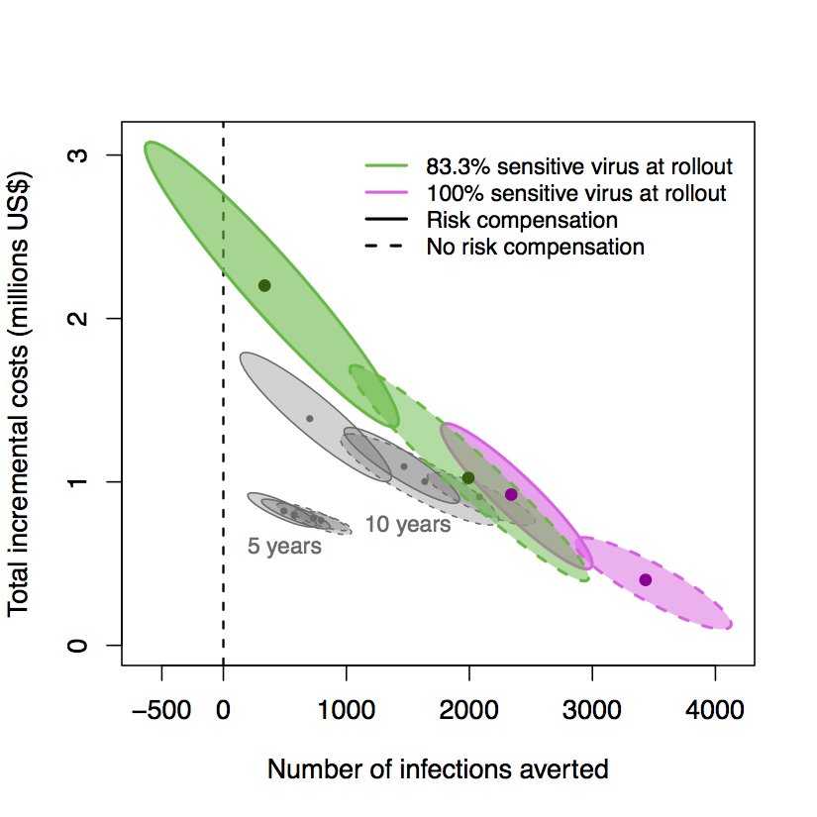
Results
Cost-effectiveness: 15-year time horizon
Notes:
In the scenario in which there is both viral adaptation and risk compensation, we can see that the point estimate of infections averted declines over time, and that the 90% ellipse crosses the x-axis at zero, representing more new infections with a vaccine over 15 years than in the absence of a vaccine in some simulations.

Slide 47
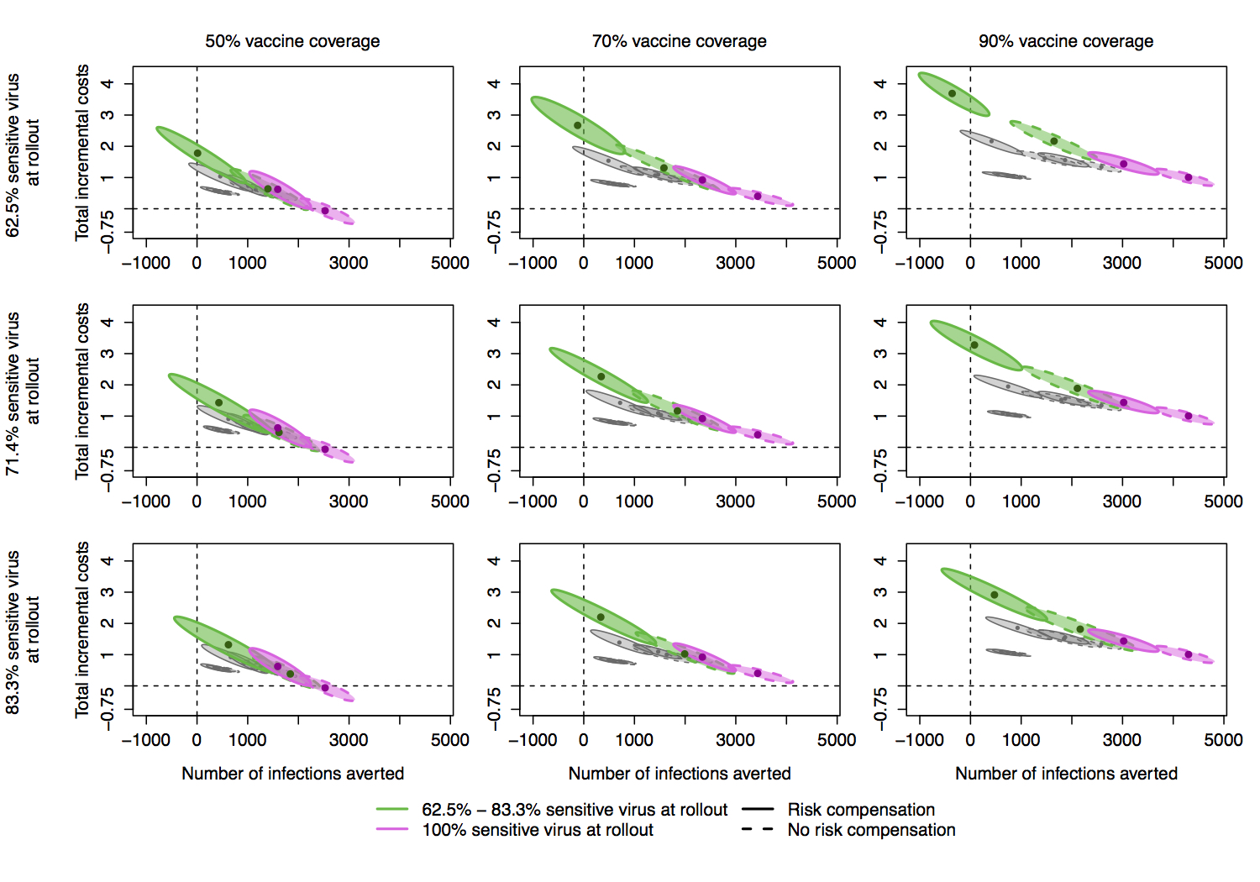
Notes:
This pattern is consistent across scenarios with varying coverage and proportions of sensitive virus at rollout.
As we noted previously with respect to prevalence, the combined effects of viral adaptation and risk compensation are strongest when there is a smaller proportion of sensitive virus at rollout, shown in the top row.

Slide 48
Notes:
In that case, the incremental costs of the program result in no infections averted if there is 50% vaccine coverage, or result in more infections with the vaccine than without, in the case of 70% and 90% coverage.

Slide 49
Conclusions
HIV vaccine models that exclude viral diversity may overestimate impact of a vaccine
Viral adaptation and risk compensation operate synergistically
Notes:
In our simulations, standing viral diversity at vaccine rollout resulted in a lower impact of an HIV vaccine than if all virus were vaccine-sensitive. Consequently, models that do not include viral diversity when modeling an RV144-like vaccine may be overly optimistic.
Furthermore, we saw that viral adaptation and risk compensation operate synergistically, resulting in worse epidemic outcomes with a vaccine than without under select scenarios.

Slide 50
Conclusions
HIV vaccine models that exclude viral diversity may overestimate impact of a vaccine
Viral adaptation and risk compensation operate synergistically
Importance of:
  Sieve analyses and surveillance
  Vaccine inserts that limit evolutionary pathways
  Balanced messaging to reduce risk compensation
Notes:
These results emphasize the importance of several aspects of vaccine implementation and design.

Slide 51
Conclusions
HIV vaccine models that exclude viral diversity may overestimate impact of a vaccine
Viral adaptation and risk compensation operate synergistically
Importance of:
  Sieve analyses and surveillance
  Vaccine inserts that limit evolutionary pathways
  Balanced messaging to reduce risk compensation
Notes:
First, sieve analyses in HVTN 702 can identify viral strains that are differentially impacted by the vaccine, and surveillance of circulating HIV strains in the population for whom the vaccine is intended can inform the risk of viral adaptation and the need for ongoing modification of a vaccine to include inserts against additional viral strains.

Slide 52
Conclusions
HIV vaccine models that exclude viral diversity may overestimate impact of a vaccine
Viral adaptation and risk compensation operate synergistically
Importance of:
  Sieve analyses and surveillance
  Vaccine inserts that limit evolutionary pathways
  Balanced messaging to reduce risk compensation
Notes:
Additionally, a second HIV vaccine trial currently enrolling in South Africa is testing a vaccine with a mosaic insert that is designed to be effective against a broader range of viral strains, which may limit rates of viral adaptation.

Slide 53
Conclusions
HIV vaccine models that exclude viral diversity may overestimate impact of a vaccine
Viral adaptation and risk compensation operate synergistically
Importance of:
  Sieve analyses and surveillance
  Vaccine inserts that limit evolutionary pathways
  Balanced messaging to reduce risk compensation
Notes:
Finally, messaging strategies that balance emphasis of the benefits of an HIV vaccine with an understanding that it is only partially effective may reduce risk compensation among vaccine recipients and the general population.

Slide 54
Limitations
Viral adaptation rates may be lower if there is decreased fitness associated with vaccine resistance
Viral adaptation rates may be higher if there are de novo resistance mutations
Risk compensation behavior in MSM populations in high-income countries may not generalize to heterosexual populations in sub-Saharan Africa
Cotton, 2014; Kawashima, 2009; Herbeck, 2013; Schellens, 2011
Notes:
There are several limitations in the work presented here. First, we modeled equal transmission fitness in both vaccine-sensitive and vaccine-resistant strains. If the vaccine-resistant strain were to be less fit for transmission, we would likely observe lower rates of viral adaptation in our models.
Second, we did not allow de novo mutations in our model that would result in vaccine resistance. Previous research, though, has shown that HIV has evolved in response to immune selection pressure, and including de novo mutations in our model that allow escape from the vaccine-elicited immune response would likely result in higher rates of viral adaptation.
Finally, as biomedical HIV prevention modalities have only recently been introduced at scale in sub-Saharan African countries, there is little data that may inform risk compensation behaviors in the South African population that we have modeled. We therefore based our estimates of risk compensation on data collected in MSM populations, which may not be applicable to the heterosexual epidemic in South Africa.
Cotton, et al., 2014: slow evolution of HLA immune escape mutations. Comparison of HLA-associated polymorphisms in HIV sequences that would confer resistance to HLA-driven immune response in historical (1979-1989) and modern specimens (2000-2011). Showed that modern specimens had about 2% greater HLA-associated polymorphisms.
Kawashima, 2009:

Slide 55
Acknowledgments
Mentors
  Josh Herbeck
  Ruanne Barnabas
EvoNet development team
  Josh Herbeck
  Steve Goodreau
  John Mittler
  James Murphy
  Neil Abernethy
  Geoff Gottlieb
  Sarah Stansfield
  Juandalyn Burke
  Molly Reid
International Clinical Research Center colleagues
Notes:
I’d like to thank my mentors on this work, Josh Herbeck and Ruanne Barnabas, for their excellent guidance, the EvoNet development team for their contributions to this work, and colleagues at the International Clinical Research Center for providing feedback on this presentation and its content. Thank you.

