Slide 1

















The SEARCH Study:
A cluster randomized HIV prevention and treatment trial in rural Kenya and Uganda
Maya Petersen
on behalf of The SEARCH Collaboration
http://www.searchendaids.com
Notes:
Like to thank the organizers, IDM, and Anna Bersteyn for inviation to talk to you today about f the SEARCH Study: a cluster randomized HIV prevention and treatment trial in rural Kenya and Uganda. Honored ot have th echance ot present on behalf of the SERCH STUdy TEAM and the SEARCH communities. .

Slide 2
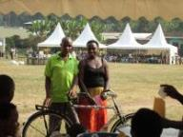
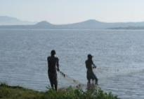
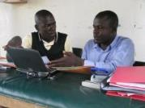
Thank You
My great appreciation for all who work on SEARCH, our multilateral partners, funders and the communities we serve.
PI: Diane Havlir
Co-Pis: Moses Kamya, Maya Petersen
Vice-Chair: Edwin Charlebois
Statistician: Laura Balzer
Virologist: Teri Liegler
KEMRI: Elizabeth Bukusi
KEMRI:/UCSF: Craig Cohen
UCSF: Tamara Clark, Gabe Chamie, Vivek Jain, Carol Camlin, Starley Shade
UC Berkeley Biostat: Mark van der Laan, Wenjing Zheng
Mathematical Modeling: Britta Jewell, Anna Bershteyn
Notes:
I’d like to thank the sponsors of the SEARCH Study: NIH, PEPFAR, Govt of Uganda and Kenya, Gilead, and the Gates foundation. Most importantly, I want to thank all of the communities in SEARCH.

Slide 3
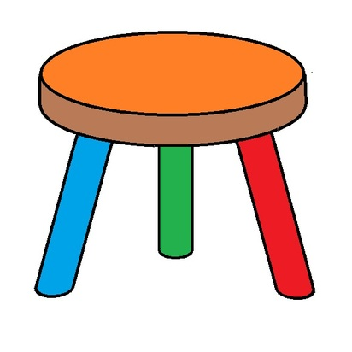



Antiretroviral Therapy
Reduces HIV transmission by 96%
Prevents HIV illness, TB and death
PrEP– 96% protection from HIV infection
Notes:
ART has potential to transform the trajectory of the HIV epidemic.
1) We know that early ART prevents HIV illness, TB and Death. In particular, ART preserves health at all CD4 levels, and All HIV infected persons should be offered ART for their own health.
2) We know that ART taken by HIV infected persons can drammatically reduce transmission to uninfected persons
3) finally, we know that modified ART, given as “Pre Exposure Prophylaxis or PreP” to HIV uninfected persons can dramatically reduce risk of bieing infected by HIV infected contacts
1995: ART halts disease progression
Only use when benefits outweigh toxicity
2000: ART prevents vertical transmission
2011: ART prevents horizontal transmission
2012: ART preserves health at all CD4 levels
All HIV infected persons should be offered ART
NOW: Can a coordinated strategy of HIV testing and treatment services* shut down the HIV epidemic?

Slide 4
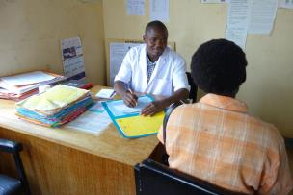
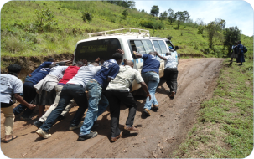
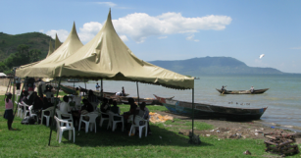
Vision
Pave the path to HIV eradication through the entry point of improving community health
Notes:
ART has tremendous potential to improve helath and prevent HIV transmission. Question now is how do we harnass that potential to end the epidemic. Want to take the chance to talk today about SEARCH’s vision for moving toward that goal though the entry point of improving community health.

Slide 5
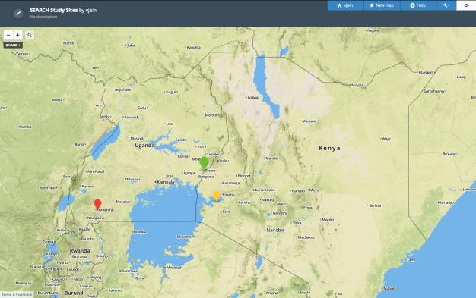
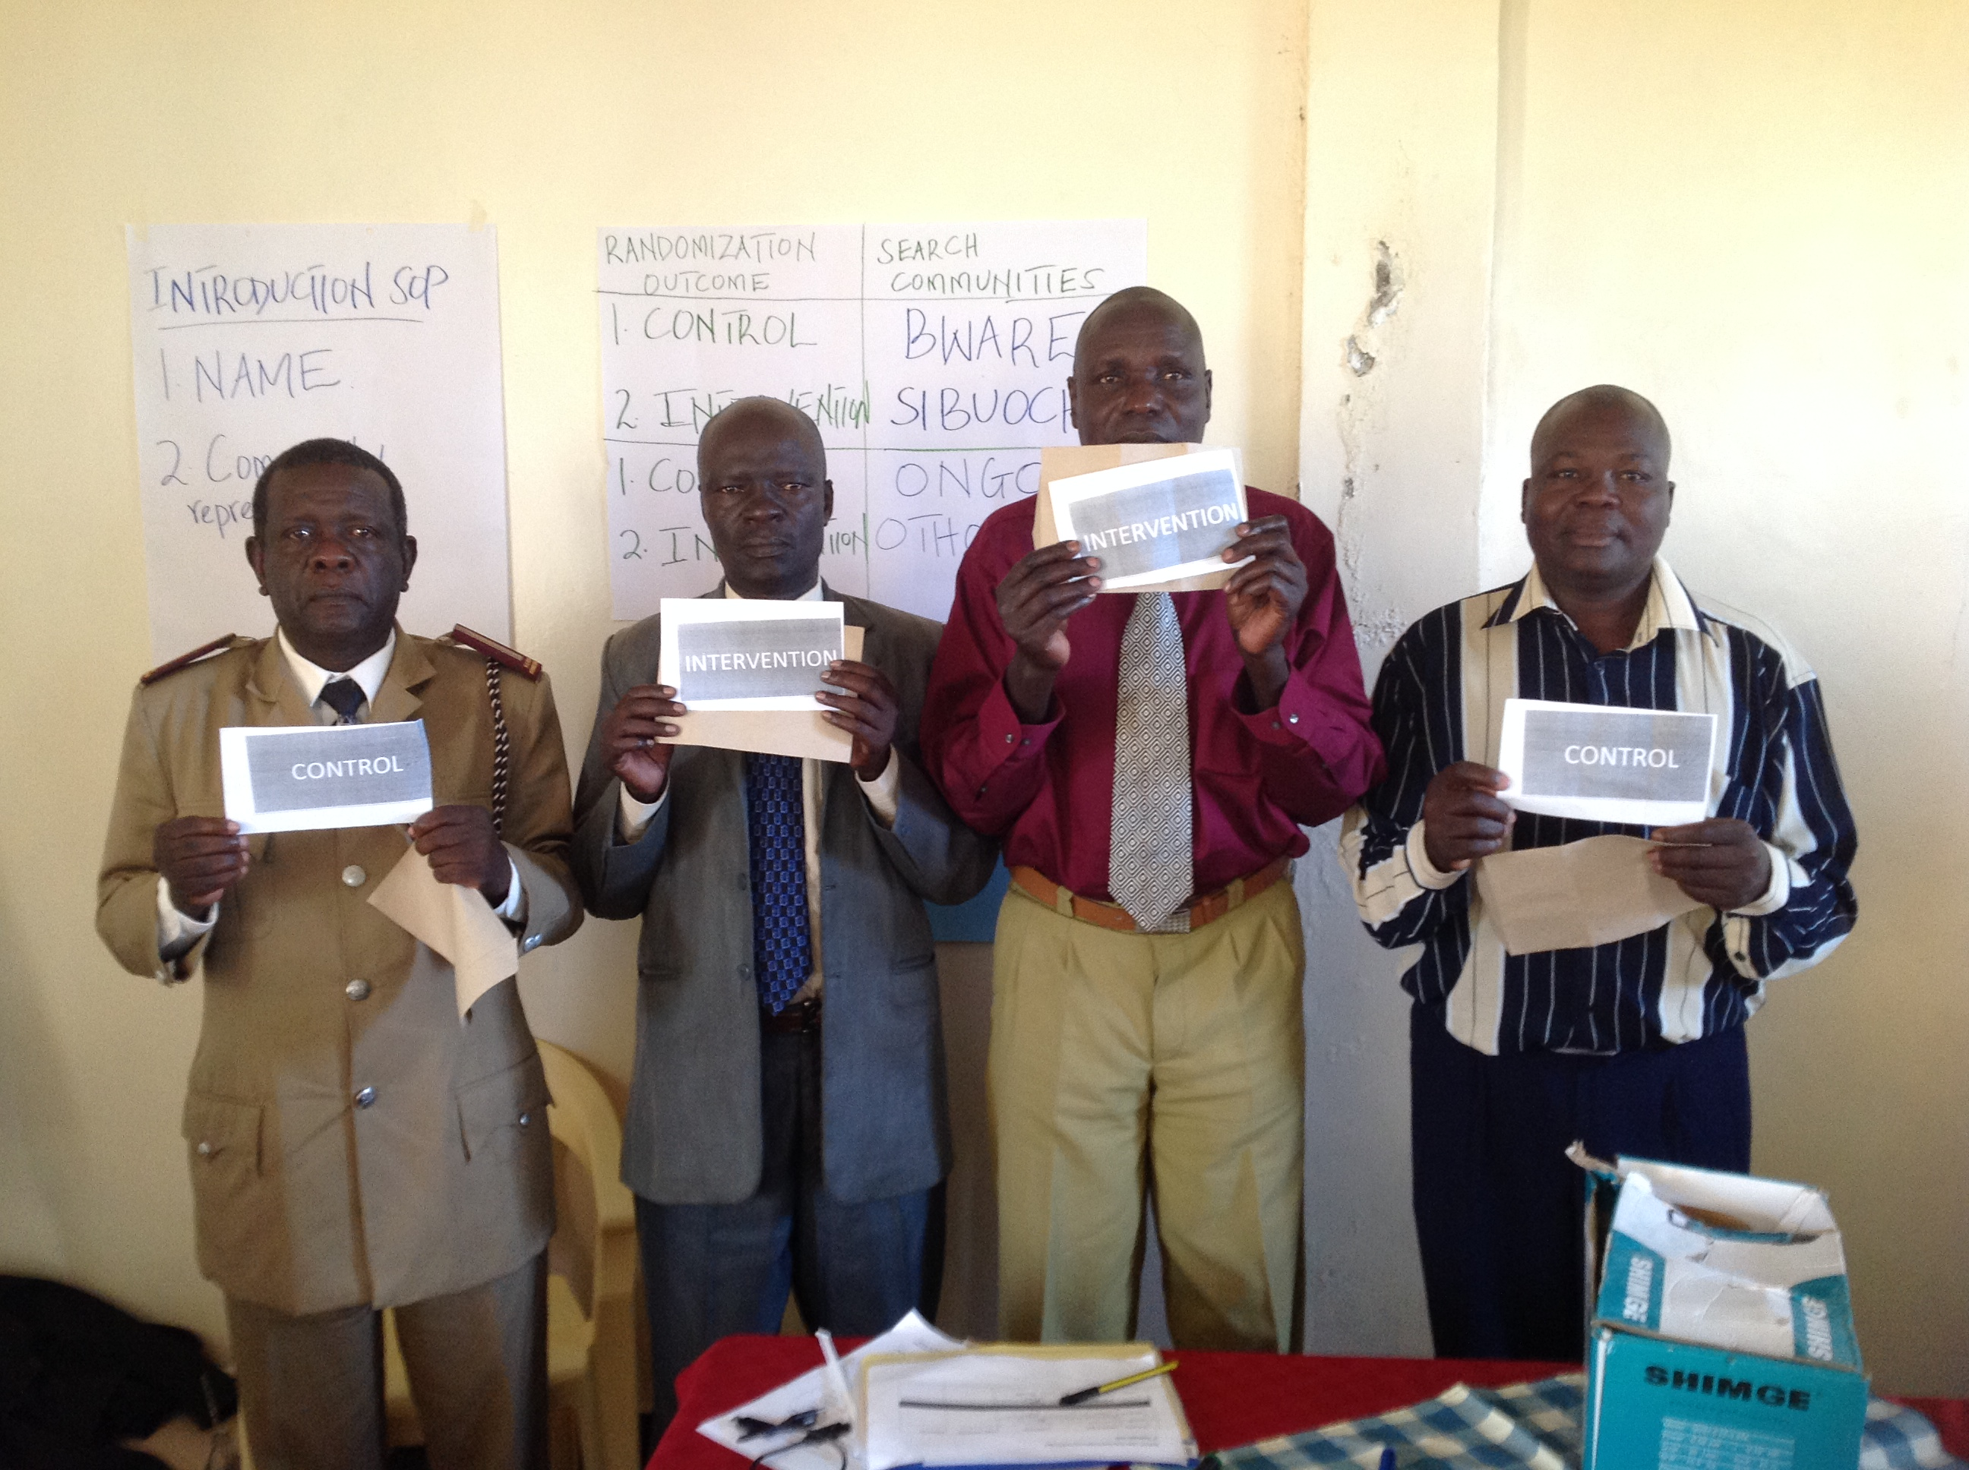
SEARCH
Ongoing cluster randomized HIV “test and treat” study
  In 3rd year of follow-up
32 communities
  12 Kenya
  10 Western Uganda
  10 Eastern Uganda
334,540 persons enrolled
  ~5,000 adults per community
UGANDA
SEARCH
Partners
PEPFAR
NIH
WHO
World Bank
UNAIDS
Gilead Sciences
Uganda MOH
Kenya MOH
Tororo
KENYA
Mbarara
Homa Bay
Notes:
First, some background on SEARCH.
Ongoing cluster RCT.
32 Communities, roguhly in homa bay region of kenya, mbrara region of sw uganda, a tororo region of eastern uganda.
Baseline enrollment 2013-2014. >300,000 persons enrolled. Or ~10,000/community. ~50% adults.
Study, will complete 3rd year of follow up this year.

Slide 6
SEARCH research strategy to achieve HIV elimination
1st Phase (2013-2017)
  HIV Test All: Multi-disease community health campaigns + mobile testing
  HIV Treat All: Universal ART eligibility with Streamlined Care
2nd Phase (2017-2020)
  PrEP: Data-driven targeted PrEP
  Test and Treat Optimization: Targeted HIV care cascade interventions
3rd Phase (2020-2025)
  Elimination phase- based on Phase II
  e.g. Real-time adaptive targeting, outbreak case-based
Notes:
SEARCH research strategy to achieve HIV elimination has three phases.
First pahse- test and treat
Second pahse…
Ultimately- move to elimination.
Today, give a brief overview of overall study design for first two phases.
Show some data on intervention uptake in the intervention arm of pahse 1 to date.
Describe intervention for phase 2, with a focus on PreP strategy.
And finally, share vision for phase 3.

Slide 7
Study Design
1st PHASE
2nd PHASE
16 Intervention
Communities
Intervention:
Baseline HIV+
Streamlined ART for all HIV+
Targeted PrEP
Targeted cascade optimization
Intervention:
Baseline + Annual HIV/multi-disease testing
Streamlined ART for all HIV+
16 Intervention
Communities
Randomize 32 pair-matched communities
Year 3 Endpoints
Re-randomize original 32 communities
Year 6 Endpoints
16 Control
Communities
Active Control:
Baseline HIV/multi-disease testing
Country-guided ART
16 Control
Communities
Active Control:
Baseline HIV testing
Streamlined ART for all HIV+
Primary endpoint:
HIV incidence
Secondary Endpoints: Community Health
• HIV population viral metrics
• AIDS
• Maternal and child health
• TB
NCD (HT, DM)
Secondary Endpoints:
Community Productivity, Cost
• Workforce participation
• Child labor, Education
• Agricultural output, Household income
• Healthcare utilization
Costs
Notes:
32 pair matched communities.
Randomized to 1st pahse intervention and control.
All communities: baseline HIV/multi disease testing using a community based model.
Control :ART by country guidelines.
Intervention: additional annual testing, ART for all HIV+ with streamlined model. Will give some more detail on each of those in a moment.
Year 3: endpoints measured. Primary: HIV indicidence (seroconversion aong baseline HIV-) : adult stable residents. Secondary- …
Year 3 also serves as new baseline for 2nd phase. New pairs- matched on phase I interention, baseline prealence. Re-randomized to 2nd pahse intervention and contro;.
All communities- baseline testing and streamlined ART for all HIV+
Intervention: also get targeted prep and cascade interventions.
(Note: active control- we are measuring impact of interventon beyond community wide bl testing.
Intentiaonally broad, in recognition of potential for ART to transform community health – secondary gains. )

Slide 8
Baseline Characteristics
 | Kenya | W Uganda | E Uganda | Total
Adults enumerated | 62,557 | 54,654 | 51,561 | 168,772
Male | 47% | 47% | 46% | 47%
Age years (median, IQR) | 29 (20,44) | 29 (21,43) | 29 (20,43) | 29 (20,43)
Occupation
Farmer | 35% | 51% | 59% | 48%
Fisher | 10% | <1% | <1% | 4%
Student | 25% | 20% | 22% | 22%
No job | 8% | 4% | 3% | 5%
HIV+ | 19% | 6% | 3% | 10%
Circumcised (% men):
Traditional | 10% | 5% | 30% | 15%
Medical | 36% | 9% | 11% | 19%
Notes:
What do these communities look like.Enrllen! 168,772 adults. Evenly split between regions, ~50% male, median age 29.
In ugnada majority farmers. In Kenya, sizable fishing community. 1/5th students
heterogeneity in HIV prev., overall 10%
And in circumcision rates
% new Dx at BL (~1/3rd by records/VL…38% by self report)
% no ART at BL: 43%
%>350: ~67%
%>500 ~50%
% BL CD4>350 at BL and not prior ART: 30%
% bl CD4>350 and no prior Dx: 20%
of these guys- 70-80% suppress by tw years

Slide 9
SEARCH 1st Phase: “Test and Treat”
HIV, multi-disease testing and specimen collection at baseline
Intervention:
Annual community-based HIV & multi disease testing
Universal ART eligibility with streamlined care
  NCD/HIV Chronic Care model
Notes:
First provide some background on two intervention components in the first phase.
Communty based HIV and multi disease testing
2. Unversal ART with stremalined care

Slide 10
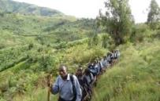
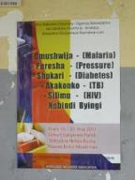
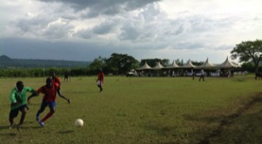
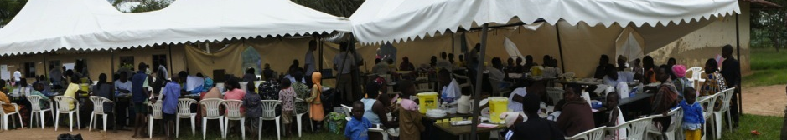
1. Testing Intervention: Annual Community-Based Testing
Goal: >90% HIV testing
Approach:
  Community based, out of facility
  Multi-disease: HIV, DM, HT, malaria
  “Collapse the Cascade”- immediate link to public health services
Census/Mobilization
Two week Health Fair
Home testing for non-participants
Chamie, Lancet HIV 2016
Notes:
In the first component of the SEARCH intervention, we sought to test at least 90% of the whole community for HIV every year.
Our approach was community-based out of facility testing, and integrated testing for multiple diseases including HIV, DM, HTN, and malaria.
A key concept was to collapse the care cascade between testing and ART start. We provided immediate linkage to health facilities for diseases we diagnosed.
Steps we used to implement this approach were
Frist: Household census and community mobilization (baseline of the study)
Second, Community Health fairs with multi-disease services
Third: we provided Home-based testing for non participants
Two weeks- local services. Total coverage by chc 90-60%.

Slide 11
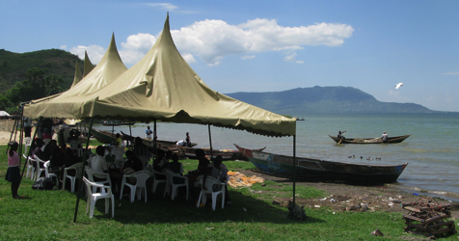
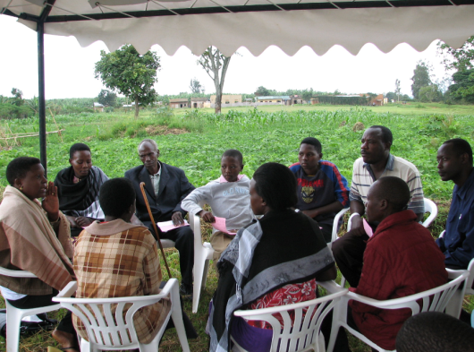
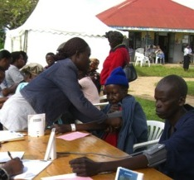
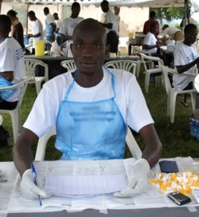
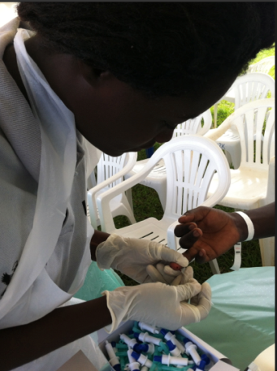
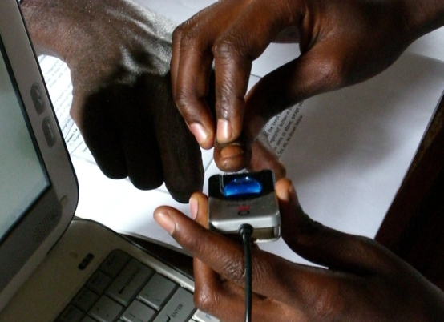
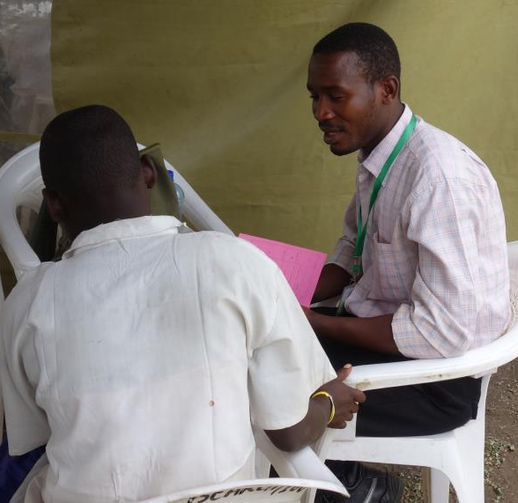
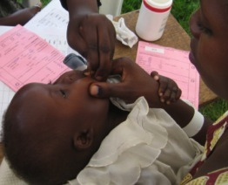
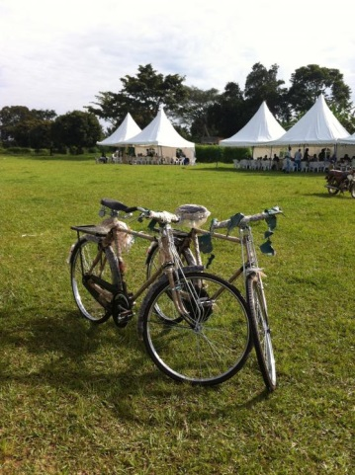
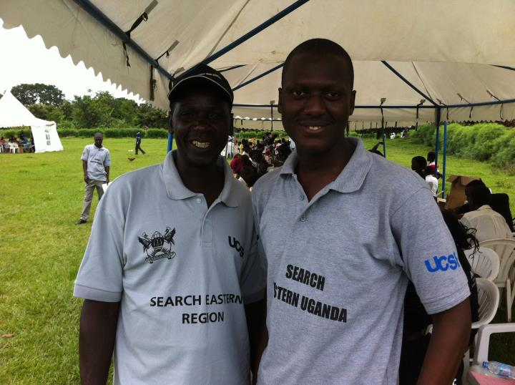
Community Health Campaigns – Virtual tour
Mobilization
Sites within communities
Health Education
Welcome Area/Biometrics
Blood Pressure Station
CHC Lab: Diabetes, HIV, Malaria
Results & Care
Deworming/Vit A
Raffle & Exit
Notes:
Here- a brief photo tour though a community health campaign. Meeting with local leaders, flyers, chirch groups. Choose convenient sites within communities.. One site for several days then move.
Campaigns provide health education. Ex: men’s tents for mens health concerns (came out of community suggestion).
Welcome area- linked to census by biometrics.
BP, lab, (malaria rapid diagnstics if fever)
Condom, mmc referal, fmily planning and cervial cancer
Immediate linkage- warm hand off (intordcution, call). Deworming- albendazole/vit A for kids. Raffle.
Not shown here- subbsequent home based tracking for non-a ttendes.

Slide 12
89% Post-Baseline Testing Coverage
NYAMUYANJA
NAMKOMA, UGANDA
NYATOTO,KENYA
Baseline
Post-CHC
Complete
Chamie, Lancet HIV 2016
Notes:
Of stable resdients. With non stable… ~80% (~22% non stable tested, non stable ~10% of enumerated resdients)
Baseline is using self report
Map of testing coverage: Colour intensity ranges from blue (HIV tested) to red (HIV untested), based on density of untested persons (population per km.). CHC=community health campaign
Shows variability in controbution of CHC vs subsequnet home based testing. Lower % in general tested via campaing in Kenay, but overall coverage still high.
Maps were created with ArcGIS (Esri, Redlands, CA, USA) by measuring the density of people meeting an outcome criterion per km. and then
standardising colour intensity scales of the outcome densities to allow for cross-community comparison.
what % on non-stable ~10%
~22% of non-stables tested
what % tested including the constable? ~80%

Slide 13
2. Streamlined Care: HIV/NCD Chronic Care Model
Efficient Visits for Patients and Staff
    • ART start at first clinic visit as indicated
    • Triage by nurse or other extender
    Co-location of services
    • Clinic visits/ART dispensation every
    3 months (rather than every 1-2 months)
2. Patient-centered approach to care
    Welcoming environment
    Fostering trust, connection, and a sense of investment in the patient
    Flexible clinic hours
    Tiered Tracking
    Multi-disease chronic care model
    3. Telephone hotline access for patients
    • Easy triage of medical questions
    • Appointment/scheduling logistics for retention
4. Appointment reminders by phone/SMS
    • One week to few days in advance
    • Retention tool
5. Viral Load Counseling
    • Structured format for discussion of undetectable and detectable results
Kwarisiima et al., CROI 2016, Kwarsiima, JIAS 2017
Notes:
Second component: stremalined care. Example of what si now being refered ot as differentiaed care. Flexibility to meet indivdual patient needs.
It has 5 key features.
We provided visits that were efficient for patients and staff. In paritcular, we saw patients for every 3 month visits.
We provided a patient centered approach to care. Key components of this included a Welcoming environment, foster trust connection and relationships between providers and patients, flexible hours, and a multi disease chronic care model, which our patients tell us reduced stigma
We provided access to a telephone hotline to patient
We provided appointment reminders by SMS/phone
5. We conducted viral load counseling with each patient as an adherence tool.
Finally, worth noting that Streamlined care did not include financial or material incentives of any kind.
NCD- same chronic care model

Slide 14
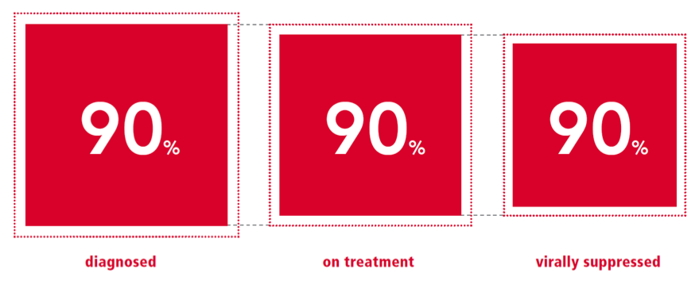
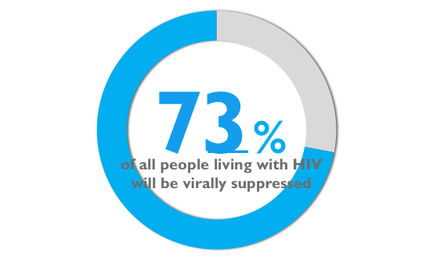
HIV Care Cascade: UNAIDS Target
This Analysis: Suppression = plasma HIV RNA< 500 cps/ml
Notes:
How has care cascade coverage changed under the test and treat intervention? As most are aware, UN AIDS 909090 has set targets of 90% HIV+ diagnosed, 90% of Diagnosed HIV+ on ART, and 90% of those on ART virally suppressed. Multiplying these cascade targets results in an overall population level target of 73% of all HIV+ individuals virally suppressed. We evalauted progress towards these targets over time in interventon communities, with suppression defined as <500.

Slide 15
Evolution in HIV Care Cascade:
SEARCH Intervention Communities
At Baseline (pre-intervention) and after one and two years of intervention, evaluated
Cascade among prevalent HIV+ adult community residents
  Serial cross-sectional analysis of open cohort
Cascade among adult residents who tested HIV+ at baseline
  Longitudinal analysis of closed cohort
Analysis adjusted for
  Incomplete ascertainment of prevalent HIV+
  Incomplete HIV RNA measures
  Censoring by death/migration (longitudinal analyses)
Petersen, IAS 2016
Notes:
Specificallt, e evaluated the cascade at study baseline and after 1 and 2 years of receiving the search intervention.
We first estimated cascade coverage among prevalent HIV+ community residents at each time point. Open cohort: enter if become HIV infected or age in infected, exit if die or leave community. Primary aalysis restricted to baseline enumerated stable resdients, secondary- included in migrants and non stable.
Second. In order to better understand cascade progression over time among individual patients, analyzed patients who tested HIV+ at baseline as a longitudinal cohort.
Importantly, aimed to estimate cascade coverage for all HIV+ (including those not tested for HIV and with missing viral loads).
Both HIV testing of overall population, and viral load testing among HIV+ high. In particular- for latter used viral loads from campaignis- did not dependion in care status. Nontehtess, prevalance and suppression might differe among those we measured vs were missing.
therefore, adjusted for an difference in characterstics between those with HIV status measured vs missing, and viral load measured or missing. Subset of analysiels also adjust for censoring by death/putmigration.

Slide 16
UN AIDS 90-90-90 Target Achieved
UNAIDS
Target
Notes:
So what did we see…. Slide shows proportion of HIV+ in each step of the care cascade for the three targets: diagnosis, ART start and virologic suppression Colored bars show change over time: at baseline before any intervention effect in blue, and after one and two years of the intervention in red and green.
For diagnosis, at baseline an estimated 65% of HIV+ had been previously diagnosed, increasing to 94% by year 1, and 96 by year.
For treatment, at baseline 80% of those previously diagnosed have started ART. This increased to 91% by year 1 and 93% by year 2.
For suppression, at baseline 86% of those ever on ART were suppressed, increasing to 88 and 89 % at years 1 and 2.
In sum, within two years, had met or exceeded all 3 UN ADIS cascade targets.

Slide 17
Year 2: 80% HIV+ Virally Suppressed
UNAIDS
Target
Notes:
What did we gain on pop level by achieving these targets? Line shows the UN ADIS target of 73% of all HIV+ who are virally suppressed.
At study baseline, less than half the HIV+ population was suppressed. After one year of intervention, we had exceeded target of 73%, and by second year were at 80%/
Not shown- 79% if include in migrants and non stable. However- unlike baseline enumerated- don’t have a comrehensive mechanism for including inmigrants.

Slide 18
Cascade by Gender
Notes:
Now look by gender, given known risk for men of cascade drop offs. Focusing on the group of bars to the right, which shows virologic suppression among all HIV+, we see that at baseline, a lower proportion of HIV+ men, compared to women were suppressed: 39 vs 48%., The gap was mostly due to first step of cascade, with a larger proportion of HIV+ men not knowing their status.. Over two years of intervention, disparity reduced.

Slide 19
Cascade by Age
Notes:
Among youth, the story differs.
Even larger gap at bl; 26% of youth compared to 47% of the general population were virally suppressed. Over two years of intervention suppression increased among youth. but Gap remains at all steps of cascade, translating to substantially lower viral suppression: 65% among youth, compared to 82% among older pops.
Imporove % on ART- facilitated linkage + elgibility. Still short retantion and suppression those on art. Over youth hae lower pop suppression
Step 2 closing the gap- due to chane in eligbility criteria (youth are ore likely ot have highcd4) and linkage intervention
Framework I limited in ability to identify lesions in cascade. Add a slide (back up) long youth among bl HIV+
Our study population consisted of all adult (>=15 years at study baseline) stable residents (>6 mo of past year spent living in the community) of the 16 intervention communities who were enumerated via household census at study baseline (June 2014-June 2015).
Post baseline, restricted to those not dead or outmigrated (represent the target population of SEARCH intervention). Objective of this analysis not assess outcomes had death/migration been prevented.
Analyses of FUY2 data were further restricted to residents of the xx communities who had completed FUY2 testing by database closure on Date
We collected the following variables for all enumerated adult residents at time of census
Basic demographic information (age, sex, occupation, education, martial status,),
mobility (nights slept away from home in past month, months living away from home in past year).
Household wealth: PCA with quintiles.
HIV status
At baseline, FUY1 and FUY2 annual testing, we measured HIV serostatus by rapid test at campaign/home based testing.
Participants also classified as HIV+ based if had an HIV RNA level >LLD, or if had a mintry of health record indicating prior HIV care.
Prior diagnosis and ART use:
Among all known HIV+, prior knowledge of HIV status and prior ART use (at any date, irrespective of evidence of current use) were assessed based on Ministry of Health clinic record. Records were obtained via biometric identifier based linkage to SEARCH records on patient presentation to a clinic in the SEARCH community. .
In primary analysis, subjects with VL<500 were classified as on ART (and by plication, previously diagnosed). In sensitivity analysis, ART and prior diagnosis restricted to clinical records only.

Slide 20
Cascade Evolution Among Subjects Tested HIV+ at Baseline (N=7108)
Viral Suppression
Viral Failure
New Diagnosis
Prior Dx, no ART
Migrated
Died
Notes:
Now lets look at a longitudinal analysis among people who tested HIV+ at baseline. This graph shows the evolution in cascade status for these people over time. Importantly, over first year, % suppressed, shown in orange, increased to 73% and remained stable in second year.
(88% if treat death/migration as censoring). By two years, ~14% had migrated or died.

Slide 21
Cascade Evolution Among Youth Tested HIV+ at Baseline (N=864)
Viral Suppression
Viral Failure
Prior Dx, no ART
New Diagnosis
Migrated
Died
Notes:
However, among youth again we see a starkly different story. Suppression increases but remains much lower. Linkage failure (shown in purple) and virological failure on ART (blue) both contributing to discrepancy. Major impact of Migration in youth 29% by year 2. (suppression with survival analysis: 78%, target 81%)

Slide 22
Viral Suppression Over Time Among Baseline HIV+ (N=7108)
Right Censored at Death/Out-migration
Notes:
Finally, I want to show you some data in subgroups of interest among baseline HIV+. First new diagnoses at baseline. Of these, 63% were suppressed at FUY1 (red) increasing to 69% at FUY2 (green).
Second, we looked at bl HIV+ with a prior diagnosis who had not started ART at baseline….of these 78% had initiated ART and suppressed by FUY1, increasing to 87% by FUY2
In contrast, among bl HIV+ who had started ART but were viroligcaly failing at baseline, we see some improvement in suppression over time, but much work remains to be done.
Finally, and reassuringly, when we look at bl HIV who were suppressed at baseline, almost all remained suppressed despite the influx of many new patients into the system.
% new Dx at BL (~1/3rd by records/VL…38% by self report)
% no ART at BL: 43%
%overall and of those with no ART at bL: >350: ~67%
%:overall of those with no ART at bL>500 ~50%
Of those without Art history at BL: CD4>350 in
% BL CD4>350 at BL and not prior ART: 30%
% bl CD4>350 and no prior Dx: 20%
of these guys- 70-80% suppress by tw years

Slide 23
Next steps towards eradication: 2nd Phase
Population viral suppression increased from 45% to 80% during two years of intervention
  Suppression lower among new diagnoses, “treatment failures”, youth…
Next steps….
  Moving beyond “big bucket” risk groups…
  To individually targeted, personalized treatment and prevention interventions
Among HIV+:
Who are the 20% who remain unsuppressed?
How do we reach them?
Among HIV-:
Who is still being infected?
Who is infecting them?
How do we protect them?
Notes:
Substantial increase in population level viral suppression over two years- but Work left to do…
20% remain unsuppressed. Not good for their health, potential surce of ongoing transmission, and harder to reach.
Next steps towards ending the epidemic eardication require us to move beyond traditonal big bucket risk groups.
Personalized public health-
Among HIV+ Data drivien approaches ot understand better whois at risk of poor outcomes and why, targeted cascade interventions to help us reach this 20%.
Among HIV- : data driven approaches to understnad who remains at risk of being infected, transmission networks, and effective ways of reaching people with prevention strategies.

Slide 24
SEARCH 2nd Phase: Data-driven PrEP and cascade optimization
HIV, multi-disease testing and specimen collection for new baseline
Intervention:
Targeted PrEP
Targeted HIV testing
Targeted cascade interventions to optimize HIV RNA suppression
Machine learning, virology/phylogenetics, social networks, human centered design
Notes:
Emphasis of SEARCH Phase 2: Data driven PrEP and cascade optimization
Measurement of endpoint for first pahse provides a new baseline for second pahse. But also an opportunity to assess risk and offer targeted interventions on a population scale.
Intervention for Pahse 2:
Targeted suppression interventions and testing
Targeted PrEP.
Will Focus here on PreP

Slide 25
SEARCH 2nd Phase PrEP Strategy
1. Community Sensitization
2. PreP Offered at:
Community Health Campaign
Home Visit
Routine clinic
Drop in clinic
3. PreP Offered to
  HIV risk: machine learning-based risk score
  HIV risk: self assessment
  HIV discordant partners
4. PrEP Dispensed at :
Clinic
Home/offsite
Nested RCT
Notes:
First- an overview of Prep strategy.
1. sensitization:
Provide education through meetings and materials on
What is Prep? Why is prep needed? What are benefits and risks of PREP to community leaders, health sector, variouis occupation organizations ( farmers, boda boda drivers). The same was done when ART introduced . As we saw, needs to be continuous not one time, in order to dispel misunderstandings that arise and provide answers to new questions that arise
2. Prep Offered at
CHC Home visit Drop in clinic Routine clinic
3. Prep offered to

Slide 26
Machine Learning-based Risk Score
Baseline covariates
  Measured at baseline HIV-negative test
Machine Learning to Predict
HIV seroconversion
  In 1st Phase intervention communities over two years
Candidate Predictors Considered
  Demographics
  Circumcision, polygamy
  Prior HIV testing, location of baseline HIV test
  Alcohol
  Contraceptive use, reproductive history
  Mobility
  Anxiety, Depression
  Employment, Hours/days worked
Notes:
Now like to give some background on Mchine learning based risk score. Work led by Wenjing Zheng at UC Berkeley.
Basic approach- in intervention commnities, measured baseline HIV status as well as a range of covariates at baseline .
Used data on seroconversion during firs two years and appied machine learning methods to build a risk score and corresponidng cutoff to assign a person as either eligible or inelgible for prep.
In buulding risk score, consdiered wide range of candidate predictors:…
Also region

Slide 27
Super Learning: Ensemble Machine Learning
Algorithms “compete”
    EX: Logistic main term, Classification and regression trees, Bayesian generalized linear models, lasso, range of pre-screening
Performance judged on independent data
  Internal cross validation
Algorithms can team up- Best “team” wins
  Optimal convex combination
Notes:
Basic method used- Super learning. Type of ensemble machine learning. Basic idea-lot s of great algorithms don’t know ahead of timef or a given problem which will work best…. Instead use them all (can also include various simple regression based approaches).
Fair compateion to chose between them- internal data splits. Split data into eg 10 parts, fit the algoruths on 9 10th, evaluate onleft out 10th. Repet 10 times so each obs serveson in validation set. Avearage perfroamcne across validaton sets.
Go fruther than chosing best- chose best convex combination. Will often beat any algorithm in isolation

Slide 28
Machine Learning For Intervention Targeting
Super Learning is general method
  Optimize prediction
  Optimize area under the ROC curve
Here: Risk classification for optimal intervention targeting with limited resources
  Constrained optimization problem
  Minimize # PrEP roll outs across all regions, with constraint of detecting at least 50% of new infections
    Assume PrEP offered to all with serodiscordant spouse
Zheng, Stat Med, 2017
Notes:
MSE, log lik
Here consider a modifcation of this problem.
We don’t just want a bigger AUROc (performance across a range of cutoffs).
Goal is to offer prep to as many future seroconversions as possible recognizing our resources are contrastrained.
Can translate this into a constrained otpimization problem. Chose the combination of algorihtsm + cutoff that minimize total # rollouts (maximize RNP) while keeping sensitivty above some minimum- set here to be 50%.
Different performance criteria when chosing best comibination of algorithms and also best cutooff..

Slide 29
“Black box” Risk Classification for PrEP
Performance evaluation (independent data)
  Sensitivity: % of seroconversions covered
  Number Needed to Treat to prevent one seroconversion (assuming perfect uptake)
For practical application (real-time in field)
  Considered subsets of variables
  Final: Age, gender, marital status, polygamy, education, circumcision, occupation, alcohol, region
Notes:
Of course- still want projections on well you do. Can achieve this through an additional layer of cross validation…. On idep data calculate Sens and NNT...
Additional practical constrain here- needed to use this in the field on tablets already quite taxed in what we were asking. So in building considered subsets of variables and look at how much performance dropped off, which subset best
(individual and community out of sample..)

Slide 30
PrEP Eligibility
All community residents at Year 3 testing
1. Tablet-based data collection
-> Real-time risk classification
Not High Risk/Decline
High Risk
2. Additional PrEP counseling
-> Risk self-assessment
Not High Risk
/Decline
High Risk
Offered PreP with immediate linkage/start
3. Clinic: Updated risk assessment
Notes:
So how implemented in practice:
Welcome station,
E score noted on card, yes, given appointment at counseling statuib which is after HIV testing station IF after HIV testing the new HIV test is negative,
If not sure they want an appot can also go to mens or other tent to get more information and then get appt at prep Tent .
What is not in flow sheet which I do not think you need ot add but just to note-- discordant coulples identified at counseling, and at clinic. This later point just FYI, and can fill you in more at the retreat.

Slide 31
PrEP Uptake
Have started >2000 people on PrEP
Key challenges:
  Individuals eligible by risk score may not perceive themselves at risk
    First Kenya community (2nd Phase control)
    Machine Learning Risk predicts Self Assessed Risk
    Only 23% of Individuals identified as PrEP eligible by Machine Learning perceived themselves at risk
  Range of barriers- many social
Ayieko, CROI, 2017
Notes:
Key- interventions to modify risk perception, indiv barriers and incentivs for uptake.
Have started > 2000 people. Data very preliminary- early days. Investigation of cascade, uptake, barriers forthcoming.
But immediate question raised- how does self perception of risk coincide with Escore.
These are data from first Kenya community. PreP Not being rolled out (phase 2 control). So minus the couseling and sensitization. And escore not used in real time. But can still assess overlap between emprical and self percieved risk.. Roughtly 20% empircally at risk (high risk area- % varies by region). And slightly less perceived themselves at risk.
But not a lot of overlap ! Which empircaland self percevied risk associated, on
Nyatototo- seen at FUY3.
OR 1.7

Slide 32
Social Networks
Additional information for intervention targeting
  Improved prediction of seroconversion to inform targeted PrEP and self-testing?
Leveraging peer effects to change beliefs, perceptions and behaviors?
  Adherence to ART/ retention in HIV care
  HIV Testing and PrEP uptake
Notes:
In sum then, optimizing impact of ART for treatment and preventin interentions reuuires predicting risk well, and inteveing effectively to optimize impact. One area investigting to imporve both- sn.
Success of prep and other prevention and cascade interventions. Depends on predicting risk well, but also changing self perceptons of risk, and indivdual barriers/icetinves for initation and uptake.
One area we are investigating in SEARCH to improve both- social network data.

Slide 33
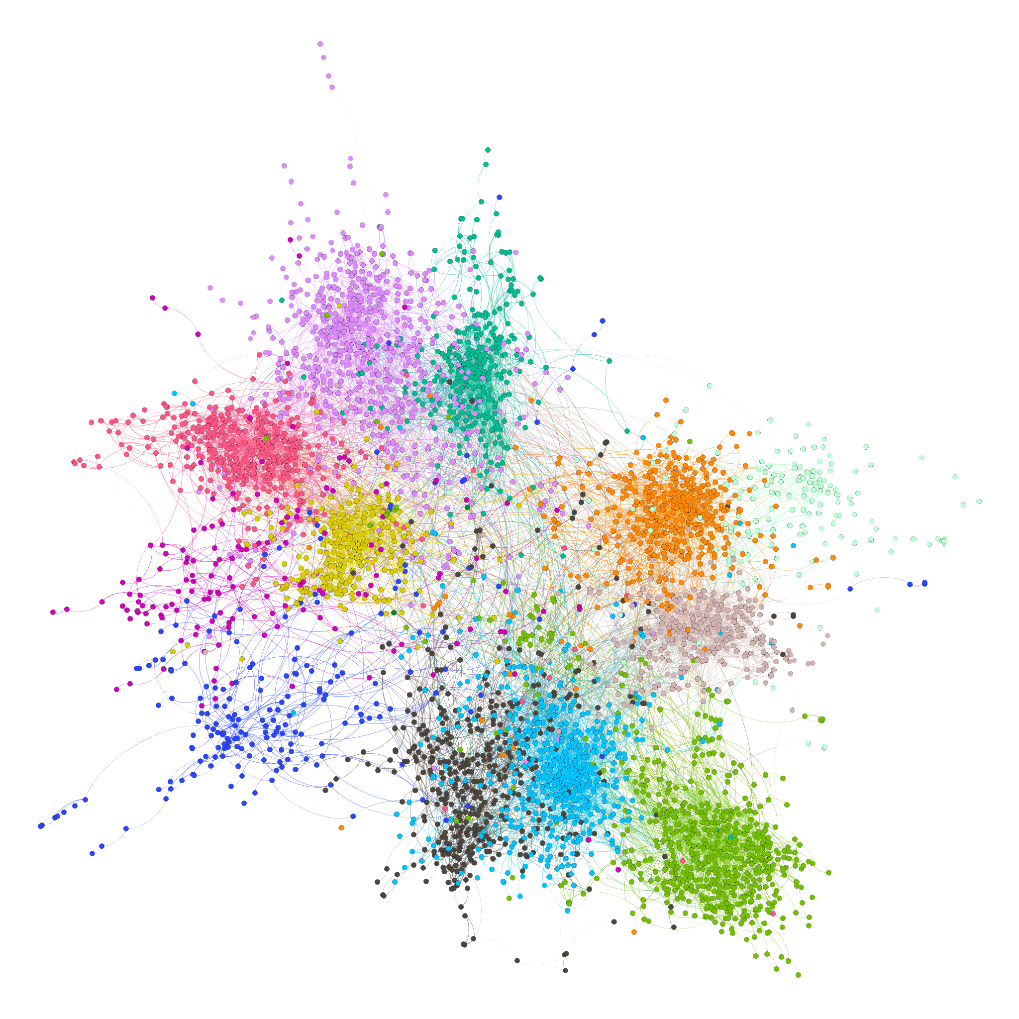
Social Networks in SEARCH
At census, adults named social contacts in 5 domains:
    Health
    Emotional Support
    Money
    Free Time
    Food
Named contacts matched to enumerated residents
Nankoma: Eastern Uganda
Notes:
At time of baseline census- adults were asked to name social contacts in 5 domains.
These named cntacts were then matched to enumerated resdients.
Showing example here of resulting social netwokr in eatern Uganda. Nodes are indiv, edge show netowrk connections (not directional here) color coded by village.
network quality- 30-60% of named contacts matched
Health: With whom have you usually discussed any kind of health issue?
Emotional support: To whom have you gone to receive emotional support?
Money: With whom have you usually discussed any type of money matters?
Free time: With whom have you usually spent time for leisure/enjoyment/relaxation?
Food: With whom [outside of household] have you shared, borrowed, received, or exchanged any food?

Slide 34
Networks and Baseline prevalent HIV
Evaluated whether having an HIV+ contact in one’s social sub-network predicted one’s baseline HIV status
  Three Kenyan communities
  After adjustment for community, demographics, and other risk factors
Social sub-networks considered:
  1st degree contacts outside household
  Overall and under each social domain
  Sub-networks stratified by sex and age
Adjusted Relative Risk (aRR) estimated by Targeted Maximum Likelihood
  Outcome and exposure propensity modeled by machine learning (Super Learner)
Multiple testing- adjusted for the number of social domains
Zheng, CROI, 2017
Notes:
As initail “proof of concept” – evaluated whether
for each adult in the community, we have their SN, their hiv status of them and HIV status of their contacts
- WE also have their risk factors
- Now we want to know if having HIV+ contacts in their SN predicted their HIV status, after adjusting for their risk factors.
- Social subnetworks considered are 1st de. Contacts oustide. Of hh, .
- we will look at sn Across all domains as well as under each domain.
- we will also stratify subnetworks by sex and age of the contacts.
- in this picture, suppose this glowing red node is a woman, all the colored nodes are its 1st deg. Contacts, red nodes are female contacts , green nodes are male contacts.
- We will use Targeted Maximum Lilkelihood to estimated the adjusted RR, wherein the outcome and..
adjusts for confounding by community, egocentric demographic information, and HIV risk factors (as described in the ‘Measurement’section)
age, sex, occupation, education, marital status, whether practice polygamy, male circumcision, household wealth, alcohol use, contraception use, depression score, anxiety score, nights spent outside main residents, months spent outside community, and number of days worked
- And we adjusted our CI for multiple testing. Boneforni – 6 tests
Outcome: ego’s baseline HIV status
Exposure: whether anyone in that group is baseline HIV+
Individual-level information collected on all residents
Age, gender, occupation, education
Marital status, polygamy, circumcision
Household wealth, days at work
Alcohol use
Contraceptive use
Migration (months away from community, nights away from home)
Depression score
Of the 15,028 adult (age>=15) residents enumerated across the 3 communities, 6,579 were men and 8,449 were women. Of these, 5374 men and 7453 women had a determinate baseline HIV test. The baseline prevalence was 12% among men and 19.5% among women. There were 2,729 young (15<=age<25) women and 2,554 young men among the adult residents in the 3 communities. 2326 of the young women had a baseline test, with a prevalence of 9.8%, and 2120 of the young men had a baseline test, with a prevalence of 1%.
There were 3110 men and 4227 women who had at least one connection within their community-wide social network. Of these, 2645 men (888 young men among them) and 3822 women (1038 young women among them) had a determinate baseline test. These individuals form the sample for our analysis. Baseline characteristics of this sample are tabulated in table 1.
----- Meeting Notes (2/9/17 10:34) -----
- exposure to social connected
-

Slide 35


Results: Predicting Baseline HIV status in Men
Risk Ratio (95% CI)
uRR: 2.1 (1.7, 2.7)
uRR: 2 (1.6, 2.4)
aRR:1.5 (1.1,2.0)
Any HIV+ female contact
Any HIV+ male contact
uRR: 2.2 (1.6,3.1)
uRR: 1.6 (1.1, 2.3)
Any HIV+ female contact 10+ yrs older
Any HIV+ male contact 10+ yrs older
Any HIV+ male contact 10+ yrs younger
Any HIV+ female contact 10+ yrs younger
Notes:
Next, we asked whether having HIV+ contacts can predict baseline risk in Men.
- before adjusting for his indivi. Risk factors, we found that. … were signif. Predictors of increased risk.
- having + younger mal, + older female, was not significant risk
- After adjusting for indiv. Risk factors, most of these associations disappear, except for having a +female, which remain signifc.
- In other words, if you are a man, having a HIV+ female contact outside of your household means you are more likelihy to be HIV+, even after adjusting for your risk factors.

Slide 36

Results: Predicting Baseline HIV status in Women
aRR: 1.4 (1.1, 1.8)
Any HIV+ male contact
Any HIV+ female contact
aRR: 1.6 (1.1, 2.5)
Any HIV+ female contact 10+ yrs older
Any HIV+ male contact 10+ yrs older
Any HIV+ male contact 10+ yrs younger
Any HIV+ female contact 10+ yrs younger
Notes:
For simplicity- showing only results sig adfter adjusting.
- After adjustment, we still find that a woman having a HIV+ male contact in general, and having an older HIV+ male contact in particular, outside of her household, is associated with increased risk.

Slide 37
Results: Predicting Baseline HIV status in Women
aRR: 1.8 (1.2,2.7)
aRR: 1.6(1.2,2.1)
Any HIV+ female contact in the HEALTH domain
Any HIV+ male contact in the EMOTIONAL domain
aRR: 1.8 (1.1, 3.0)
Any HIV+ male contact 10+ yrs older in the HEALTH domain
Notes:
- So far, we have looked at SN across any of the 5 socila domains.
- Now, We wanted to look at whether having HIV= social contacts in different domains conferred different risk
-For men , we didn’t see any significant differences.
- however for women, , we found some interesting asscoations even after adjusting for indivudla risk factors.. If you are a woman, having a HIV+ man with whom you discuss emot. Matters, or a 10 yrs older HIV+ man witho whom you discuss healh matters, means you are more likely to be HIV+ .
- Interesting, having a HIV+ female with whom to discuss health matters, also means tha tyou are more like to be HIV+ yourself.

Slide 38
Results: Predicting Baseline HIV status in Young Women (15-24 years)
Any HIV+ female contact
Any HIV+ male contact
aRR: 3.4 (1.6, 7.1)
Any HIV+ male contact 10+ yrs older
Any HIV+ female contact 10+ yrs older
Any HIV+ male contact 10+ yrs younger
Any HIV+ female contact 10+ yrs younger
Notes:
- Because young women are a known high risk group in kenya, we also looked at them separately.
- We saw very similar patterns in SN across any domain

Slide 39
Results: Predicting Baseline HIV status in Young Women (14-24 years)
aRR: 3.5 (1.2, 10)
aRR: 4.1 (1.4, 11.7)
aRR: 7.9 (3.2, 19)
Any HIV+ male contact 10+ yrs older in the HEALTH domain
Any HIV+ male contact 10+ yrs older in the FOOD domain
Any HIV+ male contact 10+ yrs older in the FREE TIME domain
Notes:
- but when we looked at HIV+ contacts in different domains, we found that …..
-
ego network ftype exp exp.group
1 young.female all male.hiv_bl 0.03 HIV+ male friend
16 young.female all female.hiv_bl 0.18 HIV+ female friend
17 young.female all old_bl10plus.male.hiv_bl 0.02 HIV+ male friend 10+ yrs older
18 young.female all old_bl10plus.female.hiv_bl 0.08 HIV+ female friend 10+ yrs older

Slide 40
Putting social networks to use….
Having HIV+ contacts in social network predicts one’s HIV status, after adjusting for individual risk factors
  Illustrates social context for shared HIV risk and HIV+ peer relationships
Longitudinal social network and seroconversion data will be available to investigate potential to:
  Predict seroconversion to inform targeted prevention and self-testing
  Enhance care cascade through peer support network
Notes:
- In conclusion, in these 3 rural kenyan communities, we found that having hiv+ social conacts predicts one’s baseline HIV status, after…
- it also illustrates social context …
- The analysis also identified previlus….
- findings may represent multiple pathways, capturing risky relationships and shared risk behavior for HIV acquisition as well peer support among those positive individuals.
- Movign forward, incorporating longi. Data on sc, we will be able to investigate whether SN will provide add. Information to predict HIV acquisition and can be used to target prep and self testing. Similarly we will be able to investigate changes in social networks among those HIV+ , and how they can be leveraged to enahce care outcomes.
----- Meeting Notes (2/9/17 10:34) -----
- bookend, the proxy part
serve as platform for intervention.
findings represent what are likely to be multiple pathways and directions of causality; e.g. the emotional domain – reverse causality (HIV+ people seeking out similar others for social support), vs. 10+years older male partners for young women likely to reflect sexual exposure

Slide 41
Next steps towards eradication: 3nd Phase
Limitations of a single static risk tool
Risk depends on context, changes over time
  Risk scores need to adapt
Adaptation process should be part of the tool
  “On line” Super Learning
Risk Score development/ performance assessment
New settings
Risk-based tool for targeting
Data
Same setting in future
Performance drop off
Notes:
Transition- social networks+ geospatial data + phylogenetics may improve our abilityt decide who is at risk.
How do we Take this to the next step, Particularly for implementation strategies
A single static risk score, no matter what methods used to construct it, is inherently limited.
Risk changes over time and place. We have region specific scores. But still expect performance ot fall off..
Further- criteria for an optimal score may change… (eg- as resources chnage)
Next step- embedded tools that take in new (context sepcific) data and output updated, location specific score.
Methods for this- tranlate into usable ground tools. Transport to new settings.

Slide 42
Next steps towards eradication: 3nd Phase
Optimizing implementation strategies
  PreP uptake/retention and HIV testing among those at high risk of infection
  Linkage and retention among those at risk of remaining non-suppressed
Different behavioral interventions/delivery mechanisms may work best for different people in different places at different times…
Notes:
What about next steps for optimizing intervention uptake? Optimizing intervention strategies...
Additional opportnities for embedded ML to to optimize uptake of interventions.
One size does not fit all. Particularly for implementation strategies aiming to influence complex behaviors.
Different approaches will work differently for different people at different times.
How do we learn which strategies work better?

Slide 43
Nested Randomized Trials
Ex: Which PrEP Delivery site results in best retention/adherence outcomes for which patients?
Classic RCT design
Home
Measure Endpoint: Adherence
Analysis: Overall and pre-specified subgroup effects
Randomize
delivery site
Clinic
Notes:
One option- nested RCTs..
Conclusion- consider a concrete exampleinvestigating in SEARCH:
Which delivery site is best?
Classic RCT design (we are doing this)
Analysis stage- classically- compare outcome sin two groups (maybe adding some prespecified subgroups).

Slide 44
Personalized Public Health
Adaptive trial design, with embedded machine learning of optimal allocation strategy
Home
Machine Learning:
Which site works better for whom?
Interim Endpoints
Randomize
delivery site
Clinic
Update randomization probabilities:
Individuals preferentially assigned the intervention
they are most likely to benefit from
Notes:
Nested RCTs great. But using classic design not taking full advantage of their protneital to learn which interventions work best for whom, nor to translate these results to changes in how intervention in the field faster.
Targeted group sequential adaptive designs for learning the optimal individualized treatment rule
• Description of targeted group sequential adaptive designs that learns the optimal individualized rule from the past groups, and assign its best
estimate to the next group.
• The targeted maximum likelihood estimator of the counterfactual mean outcome under optimal treatment rule (relative to control).
• Inference

Slide 45
Adaptive Trials for Optimal Allocation
Home
Machine Learning:
Which site works better for whom?
Randomize
delivery site
Interim Endpoints
Clinic
Output:
Optimal allocation strategy
Comparative effectiveness of optimal strategy (with inference!)
Improved power
Embedded impact: More people get the intervention that works best for them sooner

Slide 46
Ongoing, context-specific, data-driven learning
Data
Seroconversion and cascade outcomes
Conventional risk factors
Social Network
Geospatial, Phylogenetic,…
Epidemic
HIV-: New HIV infections
HIV+: Viral non-suppression
(Real time) Machine Learning
Who is at risk?
Which strategies work best for whom?
Intervention targeting
PrEP
Testing
Cascade optimization
Notes:
In sum then- envision a key role for ongoing, context sepcific data-driven learning/adaption in ending the epidemic.
As the epidemic evolves- we collect data…
Ideally- analyzed in close ot real time using machine learning methods aimed at both improving risk prediction and understanding which intervention work best for whom
Intervention deployment updated as a result
Which hopefull contributes to further suppresson and fewer new infections..

Slide 47
Conclusion
Vision: HIV epidemic elimination will be achievable through
  Integrated community-based health
  Applying and refining interventions with novel statistical, virologic and behavioral-driven field applications
We can and must adapt to changing contexts
  Data-> analysis-> result-> translation/implementation is slow and sub-optimal
Embedded self-learning systems (data-analysis-intervention cycles) as the intervention

Slide 48
Statistics Team
Laura Balzer, Harvard, U Mass., Amherst
Wenjing Zheng, UC Berkeley
Mark van der Laan, UC Berkeley

Slide 49
Funding and Support
National Institute of Allergy and Infectious Diseases (UM1AI069502 and U01AI099959 to DVH, R01AI074345 to MvdL)
PEPFAR, the Office of the Global AIDS Coordinator
Gilead sciences (Truvada donation)
UCSF-GIVI CFAR (P30 AI027763) provided indirect funding for laboratory infrastructure and TL support

Slide 51
Extra

Slide 52
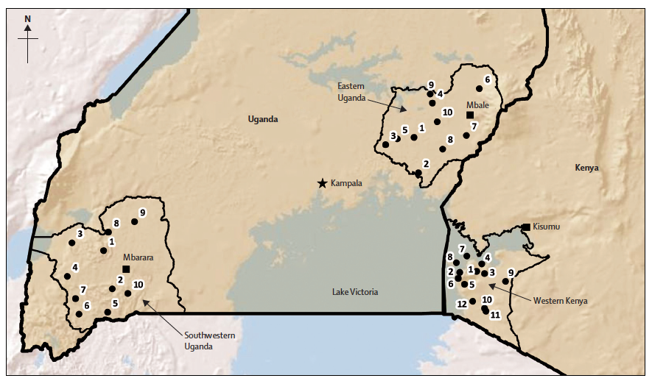
Search Communities

Slide 53
Cascade stuff

Slide 54
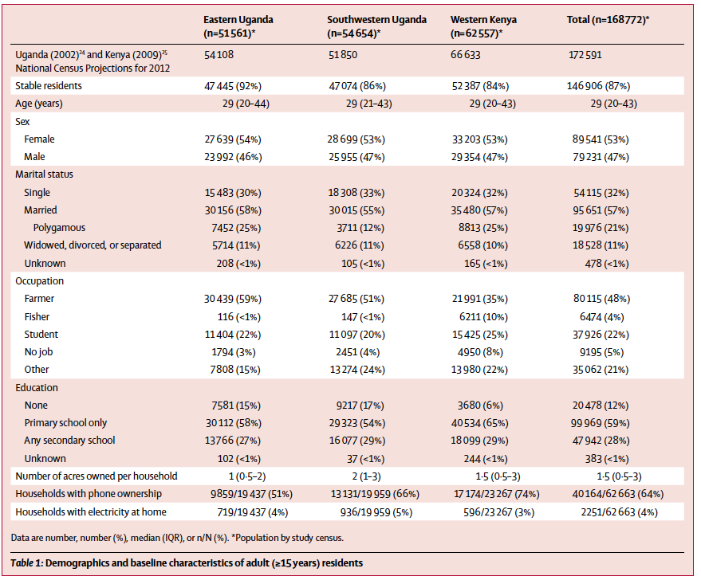
Baseline Characteristics
Chamie, Lancet HIV 2016
Notes:
146 906 (87%)
of the 168 772 enumerated adults had stable residence
(table 1). 15 582 (11%) stable adult residents reported
spending at least 1 month away from the community in
the year before enrolment, of
22% of non stable tested
90% stable
.9*.87+.22*.13

Slide 55
Baseline Characteristics among those tested
 | Kenya | W Uganda | E Uganda | Total
Stable adults (N) | 45,545 | 41,820 | 43,050 | 130,416
HIV+ | 19% | 6% | 3% | 10%
Male | 43% | 44% | 45% | 44%
Age
15-20 years | 22% | 21% | 27% | 23%
21-50 years | 57% | 60% | 56% | 58%
>50 years | 21% | 19% | 17% | 19%
Occupation
Farmer | 42% | 50% | 64% | 55%
Fisher | 11% | 0.3% | 0.2% | 4%
Student | 19% | 16% | 21% | 19%
No job | 8% | 4% | 3% | 5%
Circumcised (men) | 56% | 14% | 40% | 34%
Notes:
Note- among those with a baseline HIV test (~90%)
Our analysis sample ha the following baseline characteristics
77,773 total stable adult residents in the search intervention communities
Evenly split between regions
heterogeneity in HIV prev., overall 10%
Among the men. ~= trad vs medical
Of HIV+
57% who self reported prior HIV test, ~7% positive
Of HIV+
Ever Had an HIV Test
Yes 10,428 83.6% 64,033 54.4% 74,461 57.2%
No 2,049 16.4% 53,726 45.6% 55,775 42.8%
Result of Last Pre-Study HIV Test
Positive 7,836 75.3% 90 0.1% 7,926 10.6%
Negative 2,468 23.7% 63,473 99.2% 65,941 88.6%
Don't Know 103 1.0% 453 0.7% 556 0.7%
Ever Seen a Doctor for HIV Care
Yes 7,481 95.5% N/A - 7,481 95.5%
No 355 4.5% N/A - 355 4.5%
Taken Antiretrovirals in Past 3 Months
Yes 5,696 72.9% N/A - 5,696 72.9%
No 2,114 27.1% N/A - 2,114 27.1%

Slide 56
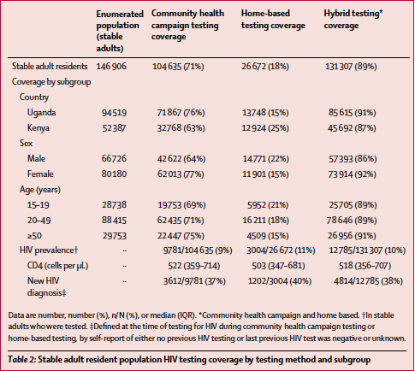
Baseline testing coverage

Slide 57
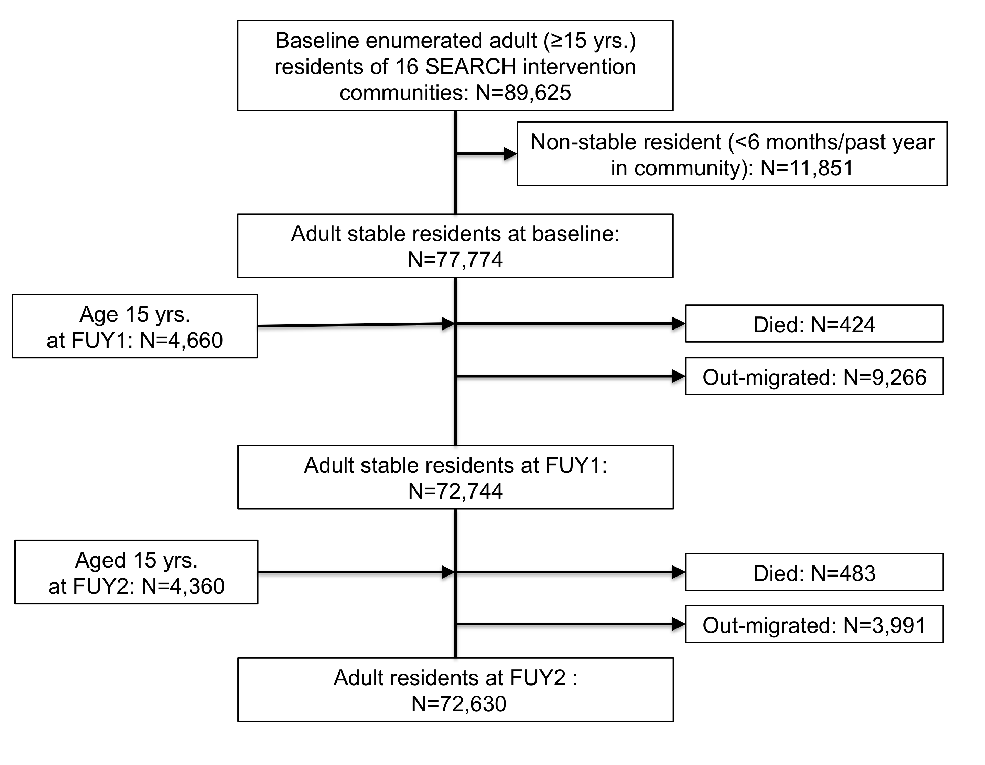

Slide 58
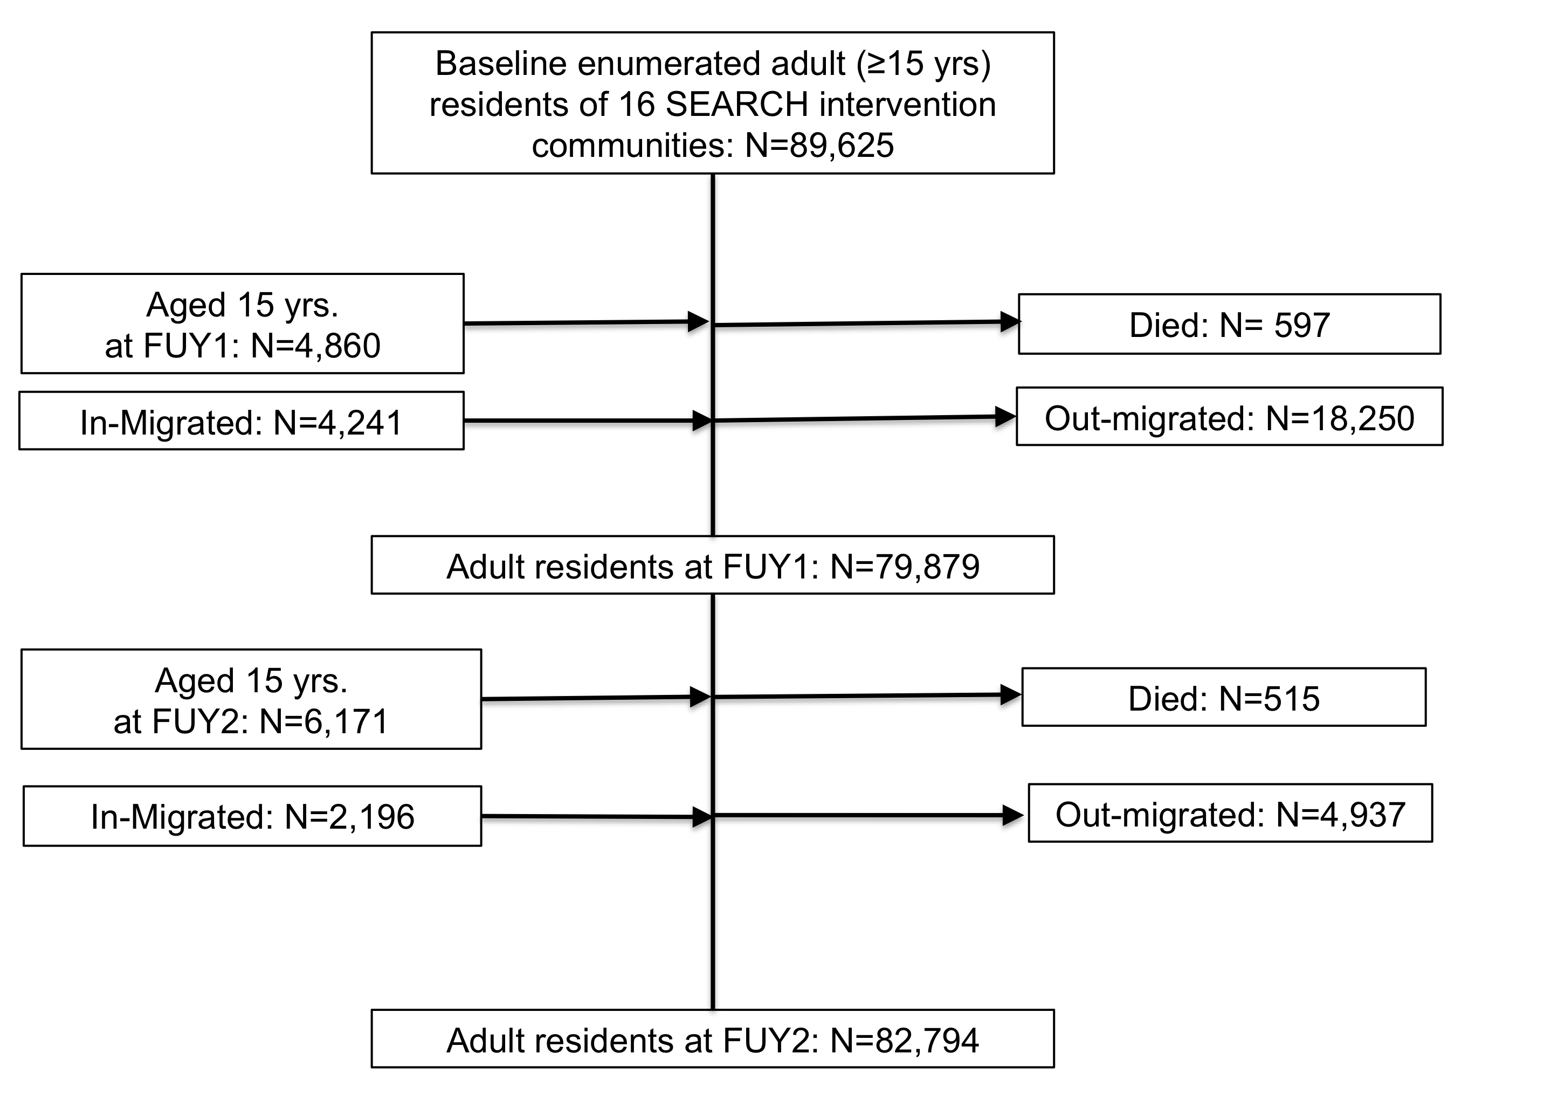

Slide 59
Cascade Evolution Among Men Tested HIV+ at Baseline
Viral Suppression
Viral Failure
Prior Dx, no ART
New Diagnosis
Migrated
Died
Notes:
Among men, story is similar, close much of the initial gap in cascade coverage over two years. (84% with survival analysis)

Slide 60
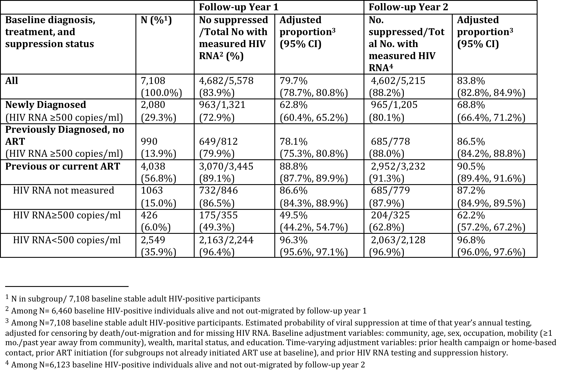
Notes:
Maong newly Dxd, and no prior art, ~50% CD4>500, 66%>350 outcomes about same as overall.

Slide 61
Prep and SL stuff

Slide 62
Super Learning
  “Black Box” risk classification
  Competition between algorithms
    Logistic main term
    Classification and regression trees
    Bayesian generalized linear models
    LASSO
    With Range of pre-screening approaches
  Internal cross-validation to build optimal convex combination

Slide 63
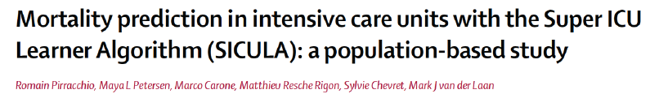
Super Learner-
Improves on alternative machine learning algorithms
Pirracchio et al, Lancet Resp Med 2015
Notes:
24,508 ICU patients were included. Roc curve.
BACKGROUND:
Improved mortality prediction for patients in intensive care units is a big challenge. Many severity scores have been proposed, but findings of validation studies have shown that they are not adequately calibrated. The Super ICU Learner Algorithm (SICULA), an ensemble machine learning technique that uses multiple learning algorithms to obtain better prediction performance, does at least as well as the best member of its library. We aimed to assess whether the Super Learner could provide a new mortality prediction algorithm for patients in intensive care units, and to assess its performance compared with other scoring systems.
METHODS:
From January, 2001, to December, 2008, we used the Multiparameter Intelligent Monitoring in Intensive Care II (MIMIC-II) database (version 26) including all patients admitted to an intensive care unit at the Beth Israel Deaconess Medical Centre, Boston, MA, USA. We assessed the calibration, discrimination, and risk classification of predicted hospital mortality based on Super Learner compared with SAPS-II, APACHE-II, and SOFA. We calculated performance measures with cross-validation to avoid making biased assessments. Our proposed score was then externally validated on a dataset of 200 randomly selected patients admitted at the intensive care unit of Hôpital Européen Georges-Pompidou, Paris, France, between Sept 1, 2013, and June, 30, 2014. The primary outcome was hospital mortality. The explanatory variables were the same as those included in the SAPS II score.
FINDINGS:
24,508 patients were included, with median SAPS-II of 38 (IQR 27-51) and median SOFA of 5 (IQR 2-8). 3002 of 24,508 (12%) patients died in the Beth Israel Deaconess Medical Centre. We produced two sets of predictions based on the Super Learner; the first based on the 17 variables as they appear in the SAPS-II score (SL1), and the second, on the original, untransformed variables (SL2). The two versions yielded average predicted probabilities of death of 0·12 (IQR 0·02-0·16) and 0·13 (0·01-0·19), whereas the corresponding value for SOFA was 0·12 (0·05-0·15) and for SAPS-II 0·30 (0·08-0·48). The cross-validated area under the receiver operating characteristic curve (AUROC) for SAPS-II was 0·78 (95% CI 0·77-0·78) and 0·71 (0·70-0·72) for SOFA. Super Learner had an AUROC of 0·85 (0·84-0·85) when the explanatory variables were categorised as in SAPS-II, and of 0·88 (0·87-0·89) when the same explanatory variables were included without any transformation. Additionally, Super Learner showed better calibration properties than previous score systems. On the external validation dataset, the AUROC was 0·94 (0·90-0·98) and calibration properties were good.
INTERPRETATION:
Compared with conventional severity scores, Super Learner offers improved performance for predicting hospital mortality in patients in intensive care units. A user-friendly implementation is available online and should be useful for clinicians seeking to validate our score.

Slide 64
Self-Assessed HIV Risk
One Kenyan Community:
  3973 adults HIV-negative at campaign or home test
High Risk:
Machine Learning
N=810 (20%)
High Risk:
Self Assessment
(no counseling):
N=675 (17%)
Both:
N=186
(4%)
Machine Learning Risk predicts Self Assessed Risk
Only 23% of Individuals identified as PrEP eligible by Machine Learning perceived themselves at risk
Ayieko, CROI, 2017
Notes:
Have started > 2000 people. Data very preliminary- early days. Investigation of cascade, uptake, barriers forthcoming.
But immediate question raised- how does self perception of risk coincide with Escore.
These are data from first Kenya community. PreP Not being rolled out (phase 2 control). So minus the couseling and sensitization. And escore not used in real time. But can still assess overlap between emprical and self percieved risk.. Roughtly 23% empircally at risk (high risk area- % varies by region). And slightly less perceived themselves at risk.
Nyatototo- seen at FUY3.
OR 1.7

Slide 65
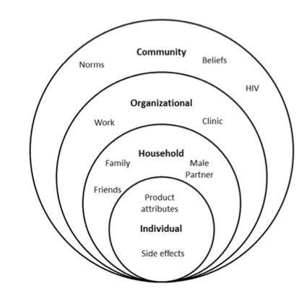
Barriers to PrEP uptake
PrEP is witchcraft
PrEP conveys promiscuity
Local Health care authorities workers don’t know about PrEP
Confidentiality at health center
Marital tension
Okay to share pills
Protects against STI
Misperceptions about Risk
Distrust on HIV status
van der Straten A. PLoS ONE 2014.
Notes:
Data from qualitative interviews, some quantitative surveys revealed...

Slide 66
Network Stuff

Slide 67
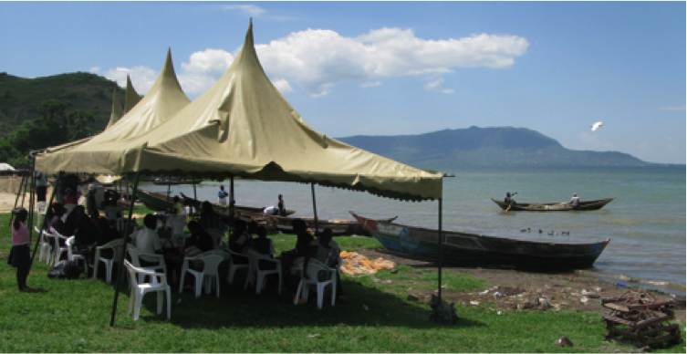
Methods – Study Population & Measures
  Population:
  Adult (≥15 years) Residents in 3 rural Kenyan communities enumerated in baseline census of the SEARCH “Test and Treat” Trial (NCT01864603)
Measures
    Baseline HIV status: Community-wide health campaigns with home-based testing for non-attendees (Chamie, Lancet HIV, 2016)
    Demographics
    Risk Factors:
    - Polygamy
    - Circumcision
    - Household wealth, days at work
    - Alcohol use
    - Contraceptive use
    - Migration (months, nights away)
    - Depression score
Notes:
We also measured a range of demographics and other risk factors such as polygamy, circumcision and others.
----- Meeting Notes (2/9/17 10:34) -----
map of region here.

Slide 68
Results – Study population: High testing coverage, heterogeneity in prevalence.
 | % (N) | Testing Coverage | HIV prevalence
Total | 15,028 | 85% (12,827) | 16% (2,109)
Men | 44% (6,579) | 82% (5,374) | 12% (655)
Women | 56% (8,449) | 88% (7,453) | 19.5% (1,454)
Young (15-24) men | 17% (2,554) | 83% (2,120) | 1% (21)
Young women | 18% (2,729) | 85% (2,326) | 9.8% (228)
Single | 30% (4,529) | 82% (3,693) | 2.8% (106)
Married | 58% (8,671) | 87% (7,504) | 20% (1,530)
Widow/Div/Sep | 12% (1,781) | 89% (1,593) | 30% (473)
Notes:
- Now, let’s look at our study population in these 3 comm. .
There are 15K adults, 85% tested for HIV at baseline, and the prevalence was 16% overall,
Preve. Was 12% in men, 19% in women.
- as seen around in sub-saharan africa, among 15-24 yr old, the prevalecne women was 10%, and the in men was 1%.
----- Meeting Notes (2/9/17 10:34) -----
- high testing coverage, hetero prevalence

Slide 69
Adult (≥15 years) Residents in 3 rural Kenyan communities enumerated in baseline census
Social Networks of adult residents
Purple nodes: HIV-
Yellow: HIV+ young (15-24) men
Red: HIV+ young women
Blue: HIV+ older (>=25) adult men
Green: HIV+ older adult women
Notes:
So what do the SN look like?
- Nodes represent individuals, links represent social interactions across the 5 domains. .
- This is a dense and highly interconnected network.
It’s different from sex network or needle-sharing network, which are typically less dense and consist of smaller clusters.

Slide 70
Results: Predicting Baseline HIV status in Men
Risk Ratio (95% CI)
uRR: 2.1 (1.7, 2.7)
uRR: 2 (1.6, 2.4)
aRR:1.5 (1.1,2.0)
Any HIV+ female contact
Any HIV+ male contact
uRR: 2.2 (1.6,3.1)
uRR: 1.6 (1.1, 2.3)
Any HIV+ female contact 10+ yrs older
Any HIV+ male contact 10+ yrs older
Any HIV+ male contact 10+ yrs younger
Any HIV+ female contact 10+ yrs younger
Notes:
Next, we asked whether having HIV+ contacts can predict baseline risk in Men.
- before adjusting for his indivi. Risk factors, we found that. … were signif. Predictors of increased risk.
- having + younger mal, + older female, was not significant risk
- After adjusting for indiv. Risk factors, most of these associations disappear, except for having a +female, which remain signifc.
- In other words, if you are a man, having a HIV+ female contact outside of your household means you are more likelihy to be HIV+, even after adjusting for your risk factors.
MULTIPLE TEST ADJUSTMENT FOR uRR CI!!!!
----- Meeting Notes (2/9/17 10:34) -----
- bigger skirt for the woman
- BOLD for MEN. WOMEN.
- semantic phrase to guide.

Slide 71
Results: Predicting Baseline HIV status in Women
Risk Ratio (95% CI)
uRR: 1.4 (1.1, 1.7)
uRR: 1.4(1.2,1.6)
aRR: 1.4 (1.1, 1.8)
Any HIV+ female contact
Any HIV+ male contact
uRR: 0.5 (0.2, 0.9)
uRR: 1.9 (1.4, 2.6)
uRR: 1.4 (1.2, 1.8)
aRR: 1.6 (1.1, 2.5)
Any HIV+ female contact 10+ yrs older
Any HIV+ male contact 10+ yrs older
Any HIV+ male contact 10+ yrs younger
Any HIV+ female contact 10+ yrs younger
Notes:
Fix animation: uRR all at once, then aRR.
- Among women, we observe that having HIV+ male or female, as well as having a hiv+ older male were significant risk factrs.
- After adjustment, we still find that for a woman having a HIV+ male contact in general, and having an older HIV+ male contact in particular, outside of her household, is associated with increased risk.

Slide 72
Results: Predicting Baseline HIV status in Women (cont’d)
Risk Ratio (95% CI)
aRR: 1.8 (1.2,2.7)
aRR: 1.6(1.2,2.1)
Any HIV+ female contact in the HEALTH domain
Any HIV+ male contact in the EMOTIONAL domain
aRR: 1.8 (1.1, 3.0)
Any HIV+ male contact 10+ yrs older in the HEALTH domain
Notes:
- So far, we have looked at SN across any of the 5 socila domains.
- Now, We wanted to look at whether having HIV= social contacts in different domains conferred different risk
-For men , we didn’t see any significant differences.
- however for women, , we found some interesting asscoations even after adjusting for indivudla risk factors.. If you are a woman, having a HIV+ man with whom you discuss emot. Matters, or a 10 yrs older HIV+ man witho whom you discuss healh matters, means you are more likely to be HIV+ .
- Interesting, having a HIV+ female with whom to discuss health matters, also means tha tyou are more like to be HIV+ yourself.

Slide 73
Results: Predicting Baseline HIV status in Young (15-24) Women
Risk Ratio (95% CI)
uRR: 2.8 (1.6, 5.0)
uRR: 1.8 (1.2, 2.6)
Any HIV+ female contact
Any HIV+ male contact
uRR: 3.7 (2.1, 6.5)
aRR: 3.4 (1.6, 7.1)
Any HIV+ male contact 10+ yrs older
Any HIV+ female contact 10+ yrs older
Notes:
- Because young women are a known high risk group in kenya, we also looked at them separately.
- We saw very similar patterns in SN across any domain

Slide 74
Results: Predicting Baseline HIV status in Young Women (cont’d)
Risk Ratio (95% CI)
aRR: 3.5 (1.2, 10)
aRR: 4.1 (1.4, 11.7)
aRR: 7.9 (3.2, 19)
Any HIV+ male contact 10+ yrs older in the HEALTH domain
Any HIV+ male contact 10+ yrs older in the FOOD domain
Any HIV+ male contact 10+ yrs older in the FREE TIME domain
Notes:
- but when we looked at HIV+ contacts in different domains, we found that …..
-
ego network ftype exp exp.group
1 young.female all male.hiv_bl 0.03 HIV+ male friend
16 young.female all female.hiv_bl 0.18 HIV+ female friend
17 young.female all old_bl10plus.male.hiv_bl 0.02 HIV+ male friend 10+ yrs older
18 young.female all old_bl10plus.female.hiv_bl 0.08 HIV+ female friend 10+ yrs older

Slide 75
Summary of stable adult networks (Uganda)
 | nodes | undir. links | Avg. deg | Avg. path lengths | % nodes in largest component
Kamuge | 4810 | 25148 | 10 | 5 | 95%
Nsiinze | 4360 | 5532 | 2.5 | 7.8 | 75%
Nankoma | 4784 | 11109 | 4.6 | 6.1 | 86%
Bugono | 3897 | 15001 | 7.7 | 5.5 | 93%
Muyembe | 5242 | 12552 | 4.8 | 7.1 | 84%
Kiyeyi | 4940 | 14513 | 5.9 | 5.8 | 89%
Rugazi | 4397 | 15221 | 6.9 | 6.1 | 93%
Mitooma | 4982 | 18357 | 7.4 | 5.8 | 95%
Kitwe | 4377 | 14773 | 6.7 | 6.3 | 94%
Rubaare | 4534 | 12267 | 5.4 | 6.7 | 90%
Bugamba | 5640 | 27931 | 9.9 | 5.4 | 96%
Rwashamire | 4346 | 8747 | 4.0 | 7.7 | 86%
Ruhoko | 4180 | 10522 | 5.0 | 6.9 | 89%
Nyamuyanja | 3952 | 8949 | 4.5 | 7.0 | 88%

Slide 76
Summary of stable adult networks (Kenya)
 | nodes | undir. links | Avg. deg | Avg. path lengths | % nodes in largest component
Nyatoto | 5172 | 3401 | 1.3 | 8.5 | 45%
Magunga | 4672 | 4926 | 2.1 | 8 | 64%
Ogongo | 5318 | 6589 | 2.4 | 7.5 | 72%
Nyamrisra | 3962 | 2704 | 1.4 | 9.8 | 47%
Kisegi | 4654 | 4133 | 1.8 | 6.2 | 52%

Slide 77
Social Networks in SEARCH
At census, adults named social contacts in 5 domains:
  Health
  Emotional Support
  Money
  Free Time
  Food
Named contacts matched to enumerated residents
Kamuge: Eastern Uganda
Notes:
At time of baseline census- adults were asked to name social contacts in 5 domains.
These named cntacts were then matched to enumerated resdients.
Showing example here of resulting social netwokr in eatern Uganda. Nodes are indiv, edge show netowrk connections (not directional here) color coded by village.
Kamuge, Eastern Uganda.
23,127 nodes, 55,384 edges over five types of connections
Health: With whom have you usually discussed any kind of health issue?
Emotional support: To whom have you gone to receive emotional support?
Money: With whom have you usually discussed any type of money matters?
Free time: With whom have you usually spent time for leisure/enjoyment/relaxation?
Food: With whom [outside of household] have you shared, borrowed, received, or exchanged any food?

