Slide 1
Improving the evidence-base for epidemic and pandemic preparedness
Monday April 16th
Institute for Disease Modelling Symposium 2018
David Pigott – pigottdm@uw.edu
Institute for Health Metrics and Evaluation, University of Washington

Slide 2
Key questions
Where could emergence occur?
Where are we most vulnerable to continued transmission?
How should we prepare and track progress?
AIM
To synthesize existing global information to provide data-driven evaluations of these questions
Today will look at some approaches to this, and what we can do to iterate and improve

Slide 3
Where could emergence occur?

Slide 4
Which pathogens to focus on?
WHO R & D Blueprint designed as a mechanism to identify pathogens to prioritise research and development
February 2018 update
  Crimean-Congo haemorrhagic fever
  Ebola and Marburg virus disease
  Lassa fever
  MERS-CoV and SARS
  Nipah and henipaviral diseases
  Rift Valley Fever
  Zika
  Disease X

Slide 5
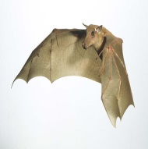

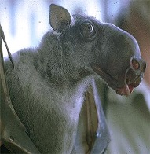
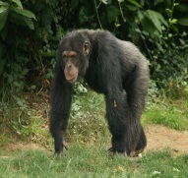
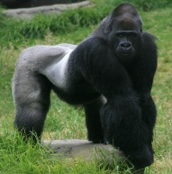
Suspected life-cycle of Ebolavirus
Notes:
Discussion of ecology of EBV
Red – represents known/suspected transmission routes
Blue – represents hypothesised links
Although advances made in recent years, there is still much to know (m and n)
Discuss problems of identifying the true zoonotic reservoir of the disease as hard to test ethically/limited data to go on

Slide 6
Reported Ebola infections
Notes:
Provenance of data: most representative depiction of where zoonotic transmission occurred as far as information in literature allows
Humans left: note the uniqueness of Guinea and Tai Forest
Animals right: Great apes – primarily in and around Odzala national park and Lossi Animal Sanctuary

Slide 7
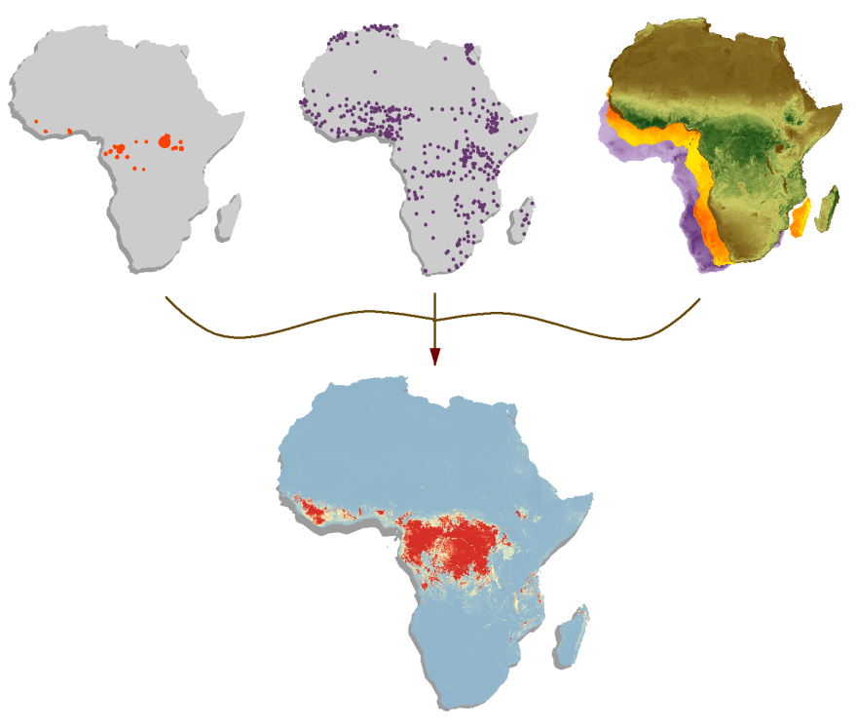
Ebola
Ebola index cases
Background samples
Covariates

Slide 8
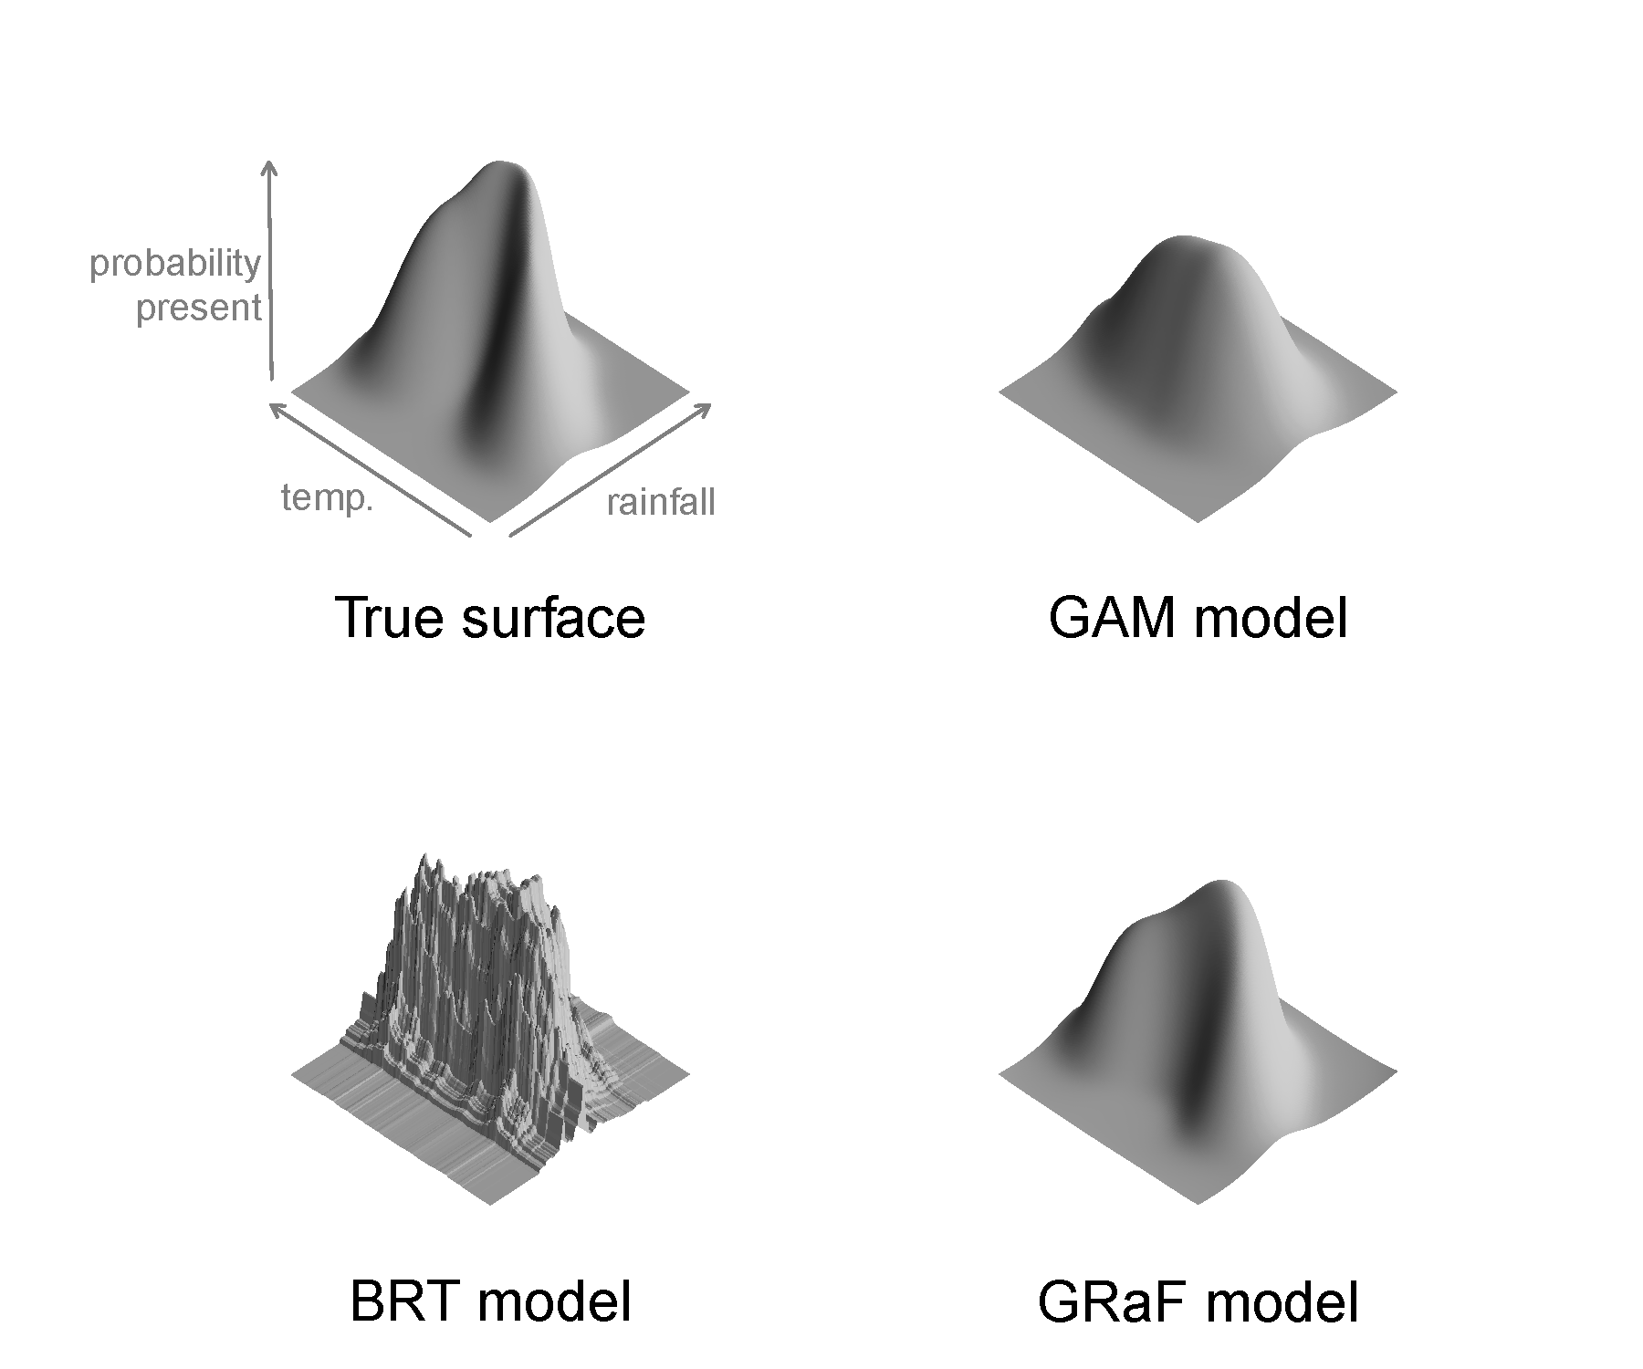
Species distribution models
Using models to interpret variation in reported occurrences within environmental space
  Extract environmental correlates at case/control locations
  Model suitability as a non-linear function of environmental correlates
  Make predictions for all other cells
  Picture: Nick Golding
Notes:
Species distribution models attempt to characterise the variation seen in observed reports of an event (whether it be a sighting of a particular species or an occurrence of a particular disease) by investigating variation in environmental space.
For each record, environmental information is extracted and the model evaluates suitability based upon a non-linear function of these environmental correlates. This suitability surface can then be used to predict likely presence in other cells based upon their similarity in environmental space to locations that already have reported occurrences
The figure below shows how a species distribution model, specifically one called a boosted regression tree attempts to define the relationship between probability of presence and temperature and rainfall. The graph on the left shows the true relationship within environmental space; the one on the right is the modelled characterisation of this relationship.

Slide 9
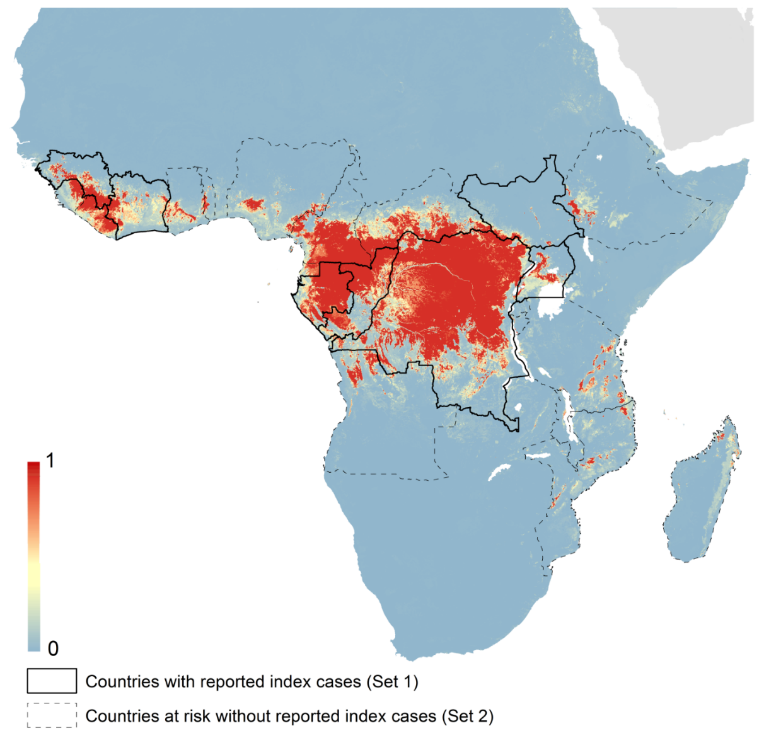
Environmental suitability for EVD
Pigott, Golding et al. 2014 eLife

Slide 10

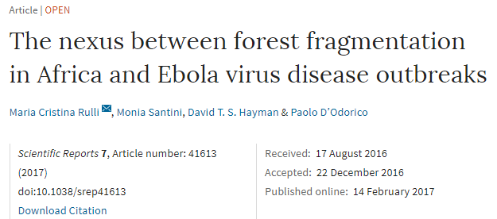
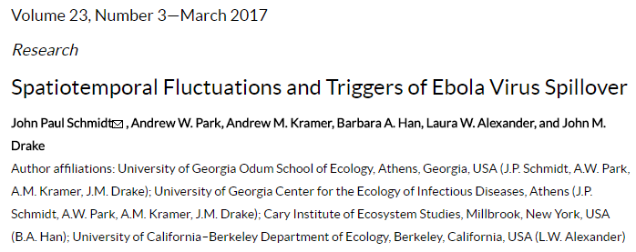
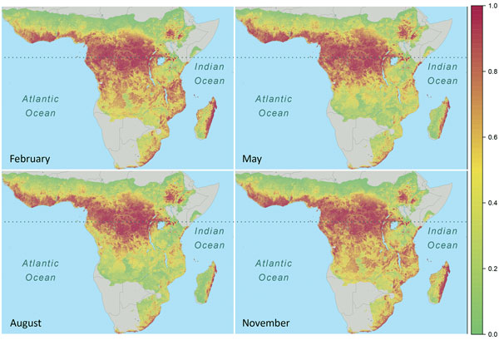
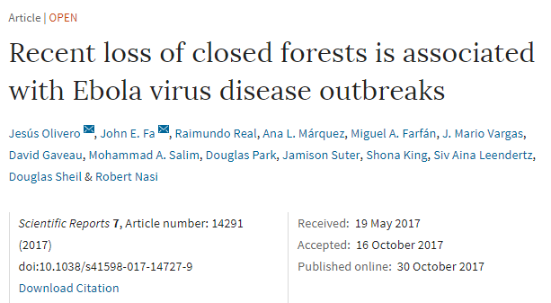
A baseline for further iteration
Seasonality
Flux

Slide 11
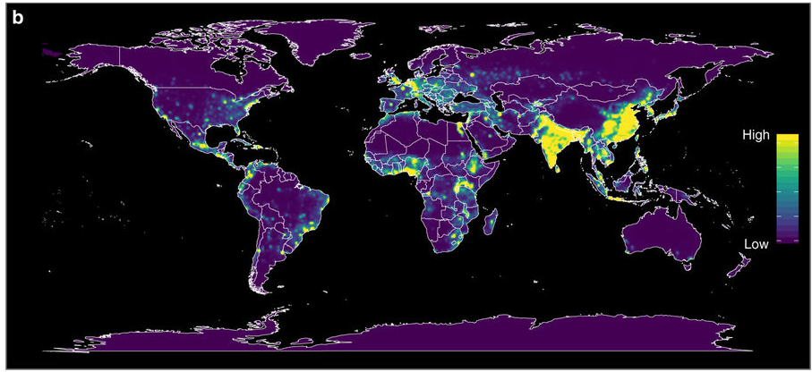
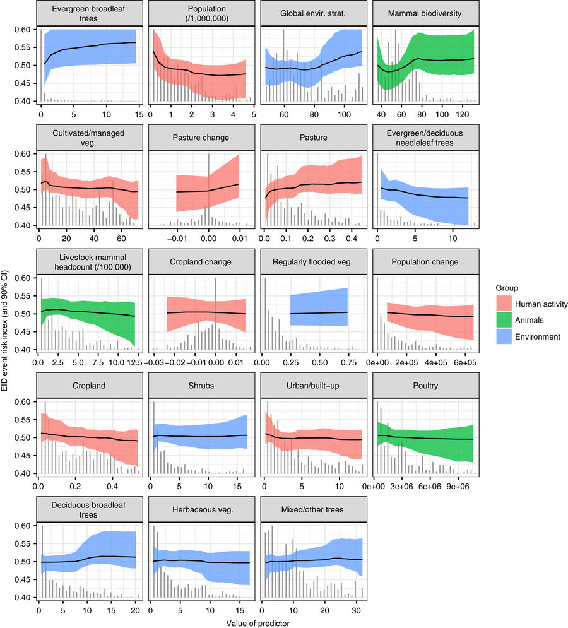
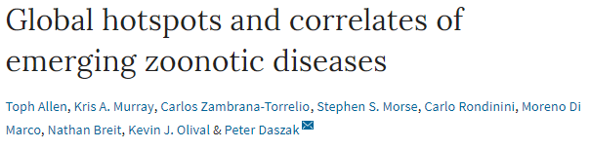
What about Disease X?

Slide 12
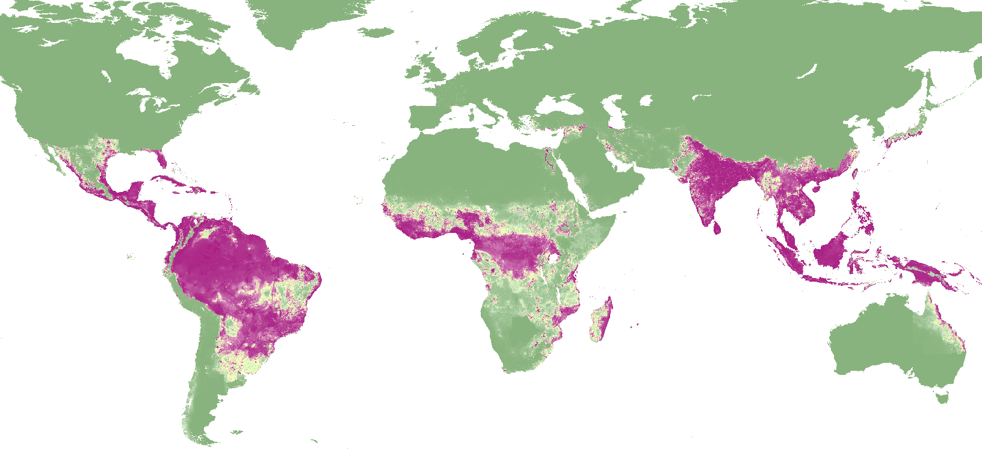

Mechanism to maintain contemporariness?
ABRAID – Atlas of Baseline Risk Assessment for Infectious Disease
Dengue environmental suitability
in collaboration with

Slide 13
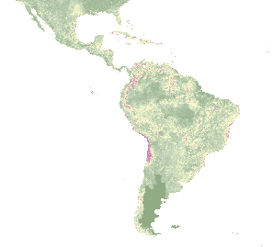
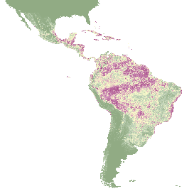
Evaluating the time series of environmental approaches
How do a time series of suitability maps evolve? Converging on a commonality, or iteratively responding to epidemiological change?
Using information theory to provide insights as to how “new data” influences model evolution
Investigating the time series of Zika
Hypothetical example

Slide 14
Where are we most vulnerable to continued transmission?

Slide 15

Identifying those most vulnerable
“And I have come to realise that the world expects WHO to do three things. To keep the world safe, to improve health, and to serve the vulnerable”
Tedros Adhanom Ghebreyesus

Slide 16
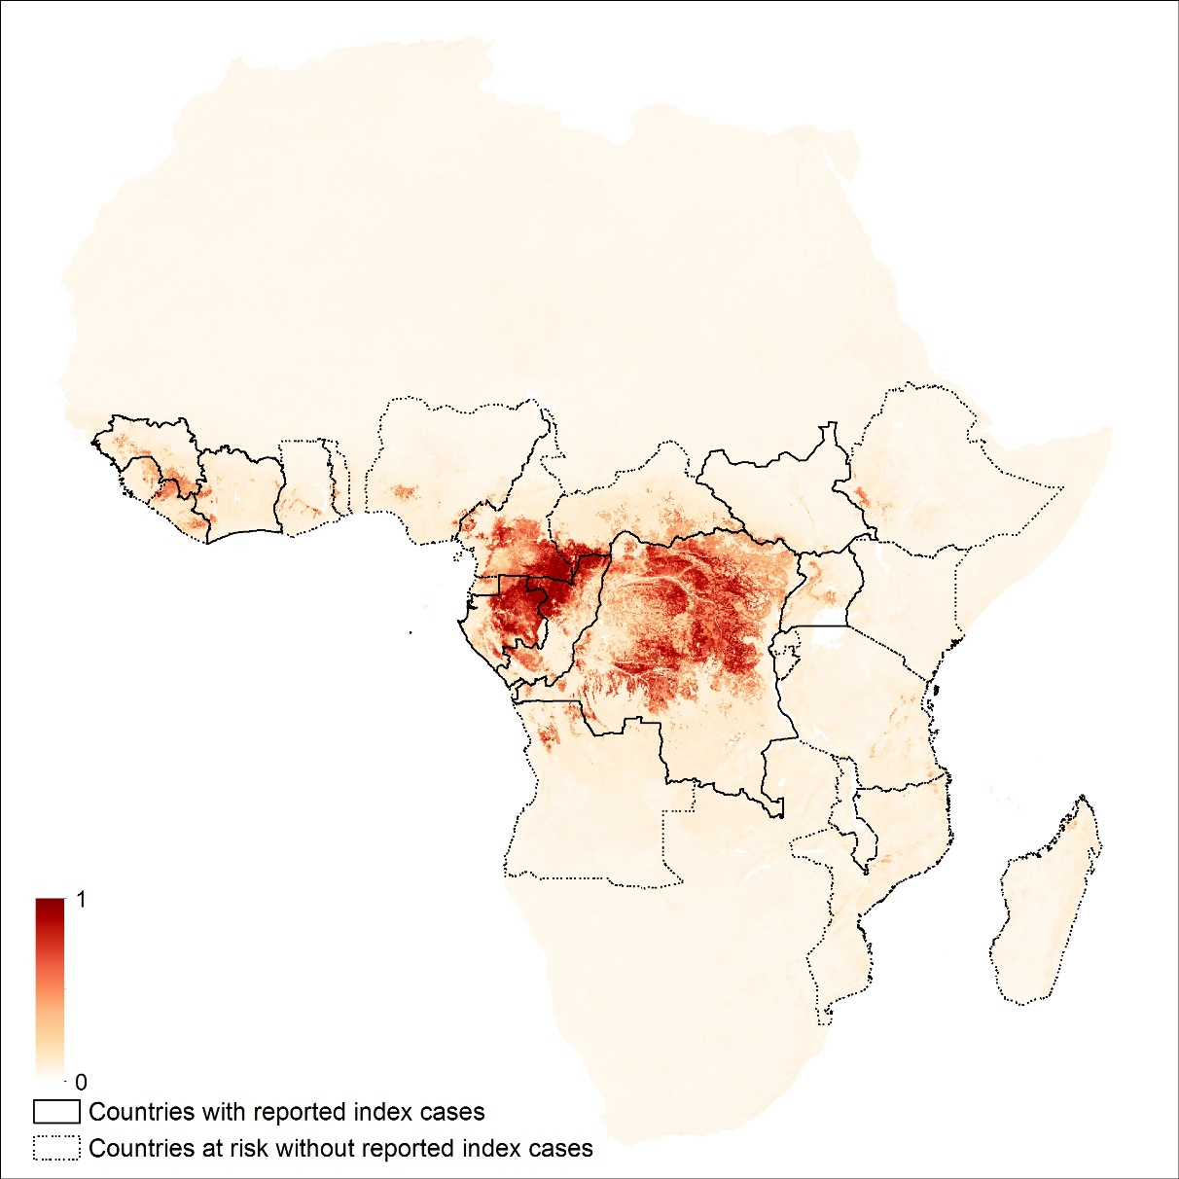
Finding those most vulnerable to these pathogens

Slide 17
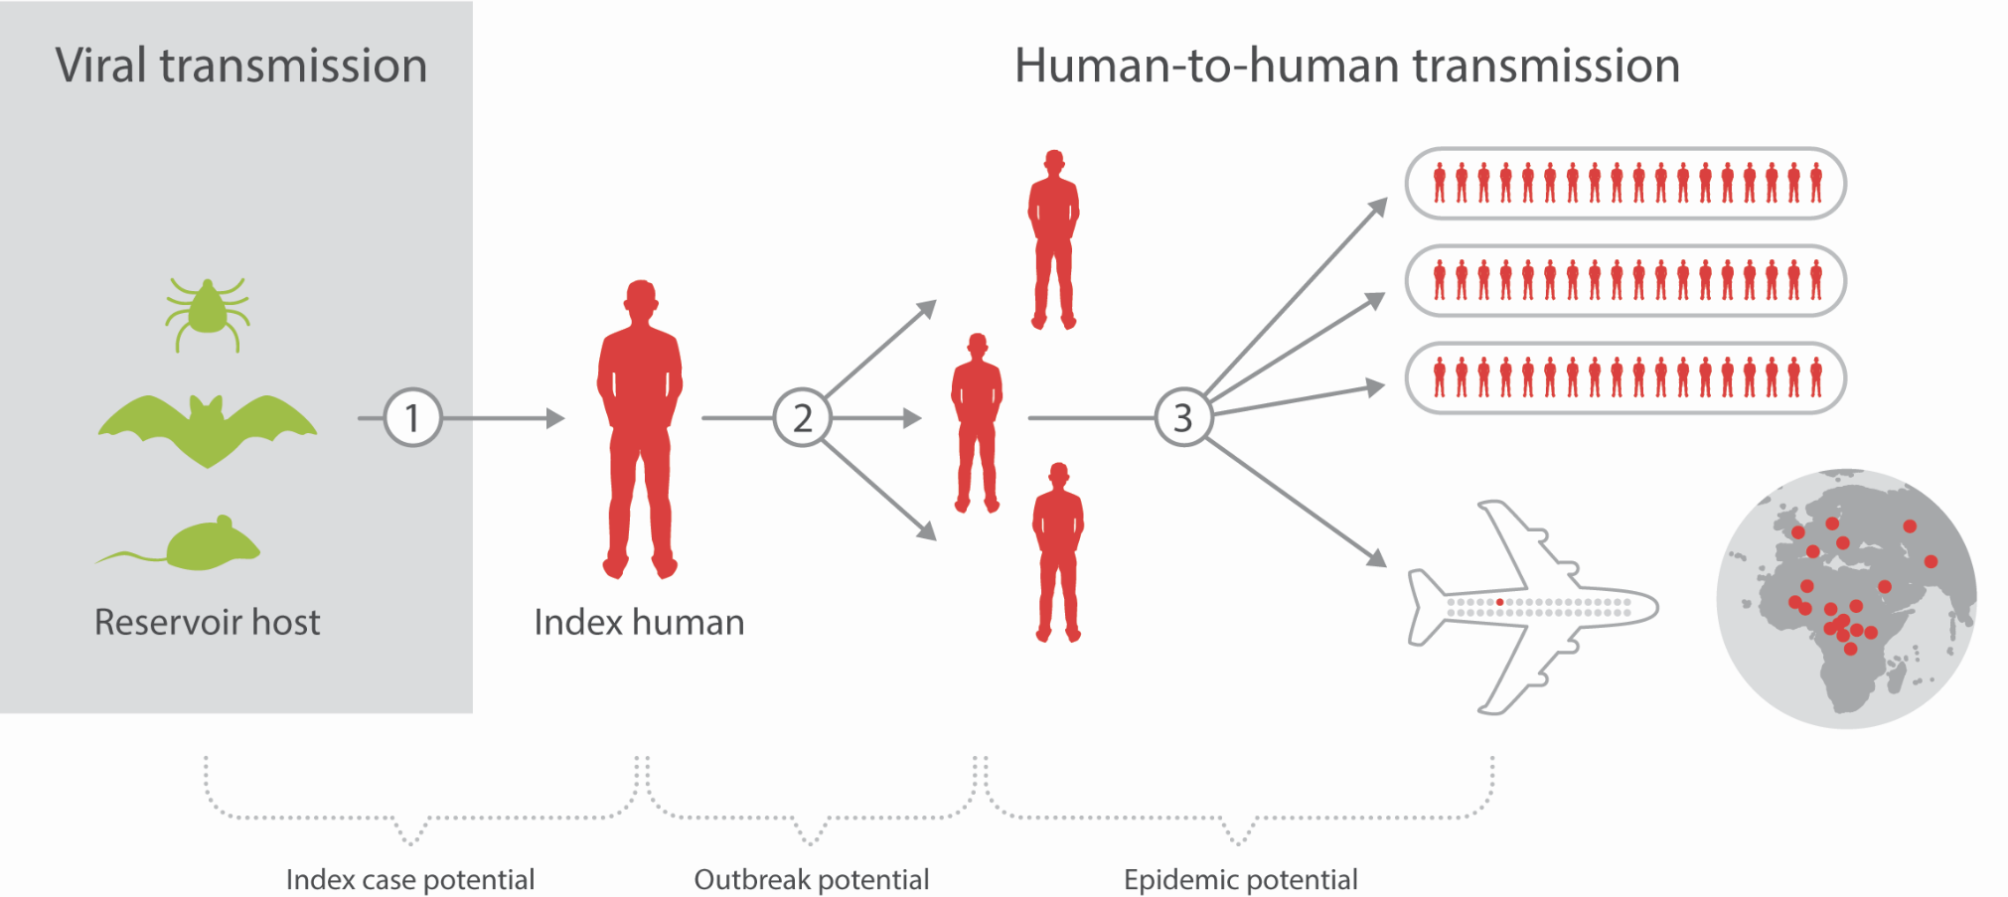
Spatial Dynamics of Viral Hemorrhagic Fevers
Human movement modelling
Species distribution modelling to define extent of zoonotic niche
Quantifying spatial heterogeneities in vulnerability
Notes:
Three stages in a hypothetical outbreak – all of which have independent modelling processes behind them
Seek to unify these methods and pre-emptively describe areas of greatest potential for infectious disease spread PRIOR to index cases presenting.
Each stage corresponds to a suite of possible interventions and preparedness measures e.g. Stage 1 – surveillance, Stage 2 – provisioning of medical supplies, Stage 3 – where to focus ring vaccination

Slide 19
Defining areas at-risk
Notes:
Convert Niche Maps/Environmental suitability outputs into binary estimate

Slide 20
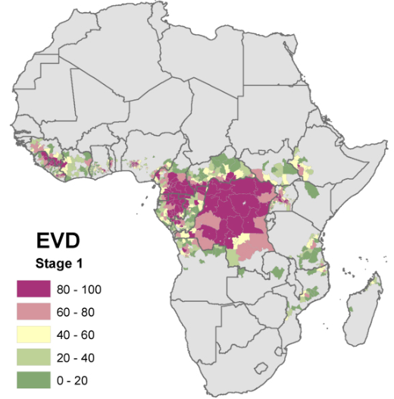
Stage 1 – Spillover Potential
Pigott et al. 2017 The Lancet
Notes:
Pair Population with At-risk classification and rank - areas in purple have greatest spillover potential i.e. where index cases are more likely to present

Slide 21
Potential vulnerabilities in rapid detection?

Slide 22
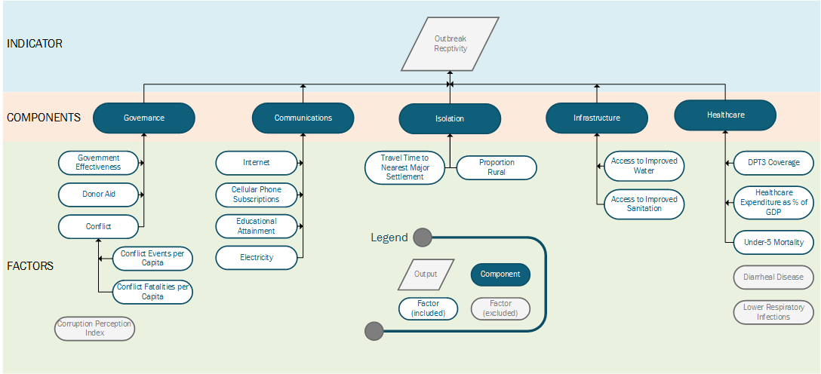
Composite Indicator of Outbreak Receptivity
Notes:
Composite Indicator aimed at classifying districts across Africa most likely to have secondary transmission due to population vulnerabilities and existing infrastructure

Slide 23
Outbreak Receptivity
Pigott et al. 2017 The Lancet
Notes:
Assessed at district level – Red identifies districts hypothesized to most likely see secondary human-to-human transmission

Slide 24
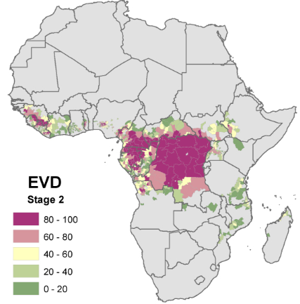
Stage 2 – Outbreak Potential
Pigott et al. 2017 The Lancet
Notes:
Pair Stage 1 Spillover Potential with Outbreak Receptivity and rank - areas in purple have greatest outbreak potential i.e. where most likely to have localized secondary transmission

Slide 25
Travel metrics
Pigott et al. 2017 The Lancet
Notes:
Left – Average travel time to nearest major city [50,000 + people]
Right – Outbound passenger numbers [Green highest #s]

Slide 26
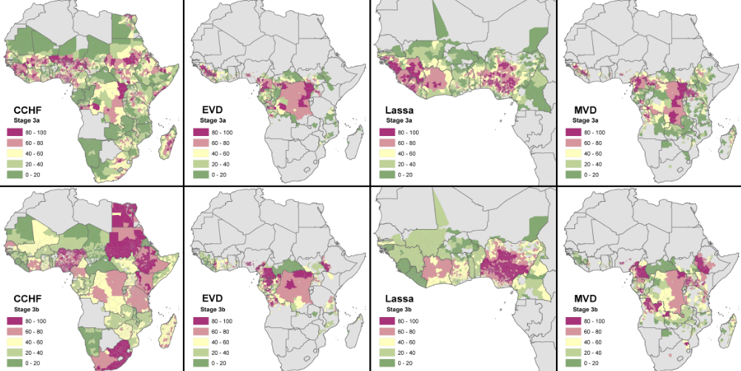
Stage 3 – Epidemic Potential
Pigott et al. 2017 The Lancet
Notes:
Pair Stage 2 Outbreak Potential with respective travel metrics and rank - areas in purple have greatest epidemic potential
Stage 3a – districts most likely to act as seeds of outbreaks in other location
Stage 3b – districts most likely to act as seeds of cases in international locations
Guecekedou province is in 98th percentile of at-risk districts for EVD

Slide 27
How should we prepare and track progress?

Slide 28
Identifying those most vulnerable
“And I have come to realise that the world expects WHO to do three things. To keep the world safe, to improve health, and to serve the vulnerable”
Tedros Adhanom Ghebreyesus
Aim to make a billion people safer from public health emergencies

Slide 29
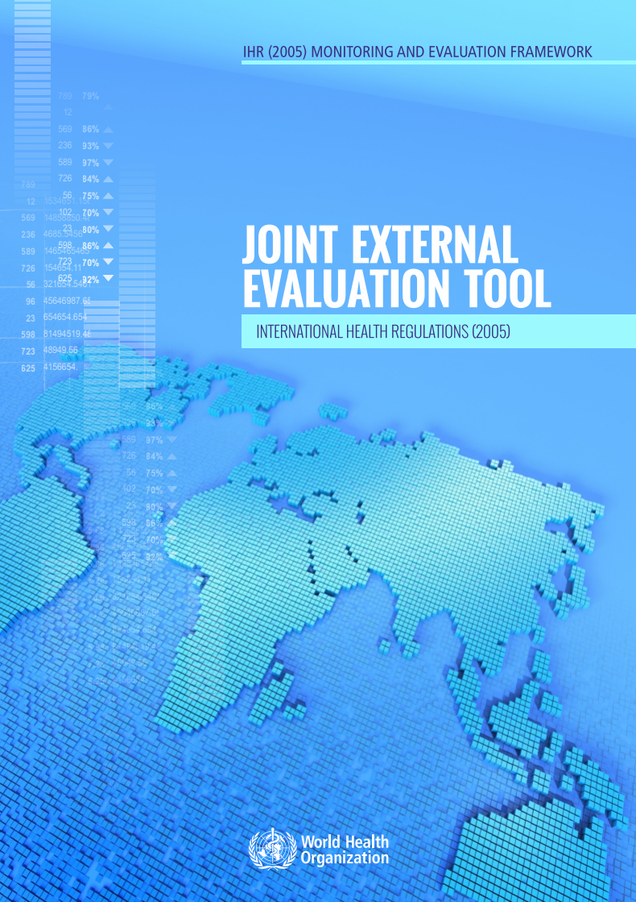
Joint External Evaluations
Identifying regions where outbreak potential overlap with poor preparedness scores from JEEs

Slide 30
Comparing JEEs with outbreak receptivity
Where both red, indicative of areas vulnerable to outbreaks with no established framework or action plan to counter
Focus on intersection of mismatched resources and high population density

Slide 31
Joint External Evaluations
Lacking in geographic completeness
Nine African nations to date have undertaken evaluation AND made it publically available
Current combined highest score is Armenia (213), United States (205), and Finland (203)
Is this tractable through time?

Slide 32
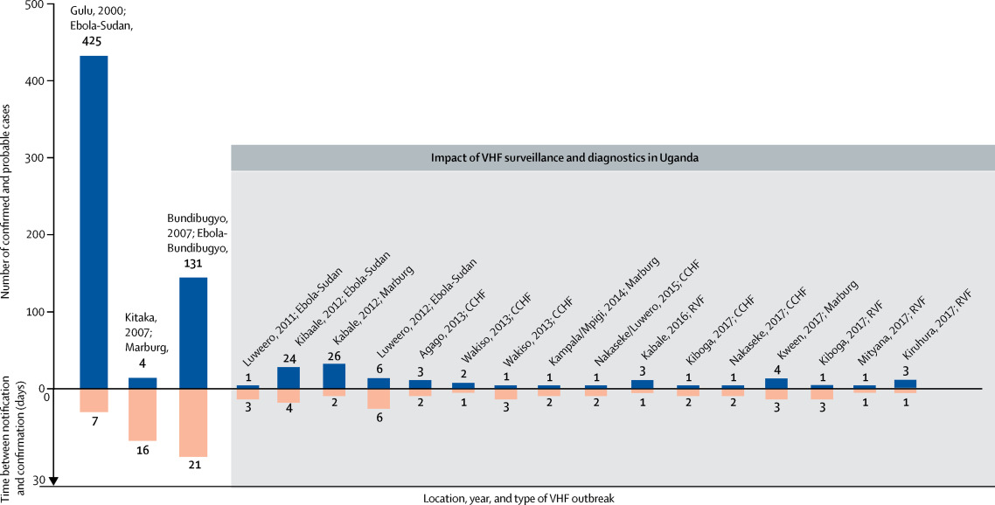

Is there a meaningful measure of improvement?
Diagnostic lag?

Slide 33
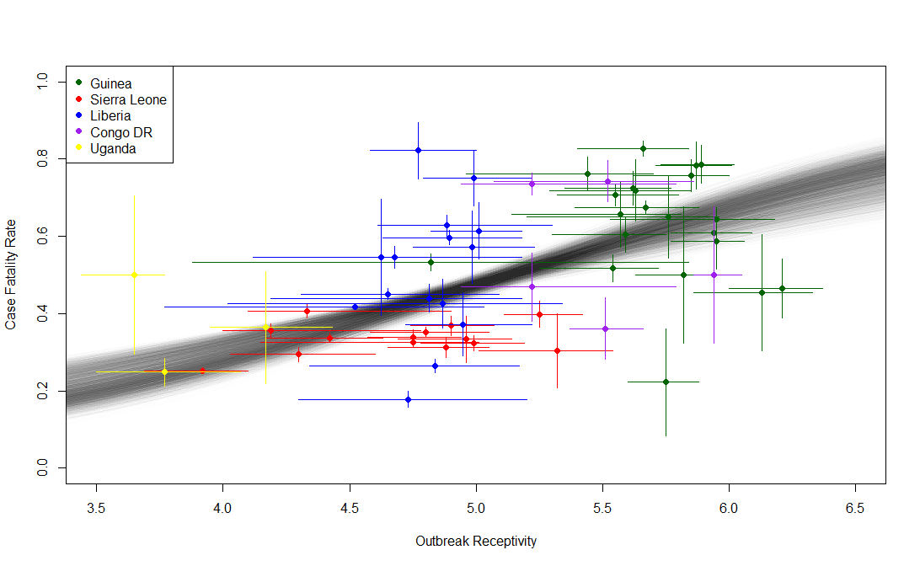
Is there a meaningful measure of improvement?
Amenable mortality and case fatality rates? Potential for benchmarking?

Slide 34
Acknowledgements
IHME
  Ani Deshpande
  Ian Letourneau
  Bobby Reiner
  Molly Biehl
  Roy Burstein
  Lucas Earl
  Nancy Fullman
  Chris Murray
  Simon Hay
  Shreya Shirude
University of Oxford
  Janey Messina
  Samir J. Bhatt
  Pete Gething
  Catherine Moyes
  Dan Weiss
  Freya Shearer
  Peter Horby
And many others
  Chloe Morozoff
  Moritz Kraemer
  Isaac Bogoch
  Kamran Khan
  Adrian Mylne
  Oli Brady
  Andy Tatem
  Tom de Groeve
  Luca Vernaccini
  Jens Kuhn
  Osman Sankoh
University of Melbourne
  Nick Golding

