Slide 1
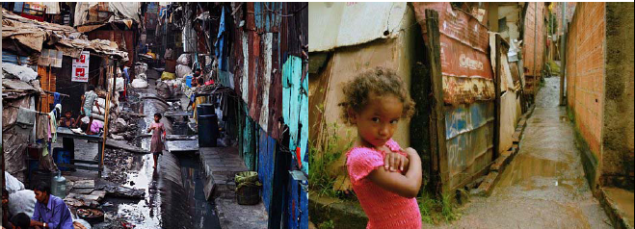
Cost-effectiveness of typhoid conjugate vaccines in Gavi-eligible countries
Ginny Pitzer
Associate Professor
Yale School of Public Heath
IDM Symposium
April 16, 2018

Slide 2
The year in typhoid vaccine policy
October 2017: WHO Strategic Advisory Group of Experts (SAGE) recommends the routine use of typhoid conjugate vaccines (TCVs) in children ≥6 mo of age in endemic countries
November 2017: Gavi pledges US$85 million for the 2019-2020 funding window to support the introduction of TCVs
January 2018: WHO announces the prequalification of the first typhoid conjugate vaccine (Typbar-TCV, Bharat Biotech)

Slide 3
Measuring (& modeling) typhoid incidence
Prior to 2017, there were only 32 population-based studies of typhoid incidence
  From 22 sites in 14 countries
Typhoid Surveillance in Africa Program (TSAP) contributed additional 13 sites in 10 countries in Africa

Slide 4
Our approach
Goal: Predict age-specific typhoid incidence based on widely-available indices of health and development
Use the existing incidence data to select the best predictors
Out-of-sample validation against TSAP data
Antillon et al, PLoS NTD (2017)

Slide 5
Out-of-sample validation (TSAP sites)
1. Nioko II, Burkina Faso.
2. Polesgo, Burkina Faso.
3. Ashanti Akim North, Ghana.
4. Bandim, Guinea Bissau.
5. Kibera, Kenya.
6. Antananarivo, Madagascar.
7. Imerintsiatosika, Madagascar.
8. Moshi rural, Tanzania.
9. Moshi urban, Tanzania
Notes:
Mention this:
Where we were successful.
While we placed the labels at the point estimates of the incidence, we also depicted the exact confidence intervals on the horizontal bars. Studies for which we seemed to miss the mark (6-9 in ages <2) are studies for which there was considerable uncertainty.

Slide 6
“Yale model” of typhoid incidence
Total incidence: 17.8 million cases (6.9-48.4 million)

Slide 7
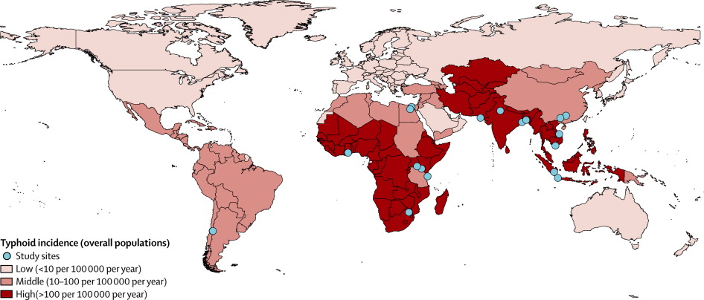
Other models of typhoid incidence
Mogasale et al, Lancet Glob Health (2014)
IHME GBD 2016, https://vizhub.healthdata.org/gbd-compare/

Slide 8
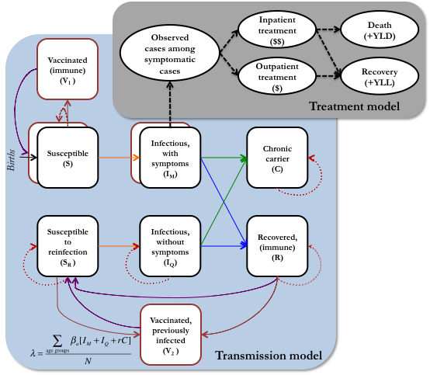
Typhoid transmission & treatment model
Key features
Age-structured deterministic dynamic model
Primary vs secondary infections
Loss of immunity to subclinical infection
Chronic carriers
Antillon et al, Vaccine (2017)

Slide 9
Uncertainty in typhoid incidence
Nigeria
Niger
Malawi
Mauritania
Mozambique
Mongolia
Myanmar
Mali
Madagascar
Moldova
Lesotho
Sri Lanka
Liberia
Laos
Kiribati
Cambodia
Krygyzstan
Kenya
India
Indonesia
Haiti
Honduras
Guyana
Guinea-Bissau

Slide 10
Predicted impact of vaccination
Used dynamic model to simulate the impact of 3 TCV delivery strategies:
  Routine immunization at 9 months old
  Routine + catch-up campaign to <5 yrs
  Routine + catch-up campaign to <15 yrs
Combined model output with estimates of treatment and vaccine delivery costs, treatment outcomes, and disability weights
  Vaccine price US$1.50 per dose
  10 year time horizon, 3% discounting
Routine immunization at 9 months
Routine immunization + catch-up campaign to <15 years

Slide 11
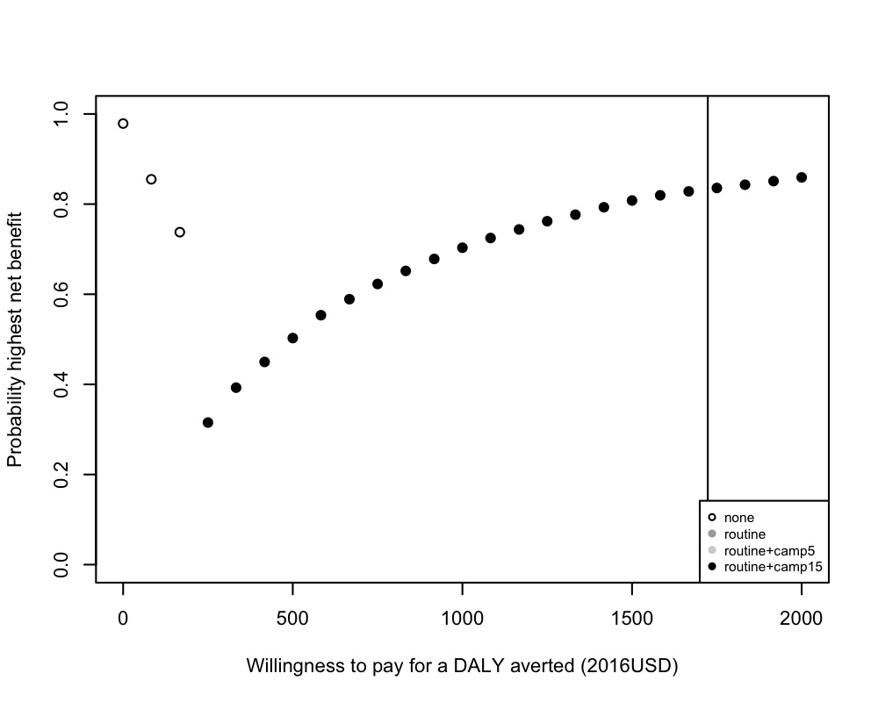
Cost-effectiveness acceptability frontier
Sample 4,000 times from input parameters (simulated incidence, impact of vaccination, costs, CFR, etc)
Calculate net monetary benefit NB = ∆E*WTP - ∆C
Examine the proportion of simulations in which the strategy that yielded the highest average net benefit was preferred for a given willingness-to-pay value

Slide 12
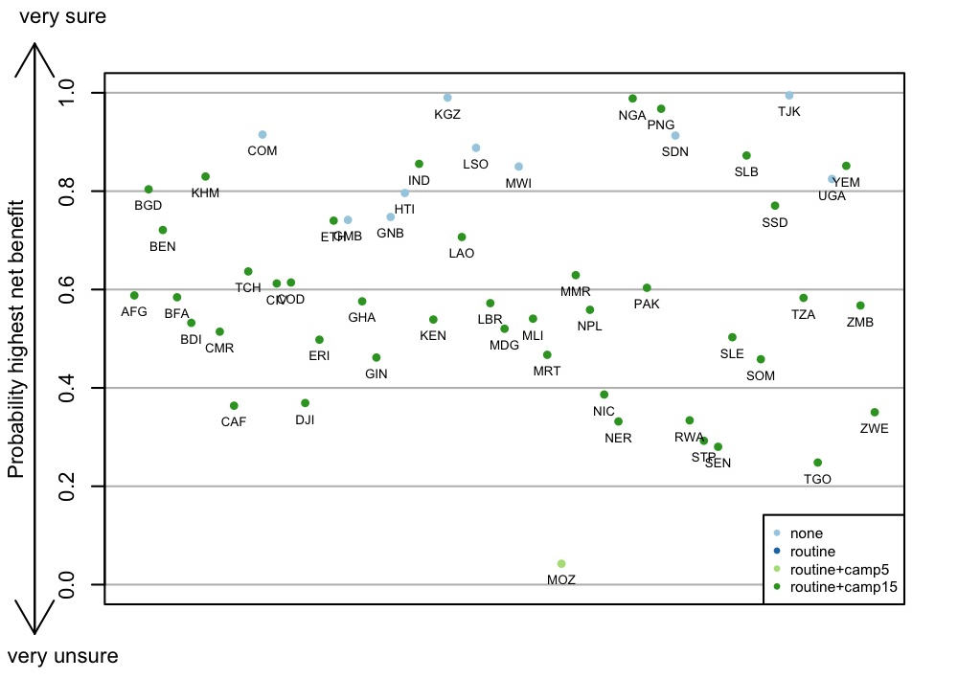
Cost-effectiveness of TCV strategies
Routine vaccination with TCV (at 9 months) + a catch-up campaign to <15 yrs old is likely to be cost-effective in most Gavi-eligible countries (42/54)
  WTP = GDP per capita
However, the probability that it is the preferred strategy is <60% in more than half (26/42) of the countries, and
  <80% in 35/42 countries
Bilcke et al, in prep
Notes:
Countries where it is >80% are generally those with high incidence, high treatment costs, and/or high CFR

Slide 13
Value of information (EVPPI)
Willingness to pay per DALY averted (2016 USD)
Willingness to pay per DALY averted (2016 USD)
Bilcke et al, in prep
Notes:
Light blue = CFR
Red = reporting rate
Dark red = prevalence & relative costs of AMR

Slide 14
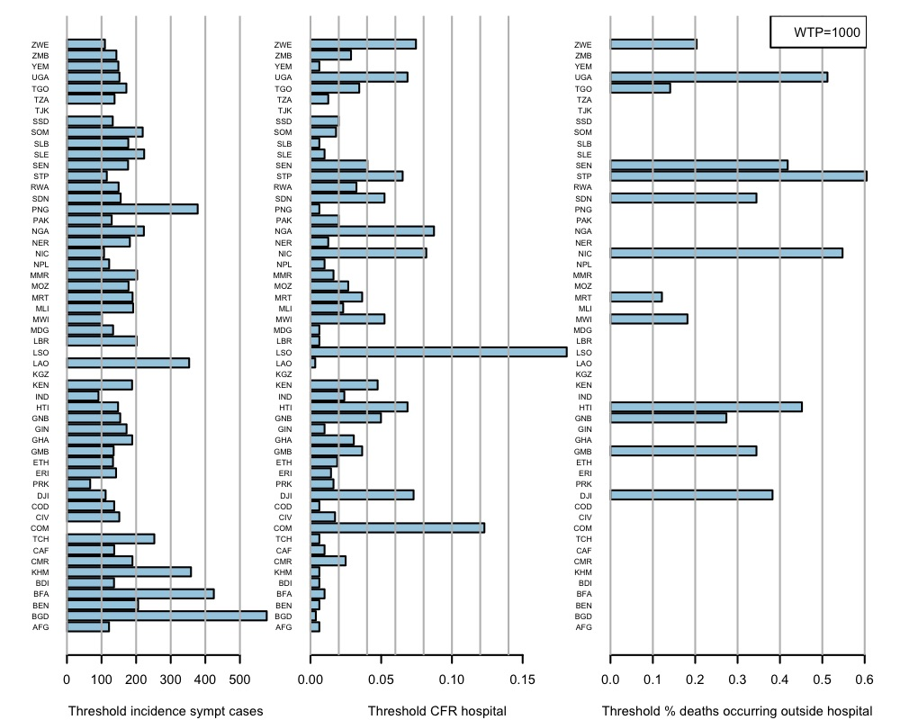
We estimated the minimum threshold value for:
incidence
CFR among inpatients
proportion of deaths occurring outside the hospital

Slide 15
Scenario analyses & conclusions
SCENARIO ANALYSES
Vaccine price = US$1.00 per dose
Vaccine delivery cost for campaigns = 1-3x cost of routine doses
Transmission rate declining by 25% over 10 years
CONCLUSIONS
Routine vaccination + catch-up campaign to <15 years of age is the preferred strategy across most Gavi-eligible countries
Primary sources of uncertainty are typhoid incidence and mortality rate

Slide 16
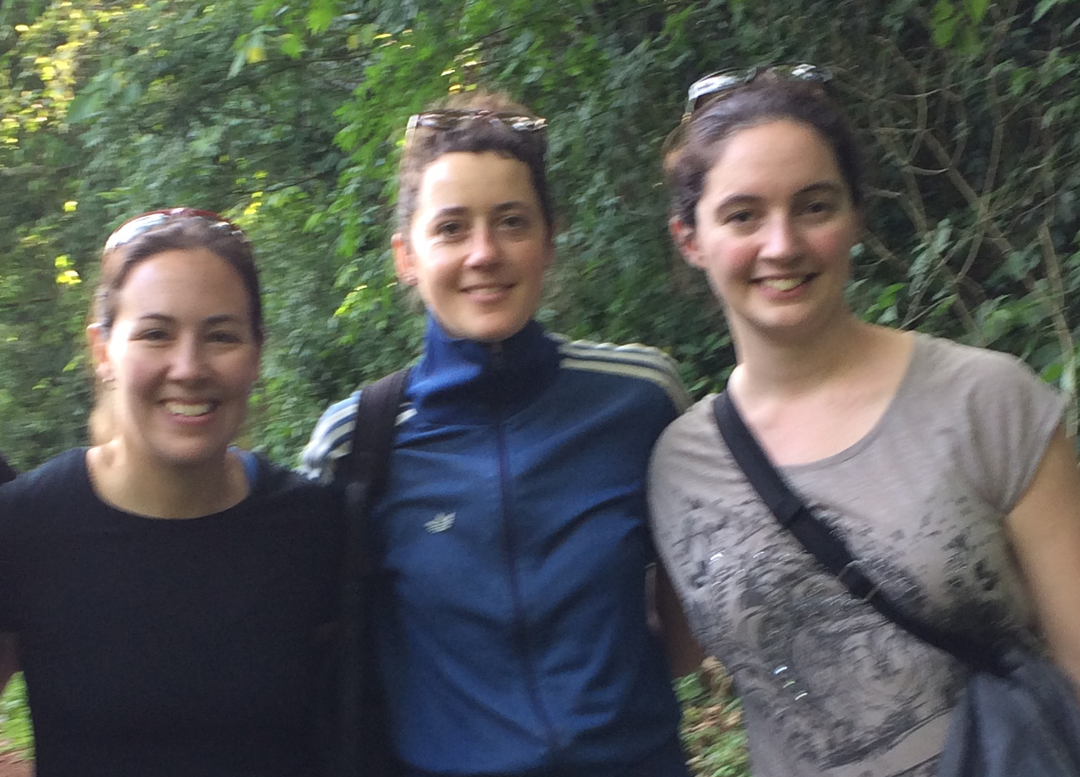
Acknowledgements
Collaborators
Joke Bilcke (University of Antwerp)
Marina Antillón (YSPH/Univ of Antwerp)
Zoë Pieters (University of Antwerp)
Linda Aboudd (University of Antwerp)
Elise Kuylen (University of Antwerp)
David Paltiel (YSPH)
Andrew Pollard (Oxford University)
Kathy Neuzil (UMD School of Medicine)
Funding
Bill & Melinda Gates Foundation (OPP1116967, OPP1151153)

Slide 17
Net monetary benefit vs incidence

Slide 18
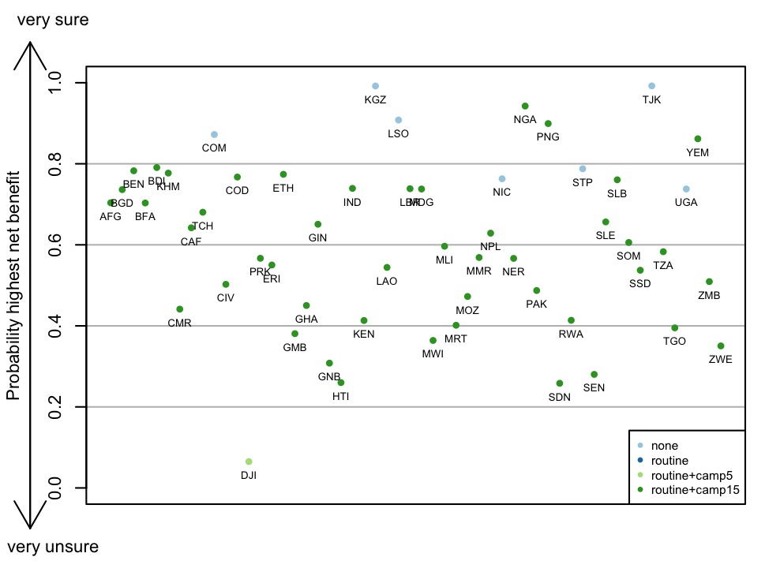
Cost-effectiveness of TCV strategies
Routine vaccination with TCV (at 9 months) + a catch-up campaign to <15 yrs old is likely to be cost-effective in most Gavi-eligible countries (42/54)
However, the probability that it is the preferred strategy is <60% in more than half (26/42) of the countries, and
  <80% in 35/42 countries
Bilcke et al, in prep
Notes:
Countries where it is >80% are generally those with high incidence, high treatment costs, and/or high CFR

Slide 19
Uncertainty in typhoid incidence
Gambia (GMB)
Guinea (GIN)
Ghana (GHA)
Georgia (GEO)
Ethiopia (ETH)
Eritrea (ERI)
Djibouti (DJI)
Cuba (CUB)
Comoros (COM)
Congo (COG)
Dem Rep Congo (DRC)
Cameroon (CMR)
Cote d’Ivoire (CIV)
Central African Repub (CAF)
Bhutan (BTN)
Bolivia (BOL)
Bangladesh (BGD)
Burkina Faso (BFA)
Benin (BEN)
Burundi (BDI)
Azerbaijan (AZE)
Armenia (ARM)
Angola (AGO)
Afghanistan (AFG)

Slide 20
Uncertainty in typhoid incidence
Ziimbabwe (ZWE)
Zambia (ZMB)
Yemen (YEM)
Vietnam (VNM)
Uzbekistan (UZB)
Ukraine (UKR)
Uganda (UGA)
Tanzania (TZA)
Timor-Leste (TLS)
Tajikistan (TJK)
Togo (TGO)
Chad (TCD)
Sao Tome e Principe (STP)
South Sudan (SSD)
Somalia (SOM)
Sierra Leone (SLE)
Solomon Islands (SLB)
Senegal (SEN)
Sudan (SDN)
Rwanda (RWA)
North Korea (PRK)
Papua New Guinea (PNG)
Pakistan (PAK)
Nepal (NPL)
Nicaragua (NIC)

Slide 21
Predicted impact of vaccination

Slide 22
Net monetary benefit vs incidence

Slide 23
Out-of-sample validation (TSAP sites)
1. Nioko II, Burkina Faso.
2. Polesgo, Burkina Faso.
3. Ashanti Akim North, Ghana.
4. Bandim, Guinea Bissau.
5. Kibera, Kenya.
6. Antananarivo, Madagascar.
7. Imerintsiatosika, Madagascar.
8. Moshi rural, Tanzania.
9. Moshi urban, Tanzania
Notes:
Mention this:
Where we were successful.
While we placed the labels at the point estimates of the incidence, we also depicted the exact confidence intervals on the horizontal bars. Studies for which we seemed to miss the mark (6-9 in ages <2) are studies for which there was considerable uncertainty.

Slide 24
Out-of-sample validation (TSAP sites)
1. Nioko II, Burkina Faso.
2. Polesgo, Burkina Faso.
3. Ashanti Akim North, Ghana.
4. Bandim, Guinea Bissau.
5. Kibera, Kenya.
6. Antananarivo, Madagascar.
7. Imerintsiatosika, Madagascar.
8. Moshi rural, Tanzania.
9. Moshi urban, Tanzania
Notes:
Mention this:
Where we were successful.
While we placed the labels at the point estimates of the incidence, we also depicted the exact confidence intervals on the horizontal bars. Studies for which we seemed to miss the mark (6-9 in ages <2) are studies for which there was considerable uncertainty.

Slide 25
Out-of-sample validation (TSAP sites)
1. Nioko II, Burkina Faso.
2. Polesgo, Burkina Faso.
3. Ashanti Akim North, Ghana.
4. Bandim, Guinea Bissau.
5. Kibera, Kenya.
6. Antananarivo, Madagascar.
7. Imerintsiatosika, Madagascar.
8. Moshi rural, Tanzania.
9. Moshi urban, Tanzania
Notes:
Mention this:
Where we were successful.
While we placed the labels at the point estimates of the incidence, we also depicted the exact confidence intervals on the horizontal bars. Studies for which we seemed to miss the mark (6-9 in ages <2) are studies for which there was considerable uncertainty.

Slide 26
Out-of-sample validation (TSAP sites)
1. Nioko II, Burkina Faso.
2. Polesgo, Burkina Faso.
3. Ashanti Akim North, Ghana.
4. Bandim, Guinea Bissau.
5. Kibera, Kenya.
6. Antananarivo, Madagascar.
7. Imerintsiatosika, Madagascar.
8. Moshi rural, Tanzania.
9. Moshi urban, Tanzania
Notes:
Mention this:
Where we were successful.
While we placed the labels at the point estimates of the incidence, we also depicted the exact confidence intervals on the horizontal bars. Studies for which we seemed to miss the mark (6-9 in ages <2) are studies for which there was considerable uncertainty.

Slide 27
Out-of-sample validation (TSAP sites)
1. Nioko II, Burkina Faso.
2. Polesgo, Burkina Faso.
3. Ashanti Akim North, Ghana.
4. Bandim, Guinea Bissau.
5. Kibera, Kenya.
6. Antananarivo, Madagascar.
7. Imerintsiatosika, Madagascar.
8. Moshi rural, Tanzania.
9. Moshi urban, Tanzania
Notes:
Mention this:
Where we were successful.
While we placed the labels at the point estimates of the incidence, we also depicted the exact confidence intervals on the horizontal bars. Studies for which we seemed to miss the mark (6-9 in ages <2) are studies for which there was considerable uncertainty.

Slide 28
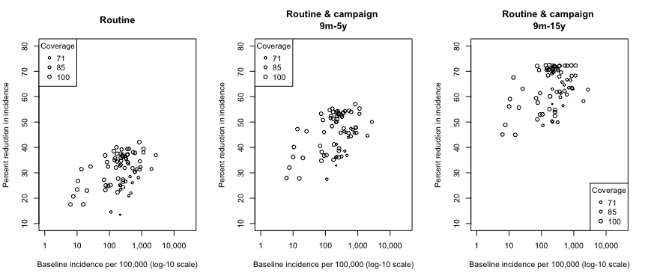
Impact of vaccination vs incidence

