Slide 1



Reactive case detection with targeted mass drug administration: Interrupting malaria transmission and achieving elimination beyond intervention areas in northwestern Peru
Dirección Regional de Salud Tumbes
Dirección Regional de Salud Piura
Antonio M. Quispe ^{1,2}, Fernando A. Quintana ³, Edwar Pozo ⁴, Margaret N Kosek ⁵, Eduardo Gotuzzo ⁶
Department of International Health, Johns Hopkins Bloomberg School of Public Health (JHBSPH), Baltimore, MD
Grupo de Investigación Biomédica, Web Med Research. Lima, Peru
Dirección Regional de Salud, Tumbes, Peru
Dirección Regional de Salud, Piura, Peru;
Instituto de Medicina Tropical Alexander von Humboldt, Universidad Peruana Cayetano Heredia, Lima, Peru
Notes:
Hola. My name is Antonio Quispe and I’m really excited to be here.
The study I’m presenting you today is entitle Reactive case detection with targeted mass drug administration: Interrupting malaria transmission and achieving elimination beyond intervention areas in northwestern Peru

Slide 2
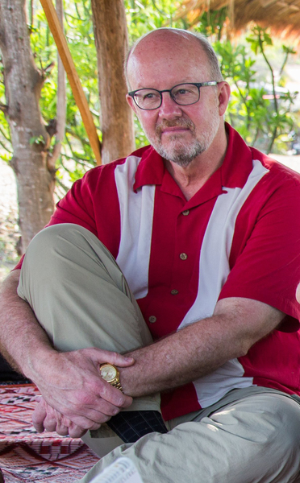
Why do RCD/tMDA?
“Well, that is a good question? It may happen that is true that passively detected cases may work as a good signal to track the human malaria reservoir by using RCD, but we need to be careful about MDA and figure out the best way to use it safely and effectively…”
February 20th , 2015, Lima, Peru
Alan Jon Magill
(November 26, 1953 – September 19, 2015)
Notes:
So why is so important to talk about Reactive Case Detection with target mass drug administration?
Well, like our good common friend told me a couple year ago: Yes, it may happen that is true that cases passively detected works as a good signal to track the human malaria reservoir by using RCD, but we need to be careful about MDA and figure out the best way to use it safely and effectively to target the asymptomatic human reservoir.

Slide 3


Where do we stand about RCD?
“Through RCD, additional secondary infections (~4-5) may be identified among the people living in proximity to the index case and people who share the same occupational risk factor”.⁽¹⁾
Uninfected
Infected but asymptomatic
Infected but symptomatic
References: 1, Littrell 2013
Notes:
Where do we stand about RCD?
The whole idea of using reactive case detection is to target as much asymptomatic cases as we can.
So depending of the intensity of malaria transmission in our population we will be able to catch more or less asymptomatic cases.
To do so we need beyond the households of every index case and target also the fraction of the population that shares their jobs and schools.

Slide 4
What is RCD?
Table 1. Activities carried on during reactive case detection activities in different experiences
Activities | MAU² | BRA³ | SRI⁴ | PER⁵ | SWA⁶ | ZAM⁷ | BHU⁸ | SEN¹ | BRA⁹ | ZAM¹⁰
Included in national guidelines | X |  | X |  | X |  | X
Year of implementation | 1998 | 1998 | 2003 | 2003 | 2009 | 2009 | 2010 | 2012 | 2013 | 2014
Named explicitly as RCD | X |  |  |  | X |  |  | X | X | X
Trigger by index cases (PCD) | X |  | X | X | X | X |  | X | X | X
Screening around index case | X | X | X | X | X | X | X | X | X | X
Screening asymptomatic malaria |  | X | X | X | X | X |  |  | X | X
Use microscopy | X | X | X | X |  | X | X |  | X
Use RDTs |  | X | X |  | X | X | X | X | X | X
Use PCR |  |  |  |  |  | X |  |  | X
Includes follow up |  | X |  | X |  |  | X
Use GPS |  |  |  |  | X | X |  |  | X | X
Focus on P. vivax malaria also |  | X | X | X |  |  | X |  | X
Ref: 2, Tatarsky 2011; 3, Macauley 2005; 4, Abeyasinghe 2012; 5 Branch 2005; 6, Kunene 2011; 7, Stresman 2010; 8, Yangzom 2012; 9 Fountura 2016; 10 Searle 2016
Notes:
How RCD is carried on around the world?
Well, it varies from country to country but the communalities includes implementing the capacity to actively screen for asymptomatic malaria around the households of every index case is detected.
So the strength of the program will rely on whether they use microscopy, RDTs or more sensitive diagnostics tools such as PCR.
Some variants include a follow up component and other al included as strategies within the national guideline.
Regardless, a key difference among the programs is that some focuses on falciparum malaria, while other on vivax malaria also.

Slide 5
Where do we stand on tMDA?
“Through tMDA, we can target a significant fraction of the human malaria reservoir that live in close proximity to the index case and/or share a workplace or occupational risk factor”.⁽⁹⁾
Uninfected
Infected but asymptomatic
Infected but symptomatic
References: 9, Sturrock 2013
Notes:
Where do we stand on tMDA?
The core concept of tMDA is to target the higher fraction of the human malaria reservoir as possible.
To do so every time we detect a index case we must follow them home and treat as much subjects have their higher risk to be a malaria carrier.
This is extremely useful given that most malaria cases occurs in clusters and that the likelihood of be or get an infection surrounding a symptomatic malaria case is higher.

Slide 6
What is tMDA?
Table 2. Activities carried on during target or focal mass drug administration in different experiences
Activities | CHI¹¹ | GRE¹² | TAN¹³ | PER¹⁴ | ZAM¹⁵ | KEN¹⁶
Included within national guidelines | X | X
Year of implementation | 2000-9 | 2013 | (Sim) | 2010-4 | 2013-4 | 2011-12
Named explicitly as tMDA or FMDA | X | X | X | X | X | X
Focused on P. vivax malaria only | X | X |  | X
Trigger by incident cases |  | X | X | X | X | X
Trigger by prevalent cases (PCD) | X
Excludes infants, pregnant women, and some chronic comorbidities | X | X | X | X | X | X
Included DOT with primaquine | X | X | X | X |  | X
Included G6PD testing | X | X | X |  |  | X
Included adverse events surveillance | X | X | X | X
References: 11, Hsiang 2013.; 12, Tseroni 2014; 13, Mosha 2013; 14, Quispe et al (in preparation), 15, Eisele et al, 16, Bousema et al
Notes:
Again, the definition of what it is tMDA varies from country to country.
Most tMDA programs are triggered by incident cases, and excludes infants, pregnant women, and some chronic comorbidities
There is a huge concern about G6PD when using 8aminoquinolines such as primaquine so most includes g6pd testing and an adverse events surveillance component

Slide 7
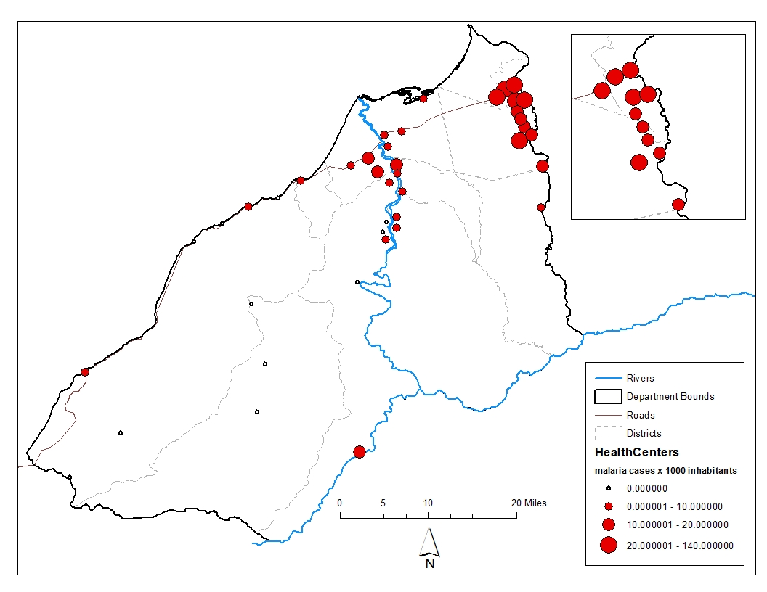
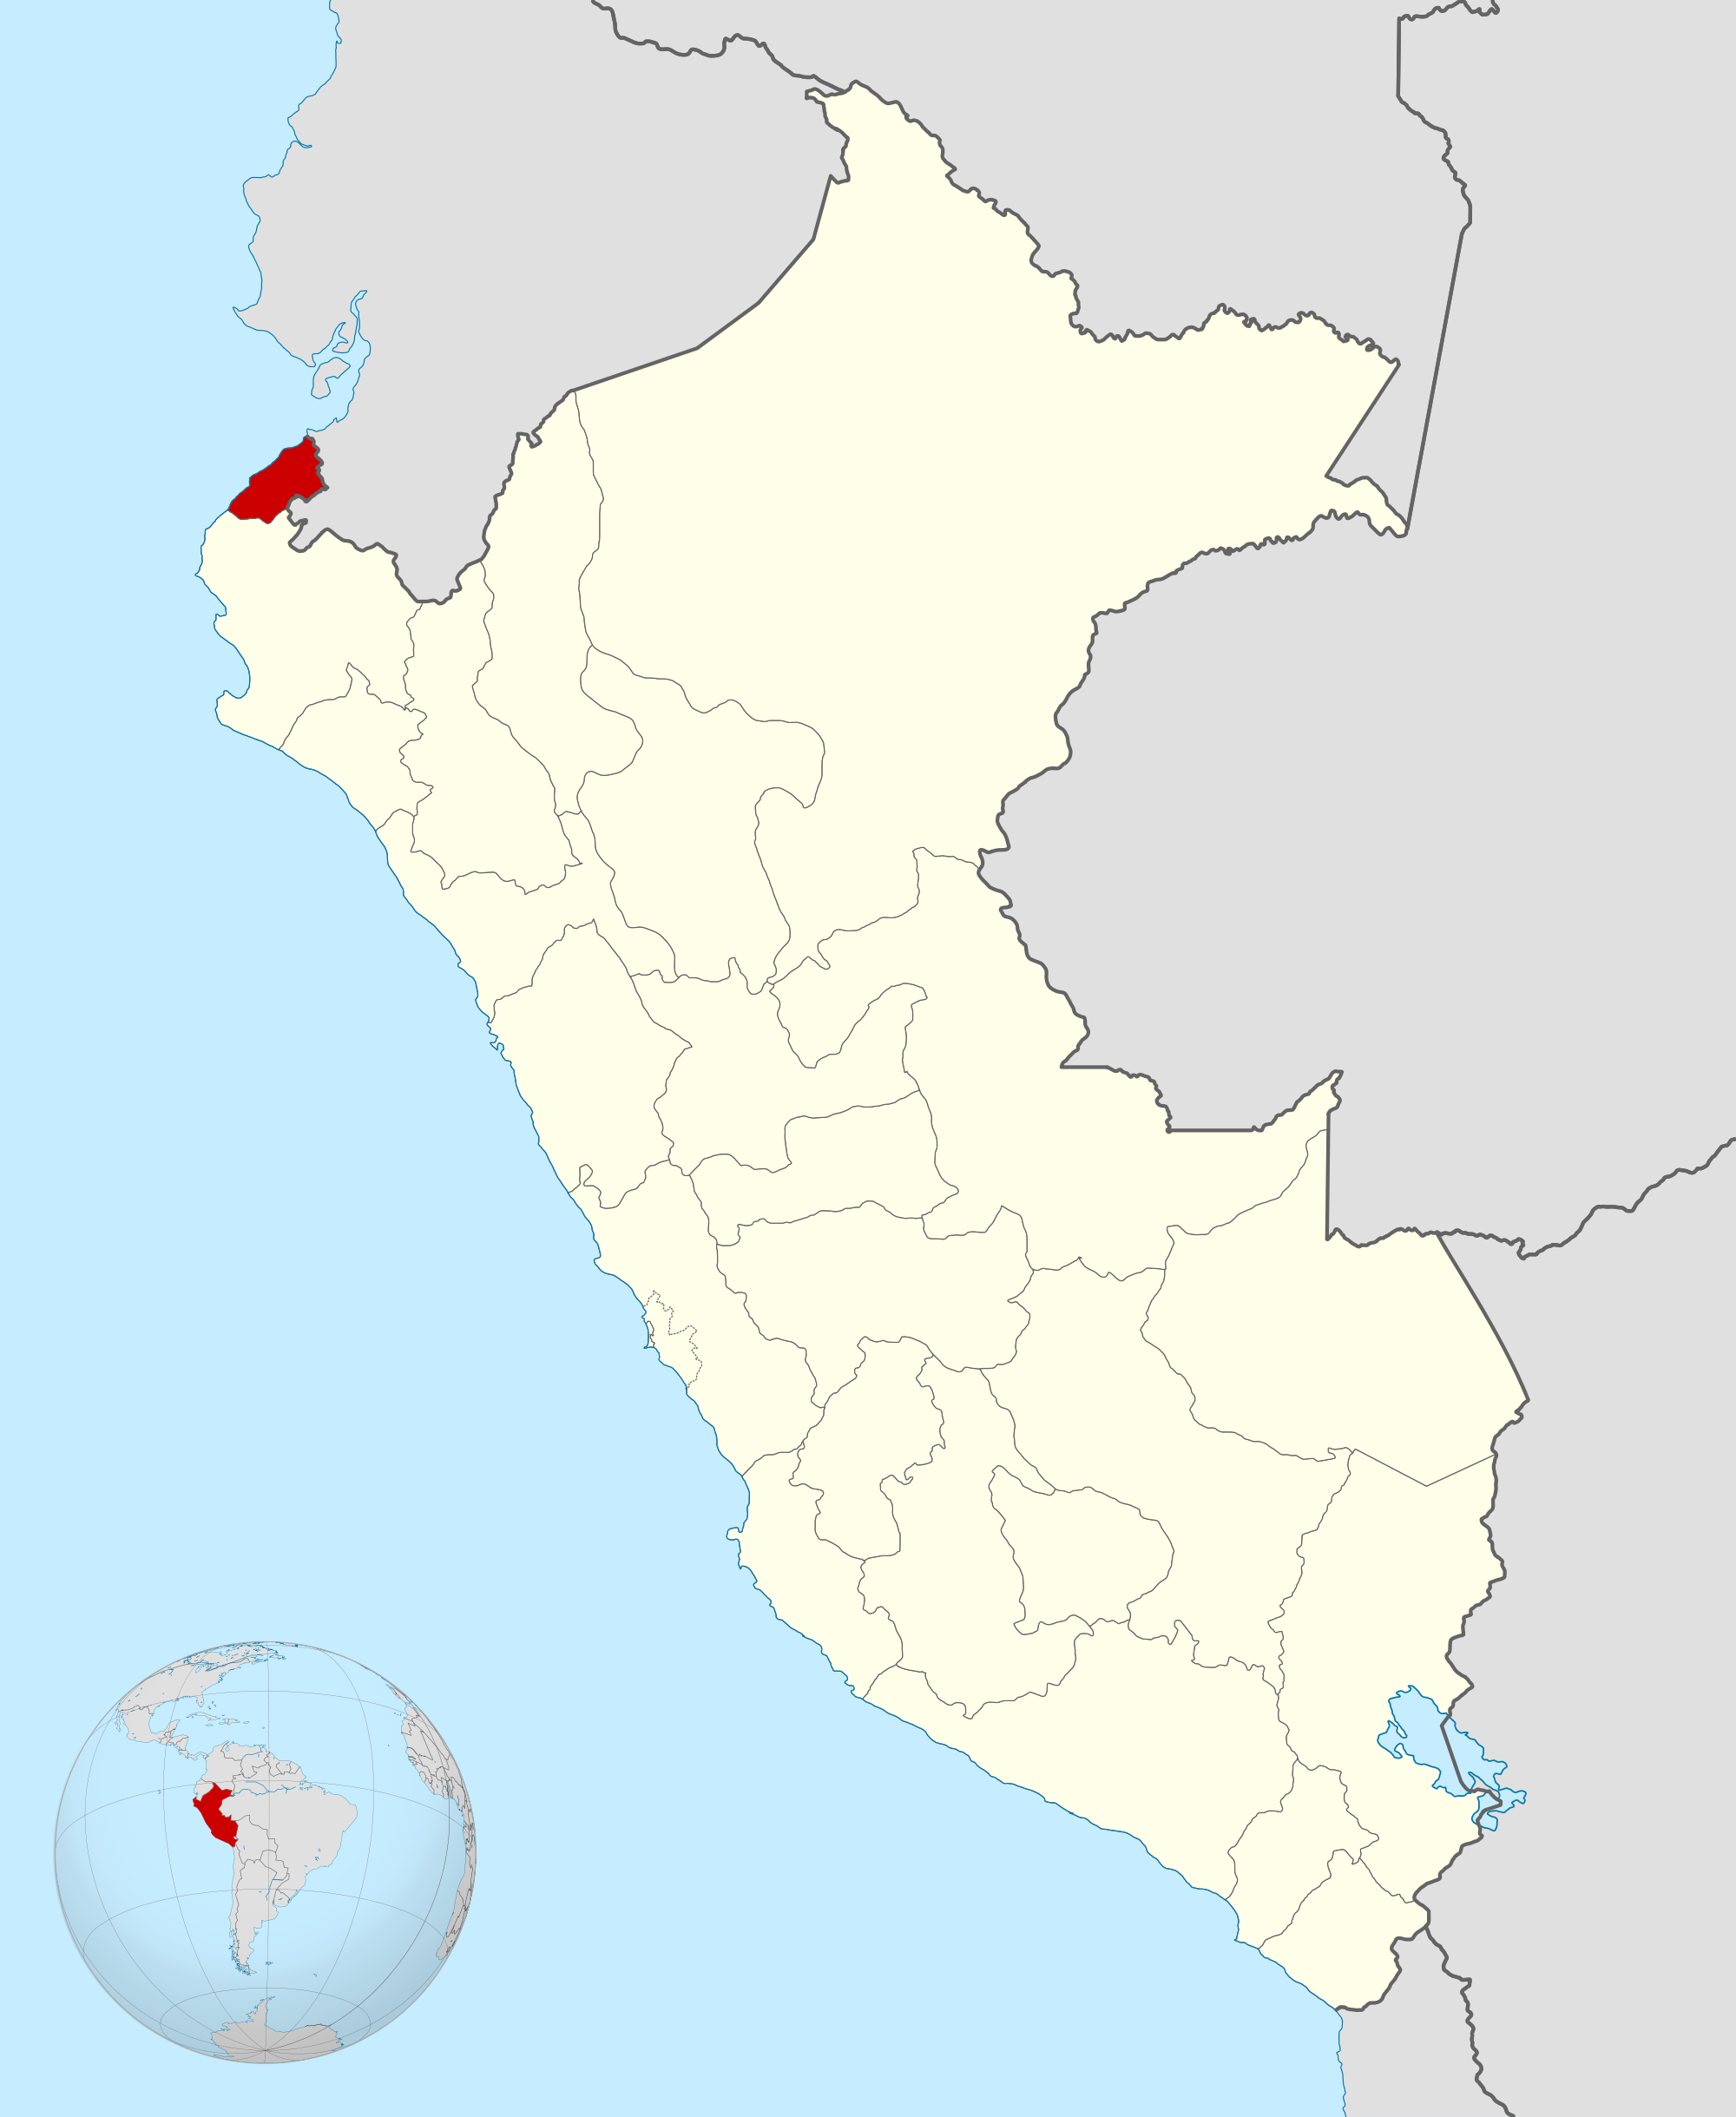
Our Experience with RCD/tMDA ^{(1/2)}
Pilot Study (2009-10): RCD/tMDA in 2 districts vs. PCD in 11 districts
Scale up (2011-15): 13 districts
Both, adverse events surveillance
Eligibility: Index cases & Contacts, excluding infants, elders, pregnant women, and chronically-ill subjects
Treatment (20,000 donation, ECU):
  Chloroquine (25mg/kg) over 72h + Primaquine (0.5mg/kg) for 7d
Aguas Verdes (API ~45)
Corrales (API ~17)
Pacific Ocean
Ecuador
Piura
Notes:
Here allow me to present you our experience with RCD tMDA
In 2009 we carried on a pilot demonstrative program in Tumbes, a small region borderline with Ecuador which was identified as a huge malaria reservoir for both countries due the intense commerce between both countries
So after years of working hard to test the idea the Peruvian epidemiologist from Tumbes leaded by Dr. Fernando Quintana finally received a donation of 20,000 complete treatments for vivax malaria from the Ecuadorian government in the scope of their own malaria program.
With those resources they went approved to lunch the program in two of the most endemic malaria districts in Tumbes, Aguas Verdes and Corrales.
When the Ministry of Health notice that malaria drop down by half at the first year while increasing in the rest of the region they gave us the authorization to scale up.

Slide 8
Our Experience with RCD/tMDA ^{(2/2)}
2009
2010
Sites | Annual Parasite Incidence
 | 2009 | 2010 | 2011 | 2012 | 2013 | 2014 | 2015-16
RCD/tMDA | 15.5 (3.7 - 27.3) | 6 (0.3 - 11.7) | 0.9 (-0.2 - 2) | 0.2 (-0.1 - 0.5) | 0 (0 - 0) | 0 (0 - 0) | 0 (0 - 0)
PCD | 2.3 (0.6 - 4) | 8.9 (3.3 - 14.5) | 1.7 (0.4 - 3) | 0.3 (0 - 0.5) | 0 (0 - 0) | 0 (0 - 0) | 0 (0 - 0)
Notes:
In 2009 we deliver 7470 treatment including 830 casos GG(+) + 6640 contacts, while in 2010, we delivered 783 treatment, including 87 cases and 696 contacts; both year a reason of 1:8 cases:contacts
So you may notice in the graphics malaria drop down dramatically to zero and remain at zero authoctonous cases until today

Slide 9
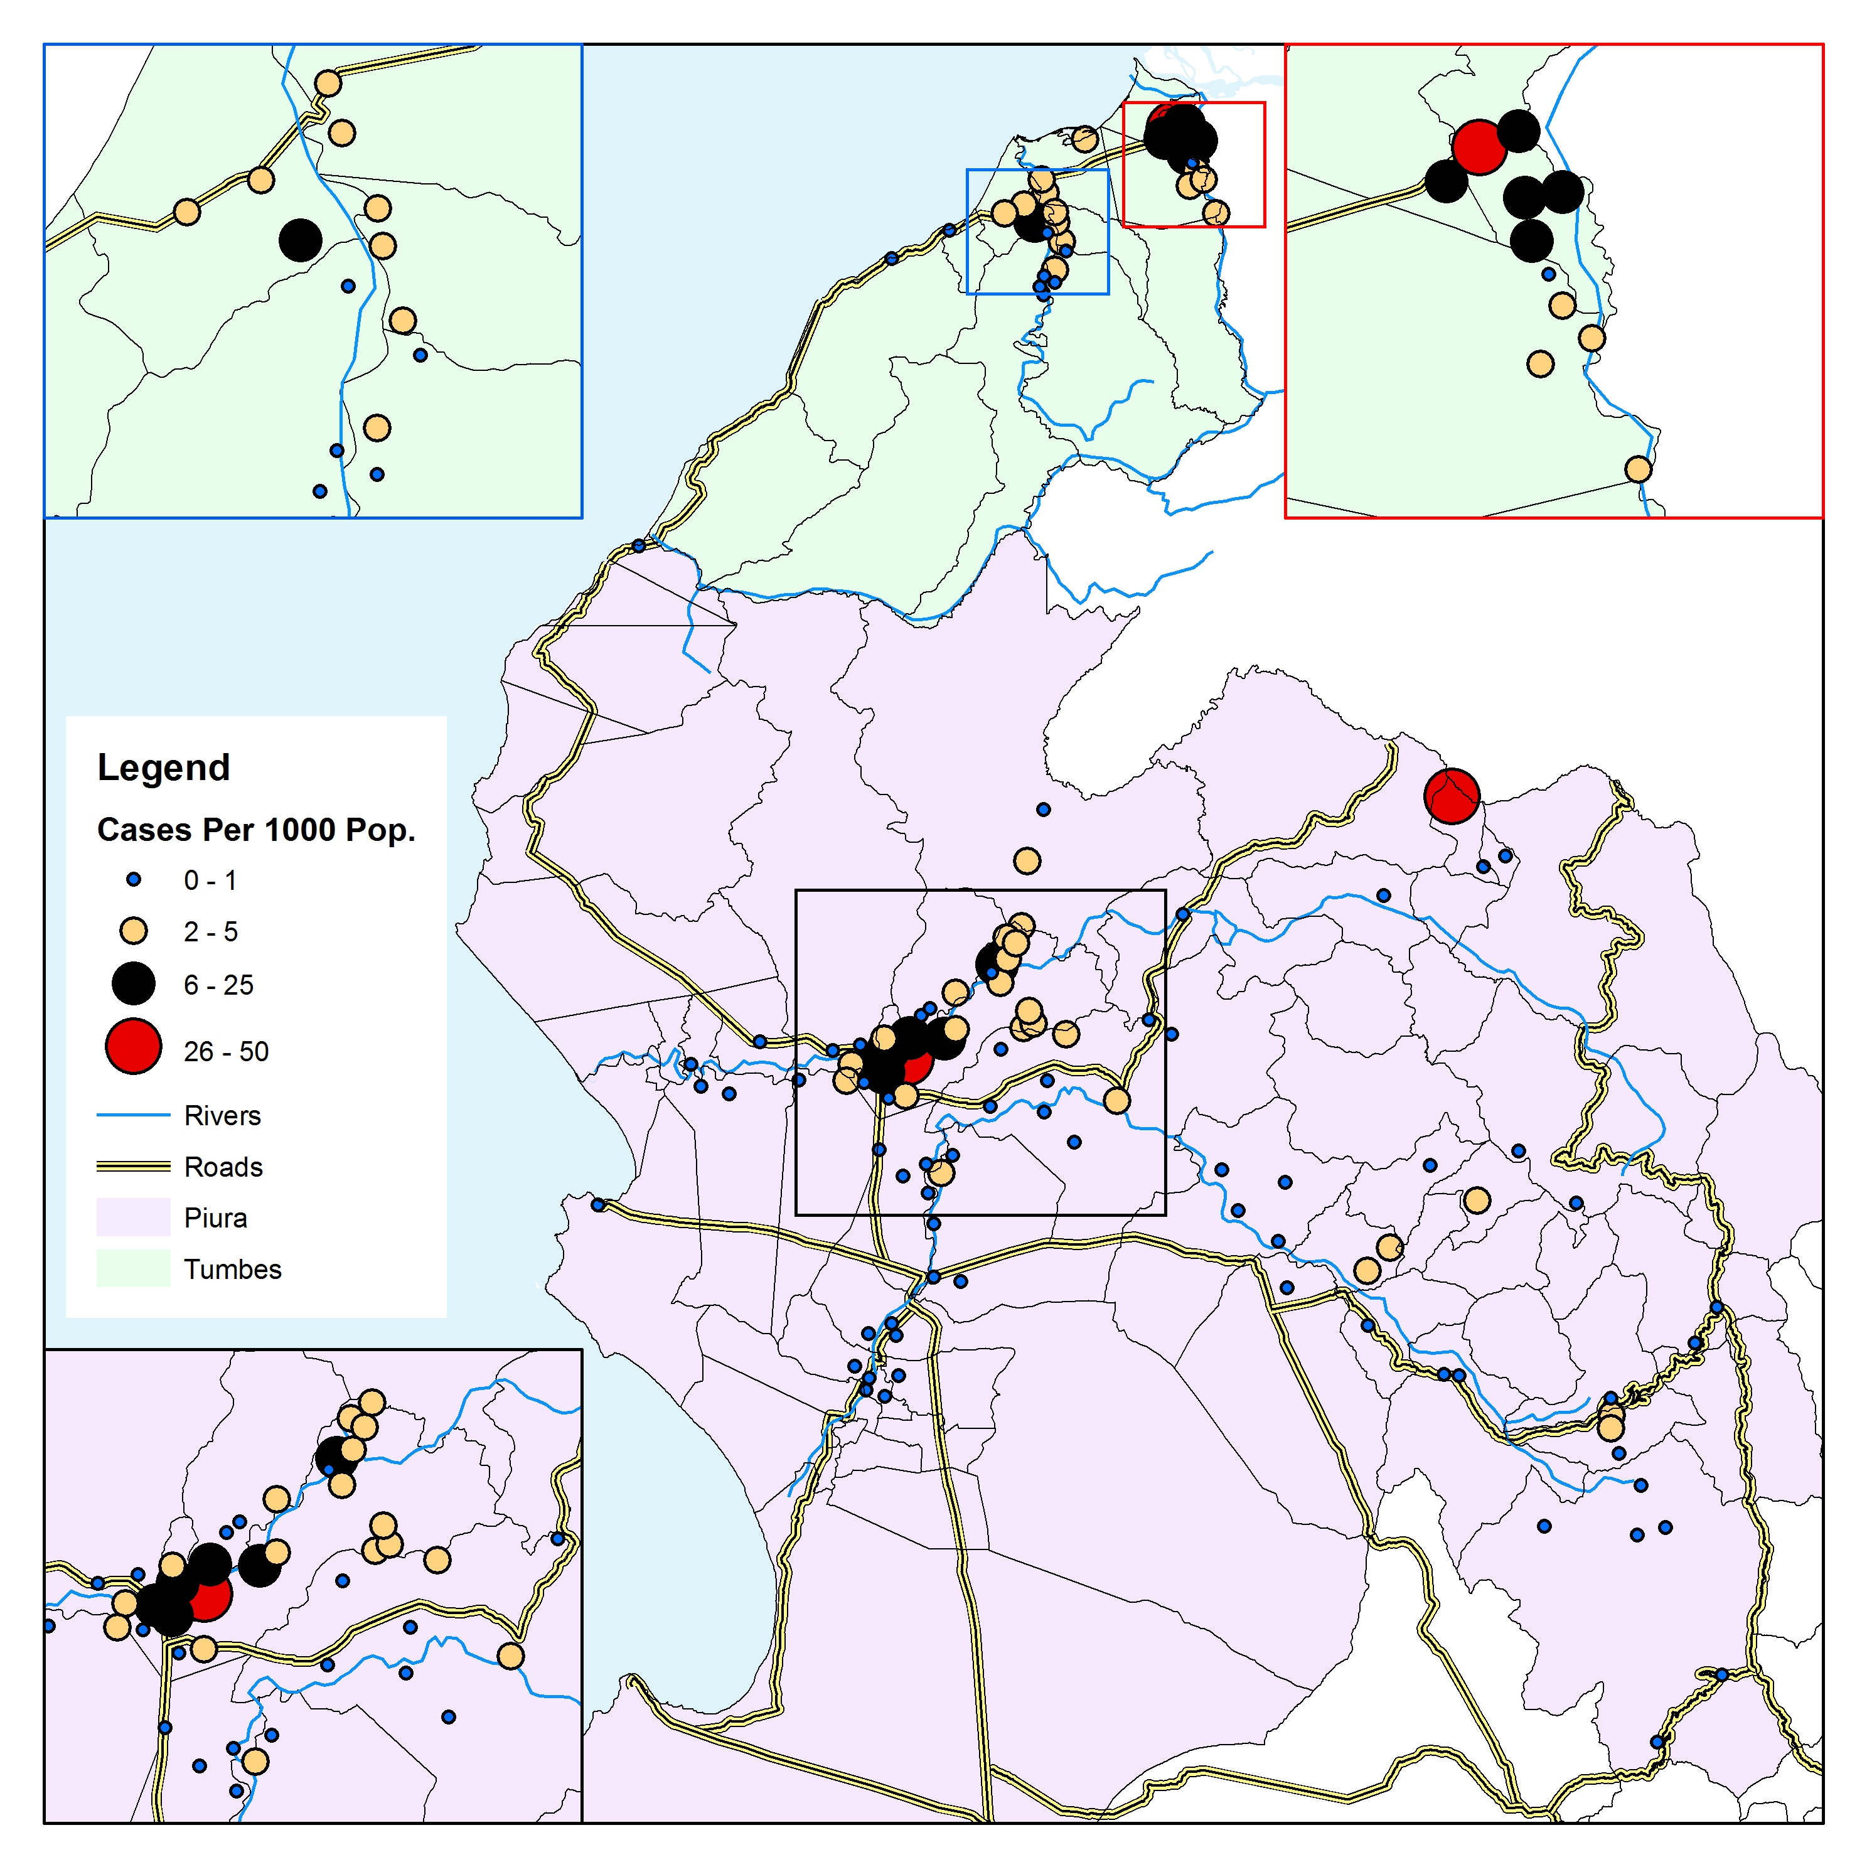
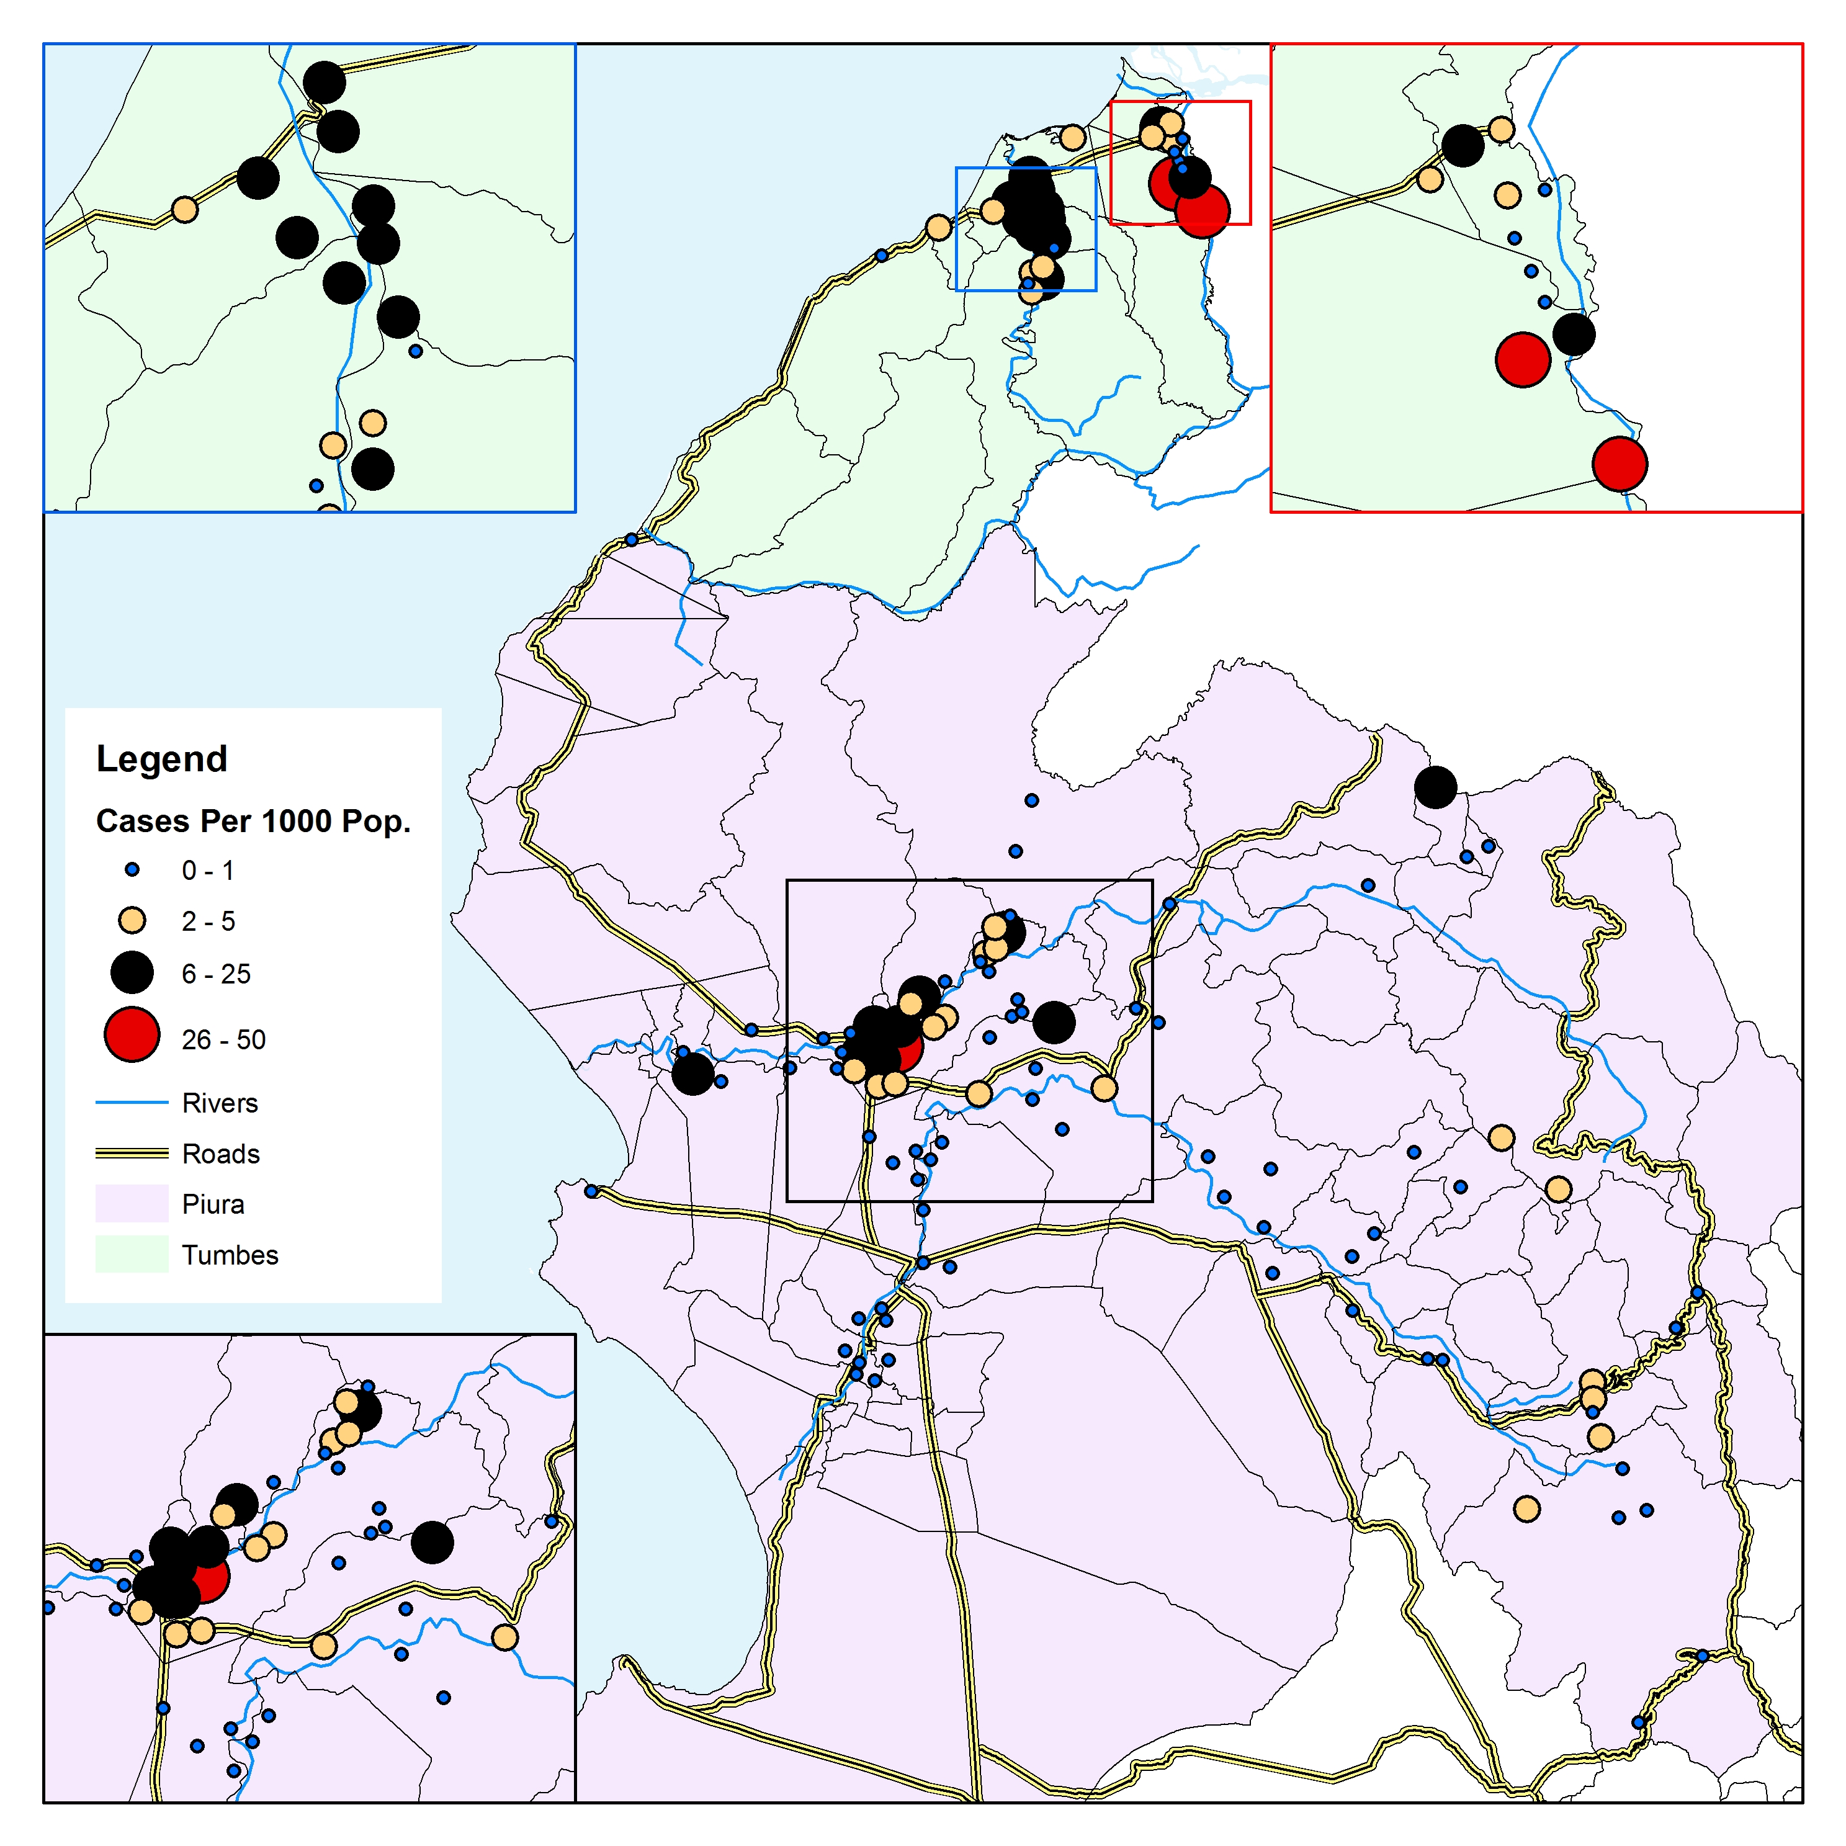
Our study aim
To assess the effect of the RCD/tMDA intervention carried on in Tumbes on the weekly parasite incidence (WPI = total malaria cases per week/ 1,000 inhabitants) in Piura.
2009
2010
Sites | Annual parasite incidence
 | 2009 | 2010 | 2011 | 2012 | 2013 | 2014 | 2015-16
RCD/tMDA | 15.5 (3.7 – 27.3) | 6.0 (0.3 – 11.7) | 0.9 (-0.2 – 2.0) | 0.2 (-0.1 – 0.5) | 0 (0 – 0) | 0 (0 – 0) | 0 (0 – 0)
PCD | 2.3 (0.6 – 4.0) | 8.9 (3.3 – 14.5) | 1.7 (0.4 – 3.0) | 0.3 (0 – 0.5) | 0 (0 – 0) | 0 (0 – 0) | 0 (0 – 0)
Close | 5.8 (1.9 – 9.7) | 5.0 (2.1 – 8.0) | 0.5 (0.1 – 0.9) | 0 (0 – 0.1) | 0 (0 – 0.1) | 0 (0 – 0.1) | 0 (0 – 0)
Mid | 0.4 (0.1 – 0.7) | 0.8 (0 – 1.5) | 0.1 (0 – 0.2) | 0 (0 – 0.1) | 0 (0 – 0) | 0 (0 – 0) | 0 (0 – 0)
Far | 1.4 (-0.4 – 3.3) | 1 (0.3 – 1.7) | 0.1 (0 – 0.2) | 0 (0 – 0.1) | 0 (0 – 0) | 0 (0 – 0) | 0 (0 – 0)
Notes:
But while carrying the study in Tumbes we observed that malaria also drop down in Piura, so we were wondering if we can probe that it happens because we interupted de transmission of malaria in tumbes and not for other reasons.
To do so we computed the distance from each reporting units from both regions to the pilot sites and notice a significant association in the variability of the annual malaria incidence and the proximity to the pilot sites.

Slide 10
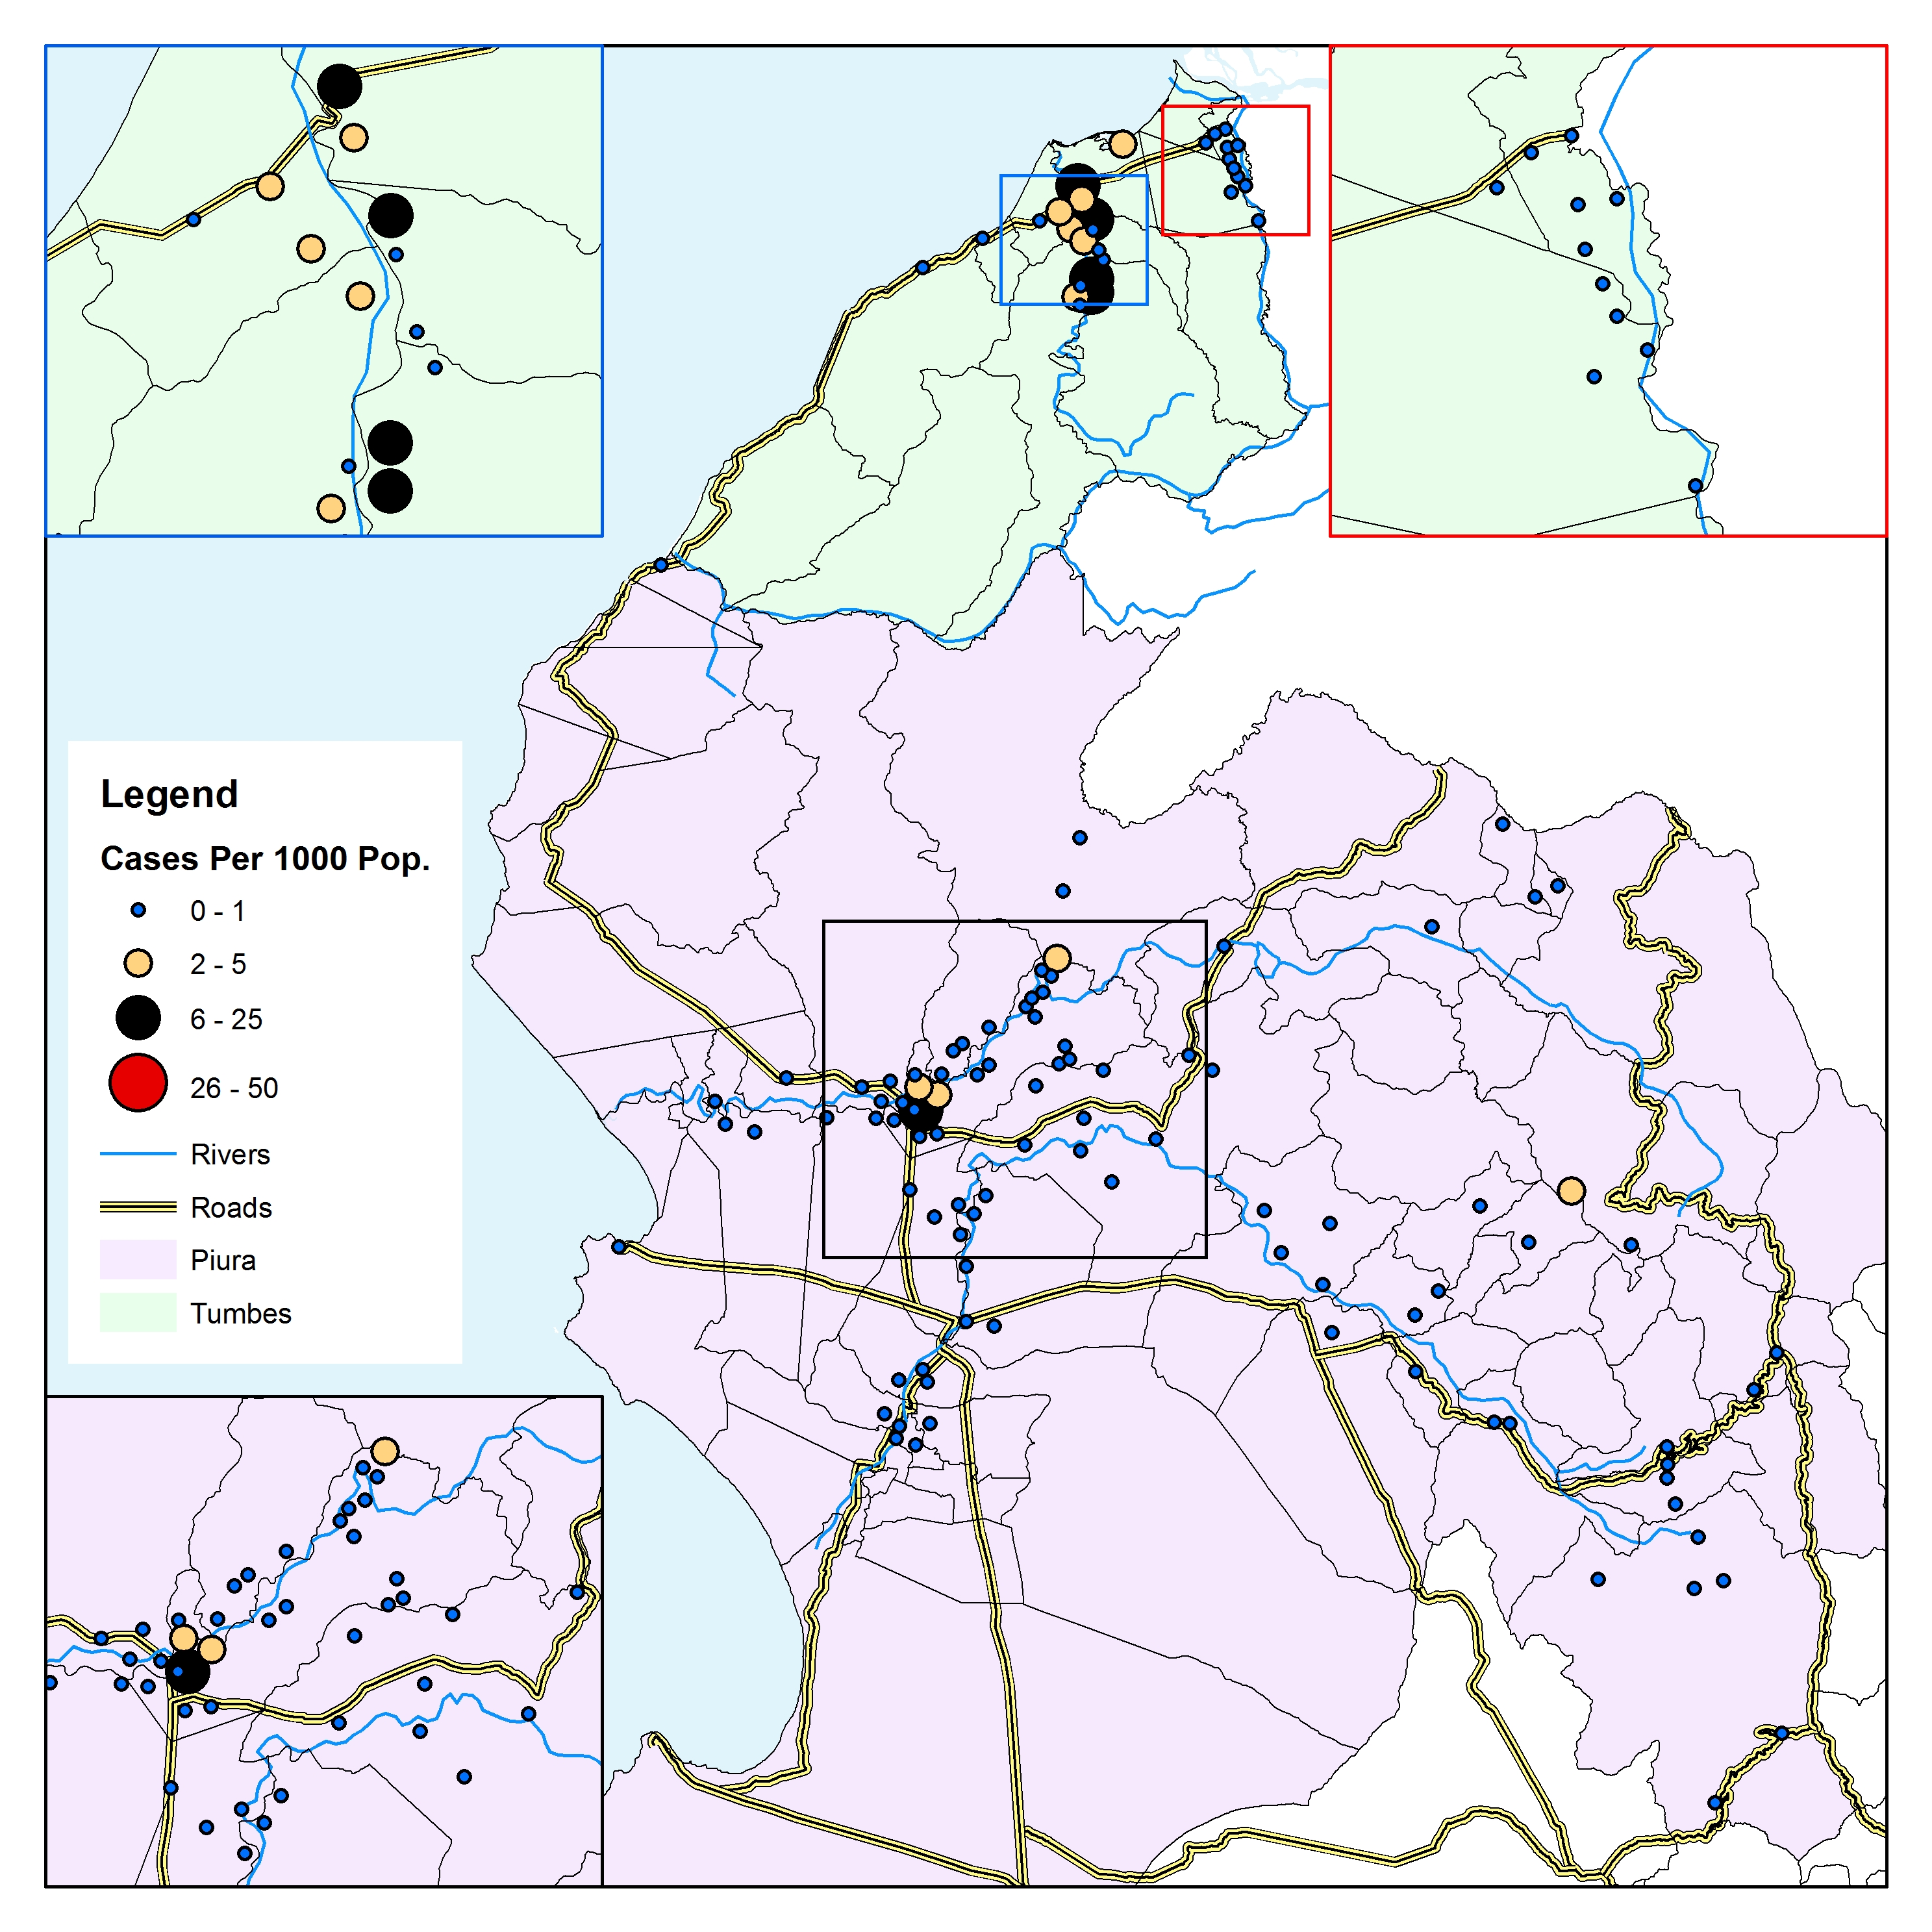



The elimination of malaria from the Peruvian north coast
2011
2012
2013
2014
Sites | Weekly parasite incidence
 | 2009 | 2010 | 2011 | 2012 | 2013 | 2014 | 2015-16
RCD/tMDA | 29.8 (21.0 - 38.6) | 11.6 (8.9 - 14.3) | 1.6 (1.0 - 2.3) | 0.6 (0.2 - 1.0) | 0.0 (0.0 - 0.0) | 0.0 (0.0 - 0.0) | 0.0 (0.0 - 0.0)
PCD | 4.4 (2.9 - 5.9) | 17.0 (12.7 - 21.3) | 3.3 (2.3 - 4.3) | 0.8 (0.2 - 1.4) | 0.0 (0.0 - 0.0) | 0.0 (0.0 - 0.0) | 0.0 (0.0 - 0.0)
Close | 10.0 (8.4 - 11.5) | 9.2 (7.6 - 10.8) | 0.9 (0.6 - 1.2) | 0.2 (0.1 - 0.2) | 0.3 (-0.1 - 0.6) | 2.0 (-0.3 - 4.4) | 0.0 (0.0 - 0.0)
Mid | 2.5 (0.7 - 4.3) | 1.4 (0.5 - 2.3) | 0.1 (0.0 - 0.3) | 0.0 (0.0 - 0.1) | 0.1 (-0.1 - 0.2) | 0.0 (0.0 - 0.1) | 0.0 (0.0 - 0.0)
Far | 1.0 (0.6 - 1.5) | 1.6 (0.8 - 2.4) | 0.1 (-0.1 - 0.3) | 0.1 (-0.1 - 0.2) | 0.0 (0.0 - 0.0) | 0.0 (0.0 - 0.0) | 0.0 (0.0 - 0.0)
* After scale up, we found a negative association between the mean WPI reduction and proximity to intervention area across the Piura districts, at both 24m (p=0.04) and 48m (p<0.01)
Notes:
So we analyzed the weekly parasite incidence and it variability in time and space across Tumbes and Piura to assess the effect of the RCD/tMDA program beyond the intervention áreas.
As you may notice, the mean average of the WPI drop down with a strong corelation with the proximity just at glance, so to be sure we build a multilevel, multivariable model incorporating layers of data at the reporting unit level, the district level and the regional level.

Slide 11
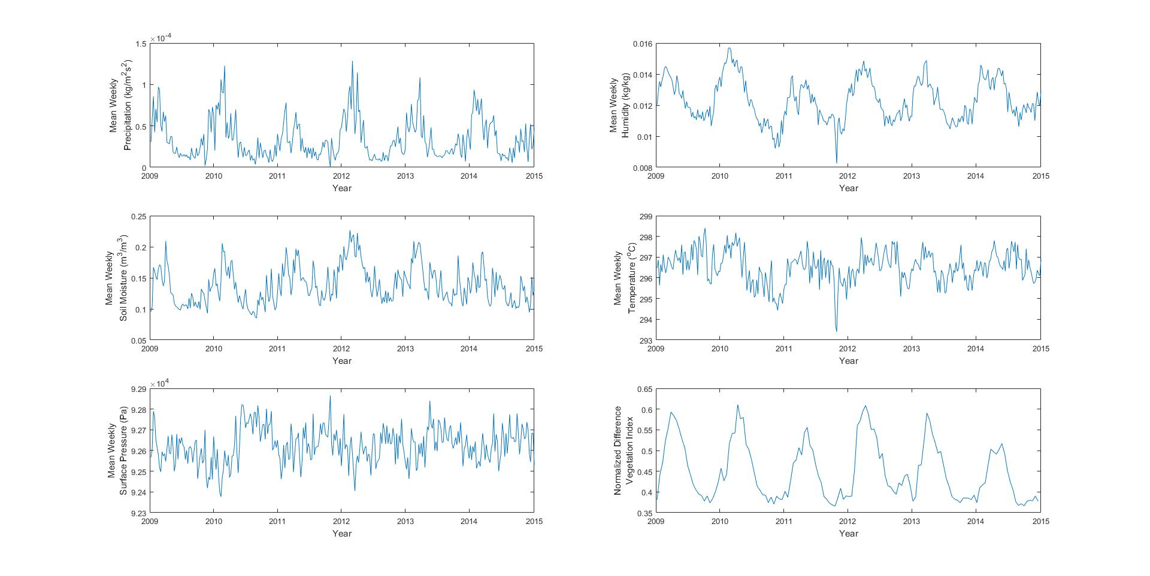
Results:
Our Multilevel Mixed-effects Poisson Regression model indicated that WPI was associated to:
  Distance (x10km) from pilot sites (β=0.39; 95%CI, 0.37–0.41)
  Normalized difference vegetation index (β=1.05; 0.90–1.21)
  Precipitation(β = 0.28; 0.25–0.31)
  Soil moisture (β = 0.0042; 0.0038–0.0044)
Notes:
The final result form out four level multvariable model are presented here.
Briefly, we were able to trace a signal the RCD/tMDA program did have some effect on the reducción of the WPI in Piura based on proximity, having as other important predictors the normalized vegetation index, precipitation and soil moisture.
Temperature was marginally significant, which could be explained by the small variability compared to other remote sensing products.

Slide 12
Conclusions
RCD/tMDA may represent an effective strategy to support malaria elimination initiatives in regions with low endemicity, a high predominance of vivax malaria, and long-term history of using primaquine without severe adverse events due to G6PD deficiency.
Further studies will be required to conclude whether the RCD/tMDA program was the primary driver towards the elimination of malaria from the Peruvian north coast.
In Peru, we recommend adopting the RCD/tMDA strategy within the national malaria control guideline as an alternative to support and sustain malaria elimination by targeting the human reservoir and containing imported cases.

Slide 13
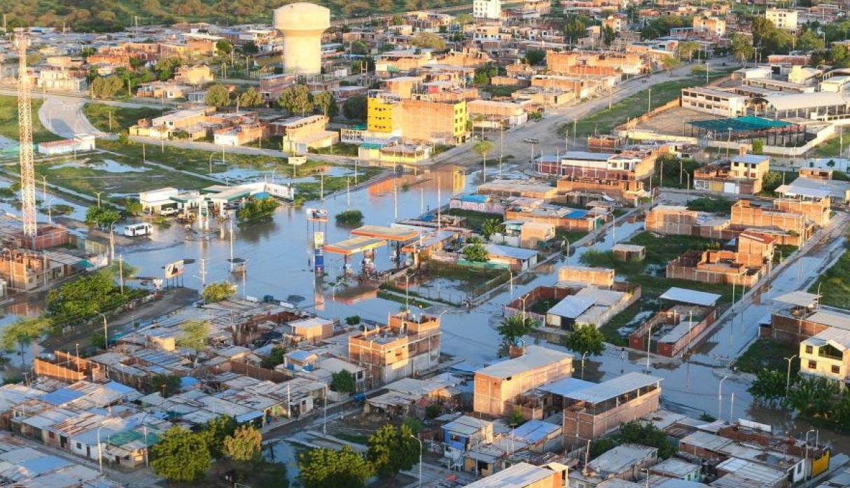
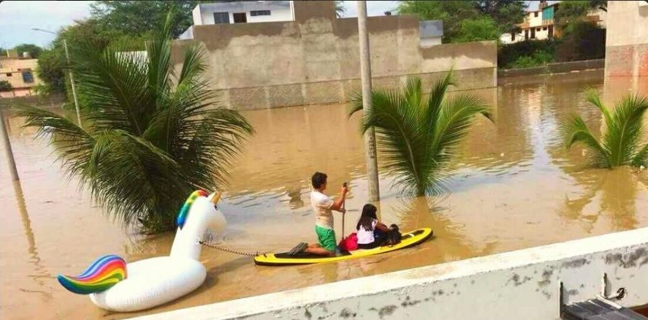
Piura, March 2017 (Source: El Comercio, Peru)

Slide 14




Acknowledgements
The community of Tumbes and Piura
Epidemiology Regional Directorates from Tumbes and Piura, Peru
Epidemiology General Directorate, Lima, Peru
Strategy for the Prevention and Control of Vector-Borne Diseases, MoH, Lima, Peru
Bill and Melinda Gates Foundation
NIH/Fogarty
Dirección Regional de Salud Tumbes
Dirección General de Epidemiología

Slide 15
Gracias!!!
Think global. Act local!
malaria delenda est
Alan Jon Magill
(November 26, 1953 – September 19, 2015)
Antonio M Quispe, MD, MSc, CPH, PhDc
aquispe@jhu.edu
* For further details in the study model please refer to: Mousam A, Maggioni V, Delamater PL,
Quispe AM. Using remote sensing and modeling techniques to investigate the annual
parasite incidence of malaria in Loreto, Peru. Advances in Water Resources 2017;108:423-38

