Slide 1
Running high-dimensional genomic models on COMPS
Albert Lee, Sharon Chen, Zhaowei Du,
Jeff Steinkraus, Benoit Raybaud, Joshua L. Proctor
IDM Symposium, April 2019

Slide 2
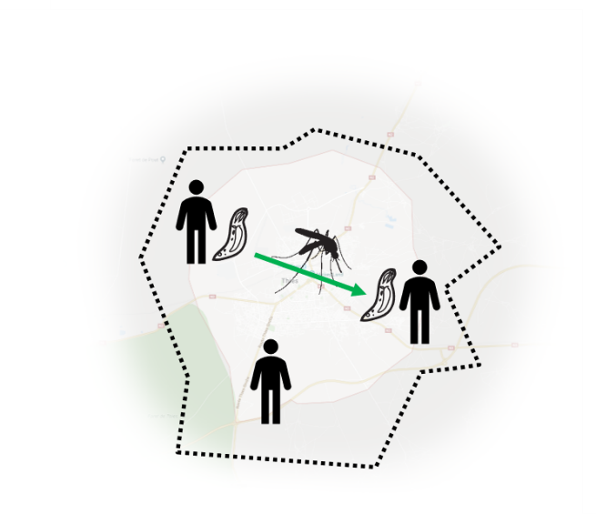
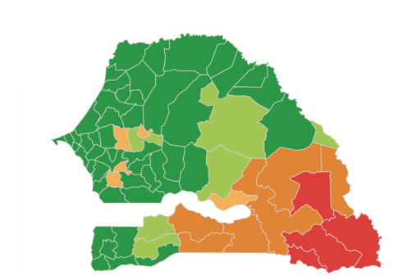
Epidemiology + Computation
Understanding driving factor for sustained transmission
Can we understand malaria transmission using genetic data?
We can use models to connect genetics to transmission
R. Daniels, W. Wong, E. Wenger, J. Proctor, et al (2015)
Notes:
Genomics lets us relate infections to one another based on the similarity of genetic information.
Previous work has shown that genetic features of the population of parasites can be used to infer transmission dynamics using a stochastic model.
Recent work has been extending this with spatial and temporal metadata.
This is important because a lot of potential info in the data and the model needs to keep up with it
I will talk about the computational challenges of extending this model to explain more complex features of genomic data.

Slide 3

Epidemiology + Computation
Spatio-temporal dynamic genomic model
Link parasite clones to ancestors using genome, time, and location
Iterative markov model
Must be sequential (long run times)
High-dimensional
3 parameters → 10+
40+ summary statistics (and growing)
Genetic data → 100s of SNPs
2009
CGATATG
2010
CGATATG
Notes:
Basic idea is that as strains are introduced to a population either by evolution or importation, they spread throughout space over some period of time and we can characterize this process with a model
The model is stochastic, markovian

Slide 4


A dynamic spatial model with genetics
Nodes
ID HostIDs
00 [01, 02, 04]
01 [00, 03, 05]
CGATATG
Hosts
ID BarcodeIDs Node
00 [03, __, __] 01
01 [00, __, __] 00
02 [02, __, __] 00
03 [05, __, __] 01
04 [__, __, __] 00
05 [01, 04, __] 01
Hosts
ID BarcodeIDs Node
00 [03, __, __] 01
01 [00, __, __] 00
02 [02, __, __] 00
03 [__, __, __] 01
04 [__, __, __] 00
05 [01, __, __] 01
CTAGATG
CTATACG
CGATATG
CTAGACG
Reservoir
ID Barcode Host
00 CGATATG 01
01 CTATACG 05
02 CTAGATG 02
03 CTAGACG 00
04 CGATATG 05
05 CTAGATG 03
CTAGATG
Notes:
Show upgrade to model – means I need more params

Slide 5
Model Mechanics: A detailed look at a single simulation step
New state
Current state
Time step
Reservoir
ID Barcode
0 CTANAAGAC
1 GTAGATGAC
2 CTAGATGAC
4 GTCGATGAC
5 CTAGATGAC
6 CTAGAAGAC
Reservoir
ID Barcode
0 CTANAAGAC
1 GTAGATGAC
2 CTAGATGAC
3 CTCGAATAC
4 GTCGATGAC
1. deaths
2. births
a. clonal
b. meiotic
3. importation
History
ID Barcode
0 CTACAAGAC
1 CTAGATGAC
2 CTAGAAGAC
History
ID Barcode
0 CTACAAGAC

Slide 6
Dynamic Model Overview
Parameters
Floating:
R_{0A}, R_{0B}, R_{0C}
Fixed:
Extinction rate
Outcrossing rate
Importation rate
Reservoir, hosts, nodes
Mechanics:
Outcrossing
Importation
Clonal propagation
Infection history
Sampling model
Sampled infections
Constants:
Allele frequency
SNP positions
Chromosomes
Rainfall
Host population
Diversity metrics:
COI
Repeated clones
Number of strains
Senegal data
Likelihood

Slide 7
Parameter sweep
Model
Simulation
Senegal data
Parameters:
(R_{0A}, R_{0B}, R_{0C})
= (1.2, 1.2, 1.2)
Likelihood
Model
Simulation
Parameters:
(R_{0A}, R_{0B}, R_{0C})
= (1.2, 1.2, 1.8)
Likelihood
Model
Simulation
Parameters:
(R_{0A}, R_{0B}, R_{0C})
= (1.2, 1.2, 2.4)
Likelihood
Notes:
Max out at around 5 parallel jobs locally

Slide 8
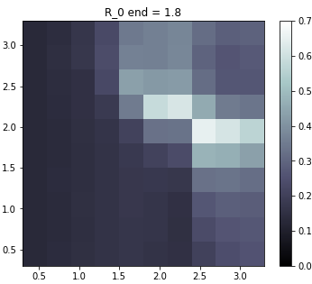
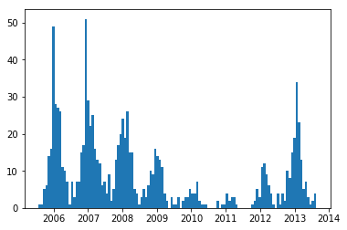
Parameter sweep results
Malaria incidence (simulation)
R₀ª = 2.4
R₀^{c} = 2.1
R₀^{b}
likelihood
R₀^{b} = 1.8
R₀ª

Slide 9
Some geeky trivia
Python
Numpy, pandas
Operate on arrays as much as possible
Try to build dataframes only once
Appends are costly
Make timesteps, random draws, array ops cheap
Replace searches with lookups
Barcode comparisons are bitwise logic operations
vs.
Typical simulations: 3 to 300 seconds

Slide 10
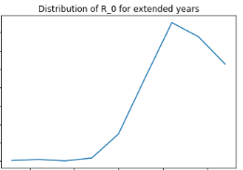
Architecture on local
COMPS or cloud
LOCAL
Analysis
script
1.2
output
Batch script
1.8
output
output
2.4
1.2 1.8 2.4

Slide 11
Architecture on COMPS
model
launcher
output
queue
model
launcher
output
COMPS (Windows HPC)
model
launcher
output
LOCAL
output
Python script
Analyzer
output
output
1.2 1.8 2.4

Slide 12
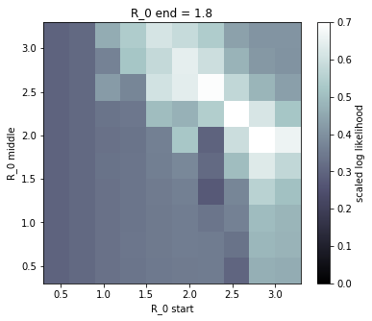

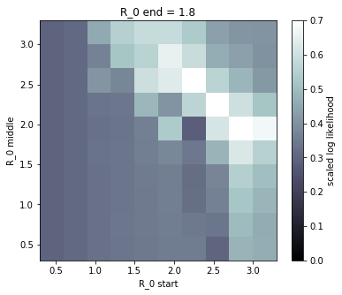
Likelihood surfaces from 3 parameterizations (1-day per sweep)
p_{day} = 0.0001
p_{day} = 0.02
p_{day} = 0.5
Summary statistics cannot distinguish between models on yearly timescales
(it took an entire weekend just to be able to know this)

Slide 13
Parameter sweeps are expensive
Current model needs R₀ for every quarter:
4 parameters, 10 grid points each = 10⁴
100 sims per 4-param vector = 10⁶ sims
~1-5 minutes per sim = ~36 hours on 1000 cores
Future models will need 10+ parameters:
10¹⁰ grid points → already intractable
Need better way to explore parameter space

Slide 14
Optimizing Parameter space
Most of the grid evaluations are wasted
If we knew where the solution were beforehand we could save time
Solution: adaptive sampling
Metropolis-Hastings
Importance sampling
Gradient descent
All of these require talking to cluster and updating the list of sims I want to run

Slide 15
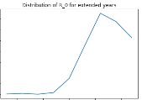
Architecture with IMIS (Calibtools)
...
Q1
Q2
COMPS
...
LOCAL
Python
script
(init params)
Python
script
(refine params)
Analyzer
Analyzer

Slide 16
Conclusions and next steps
COMPS gives >100x speed up via parallelization
More flexible parameter fits
Explanatory power of model greatly increased
HPC architecture allows us to analyze simulations in aggregate and then iterate
Next steps
Implementing IMIS
Theoretically unlimited number of parameters
Potentially more robust framework for model evaluation
Dynamic job scheduler
Notes:
Dynamic job scheduler? ***
Bring more science in
why do we need more params

Slide 17
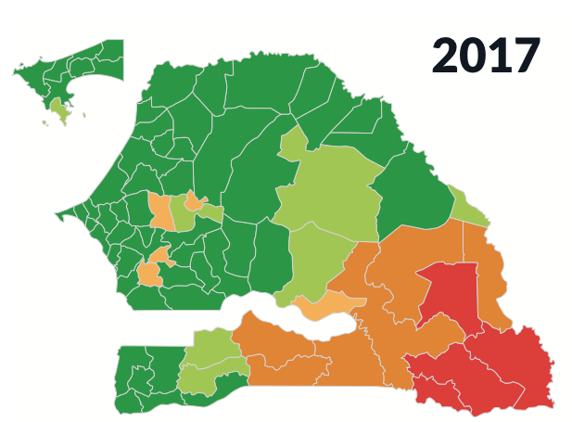

What about the science…
Sarah Volkman, Tuesday 9am
Genetic Signals of Plasmodium falciparum Reveal Transmission Dynamics and Track Infections
Albert Lee, Wednesday 11am
Molecular surveillance reveals spatio-temporal trends of malaria transmission in Senegal

Slide 18
End

Slide 19
Appendix

Slide 20
Barcode Data
CTAGAATAC
CTAGAAGAC
CTACAAGAC
CTAGAATAC
CTAGAATAC
CTAGAAGAC
CTACAAGAC
CTAGAATAC
…TTACG… …CAT… …GAC… …G… …AGTC…
…TTACG… …CAT… …GAC… …G… …AGTC…
CTANAANAC
CTAGA
CTAGA?GAC
ID Barcode
0 CTANAANAC
1 GTAGATGAC
2 CTAGAXGAC
3 CTCGAATAC
:
CTAGAXGAC
Notes:
14 chromosomes

Slide 21

Dynamic genomic model
CGATATG
Reservoir
CGATATG
CTAGATG
CTAGACG
CGATATG
CTAGATG
CGATATG
CTAGATG
Infection history
CGATATG
CTAGATG
CTAGACG
CTAGATG
Notes:
Ask Caitlin about mosquito ☺

