Slide 1
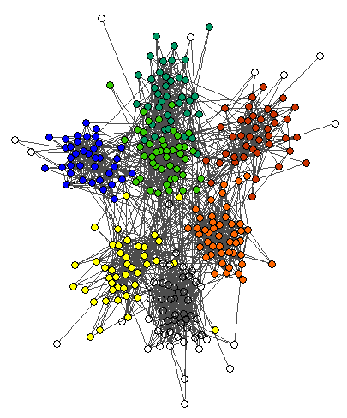


Quantifying influenza transmission risks for school-age children
The role of community, social networks and school structures
Jonathan Read
E: jonathan.read@lancs.ac.uk
IDM Symposium 2018

Slide 2
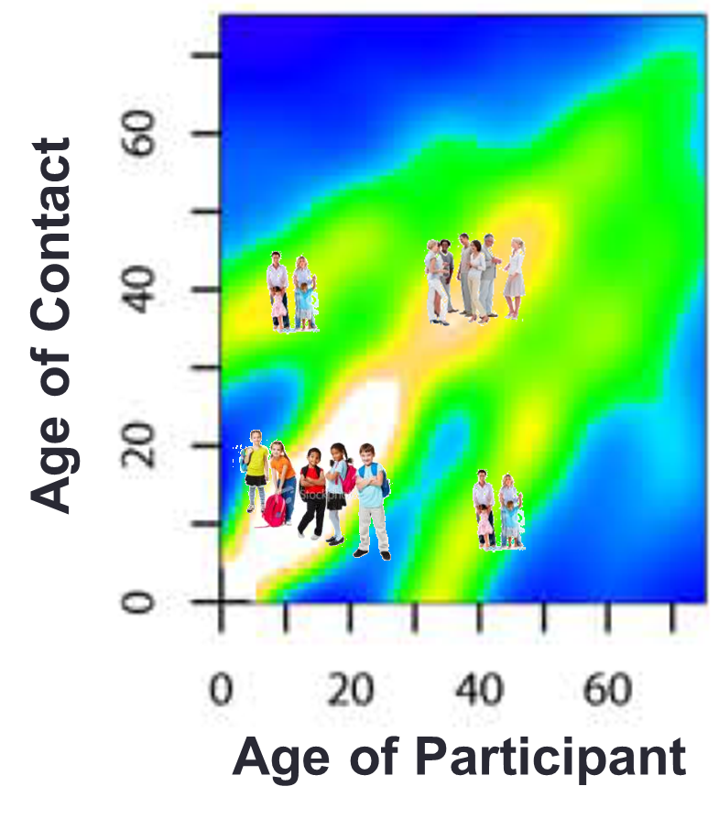
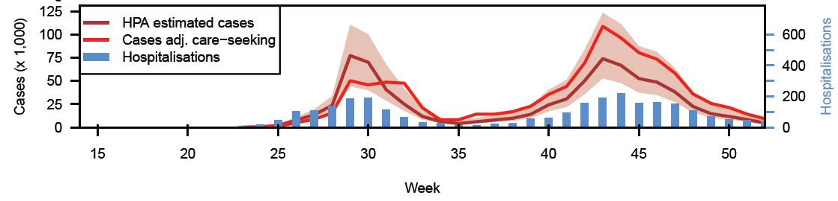
School children and influenza epidemics
“The fires of the epidemic are carried by healthy school-age children”
Glezen 1996
Observed social mixing rates
England 2009 pandemic
School
holiday
Glezen 1996 Epidemiologic reviews
Mossong et al 2008 PLoS Medicine
Case estimates courtesy of Public Health England
Notes:
Suspicion that school holidays dramatically reduced transmission rate in England & Wales during 2009 influenza pandemic. Second (autumn) wave appears to have exhausted susceptibles and impact of holidays less pronounced.

Slide 3
School children and influenza epidemics
Multiple factors may explain the apparent role of school children
  Mixing rates
  Social networks
  Susceptibility
  Hygiene
  School environment
Are some children more important than others?
  Demographic factors
  Network centrality
Mechanistic understanding, better predictions
  School closures as epidemic control
Notes:
Evidence of differential social mixing, from POLYMOD study, that can help to explain (at aggregate level) why schools may be important driver of epidemics.
But this is a phenomenological ‘explanation’: can we quantify the role of schools and schoolchildren in influenza transmission?

Slide 4
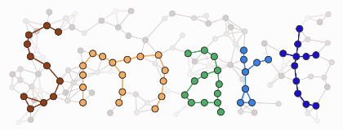
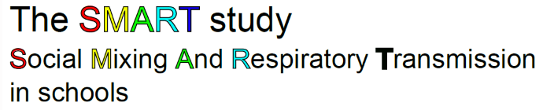
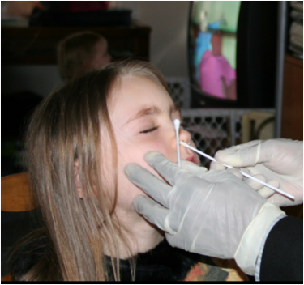
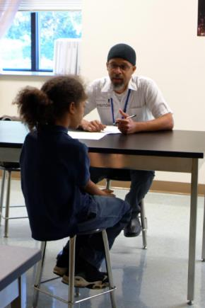
US CDC funded series of studies
  Cohort study of social mixing patterns
  Variety of methods (diary, motes, video)
  Outside school contact during closures
  Cohort study of influenza infection
  Surveillance of Influenza-Like Illness (ILI)
  Virological confirmed infection (PCR)
  Social network sampling
Notes:
Ringed text is what will be talked about here.

Slide 5
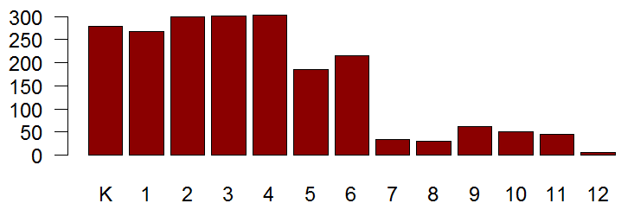
Study population
Pittsburgh metropolitan area, PA, USA (~2m people)
2 school districts; 9 schools (3 + 6)
Elementary, Middle, High schools (K, 1, 2, …, 12)
Recruitment: Opt-out (90-95% participation)
Total 2,519 students
2,077 observable during flu season
  excluding dropouts/unreachable
Notes:
Surveillance of students depended on being about to contact their parents when the student was absent, to obtain symptom information and identify ILI (influenza-like illness). This wasn’t always possible (wrong numbers for parents, being the main reason), so some students were essentially unobservable, and are excluded from attack rate analysis.

Slide 6
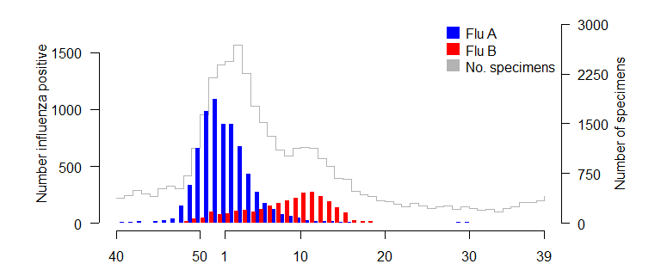
State-level clinical surveillance
Winter 2012/13
SMART
2012
2013
Week of year
Notes:
Lab confirmed state-wide surveillance information; based on clinical subjects usually, therefore possibly biased.
SMART surveillance period covered the B epidemic well, but less so the epidemic of H3N2

Slide 7
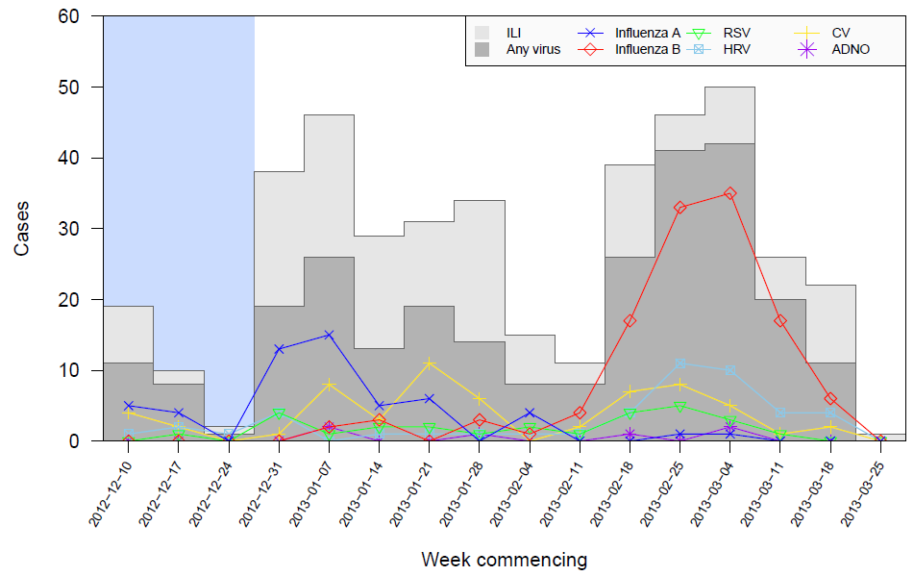
In-school surveillance
Absent from school
  Study team call parents
  Symptoms recorded
  Swabbed on return to school
Sick at school
  Present to school nurse
  Symptoms and swab
  Sent home
Notes:
Blue region indicates that only 3 schools had our surveillance up and running. It was a very early flu season in Pittsburgh, usually starts Feb, this started before Xmas.

Slide 8
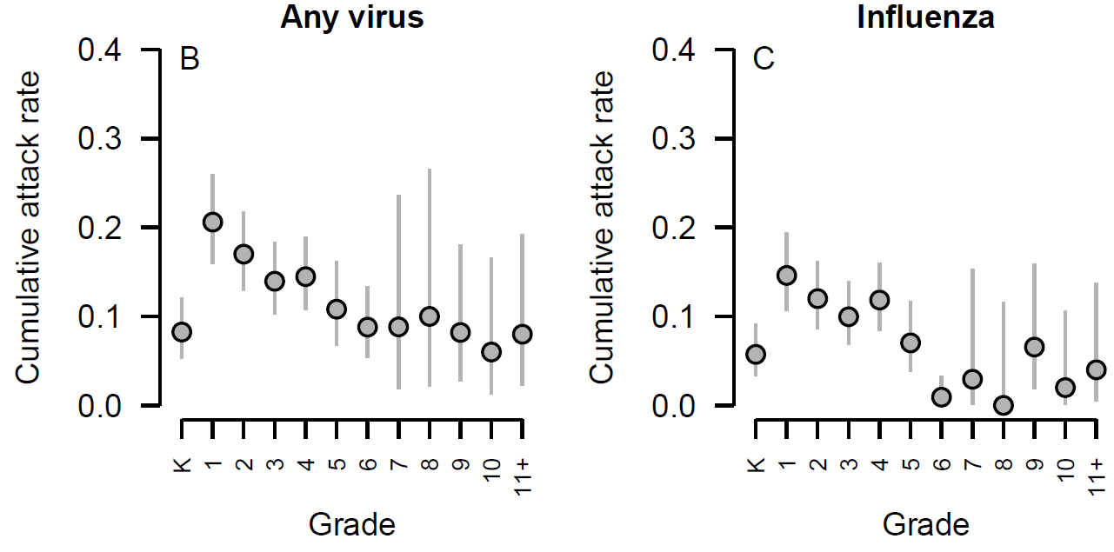
Cumulative attack rate
Read et al. 2018 submitted
Notes:
Over the whole flu season. Note the general decline with increasing grade (age), and the curious lower rate for Kindergarten students.
This doesn’t tell us about specific transmission routes. Can a transmission model help explain these features as well as inform on transmission routes?

Slide 9
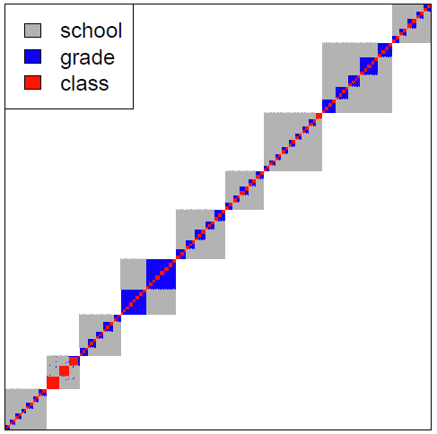

School-based networks
School membership
Student j
Class membership
Student i
Notes:
Information provided by schools allowed us to construct these networks.

Slide 10
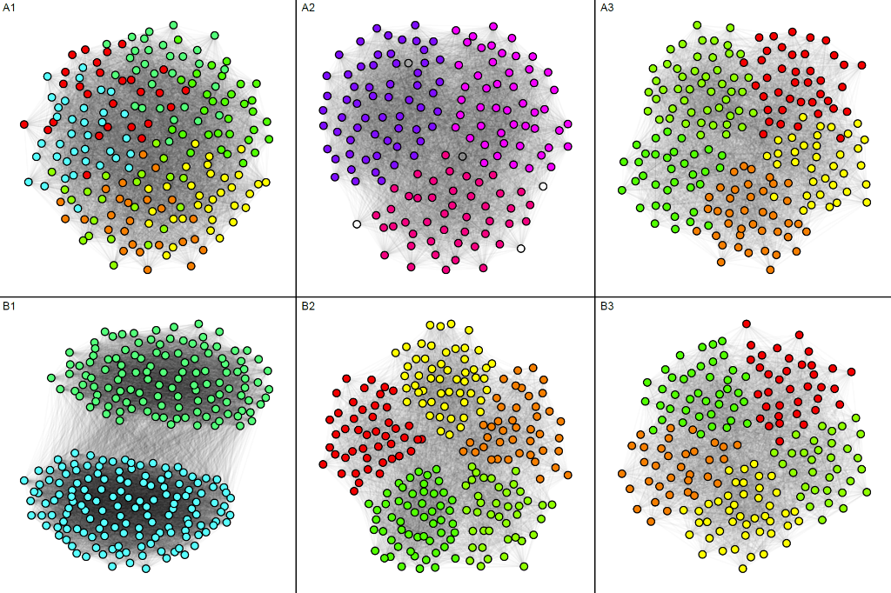
Social networks
3 network types:
Know
Friend
Talk
Example social networks in six schools showing which students reported knowing each other. Grades (age) of students are represented by different colours.
Notes:
Constructed Kknow networks for 6 schools; note the similarities and different structures (e.g. compare A1 and B2 – this must be due to architectural differences in the schools). A2 was a high school, with less class structure than the other schools. A1 was a primary school attach to A2.

Slide 11
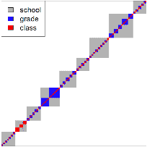

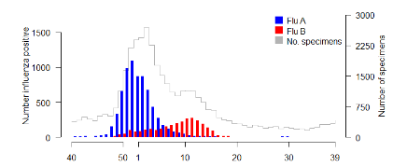

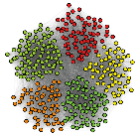

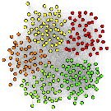
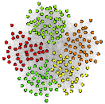
Infection model
+ school attendance
Kschool
Kgrade
Exogenous
(community)
Kclass
Currently infectious
Kknow
Kfriend
Grade (age)
Half-day at school
Ktalk
Notes:
2 individual-level parameters that determine susceptibility (linear term for grade, half-day effect for K students)
Attendance information used to determine which children are present in school on particular days, affecting their exposure and infectivity.

Slide 12
Model description
Exogenous
infection
School network infection
Social network infection
Features
  Susceptibility
    Grade (age)
  Exogenous infection
  School network infection
    Class / Grade / School membership
    Half-day attendance
    Attendance at school
  Social network infection
    Know / Friend / Talk
Assumptions
  2 day incubation period
  Infective at symptom onset
  Recovered upon return to school
Fitting
  Likelihood-based
  Forward selection process
  Parameter selection + fitting for flu A and B incidence independently

Slide 13
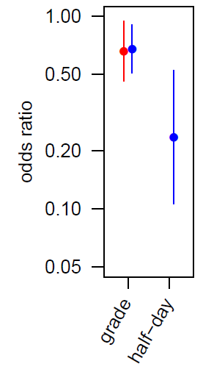
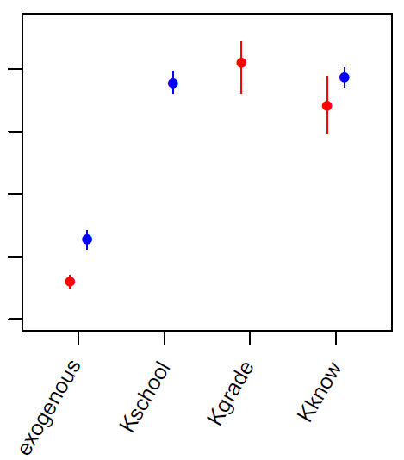
Final model parameters
Influenza A
Influenza B
10⁻³
10⁻⁴
transmission rate d⁻¹
10⁻⁵
10⁻⁶
10⁻⁷

Slide 14
Final models – Influenza A and B
Both school-based network and social network selected for influenza A and B transmission models
Protective effect of increasing age, by grade
  Flu A, 34% (95%CI: 5%, 54%) reduction in infection risk
  Flu B, 32% (95%CI: 9%, 49%)
Half-day attendance significantly reduces influenza B risk
  Half-day K students 23.6% (95%CI: 10.6%, 52.4%) risk of acquiring influenza B compared to full-day K students
Comparable effect sizes and transmission rates for influenza A and B

Slide 15
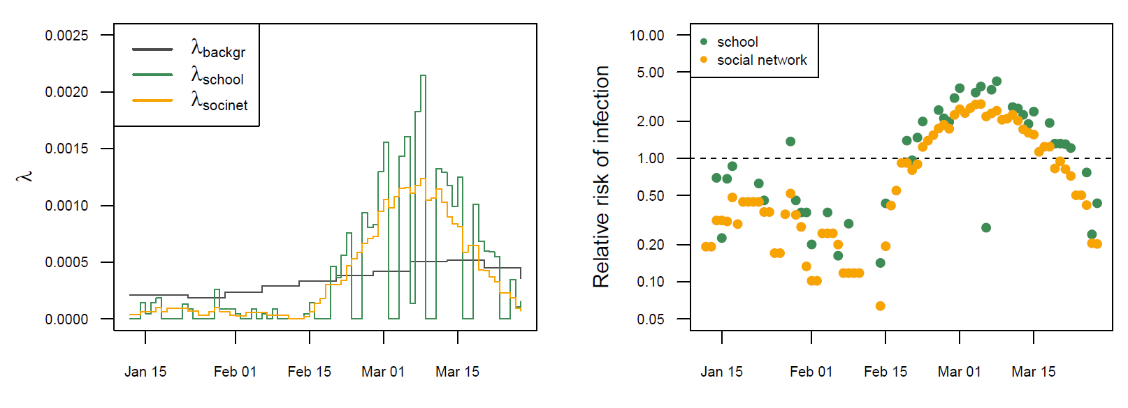
Comparing transmission routes, over time
Influenza B
Daily average FoI
Hazard ratio
Hazard ratio
(relative to background risk)
Uses observed infections and school attendances
Notes:
Here, school-based includes the transmission within school via school-structure networks (e.g., school membership and class membership).
Relative risk of infection is relative to exogenous risk.
The odd point for school on ~8th March corresponds to a short holiday period.

Slide 16
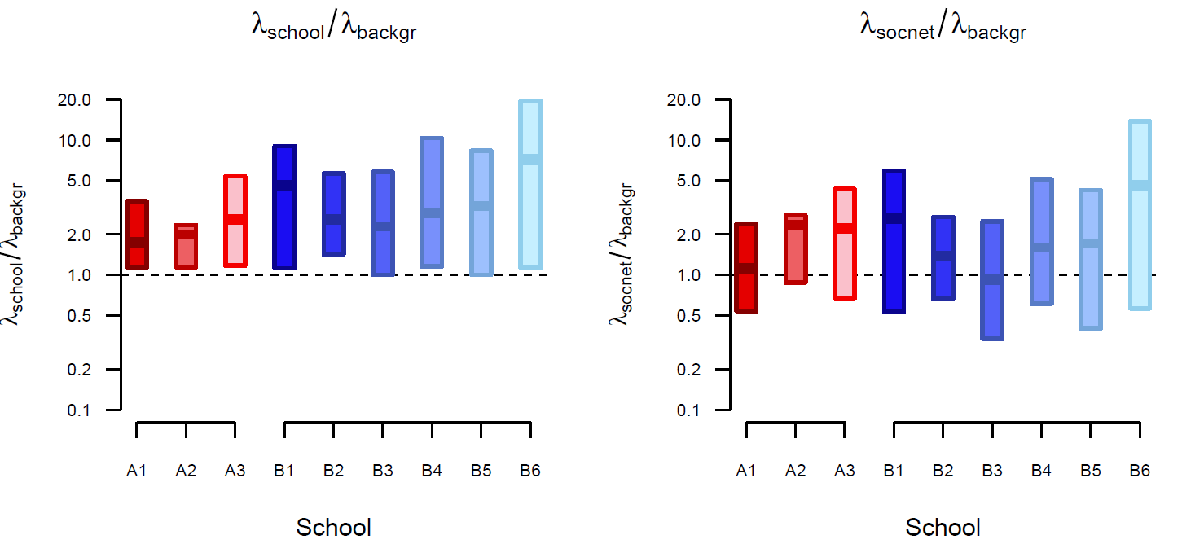
Comparing transmission routes, by school
Influenza B
School-based network
Social network
Hazard ratio
(relative to background risk)
Hazard ratio
(relative to background risk)
Range and average hazard ratios
Notes:
Boxes show the range of mean individual risk within each school for the whole epidemic period. Horizontal bars show within-school average for the period.

Slide 17
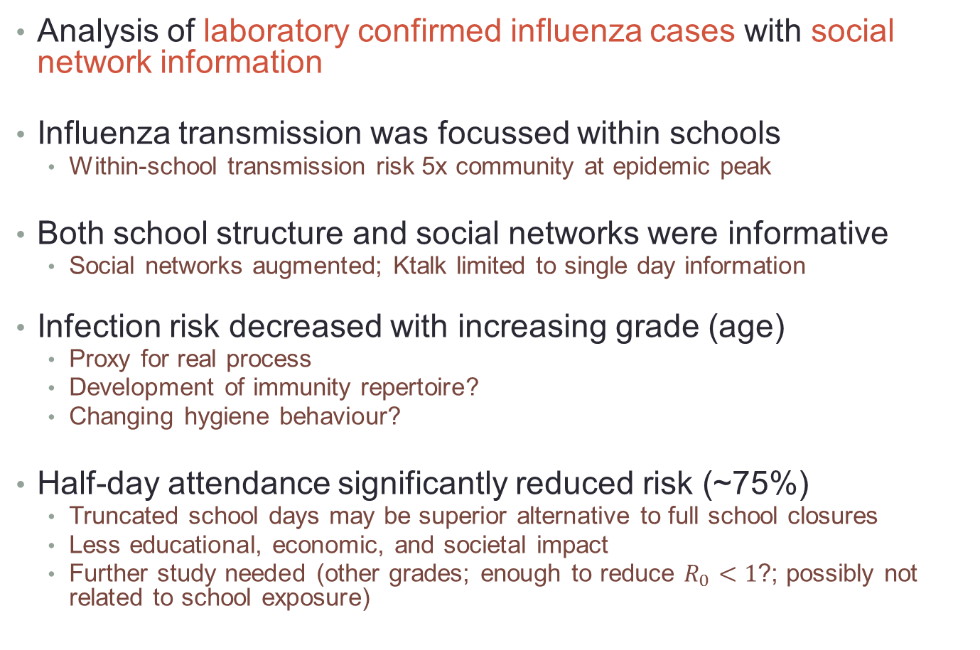
Summary
Analysis of laboratory confirmed influenza cases with social network information
Influenza transmission was focussed within schools
  Within-school transmission risk 5x community at epidemic peak
Both school structure and social networks were informative
  Social networks augmented; Ktalk limited to single day information
Infection risk decreased with increasing grade (age)
  Proxy for real process
  Development of immunity repertoire?
  Changing hygiene behaviour?
Half-day attendance significantly reduced risk (~75%)
  Truncated school days may be superior alternative to full school closures
  Less educational, economic, and societal impact
  Further study needed (other grades; enough to reduce $R_{0}<1$?; possibly not related to school exposure)

Slide 18

Acknowledgements
Derek Cummings Kyra Grantz | Florida
Shanta Zimmer | Columbia
Patti Calderone David Galloway Hasan Guclu Carrie Lingle Charles Rinaldo Mary Lou Schweizer Chuck Vukotich Jr Gaby Yearwood | Pittsburgh
Eva Noble | Johns Hopkins
Students and staff
Canon McMillan and Propel Charter Schools, Pittsburgh
Chris Jewell | Lancaster
Rebecca Lester | LSTM
Hongjiang Gao Amra Uzicanin Jeanette Rainey | CDC
Notes:
emphasised names are key persons for this work

Slide 20
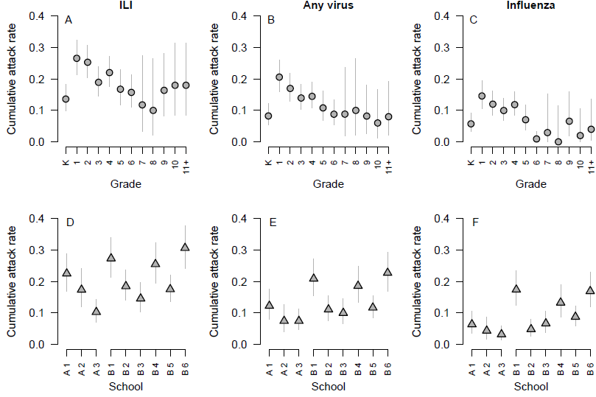
Cumulative attack rates

Slide 21
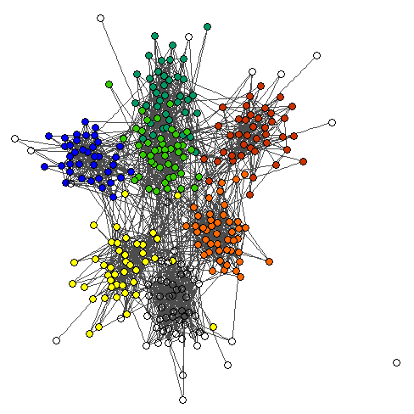


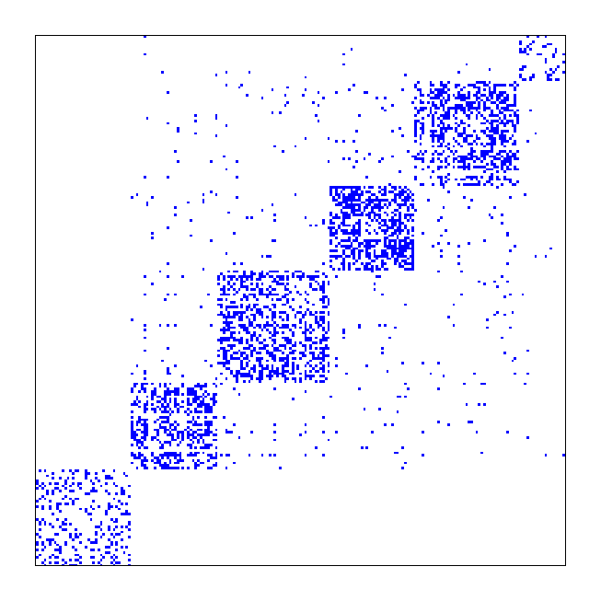
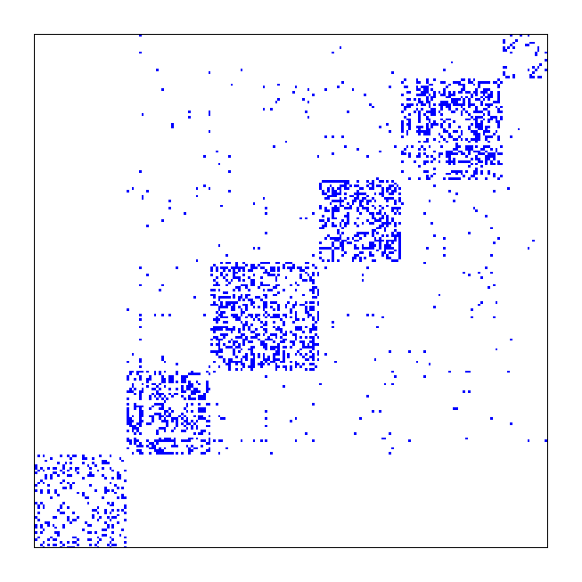
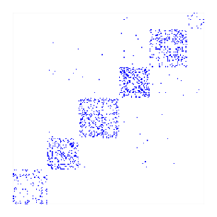
Social networks
Example Friendship network, single school
Self-reported
Know
Do you know this person?
Friend
Are you friends with them?
Talk
Did you talk with them?
Notes:
Sampling of social networks using face-to-face interview of students sampled from classes throughout the surveillance period. Each student was asked about a specific (to them) 12 named students. Full networks were constructed using augmentation (prediction of logistic model fitted to sampled pairs, using information on school, grade, sex of the pair and classroom membership).

Slide 22
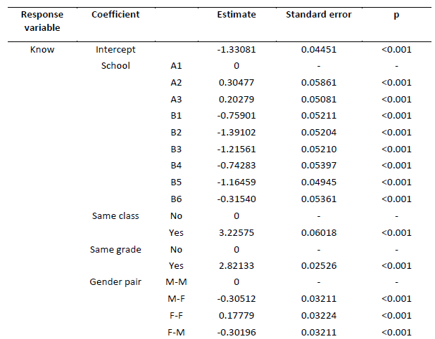
Network augmentation – K_{know} model

Slide 23

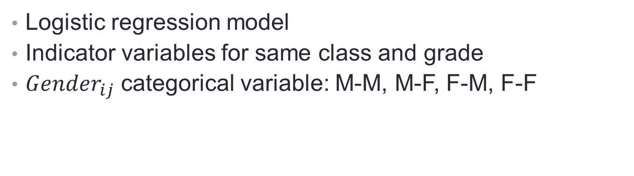
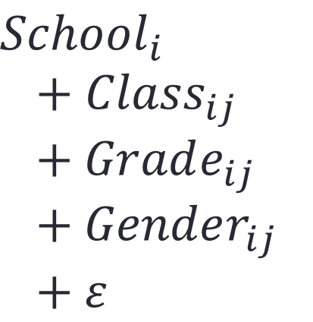
Network augmentation
$$p\left(K_{ij}=1\right) \sim$$
$$School_{i}$$
$$+ Class_{ij}+Grade_{ij}+Gender_{ij}+ε$$
Logistic regression model
Indicator variables for same class and grade
$Gender_{ij}$ categorical variable: M-M, M-F, F-M, F-F

Slide 24
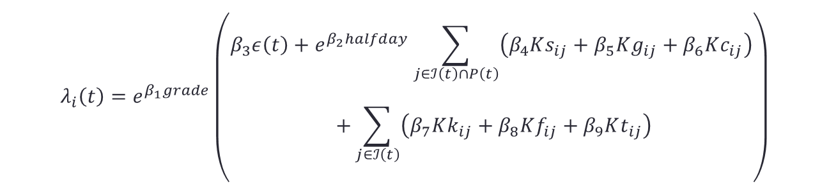
Force of infection
Exogenous
Half-day
School
Grade
Class
$$λ_{i}\left(t\right)=e^{β_{1}grade}\left(\begin{aligned}\begin{aligned}β_{3}ε\left(t\right)+e^{β_{2}halfday}\sum_{j∈ℐ\left(t\right)∩P\left(t\right)}{\left(β_{4}Ks_{ij}+β_{5}Kg_{ij}+β_{6}Kc_{ij}\right)} \\ +\sum_{j∈ℐ\left(t\right)}{\left(β_{7}Kk_{ij}+β_{8}Kf_{ij}+β_{9}Kt_{ij}\right)}\end{aligned} \\ \end{aligned}\right)$$
Grade
Know
Friend
Talk
Assumptions: 2 day incubation period; infectiousness corresponds with symptom onset; return to school as recovered
Fitted to Influenza A and B observed infections independently: optim() in R
Nested model: parameters added iteratively, selection based on AIC and likelihood ratio test
‘Agnostic’ parsimonious approach

Slide 25
Model fitting – Influenza B
Iteration
Best model
1.
Background
2.
Background
School
3.
Background
School
Know
4.
Background
School
Know
Half-day
5.
Background
School
Know
Half-day
Grade
Grade
Class
Fiend
Talk
Notes:
Note, not all parameters/covariates included in final models.

Slide 26
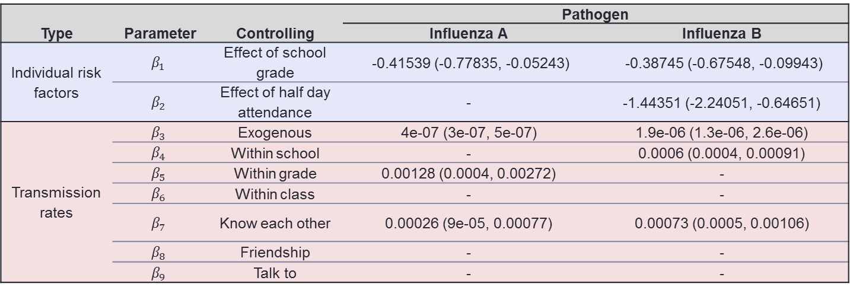
Final models – Influenza A and B
 |  |  | Pathogen
Type | Parameter | Controlling | Influenza A | Influenza B
Individual risk factors | $$β_{1}$$ | Effect of school grade | -0.41539 (-0.77835, -0.05243) | -0.38745 (-0.67548, -0.09943)
 | $$β_{2}$$ | Effect of half day attendance | - | -1.44351 (-2.24051, -0.64651)
Transmission rates | $$β_{3}$$ | Exogenous | 4e-07 (3e-07, 5e-07) | 1.9e-06 (1.3e-06, 2.6e-06)
 | $$β_{4}$$ | Within school | - | 0.0006 (0.0004, 0.00091)
 | $$β_{5}$$ | Within grade | 0.00128 (0.0004, 0.00272) | -
 | $$β_{6}$$ | Within class | - | -
 | $$β_{7}$$ | Know each other | 0.00026 (9e-05, 0.00077) | 0.00073 (0.0005, 0.00106)
 | $$β_{8}$$ | Friendship | - | -
 | $$β_{9}$$ | Talk to | - | -

Slide 27
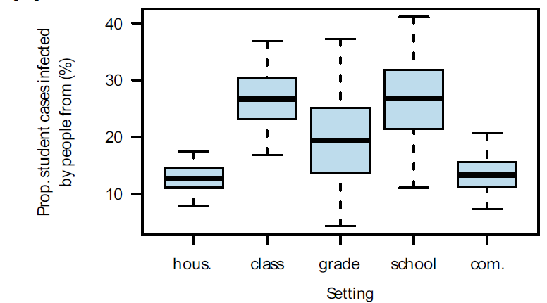
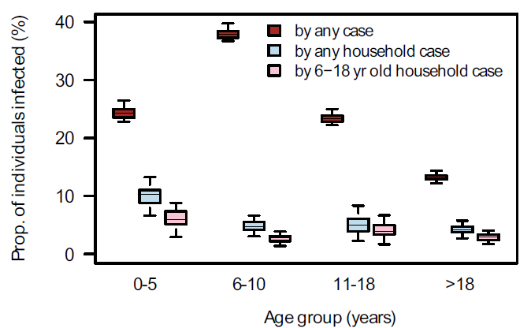
Cauchemez et al 2009 PNAS
Syndromic case definition (not lab confirmed)

