Slide 1

Malaria in Haiti:
Genomic Epidemiology at the Lower Limits of
Transmission
Haiti 5c Stamp, 1962 ©Wellcome Collection
Seth Redmond
Harvard TH Chan School of Public Health /
Broad Institute / Monash University
Notes:
Hispaniola is the last island in the Caribbean where malaria persists
Haiti has ~10m population (same as dom rep) has the vast majority of that malaria - 80% at risk.
1968 Haiti reduced prevalence to 1% (assessed by microscopy) after MDA / DDT spraying
Earthquake in 2010, resurgence of malaria + cholera afterwards

Slide 2
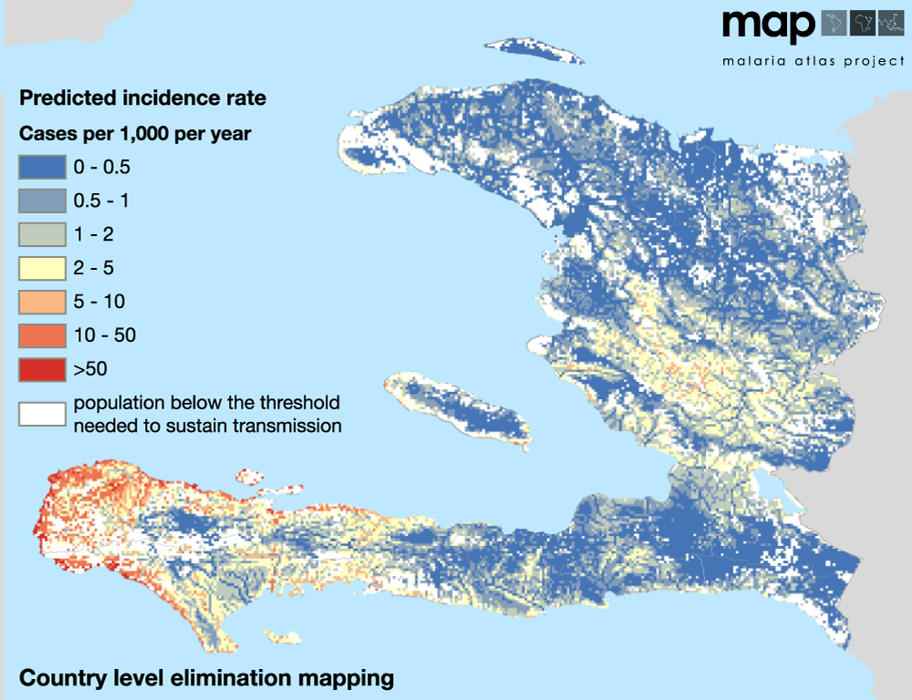
Malaria elimination in Haiti is an achievable goal
  Malaria elimination targeted by 2020
Malaria burden is low:
  ~20,000 cases per year (confirmed)
  ~ 30,000 suspected
Effective drugs are available:
  > 99% P.falciparum
  Little chloroquine resistance
Current control regime:
  Passive case detection and
  bednet distribution
  Vector: An. albimanus
  (predominantly bites outdoors)
Notes:
Largest number of cases is in port au prince where 1/4 of population lives,
but most intensive transmission likely to be in south eastern tip of hispaniola (
Current regime – passive case detection and bednet distribution – but… exophilic vector
Steinhardt et al (Lancet inf dis 2017) found no significant protective effect of ITNs
can we do better?

Slide 3
Malaria elimination in Haiti is an achievable goal
CHAI Elimination assessment, 2013:
Current control regime:
  Cost $9m per year
Elimination regime:
  Low risk areas: test+treat
  Med/High risk areas: MDA
  $18m per year
  (greatly reduced by targeting foci)
Can genetics aid in targeting interventions?
Grande Anse
Nippes
Sud
Notes:
Clinton health access assessed a potential elimination campaign
Elimination regime – min $18m per year (but would be greatly reduced with better targeting of foci)
CHAI highlighted that understanding parasite mobility would greatly reduce costs of an elimination campaign
Unfortunately, severe lack of epi data across island, resource limited.
So this may be a location where genetic analysis provide valuable and cost-effective insight
Analysed data 2016, consisting of passively-detected cases from 3 departements
with comparatively high transmission in the south east of Haiti, Grande Anse, Sud and Nippes

Slide 4
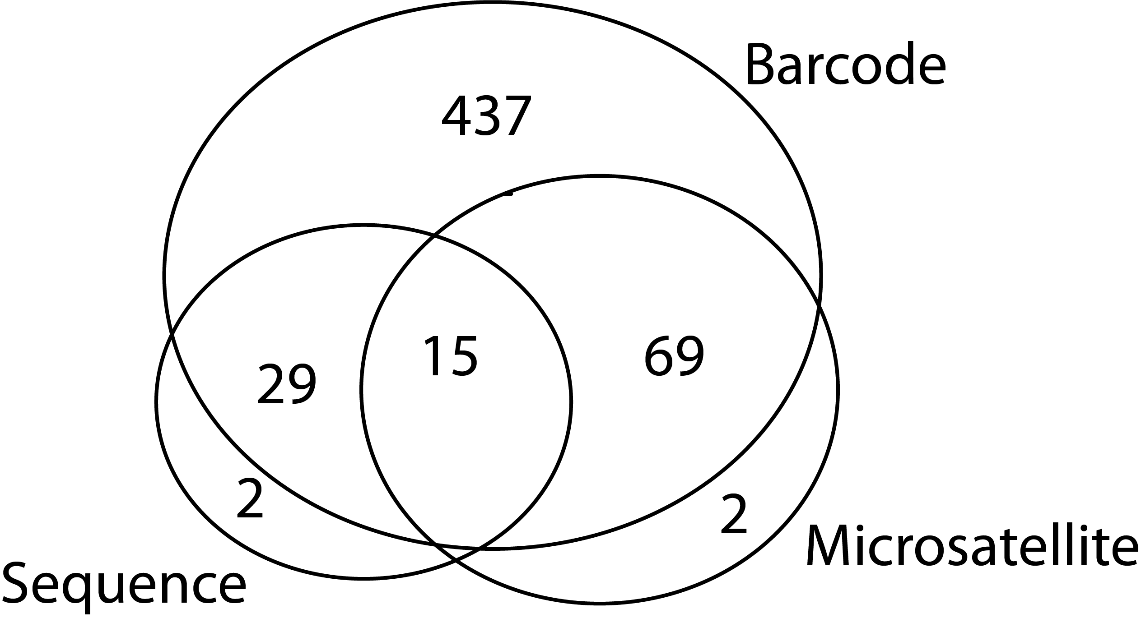
Can genetics help target sites for elimination?
  All data generated from dried blood spots
  3 genotyping methods:
    24-SNP barcode
    6 x Microsatellites
    Whole Genome Sequencing
    SWGA, Pf3K only (5218 SNPs)
  Overlapping datasets:
Notes:
All the data presented was taken from bloodspots, collected after a +ve test.
Meaning it’s relatively cheap to collect and doesn’t require cold chain.
To compare which methods would work best in this environment these were genotyped using 3 methods
24-SNP barcode
microsatellite – thanks to kumar venkatachalam @ CDC
SWGA+seq– generated by Rachel Daniels / Sarah Volkman
Few samples covered by all 3 methods, but good overlap of barcode with both methods.

Slide 5

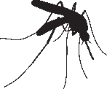


Which genetic signals can we use?
Outcrossing
Complexity of Infection
Clonal Proportion
Relatedness / IBD
Genetic Distance*
Clonal transmission
* De Novo Mutations Resolve Disease Transmission
Pathways in Clonal Malaria – Redmond et al. MBE 2018

Slide 6
Which genetic signals can we use?
Outcrossing
Complexity of Infection
Clonal Proportion
Relatedness / IBD
Genetic Distance*
Clonal transmission
* De Novo Mutations Resolve Disease Transmission
Pathways in Clonal Malaria – Redmond et al. MBE 2018

Slide 7
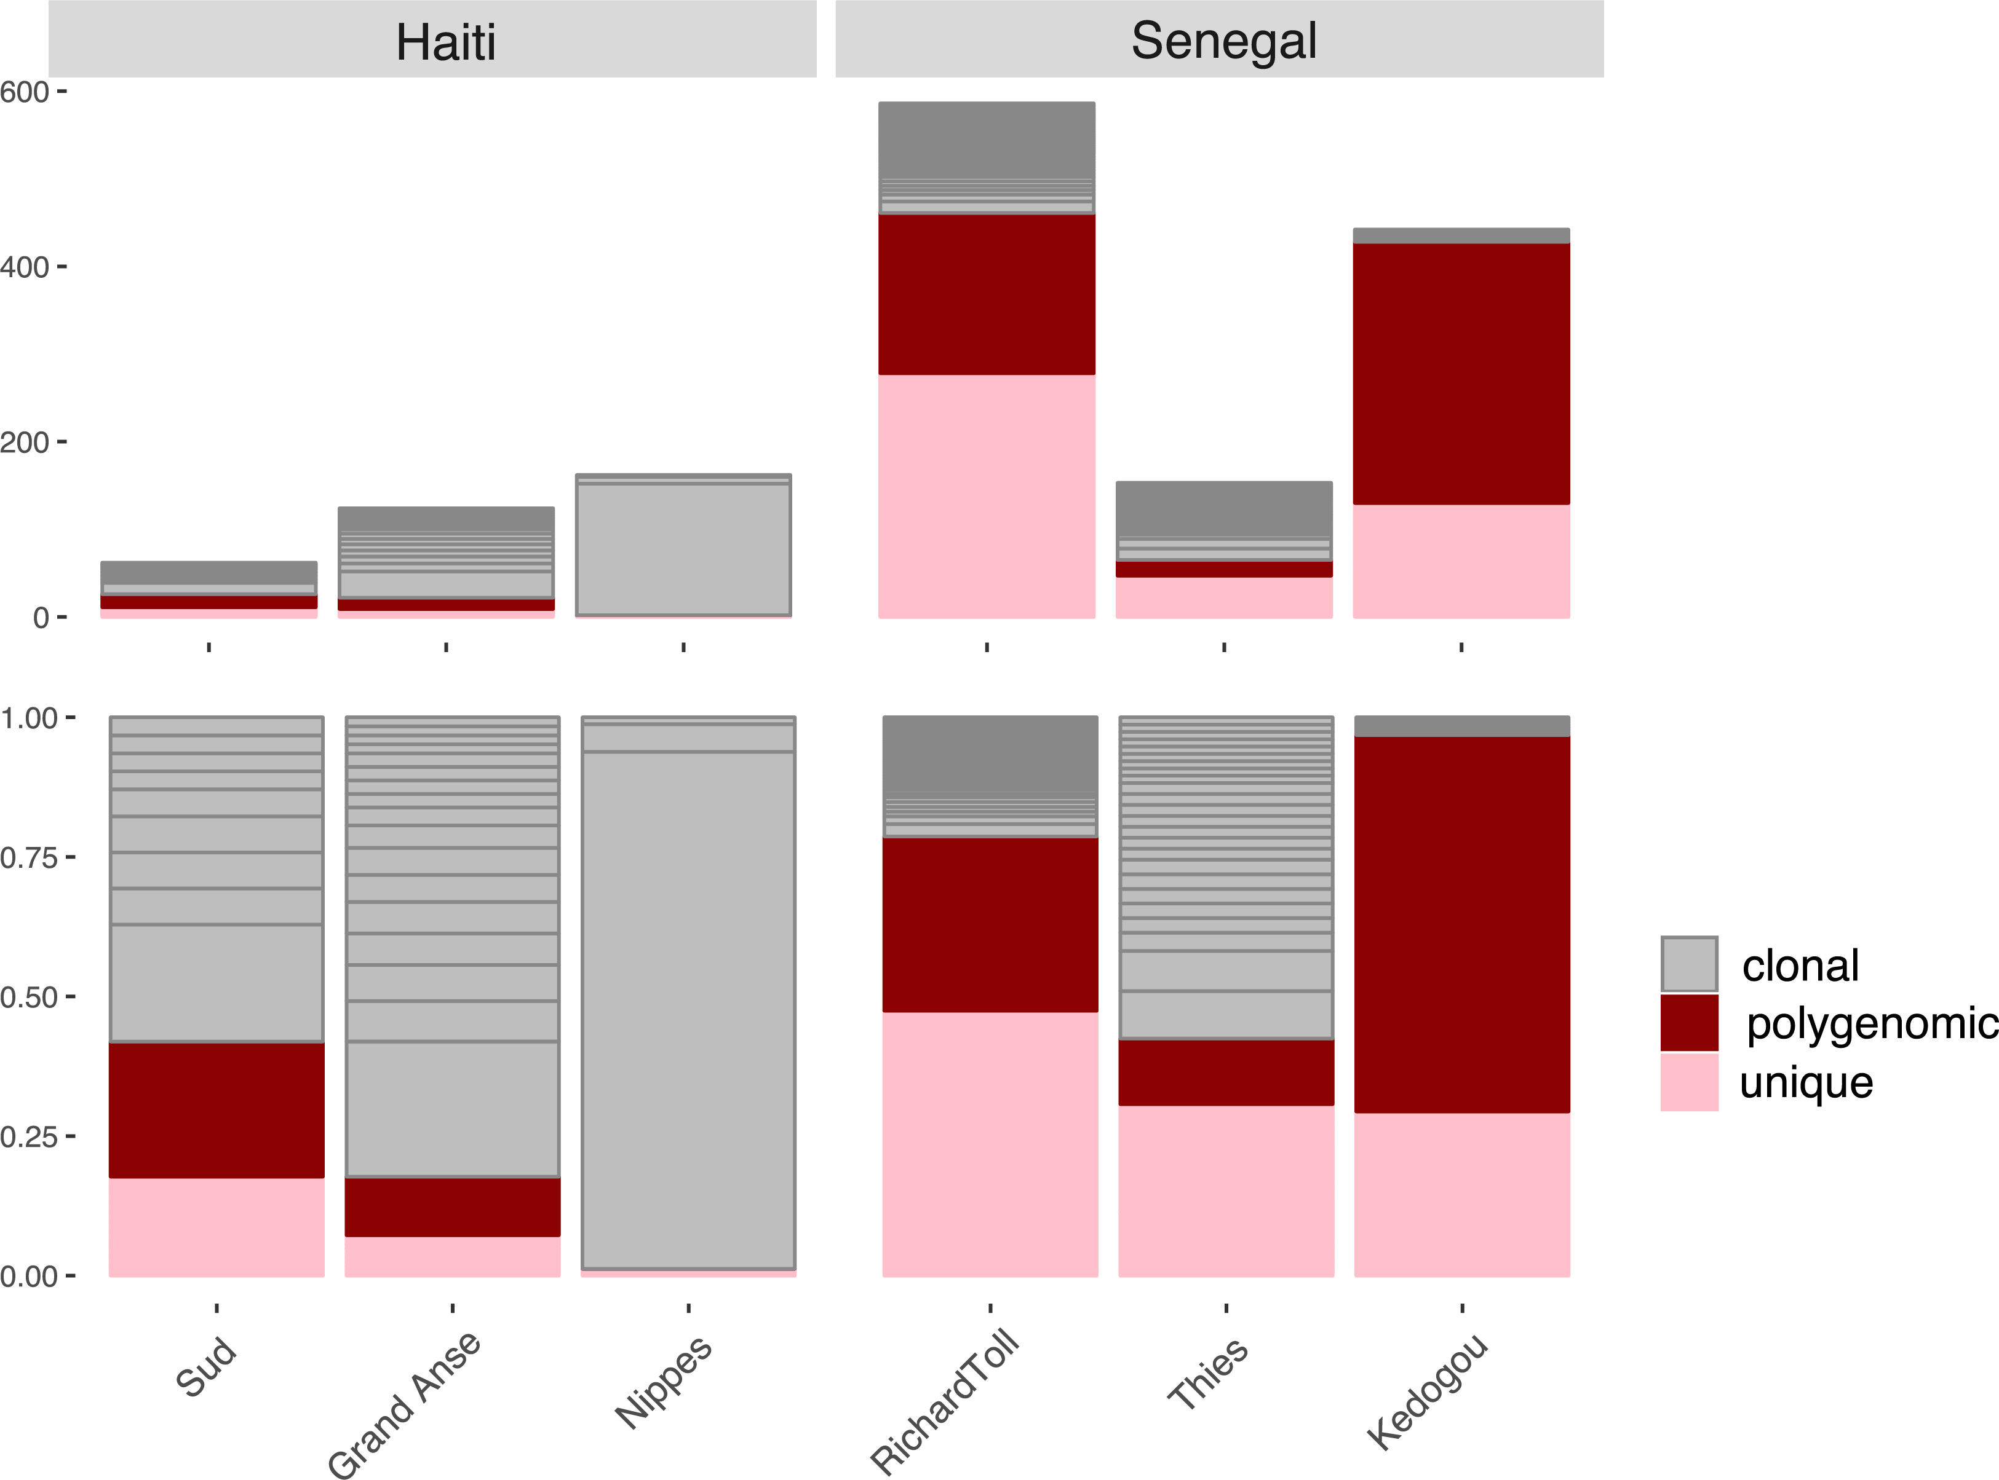
Haiti exhibits Low diversity, high inbreeding
Unique / clonal / polygenomic proportions via barcode
Barcode indicates lower diversity in Haiti than in previous applications
Regions dominated by small number of clones
Proportion polygenomic samples not useful as a measure of transmission
Notes:
the largest dataset here, the barcodes,
Comparing Haiti to 3 regions within Senegal with low, medium, high transmission
Incidence:
Thies 5/1000
RichardToll 1/1000
- walk through graph…
Unique barcodes, clonal (infections with identical 24-SNP barcodes), and
polygenomic infections (more than one clone in a single infection)
Far lower diversity than in other regions, All 3 locations dominated by clusters of ‘clonal groups’
One of these regions, Nippes is almost entirely dominated by a single clone.
In this region we also see a total lack of polygenomic infections –
any superinfections here would overlay the same barcode on another – we wouldn’t have power to detect it.

Slide 8
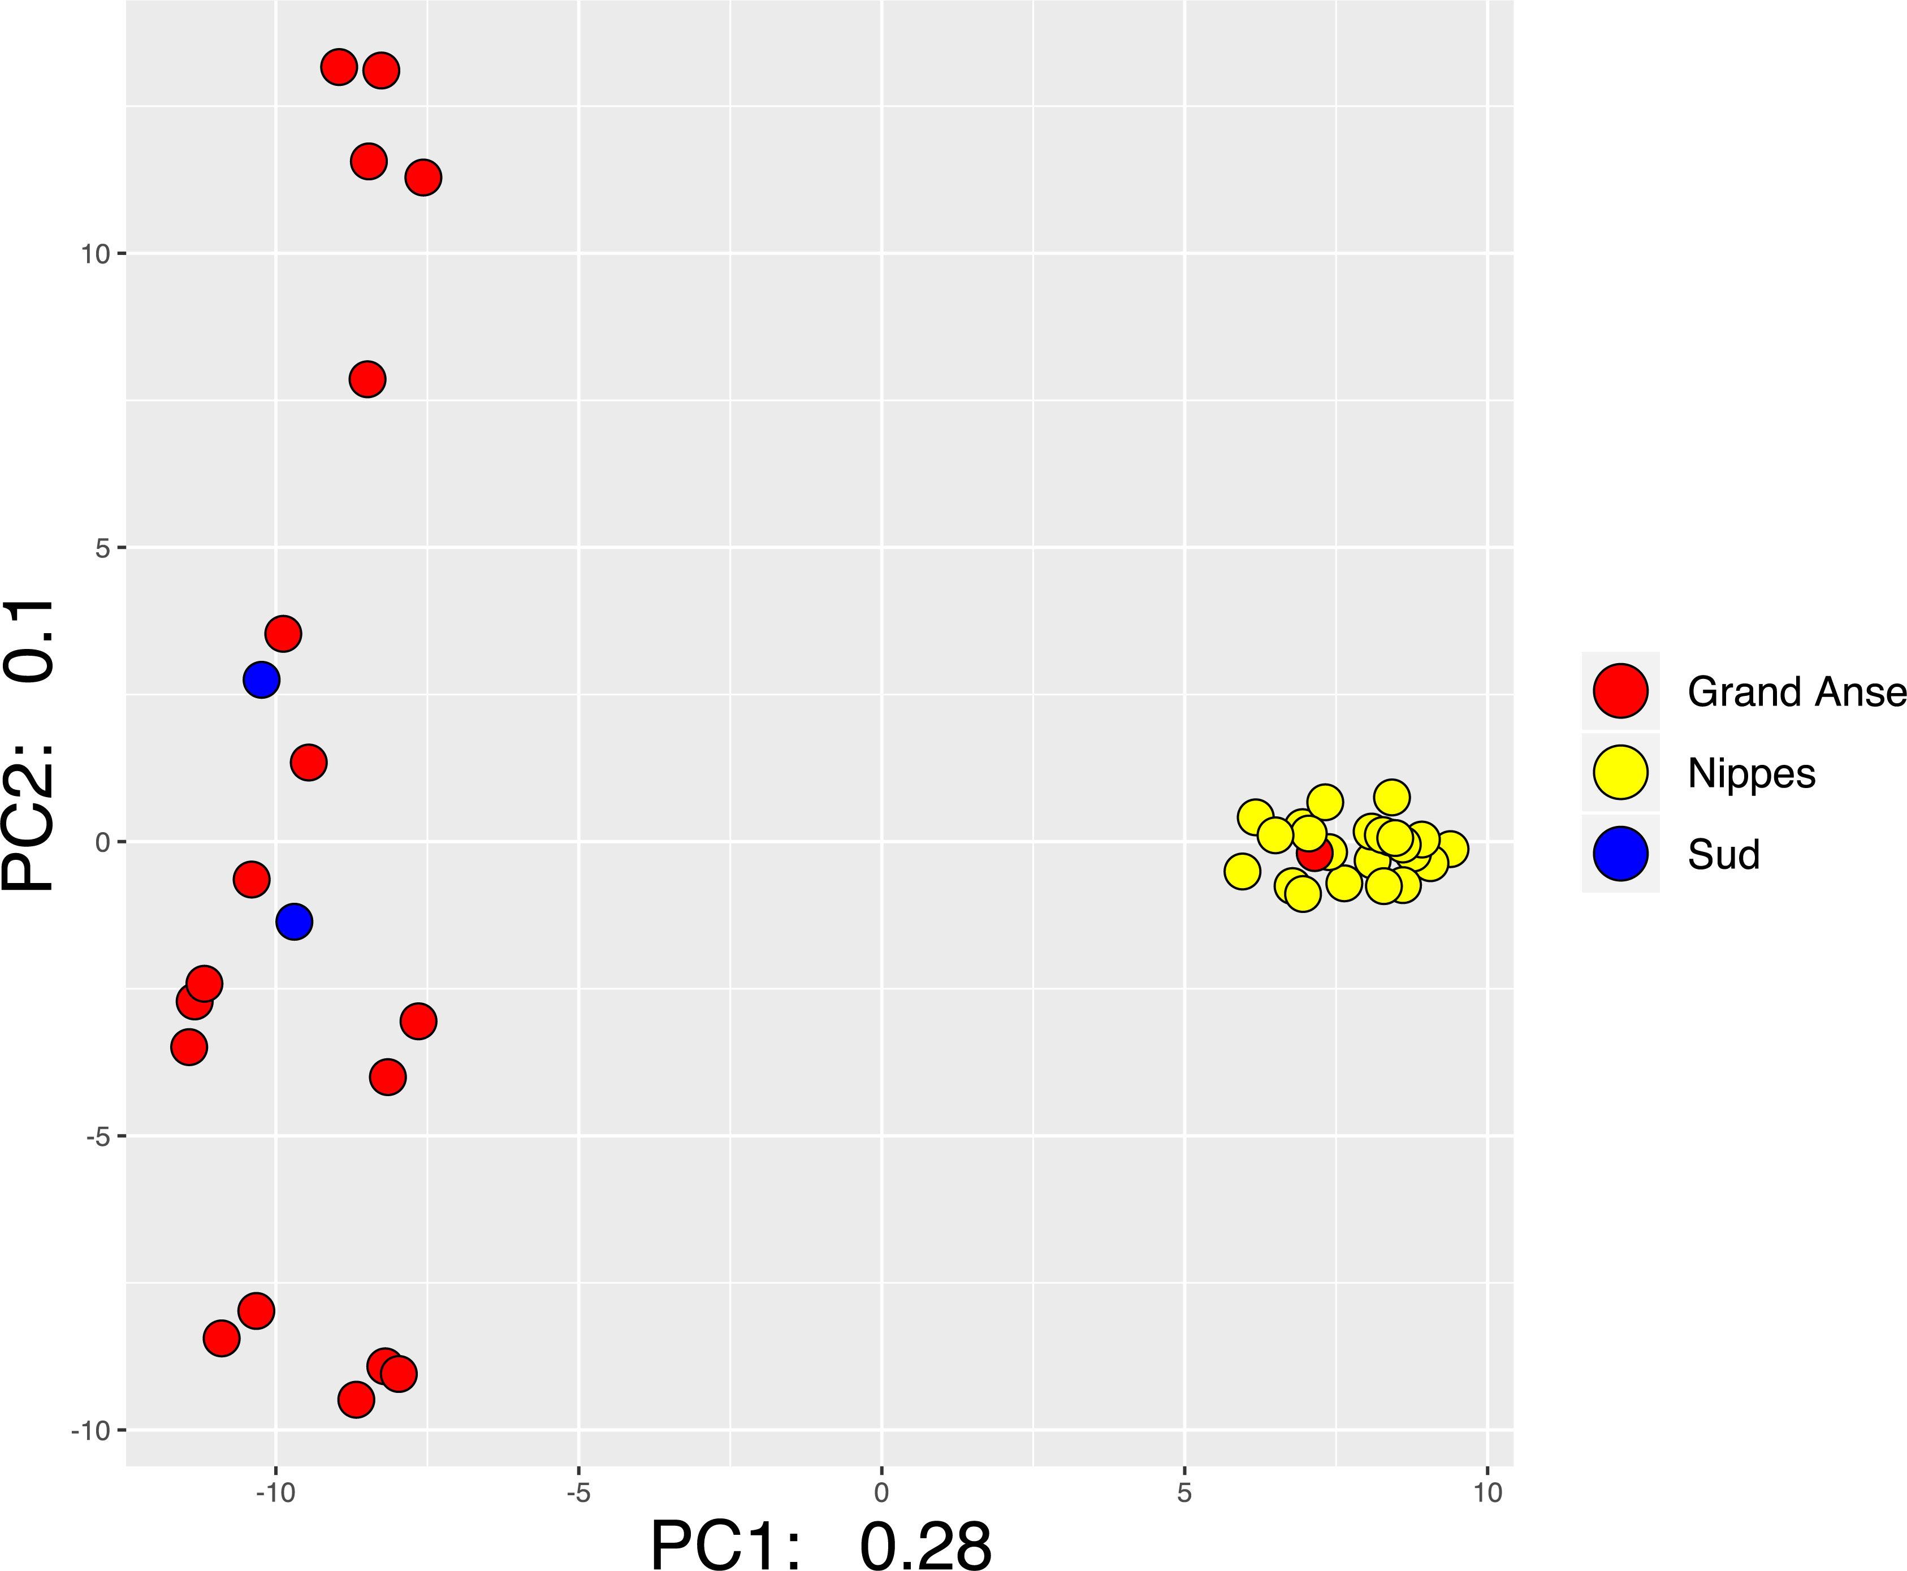
Parasite populations are structured within Haiti
PCA: Sequence data
Grande Anse / Sud:
Intermixed samples from two départements
Nippes:
Little diversity within cluster
Nippes ‘export’ in Grande Anse
Clear genetic structure indicates between-site IBD will be informative
Notes:
Despite the inbreeding within these regions, we see distinct population structure between them.
–Grande Anse and Sud are intermixed, but Nippes is distinct from these
(with one apparent export from Nippes found in Grande Anse)
Importantly we can expect to see very different haplotypes in each region
Meaning that signals of relatedness between them would be informative.

Slide 9
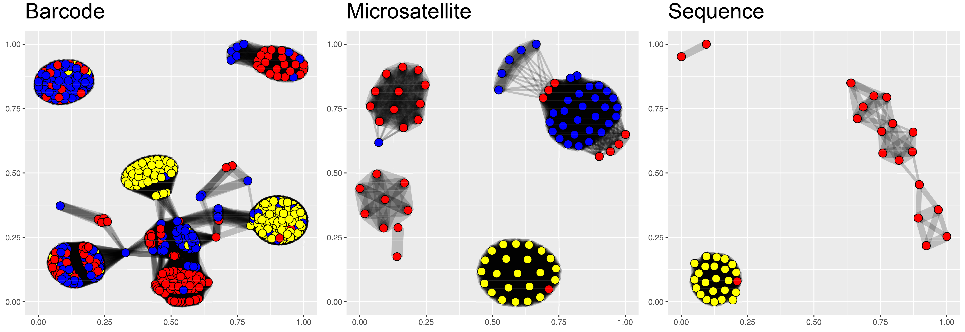
IBD networks all show isolation of Nippes
IBD networks, >25% relatedness:
Nippes forms high-IBD clusters using all 3 data types
Extensive IBD is seen between Grande Anse / Sud
Little IBD between Nippes and other two depts
Notes:
IBD network, where samples are joined if they have more than 25% identity by descent
Despite assaying different sets and numbers of samples, we see some commonalities between all 3 plots
In barcode and microsat plots:
Sud and grande-anse have numerous high IBD clusters, indicating ongoing gene flow between these two regions.
Nippes forms a small number of highly related clusters in all 3 datasets
So if we can get this from the low-cost methods, why would we go to the trouble of sequencing?
Particularly when limited resources mean we will inevitably get fewer samples…

Slide 10
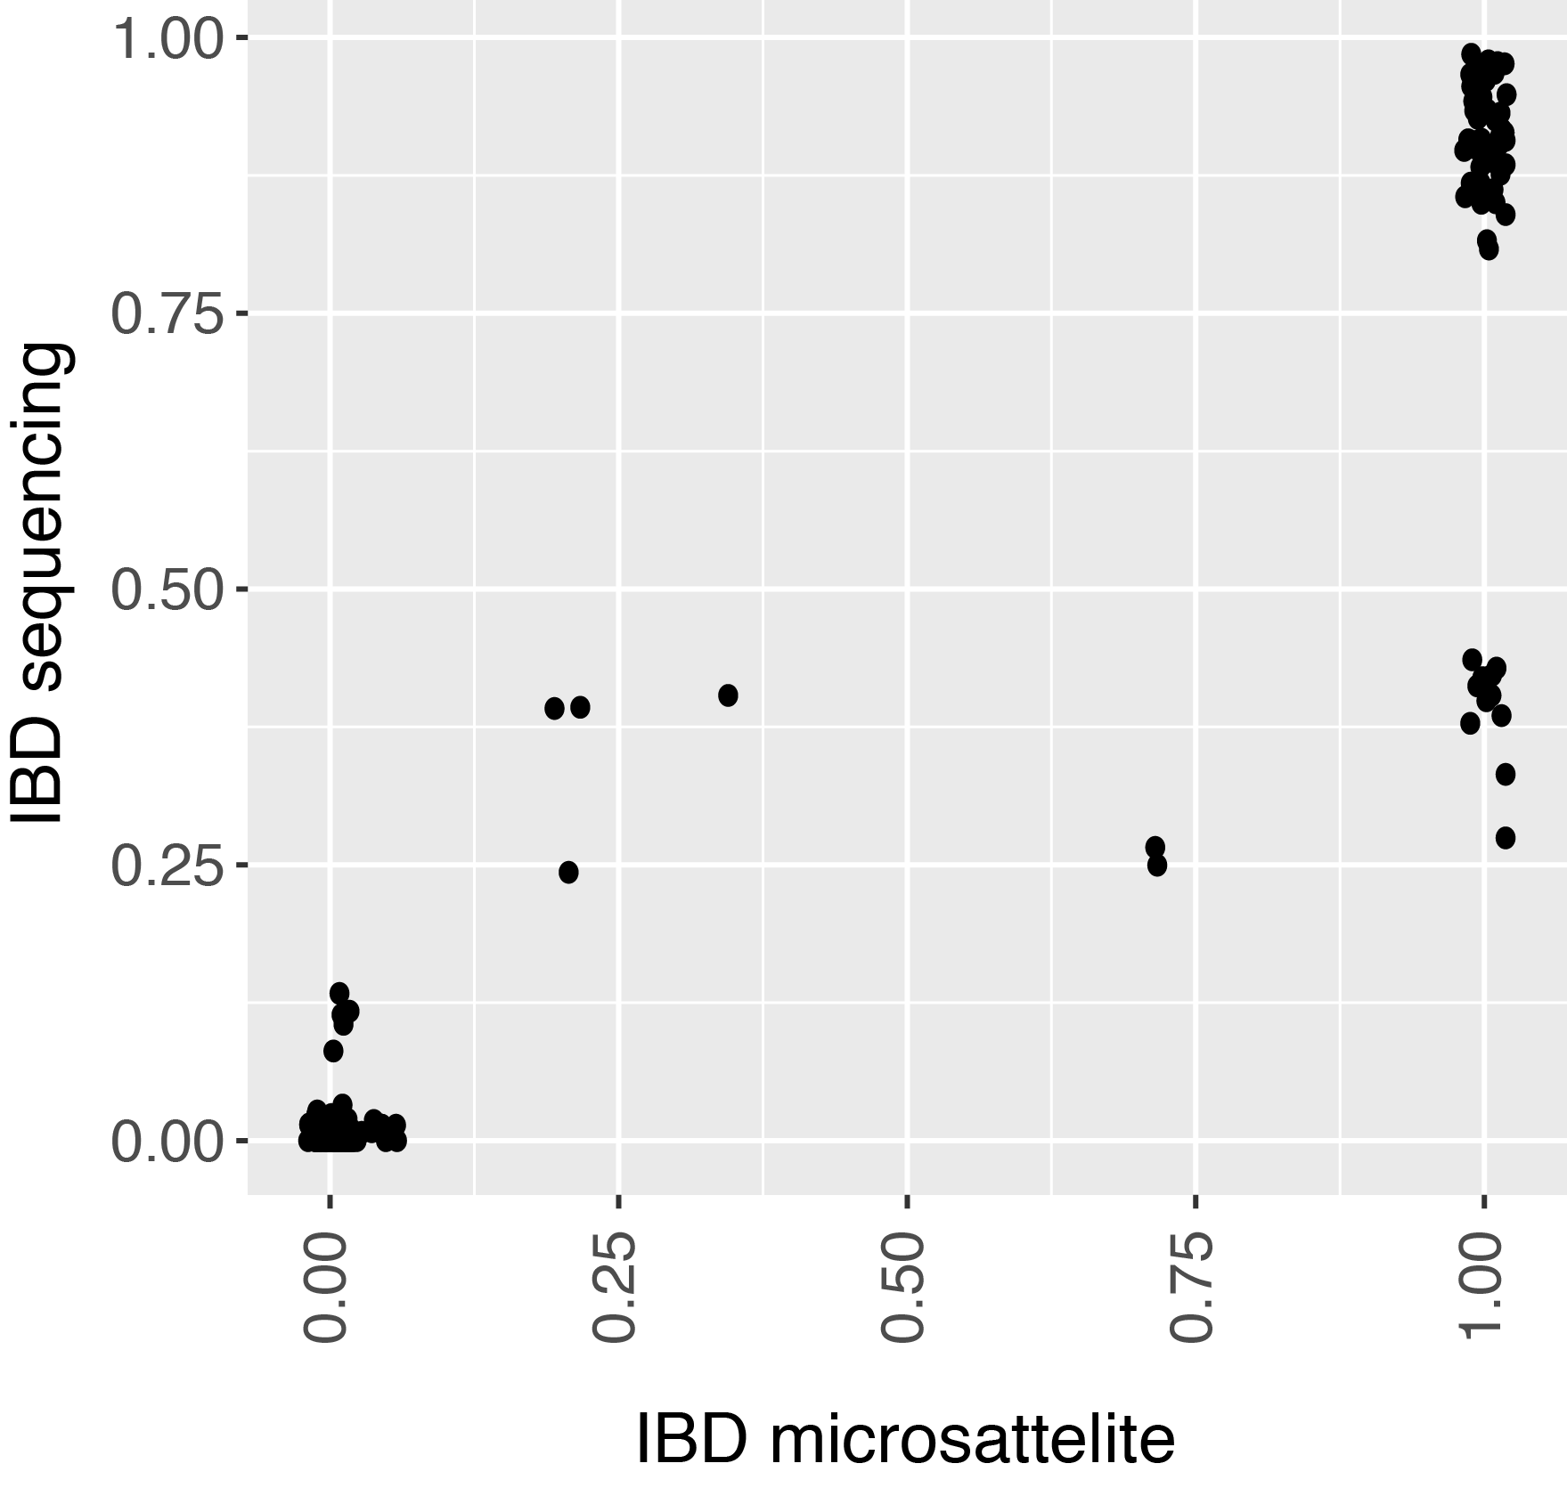
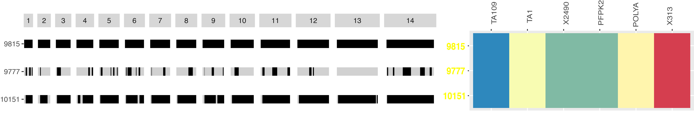
Sequencing aids resolution of partial relatedness
9815 - 10151
r=0.93
Strong correlation between microsatellite / sequencing
Whole genome coverage maximises ability to detect non-IBD regions
Partial IBD in Nippes indicates ongoing recombination
9815 - 9777
9815
41%
9777
95%
10151
IBD blocks (via sequencing)
Microsatellite alleles
Notes:
In general where we can compare samples, we find strong correlation between measures of identity by descent.
Comparing microsatellites to whole genome sequence we find (Pearson's product-moment correlation) r is above 90%,
a small number where the microsatellite overestimates relatedness.
Comparing two pairs from these we can see why: all six microsattelites are identical by state, so they look to be 100% related
But actually by whole-genome sequencing one of these pairs is only around 40% related.
This measure of partial IBD suggests ongoing recombination (and therefore ongoing polygenomic infections)

Slide 11
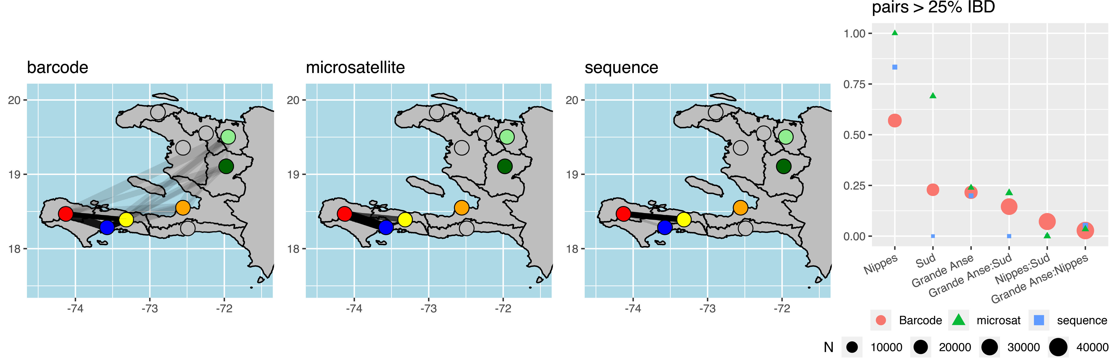
Different data types can be compared via IBD
Summary statistics are comparable between data types
  Proportion highly related pairs (>25% IBD)
  All data types highlight inbreeding in Nippes
  & isolation from the other two départements
Notes:
While genome-wide markers are needed to assess relatedness on an individual level.
On a pop level summary statistics – such as the proportion of pairs that are highly related - are highly comparable
here we’ve shown links between departments, with the thickness of the line showing the proportion of pairs that are highly related.
all of these measures consistently show stronger gene flow between Grand Anse and Sud, and the isolation of the Nippes population

Slide 12
conclusions
Grande Anse / Sud show ongoing gene flow between sites
Nippes is isolated and a good candidate for local elimination
IBD can inform us of import/export patterns between different sites
CoI may underestimate transmission rate in low-diversity settings
Valuable information derived from low-cost genotyping
Genetics are cost effective in areas without strong infrastructure
Notes:
Nippes is isolated, has ongoing transmission and is a good candidate for local elimination
More generally, IBD can illustrate import/export patterns between sites
And low-cost, bloodspot derived genetic data could aid in providing epi data that cannot easily be obtained in Haiti
Pathway from broad, low-cost methods to get a snapshot of a large country or region,
followed by WGS in regions where we think diversity is low enough to require it.
There’s a clear role for both statistics and modeling to play in that last step,
to tell us when we need to make the step from one method to another.
or which samples to sequence in order to get a full picture of the true relatedness in a region.

Slide 13




Sarah Volkman
Rachel Daniels
Dyann Wirth
Stella Chenet
Breanna Walsh
Broad Institute / Harvard TH Chan School of Public Health
Daniel Neafsey
Bronwyn MacInnis
Angela Early
Tim Farrell
Aimee Taylor
Caroline Buckee
Programme National de Contrôle de la Malaria, Haiti
Jacques Boncy
Baby Pierre
Jean Frantz Lemoine
CDC
Kumar Venkatachalam
Michelle Chang
Eric Rogier
Curtis S. Huber
Camelia Herman
April 2019 -> Institute for Vector-Borne Disease,
Monash University, Melbourne
seth.redmond@monash.edu
https://www.monash.edu/ivbd

