Slide 1
The global burden of disease:
Diarrhea and lower respiratory infections
Robert Reiner
April 18th, 2017

Slide 2
Results
Global burden of disease – 2015
Lower respiratory infections
  2.7 million deaths (ranked 4th across all diseases, 1st in infectious diseases)
  700,000 deaths in children under the age of 5 (3rd across all diseases, 1st in infections diseases)
  291 million episodes, 100 million episodes in children under the age of 5
Diarrheal diseases
  1.3 million deaths (ranked 9th across all diseases, 2nd in infectious diseases)
  500,000 deaths in children under the age of 5 (4th and 2nd)
  3.9 billion episodes, 1.47 billion episodes in children under the age of 5
Notes:
Something we’re experimenting with.
Search terms included things like: “Global Burden of Disease,” “Institute for Health Metrics and Evaluation,” "Institute of Health Metrics and Evaluation,” “IHME,” "Global Burden,” "Burden of Disease,” "GBD 2010," "GBD 2013,“ and "GBD study“
The list of countries includes both highly developed and less developed countries, such as the US, South Africa, Thailand, Peru, and Kenya.
We excluded “burden of disease/GBD” search terms from the WHO website and only searched for IHME/Institute for Health Metrics and Evaluation

Slide 3
Outline
GBD Overview
Methods
Results
Conclusions
Model-based geostatistics
Notes:
Something we’re experimenting with.
Search terms included things like: “Global Burden of Disease,” “Institute for Health Metrics and Evaluation,” "Institute of Health Metrics and Evaluation,” “IHME,” "Global Burden,” "Burden of Disease,” "GBD 2010," "GBD 2013,“ and "GBD study“
The list of countries includes both highly developed and less developed countries, such as the US, South Africa, Thailand, Peru, and Kenya.
We excluded “burden of disease/GBD” search terms from the WHO website and only searched for IHME/Institute for Health Metrics and Evaluation

Slide 4
Introduction to IHME
Independent global research center at the University of Washington
Goal is to improve population health by providing the best evidence possible to guide health policy – and by making that evidence easily accessible to decision-makers
IHME seeks to answer three key questions:
  1) What are the major health problems?
  2) How well is society addressing these problems?
  3) How do we best dedicate resources to get the maximum impact in improving population health in the future?

Slide 5
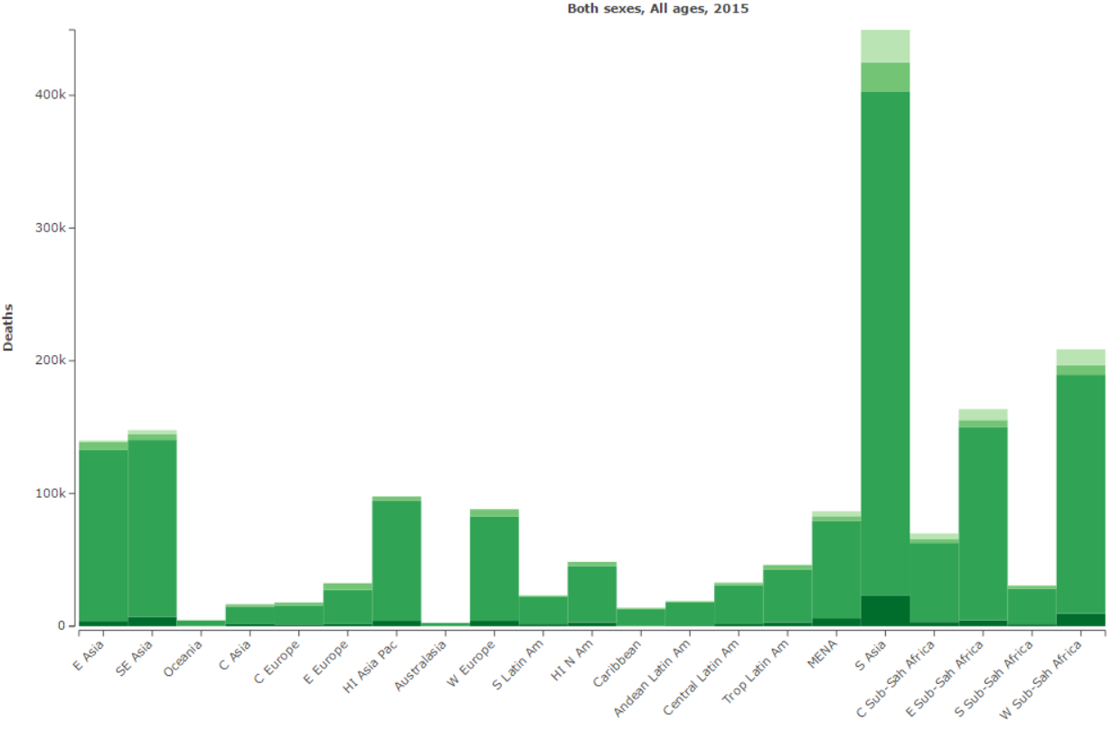
GBD overview
Generating evidence to improve the world’s health
A systematic, scientific effort to quantify the comparative magnitude of health loss from all major diseases, injuries, and risk factors
Comprehensively and comparably produces annual estimates at the global, regional, and country levels by sex and age group for:
  Cause-specific mortality
  Disability-adjusted life years (DALYs) due to specific diseases, injuries, and risk factors
Number of Deaths per Region by Etiology

Slide 6
GBD overview
Producing multiple metrics for health
  Traditional metrics: Disease and injury prevalence and incidence, death numbers and rates
  Years of life lost (YLLs) due to premature mortality – count the number of years lost at each age compared to a reference life expectancy of 86 at birth.
  Years lived with disability (YLDs) for a cause in an age-sex group equals the prevalence of the condition times the disability weight for that condition.
  Disability-adjusted life years (DALYs) are the sum of YLLs and YLDs and are an overall metric of the burden of disease.

Slide 7
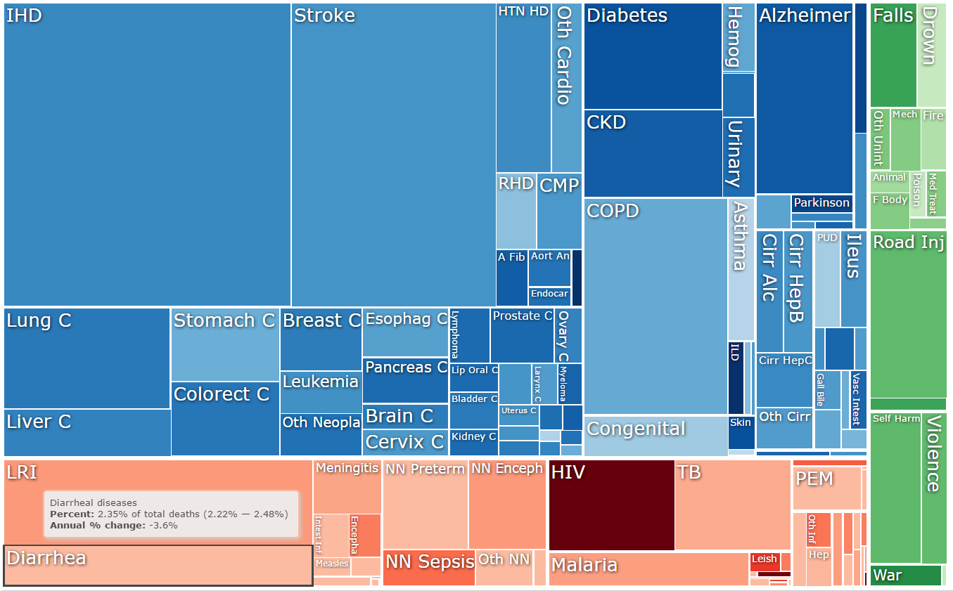
GBD overview
Improving upon existing estimation efforts
The GBD 2016 study has substantially expanded its analyses to:
  Expanded subnational
  estimation
  Over 300 diseases and
  injuries, 2,337 sequelae,
  76 risk factors
  Cover the time period of
  1990–2016 and
  re-estimate previous time
  periods

Slide 8
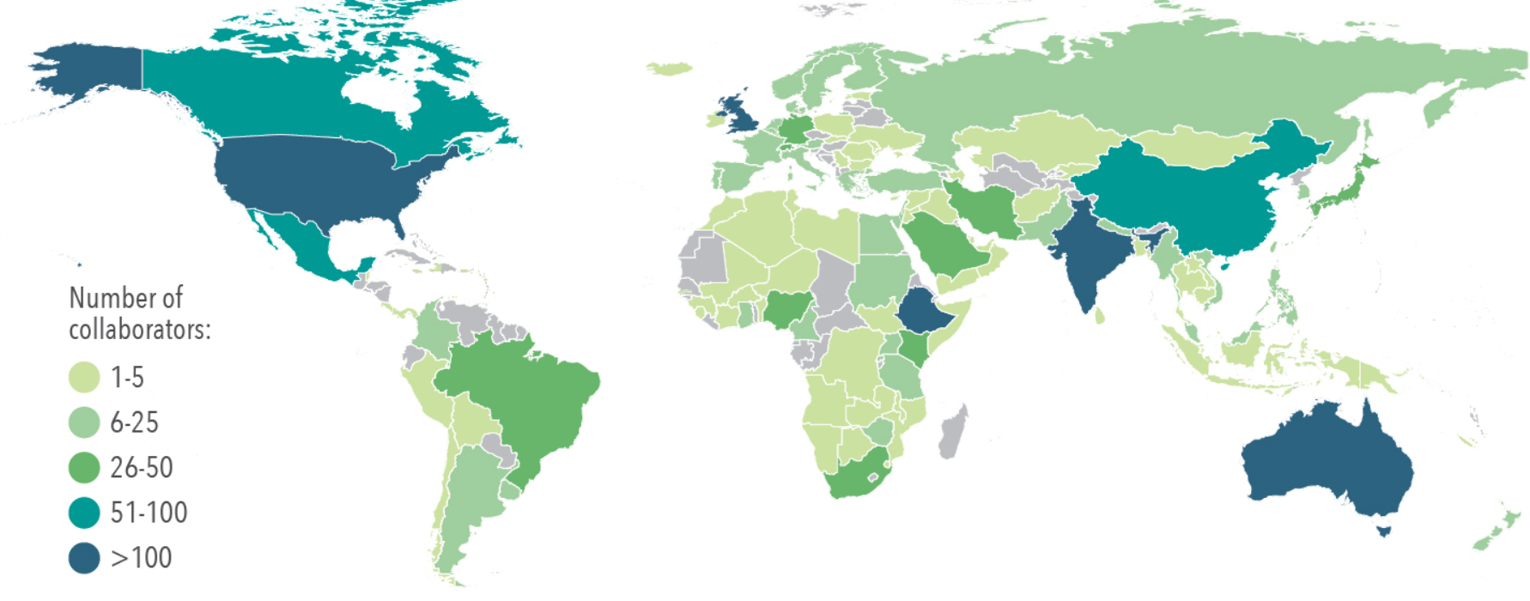
GBD overview
Engaging an international research collaboration
Over 1,300 GBD collaborators in 114 countries contribute to analysis of data, provide country-specific insights, and champion the use of data for policymaking.
Visualization tools are publicly available at http://www.healthdata.org/results/data-visualizations

Slide 9
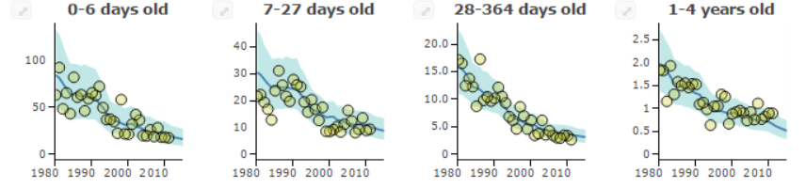
Methods
Mortality
Modeled in the Cause of Death Ensemble modeling platform (CODEm)
  Vital registration, verbal autopsy, surveillance
  Suite of independent sub-models
    Covariates
    Space-time information
Estimates by age, sex, year, location
http://vizhub.healthdata.org/cod/

Slide 10
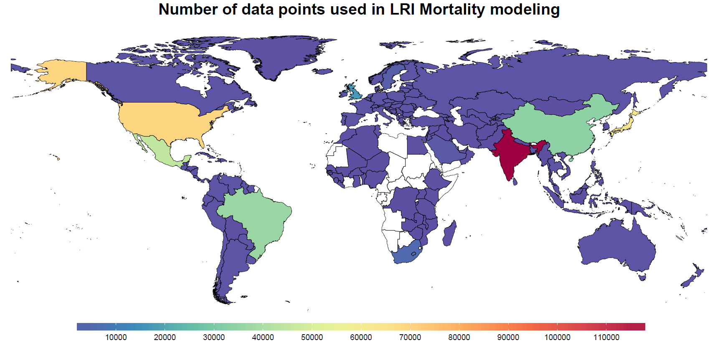
Methods
Mortality

Slide 11
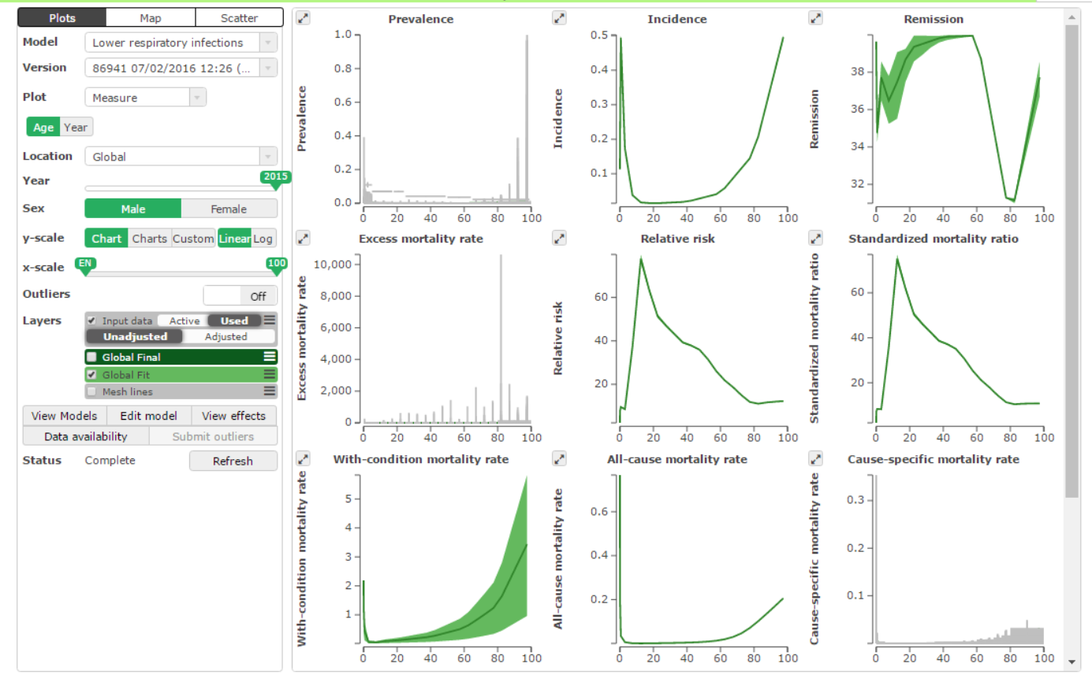
Methods
Morbidity
Incidence, prevalence, remission, case fatality modeled in DisMod-MR
  Age-integrating meta-regression tool
Input data:
  Hospital records
  Population-representative
  surveys
  Cross-sectional & cohort data
  from scientific literature

Slide 12
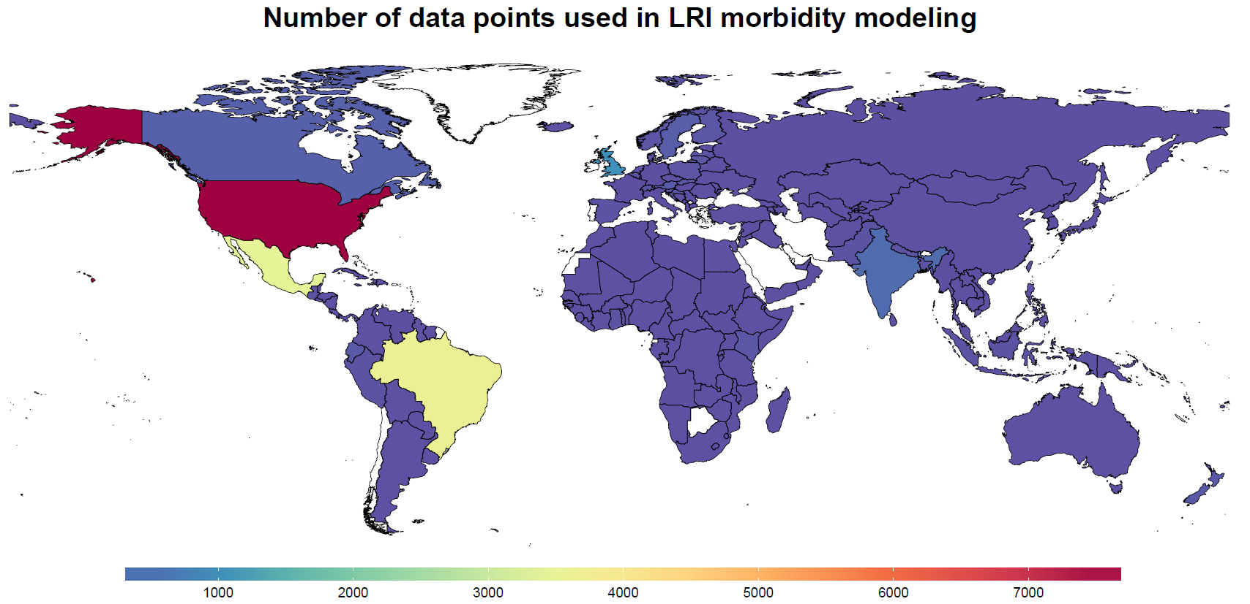
Methods
Morbidity

Slide 13
Methods
Etiology Attribution
Lower Respiratory Infection
Causes:
  Respiratory syncytial virus (RSV)
  Influenza
  Haemophilus influenzae type B (Hib)
  Streptococcus pneumoniae (pneumococcal pneumonia)
Counterfactual attribution strategy
  Accounts for co-detection, detection in healthy individuals
  Different approach for viral, bacterial causes
Diarrheal diseases
Causes:
  13 causes: adenovirus, aeromonas, amoebiasis, campylobacter enteritis, cholera, clostridium difficile, cryptosporidium, EPEC, ETEC, norovirus, salmonella, and rotavirus
Three approaches
  Counter-factual population attributable fractions
  Cholera under-reporting model
  Clostridium difficile natural history model
Notes:
EPEC = Enteropathogenic E. coli
ETEC = Enterotoxigenic E. coli

Slide 14
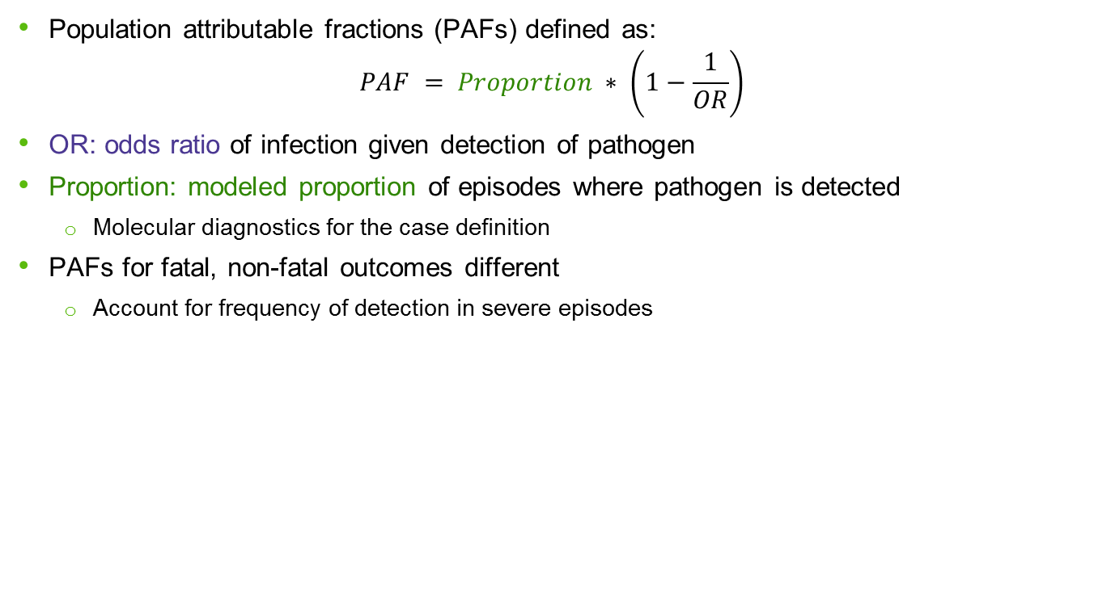
Methods
Etiology Attribution
Population attributable fractions (PAFs) defined as:
$$PAF = Proportion ∗ \left(1−\frac{1}{OR}\right)$$
OR: odds ratio of infection given detection of pathogen
Proportion: modeled proportion of episodes where pathogen is detected
  Molecular diagnostics for the case definition
PAFs for fatal, non-fatal outcomes different
  Account for frequency of detection in severe episodes

Slide 15
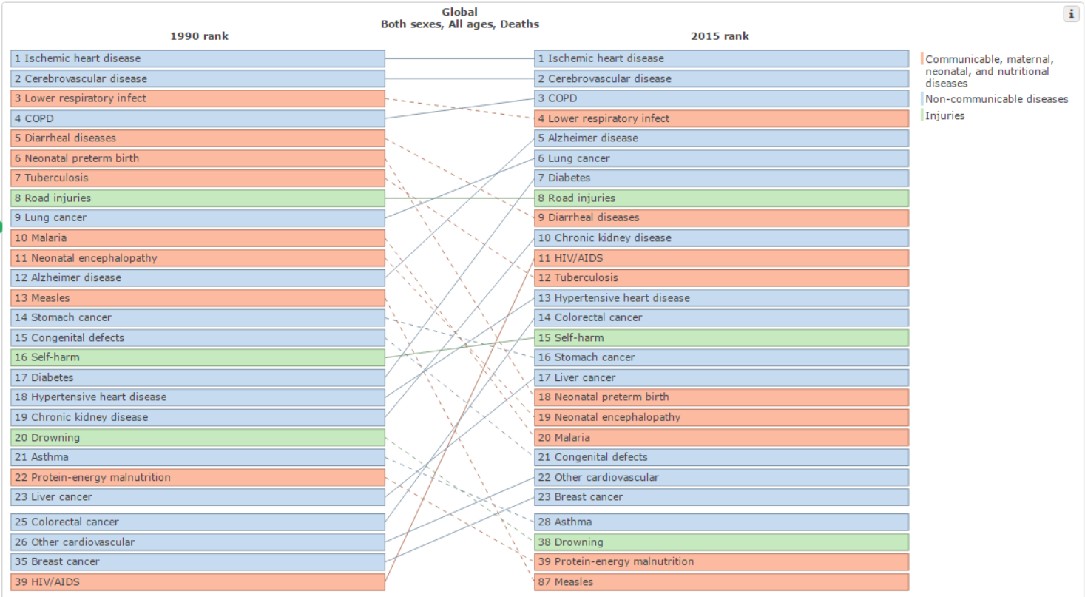
Results
LRI: 2.74 million deaths
(95% UI: 2.50-2.86)
19.4% decrease from 1990
Diarrhea: 1.31 million deaths
(95% UI: 1.23-1.39)
43.5% decrease from 1990

Slide 16
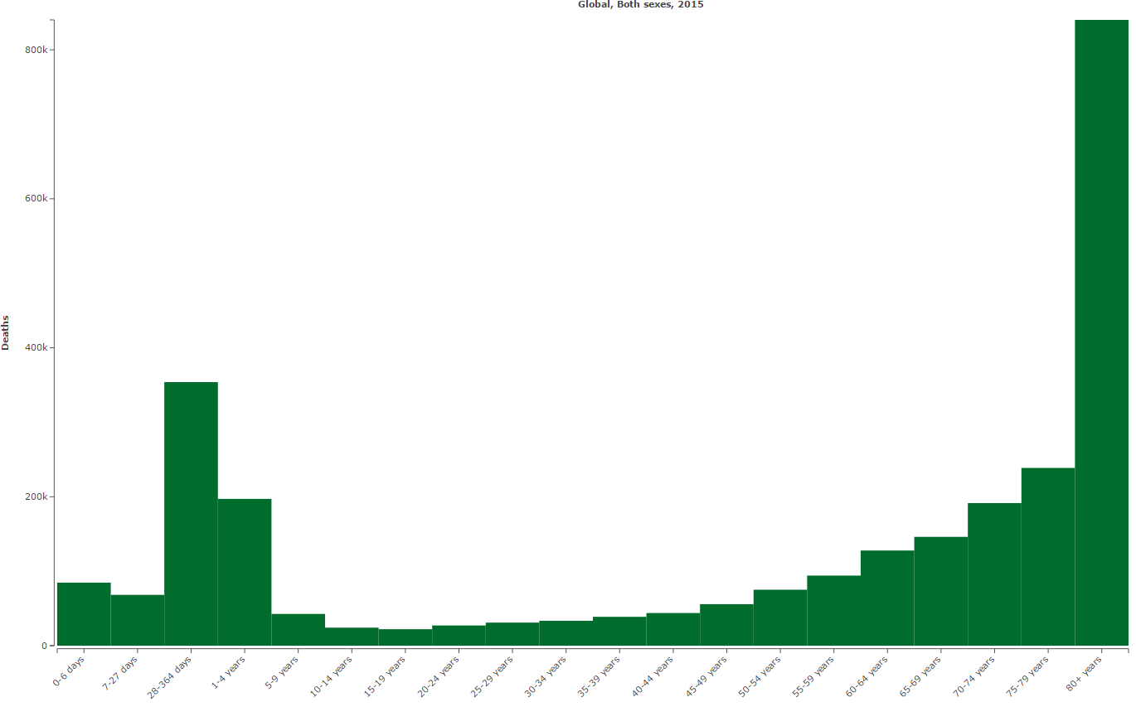
Results
Lower respiratory infection
Age pattern of LRI mortality
353,900 deaths
(95% UI: 322,200-387,100)
840,200 deaths
(95% UI: 778,000-886,300)
http://vizhub.healthdata.org/gbd-compare/

Slide 17
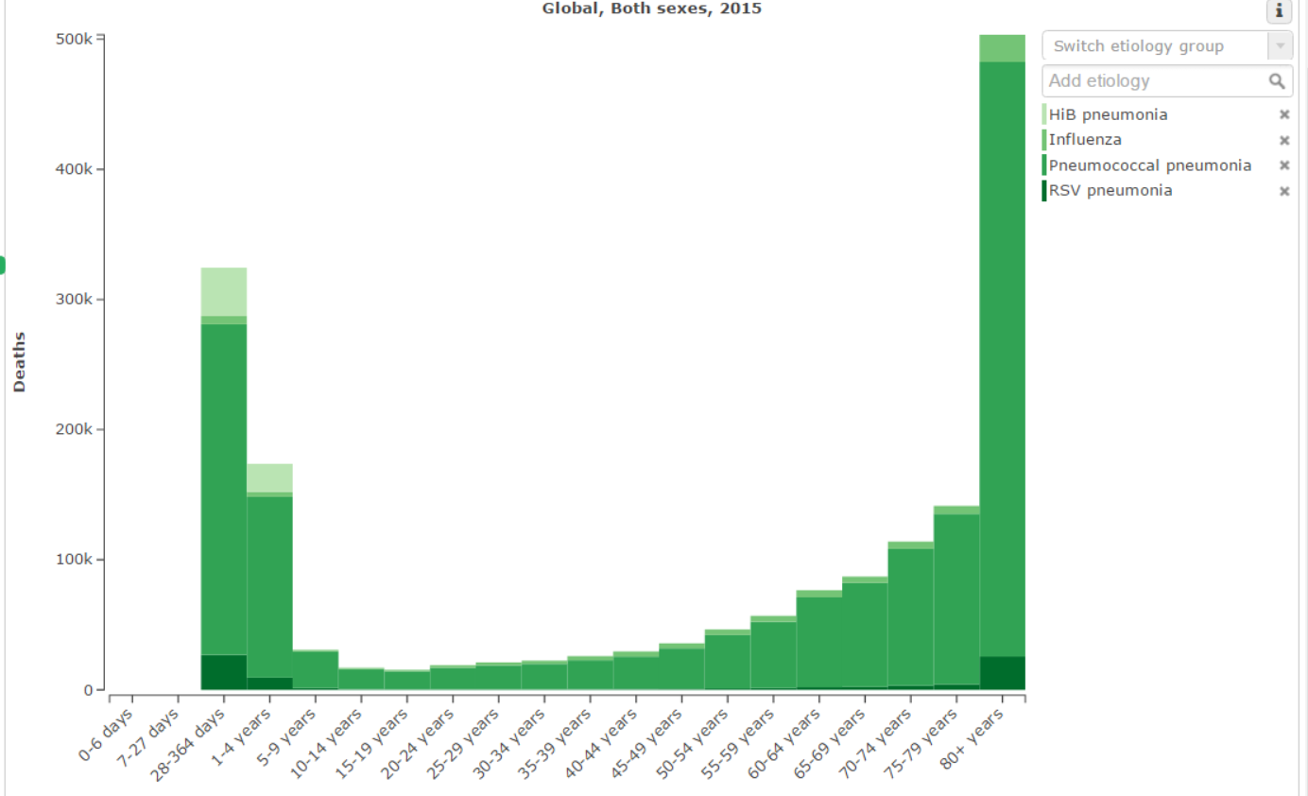
Results
Lower respiratory infection
Age pattern of LRI mortality
Pneumococcal pneumonia: 1,517,400 deaths
Influenza: 83,100 deaths
RSV: 82,000 deaths
Hib pneumonia: 58,700 deaths
http://vizhub.healthdata.org/gbd-compare/
17

Slide 18
Results
Lower respiratory infection
LRI Mortality under-5 etiology
Pneumococcal pneumonia: 392,900 deaths
Hib pneumonia: 58,700 deaths
RSV: 36,400 deaths
Influenza: 10,200 deaths

Slide 19
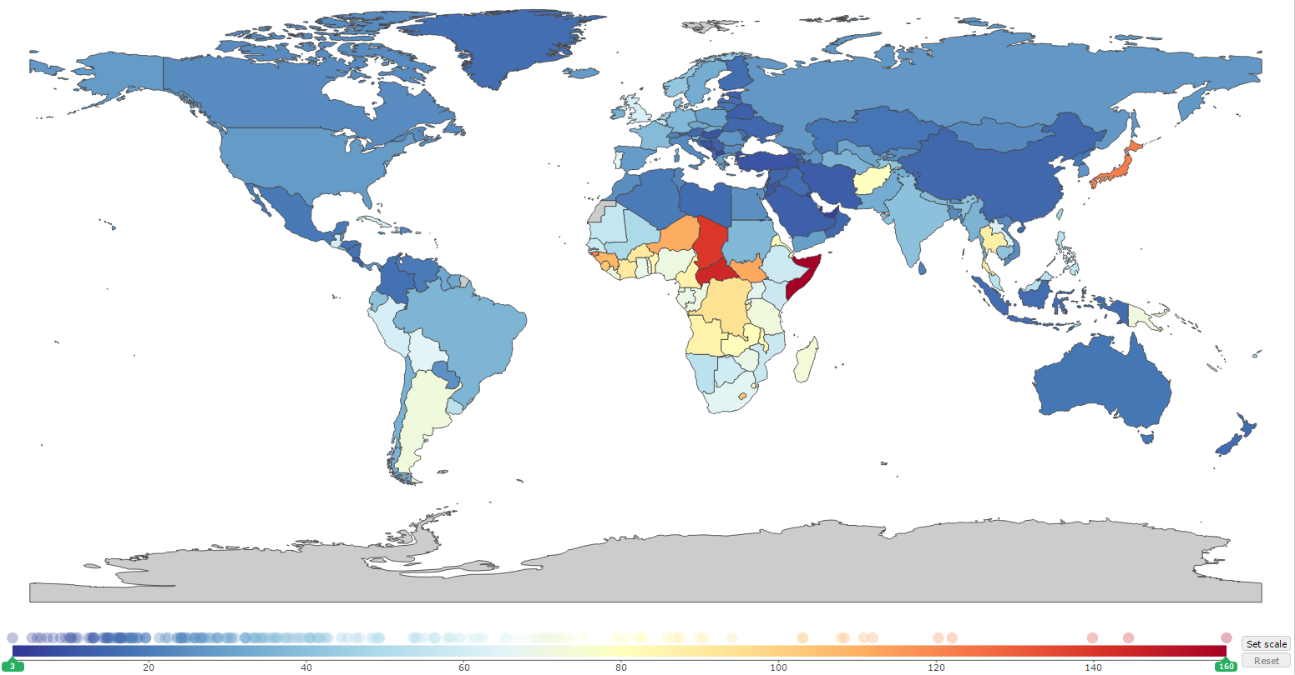
Results
Lower respiratory infection
Mortality rate per 100,000

Slide 20
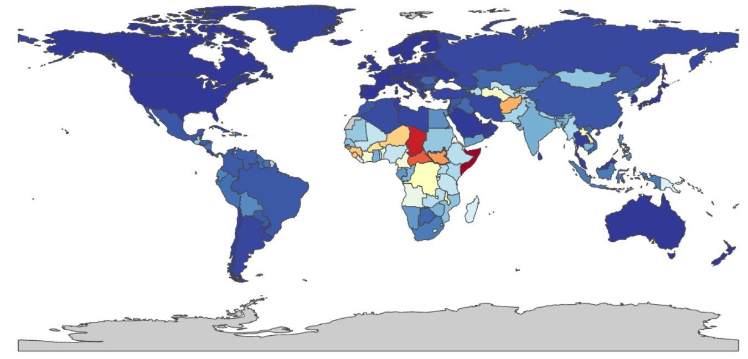
Results
Lower respiratory infection
Under 5 Mortality rate per 100,000

Slide 21
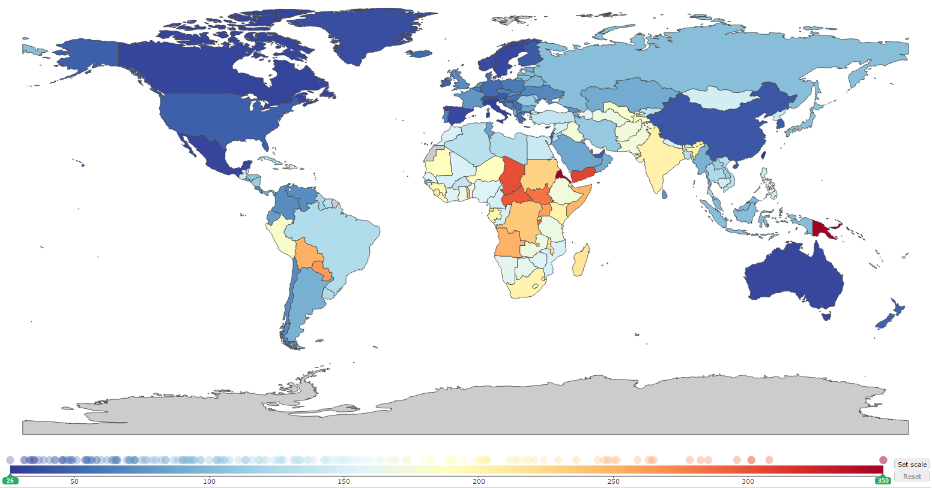
Results
Lower respiratory infection
Prevalence per 100,000

Slide 22
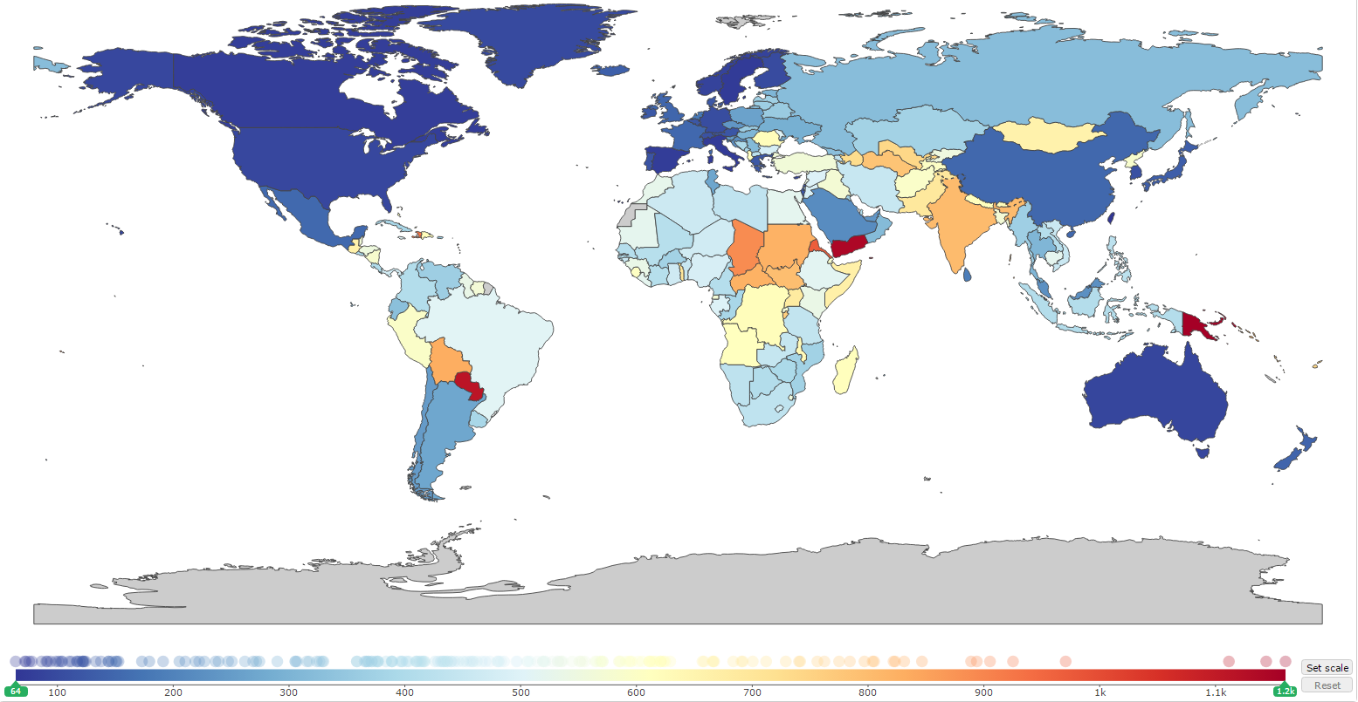
Results
Lower respiratory infection
Under 5 prevalence per 100,000

Slide 23
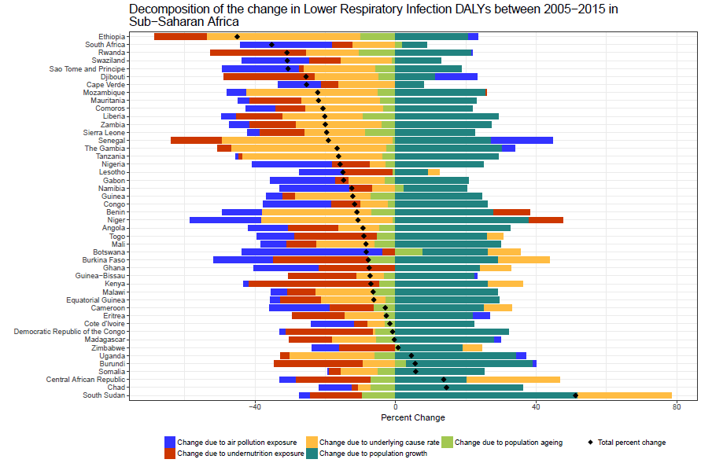
Results
Lower respiratory infection
Drivers of 2005-2015 change
Population growth increases burden
Age distribution almost always decreases burden (light green)
Air pollution typically decreased, decreasing burden (blue)
Undernutrition typically decreased, decreasing burden (red)
Few countries had increasing burden from 2005 to 2015. They were Zimbabwe, Uganda, Burundi, Somalia, Central African Republic, Chad, South Sudan.

Slide 24
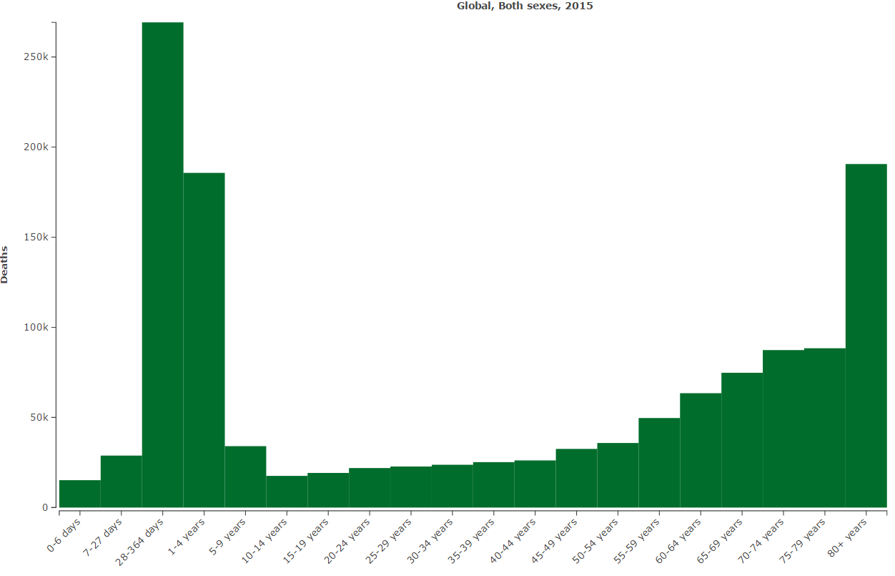
Results
Diarrheal diseases
Age pattern of Diarrhea mortality
269,200 deaths
(95% UI: 235,200-306,100)
353,900 deaths
(95% UI: 322,200-387,100)
840,200 deaths
(95% UI: 778,000-886,300)
190,600 deaths
(95% UI: 174,500-208,400)
http://vizhub.healthdata.org/gbd-compare/

Slide 25
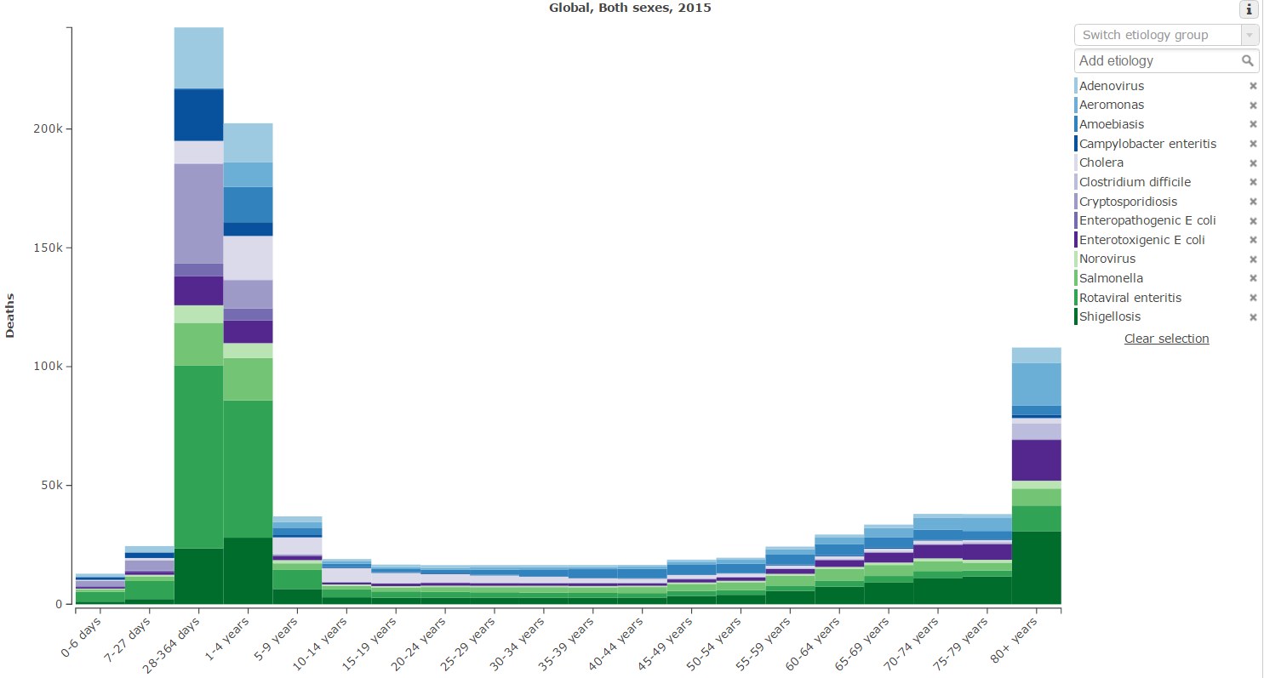
Results
Diarrheal diseases
Age pattern of Diarrhea mortality
Rotavirus: 199,200 deaths
Shigella: 164,300 deaths
Salmonella: 90,300 deaths
6. Cholera: 68,400 deaths
269,200 deaths
(95% UI: 235,200-306,100)
353,900 deaths
(95% UI: 322,200-387,100)
840,200 deaths
(95% UI: 778,000-886,300)
190,600 deaths
(95% UI: 174,500-208,400)
http://vizhub.healthdata.org/gbd-compare/

Slide 26
Results
Diarrheal diseases
Diarrhea Mortality under-5 etiology
Rotavirus: 146,500 deaths
Cryptosporidium: 60,400
Shigella: 54,900
Adenovirus: 46,000

Slide 27
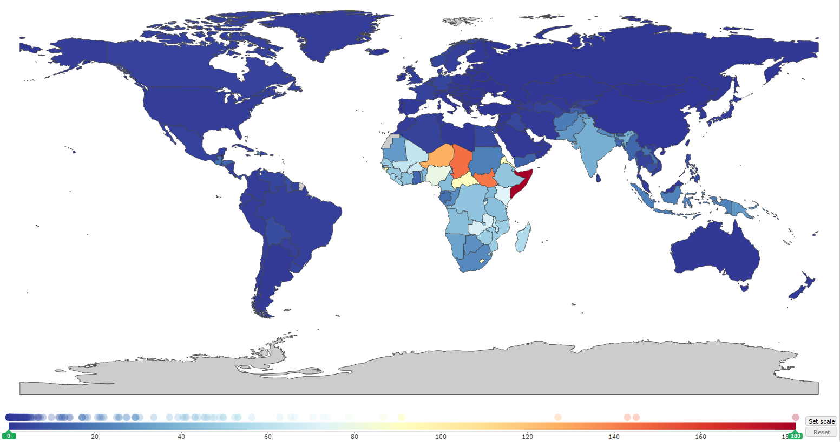
Results
Diarrheal diseases
Mortality rate per 100,000

Slide 28
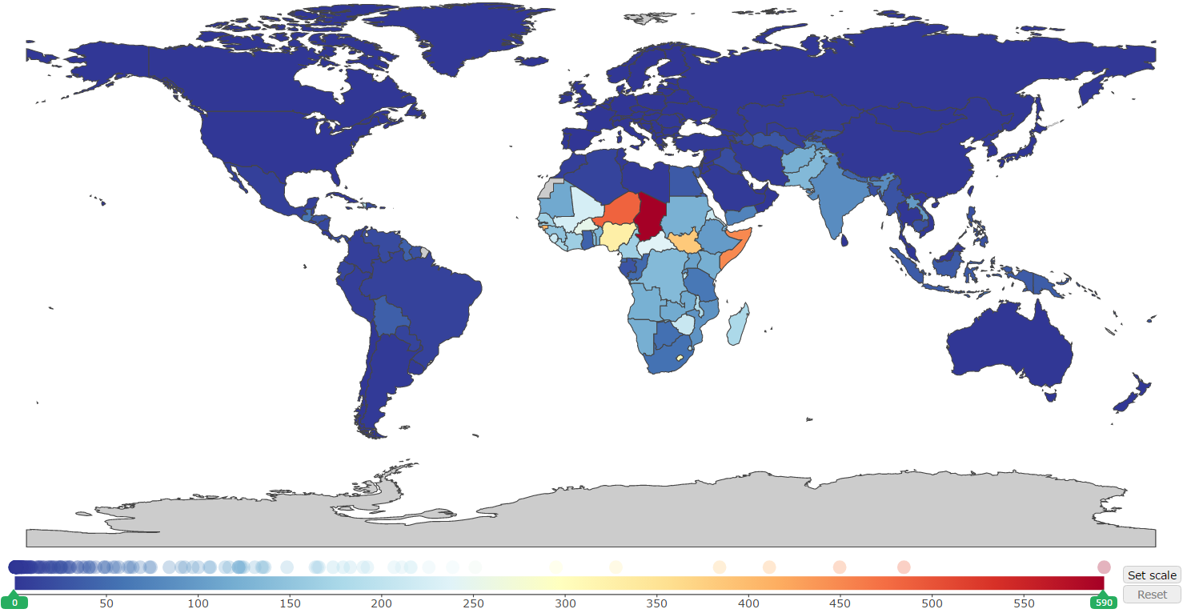
Results
Diarrheal diseases
Under 5 Mortality rate per 100,000

Slide 29
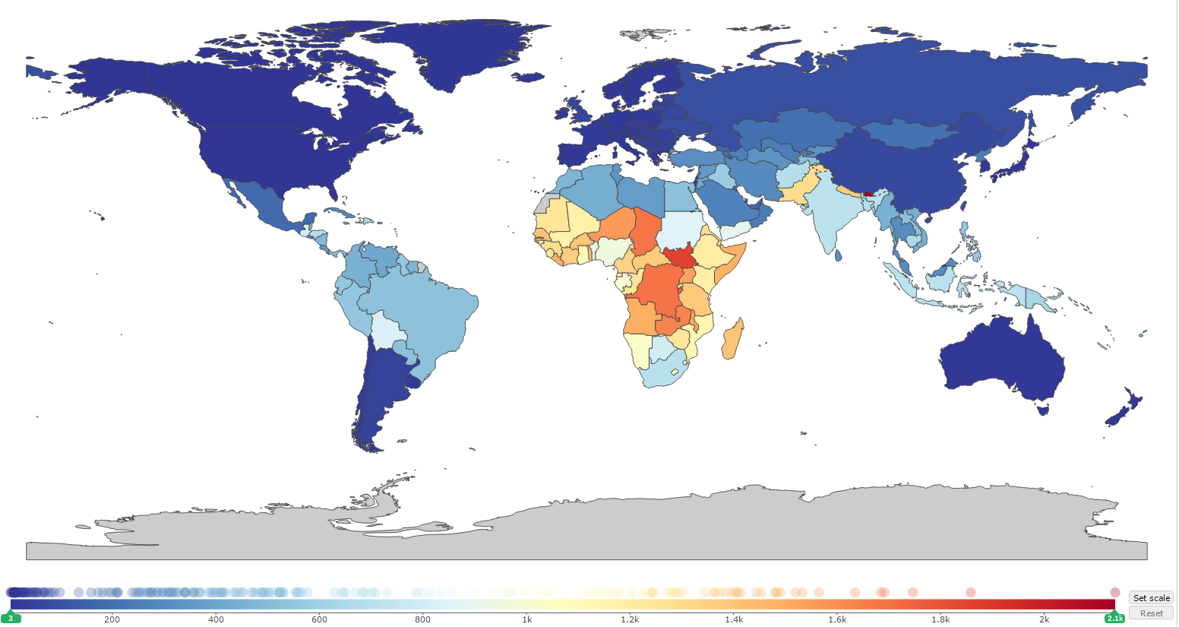
Results
Diarrheal diseases
Prevalence per 100,000

Slide 30
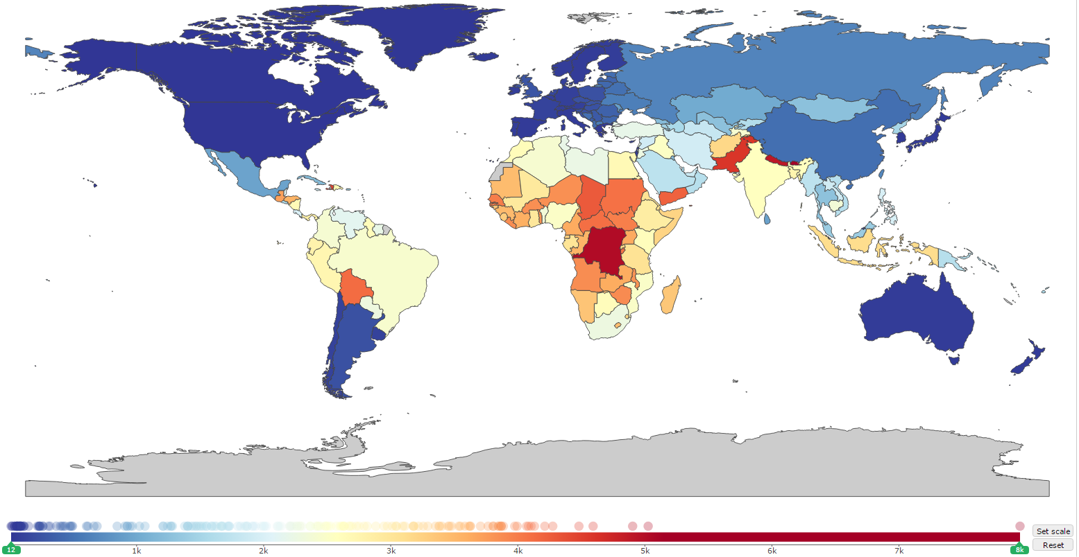
Results
Diarrheal diseases
Under 5 prevalence per 100,000

Slide 31
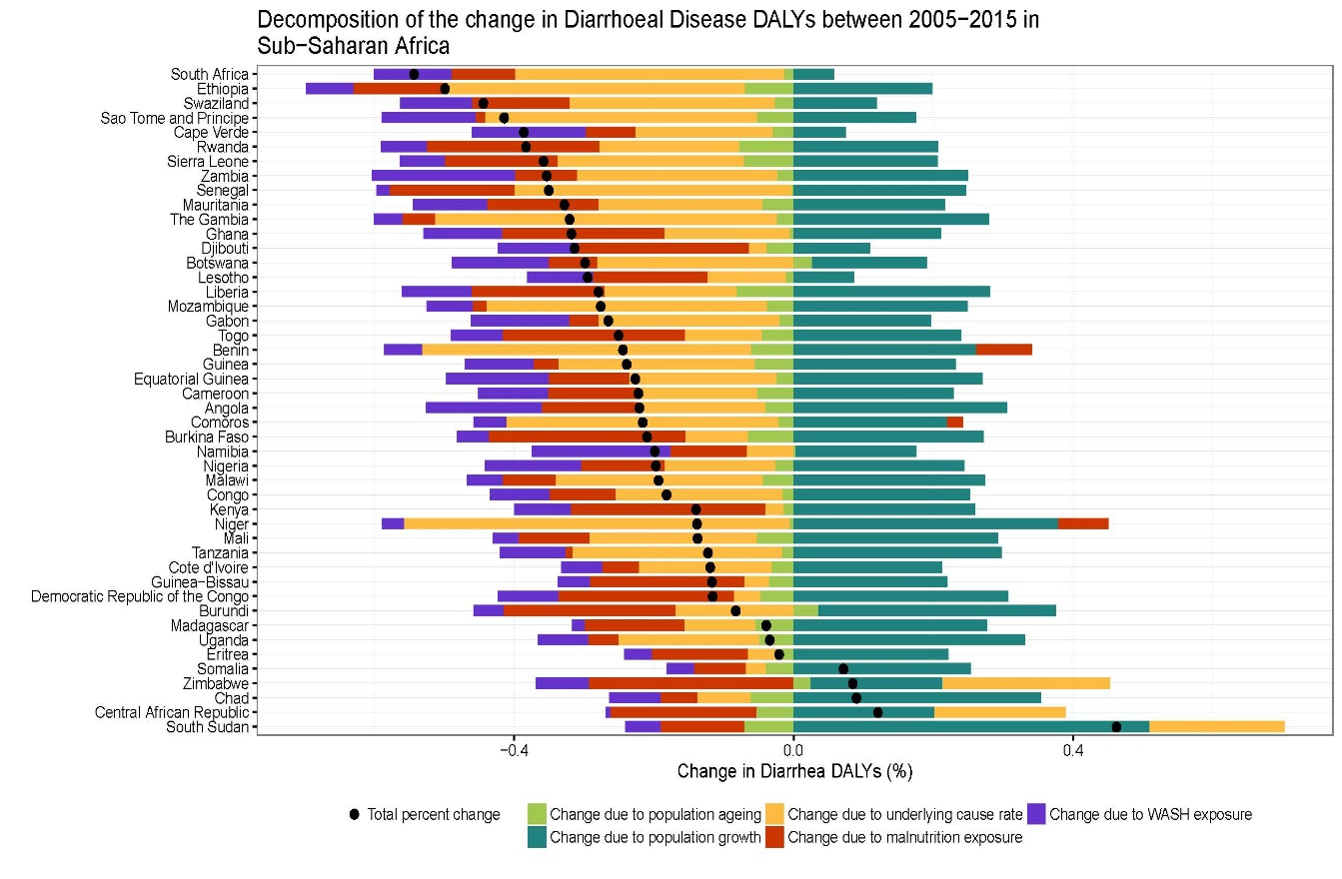
Results
Diarrheal diseases
Drivers of 2005-2015 change
Population growth increases burden
Age distribution almost always decreases burden (light green)
Water, sanitation, and hygiene typically imporved, decreasing burden (blue)
Undernutrition typically decreased, decreasing burden (red)
Few countries had increasing burden from 2005 to 2015. They were Zimbabwe, Chad, Central African Republic, and South Sudan.

Slide 32
Conclusions
Lower respiratory infections and diarrhea are leading causes of infectious mortality globally
Mortality has decreased sharply among children under-5 but more slowly among all ages
Pneumococcal pneumonia is the largest cause of LRI mortality
Rotavirus is the largest cause of diarrheal mortality
GBD 2015 provides systematic, comprehensive estimates of lower respiratory infection burden
Methods, results are available at www.healthdata.org/

Slide 33
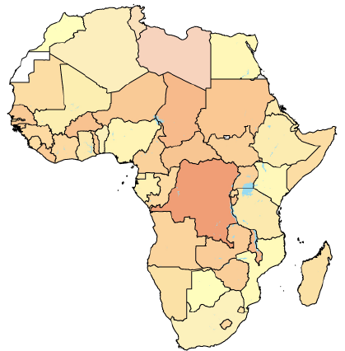
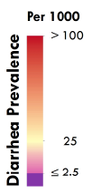
Mapping diarrheal prevalence in Africa
Diarrheal diseases – GBD 2015
Why use a geospatial approach?
Identify fine-scale geographic inequity
Evaluate progress within-country
Can use data that is ‘only’ locally representative
Aggregate to area where policy happens
Identify covariate relationships / protect somewhat against ecological fallacy

Slide 34
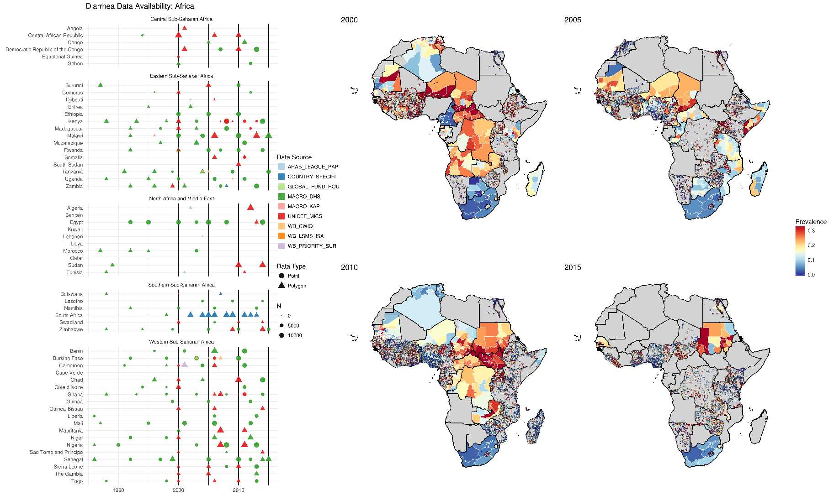
Diarrhea data coverage

Slide 35
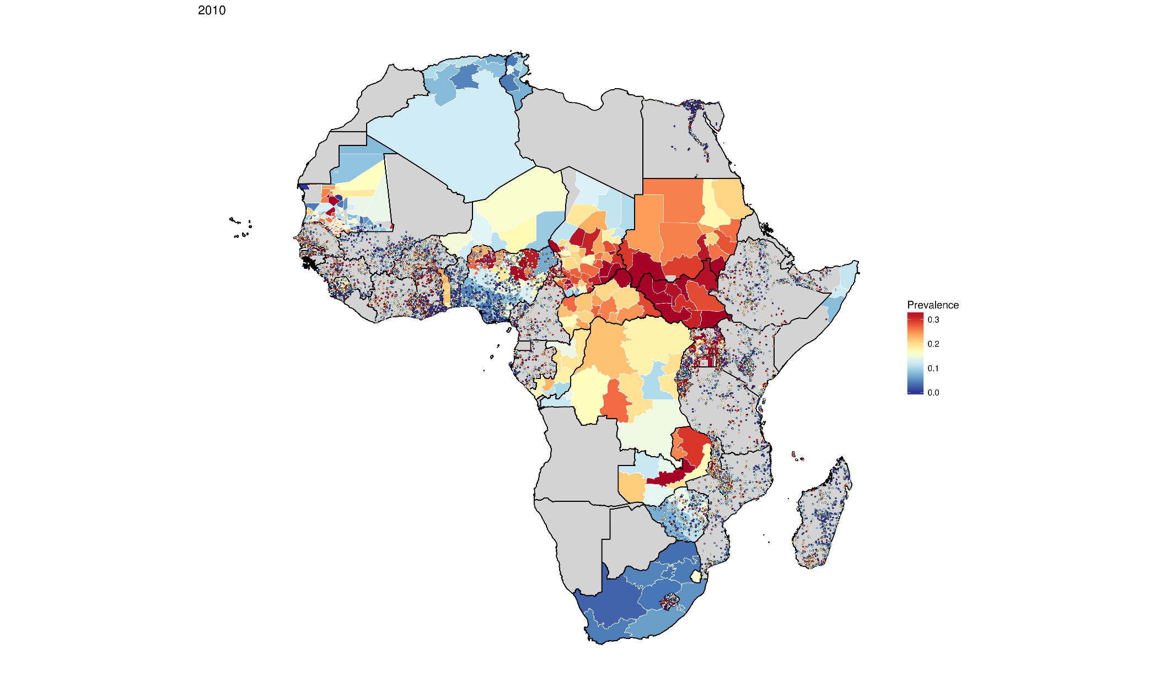
Diarrhea data coverage
Some areas have robust data coverage, and we can make confident predictions
Others have more sparse vaccine coverage, so our predictions are less certain

Slide 36
Model-based geostatistics
How do we fill in predictions for areas where we have no / scant data?
Borrow strength from:
Spatial trends: areas closer in space are more similar
Temporal trends: areas closer in time are more similar
Covariates: areas that are more similar in terms of access to care, maternal education, urbanicity, etc. will have more similar vaccine coverage

Slide 37
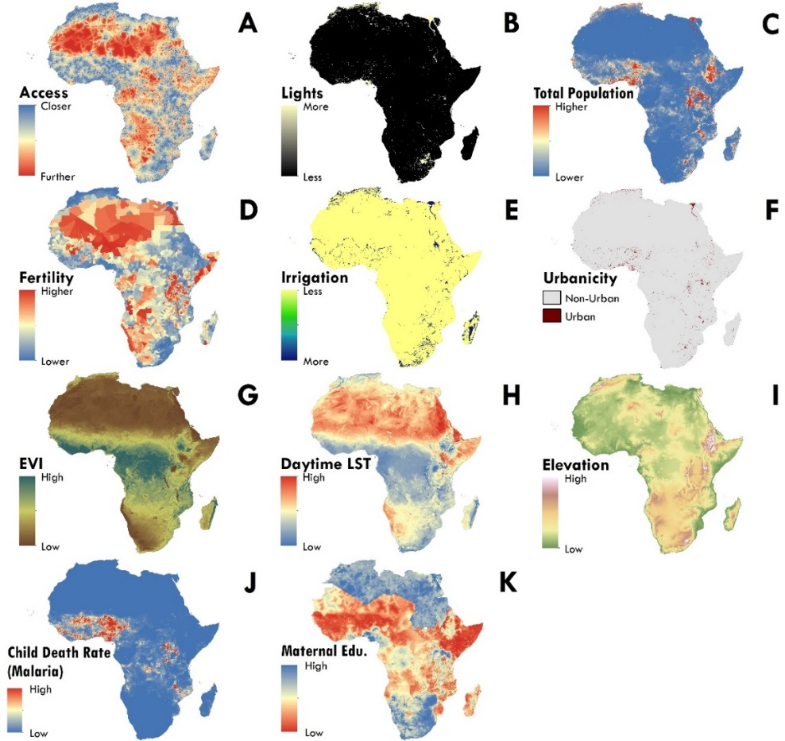
Model-based geostatistics
Covariates
Geospatial team is home to a continually growing
spatial covariate repository
Both external (e.g. satellite data) and internal (i.e. model outputs) covariates available, in a standardized format

Slide 38
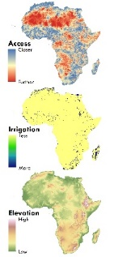



Model-based geostatistics
1-D example
$$X_{1}$$
$$X_{2}$$
$$X_{3}$$
Value of interest
1D index of space

Slide 39

Model-based geostatistics
1-D example
$α+X_{i}β+Z_{i}$
$$X_{1}$$
$$X_{2}$$
$$X_{3}$$
Value of interest
1D index of space

Slide 40
Model-based geostatistics
1-D example
$α+X_{i}β+Z_{i}$
$$X_{1}$$
$$X_{2}$$
$$X_{3}$$
Value of interest
1D index of space

Slide 41
Model-based geostatistics
1-D example
$α+X_{i}β+Z_{i}$
$$X_{1}$$
$$X_{2}$$
$$X_{3}$$
Residual
1D index of space

Slide 42
Model-based geostatistics
1-D example
$α+X_{i}β+Z_{i}$
$$X_{1}$$
$$X_{2}$$
$$X_{3}$$
Residual
1D index of space

Slide 43
Model-based geostatistics
1-D example
$α+X_{i}β+Z_{i}$
$$X_{1}$$
$$X_{2}$$
$$X_{3}$$
Value of interest
1D index of space

Slide 44
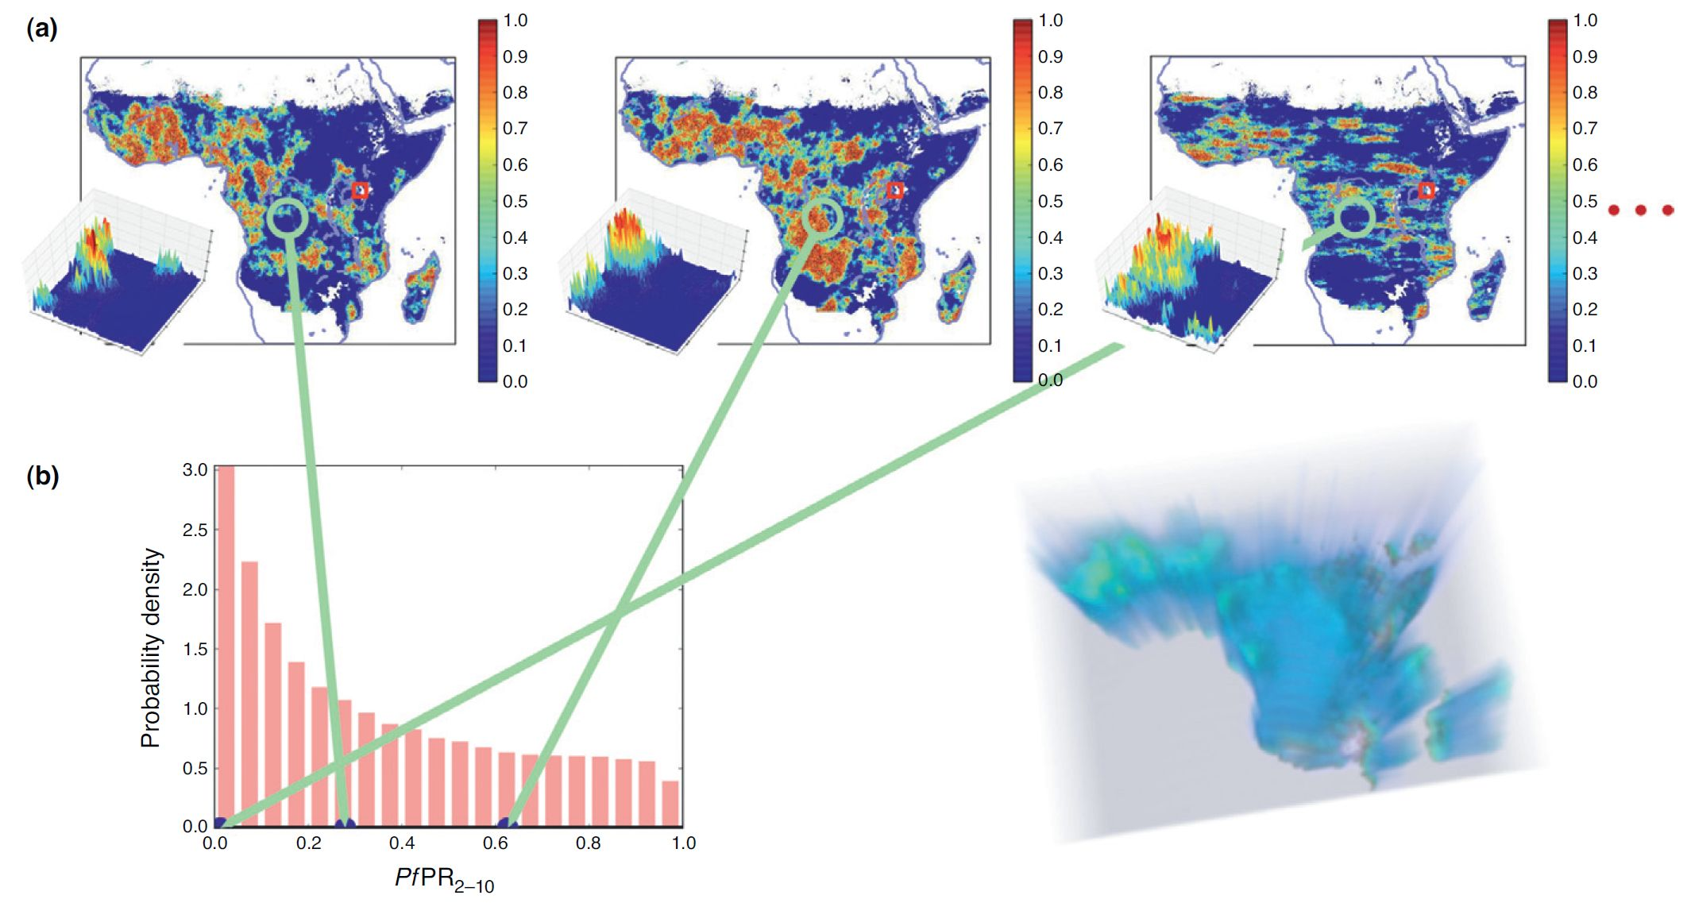
Model-based geostatistics
Bayesian geostatistics and uncertainty
Patil, Gething, Piel, and Hay. Trends Parasitol. 2011 Jun; 27(6): 246–253.

Slide 45
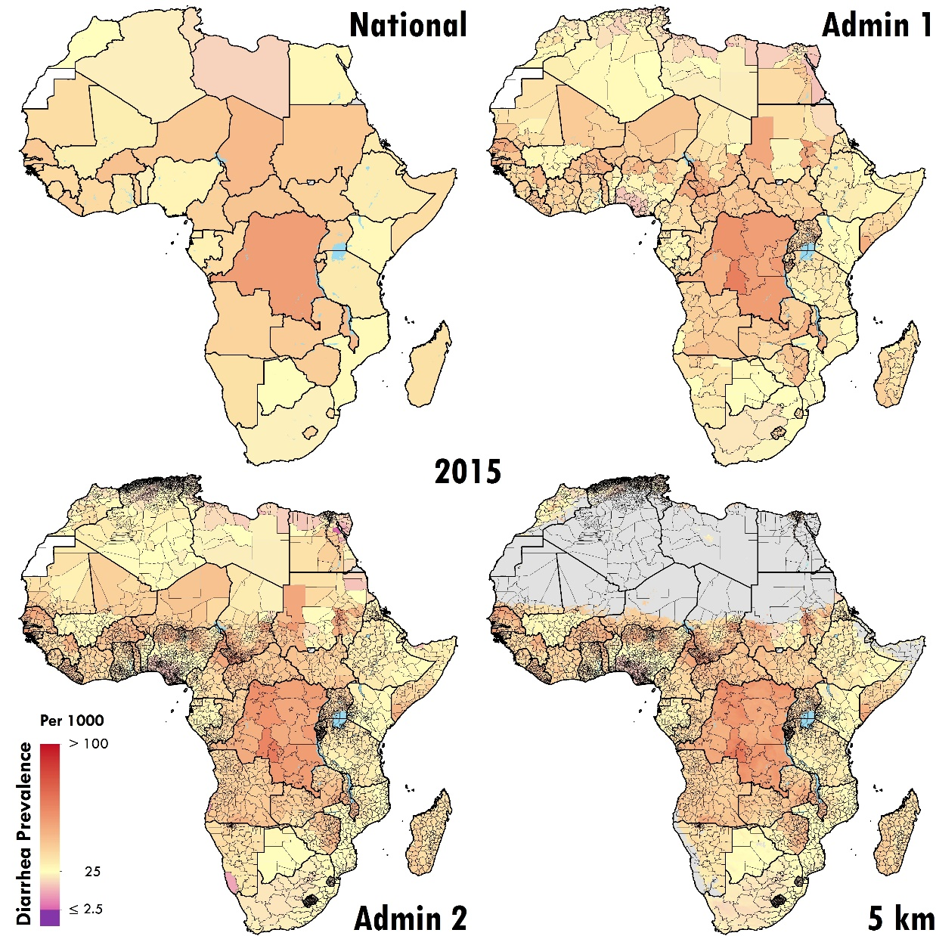
Diarrhea prevalence in Africa
2015

Slide 46
Diarrhea prevalence in Africa
2015

Slide 47
Diarrhea prevalence in Africa
2015

Slide 48
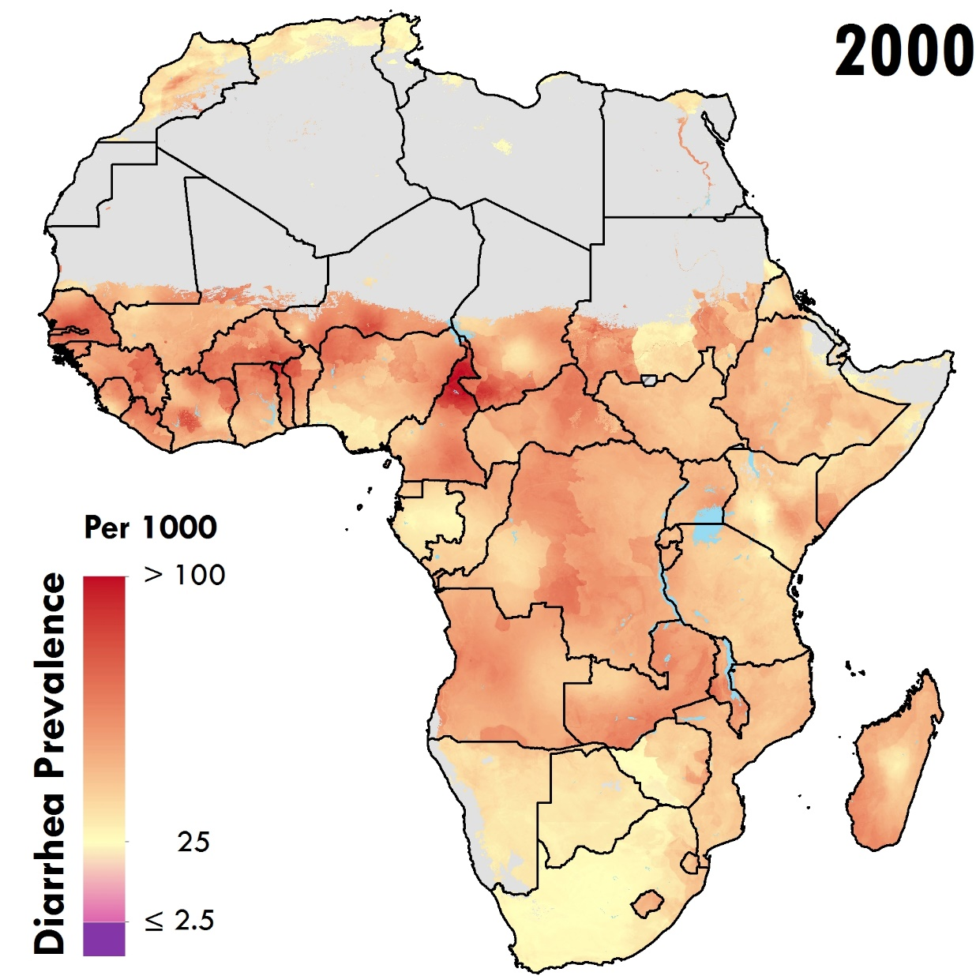
Diarrhea prevalence in Africa

Slide 49
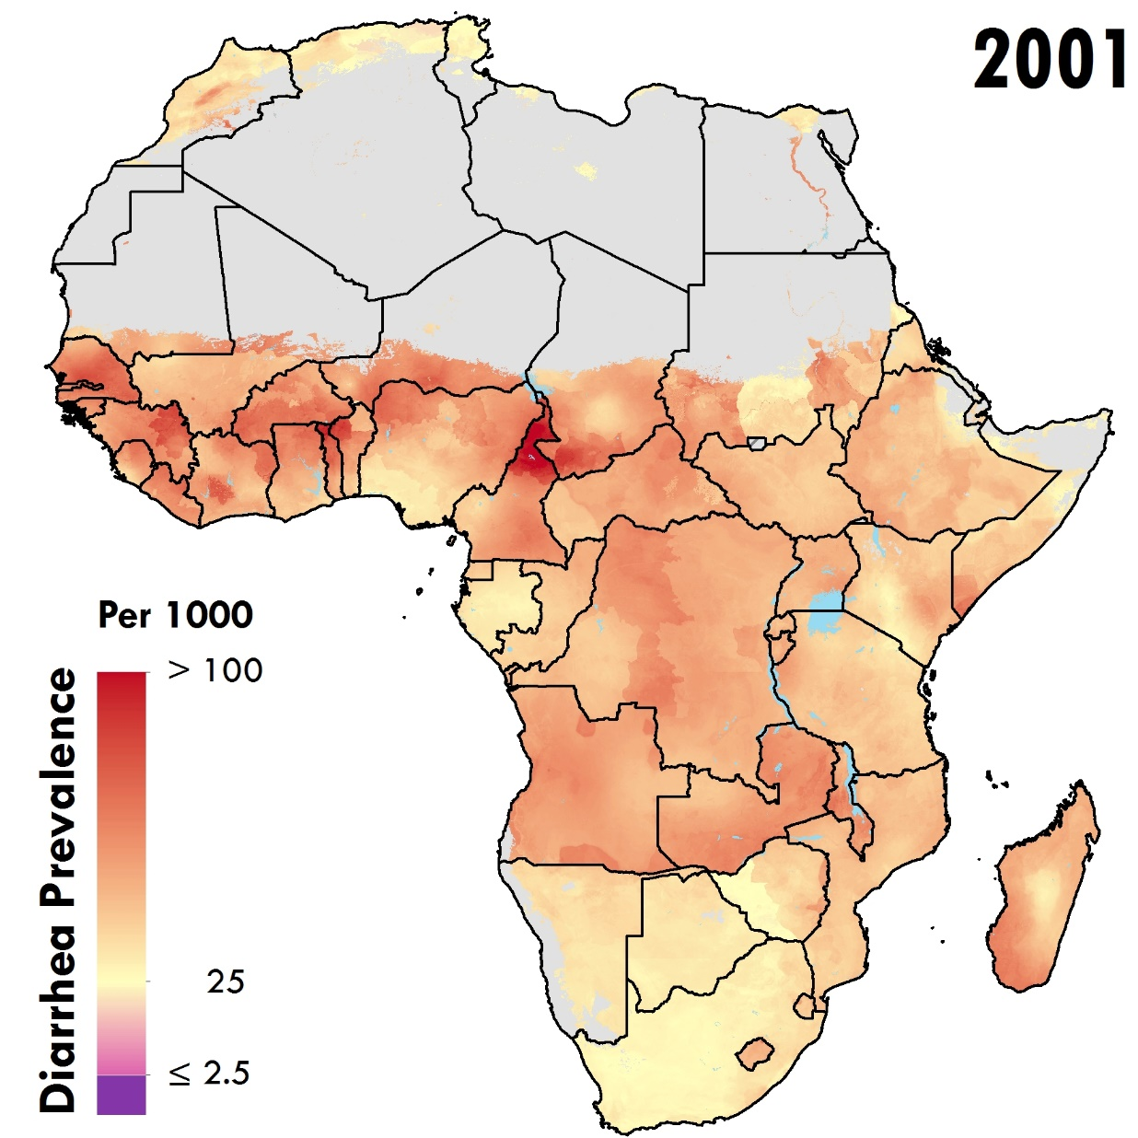
Diarrhea prevalence in Africa

Slide 50
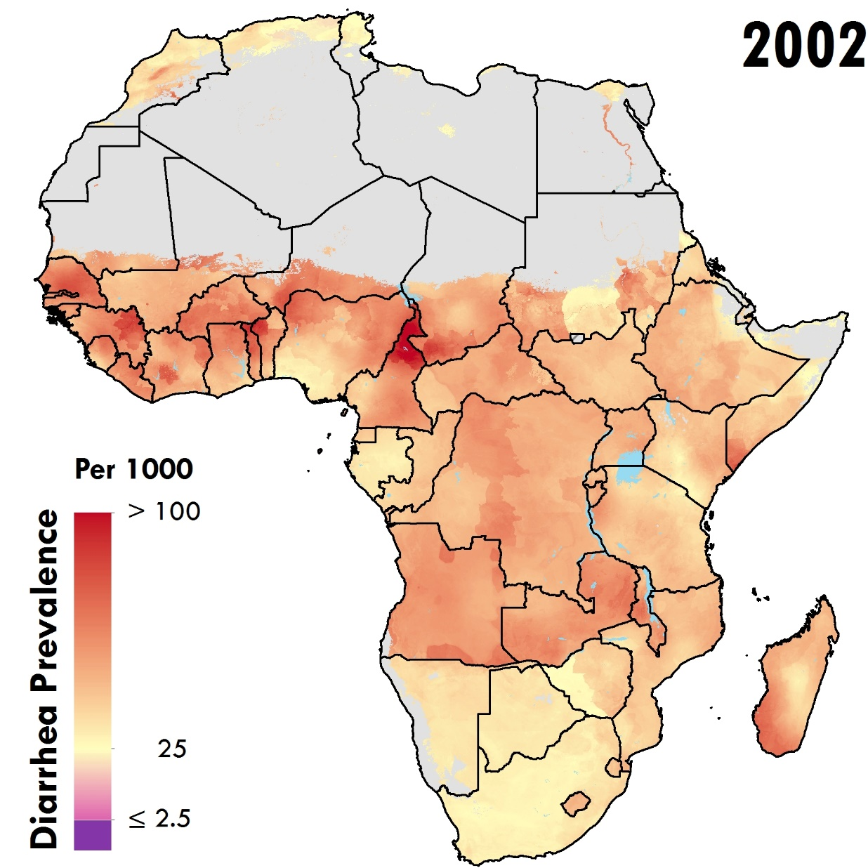
Diarrhea prevalence in Africa

Slide 51
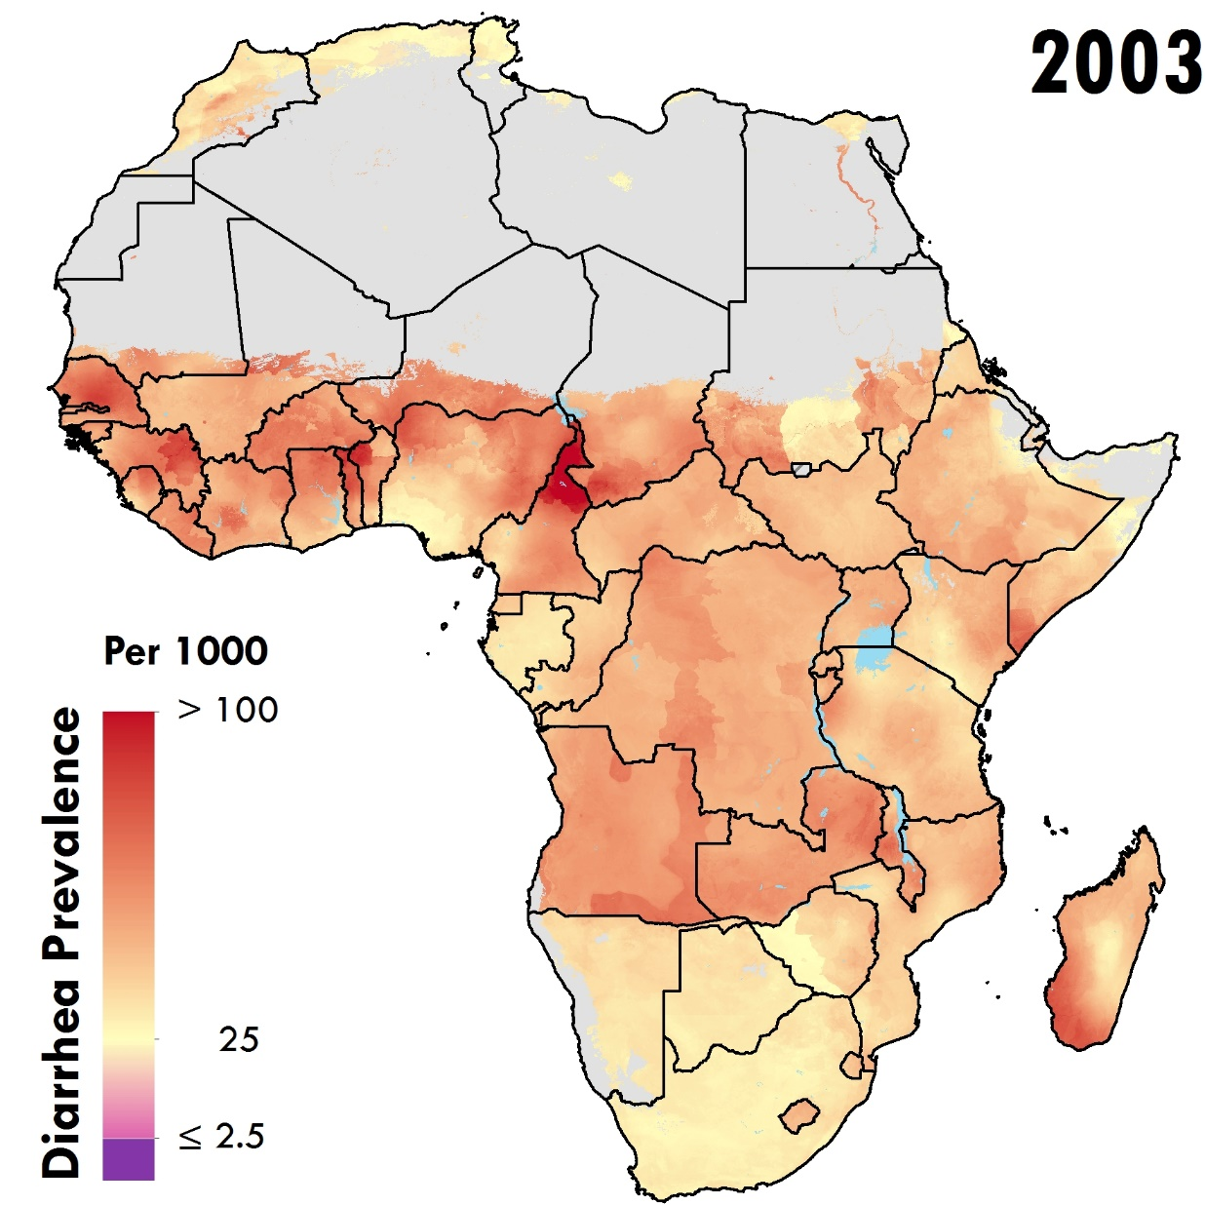
Diarrhea prevalence in Africa

Slide 52
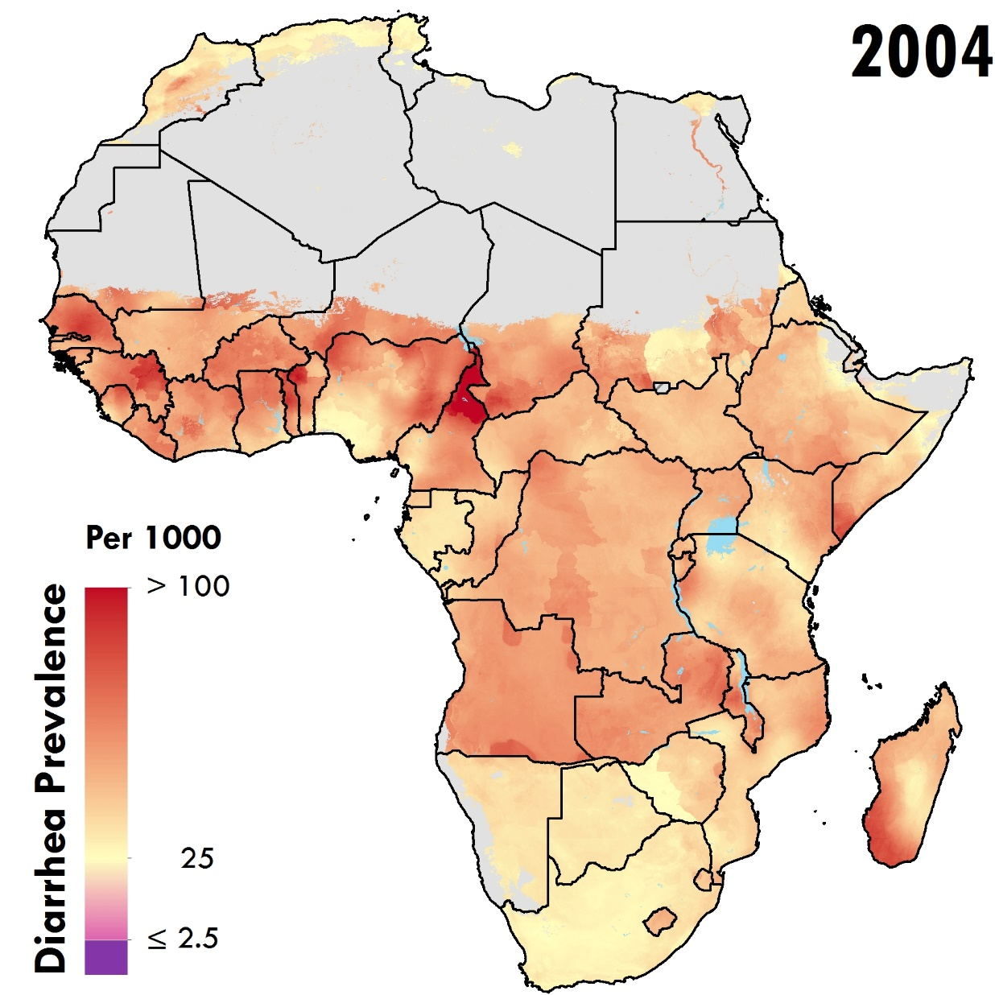
Diarrhea prevalence in Africa

Slide 53
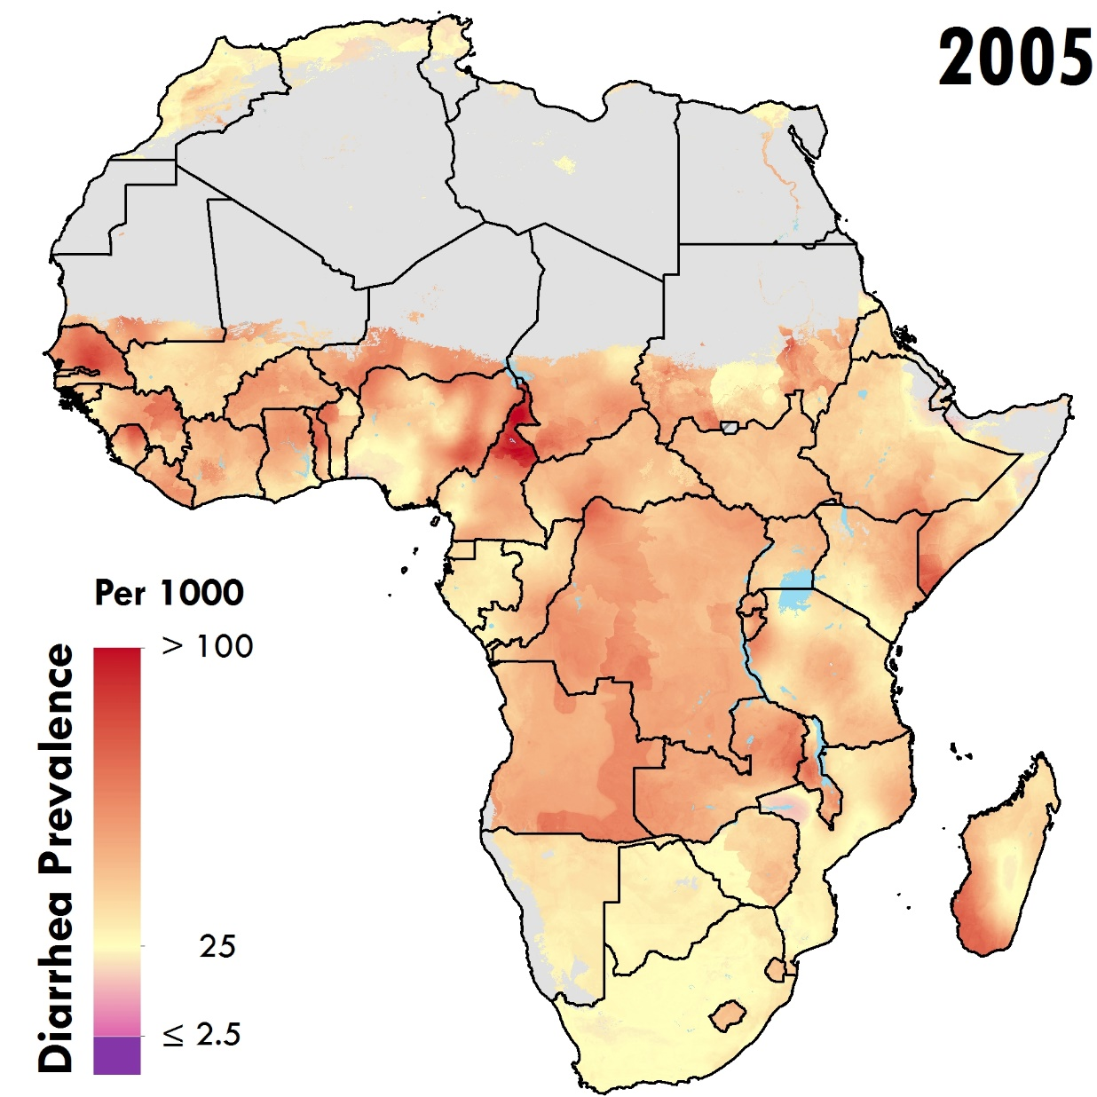
Diarrhea prevalence in Africa

Slide 54
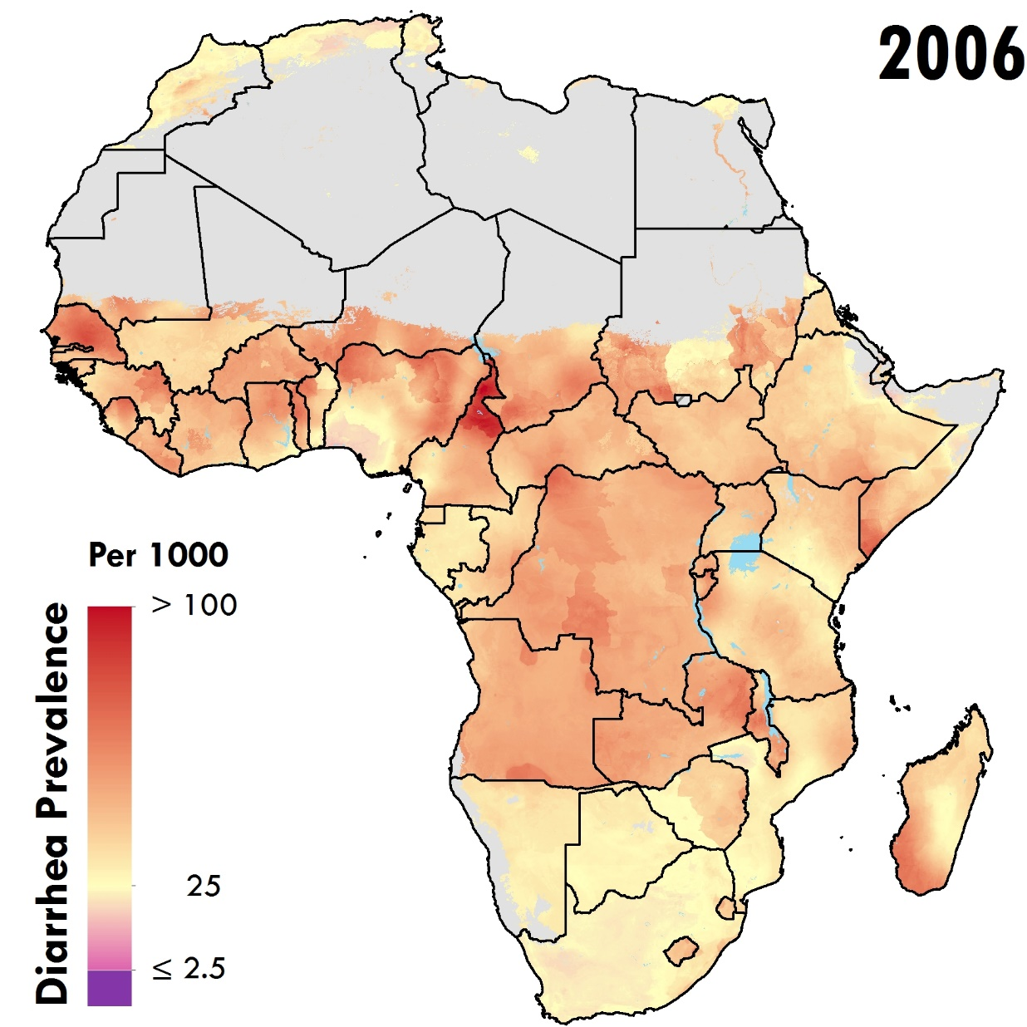
Diarrhea prevalence in Africa

Slide 55
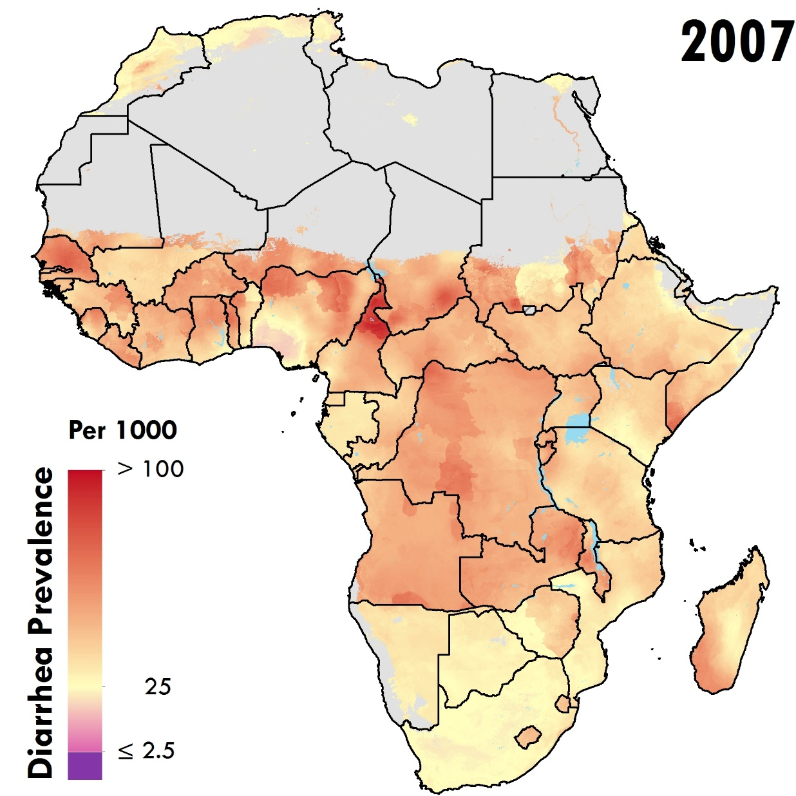
Diarrhea prevalence in Africa

Slide 56
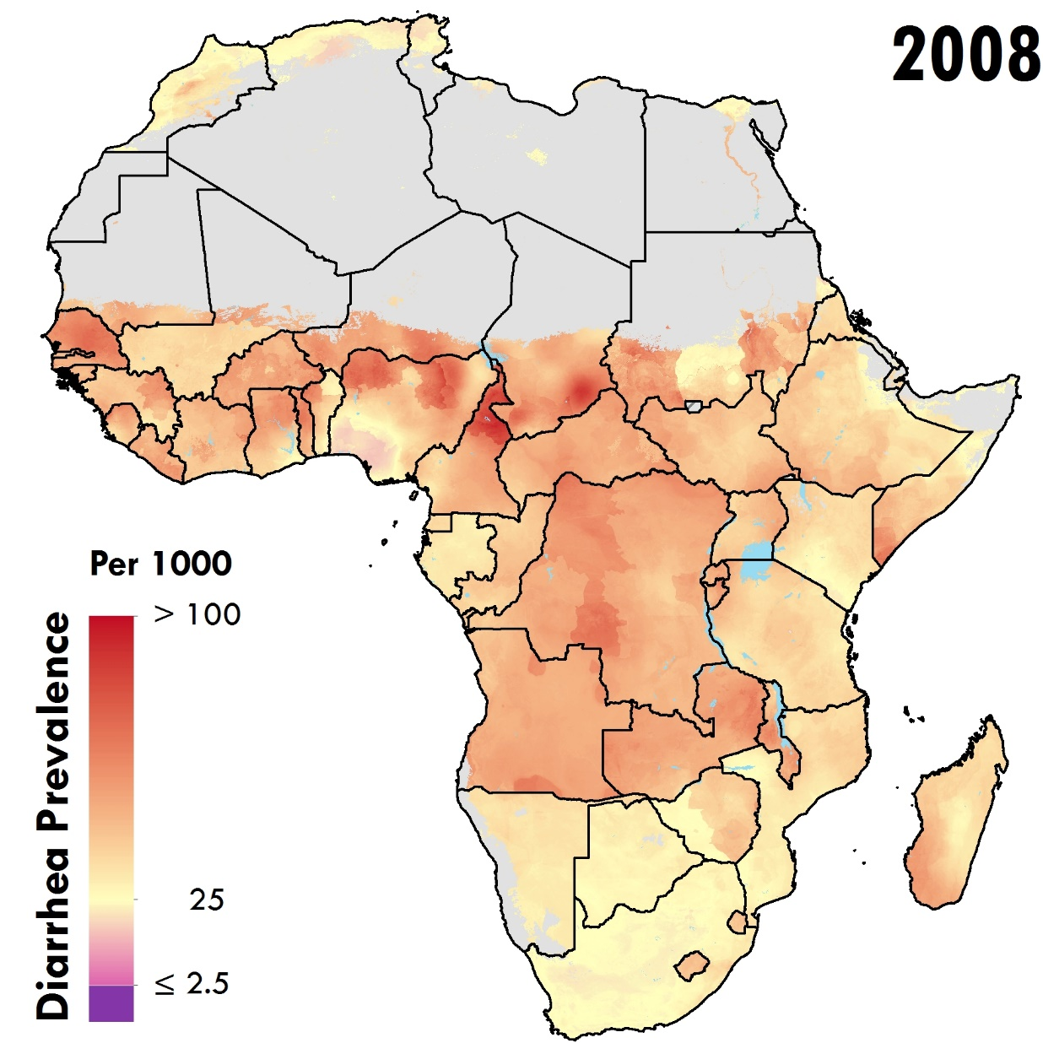
Diarrhea prevalence in Africa

Slide 57

Diarrhea prevalence in Africa

Slide 58
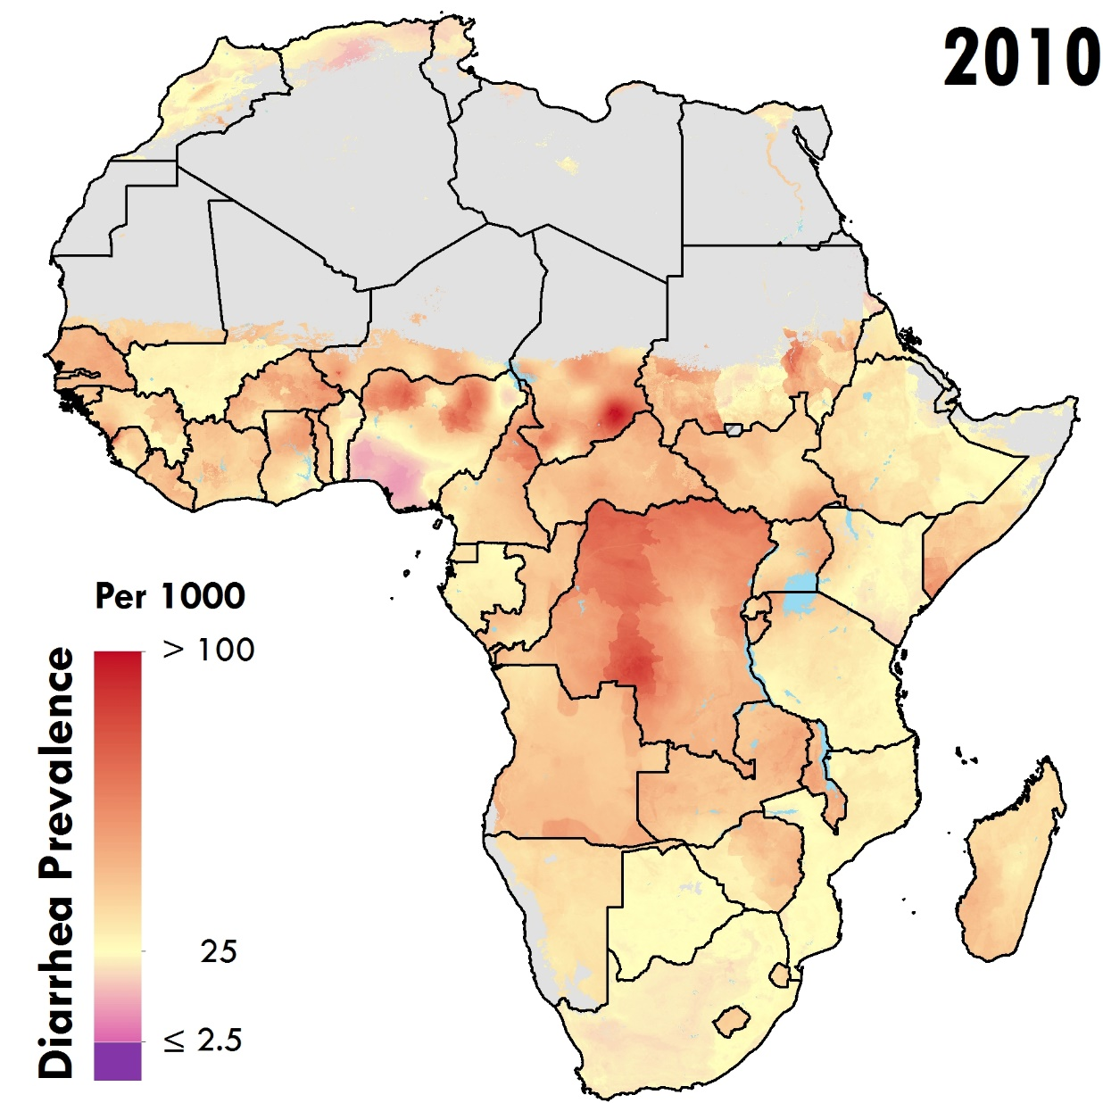
Diarrhea prevalence in Africa

Slide 59
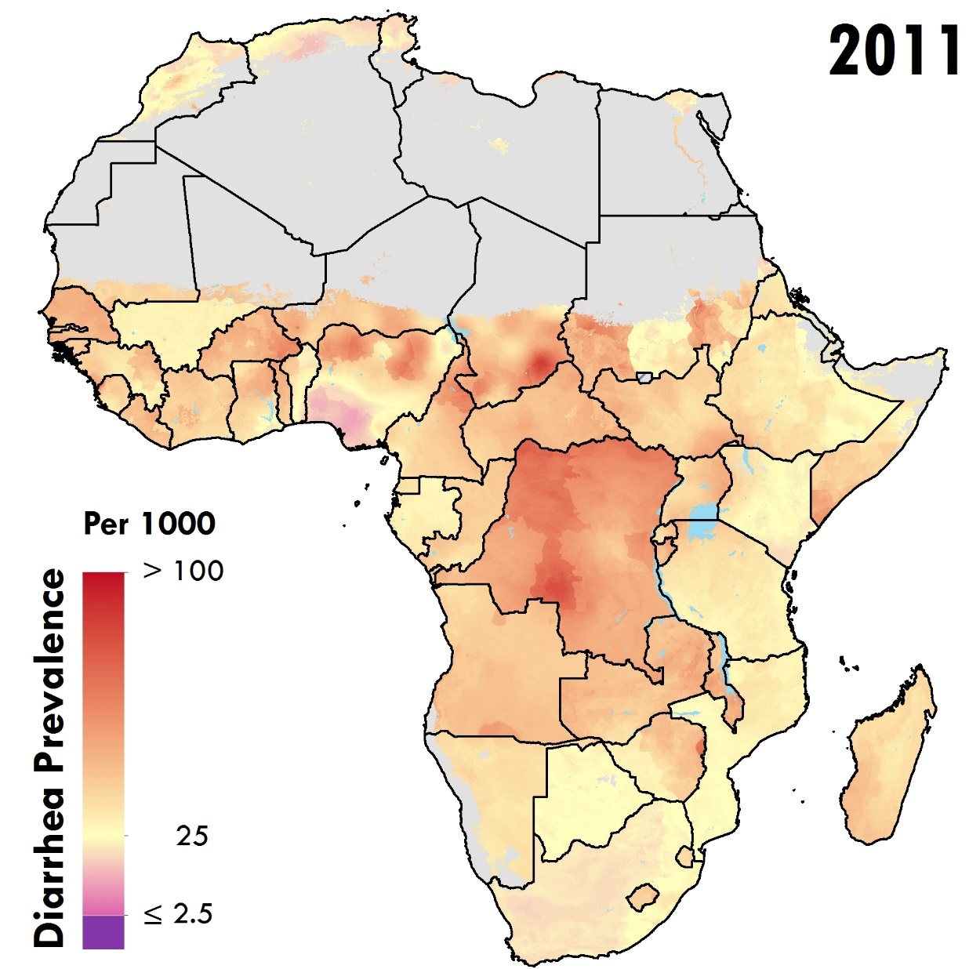
Diarrhea prevalence in Africa

Slide 60
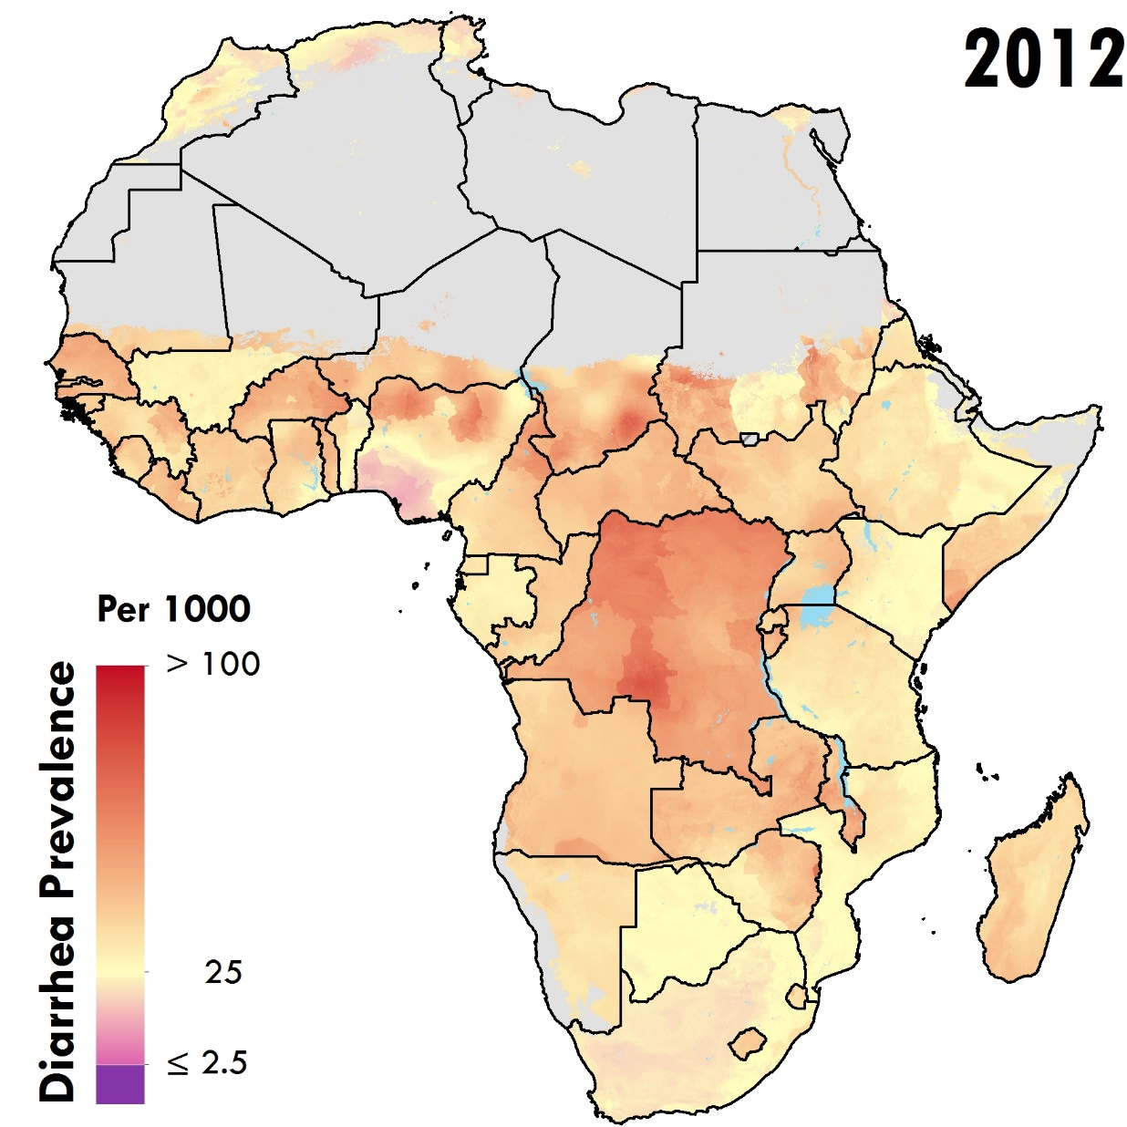
Diarrhea prevalence in Africa

Slide 61

Diarrhea prevalence in Africa

Slide 62

Diarrhea prevalence in Africa

Slide 63
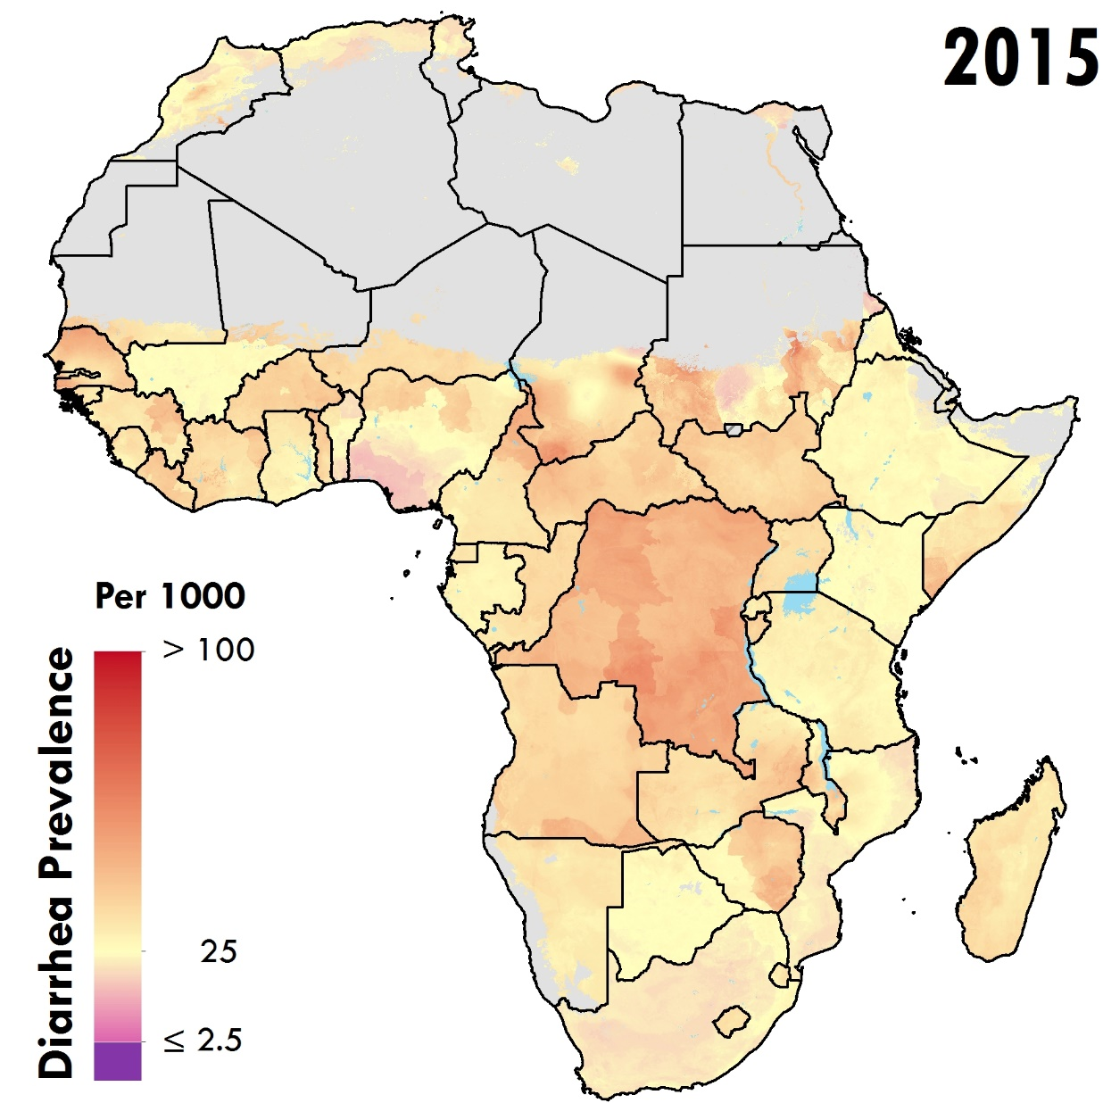
Diarrhea prevalence in Africa

Slide 64
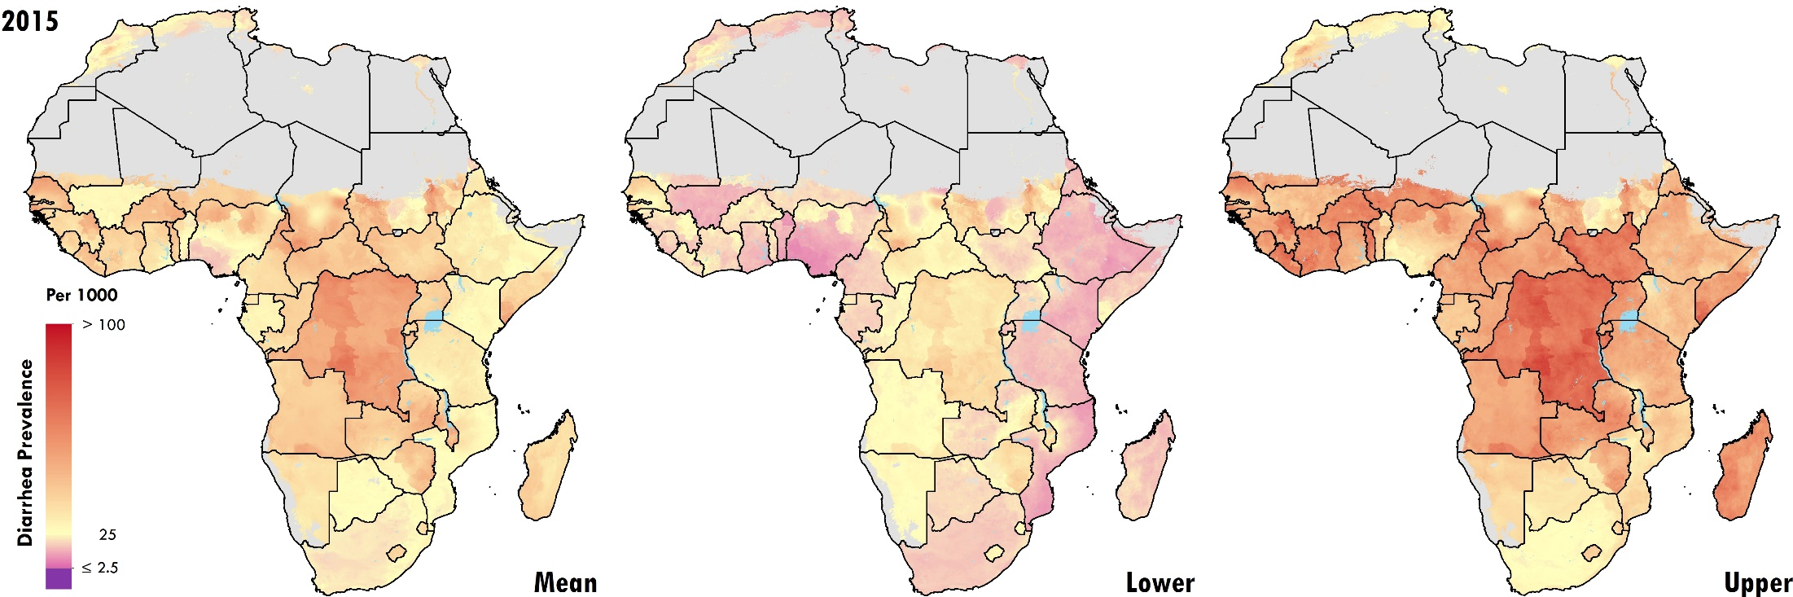
Diarrhea prevalence in Africa
Uncertainty

Slide 65
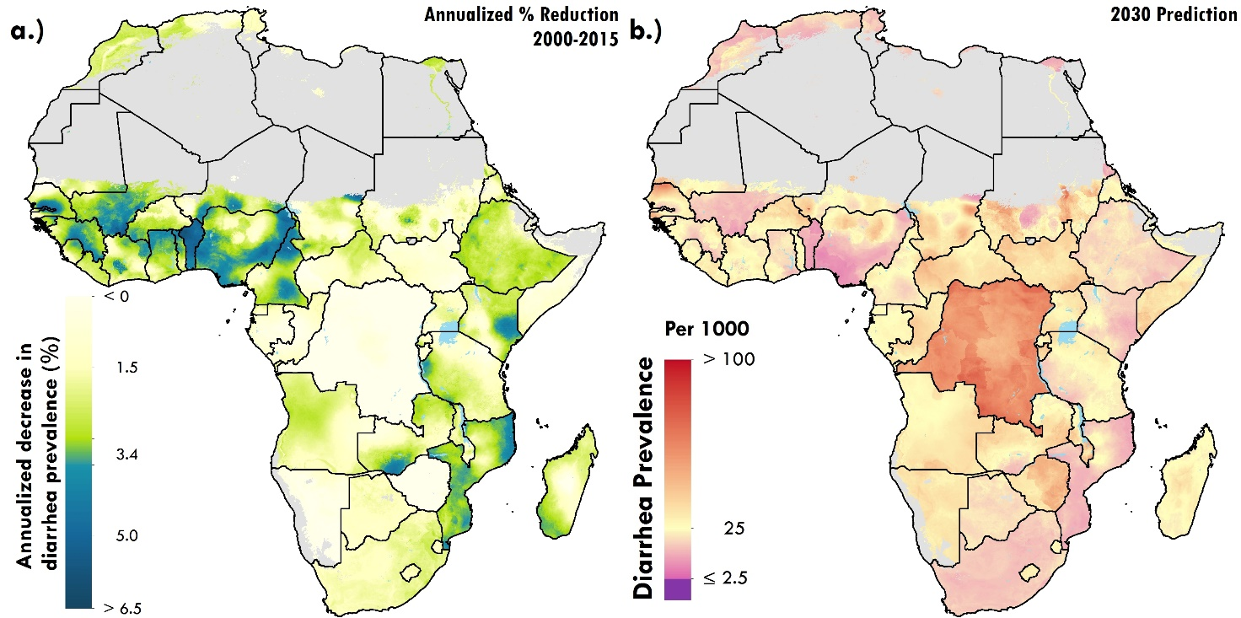
Diarrhea prevalence in Africa
Change over time and forecast

Slide 66
Next steps
Complete data collection
Model validation
Incorporate uncertainty from modeling efforts for key covariates
  WASH
  Vaccine coverage
Deeper dive into lower respiratory infection data
  appearance of negative correlations in time
Go Global!!!

Slide 67













Thank you on behalf of our team!
Jonathan Mosser
Postdoc Fellow

