Slide 1
IHME Software overview
Bobby Reiner
April 16th, 2018
6th Annual IDM Symposium

Slide 2
Outline
GBD Overview
GBD Modeling & Visualization Tools
  CODEm
  DisMod-MR
  GBD Compare
Local Burden of Disease
Future Health Scenarios
Notes:
Something we’re experimenting with.
Search terms included things like: “Global Burden of Disease,” “Institute for Health Metrics and Evaluation,” "Institute of Health Metrics and Evaluation,” “IHME,” "Global Burden,” "Burden of Disease,” "GBD 2010," "GBD 2013,“ and "GBD study“
The list of countries includes both highly developed and less developed countries, such as the US, South Africa, Thailand, Peru, and Kenya.
We excluded “burden of disease/GBD” search terms from the WHO website and only searched for IHME/Institute for Health Metrics and Evaluation

Slide 3
GBD Overview – what is the GBD study?
A systematic, scientific effort to quantify the comparative magnitude of health loss from all major diseases, injuries, and risk factors by age, sex, and population, over time
Fundamental premise: Policy should be informed by accurate and timely data; poor-quality data → poor decisions → lost opportunities to improve population health
Key principles:
  Comprehensiveness
  Informed estimates are better than no estimates
  Comparability of estimates is critical (across countries, time, diseases, injuries, risk factors, age, and sex)

Slide 4

GBD Overview – DALYs

Slide 5
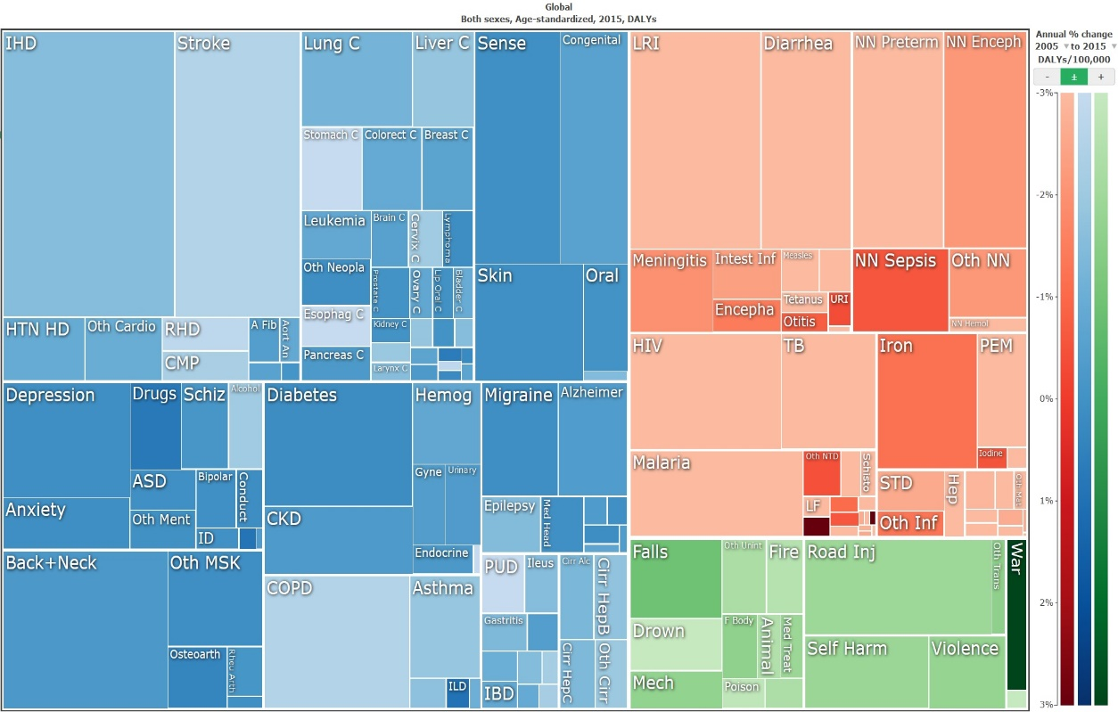
GBD Overview – Multiple metrics for health
Death counts, mortality rates
Incidence, prevalence
Years of life lost (YLLs) to premature death
Years lived with disability (YLDs)
  Time spent sick or injured
Disability adjusted life years (DALYs)
  Years of healthy life lost

Slide 6





GBD Overview – input data sources
Gathering data on 700+ geographies
Vital records (births, deaths)
Age-specific surveys
Subject-specific surveys
Regular population sample surveys
National censuses
Hospital records
Police records
Satellite data
Financial data
Livestock records, etc.

Slide 7
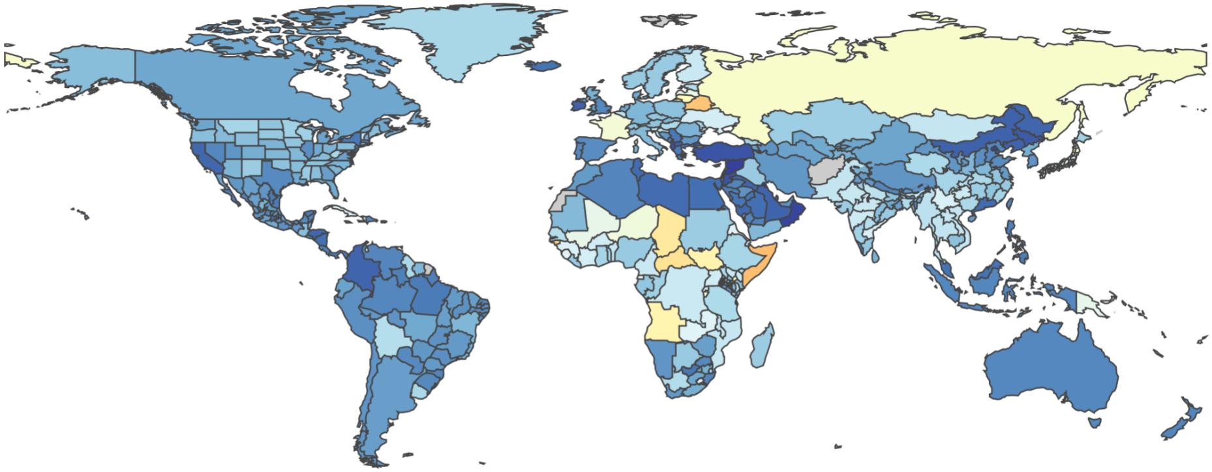

GBD Overview – by the numbers
  2,600+ international collaborators
  300 full-time professionals in Seattle, USA
  30 full-time faculty
  30 member scientific counsel
  100+ statisticians, data and modelling professionals
  50+ outreach and training personnel
  315 diseases, 2,600 sequelae, 79 risks - in 519 geographical units

Slide 8
GBD Overview – a global enterprise

Slide 9
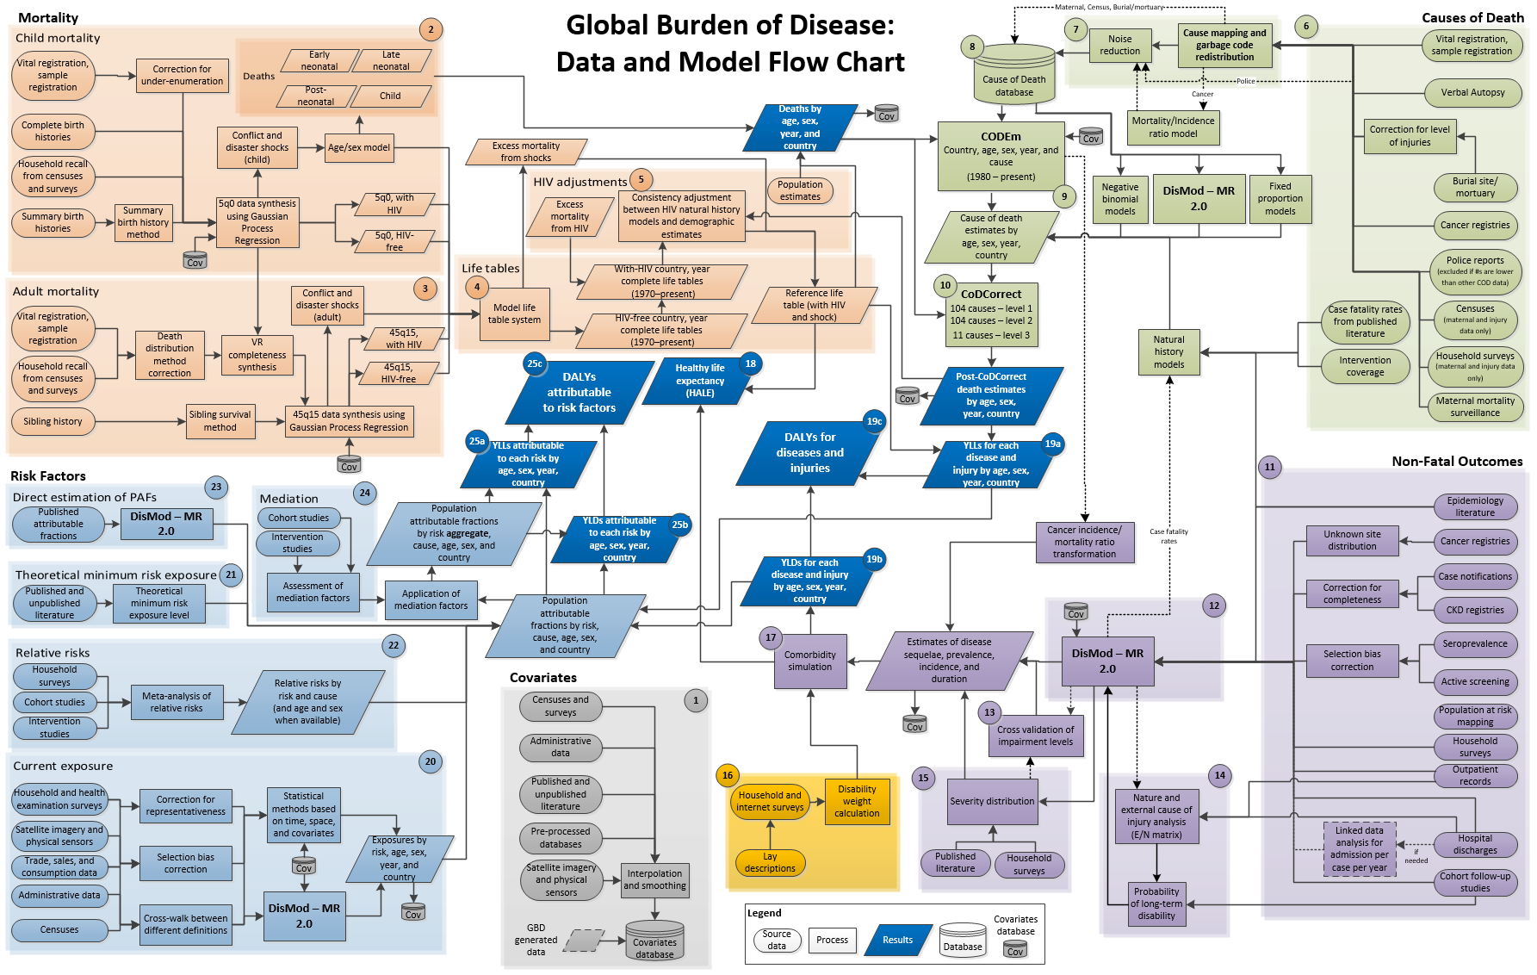

Slide 11
GBD Modeling Tools - CODEm
CODEm = Cause Of Death Ensemble modeling
Make cause of death estimates for each cause of death, sex pair for every location, age, year, sex
To make those estimates, CODEm
  Uses all available data
  Correct for known biases in the data
  Make estimates so that we have
    Number of Deaths
    Log (rate)
    Cause Fraction
CODEm will then pass these estimates to DisMod

Slide 12
GBD Modeling Tools - CODEm
Development of individual models
  Step 1: Covariate selection
  Step 2: Assess individual model performance
Step 3: Development of an ensemble model

Slide 13
GBD Modeling Tools - CODEm
Step 1: Covariate selection
Identify all covariates that may be related to a given cause of death based on biological, etiological, or socioeconomic links
Based on the literature, identify the expected direction of the relationship: positive, negative, either
Classify covariates into levels:
  Strong proximal relationship, well known biological pathway
  Strong evidence of relationship but no direct biological link
  Weak evidence of relationship or distal in the causal chain

Slide 14
GBD Modeling Tools - CODEm
Step 2: Assess individual model performance
Metrics
  Root mean squared error (RMSE)
  Whether predicted direction of relationship matches fitted direction
  Percent of data included in uncertainty interval (coverage)
Out-of-sample testing
  Keep 70% of data for model development, 30% for testing
  Hold out data according to existing patterns of missingness in input data
  Repeat for multiple holdouts

Slide 15
GBD Modeling Tools - CODEm
Patterns of missingness in countries
 |  | Scenario A: Complete Missingness
 | Year
 | 1980 |  |  |  | 1985 |  |  |  |  | 1990 |  |  |  |  | 1995 |  |  |  |  | 2000 |  |  |  |  | 2005 |  |  |  |  | 2010
Age | 0
 | 20
 | 40
 | 60
 | 80
Scenario B: Missing in Middle of Sequence
 | Year
 | 1980 |  |  |  | 1985 |  |  |  |  | 1990 |  |  |  |  | 1995 |  |  |  |  | 2000 |  |  |  |  | 2005 |  |  |  |  | 2010
Age | 0
 | 20
 | 40
 | 60
 | 80
Scenario C: Missing at Beginning of Sequence
 | Year
 | 1980 |  |  |  | 1985 |  |  |  |  | 1990 |  |  |  |  | 1995 |  |  |  |  | 2000 |  |  |  |  | 2005 |  |  |  |  | 2010
Age | 0
 | 20
 | 40
 | 60
 | 80

Slide 16
GBD Modeling Tools - CODEm
Patterns of missingness in countries
 | Scenario D: Missingness at End of Sequence
 | Year
 | 1980 |  |  |  | 1985 |  |  |  |  | 1990 |  |  |  |  | 1995 |  |  |  |  | 2000 |  |  |  |  | 2005 |  |  |  |  | 2010
Age | 0
 | 20
 | 40
 | 60
 | 80
 | Scenario E: Missing in Some Age Groups
 | Year
 | 1980 |  |  |  | 1985 |  |  |  |  | 1990 |  |  |  |  | 1995 |  |  |  |  | 2000 |  |  |  |  | 2005 |  |  |  |  | 2010
Age | 0
 | 20
 | 40
 | 60
 | 80
 |  | Combination of Scenarios
 | Year
 | 1980 |  |  |  | 1985 |  |  |  |  | 1990 |  |  |  |  | 1995 |  |  |  |  | 2000 |  |  |  |  | 2005 |  |  |  |  | 2010
Age | 0
 | 20
 | 40
 | 60
 | 80

Slide 17
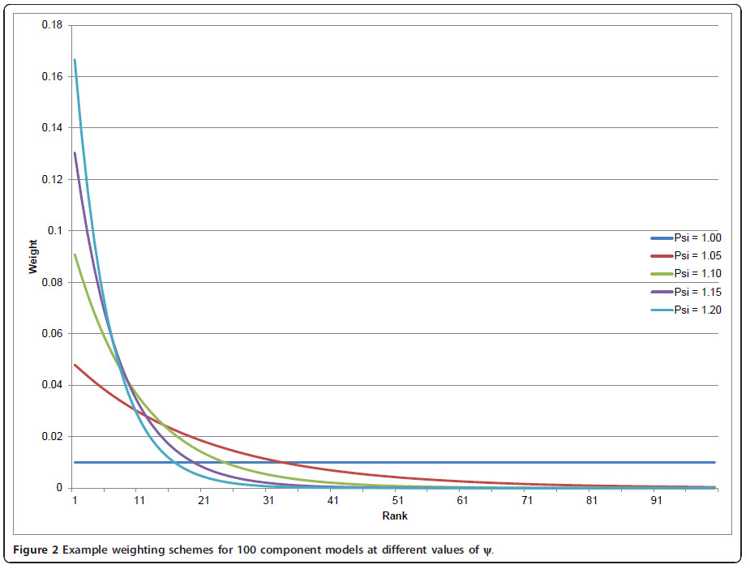
GBD Modeling Tools - CODEm
Step 3: Development of an ensemble model
Use out-of-sample performance of each component model to rank their performance.
Final “rank” is sum of rank across metrics
A range of ensemble created using

Slide 18
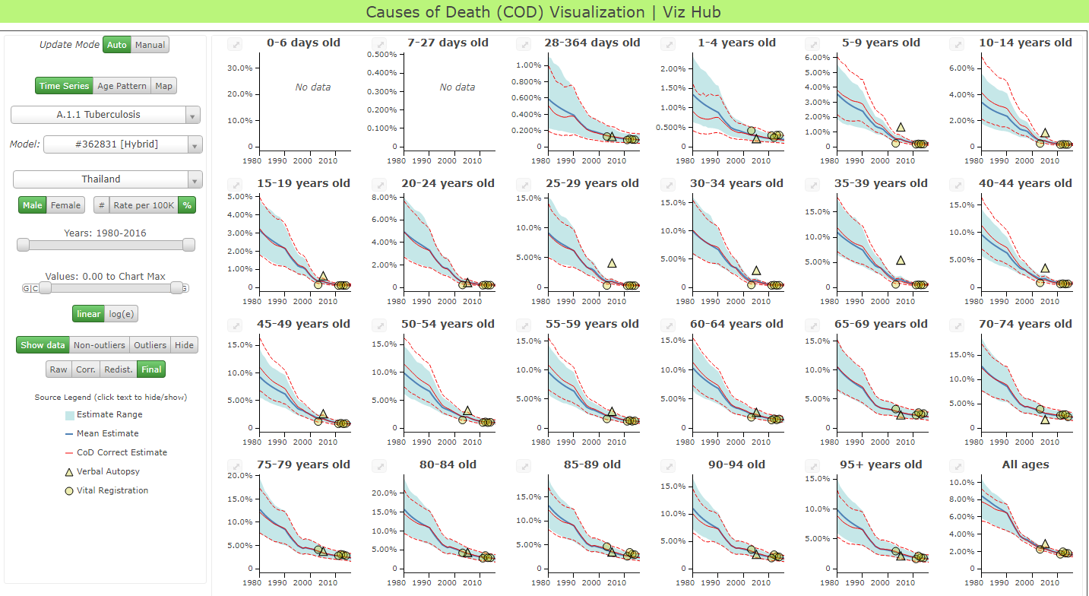
GBD Modeling Tools – CODEm visualization
Please visit: vizhub.healthdata.org/cod

Slide 19
GBD Modeling Tools – DisMod-MR
DisMod = Disease Modeling
Bayesian meta-regression tool
Initial “best guess” estimates are revised upon introduction of better information
Meta-analysis:
Pooled estimate: weighted average of many data points
Regression:
Estimates association between multiple variables
e.g. alternative case definition and prevalence OA
Meta-regression:
Weighted pooled estimates using information from associations with known variables

Slide 20
GBD Modeling Tools – DisMod-MR
DisMod base model
Mixed effects meta-regression
Lognormal distribution
Fixed effects:
sex
study-level characteristics
country-level covariates (optional)
Nested random effects:
super-region
region
country

Slide 21
GBD Modeling Tools – DisMod-MR
Computational details
Markov chain Monte Carlo (MCMC)
Age integration, distinct solutions for each year by sex
Single-parameter or compartmental
Cascading geographic hierarchy

Slide 22


GBD Modeling Tools – DisMod-MR
Incidence
Measure of new cases
Prevalence
Measure of existing cases
Cured
RIP
Healthy

Slide 23
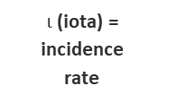

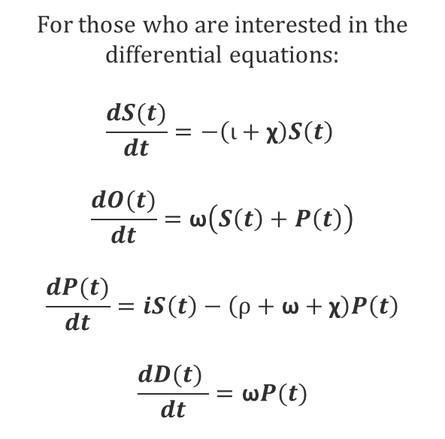
GBD Modeling Tools – DisMod-MR
ω (omega) = “all other” mortality rate (mtother)
For those who are interested in the differential equations:
$$\frac{dS(t)}{dt}=−\left(ι+\text{χ}\right)S\left(t\right)$$
$$\frac{dO(t)}{dt}=\text{ω}\left(S\left(t\right)+P\left(t\right)\right)$$
$$\frac{dP(t)}{dt}=iS\left(t\right)−\left(ρ+\text{ω}+\text{χ}\right)P\left(t\right)$$
$$\frac{dD(t) }{dt}=\text{ω}P(t)$$
Susceptible Population S(t)
Other Deaths O(t)
$ι$ (iota) = incidence rate
$ρ (rho)$ = remission rate
ω (omega) = “all other” mortality rate (mtother)
Prevalent Population P(t)
Cause-Specific Deaths D(t)
χ = excess mortality rate (mtexcess)

Slide 24
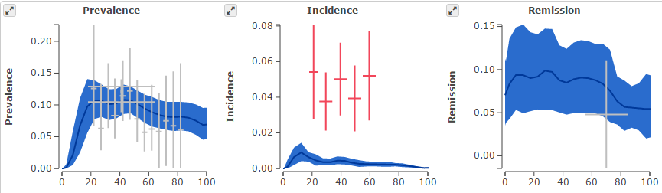
GBD Modeling Tools – DisMod-MR
Inconsistency example: Anxiety, Netherlands, F 1995

Slide 25
GBD Modeling Tools – DisMod-MR
DisMod Data Types
Measures of frequency
incidence
prevalence
Remission = ‘cure rate’
Measures of fatality
with-condition mortality rate (all deaths in prevalent cases)
cause-specific mortality rate (excess deaths per population)
excess mortality rate (excess deaths per prevalent cases)
relative risk (death rate cases/death rate non-cases)
standardized mortality ratio (deaths cases/’expected’ deaths pop)

Slide 26
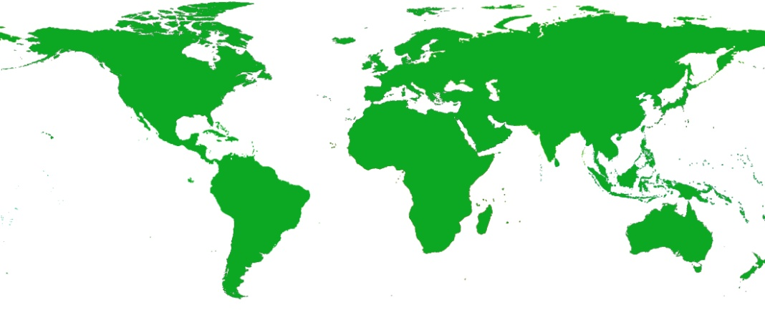
GBD Modeling Tools – DisMod-MR
Location Hierarchy
Global:
Use all data, all time periods
Calculate & apply covariate coefficient & random effects
Determine age pattern
Consistent fit between parameters
1 model
Both sexes
All time periods

Slide 27
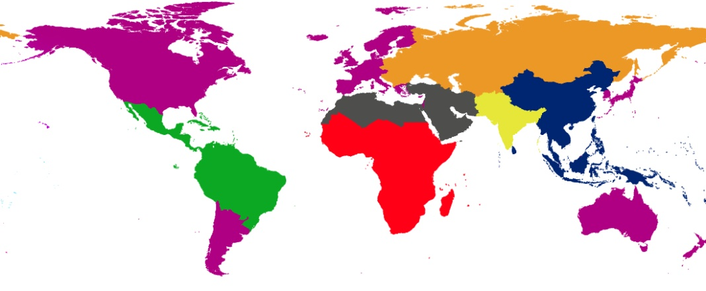
GBD Modeling Tools – DisMod-MR
Location Hierarchy
Super-Region:
Global fit = prior
Modified by random effects and betas of country covariates
84 Models
7 Super-regions
6 Time periods
Male & Female

Slide 28
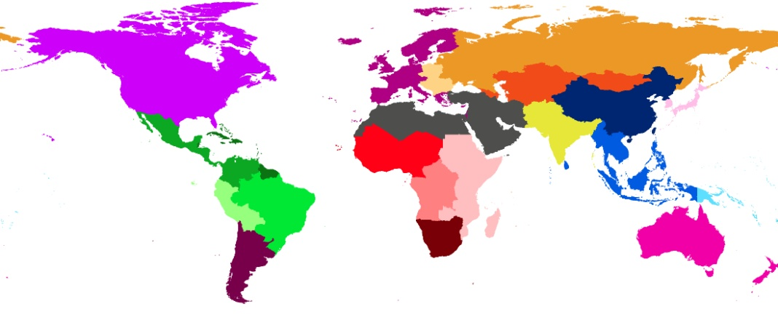
GBD Modeling Tools – DisMod-MR
Location Hierarchy
Region:
Super-region fit = prior
Modified by random effects and betas of country covariates
228 Models
19 Regions
6 Time periods
Male & Female

Slide 29
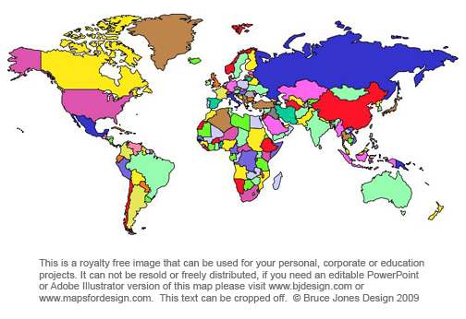
GBD Modeling Tools – DisMod-MR
Location Hierarchy
Country:
Region fit = prior
Modified by random effects and betas of country covariates
2256 Models
188 Countries
6 Time periods
Male & Female
+ Subnational estimation for US, Russia, Kenya, Ethiopia, South Africa, Japan, UK UTLAs, Mexico, Sweden, Norway, Iran, New Zealand, Brazil, China, Indonesia & India

Slide 30
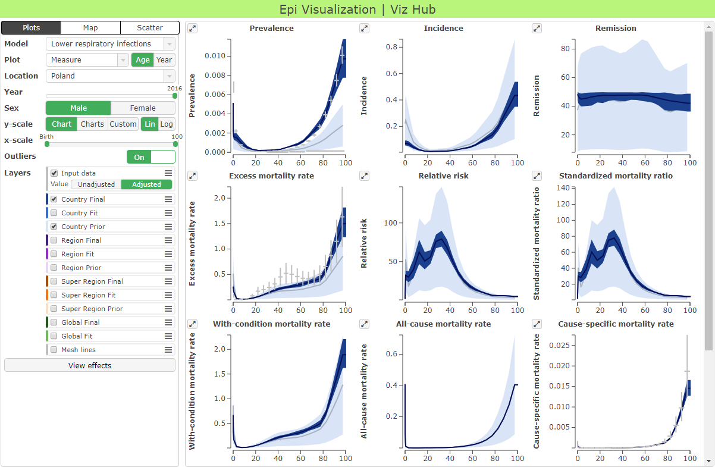
GBD Modeling Tools – DisMod-MR visualization
Please visit: vizhub.healthdata.org/epi

Slide 31
GBD Compare
All GBD estimates are available for download
The most popular tool to investigate GBD estimates is GBD Compare
Please visit: vizhub.healthdata.org/gbd-compare

Slide 32
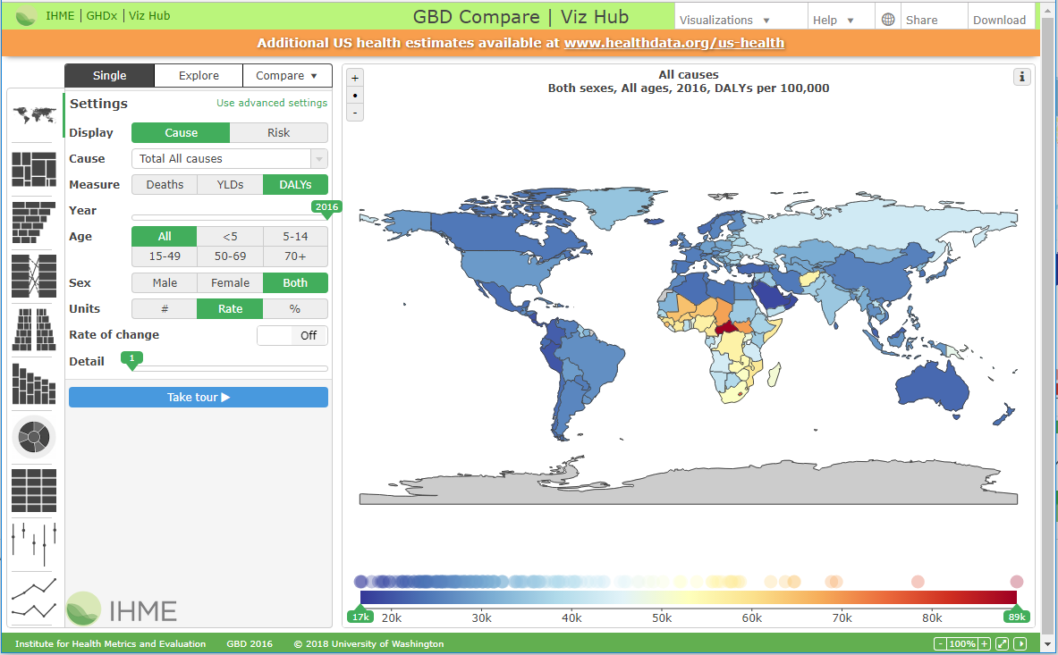
GBD Compare
All GBD estimates are available for download
The most popular tool to investigate GBD estimates is GBD Compare
Please visit: vizhub.healthdata.org/gbd-compare

Slide 33
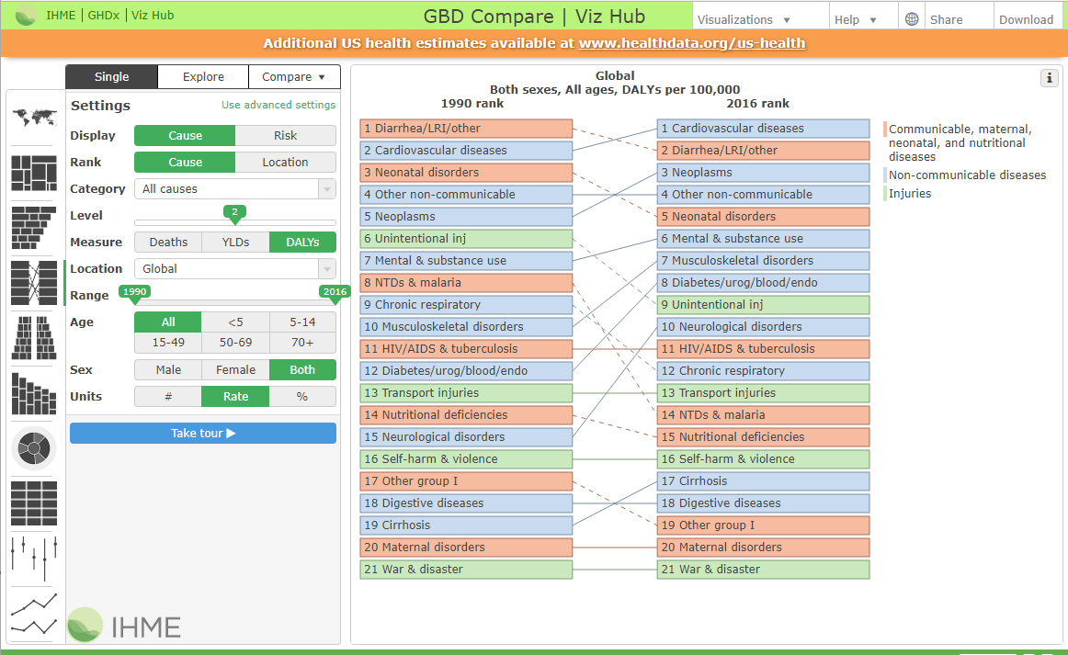
GBD Compare
All GBD estimates are available for download
The most popular tool to investigate GBD estimates is GBD Compare
Please visit: vizhub.healthdata.org/gbd-compare

Slide 34
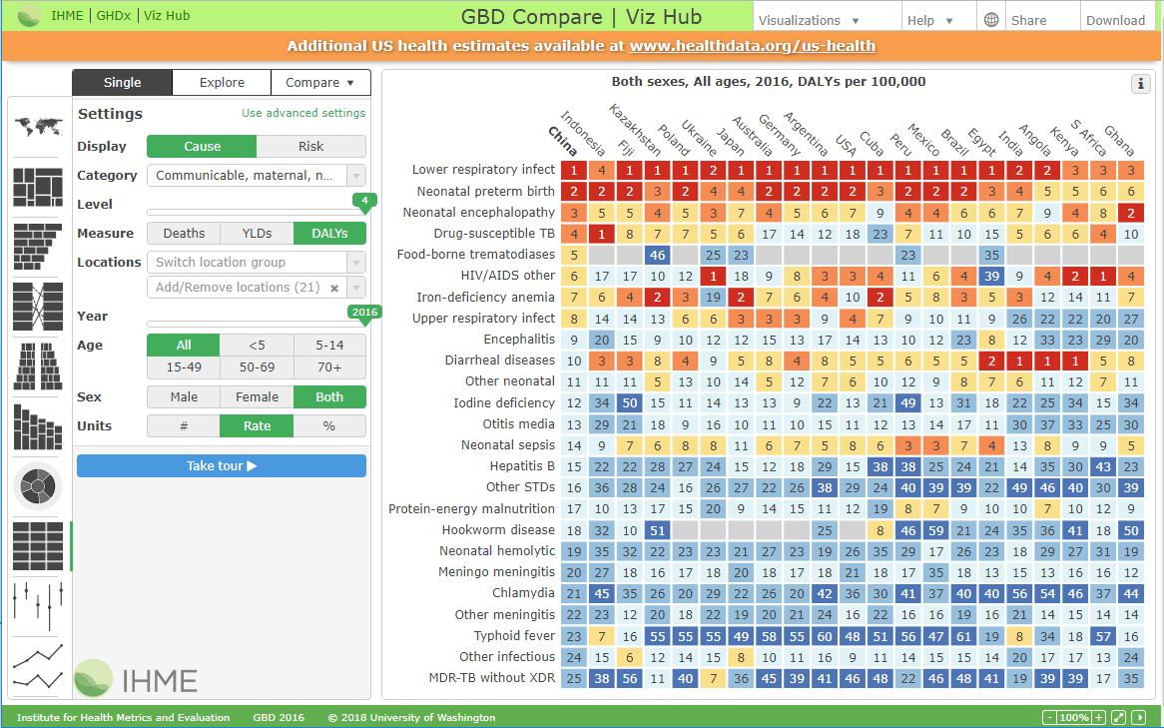
GBD Compare
All GBD estimates are available for download
The most popular tool to investigate GBD estimates is GBD Compare
Please visit: vizhub.healthdata.org/gbd-compare

Slide 35
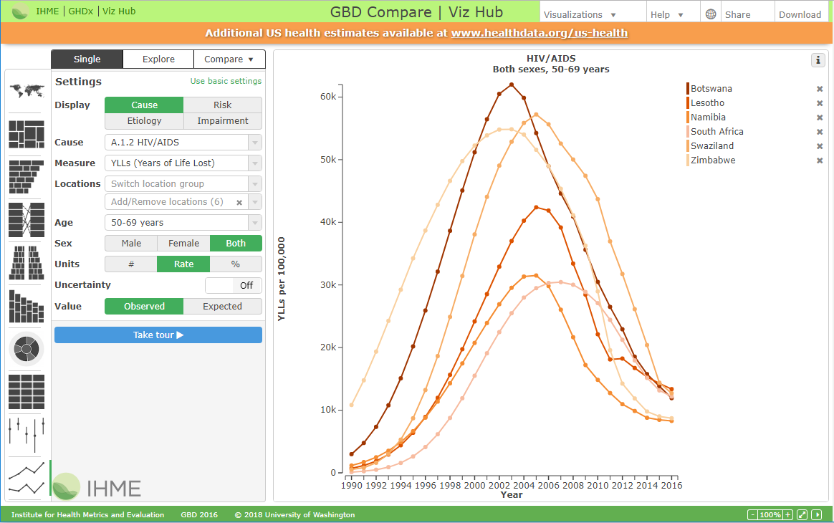
GBD Compare
All GBD estimates are available for download
The most popular tool to investigate GBD estimates is GBD Compare
Please visit: vizhub.healthdata.org/gbd-compare

Slide 36
Local Burden of Disease

Slide 37
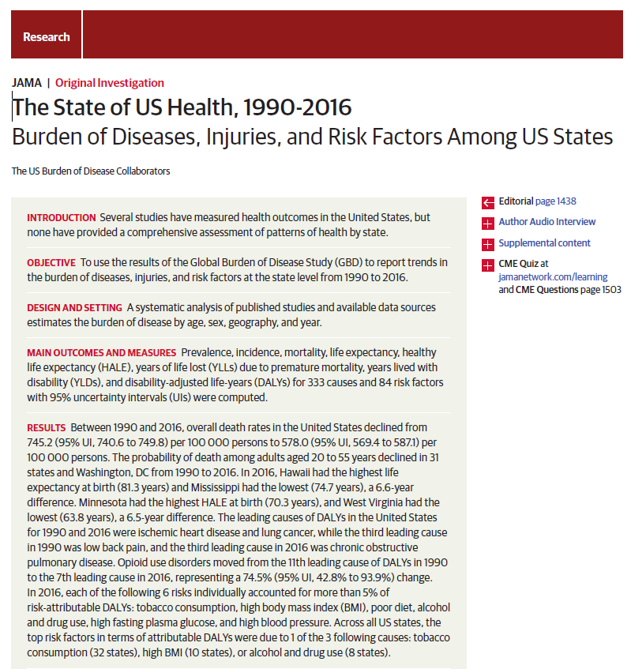
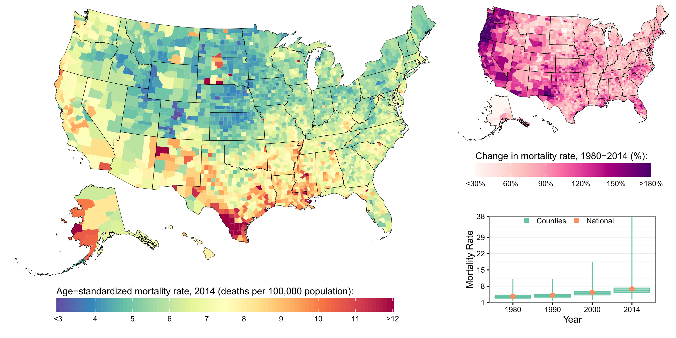
Local Burden of Disease – Small-area estimation
Visualization tools available at: vizhub.healthdata.org/subnational/usa
See also: projects.fivethirtyeight.com/mortality-rates-united-states/

Slide 38
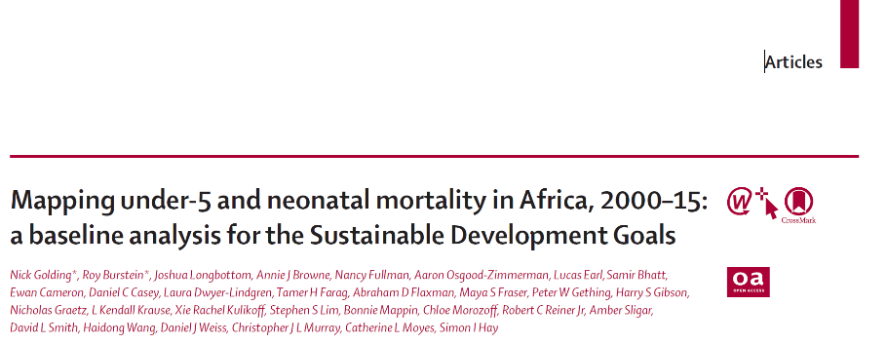
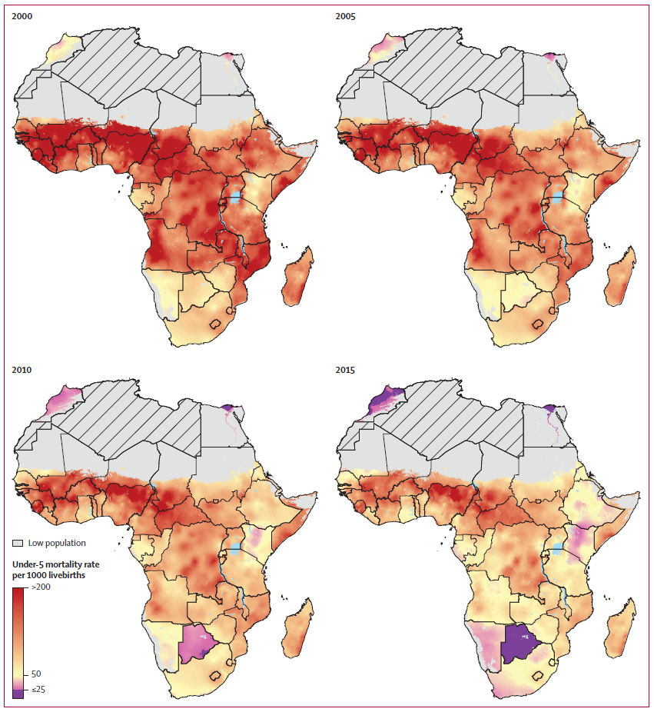
Local Burden of Disease – Hierarchical Bayesian Geostatistics
Please visit: vizhub.healthdata.org/lbd/under5

Slide 39
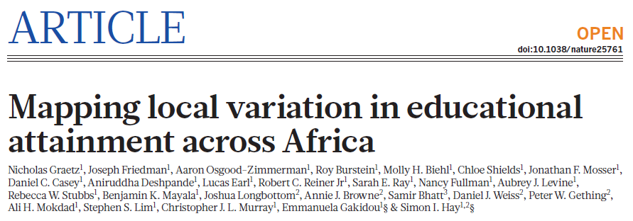
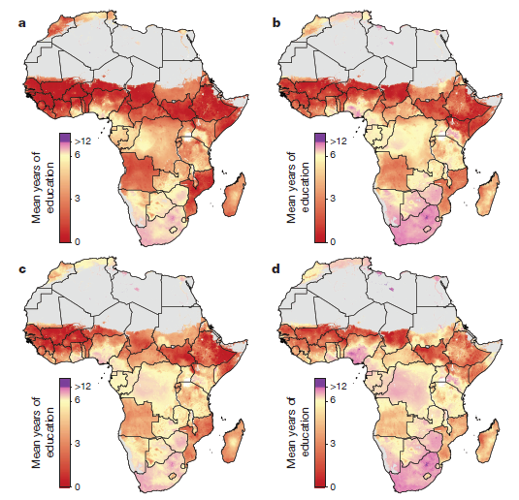
Local Burden of Disease – Hierarchical Bayesian Geostatistics
Please visit: vizhub.healthdata.org/lbd/education

Slide 40
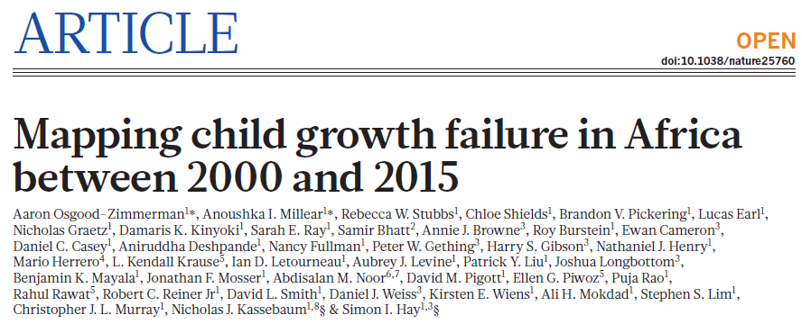
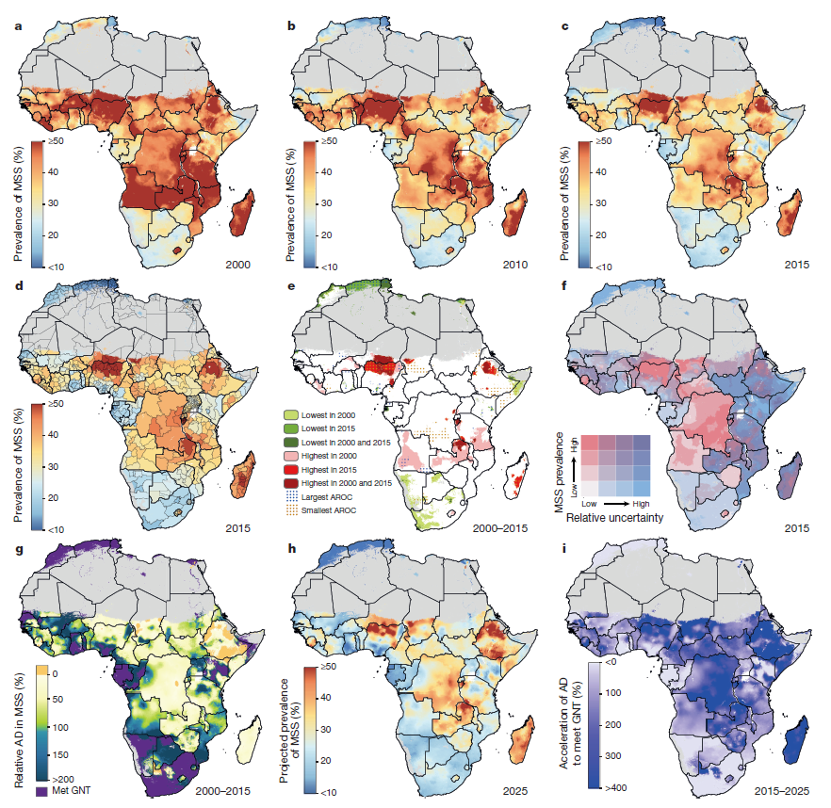
Local Burden of Disease – Hierarchical Bayesian Geostatistics
Please visit: vizhub.healthdata.org/lbd/cgf

Slide 41
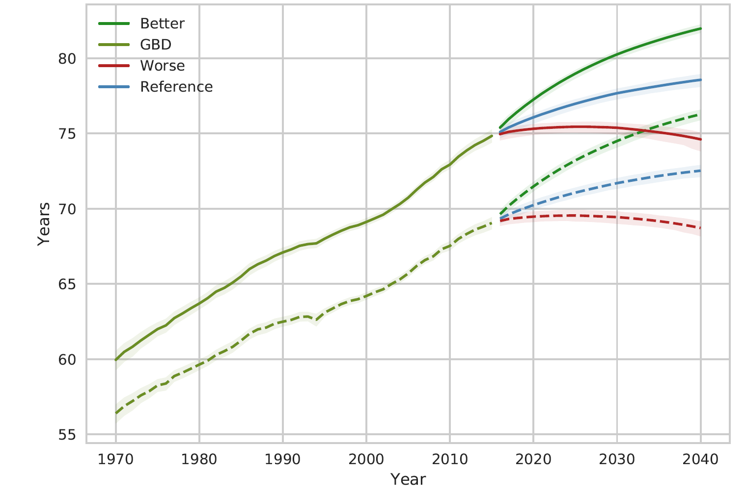
Future Health Scenarios
Global life expectancy at birth
Many investment decisions with long-run payoffs such as R&D, health workers, hospitals, and other infrastructure need some quantified scenarios for the future.
Scenarios can also identify challenges that may become more important in determinants of health in the future
Provide insights into the implications of health change for health and social protection systems.
Identify and mitigate risks for future health.

Slide 42
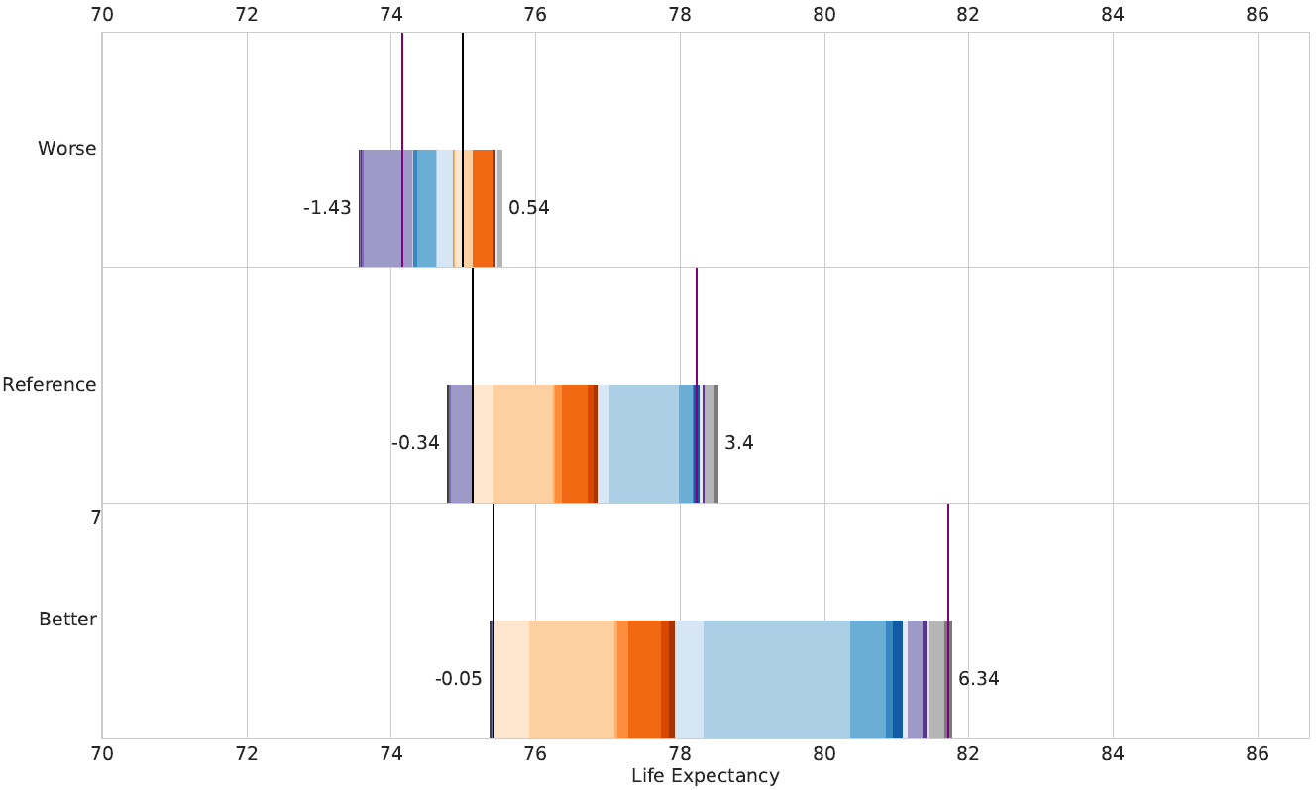
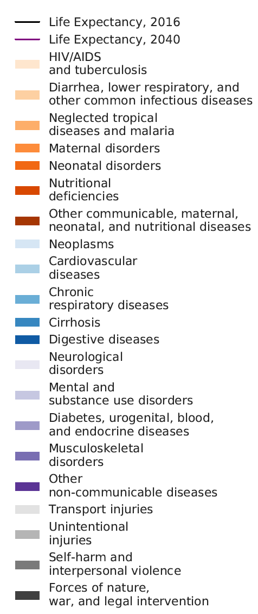
Future Health Scenarios
Global life expectancy at birth
Many investment decisions with long-run payoffs such as R&D, health workers, hospitals, and other infrastructure need some quantified scenarios for the future.
Scenarios can also identify challenges that may become more important in determinants of health in the future
Provide insights into the implications of health change for health and social protection systems.
Identify and mitigate risks for future health.

Slide 43
Thank you!
For more information please visit: www.healthdata.org/

