Slide 1
Mapping existing and potential infection risk zones of yellow fever worldwide
Bobby Reiner and Freya Shearer
April 17th, 2018
6th Annual IDM Modeling Symposium

Slide 2
Outline
Estimating yellow fever vaccination coverage
  Data collation & data issues
  Age cohort models
  Results
Estimating yellow fever infection risk zones
  Data collation
  Spatial model
  Results
Notes:
Something we’re experimenting with.
Search terms included things like: “Global Burden of Disease,” “Institute for Health Metrics and Evaluation,” "Institute of Health Metrics and Evaluation,” “IHME,” "Global Burden,” "Burden of Disease,” "GBD 2010," "GBD 2013,“ and "GBD study“
The list of countries includes both highly developed and less developed countries, such as the US, South Africa, Thailand, Peru, and Kenya.
We excluded “burden of disease/GBD” search terms from the WHO website and only searched for IHME/Institute for Health Metrics and Evaluation

Slide 3
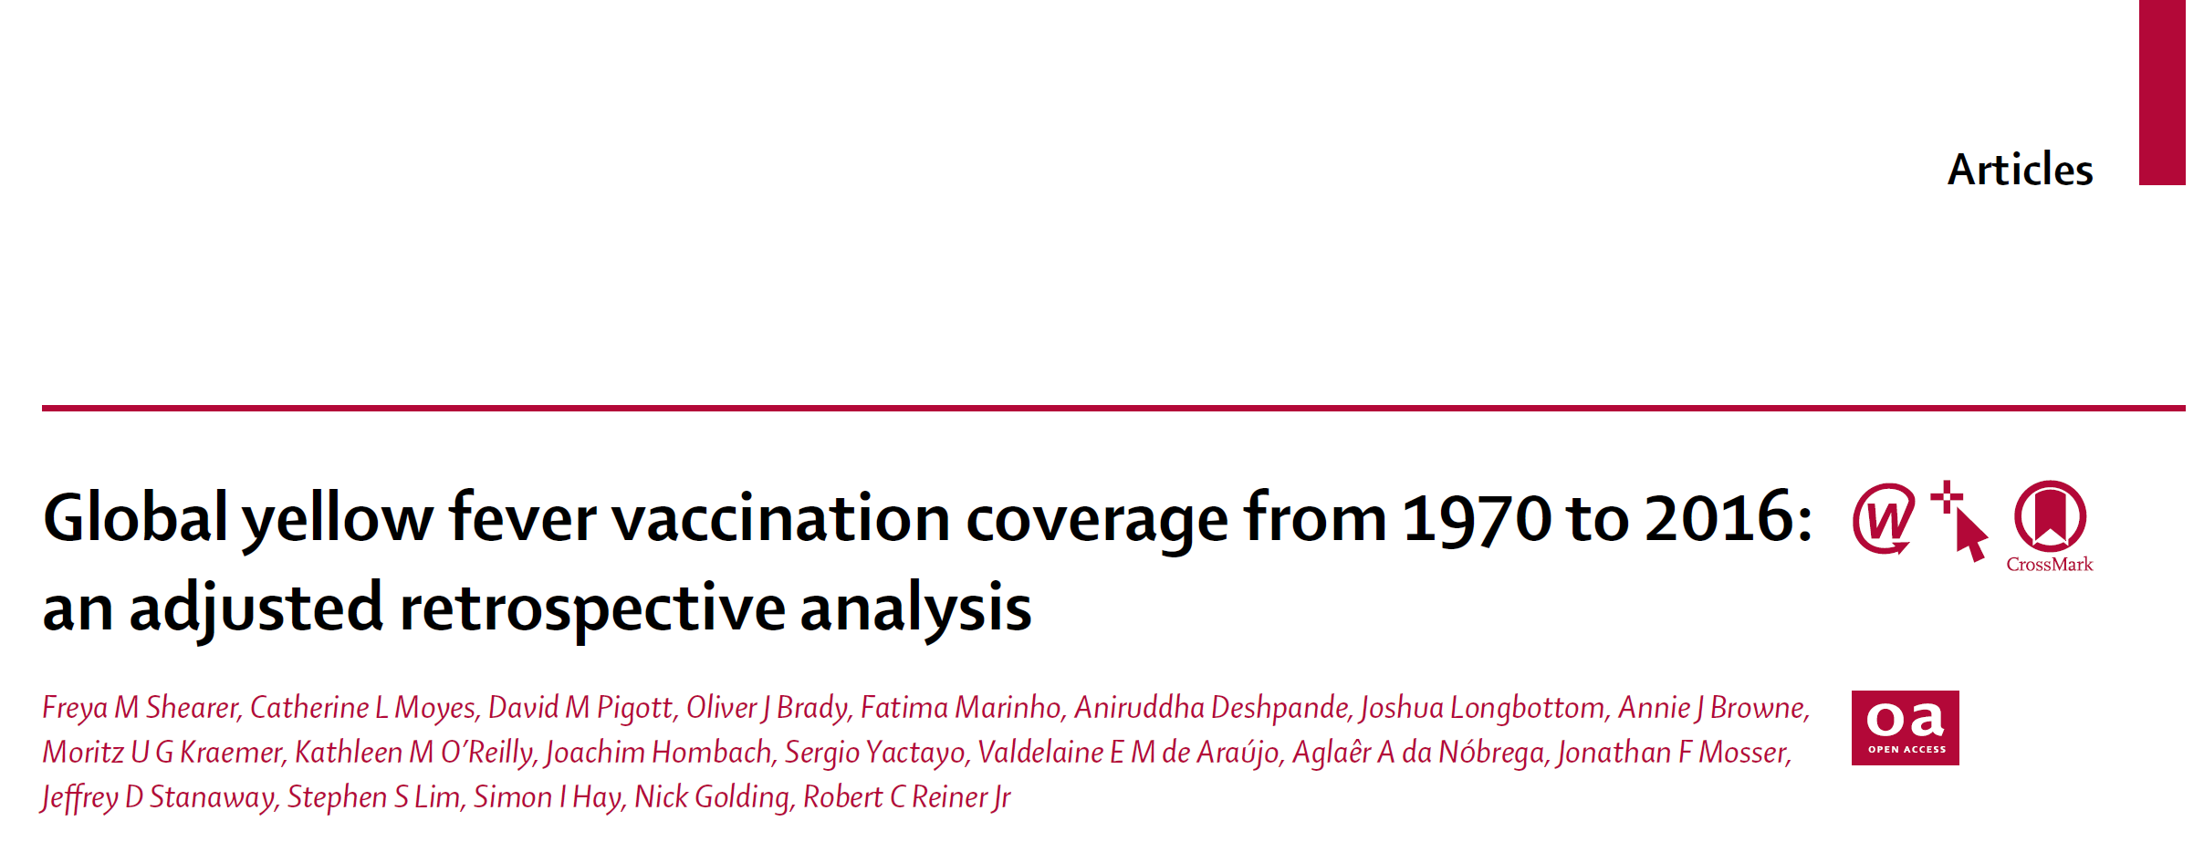
Estimating yellow fever vaccination coverage

Slide 4
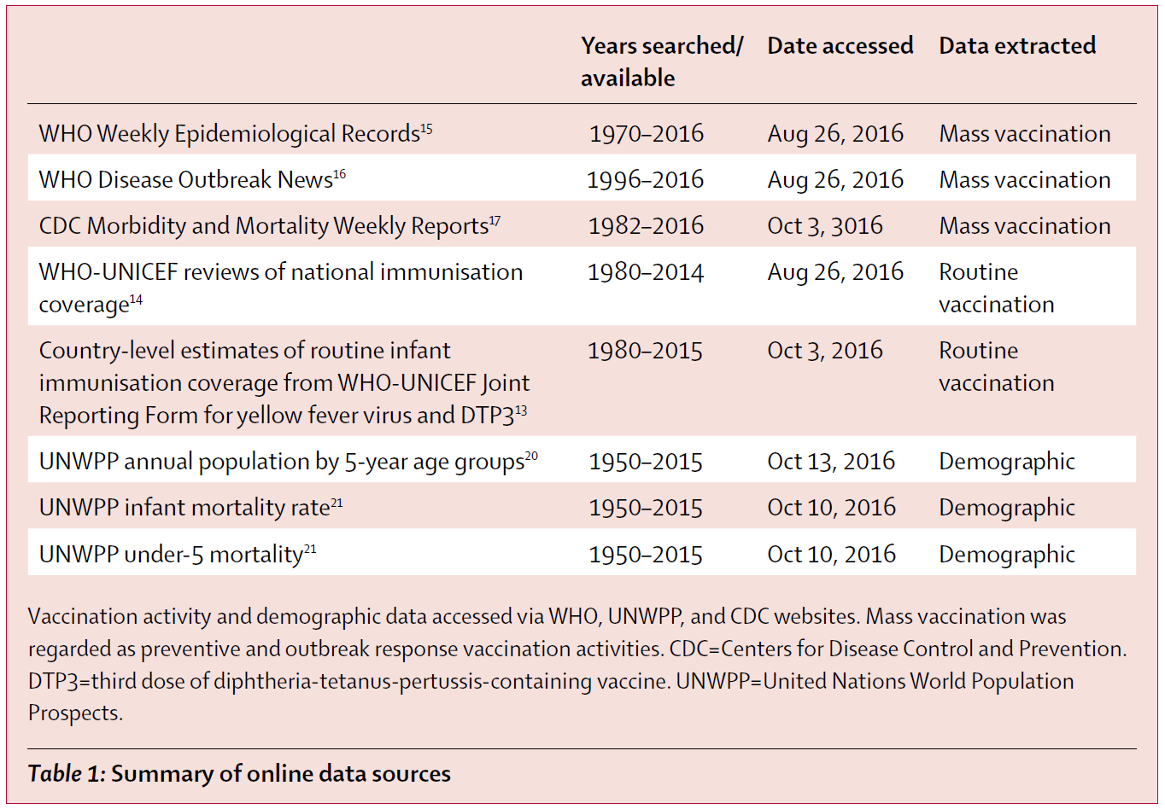
Estimating yellow fever vaccination coverage
Data collation
A systematic literature search was used to identify
  Routine vaccination
  Mass preventative campaigns
  Outbreak response campaigns
  Traveler vaccination
Data on age range of vaccination was tracked
When available, spatial extent was recorded
Non-survey data was adjusted for biases

Slide 5
Estimating yellow fever vaccination coverage
Data collation
The Brazilian national immunization program information system provided us with much more detailed data
  Spatial scale: Admin 2
  Temporal scale: 2006-2015
  Age bins:
    1 year bins from 0-4
    5 year bins from 5-14
    15 to 59
    60+
We assumed this data incorporated both routine and mass vaccination

Slide 6
Estimating yellow fever vaccination coverage
Data issues
When more vaccine doses were said to have been distributed than there were people in the population (after bias correction), we set doses to the population
When age was omitted, we assumed all ages were equally likely
When age was listed as “children”, we assumed age was < 5
There was almost always no information on which people/children were vaccinated

Slide 7
Estimating yellow fever vaccination coverage
Age cohort models
Using age, time, and location-specific vaccination coverage and population, we tracked each age cohort (from 0 to 99 years) in every district through time
  Started in 1871 to track coverage of individuals
We assumed mortality rate for vaccinated and unvaccinated individuals was the same
We assumed there was no movement ☹

Slide 8
Estimating yellow fever vaccination coverage
Age cohort models
It was unclear (and unlikely) if vaccination campaigns only targeted those who had not previously been vaccinated. We developed three vaccination scenarios
  Targeted – Vaccination history was taken into account and only unvaccinated individuals received vaccine [most optimistic scenario]
  Untargeted, unbiased – Vaccination history was not taken into account, but all individuals are equally likely to have received the vaccine
  Untargeted, biased – Vaccination history was not taken into account and those who had already been vaccinated were more likely to receive vaccine than unvaccinated individuals [most conservative scenario]

Slide 9
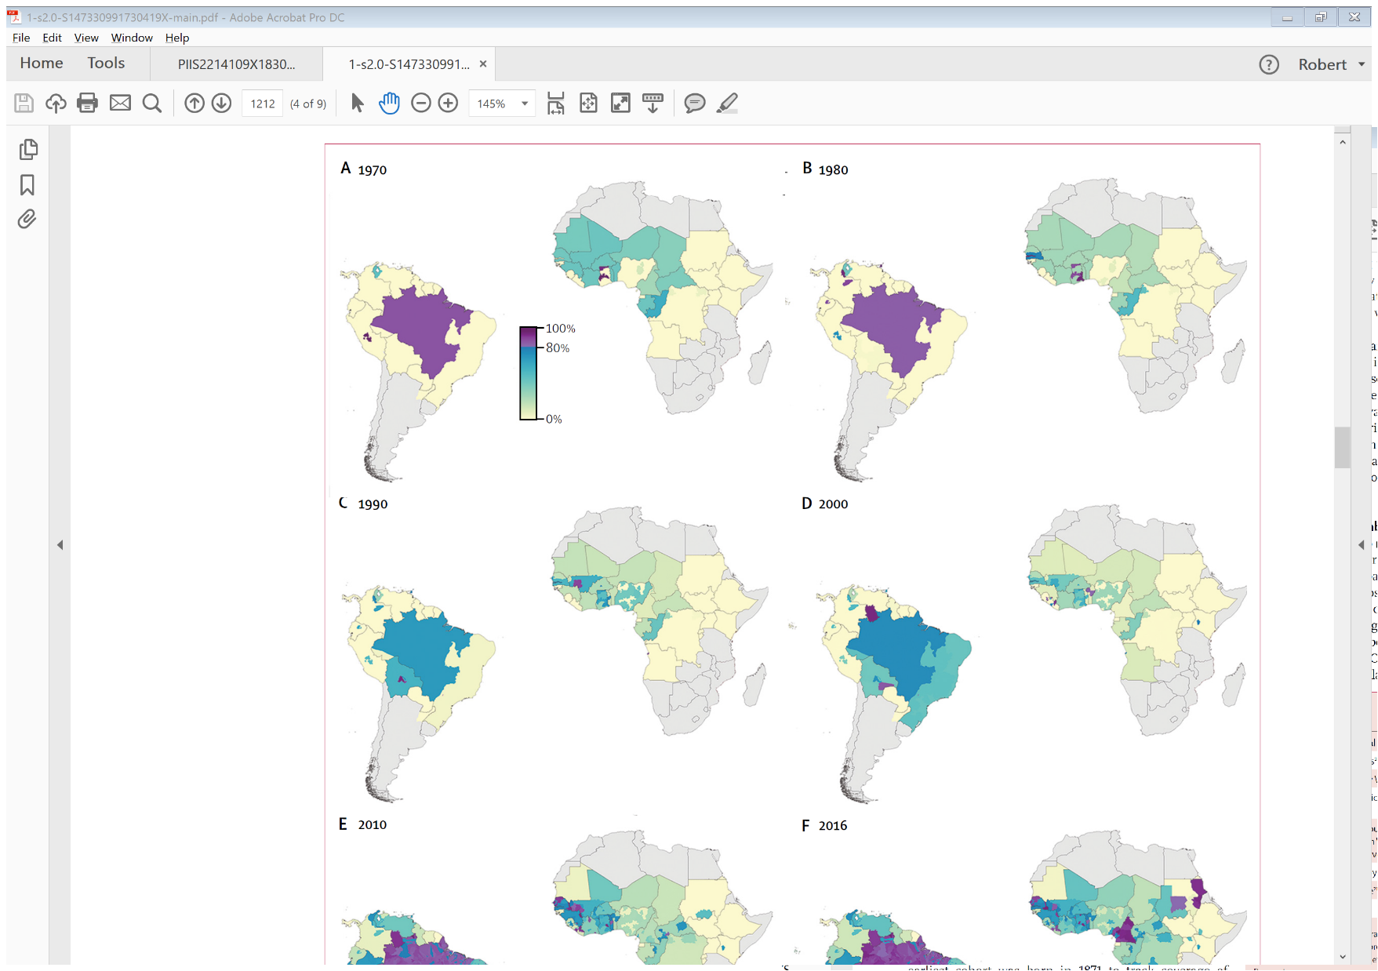
Estimating yellow fever vaccination coverage
Results
Untargeted, unbiased vaccine strategy

Slide 10
Estimating yellow fever vaccination coverage
Results
Untargeted, unbiased vaccine strategy

Slide 11
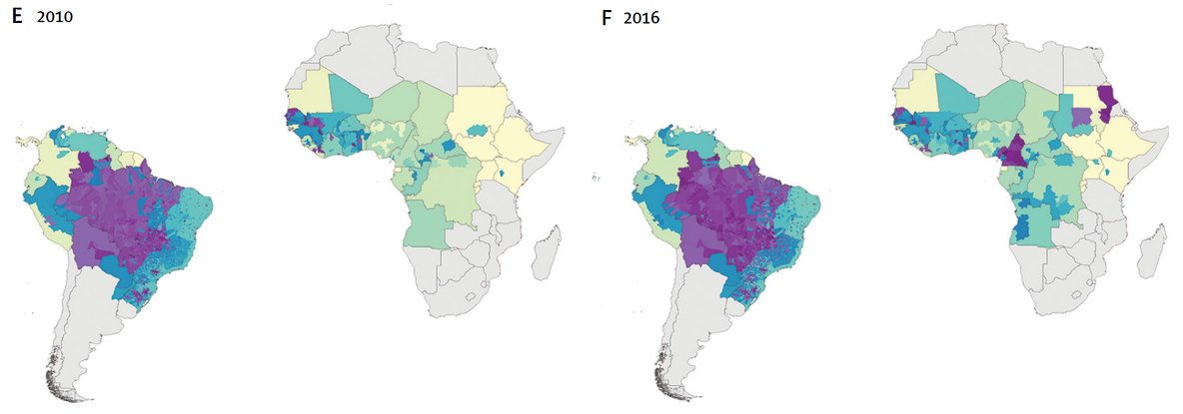
Estimating yellow fever vaccination coverage
Results
Untargeted, unbiased vaccine strategy

Slide 12
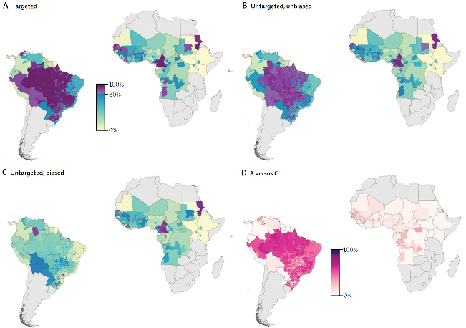

Slide 13
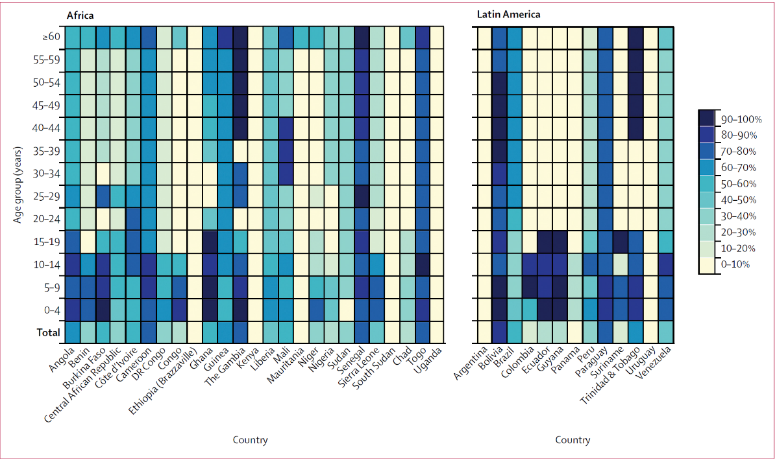
Estimating yellow fever vaccination coverage
Results
2016 Untargeted, unbiased vaccine strategy

Slide 14
Estimating yellow fever vaccination coverage
Results
We calculated the estimated number of individuals that still need the vaccine to achieve a population coverage threshold of 80% by district (WHO recommendation)
We further broke this down either overall, or only those who live in an “at risk” district
  Targeted – 529,900,000 individuals overall, 393,700,000 individuals in “at risk” districts
  Untargeted, unbiased – 568,200,000 individuals overall, 412,800,000 individuals in “at risk” districts
  Untargeted, biased – 669,500,000 individuals overall, 472,000,000 individuals in “at risk” districts

Slide 15
Estimating yellow fever vaccination coverage
Results
There is an ongoing outbreak in coastal Brazil. In particular, Mairiporã in São Paulo, Valença and Teresópolis in Rio de Janeiro, and Belo Horizonte in Minas Gerais.

Slide 16
Estimating yellow fever vaccination coverage
Results
There is an ongoing outbreak in coastal Brazil. In particular, Mairiporã in São Paulo, Valença and Teresópolis in Rio de Janeiro, and Belo Horizonte in Minas Gerais.
Municipality | Conservative | Untargeted | Optimistic | Cases (Deaths)
Mairiporã | 8% (68,902) | 41% (36,883) | 58% (21,399) | 61 (21)
Valença | 17% (49,217) | 49% (24,049) | 65% (11,742) | 18 (7)
Teresópolis | 8% (132,560) | 40% (73,137) | 55% (45,451)
Belo Horizonte | 30% (1,273,264) | 72% (206,960) | 95% (0) | 50 (24)

Slide 17
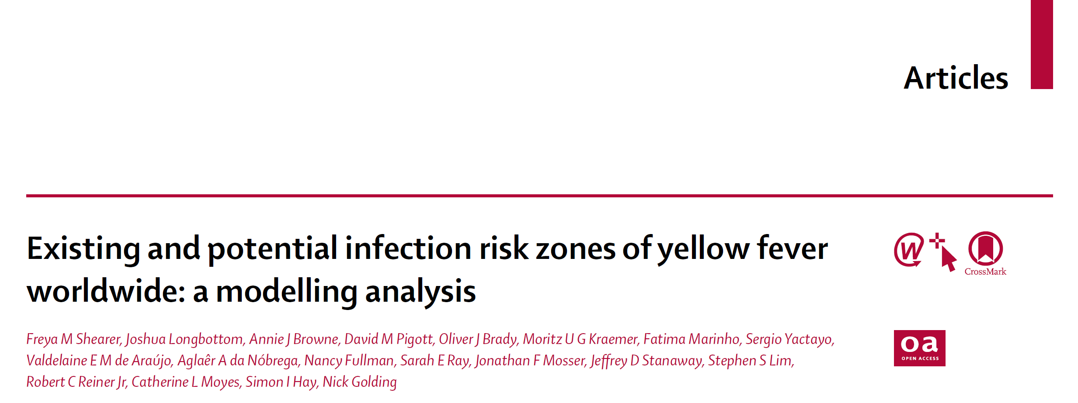
Estimating yellow fever infection risk zones

Slide 18
Estimating yellow fever infection risk zones
Data collation
A database of locations where at least one symptomatic YFV case was reported was assembled.
Locations were recorded either to 5km² resolution (when finer resolution was provided) or to finest administrative unit if nesseasary
Of the 1,154 records in the final dataset:
  402 were PCR confirmed
  444 were serologically confirmed
  308 were reported as “confirmed cases” without specifying the diagnostic test used.
A sensitivity analysis was conducted where only PCR-confirmed data was used

Slide 19
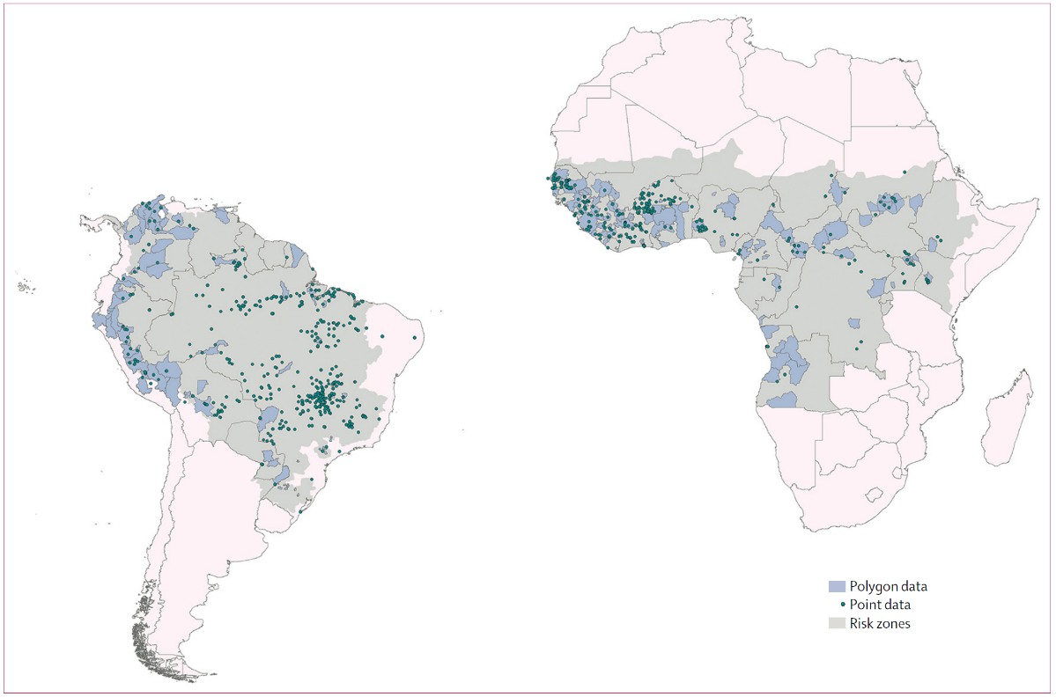
Estimating yellow fever infection risk zones
Data collation
Grey areas represent contemporary risk zones as defined by Jentes et al

Slide 20
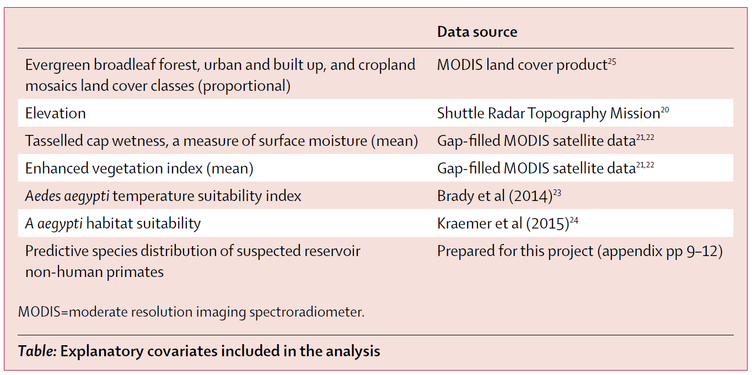
Estimating yellow fever infection risk zones
Spatial model
Our goal was to create a single, temporally static map estimating relative risk of YFV infection
We used 10 spatial covariates
As well as our YFV vaccination coverage estimate
We fit an inhomogeneous Poisson point process model using a Boosted Regression Tree approach

Slide 21
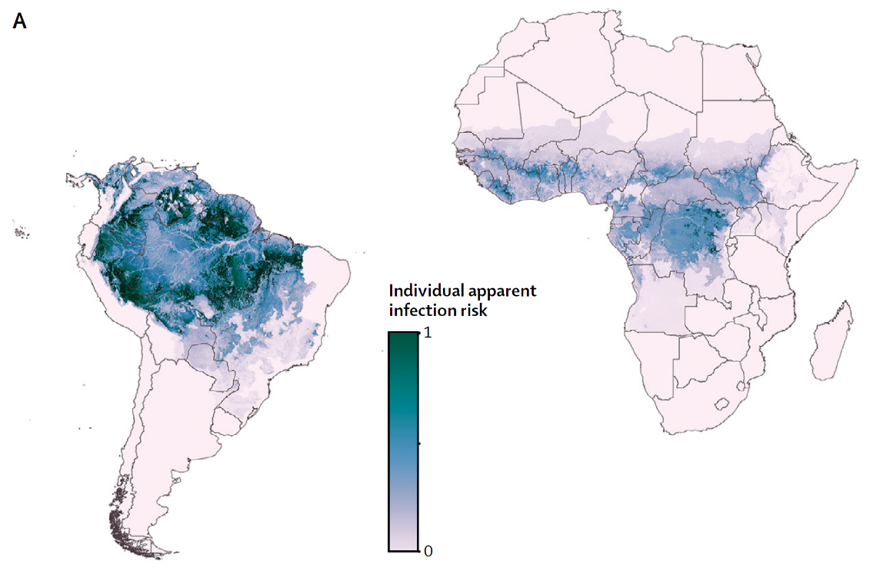
Estimating yellow fever infection risk zones
Results

Slide 22
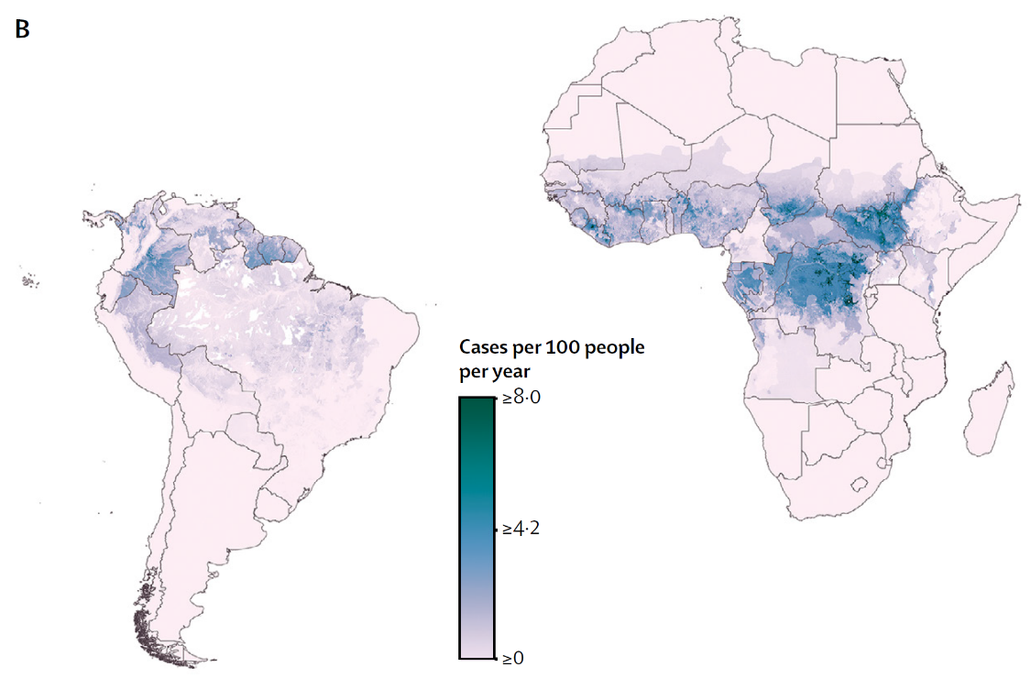
Estimating yellow fever infection risk zones
Results

Slide 23
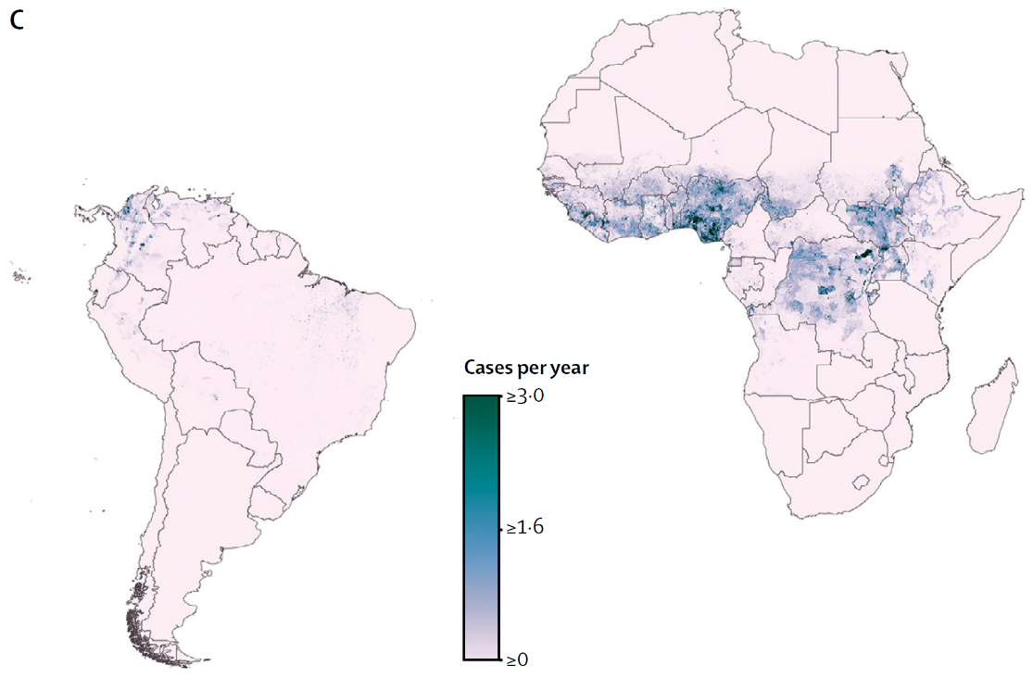
Estimating yellow fever infection risk zones
Results

Slide 24
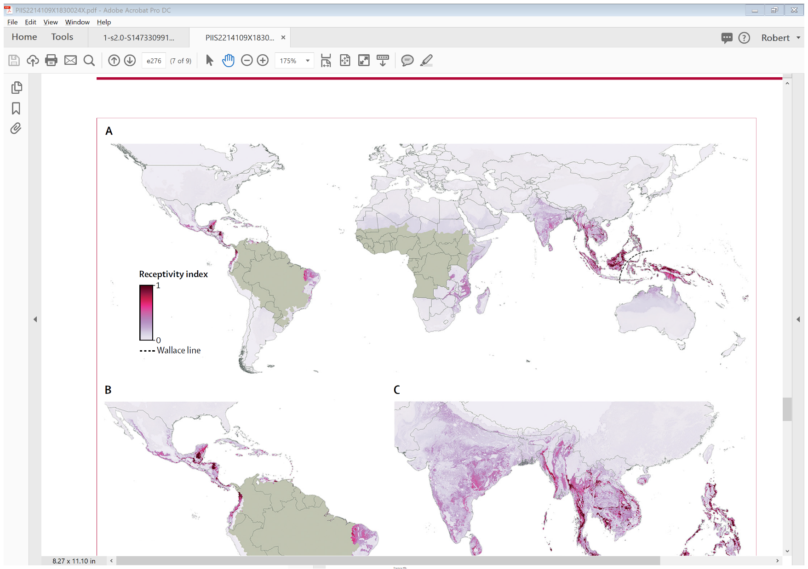
Estimating yellow fever infection risk zones
Results

Slide 25
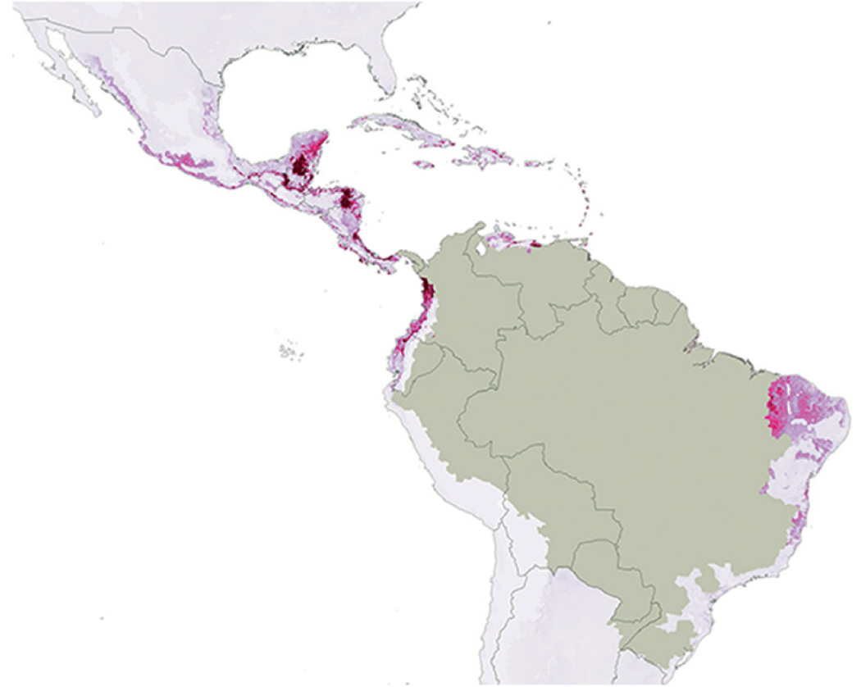
Estimating yellow fever infection risk zones
Results

Slide 26
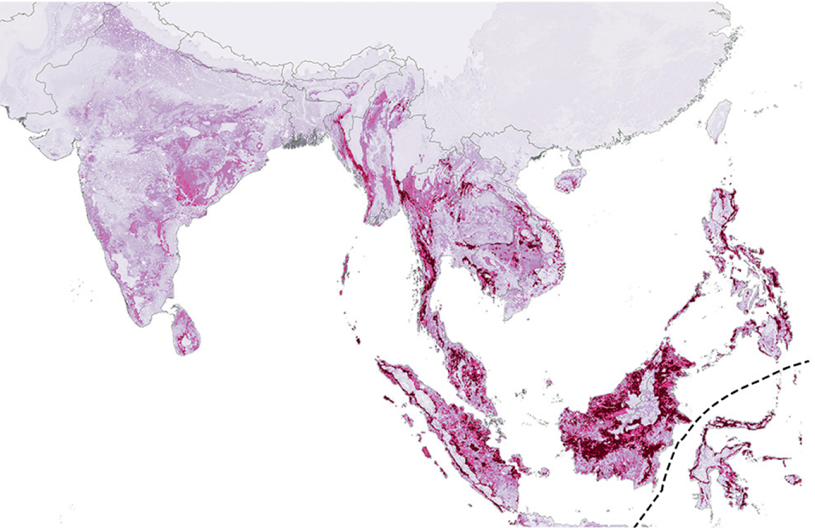
Estimating yellow fever infection risk zones
Results

Slide 27
Conclusions
We estimated that vaccination coverage levels achieved by 2016 avert between 94,000 and 119,000 cases of yellow fever within risk zones, based on either optimistic or conservative vaccination scenarios.
High-quality spatial data on yellow fever are lacking, largely because of diagnostic complexity and limitations of health-care systems in many affected countries.
Although our vaccination map indicated poor coverage in many of the locations experiencing YFV cases in Brazil, some of those same locations were not estimated to have a high likelihood of cases.

Slide 28
Thank you!
Questions?

