Slide 1


Predicting intensities of Zika infection and microcephaly using transmission intensities of other arboviruses
Challenges in the interpretation of dengue vaccine trial results
Isabel Rodríguez-Barraquer
(with Derek Cummings, Luis Mier y Terán Romero, Neil Ferguson, Natsuko Imai)
IDM symposium
April 20, 2017

Slide 2
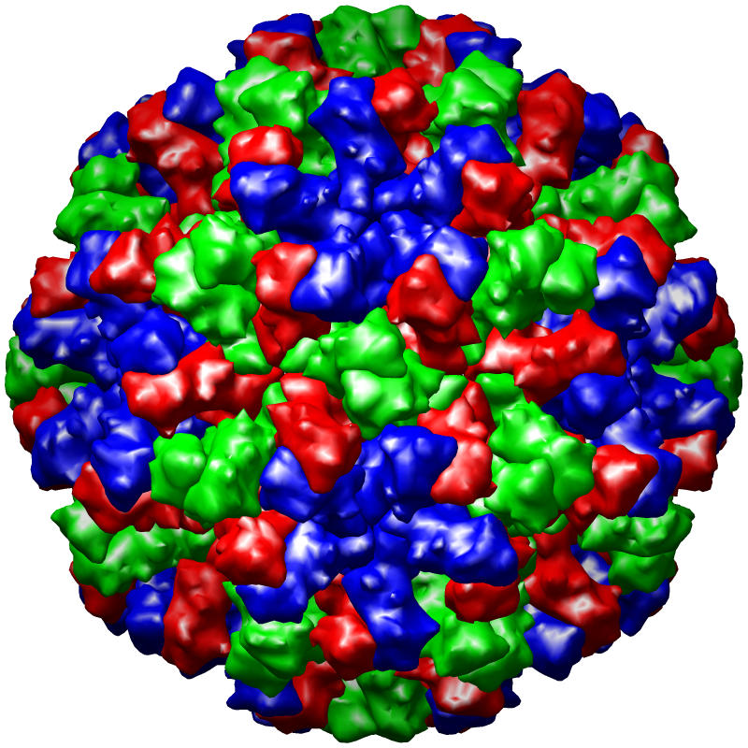
Dengue is the most rapidly spreading arboviral disease
2.05-3.74 billion people at risk
>300 million people infected annually
> 50 million symptomatic infections
2.1 million cases/year of dengue hemorrhagic fever (DHF)
  Mostly in children
Dengue virus model
Notes:
21,000 deaths/year ????

Slide 3
Dengue basics
Flavivirus (4 serotypes)
dengue infection
1st
2nd
3rd
4th
?
?
susceptible
monotypic
life-long
multitypic
Low
High
Prob. severe disease upon infection

Slide 4
The slow path to a dengue vaccine
Risk of immunopathogenicity has slowed down dengue vaccine development significantly
It is thought that a vaccine should induce a balanced protective response against the four dengue serotypes
  To avoid potentially immunopathogenic effects of imperfect vaccines
The first dengue vaccine (CYD-TV*) was recently licensed for use in several countries
There are several other candidates in advanced stages of development
*Live attenuated chimeric Yellow Fever – Dengue tetravalent vaccine (Sanofi-Pasteur)

Slide 5
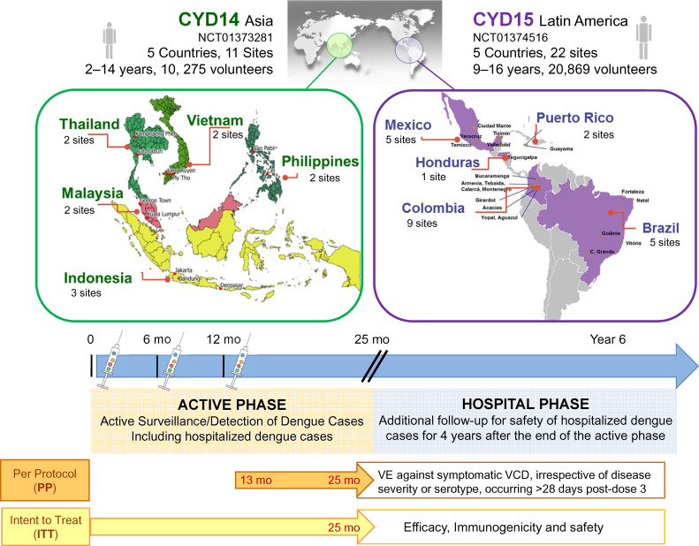
CYD-TV Clinical trials
Guy et al. Vaccine, 2015

Slide 6
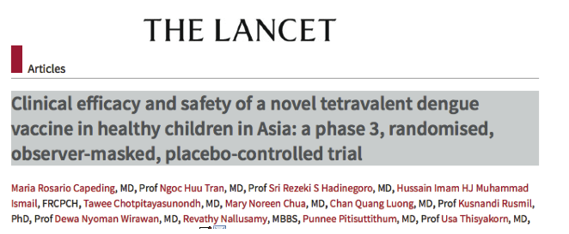
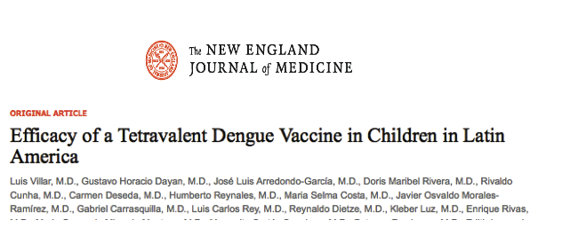
CYD-TV Clinical trials
Primary outcome:
Vaccine efficacy against virologically confirmed symptomatic disease: ~60%
Safety profile similar to that of placebo
Secondary outcomes:
Heterogeneous efficacy by serotype
High efficacy against hospitalization
Heterogeneity by immune status
Heterogeneity by age (lower in younger age groups)
*Live attenuated chimeric Yellow Fever – Dengue tetravalent vaccine (Sanofi-Pasteur)

Slide 7
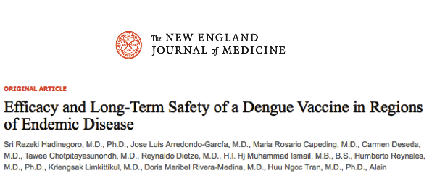
CYD-TV Long term follow-up
Long term follow-up
First year of hospital based long-term follow-up (ongoing)
RR of hospitalization 7.5x higher in children aged 2-5y
Still protective in other age groups but lower protection than before

Slide 8
CYD-TV Long term follow-up

Slide 9
Key Questions
Should a vaccine with these characteristics be licensed and rolled-out?
How would you roll it out?
What would be the potential impact of vaccine with these characteristics at the population level?

Slide 10
Why is modeling necessary?
Results from clinical trials can’t be directly extrapolated to know what is going to happen at the population level
  Different transmission settings
  Direct vs. indirect effects of vaccination
This is particularly true for the dengue vaccine
  Vaccine efficacy against clinical disease is not the same as vaccine efficacy against infection
  Uncertainty about the vaccine mode of action
    Reconciling active phase results vs. hospital phase results
Modeling allows explicit exploration of competing hypotheses about mode of action

Slide 11
Challenges in the interpretation of vaccine trials

Slide 12
Challenges in the interpretation of vaccine trials

Slide 13

Modeling the potential impact of CYD-TV
Flexible compartmental dengue transmission model
  Age-stratified
  4 serotypes
  Seasonality, cross-immunity and cross-enhancement
Fitted to publicly available trial data
  Phase 3 study in Asia
  Phase 3 study in Latin America
  Long-term hospital based follow-up
Considered several competing models of vaccine action

Slide 14
Proposed mode of action of CYD-TV vaccine
Vaccine acts like a silent infection
Unvaccinated
Vaccinated
seronegative
Vaccinated
seropositive
Prob. severe disease upon infection
Low
High

Slide 15
Model fits publicly available trial data well

Slide 16
Simulating the potential impact of vaccine roll-out in different settings
Simulating the impact of CYD-TV introduction
80% coverage
Varied the age of routine vaccination (2-18 years)
Varied the transmission setting (R₀ 1.2 - 5)
  Proportion of children aged 9 years who are seropositive
Looked at proportion of symptomatic/hospitalized cases averted over different time periods (10y and 30y)
Ferguson N*, Rodríguez-Barraquer I*, et al. Science 2016

Slide 17
Different settings have different levels of endemicity
Recife, Brazil
(n=1427)
Pied., Colombia
(n=1248)
Morelos, Mexico
(n=1196)
Rayong, Thailand
(n=1744)
Chennai, India
(n=1000)
Rodriguez-Barraquer et al, PLoS NTDS (2011); Rodríguez-Barraquer et al, AJE (2014); Rodríguez Barraquer et al, PLoS NTD (2015)
Notes:
This figure shows the age-specific seroprevalence curves for the five settings.
The assay used was for all studies was a commercially available indirect IgG Elisa as the serological test, except for the Thai study where we used a neutralization assay that is known to be a bit more sensitive. And while they are all consistent with endemic circulation, they do show significant differences in the seroconversion rates, and hence in the transmission intensity. So these results are suggestive of extremely high transmission in Chennai, and much lower in the mexican setting.
By fitting models to this data we can actually estimate the transmission intensity, and other key transmission parameters such as the Basic Reproductive number

Slide 18
Vaccination could lead to positive or negative impacts
Symptomatic
Hospitalizations
Proportion
averted (30y)
Ferguson N*, Rodríguez-Barraquer I*, et al. Science 2016
Notes:
These figures show the expected 30 years impact of vaccination with this vaccine. In the y axis we have the age of vaccination and on the x axis we have the transmission setting. As I explained before, we decided to define transmission intensity by the proportion seropositive at age 9 years, so lower seropositivity implies lower transmission and higher seropositivity implies higher transmission. . And the colors represented the expected proportion of symptomatic cases averted over a 30 year period on the left and hospitalizations averted to the right.
So what this figure shows is that, In high transmission settings, vaccination is generally associated with modest (20-30%) reductions in both symptomatic disease and hospitalization. For a specific level of transmission, there is an optimal age of vaccination that decreases as transmission intensity increases. However, for both symptomatic and hospitalized disease, negative long-term impacts of vaccine are also possible particulary if used in low transmission settings if very young age groups are targeted. And the division between positive and negative effects is delineated by the dashed contours. And these results make sense, because it is li kely in low transmission settings substantial fraction of seronegative recipients would not have normally been expected to experience a natural secondary infection and this vaccine is priming them so that this infection behaves as a secondary one.

Slide 19
Overall vaccine impact hides enormous heterogeneity
Seronegative
Proportion of
hospitalizations
averted (30y)
Seropositive
Ferguson N*, Rodríguez-Barraquer I* et al. Science 2016
Notes:
If we focus on the hospitalized results, and we stratify them by seropositivity at the time of vaccination, we see population level impacts of vaccination hide enormous heterogeneity in benefits and risk at the level of the individual recipient: seropositive recipients always gain a substantial benefit from vaccination (>90% reduction in the risk of hospitalized dengue), while seronegative almost recipients experience negative impacts (i.e. an increased risk of hospitalized dengue). And again, these results make sense because the vaccine is priming them to experience a more severe infection. And these findings raise fundamental issues regarding the individual vs. population benefits of vaccination, because even if the overall impact of vaccination is a reduction in hospitalized , seronegative individuals will almost always experience increased risk of hospitalization.

Slide 20
What proportion should be seropositive to avoid negative impacts?
Rodríguez-Barraquer I*, Ferguson N* et al. Science 2016
Notes:
And to emphasize this point, this figure shows the proportion of the target age groups that would need to be seropositive to avoid negative impacts. You can avoid overall negative impacts by ensuring that over 30% of the target age-group is seropositive, but you need much higher levels to ensure that risks in seronegative recipients are not increased.

Slide 21
WHO’s Comparative modeling working group (CMDVI)
Group | Model type | Fitted to trial | Vectors | Trans ∝ symptoms | Demography
Sanofi Pasteur | Deterministic non-spatial | Yes (both, pre LTFU) | Yes | Yes | Brazil
Johns Hopkins + Univ Florida | Deterministic non-spatial | Yes (both) | Yes | Yes | Brazil
Imperial College London | Deterministic non-spatial | Yes (both) | Yes | Yes | Brazil
Duke Univ | Deterministic non-spatial | Calibrated | No | No | Brazil
Univ Florida | Stochastic spatial | No | Yes | Yes | Mexico
Univ Western Australia | Stochastic spatial | No | Yes | No | Thailand
Notre Dame Univ | Stochastic spatial | No | Yes | Yes | Peru
Exeter+Oxford Univs | Stochastic spatial | Yes (CYD14) | Yes | No | Generic (65 y mean lifespan)

Slide 22
Reference scenario: cases averted (%) over 30 years
Routine vaccination at 9y with 80% coverage. All groups show negative impacts in SP9=10%; more mixed results for SP9=30% setting. For SP9=50% and above, no negative impacts at the population level predicted.
Jit et al, PLoS Med, 2016

Slide 23
WHO SAGE on immunization: April 12-14 2016
SAGE recommended the use of the vaccine only in geographic settings with high endemicity (70% or greater seroprevalence in vaccinated group)
Not recommended if seroprevalence is <50%.
Full text available at: http://www.who.int/immunization/policy/sage/en/

Slide 24
Characterizing the global dengue epidemiology
Areas environmentally
suitable for dengue transmission
(prob. occurrence >.2)
Adapted from Bhatt et al, Nature 2012 and
Imai et al, PLoS NTDs, 2014
Notes:
And we have also worked collecting age-specific case data from surveillance systems from around the world.

Slide 25
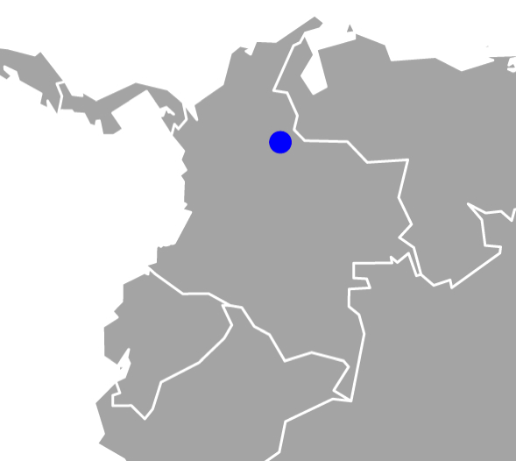
Large heterogeneity in dengue transmission
urban
rural
Notes:
Piedecuesta population 100,000 (50% urban 20%rural)
Bucaramanga population 500,000 (12 miles away)

Slide 26
Using case data to estimate seroprevalence
Thailand
Philippines
Yes
No
Brazil
Colombia
Mexico

Slide 27
Predicted target vaccination age (70% seropositivity)
Thailand
Philippines
Brazil
Colombia
Mexico

Slide 28
How to target vaccination?
Thailand
Philippines
Mexico
Brazil

Slide 29
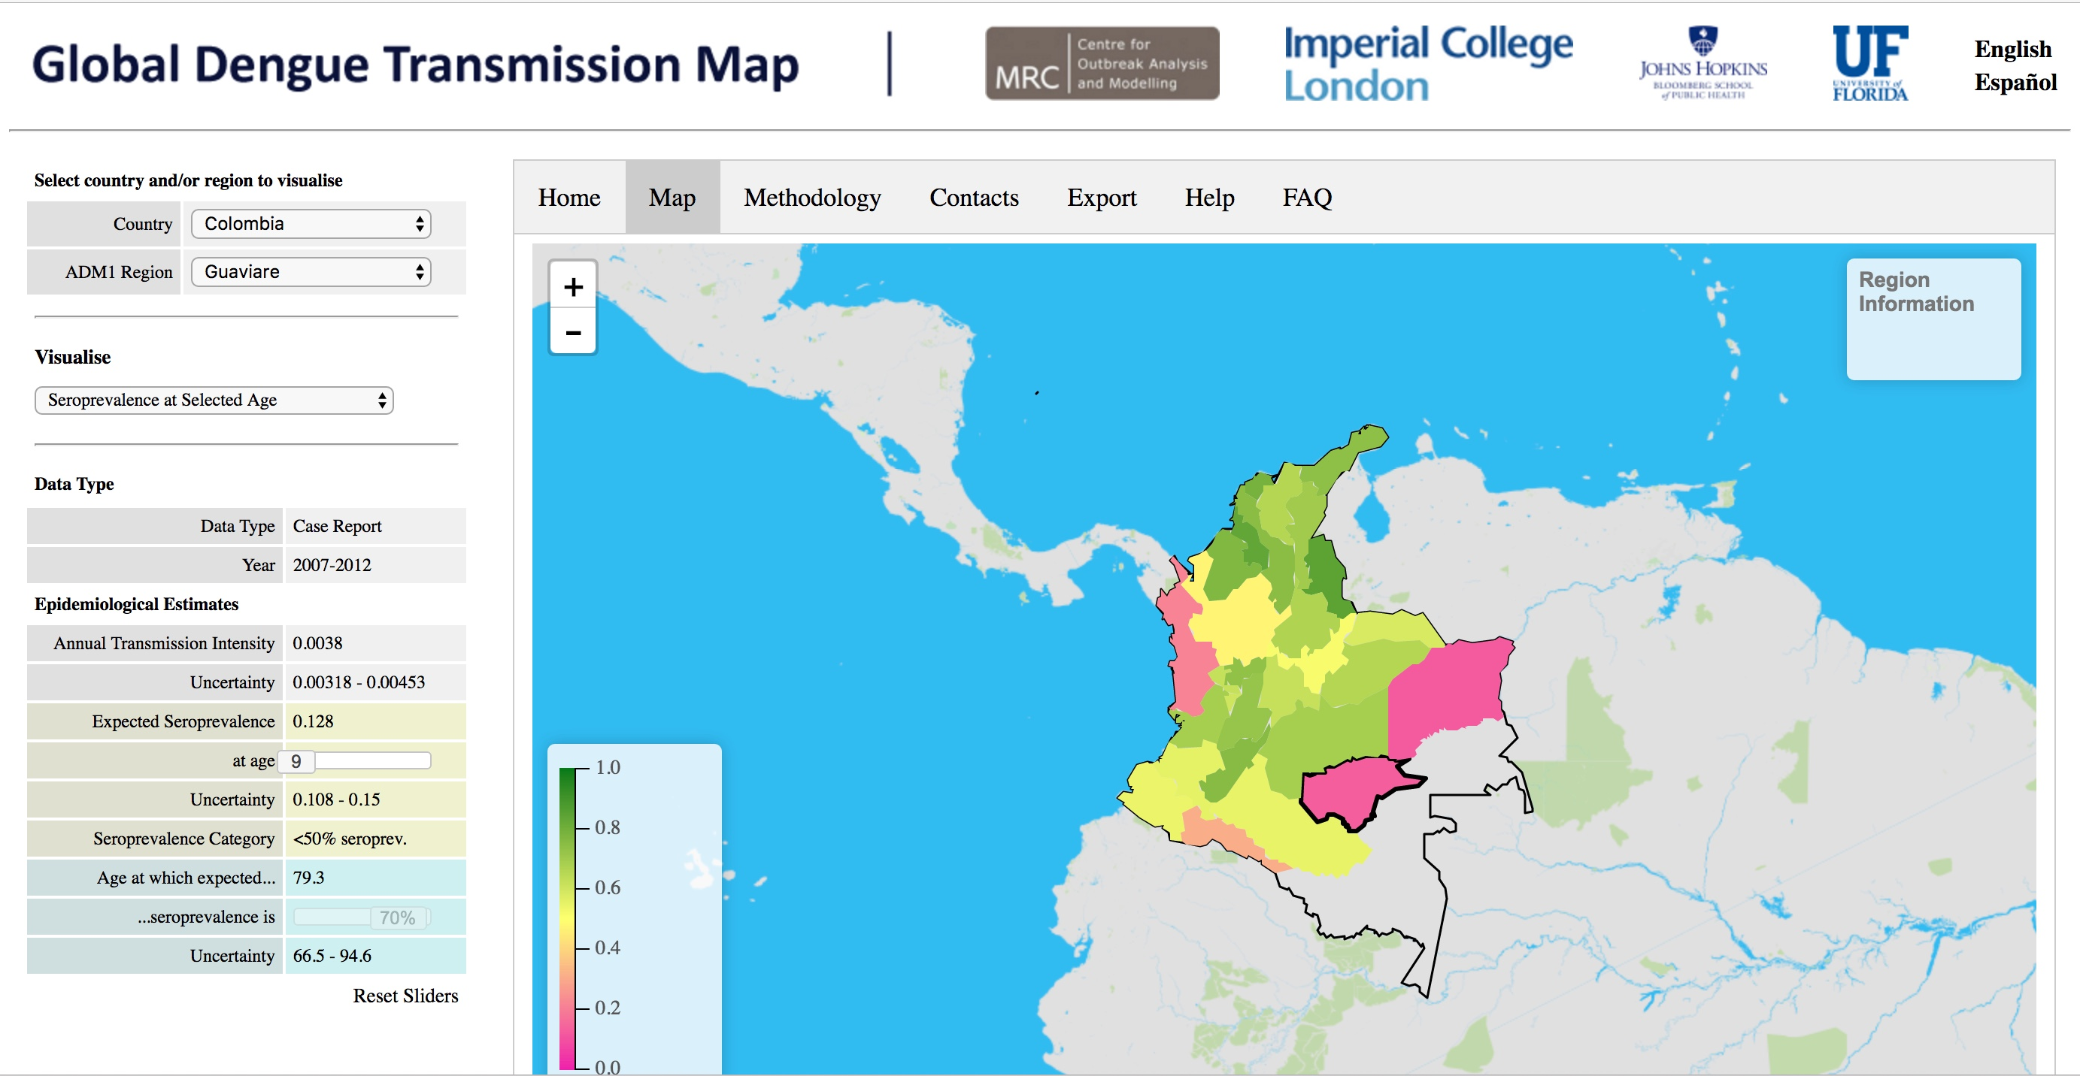
Dengue transmission map: Web tool

Slide 30
Summary and conclusions
Lots to learn about this and other dengue vaccines!
Routine immunization with CYD-TV vaccine predicted to reduce dengue disease by 20-30% moderate-to-high transmission settings
Vaccine not beneficial in low transmission settings
  Potentially harmful!
Trade-off between individual and population benefits
Countries should target vaccine carefully
  Vaccinating seropositives only should be considered as an option
Other vaccine candidates that are being developed could behave in a similar way

Slide 31











Molecular and computational infectious disease epidemiology
This could be you!
Notes:
Isabel and I are looking for postdocs to join our group at UCSF and the Chan Zuckerberg Biohub,
where we study transmission epidemiology and immunology of malaria, dengue, and other infectious diseases by combining
high quality field work with laboratory and computational tools

Slide 32
Should we focus on vaccinating only seropositives?
Proportion of
hospitalizations
averted
Ferguson N*, Rodríguez-Barraquer I* et al. Science 2016

Slide 33
Acknowledgements
Derek Cummings
Luis Mier-y-Terán-Romero
Henrik Salje
Neil Ferguson
Natsuko Imai

Slide 34
Questions?
(isabelr@jhu.edu)

Slide 35
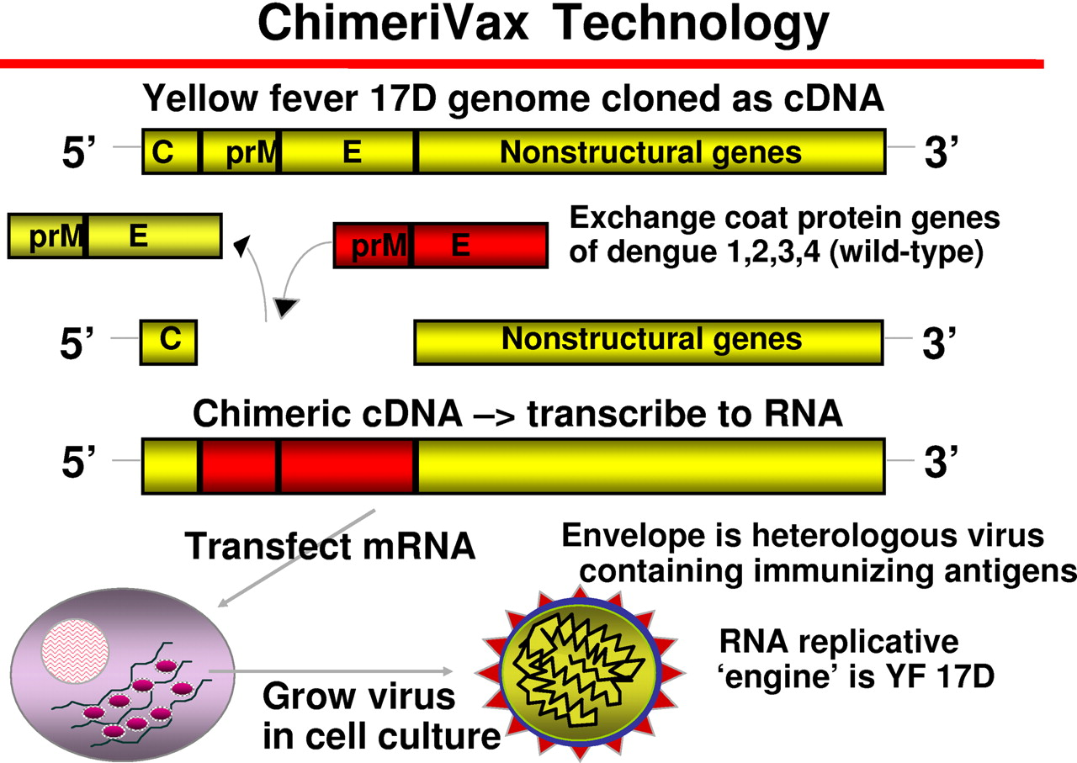
Sanofi Pasteur CYD vaccine

