Slide 1
Current status of PCV alternate dosing strategy studies
Gail L. Rodgers, MD

Slide 2
Pneumococcus Strategy
Goal: Reduce the burden of pneumococcal infections
Vaccine Development |  | Evidence Generation for Sustainable Pneumococcal Immunization Programs
 |  | Assessment of PCV Impact | Alternate Dosing Strategy
Develop lower cost vaccines that provide equal or great protection of the currently available PCVs |  | Select Gavi Countries | 1+1 vs. 2+1 and 3+0
 |  |  | Toddler dose only: 0+1, 0+2
 |  | PCV10 and PCV13 | PCV10 and PCV13
 |  | IPD, Pneumonia, NP Carriage | Immunogenicity and NP Carriage
 |  | Direct and Indirect Effects, Serotype Replacement | Evaluate in: HIC (UK) and LMICs (India, SA, Vietnam)
 |  | Evaluation of Administrative Databases in LMICs

Slide 3
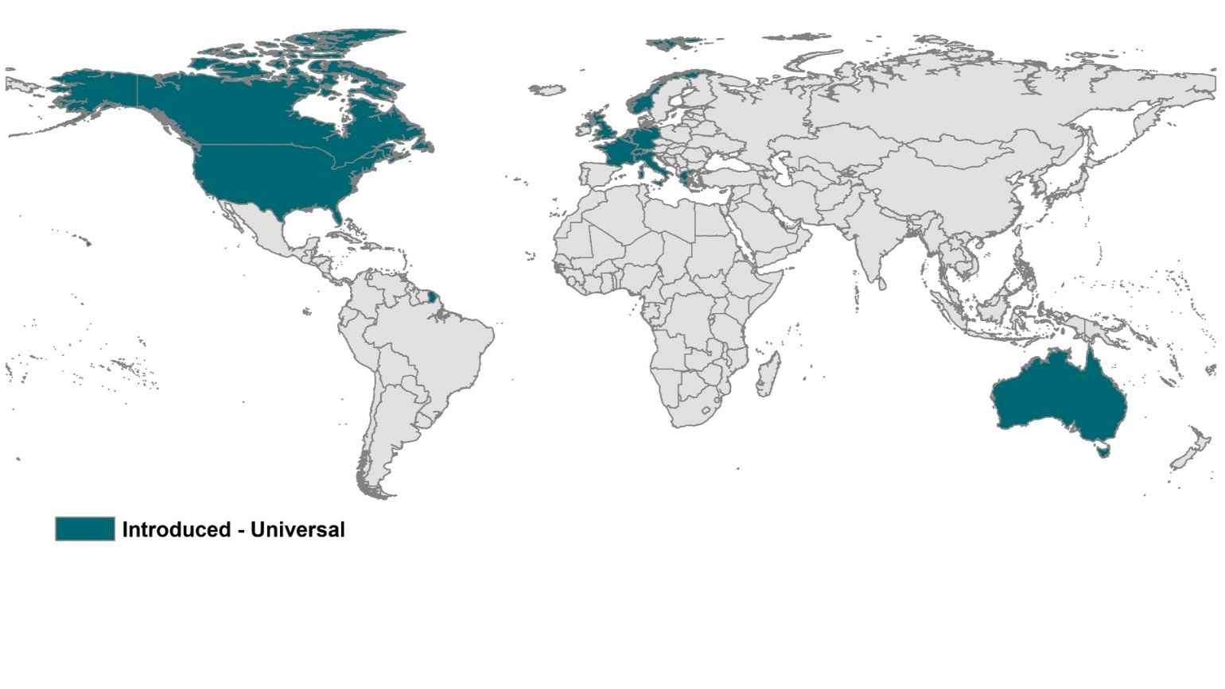
Global PCV Introduction Status - 2006
Source: IVAC/JHSPH – VIMS Report Dec. 2013

Slide 4
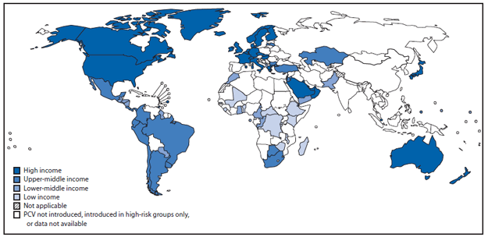
Global PCV Introduction Status -2012
MMWR 2013;62:308-11.

Slide 5
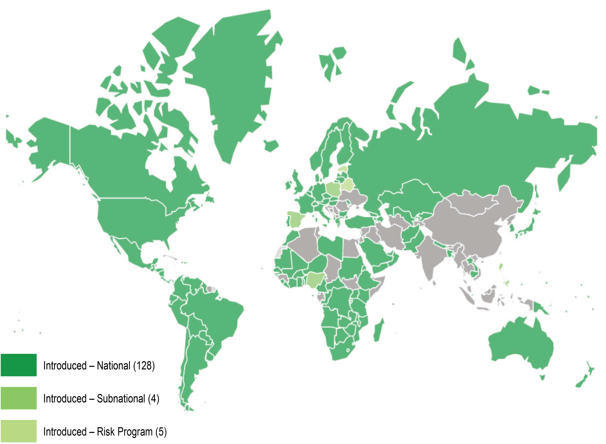
Global PCV Introduction Status - 2016
(130)
Source: IVAC VIEW-Hub and Gavi

Slide 6
Hib UPTAKE in HIC Vs LIC
Source: IVAC/JHSPH – VIMS Report Dec. 2013
Notes:
Gambia, Guyana, and Rwanda switched from PCV7 to PCV13 in 2011.
-Dashed lines: projections

Slide 7
PCV UPTAKE FASTEST EVER IN LOW Income countries
Source: IVAC/JHSPH – VIMS Report Dec. 2013
Notes:
Gambia, Guyana, and Rwanda switched from PCV7 to PCV13 in 2011.
-Dashed lines: projections

Slide 8
Global PCV Introduction Status - 2016
Gavi | Global
National Introductions (as of Dec 2016)
57 (78%) | 139 (72%)
Surviving Infants have access to PCV
41M (51%) | 69M (52%)
Surviving Infants immunized with PCV
29M (35%) | 53M (37%)
Top 10 PCV countries with most unimmunized/underimmunized infants
Nigeria, Pakistan, Bangladesh, DRC, Uganda, Ethiopia, Angola, Nepal, Kenya, Afghanistan | Philippines, Venezuela, Poland, South Africa, U.S., Dominican Republic, Brazil, Spain, Mexico, Argentina
(130)
Source: IVAC VIEW-Hub and Gavi

Slide 9
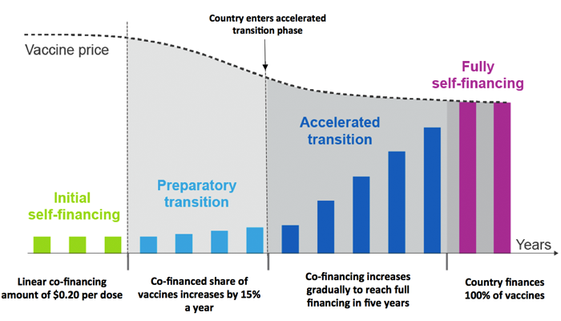
Gavi transition process: eligibility
$1,580* on average over the previous three years
Above $1,045* but at or below $1,580
* GNI per capita (as per World Bank) threshold in 2015

Slide 10
Gavi Transition Process: Country GROUPINGS as of 01/01/17
Variable duration
Variable duration
Five year ramp up period
Initial self-financing (32)
Preparatory transition phase (15)
Accelerated transition phase (16)
Fully self –financing (10)
Eligible for new vaccine and HSS support
Eligible to apply for new support in 2016
No longer eligible to apply for new support
Fully self-financing (fully transitioned)
Afghanistan
Benin
Burkina Faso
Burundi
CAR
Chad
Comoros
Congo DR
Djibouti
Eritrea
Ethiopia
Gambia
Guinea
Guinea-Bissau
Haiti
Korea DPR
Madagascar
Malawi
Mali
Mozambique
Nepal
Niger
Liberia
Rwanda
Senegal
Sierra Leone
Somalia
South Sudan
Tanzania
Togo
Uganda
Zimbabwe
Bangladesh
Cambodia
Cameroon
Cote d’Ivoire
Kenya
Kyrgyzstan
Lesotho
Mauritania
Myanmar
Pakistan
Sao tome and Principe
Sudan (Republic of)
Tajikistan
Yemen
Zambia
Ghana
India
Lao PDR
Solomon Islands
Nigeria
Angola
Armenia
Azerbaijan
Bolivia
Congo Rep.
Georgia
Timor-Leste
Vietnam
Uzbekistan
PNG
Nicaragua
Bhutan
Cuba
Guyana
Honduras
Indonesia
Kiribati
Moldova
Mongolia
Sri Lanka
Ukraine
Source: Gavi, The Vaccine Alliance
Notes:
preparatory transition (phase 1), when the country’s 3-year average GNI per capita exceeds the World Bank low-income threshold, but remains below the threshold for Gavi eligibility threshold (i.e. between $1025 and $1580
co-financing requirement steadily increases at 15% annually from the beginning price of $0.20 per dose.
accelerated transition (phase 2), Once GNI per capita exceeds the Gavi threshold of $1580,
after one year they cannot apply for any new vaccine support.
responsible for 20% of the difference between the current co-financing amount and the projected vaccine price in five years.
co-financing requirement increases linearly over four years to reach 100% of the projected cost per dose before Gavi support comes to an end.

Slide 11
Alternate dosing strategy studies
Countries
Study Design
Individual vs. Community Randomized
Both Currently Licensed Vaccines
Dosing Schedules
Income
Region
Endpoints
Immunogenicity
NP Carriage
Pneumonia
PCV Experience
Safety

Slide 12
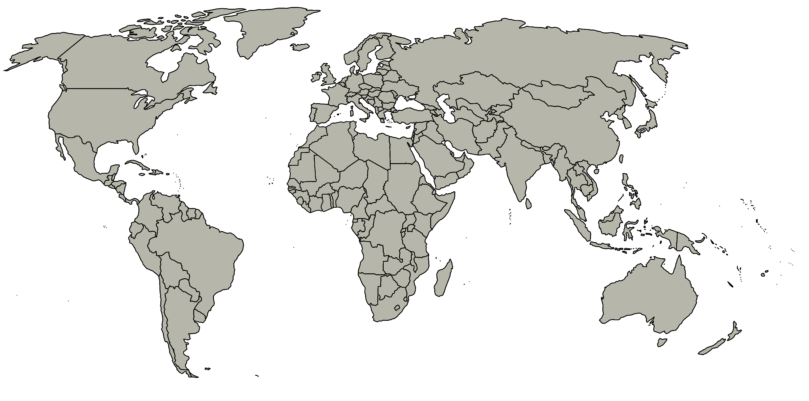
BMGF Sponsored Alternate PCV Dosing Studies
United Kingdom (PI: David Goldblatt)
Individual randomization
PCV13
2+1 vs. 1+1 (2mo + 12 mo)
Endpoints: immunogenicity, NPC
Results: Sept 2017
India (PI: Ashish Bavdekar)
Individual randomization
PCV10 and PCV13
3+0 and 2+1 vs. 1+1 (6 +9mo)
Endpoints: Immunogenicity, NPC
Results: May 2019
Vietnam (PI: Kim Mulholland)
Individual randomization
PCV10 and PCV13
3+1, 3+0, 2+1,1+1, 0+1
Endpoints: Immunogenicity, NPC
Results: 4Q2019
South Africa (PI: Shabir Madhi)
Individual randomization
PCV10 and PCV13
2+1 vs. 1+1 (6 or 14 wks +9mo)
Endpoints: immunogenicity, NPC
Results: 2Q2019
Vietnam (PI: Lay-Myint Yoshida)
Cluster randomized
PCV10: 3+0, 2+1,1+1, 0+1
Endpoints: NPC, pneumonia
Results: 1Q2021

Slide 13
PCV Dosing Recommendation Process
WHO – SAGE Recommendation
Evaluate
3+0 & 2+1
? Preferential rec for 2+1
Evaluate data on 1+1
? Move to 1+1
Notes:
Our grantmaking process starts with an idea or concept that ties directly to our strategic priorities. The length of time for each stage varies significantly based on such factors as the capacity and geographic location of the applicant organization, and the complexity of the grant.
We engage with our grantees and partners in a spirit of trust, candid communication, and complete transparency. We encourage our grantees to communicate openly about the grant progress, our partnership, and any questions or concerns that arise during the course of the grant. We commit to doing the same.
Stage 1 – Generate Ideas and Identify Applicants
Program staff identifies ideas and concepts in support of our strategic priorities. We shape these through conversations with practitioners, researchers, policymakers, and other resources in the field. When an idea or concept is sufficiently formed, a program officer begins outreach to potential applicants, using one of three approaches:
direct solicitation
letter of inquiry (LOI)
request for proposal (RFP)
Stage 2 – Develop and Analyze Proposal
We provide relevant guidelines and templates for applicants to use when developing a proposal and budget. The program officer reviews the proposal and budget with internal and external experts, and works with the applicant to integrate recommended changes.
Stage 3 – Determine Funding Decision and Develop Grant Agreement
When a grant proposal is ready for funding review, the program officer prepares a proposal analysis and recommendation (PAR) for review by a foundation executive who approves or declines the grant. If the grant is approved, we prepare a grant agreement that includes intended results, payment schedule, and reporting requirements.
Stage 4 – Manage Grant and Measure Progress
In partnership with the grantee, the program officer develops a plan for ongoing management of the grant. The grantee is responsible for tracking the work done in the field, and keeping us informed through submission of periodic reports. The program officer is responsible for monitoring the performance of the grant and working to understand key learnings—through conversations with the grantee, review of progress reports, and site visits.

Slide 14
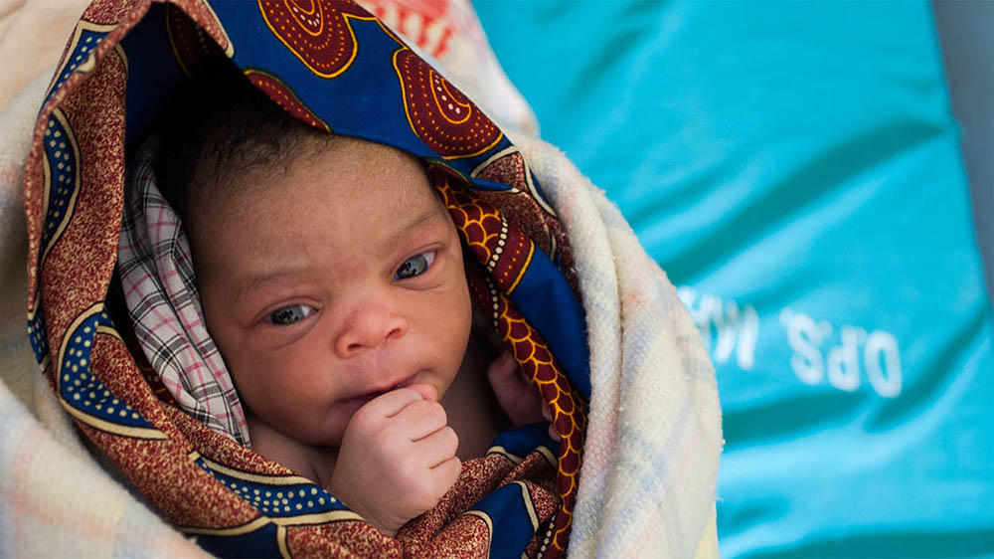

Slide 15
United kingdom
Assessment of antibody responses and NP carriage in UK infants given a reduced priming schedule of 13 valent pneumococcal conjugate vaccines (PI: David Goldblatt)
Rationale | PCV experience (2+1) Individual randomization POC/ Provides credibility for other countries
Vaccine | PCV13
Dose Schedule | 2+1 (2, 4 + 12 mo) vs. 1+1 (3 + 12 mo)
Number of Subjects /Group | 100
Endpoint | Immunogenicity | Primary endpoint immunogenicity at 13 mo (1 mo after booster dose) Also evaluating at 5 mo of age
 | NP Carriage | 18 mo visit
Status | Data Availability (estimated)
Fully enrolled | 4Q 2017

Slide 16
India
India Alternate PCV Dosing Study (PI: Ashish Bavdekar)
Rationale | PCV naive Individual randomization
Vaccines | PCV10 and PCV13
Dose Schedule | 3+0 (6, 10 and 14 wks) 2+1 (6, 14 wks + 9 mo) 1+1 (6 wks +9 mo)
Number of Subjects /Group | 115
Endpoint | Immunogenicity | Primary endpoint immunogenicity and NPC at 10 mo Also evaluating at 18 wks
 | NP Carriage | 15 and 18 mo visit
Status | Data Availability (estimated)
Start: July 2016; Fully enrolled as of Jan 2017 | May 2019

Slide 17
South Africa
Evaluation of an Alternate PCV Dosing Schedule in South Africa (PI: Shabir Madhi)
Rationale | PCV experienced (2+1) Individual randomization
Vaccine | PCV10 and PCV13
Dose Schedule | 2+1 (6, 14 wks + 9 mo) 1+1 (6 wks +9 mo; 14wks + 9mo)
Number of Subjects /Group | 100
Endpoint | Immunogenicity | Primary endpoint immunogenicity and NPC at 10 mo Also evaluating 1 mo post-primary (at 10 & 18 wks)
 | NP Carriage | 10 mo
Status | Data Availability (estimated)
Start: Jan 2017; Enrolment anticipated to be complete: Aug 2017 | 2Q2019

Slide 18
Vietnam – Ho Chi Mihn
Immunogenicity and NP carriage study on alternative PCV schedules building on existing MCRI trial in Vietnam (PI: Kim Mulholland)
Rationale | PCV naive Individual randomization
Vaccines | PCV10 and PCV13
Dose Schedule | Project 1 |  | Project 2
 | PCV10 3+1 (2, 3, 4 + 9 mo) 3+0 (2, 3, 4 mo) 1+1 (2 + 6 mo) 0+1 (18 mo) | PCV10 and PCV13 2+1 (2, 4 + 9.5mo) | PCV10 and PCV13 0+1 (12 mo) 1+1 (2+12 mo)
Number of Subjects | 1400 |  | 1000
Endpoint | Immunogenicity |  | Immunogenicity
 | NP Carriage |  | NP Carriage
Status | Analysis |  | Started March 2017
Data Availability | 4Q2017

Slide 19
Vietnam – Nha trang
Evaluation of PCV schedules in a naive population in Vietnam (PI: Lay-Myint Yoshida)
Rationale | PCV naive Cluster randomized
Vaccine | PCV10
Dose Schedule | 3+0 2+1 1+1 |  | 0+1 No vaccine
Number of Subjects /Group | 27 communes – 13,500 catch-up population < 36 mo and 4,500 randomized annually
Endpoint | NP Carriage Pneumonia | Children annually at 4-11mo and 14-24 Children presenting with pneumonia Mothers
Status | Data Availability (estimated)
Study started in Oct 2016 with baseline NP carriage survey Catch-up vaccination campaign complete Randomization ongoing | 1Q2021

Slide 20
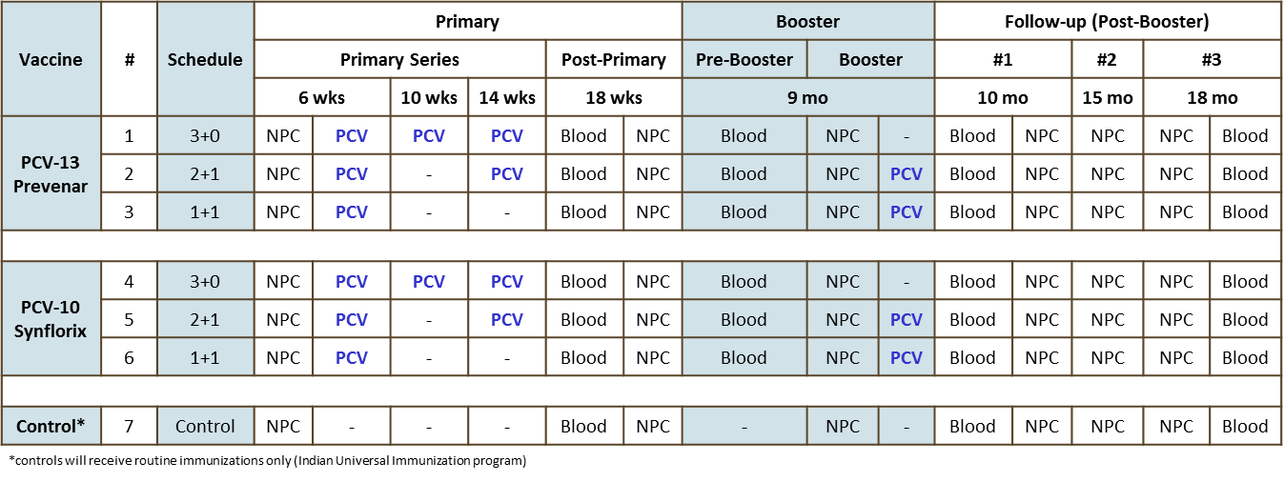
India Alternative PCV Dosing Study

Slide 21
Study Timelines
Proposal Title | Nasopharyngeal pneumococcal carriage and immunogenicity with reduced and alternate dose schedule of pneumococcal conjugate vaccine in infancy.
 |  | 2016 |  |  |  |  |  |  |  |  |  | 2017 |  |  |  |  |  |  |  |  |  |  |  | 2018 |  |  |  |  |  |  |  |  |  |  |  | 2019
 |  | Mar | Apr |  | Jun | Jul |  |  | Oct |  |  | Jan |  |  | Apr |  |  | Jul |  | Sep | Oct |  |  | Jan |  |  |  |  | Jun |  | Aug |  |  | Nov |  | Jan |  | Mar | Apr | May | Jun
Planned Milestone |  |  | Year 1 |  |  |  |  |  |  |  |  |  |  |  | Year 2 |  |  |  |  |  |  |  |  |  |  |  | Year 3 |  |  |  |  |  |  |  |  |  |  |  | Year 4
Expected Milestone based on current status |  | 0 | 1 | 2 | 3 | 4 | 5 | 6 | 7 | 8 | 9 | 10 | 11 | 12 | 13 | 14 | 15 | 16 | 17 | 18 | 19 | 20 | 21 | 22 | 23 | 24 | 25 | 26 | 27 | 28 | 29 | 30 | 31 | 32 | 33 | 34 | 35 | 36 | 37 | 38 | 39
Objective 1 Obtaining Approvals
HMSC, DCGI and Ethics Committee Approvals | 1.1
Execution of Contracts | 1.2
Objective 2 Study preparation
Readiness of Infrastruture , operational documents and data management systems | 2.1
Identification of study staffs & training activities | 2.2
ANC Registration & Enumeration of potential participants | 2.3
Objective 3 Site Initiation & Recruitment
First Subject First Visit (Initiation of Recruitment) | 3.1
Completion of 50% Subject Recruitment | 3.2
Last Subject First Visit (Completion of Recruitment) | 3.3
Objective 4 Subject Follow-up
Completion of 18 weeks visit (Visit 4) | 4.1
Completion of booster doses of PCV at age 9 months (Visit 5) | 4.2
Completion of 10 months visit (Visit 6) | 4.3
Completion of 15 months visit (Visit 7) | 4.4
Completion of 18 months visit (Visit 8 End of Study Visit) | 4.5
Objective 5 Biosample shipment & analysis
First shipment to ICH, UK sent | 5.1
Second shipment to ICH, UK sent | 5.2
Third shipment to ICH, UK sent | 5.3
Lab reports received and ready for analysis | 5.4
Objective 6 Data analysis & Report Writing
Data base lock done | 6.1
Data analysis completed | 6.2
Clinical study report complted | 6.3

Slide 22
South Africa Alternate Dose Study Design
 | 6wks | 10 wks | 14 wks | 18 wks | 6 mo | 9 mo |  | 10 mo | 12 mo
1+1 (6 wks +9mo) | PCV10 | Blood* |  |  | Measles Vaccine | Blood** | PCV10 | Blood^ NP | Varicella or Hep A
 | PCV13 | Blood* |  |  | Measles Vaccine | Blood** | PCV13 | Blood^ NP | Varicella or Hep A
1+1 (14 wks +9 mo) |  |  | PCV10 | Blood* | Measles Vaccine | Blood** | PCV10 | Blood^ NP | Varicella or Hep A
 |  |  | PCV13 | Blood* | Measles Vaccine | Blood** | PCV13 | Blood^ NP | Varicella or Hep A
2+1 (6, 14 wks + 9 mo) | PCV10 |  | PCV10 | Blood* | Measles Vaccine | Blood** | PCV10 | Blood^ NP | Varicella or Hep A
 | PCV13 |  | PCV13 | Blood* | Measles Vaccine | Blood** | PCV13 | Blood^ NP | Varicella or Hep A
*ELISA only **Blood to be drawn and saved ^ELISA, OPA on 20% of samples

Slide 23
Alternate Dosing Study – Ho Chi Minh
Group | Schedule | Age in months
 |  | 2 | 3 | 4 | 5 | 6 | 7 | 9 | 9.5 | 10.5 | 12 | 13 | 18 | 19 | 24
A | 3+1 (n=150) | PCV10 Bld* NP | PCV10 | PCV10 | Bld | NP |  | PCV10 Bld NP |  | Bld | NP |  | Bld* NP |  | NP
B | 3+0 (n=150) | PCV10 NP | PCV10 | PCV10 | Bld | Bld NP |  | Bld* NP |  | Bld | NP |  | Bld* NP |  | NP
C | 2+1 (n=250) | PCV10 NP |  | PCV10 | Bld | Bld* NP |  | Bld NP | PCV10 | Bld | NP |  | Bld* NP |  | NP
D | 1+1 (n=200) | PCV10 NP | Bld |  |  | PCV10 Bld NP | Bld | Bld* NP |  |  | NP |  | Bld* NP |  | NP
E | 2+1 (n=250) | PCV13 NP | Bld* | PCV13 | Bld | NP |  | Bld NP | PCV13 | Bld | NP |  | Bld* NP |  | NP
F | 0+1 (n=200) | NP |  |  |  | NP |  | NP |  |  | NP |  | PCV10 Bld NP | Bld | PCV10 NP Bld
G | control (n=200) |  |  |  |  |  |  |  |  |  |  |  | NP |  | PCV10 NP Bld
V | 0+1 n=200 |  |  |  |  | NP |  |  |  |  | PCV10 NP Bld | Bld | NP |  | NP Bld
W | 0+1 n=200 |  | Bld |  |  | NP |  |  |  |  | PCV13 NP Bld | Bld | NP |  | NP Bld
X | 1+1 n=200 | PCV10 | Bld |  |  | NP |  |  |  |  | PCV10 NP Bld | Bld | NP |  | NP Bld
Y | 1+1 n=200 | PCV13 | Bld |  |  | NP |  |  |  |  | PCV13 NP Bld | Bld | NP |  | NP Bld
Z | control n=200 |  |  |  |  | NP |  |  |  |  | NP | Bld | NP |  | PVC10 NP Bld

