Slide 1
Prioritizing TB Active Case Detection in Guatemala
Jennifer Ross, MD, MPH
Institute for Disease Modeling Symposium
April 15, 2019

Slide 2
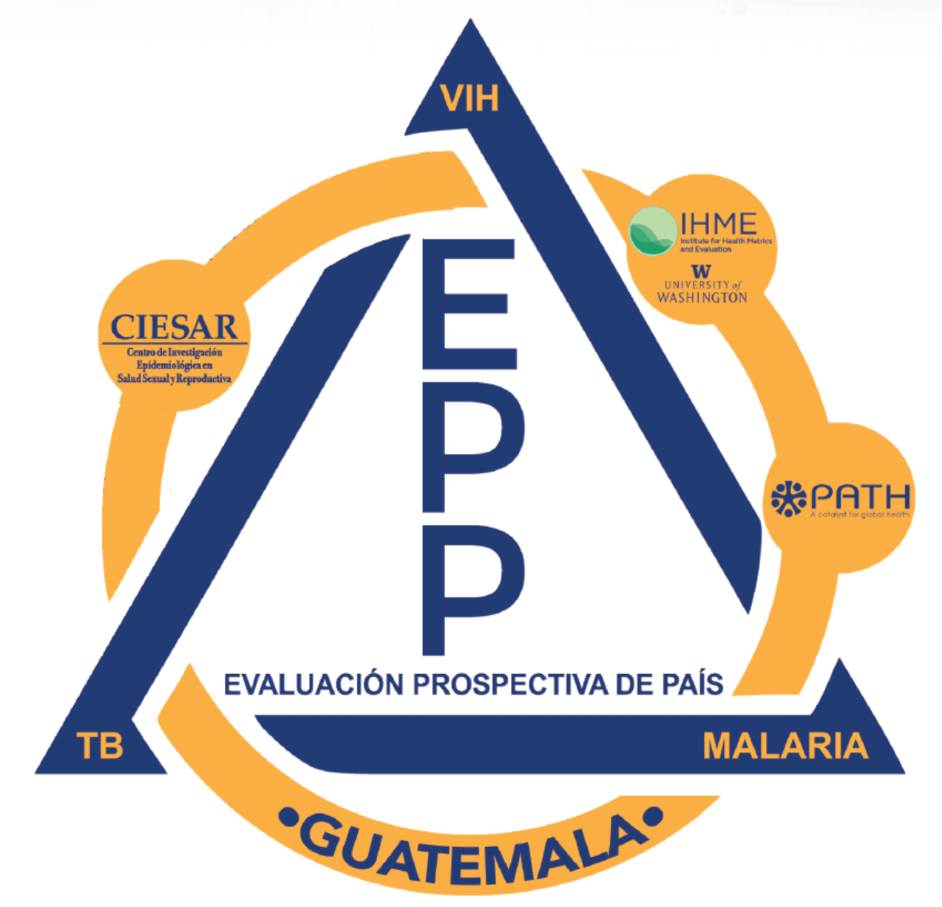
Presentation Outline
Credits to CIESAR team
TB epidemiology in Guatemala
Methodology
Key findings
Use of findings
Future plans

Slide 3
Global Fund Prospective Country Evaluation
Mixed methods, prospective evaluation of the Global Fund business model from country perspective
Partnership w/ organizations in DRC, Guatemala, Uganda
Platform for disseminating the latest results to global and national policy-makers and program implementers
Reports to GF Grant & Policy-Makers
Local Results
Global Fund Policy & Guidance
Country-Level Programs
Resource Tracking
Health System Monitoring
Reports to National Programs & Grantees
Local Burden
Ongoing Dissemination to Country Implementers
Qualitative Research

Slide 4
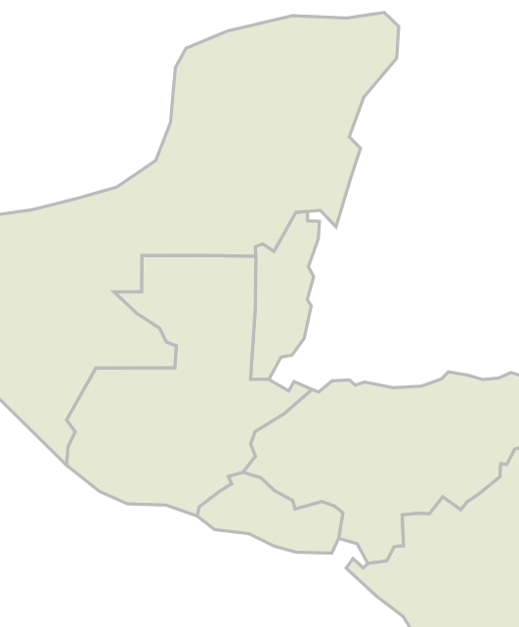
TB Epidemiology in Guatemala
Medium → low-burden for TB per Global Fund classification
Disproportionate burden in men, PLHIV, prisoners
3445 (all-forms) TB cases notified in 2017
5% gap below GBD estimates
20% gap below WHO estimates
MEX
17.2
GTM
20.5
HON
34.5
SLV
28.6
TB incidence per 100,000 persons.
Global Burden of Diseases Study 2017.

Slide 5
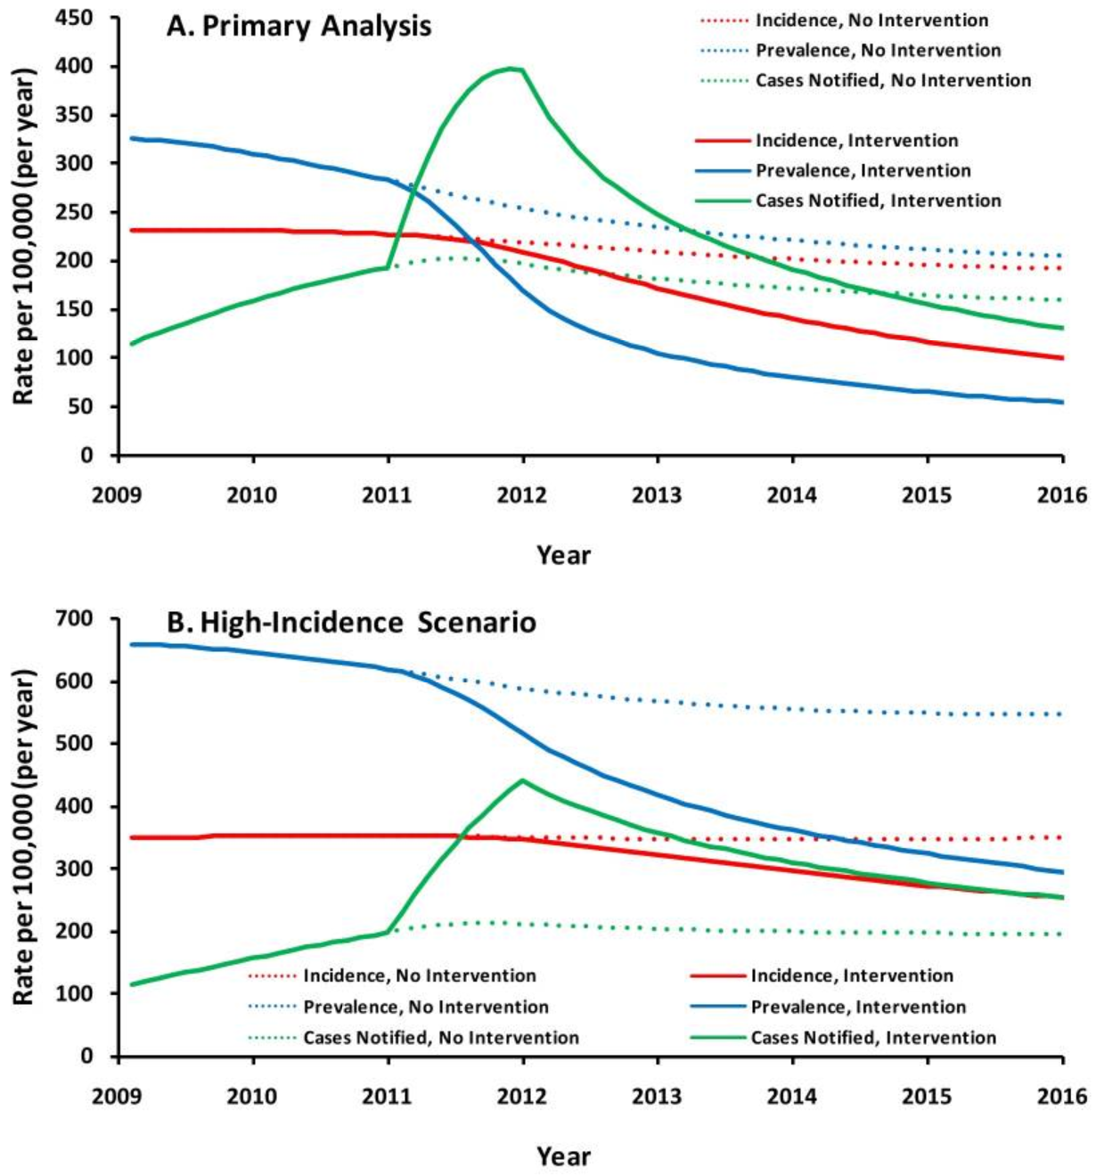
Active case detection - find missing persons
Estimated 3.4 million (34%) of persons with TB globally not notified to national TB programs in 2017.¹
Scaling up a “proven strategy”²
Expensive → need for prioritization³
Prioritization strategies – risk groups^{2,3}
Household contacts
Prisoners
Male-focused workplace interventions
Geographic prioritization?
Dowdy, et al. Plos One 2013.
1. WHO. Global TB Report 2018.
2. Reid, et al. Lancet Commission on TB. 2019.
3. WHO Guidance on Systematic Screening for TB. 2013, 2015.
Notes:
Projected TB Epidemics After Implementation of a Case-Finding Intervention in Karachi, Pakistan.TB incidence is shown in red, prevalence in blue, and notification rates in green. Dotted lines represent the counterfactual scenario of no intervention, whereas solid lines presume that the intervention is maintained at equal intensity for five years. The primary analysis assumes an underlying TB incidence of 231 per 100,000/year (representative of Pakistan [1]) in 2008, whereas the high-incidence scenario assumes a baseline incidence of 350 per 100,000/year. In the primary analysis, case notifications rise transiently above both incidence and prevalence because both incident and prevalent cases are simultaneously being detected and treated.
BACKGROUND:
The potential population-level impact of private-sector initiatives for tuberculosis (TB) case finding in Southeast Asia remains uncertain. In 2011, the Indus Hospital TB Control Program in Karachi, Pakistan, undertook an aggressive case-finding campaign that doubled notification rates, providing an opportunity to investigate potential population-level effects.
METHODS:
We constructed an age-structured compartmental model of TB in the intervention area. We fit the model using field and literature data, assuming that TB incidence equaled the estimated nationwide incidence in Pakistan (primary analysis), or 1.5 times greater (high-incidence scenario). We modeled the intervention as an increase in the rate of formal-sector TB diagnosis and evaluated the potential impact of sustaining this rate for five years.
RESULTS:
In the primary analysis, the five-year intervention averted 24% (95% uncertainty range, UR: 18-30%) of five-year cumulative TB cases and 52% (95% UR: 45-57%) of cumulative TB deaths. Corresponding reductions in the high-incidence scenario were 12% (95% UR: 8-17%) and 27% (95% UR: 21-34%), although the absolute number of lives saved was higher. At the end of five years, TB notification rates in the primary analysis were below their 2010 baseline, incidence had dropped by 45%, and annual mortality had fallen by 72%. About half of the cumulative impact on incidence and mortality could be achieved with a one-year intervention.
CONCLUSIONS:
Sustained, multifaceted, and innovative approaches to TB case-finding in Asian megacities can have substantial community-wide epidemiological impact.

Slide 6
Methods – Process Evaluation and Analysis
Process evaluation
Review historical and current prioritization strategies in Guatemala
Stakeholder interviews
Quantitative analysis
Evaluate yield (cases detected) of current strategies
Explore alternative variables and variable transformations for prioritization

Slide 7
Key findings – Process evaluation
Two recent geographic prioritization exercises
Support from national TB program and international stakeholders
Included in National Strategic Plan 2016-2020 and donor funding requests
Primary prioritized activity - Outreach team
Functions:
Household screening of contacts for respiratory symptoms
TB treatment adherence support

Slide 8
Evolution of geographically-prioritized TB strategies
National Strategic Plan, 2016 – 2020
Select 8 departments by TB case notification rate (cases/100,000 pop).
Select 50 municipalities within these departments by index:
TB case notification rate, 2014
Proportion of population – in poverty, indigenous, rural
Marginalization index, 2007 (literacy, primary school completion, piped water, dirt floor, electricity, sewer, household crowding)
Major public health services
Municipality-prioritization map. National Strategic Plan for Tuberculosis. Guatemala 2016 – 2020.

Slide 9
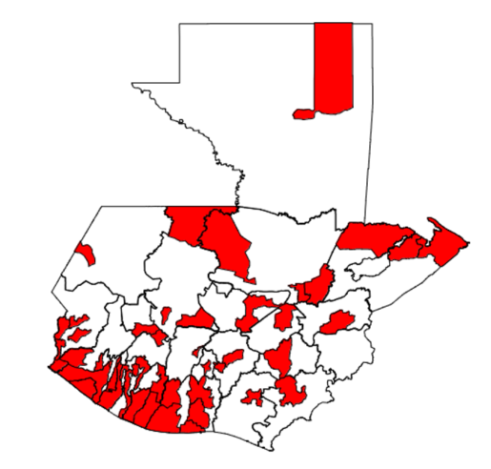
Updated prioritization NTP in 2017
Global Fund Funding Request, 2019 – 2023.
Prioritize 10 departments by index (equal weighting)
Population density 2015, case notification rate 2017, respiratory symptoms, lab sputum sample quality, percentage detection pediatric cases, diabetes prevalence, HIV prevalence 2016, notification rate among prisoners, treatment success rate (first-line), proportion in poverty, indigenous, chronic malnutrition, literacy, household overcrowding, geographic accessibility, GINI index 2014.
Prioritize 47 municipalities within departments
Shorter index
Department capitals
47 municipalities
prioritized for outreach
Notes:
Each of the 16 variables had the same weight for the estimation of the index value. Subsequently, a specific value or sub index was created for each variable, ranging from "0" to "1". The sum of the 16 sub-indexes was further denominated as the classification index. To calculate the value of each sub index departments were arranged by their variable values, assigning a “1” to the highest and a “0” to the lowest, while the rest of the departments were distributed accordingly and proportionally to its position.

Slide 10
Key findings – quantitative analysis
Yield of outreach worker case finding in 2017
PCE alternatives to current prioritization strategy

Slide 11
Findings – Household contact screening - 2017
9 outreach teams
Yield among persons with respiratory symptoms
2861 contacts with respiratory symptoms screened
136 contacts with bacteriologically confirmed TB identified
Screen 21 to find 1
Contributed 10.3% of bacteriologically confirmed cases in these municipalities
Additional yield 462 child <5 contacts (nearly 50% of total)
Bacteriologically-confirmed TB cases,
outreach teams vs. routine reporting
Total Outreach

Slide 12
Geographic strategy updated by PCE
Updates departmental selection
Inverts ranking
TB treatment success - lower success rate leads to higher prioritization
Detection of persons with respiratory symptoms
Removes prison from the index and adds all departments with a prison to the list
Adds change in TB case notification rate 2012 - 2016
Standardizes continuous variables, calculates z-scores
Jorge Matute, CIESAR

Slide 13
Comparing prioritized departments
NTP
PCE
Suchitepéquez
Retalhuleu
Quetzaltenango
Huehuetenango
Alta Verapaz
Izabal
Guatemala
Escuintla
Jutiapa
Zacapa
Chimaltenango
Sacatepéquez
Totonicapán
Santa Rosa
San Marcos
Quiché

Slide 14
Use of findings
Alternative prioritization strategy
Shared with national TB program and Global Fund Technical Evaluation Reference Group
Ongoing evaluation
Scale-up of outreach worker activities in Global Fund grant 2019 – 2022

Slide 15
Future plans
Evaluation of case finding yield in 2018 and 2019
Statistical modeling
Estimate yield of outreach scale-up under alternative prioritization strategies
Consider a prioritization strategy that includes TB mortality

Slide 16
Acknowledgements
CIESAR team
Guillermo Ambrosio
Carmen Cerezo
Edgar Kestler
Enrique Maldonado
Jorge Matute
Rosario Orozco
Margarita Ramirez
Sandra Saenz Tajeda
IHME & PATH Prospective Country Evaluation team
http://www.healthdata.org/pce
National TB Program Guatemala
Funding – Technical Evaluation Reference Group of the Global Fund to Fight AIDS, TB, and Malaria
https://www.theglobalfund.org/en/technical-evaluation-reference-group/prospective-country-evaluations/

