Slide 1
Estimating TB and HIV mortality rates by municipality in Brazil
Jennifer Ross, MD, MPH
UW Division of Allergy and Infectious Diseases
April 18, 2018

Slide 2
Outline
Rationale for subnational burden estimation
Example study – Small area estimation of TB + HIV mortality in Brazil
Methods
Results
Discussion

Slide 3
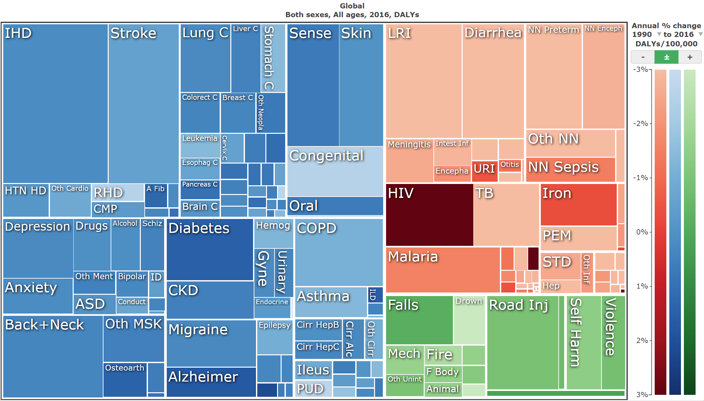
Institute for Health Metrics and Evaluation
Comprehensive, comparable, and systematic analysis of health loss around the world: http://healthdata.org
Global Burden of Disease Study:
Incidence, prevalence, and mortality for 300+ causes, 1990-present
Broken down by country, age, and gender
Collaborator network of over 2,700 health professionals worldwide: http://bit.ly/2hA1dxI
Notes:
GBD currently provides subnational estimates for 11 countries.

Slide 4
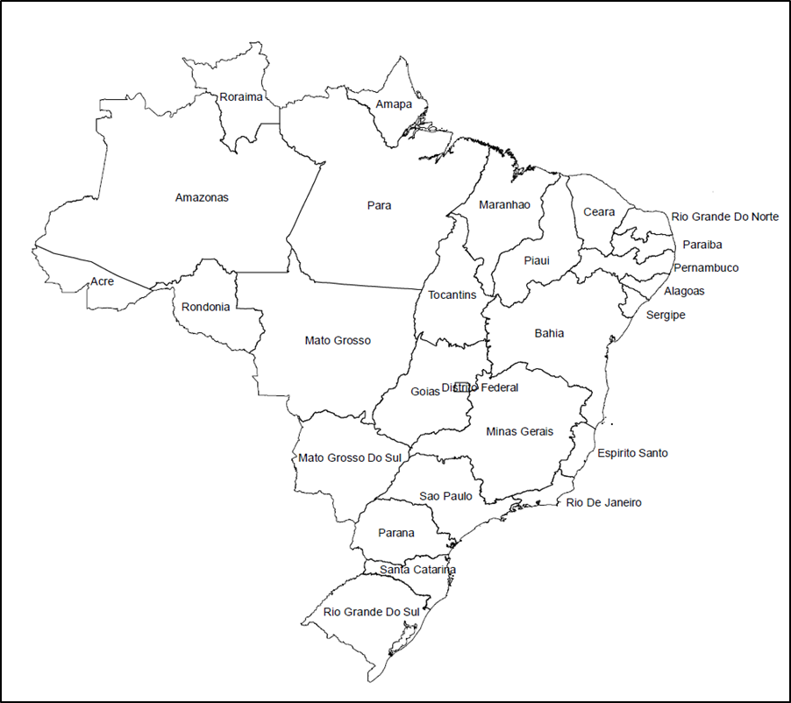
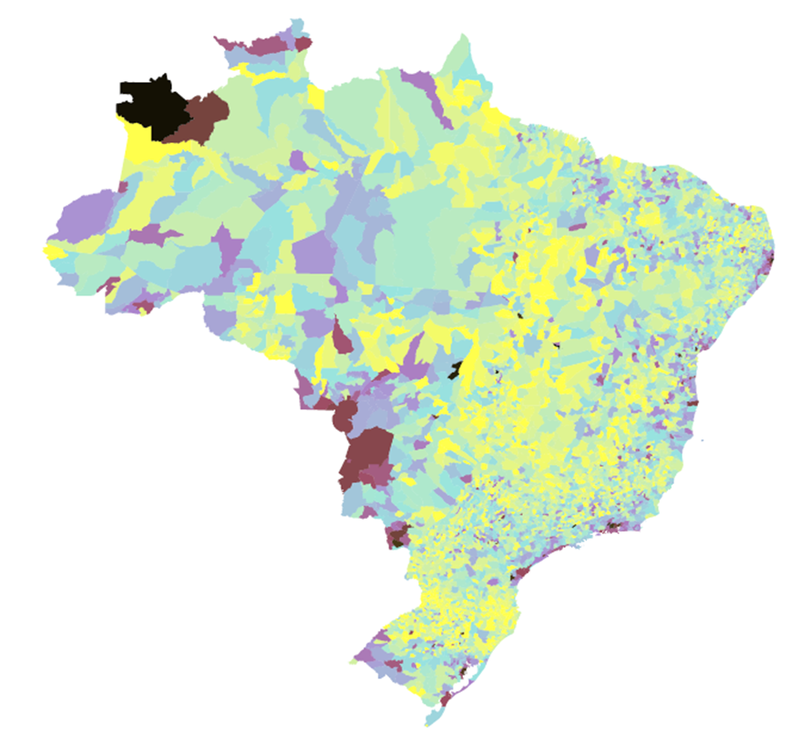
Increase geographic detail
26 States + Federal District
5565 Municipalities
Notes:
The GBD Brazil collaborators completed extensive subnational burden estimation for the 26 states and Federal District. The current work aims to make these estimates for the >5500 municipalities in Brazil

Slide 5
Challenges with detailed mortality estimation
Challenge
Strategy
1. Difficulty distinguishing true differences in risk from random noise
due to
Small populations
Rare causes of death
2. Assignment of TB/HIV deaths to HIV as underlying cause
3. Completeness of vital registration data
1. Model borrows strength across
Neighboring municipalities
Consecutive years
Adjacent age groups
2. GBD cause of death modeling hierarchy specifies TB/HIV within HIV
3. Country choice, age groups

Slide 6
Example Study: TB and HIV Mortality in Brazilian Municipalities, 2001-2015

Slide 7
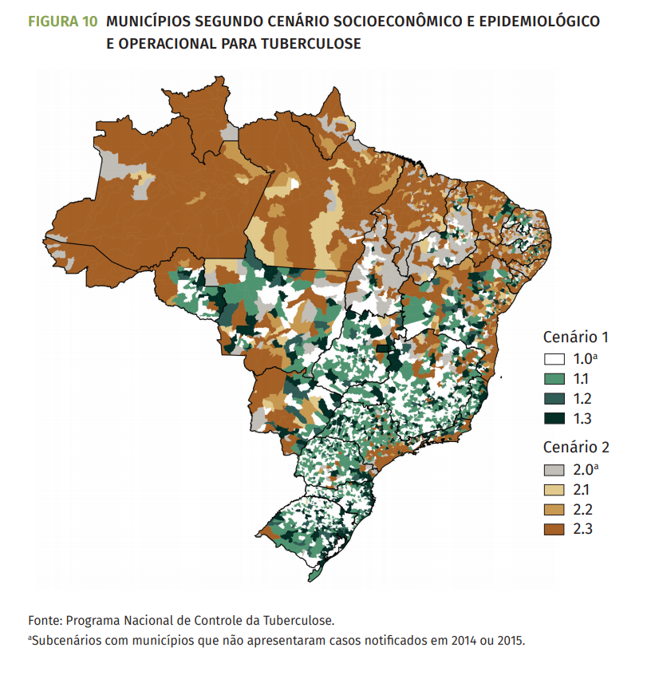
Rationale
200 million population, high-burden country for TB and TB-HIV (WHO)
High-quality vital registration data at municipality level
Extensive network of GBD collaborators in Brazil*
National Strategic Plan for TB includes municipal-level analysis and planning
*Revista Brasileira de Epidemiologia
Vol. 20 Supp (1) May 2017
Brazil Free from Tuberculosis: National Strategic Plan
2017.

Slide 8
Methods
Access de-identified mortality and case notification data
Assign single cause of death per GBD 2016 protocol
Merge municipalities with boundary shifts to create 5477 stable units of analysis
Adapt small area estimation model from US counties to Brazil
Calibrate to GBD and validate

Slide 9
Methods - Small area estimation model
Bayesian spatially explicit mixed effects regression model*
Model terms follow a conditional autoregressive distribution
informed by data from neighboring municipalities, age groups, or years
1000 draws (candidate maps) – point estimates and uncertainty intervals
Validate model for small population subsets of highly-populated municipalities**
*Dwyer-Lindgren, et al. JAMA. 2016;316(22):2385-2401.
**Srebotnjak, et al. Population Health Metrics. 2010;8:26.
Notes:
One thousand draws (i.e. candidate maps) were sampled from the posterior distributions of modelled parameters. Point estimates were produced from the mean of these draws, and uncertainty intervals were generated from the 2.5th to 97.5th percentiles for each age, sex, year, municipality, and cause.

Slide 10
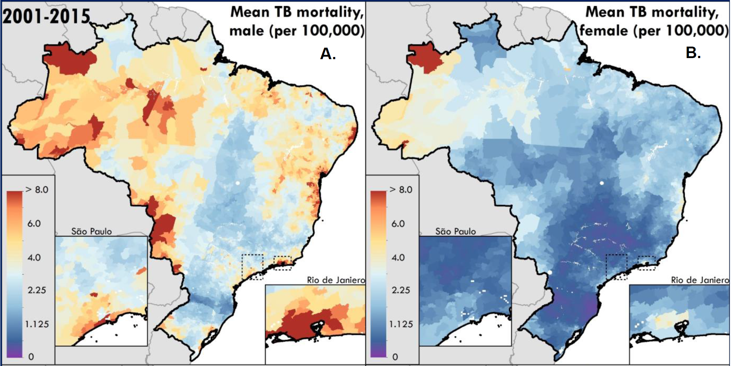
Results
Notes:
National age-standardised mortality due to TB in persons without HIV decreased by nearly 50% from 6.7 (95% UI 6.5 – 6.9) deaths per 100,000 in 2001 to 3.5 (95% UI 3.4 – 3.6) deaths per 100,000 in 2015 among men, and from 2.3 (95% UI 2.2 – 2.4) deaths per 100,000 in 2001 to 1.2 (95% UI 1.1 – 1.2) deaths per 100,000 in 2015 among women. National age-standardised mortality due to HIV was 11.0 (95% UI 10.8 – 11.2) deaths per 100,000 in 2001 versus 8.6 (95% UI 8.5 – 8.8) deaths per 100,000 in 2015 among men, and 5.0 (95% UI 4.8 – 5.1) deaths per 100,000 in 2001 versus 4.4 (95% UI 4.2 – 4.5) deaths in 2015 among women. Large geographic variation in TB and HIV mortality, with the municipalities in the worst decile for TB and HIV mortality had a mortality rate more than twice as high as municipalities in the best 10%. Mortality rates within states varied as much as within the nation as a whole. Consistent with past studies and known epidemiologic patterns, we also found a much higher burden of TB and HIV mortality in men than in women.

Slide 11
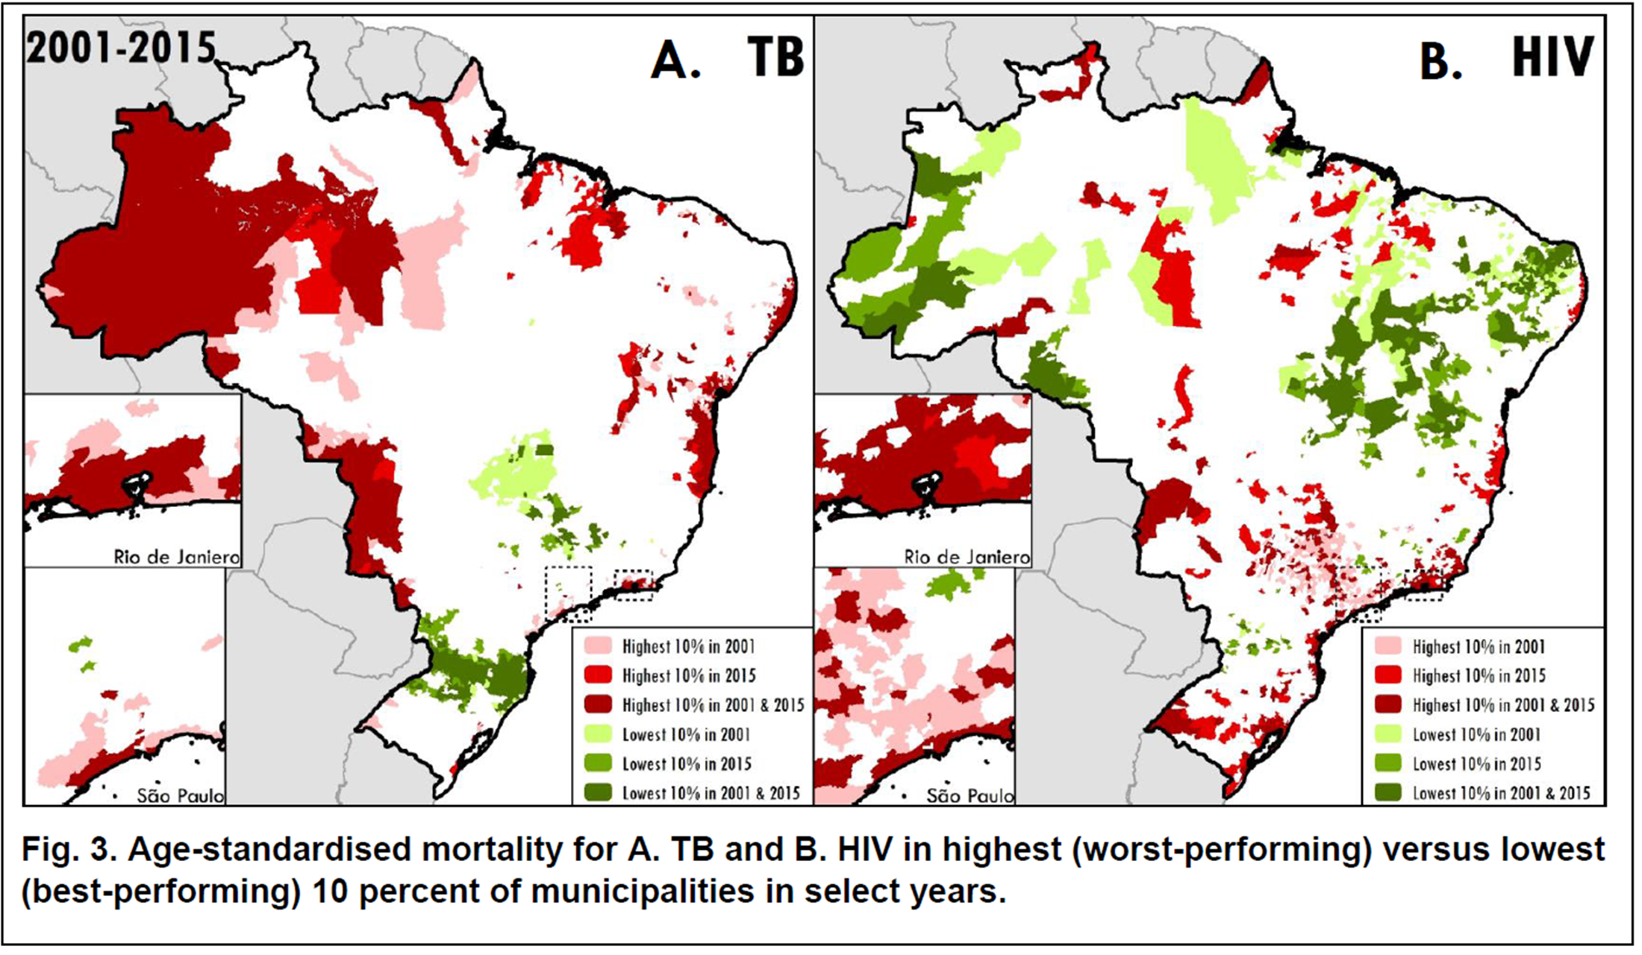
Best and worst areas in 2001 versus 2015
Notes:
There was geographic consistency over time for TB. More than 70% of municipalities in the worst decile for TB in 2001 were still there in 2015. There was less consistency for HIV, where 50 and 60% (men and women respectively) were in worse decile in 2001 and 2015.

Slide 12
Within-state mortality rate ratios
Mean ratio of Tuberculosis or HIV mortality for municipalities in 90th percentile
versus 10th percentile, by state and 95% uncertainty intervals.

Slide 13
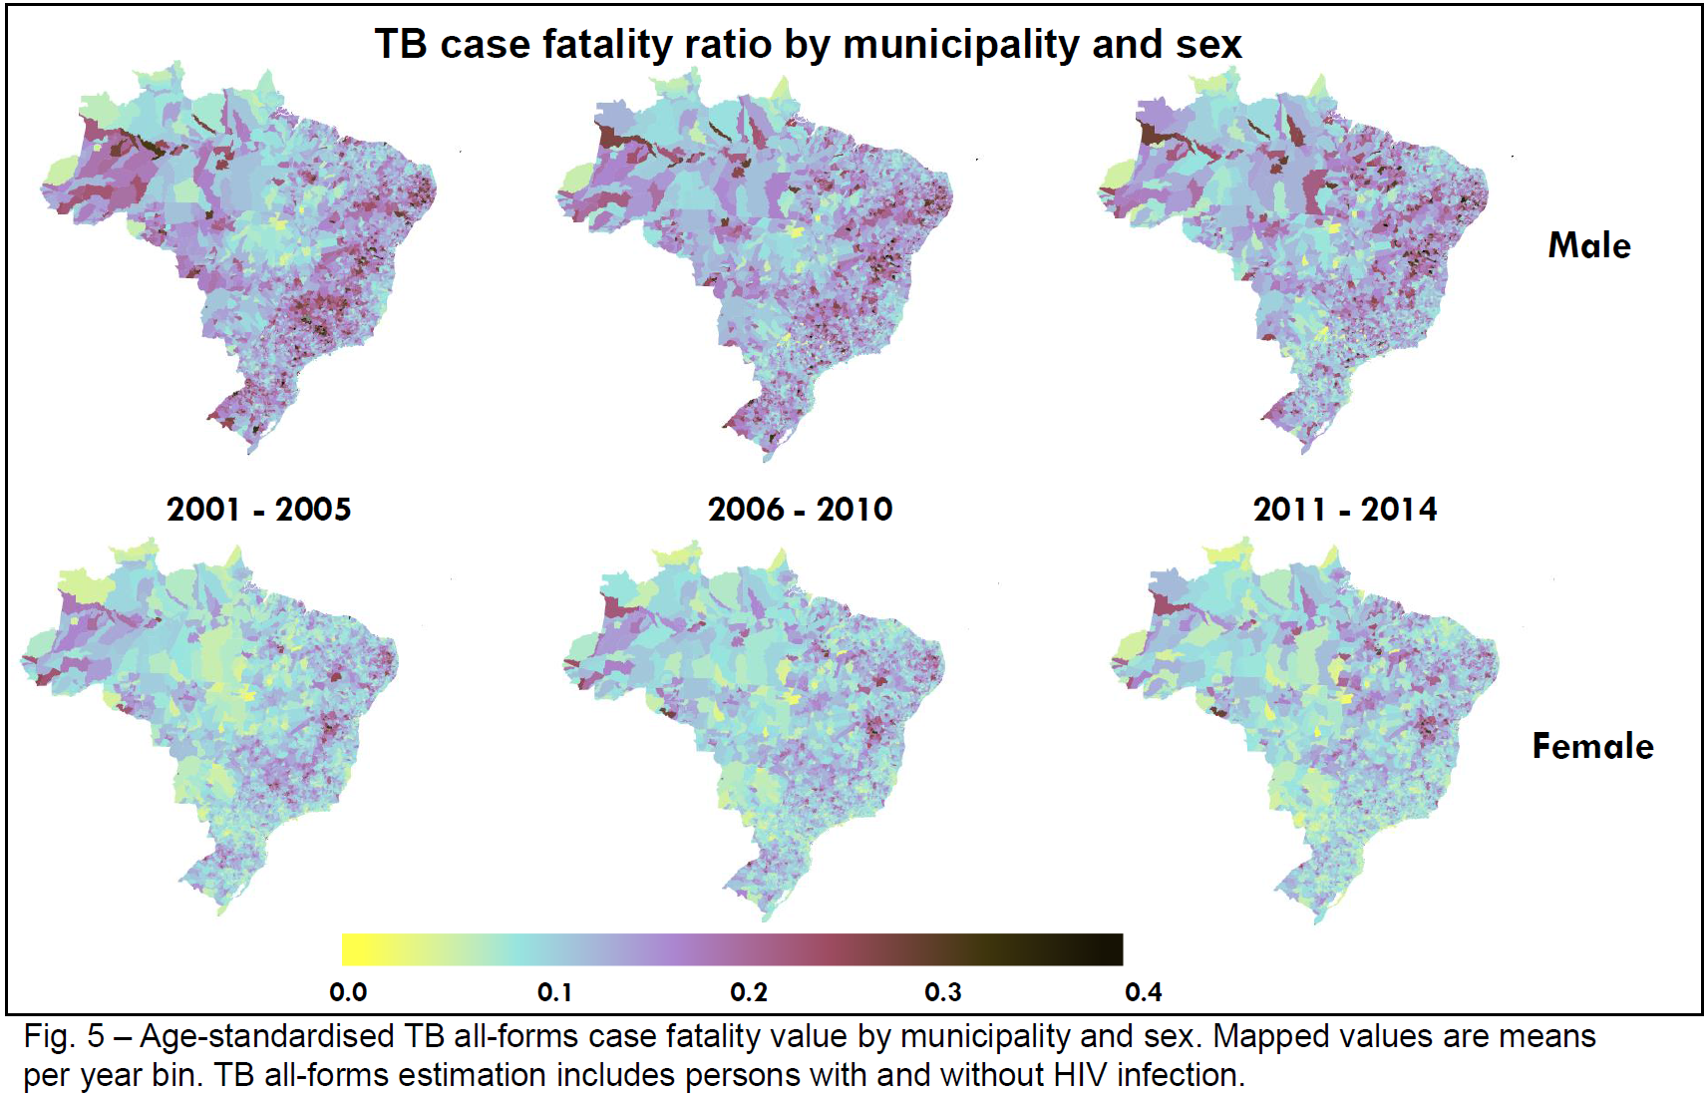
TB case fatality above WHO goal in most municipalities
Notes:
The WHO End TB strategy calls for TB case fatality rates of <10%. The majority of municipalities were not meeting this goal in 2015, particularly for men.

Slide 14
Relationships with Covariates
Covariate | Male TB* | Female TB* | Resolution | Source
HIV mortality | >0.999 | >0.999 | State | GBD
Air temperature | >0.999 | >0.999 | Municipality | CRUTS
Population density | >0.999 | >0.999 | Municipality | Census (derived)
Outdoor air pollution | >0.999 | 0.952 | Municipality | Cornell model
Male prison population | >0.999 | 0.867 | Municipality | Min. of Justice
GBD state-level fasting plasma glucose, alcohol consumption, smoking, indoor air pollution
Literacy | 0.008 | <0.001 | Municipality | Census
Income | <0.001 | <0.001 | Municipality | Census
*Proportion of draws with a positive coefficient

Slide 15
Discussion
Large geographic variation in TB and HIV mortality, including variation within states
Within state variation indicates need for municipal-level analysis
Model is adaptable to other causes of death or notifiable diseases
Biggest limitation
Incomplete ascertainment of deaths, especially deaths in children

Slide 16
Acknowledgements
GBD Brazil collaborator network, Dr. Fatima Marinho de Souza
Andrea de Paula Lobo, Brazil national TB program
IHME Local Burden of Diseases Team (PI: Prof. Simon Hay)
http://www.healthdata.org/lbd
Funding: Bill and Melinda Gates Foundation

Slide 17
Additional Slides

Slide 18
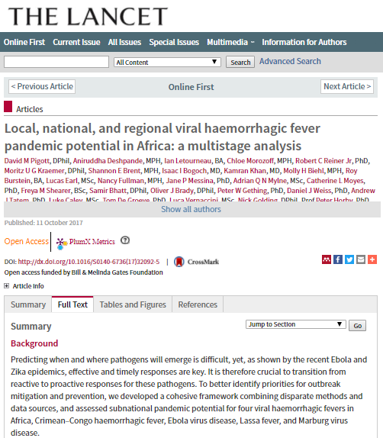
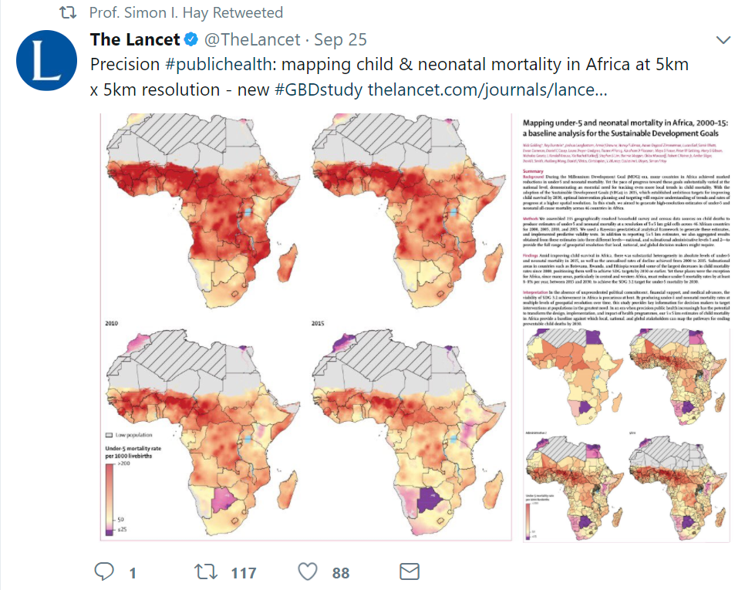
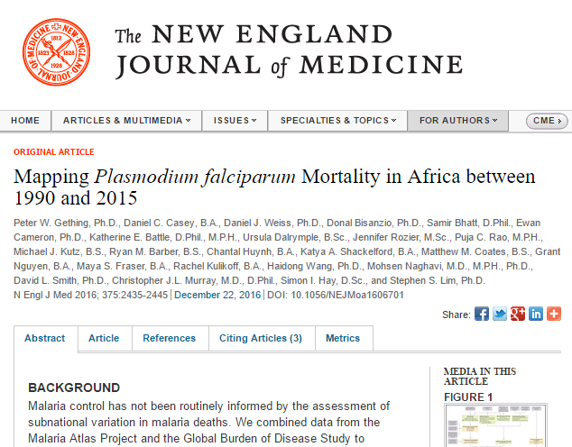
Dissemination: Publications

Slide 19
Redistribution pattern for TB deaths
Redistribution diagram for deaths due to tuberculosis in persons without HIV infection. Categories on the left-hand side show the contribution of deaths within various ICD-10 codings to the final analysis dataset, represented on the right-hand side. The “Original” category on the left-hand side represents deaths already coded to tuberculosis before redistribution.

Slide 20
Redistribution pattern for HIV deaths

Slide 21
Model equations
The small area model was estimated separately for males and females:
E_{j,t,a} ~ Poisson (m_{j,t,a} · P_{j,t,a})
log(m_{j,t,a}) = β₀ + β₁ · X_{j,t} + γ_{1,a,t} + γ_{2,j} + γ_{3,j} ·t + γ_{4,j,t} + γ_{5,j} ·a
j, t, and a are indices for municipality, calendar year (2001 – 2015), and age group (0-4, 5-9, …, 75-79, and 80+), respectively;
E_{j,t,a} and P_{j,t,a} are the number of events (eg cause-specific deaths or case notifications) and the population count, respectively, in municipality j, year t, and age group a;
m_{j,t,a} is the underlying cause-specific mortality rate in municipality j, year t, and age group a;
β₀ is an intercept;
X_{j,t} is a vector of covariates for municipality j and year t, and β₁ is the associated vector of regression coefficients;
γ_{1,a,t} is an age group- and year-level random intercept;
γ_{2,j} is a municipality-level random intercept;
γ_{3,j} is a municipality-level random slope on year;
γ_{4,j,t} is a municipality- and year-level random intercept;
and γ_{5,j} is a municipality-level random slope on age group.

Slide 22
γ₂, γ₃, and γ₅ were each assumed to follow a conditional autoregressive distribution where the full conditional distribution is given by:
$γ_{j}|γ_{k∼j}, σ^{2}, ρ∼Normal\left(\frac{ρ · \sum_{k \sim j}{γ_{k}}}{n_{j} · ρ + 1 − ρ }, \frac{σ^{2}}{n_{j} · ρ + 1 − ρ}\right)$
where
k ~ j indicates the set of municipalities k that are adjacent to municipality j;
n_{j} is the number of counties in k ~ j;
and σ² and $ρ$ are variance and correlation parameters, respectively.

Slide 23
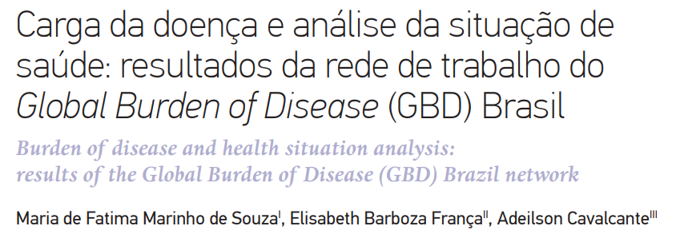
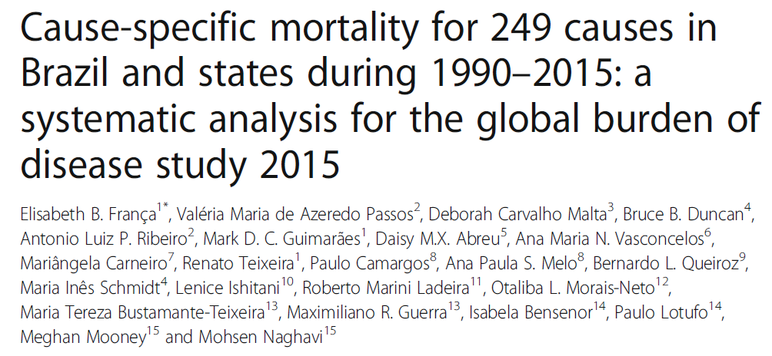
Burden of Disease Network in Brazil
Disease burden estimation by state
Revista Brasileira de Epidemiologia
Vol. 20 Supp (1) May 2017
17 research articles
França, et al. November, 2017.
Mortality estimation for 249 causes

