Slide 1
Community health workers: a strategy to improve healthcare access for malaria elimination in Zambia
Understanding health seeking
Marie-Reine I. Rutagwera
PATH MACEPA
mrutagwera@path.org
IDM 7th Annual Disease Modelling Symposium 2019

Slide 2
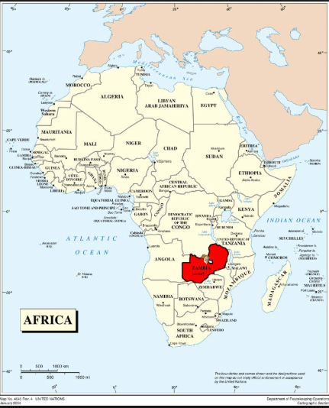
Zambia- Located Southern part of Africa

Slide 3
Engaging communities to eliminate malaria
Zambia Ministry of Health has a goal of achieving malaria elimination by 2021
Requires a package of tools, interventions and a substantial work force
A robust surveillance system that is able to collect timely information at more granular level
Good planning and management, resources, etc.
One of the strategies being deployed since 2011 is to involve community health workers (CHWs) to provide case management & surveillance in their communities

Slide 4
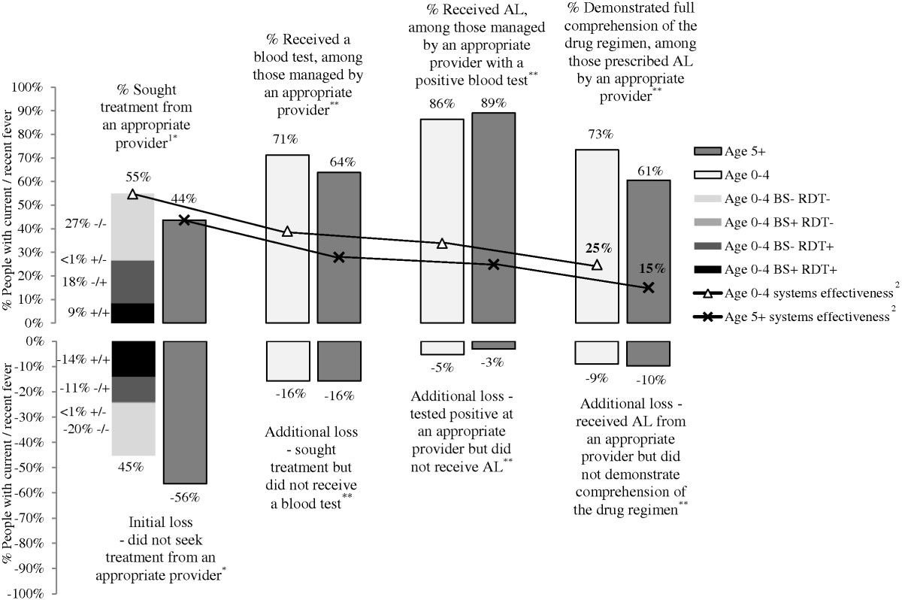
Malaria case management coverage
Improving access to treatments critical for Zambia’s elimination efforts
Evidence to suggest that there is a lot of room for improvement
The biggest gap is simply accessing treatment services
Littrell, M., J. M. Miller, M. Ndhlovu, B. Hamainza, M. Hawela, M. Kamuliwo, D. H. Hamer and R. W. Steketee (2013). "Documenting malaria case management coverage in Zambia: a systems effectiveness approach." Malar J 12: 371.
Notes:
Generally, Zambia’s malaria burden is still quite high in most areas of the country. The need to greatly expand malaria treatment coverage has been documented.
The graphic here shows an example of the gap in case management coverage using 2012 data in Zambia. Light colored bars are children under 5 and dark colored bars are individuals 5 and older. Of all children under 5 with confirmed malaria, 55% sought treatment from an appropriate provider; of those, 71% received a blood test; of those 86% received appropriate treatment; and finally, of those, 73% completed the treatment. In the end, only 25% of children under 5 with confirmed malaria received effective treatment.

Slide 5
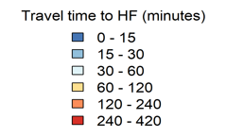
Understanding areas where increasing access to treatment may be most beneficial (for burden reduction) is critical Mean travel time for most patients is more than 1 hour via walking Thus, prompt treatment is a big challenge
HFCA population-weighted mean travel time to nearest health facility
Each black point is a health facility
Notes:
It is critical to understand where increased access to treatment may be most beneficial for burden reduction

Slide 6
Access to treatment – travel time to nearest facility
With access to motorised transport
Without access to motorised transport (walking only)
Notes:
In rural Zambia, most patients walk to the health facilities . Motorised transport = all forms of transport faster than walking with maximum speed capped at 5 km/hr across any pixel
Yellow indicates travel time of less than 15 min; mostly characterised among those with motorised transport
Dark Purple with those with mean travel of more than 4 hours .
Mean travel time for most patients is more than 1 hour making access to prompt treatment a big challenge

Slide 7
Zambia’s experience with combining activities
In Zambia:
Clear that the need to expand access to care and treatments exists
Also need to strengthen surveillance to support elimination goals
Challenges with staffing at local rural facilities to meet health care needs within the formal (mainly public) health sector
The solution to address these needs/challenges was:
to combine malaria community case management through iCCM and surveillance training
and where appropriate, reactive case detection activities into a single training platform to scale nationally using all available resources (PMI, Global Fund, GRZ, MACEPA)

Slide 8
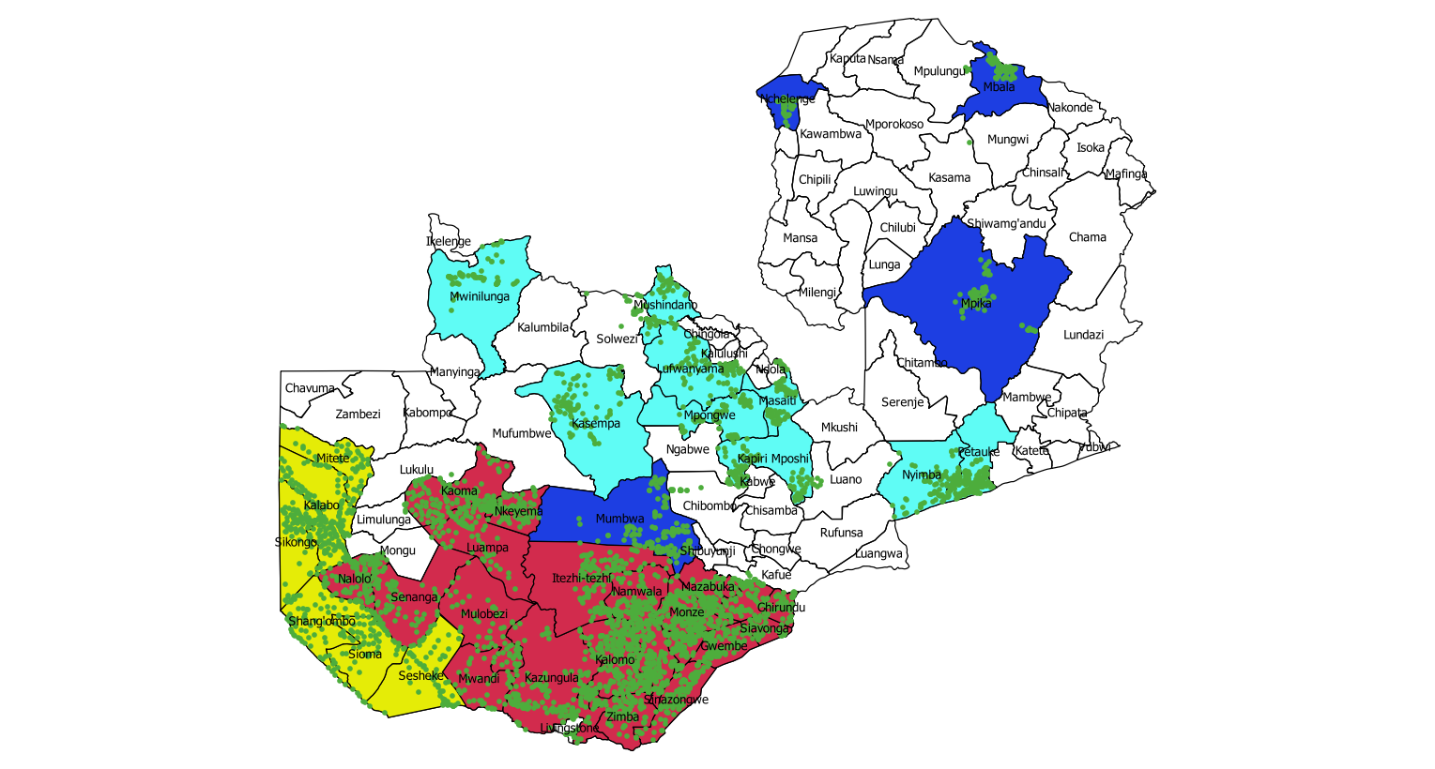
Expansion of malaria community case management & surveillance through CHW as of December 2018
5000 CHWs trained!
Notes:
Need to update the map . as of March 2019 . ˜6200 CHWs trained!

Slide 9
Community case management plus reactive case detection
CHWs and clinics test patients (passive)
Index cases (RDT positive) are actively followed up
Data recorded in paper registers
Aggregate data transmitted monthly via mobile phones to DHIS2 server
Data can then be viewed and analyzed by all stakeholders using already built in dashboards in DHIS2 and Tableau

Slide 10
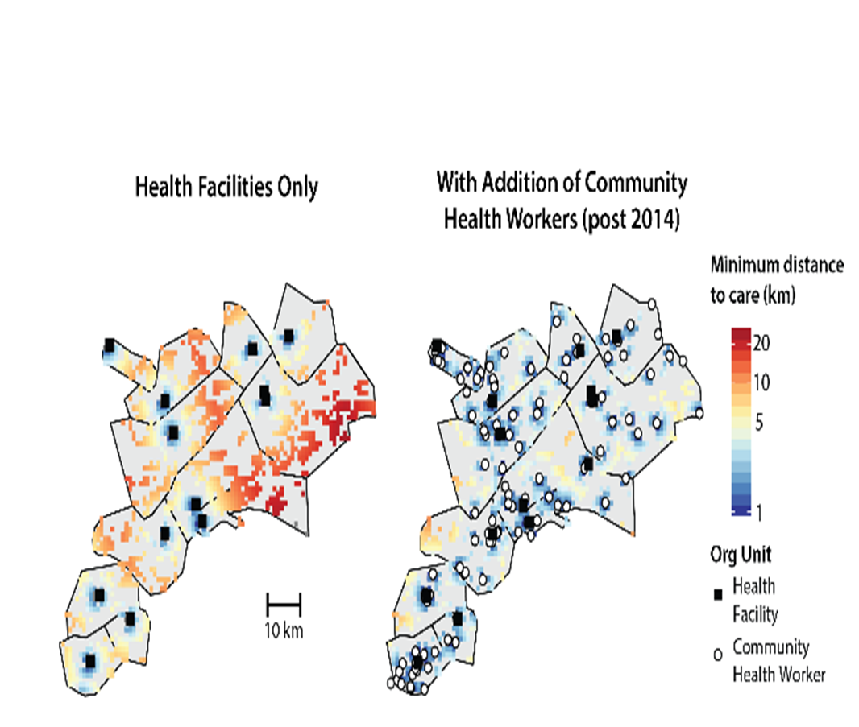
Addition of CHWs has drastically altered travel distances for treatment
Access to health care services for malaria has been a major barrier to progress
Addition of CHWs has drastically altered travel distances for case management from most patients covering over 20 km to less than 5 km
Thereby, reducing the time between the onset of the symptoms, diagnosis and treatment which is vital in an elimination setting
Source: C. Bever, Institute for Disease Modelling
Notes:
The map on the left shows that prior addition of CHWs most patients travelled over 20km to access health services a distance that has been to less that 5km ( right map)

Slide 11
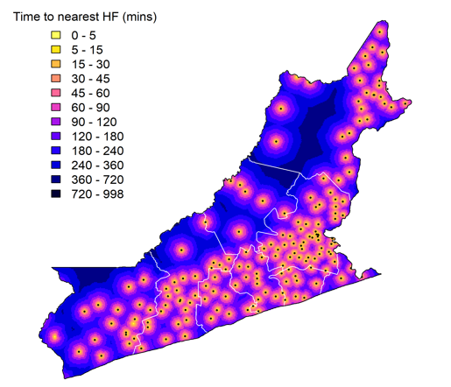
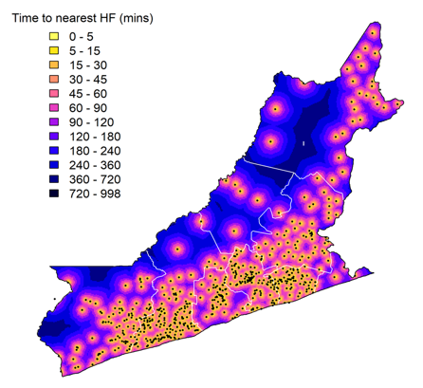
Impact of increasing access to treatment - Travel time to nearest health facility or CHW without motorised transport
Without access to motorised transport (walking only) – Facility only
Without access to motorised transport (walking only) with addition of CHWs
Adding in CHWs greatly reduces travel times in this area
Notes:
From mean time of 1 hr to around 15 min

Slide 12
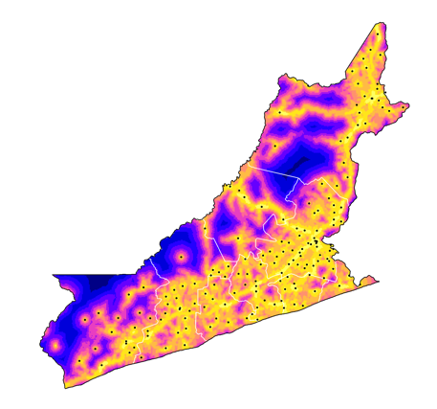
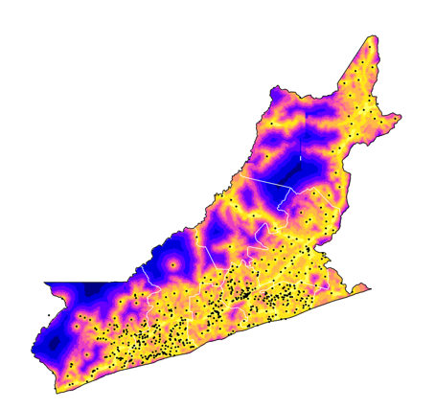
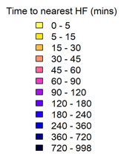
Impact of increasing access to treatment Travel time to nearest health facility or CHWs with motorised transport
With access to motorised transport – To health facility only
Without access to motorised transport – With addition of CHWs
Adding in CHWs greatly reduces travel times in this area
Notes:
From mean time of about 30min to around 10min

Slide 13
Schematic graph of events after CHW roll out
1.
Health Facilities
CHWs Added
CHWs
2.
Cases
Time
1. Soon after roll out, with the addition of community case management malaria cases tend to increase relative to only those attending facilities . This is due to increased service availability closer to under-served areas with malaria transmission
2. The additional data coming from community levels can take at least one malaria season (one calendar year) to stabilize in order to understand the new ‘baseline’. Thereafter, it takes a couple of years to be able to notice the benefits of the intervention on a trend line

Slide 14
Each dot is a reported location of a CHW
Red dots are CHWs reporting ≥ 75% of months

Slide 15
Lessons learnt from community malaria case management and surveillance in Zambia
Operationally, linking case management resources (through iCCM) and surveillance, NMEC developed a single scalable platform to meet elimination needs
For areas with few malaria cases, integration of activities at community level is vital to keep CHWs engaged in case of resurgence
Expanding case management and RCD requires significant systems strengthening to improve logistics
Saturating the number of CHWs per population to be able to meet % index case follow-ups
Targeted 1 CHW per 850 population in Southern, but slightly higher in other areas where more transmission (1:750)
Notes:
supply chain (RDT & anti-malarial drugs), transportation ( parts for broken bikes , lack of rain gear)

Slide 16
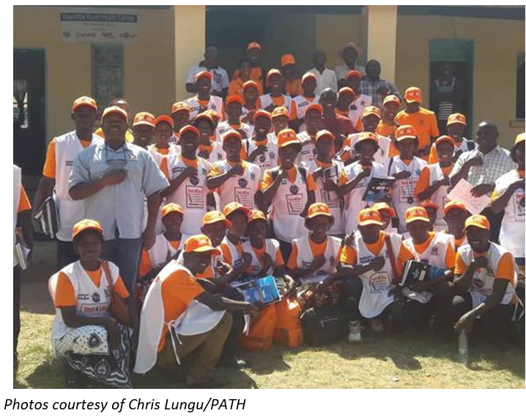
Conclusion
Timely acquisition of quality data in a more focalized manner helps gain insight of the granularity of malaria transmission patterns to efficiently deploy commodities, plan interventions, and focus attention where most needed
Progress towards Zambia’s malaria elimination goal will be enhanced by prompt detection and effective treatment of malaria cases at the community level
Therefore, it is key to continue involving CHWs who are closer to the under-served in the community

Slide 17
Acknowledgement
On behalf of PATH-MACEPA
MACEPA Leadership team
Dr John Miller
Hannah Slater
Chris Lungu
Michael Hainsworth
Jonathan Drummey
Caterina Guinovart
Maya Fraser
Sandi Litia
Prudence Malama
Mathews Monde
Institute for Disease Modelling (IDM)
Edward Wenger
Jaline Gerardin
Caitlin Bever
AKROS Global Health Zambia team
PMI/PAMO Zambia malaria team
GF/CHAZ Zambia malaria team
NMEC, MoH :
Dr Elizabeth Chizema
Dr Anthony Yeta
Dr Busiku Hamainza
Mr Japhet Chiwaula
Ms Mercy Mwanza
Mr Ignatious Banda
Provincial and District Health teams
The communities and the Community Health Volunteers in areas where Community case mgt & surveillance is implemented

Slide 18
Questions?
Thank you for your attention!

