Slide 1

April, 2019
Making connections, taking action
PATH’s vision for a learning health system
Jessica Shearer
Acting Director, Health Systems Innovation and Delivery, PATH

Slide 2
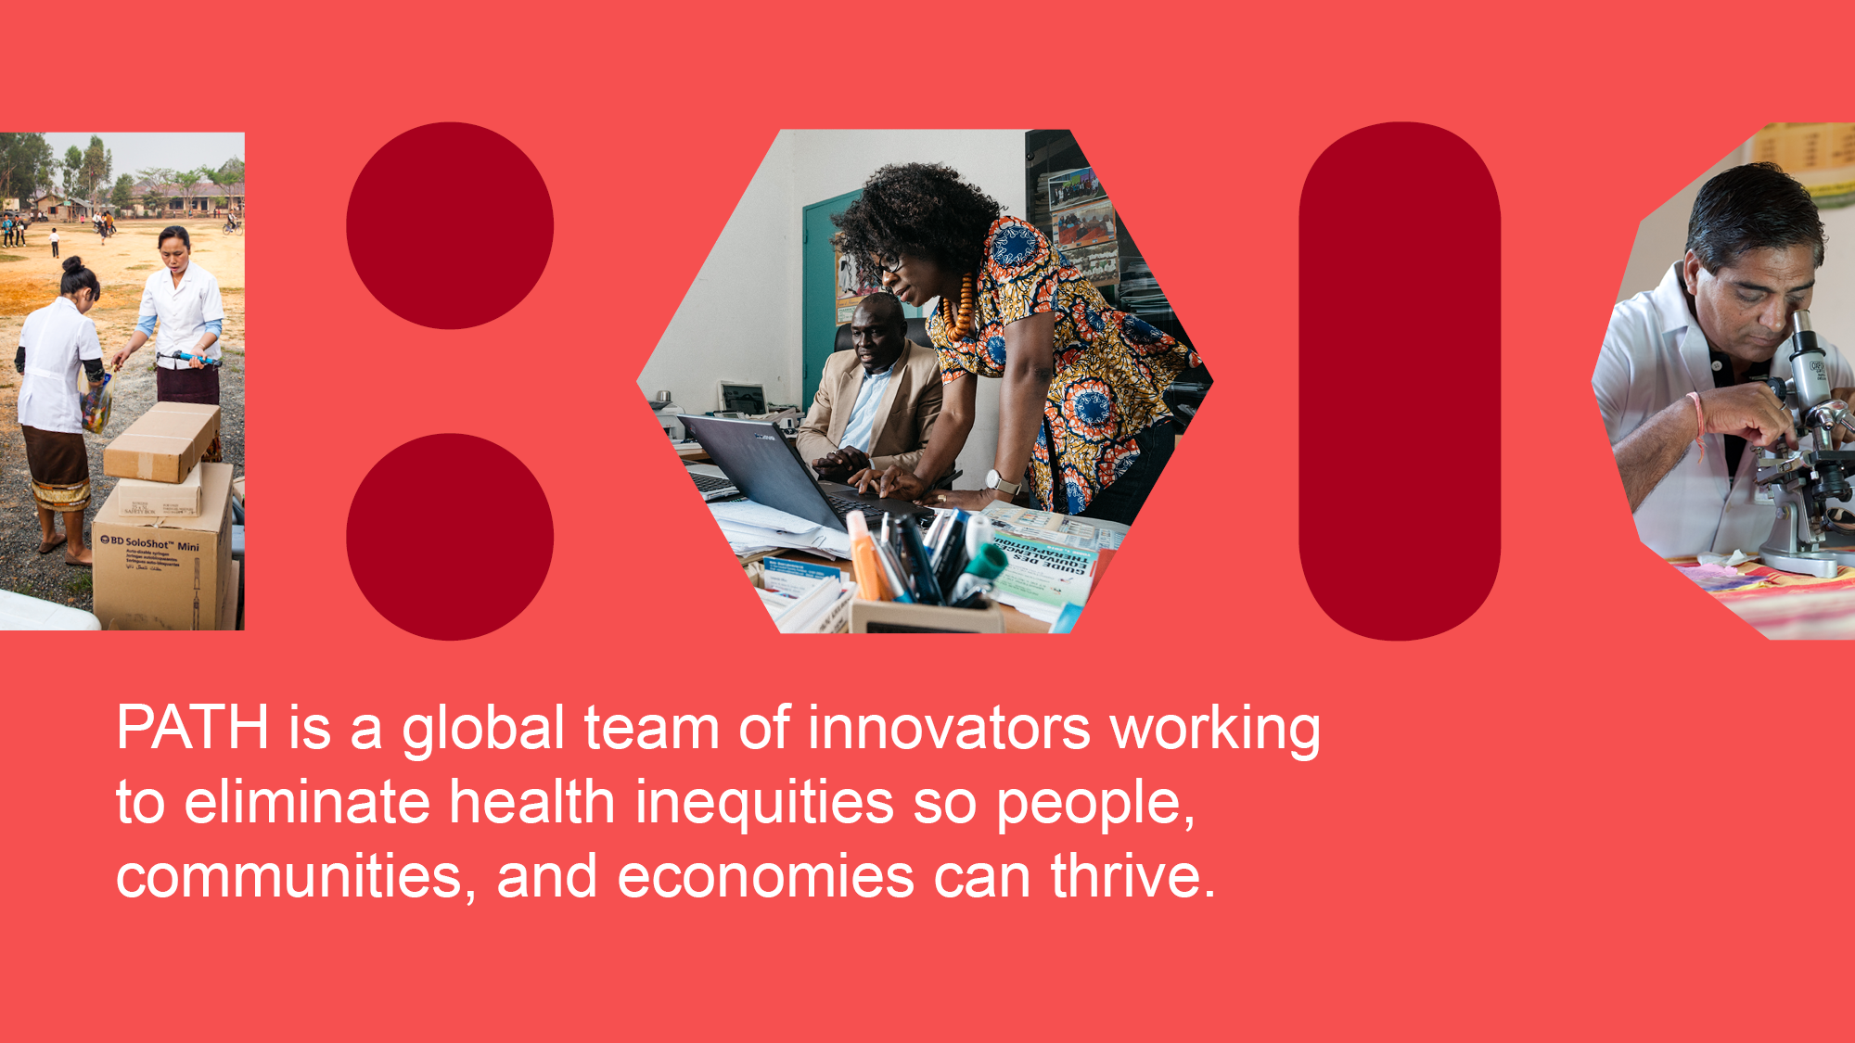

Photos: PATH/Aaron Joel Santos,
PATH/Gabe Bienczycki, PATH/Gabe Bienczycki

Slide 3
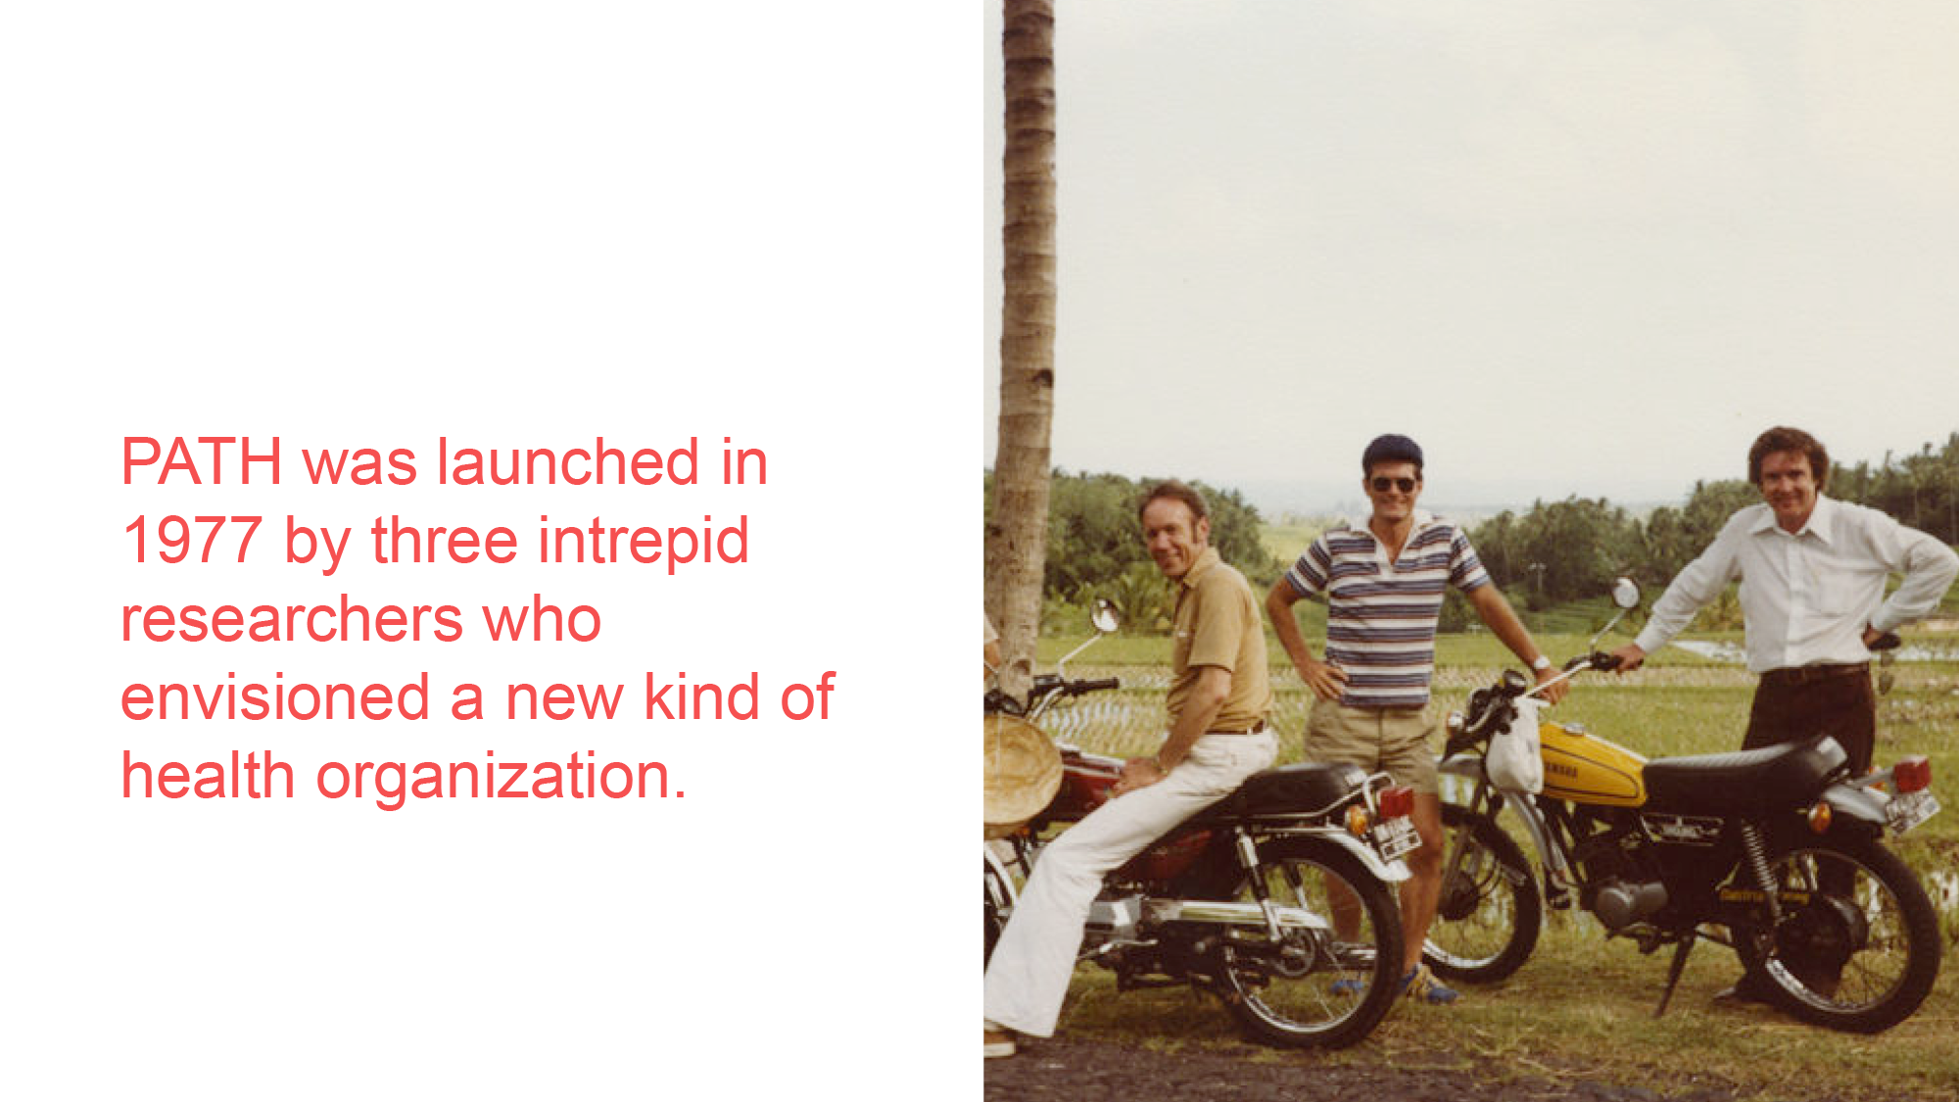
Photo: PATH

Slide 4
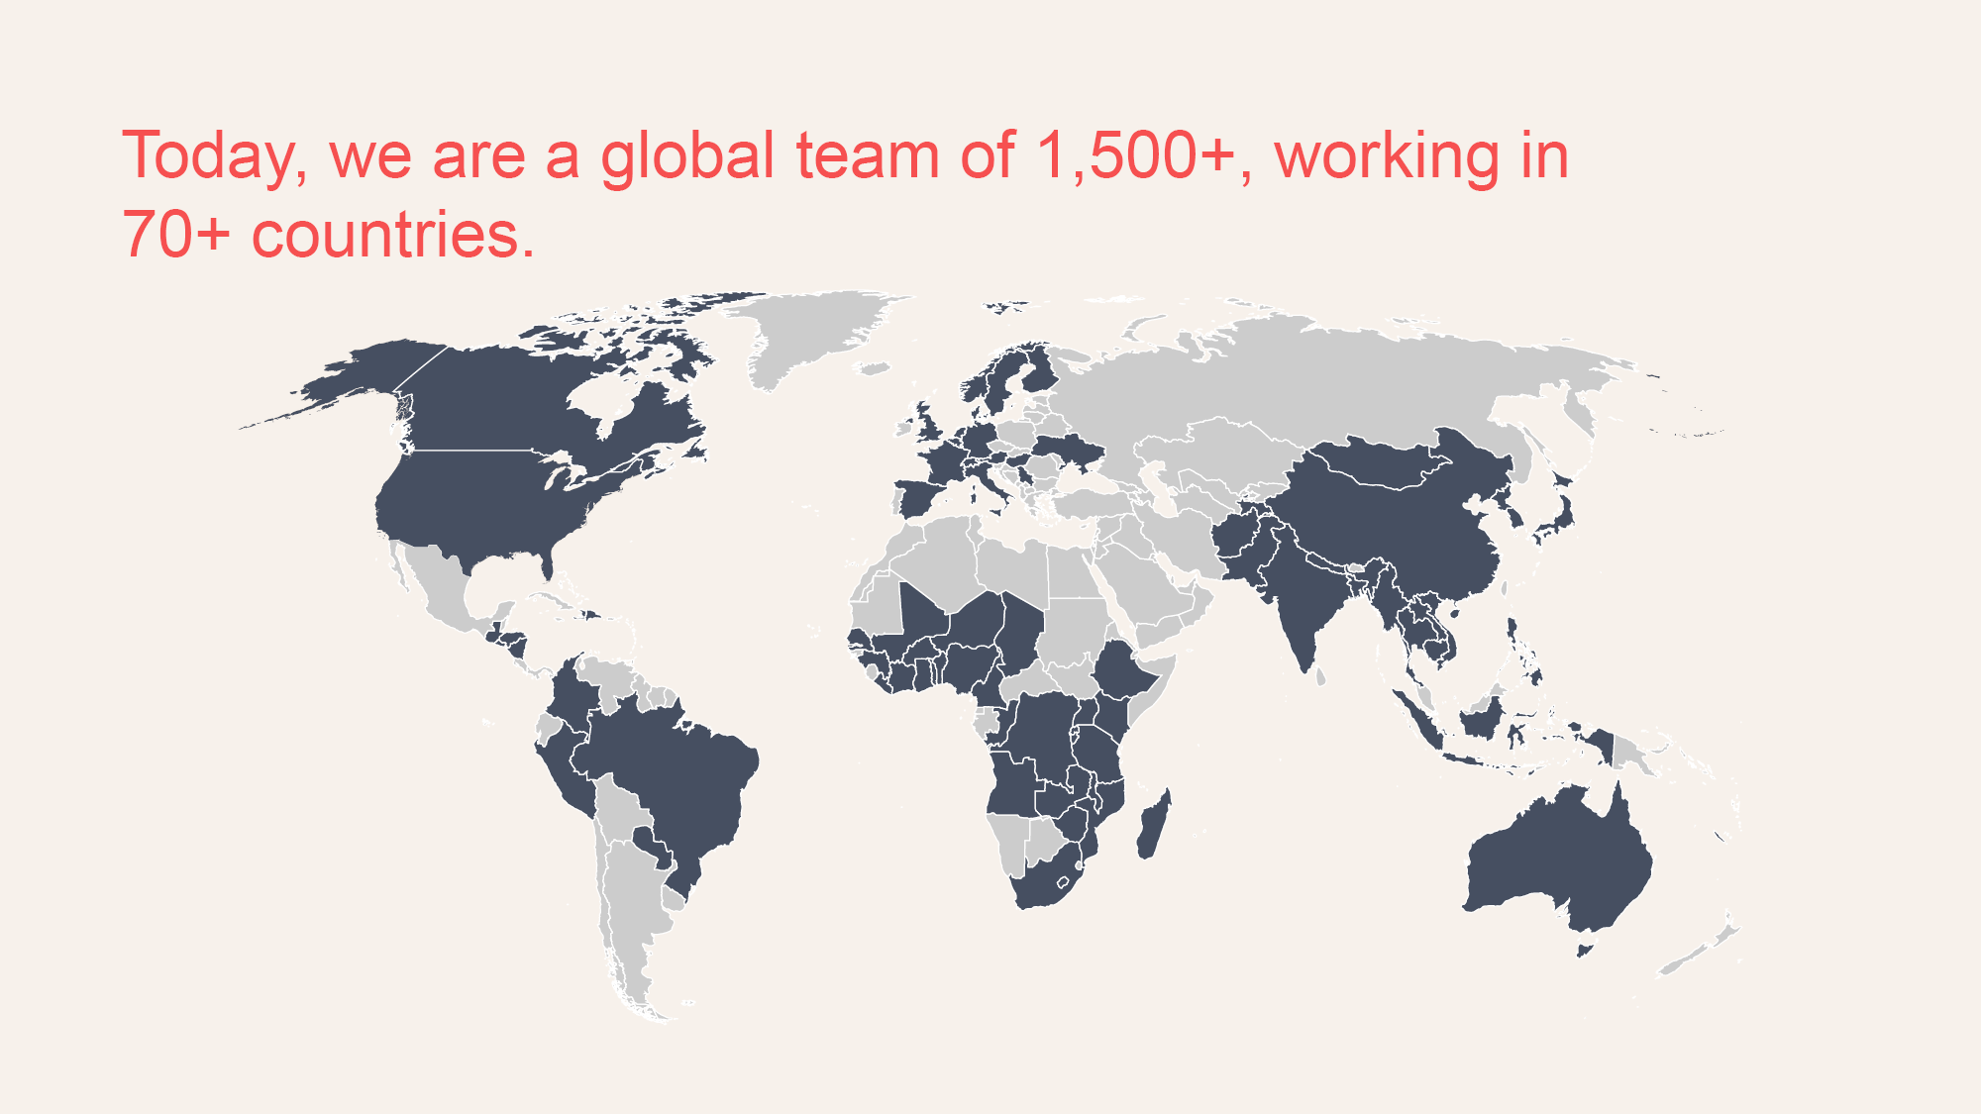

4

Slide 5
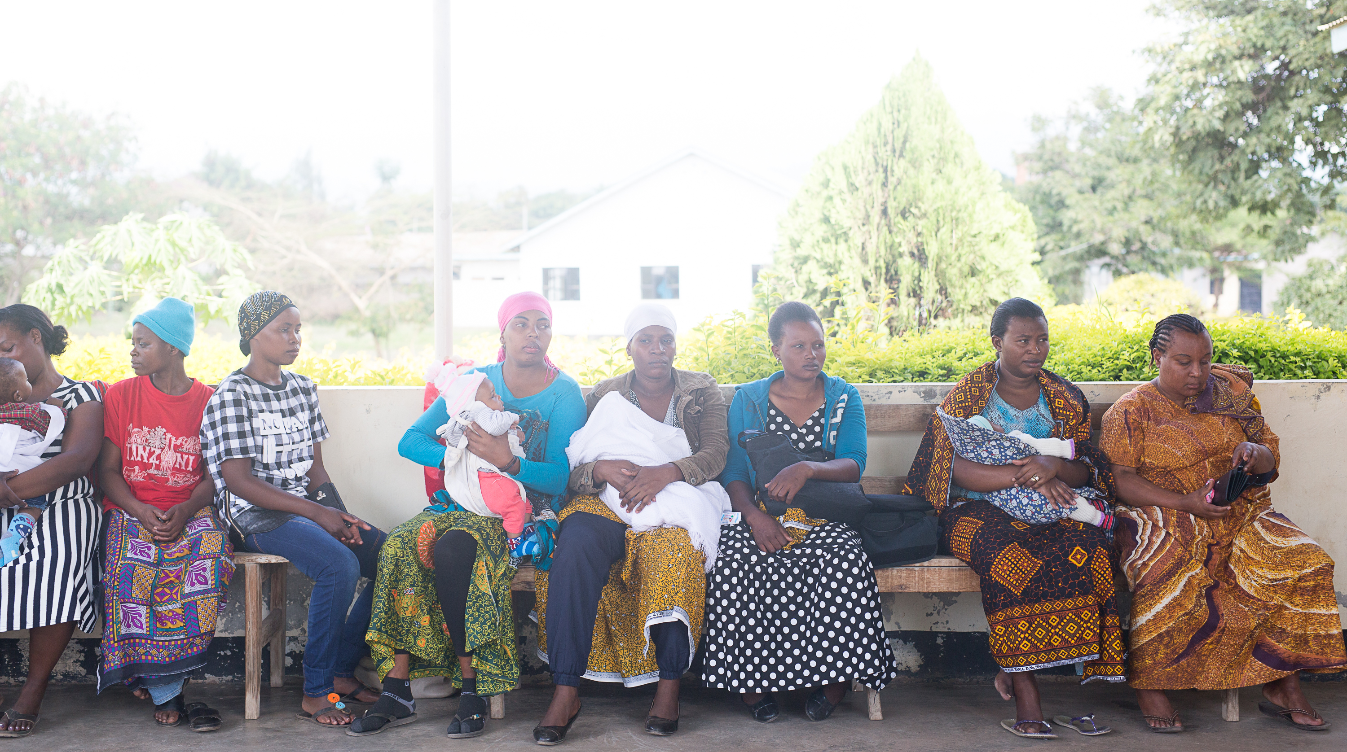
An avalanche of data.

Slide 6

Human Learning
Human Intelligence

Slide 7





Making the connections
Generating information
Empowering to make meaning

Slide 8

Meet Beatrice.

Slide 9
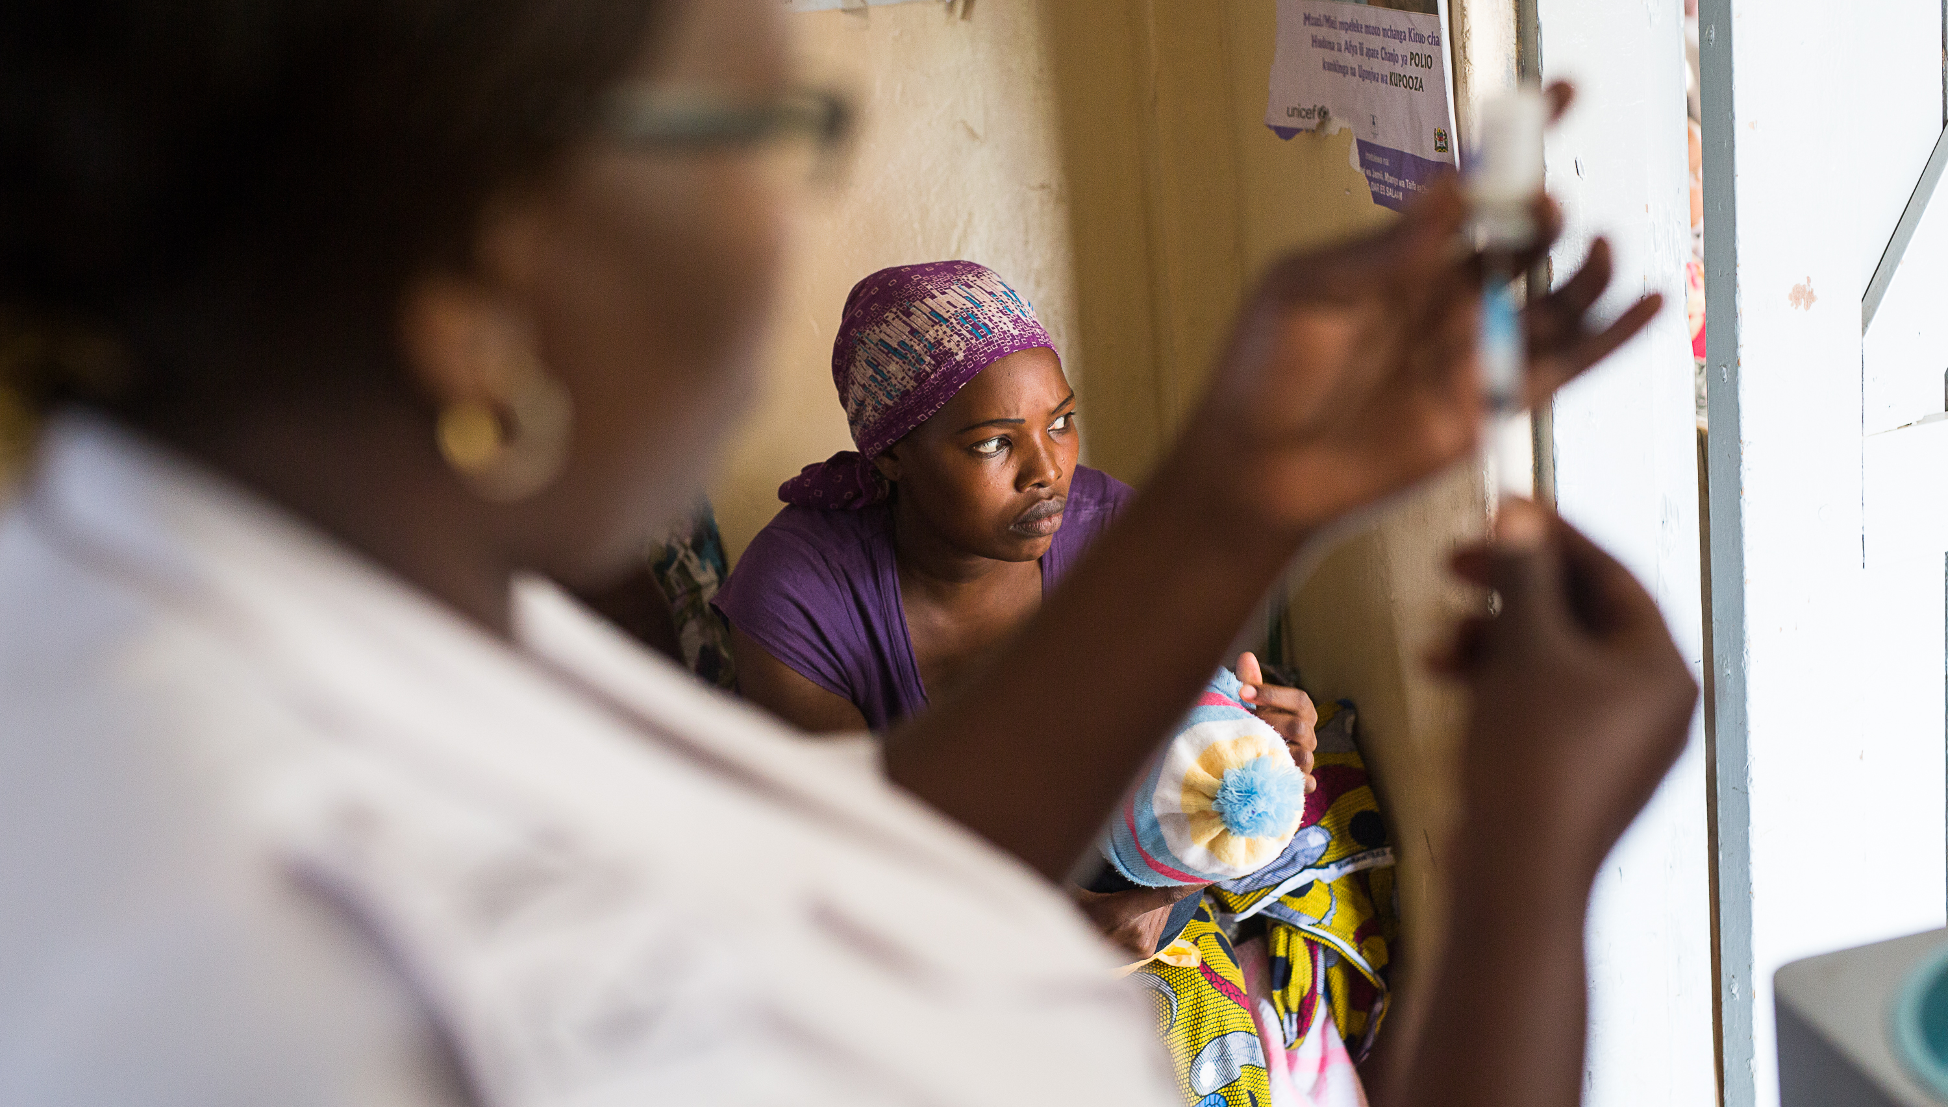
She had trouble planning for immunization clinics.

Slide 10

And felt no connection to the data.

Slide 11
Making the connections
Generating information
Empowering to make meaning

Slide 12
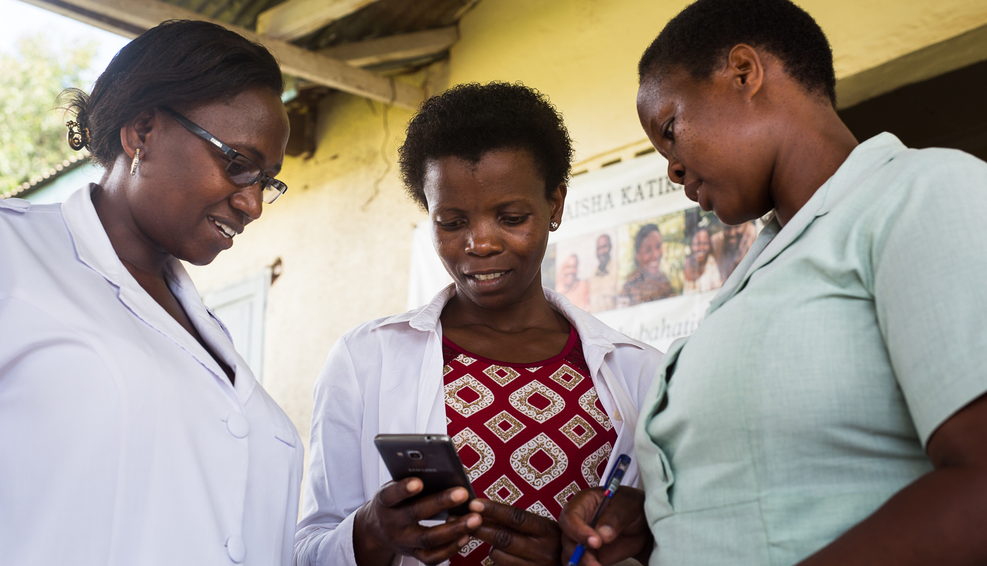
Better Immunization Data (BID)

Slide 13

Existing health information systems in Tanzania
There are >63 systems which deal with individual client health data.
18 could be classified as hospital management systems.
13 are primarily for laboratories.
3 focus on referrals.
29+ are systems for different vertical programs.

Slide 14




Digital Health Investment Road Map
17 investment recommendations
The Data Use Partnership is currently focused on 3 investment areas:
  Strengthening governance and policy.
  Improving the use of data in primary care and supervision.
  Data consistency and exchange
Including computerizing primary health care data.

Slide 15
Making the connections
Generating information
Empowering to make meaning

Slide 16
Better Immunization Data (BID)

Slide 17
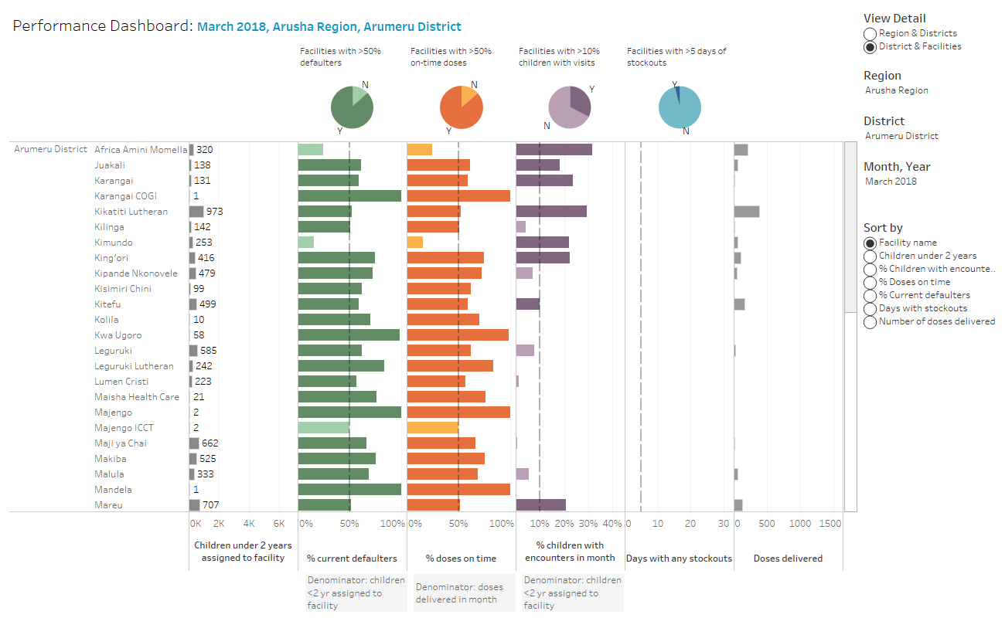
Sample facility performance dashboard

Slide 18
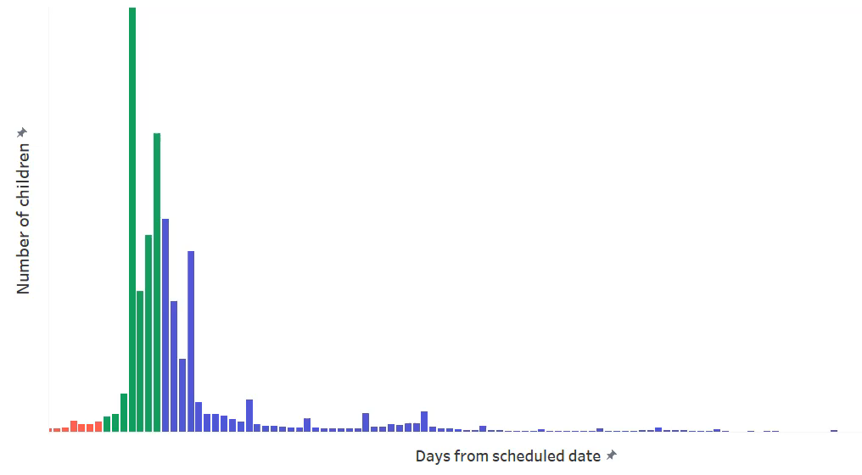
Dot plot of days since due date

Slide 19


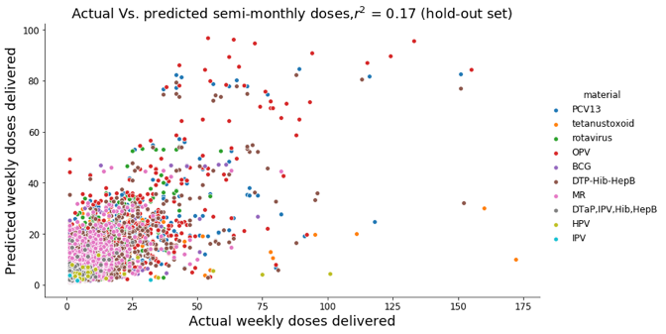
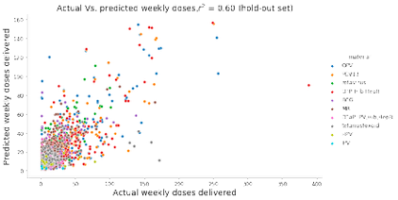
macro-eyes.com / @macroeyeshealth
Does routinely collected supply chain data contain signal for predicting future utilization?
Data I: Jan 2015 - Feb 2018
Data II: Jan 2015 - Feb 2018
Partial roll out dates
Data III : Jun 2017 - Jun 2018
Full roll out dates
R² = 0.17
R² = 0.24
R² > 0.70
PATH provides data dictionary
New data is collected to TImR
Data is uploaded to macro-eyes model
Partial rollout dates
PATH restructures TImR
Cleaned data set is uploaded to macro-eyes model
Data uploaded to macro-eyes model
Full rollout dates
© 2018 Macro-Eyes, Inc.: all rights reserved. Confidential and proprietary.

Slide 20
Connected diagnostics + machine learning

Slide 21
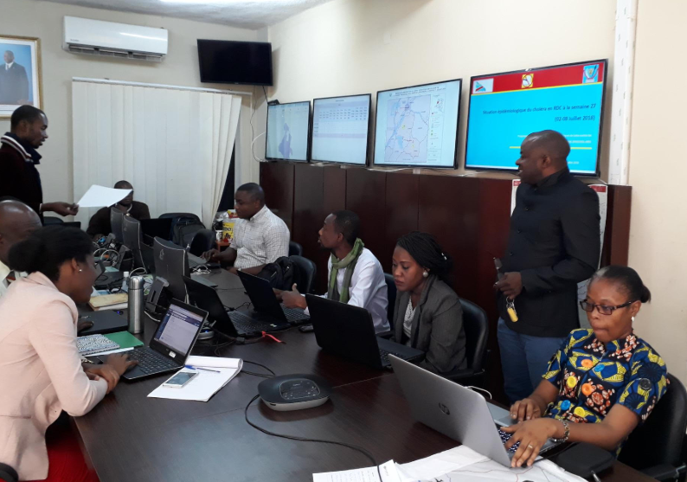
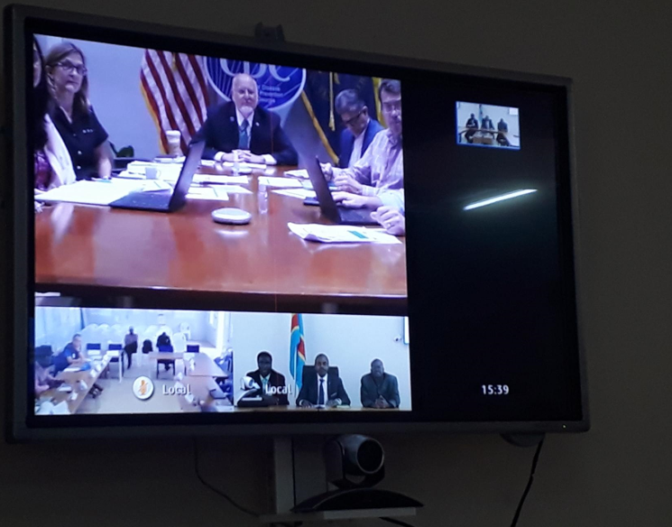
PATH DRC Emergency Operating Centers (EOC)
Kinshasa, satellite and mobile EOCs
Daily Ebola surveillance maps, MoH-DHIS2, DHIS2 tracker for case management and contact tracing, WHO-EWARS, audio/video conference
Provides decision-makers and epidemiologic investigators with real-time data and video connectivity, ensuring that these individuals have the information necessary for a rapid response

Slide 22
Making the connections
Generating information
Empowering to make meaning

Slide 23
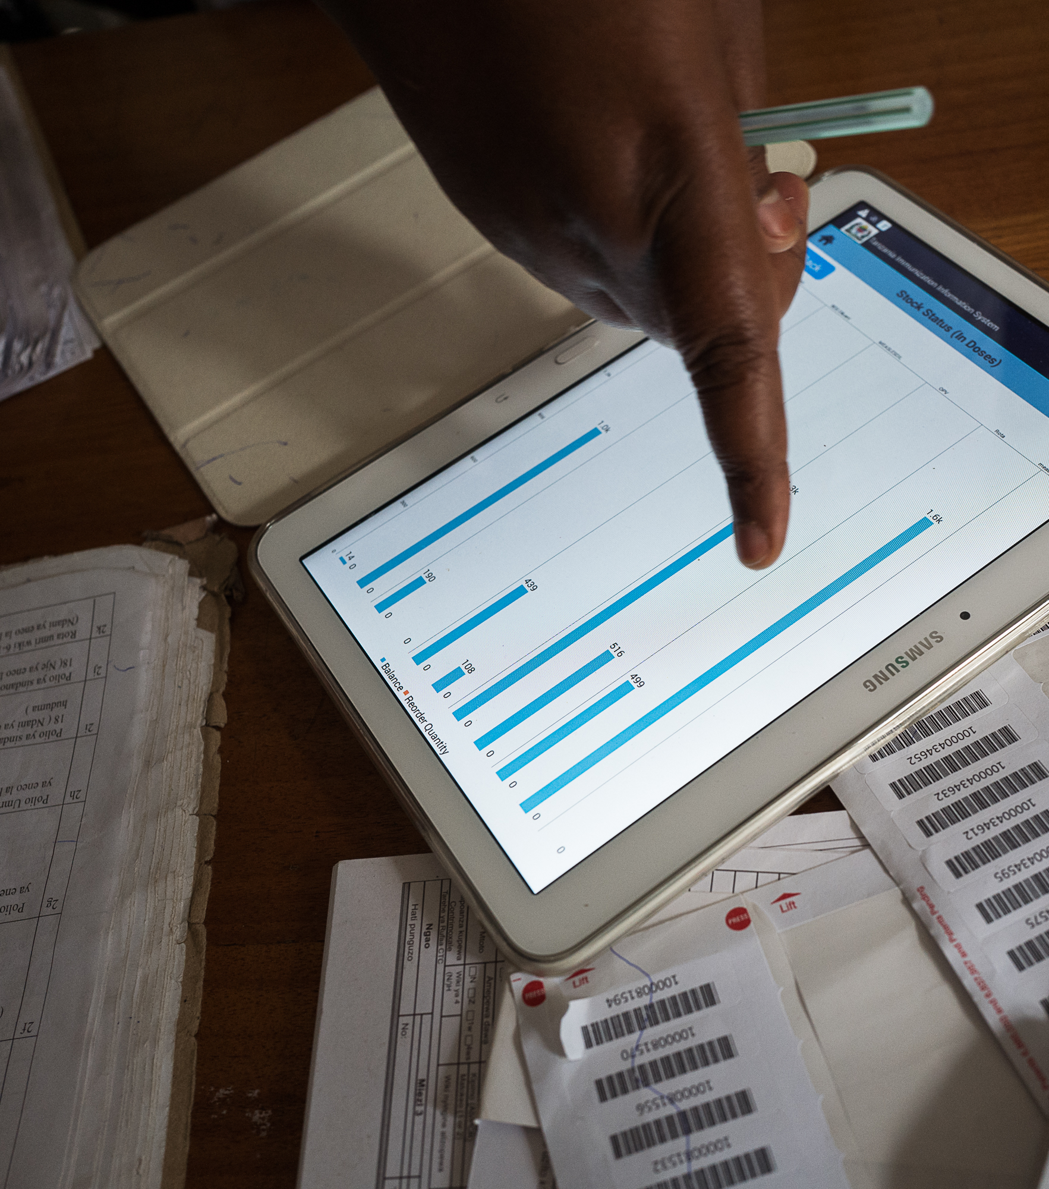
Through behavioral interventions and supportive supervision…
Beatrice is now more likely to act on immunization coverage and defaulter data

Slide 24
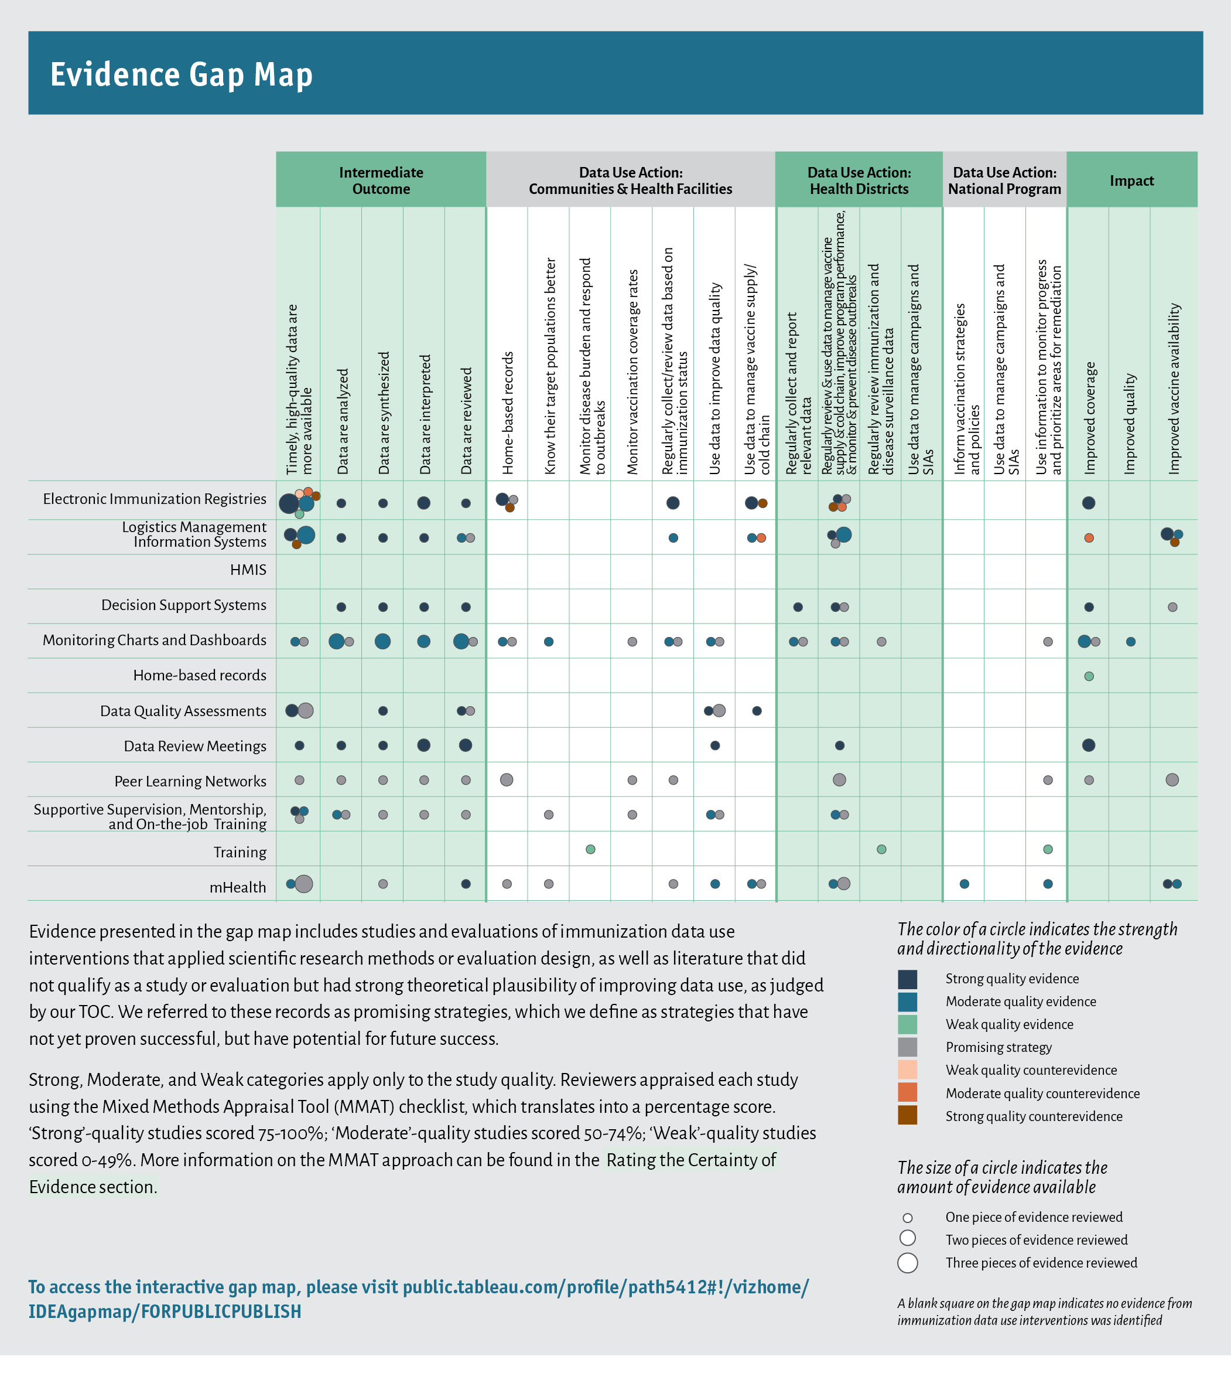
What works to improve data use for decision-making: evidence gap map

Slide 25
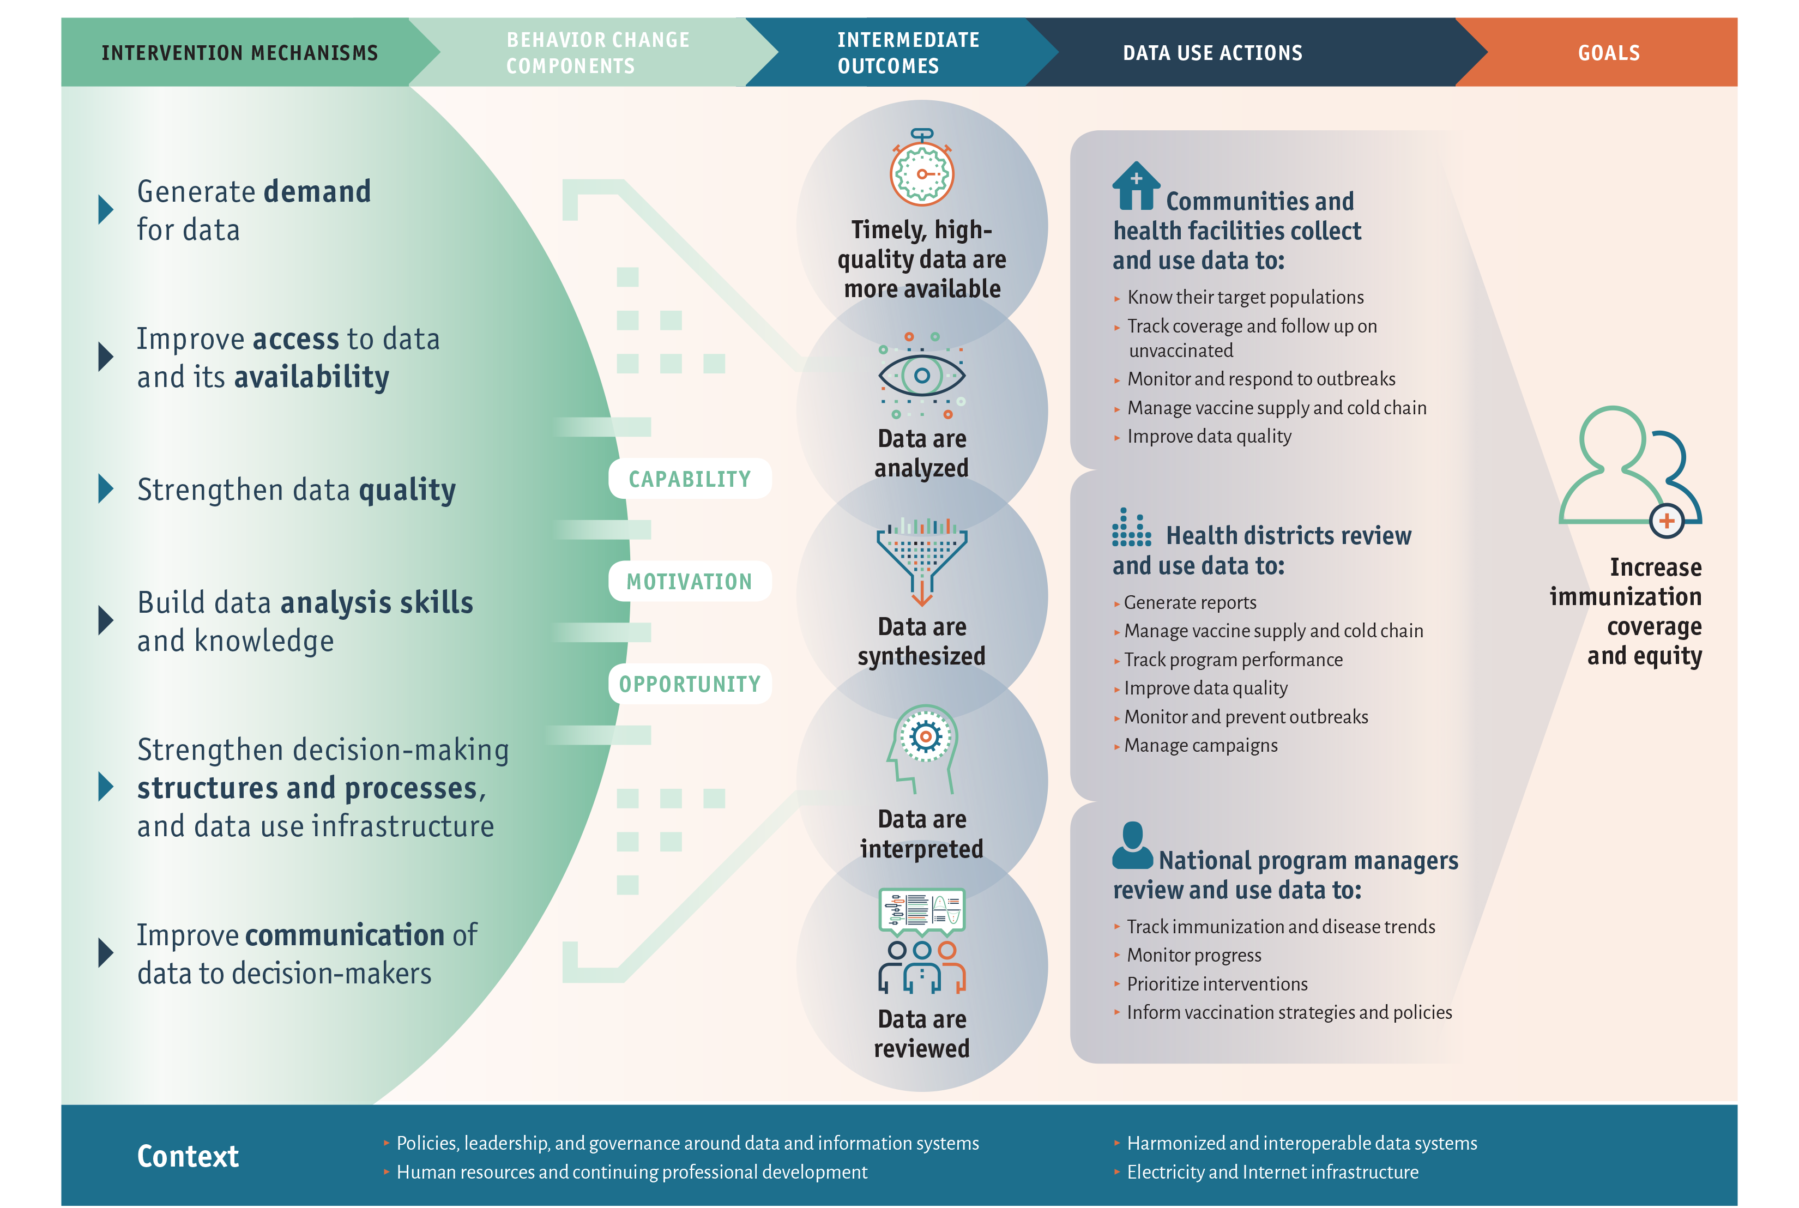
Capability, motivation, and opportunity are requirements for data use

Slide 26
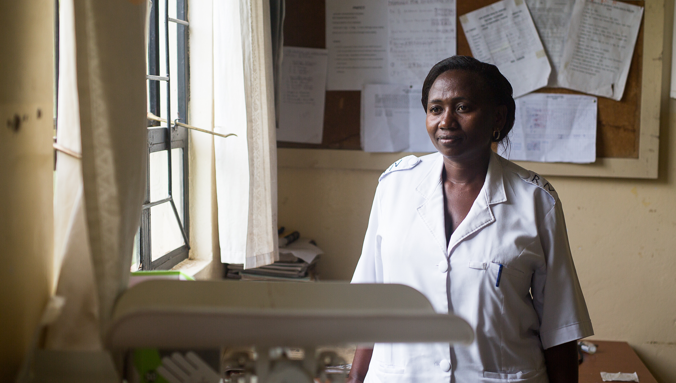
For more information:
jshearer@path.org

