Slide 1
Opportunities at interface of social science and mathematical modeling
Understanding the context in which behavior change is expected
Developing frameworks for quantitatively describing the context
Innovating through interdisciplinary efforts at data collection and intervention

Slide 2
Context
No previously recorded outbreaks of Ebola virus disease in West Africa
Pre-existing, post-conflict fragility of health, economic, and social systems
Settings where the traditional practices conflicted with standard solution response measures
The disruption of the status quo (i.e., pre-Ebola) condition created needs.
Some needs were due to losses (e.g., need for education, food, and income; need for sense of safety/security due to the fear associated with the ambulance siren, dress of the burial team).
Others were generated as a means of addressing the outbreak (e.g., need for information and sensitization, hand-washing materials, training on safe and dignified burials).
Notes:
2014-2016 Ebola outbreak in West Africa – why was it a big deal?
It had not been experienced in the region before
The 3 most affected countries were already struggling with systemic weaknesses
There were also cultural practices that were in conflict with the interventions required to control the outbreak – taking the sick to hospital with no caregiving from family, burial of the dead without engagement of community and religious leaders

Slide 3
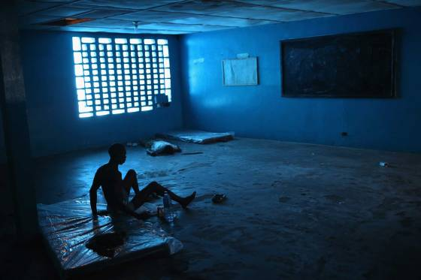
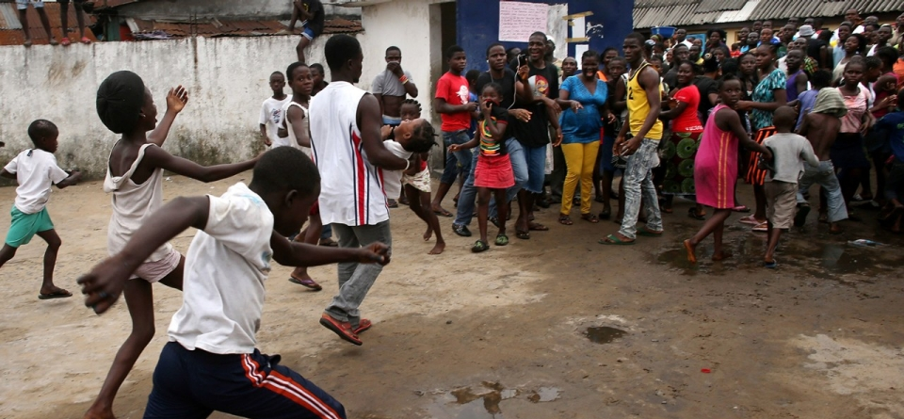
Context
What was observed and what motivated behavior
Looting of treatment centers → produce items to use or sell to enhance survival + demonstrate discontent + exposure to a deadly virus
Fleeing under-resourced treatment centers → basic needs met + no treatment + exposing loved ones to a deadly virus
Hiding bodies → traditional burial + exposure to a deadly virus
Handwashing stations at entrances to private and public facilities
Local rules about visitors
….
John Moore, Getty Images
Notes:
This disruption of the status quo created unrest
So some of the situations or behaviors observed were…
Something had been taken away – sense of control or feeling of safety – and in the attempt to “correct” the problem, it is leading to something worse – no-win
The photos show a treatment center in Liberia that was looted (father carrying child from the center) and led to quarantine of the community
Satisfaction of needs…
A little background on needs and theories of motivation

Slide 4
Community engagement
Social Mobilization Action Consortium (SMAC)
Five partnering organizations, including Restless Development, US CDC, BBC Media Action, GOAL, and FOCUS 1000
Semi-structured weekly reports from over 12,000 communities
Mobilizers triggered communities to create sense of urgency and then facilitated their development of action plans
Encourage contexts supportive of more autonomous motivation (less top-down enforcement)
In order to facilitate a community’s readiness for internalizing ambient values and regulations
Notes:
The role of community engagement, creating needs-supportive environments

Slide 5
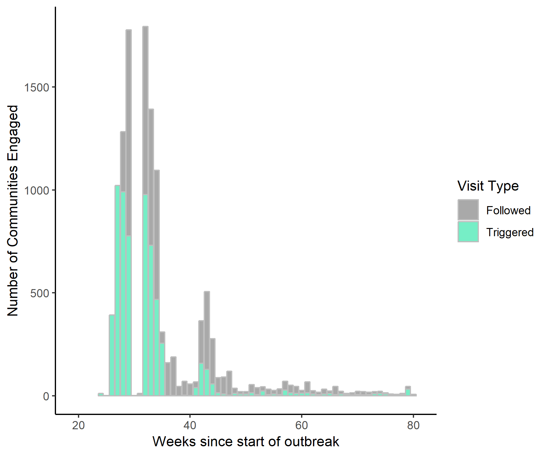
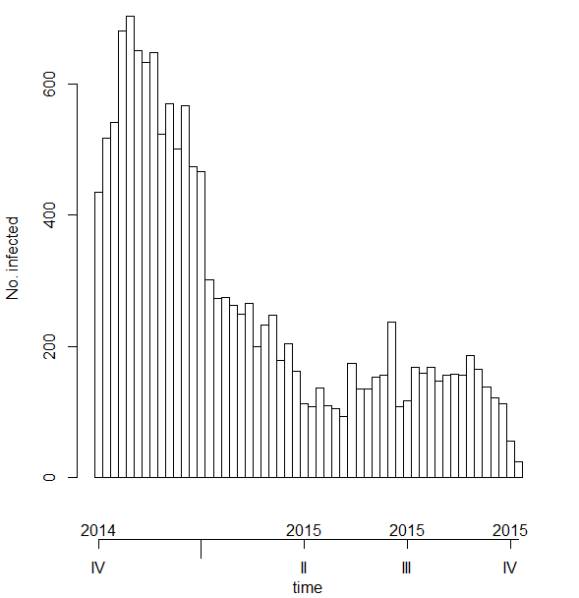
Weekly visits by SMAC
Epidemiological curve for Ebola outbreak in Sierra Leone

Slide 6
http://restlessdevelopment.org/resources?country=5090

Slide 7
Motivating Behavior Change in Needs-Supportive Contexts to Control an Ebola Outbreak

Slide 8
Classification | Themes/Terms | Example Response
Basic | Food, hunger, drinking water, more poverty, higher prices, no trade or market | “Ebola have cause hardship and shortage of food”
 |  | “They have been benifiting from the food supply as other neighbouring communities”
Safety/Security | Fear due to ambulance, place to isolate survivors, no school, teenage pregnancy | “The over speeding of ambulances not checking on bad roads is the community concern”
 |  | “Less fear in community people to visit the health centre as compare to the previous ones due to our interrractions.”
Social Support | Ebola is manmade, HCWs do not want Ebola salaries to end, children defying parents | “Because of the huge money paid to health workers, they will not want the outbreak to stop”
 |  | “No fighting between husband and wife as was a common practice among the community members but it has stoped since the development of the bye-laws”
Respect and Pride | Bad treatment at hospitals, disrespect for survivors, attitude of burial team | “The community said the health workers should treat the Ebola patient with respect and care while taking them to the treatment center”
 |  | “their family are treated well in the holding centers”
Autonomy | Movement restricted, hunting not allowed, overall activities on hold | “They have been deprived from eating [bushmeat] some of their favourite food”
 |  | “Community people have taken the lead in putting an end to ebola.”
Mastery | Ebola is real, reiteration of bylaws, widespread handwashing | “Since the ebola virus is transmitted through body contact, therefore we need to avoid body contact”
Capacity | Buckets, chlorine, training, sensitization | “More veronica rubbers needed because there is only one rubber that is serving a community of over 40 houses”
 |  | “Every house hold have water and soap to wash hands placed in front of there houses”
Notes:
Maslow’s hierarchy of needs
Tay and Diener – used Gallup data to evaluate the relationship between needs satisfaction and social well-being – investigating the universality of human needs fulfillment – cross cultural

Slide 9
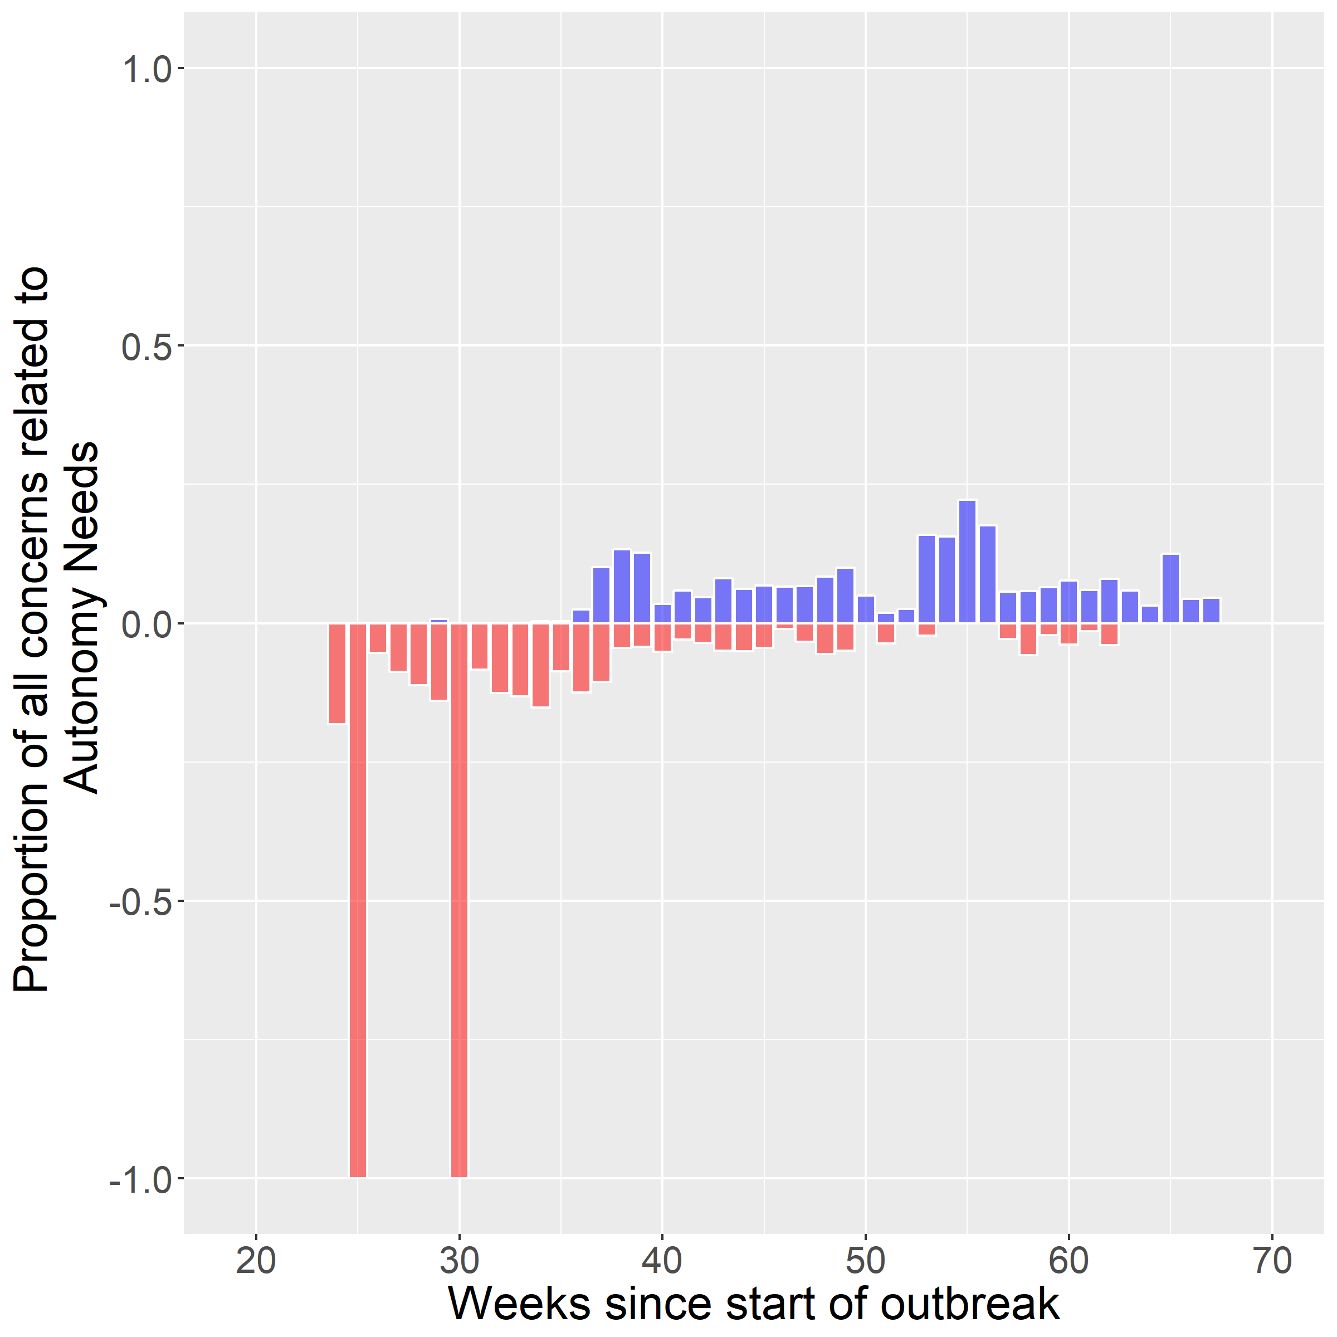
Autonomy Needs
Autonomy Needs

Slide 10
Innovating through interdisciplinary efforts at data collection and intervention
Context
Behavior
Disease
Social science to inform participatory processes to achieve contexts most conducive to behavior change
Epidemiology
Communities
Modeling to quantitatively inform contexts most conducive to disease transmission
Clinicians

